Slide 1
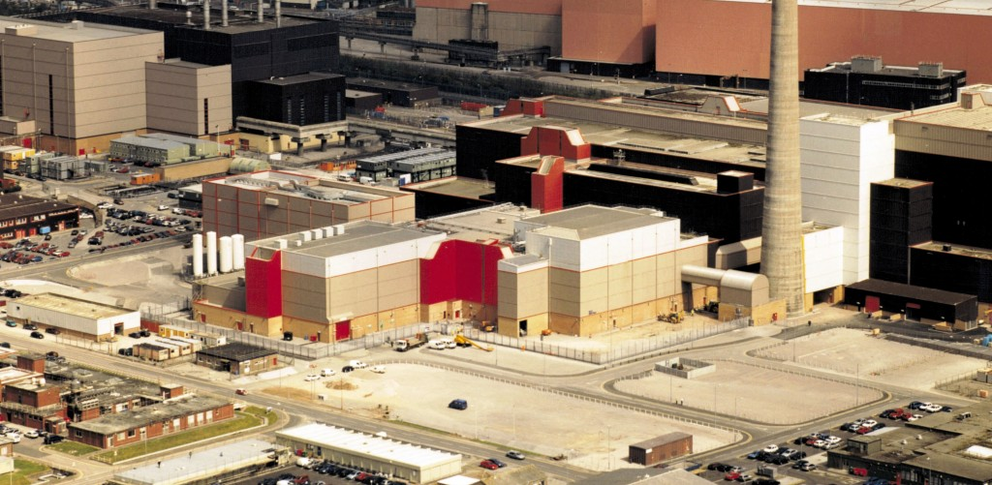
ECJ. Mox Plant, Commission of the European Communities v. Ireland

Slide 2
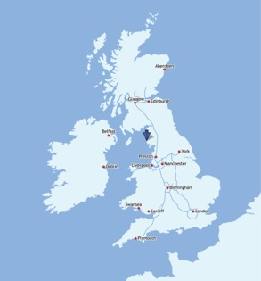
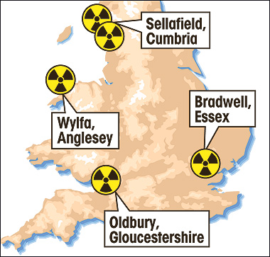
sellafield

Slide 3
Mixed oxide fuel

Slide 4
Nuclear scare

Slide 5
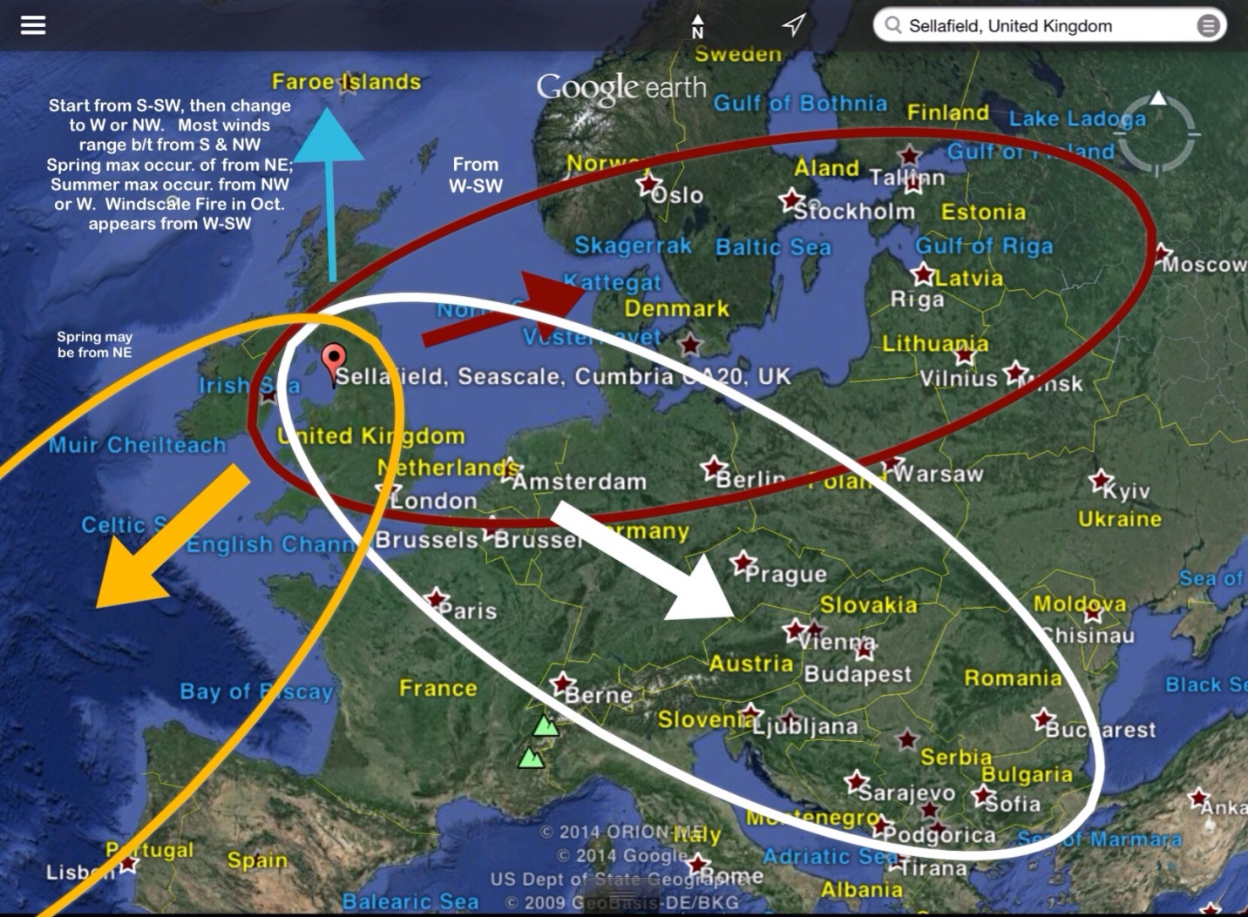
Nuclear scare

Slide 6
Convention for the Protection of the Marine Environment of the North-East Atlantic (ospar)
1. The Contracting Parties shall ensure that their competent authorities are required to make available the information described in paragraph 2 of this Article to any natural or legal person, in response to any reasonable request, without that person's having to prove an interest, without unreasonable charges, as soon as possible and at the latest within two months.
2. The information referred to in paragraph 1 of this Article is any available information in written, visual, aural or data-base form on the state of the maritime area, on activities or measures adversely affecting or likely to affect it and on activities or measures introduced in accordance with the Convention.

Slide 7
UNITED NATIONS CONVENTION ON THE LAW OF THE SEA (unclos)
Article 145
Protection of the marine environment
Necessary measures shall be taken in accordance with this Convention with respect to activities in the Area to ensure effective protection for the marine environment from harmful effects which may arise from such activities. To this end the Authority shall adopt appropriate rules, regulations and procedures for inter alia:
(a) the prevention, reduction and control of pollution and other hazards to the marine environment, including the coastline, and of interference with the ecological balance of the marine environment, particular attention being paid to the need for protection from harmful effects of such activities as drilling, dredging, excavation, disposal of waste, construction and operation or maintenance of installations, pipelines and other devices related to such activities;
(b) the protection and conservation of the natural resources of the Area and the prevention of damage to the flora and fauna of the marine environment.

Slide 8
Arbitral proceeding at ospar
1. Any disputes between Contracting Parties relating to the interpretation or application of the Convention, which cannot be settled otherwise by the Contracting Parties concerned, for instance by means of inquiry or conciliation within the Commission, shall at the request of any of those Contracting Parties, be submitted to arbitration under the conditions laid down in this Article.
6. (a) The arbitral tribunal shall decide according to the rules of international law and, in particular, those of the Convention. (b) Any arbitral tribunal constituted under the provisions of this Article shall draw up its own rules of procedure. (c) In the event of a dispute as to whether the arbitral tribunal has jurisdiction, the matter shall be decided by the decision of the arbitral tribunal.

Slide 9
Arbitral proceeding at unclos
Different possible settlement methods (Arts. 287,288):
International Tribunal for the Law of the Sea (ITLOS)
International court of Justice (ICJ)
Ad hoc arbitral tribunals
5. If the parties to a dispute have not accepted the same procedure for the settlement of the dispute, it may be submitted only to arbitration in accordance with Annex VII, unless the parties otherwise agree.

Slide 10
Arbitral proceeding at unclos
Ireland decided to request provisional measures from ITLOS
Article 290(5)
5. Pending the constitution of an arbitral tribunal to which a dispute is being submitted under this section, any court or tribunal agreed upon by the parties or, failing such agreement within two weeks from the date of the request for provisional measures, the International Tribunal for the Law of the Sea or,
with respect to activities in the Area, the Seabed Disputes Chamber, may prescribe, modify or revoke provisional measures in accordance with this article if it considers that prima facie the tribunal which is to be constituted would have jurisdiction and that the urgency of the situation so requires. Once constituted, the tribunal to which the dispute has been submitted may modify, revoke or affirm those provisional measures, acting in conformity with paragraphs 1 to 4.

Slide 11
Arbitral proceeding at unclos
The ITLOS decided that had, prima facie, jurisdiction, and that the parties should cooperate on the matter of the Mox Plant. The tribunal left the decision on the merits to the arbitral tribunal.
The arbitral tribunal accepted UK’s objection (european jurisdiction) and stayed the proceedings until decision by European Court of Justice
The European Commission started a procedure against Ireland on:
Article 292 EC
Member States undertake not to submit a dispute concerning the interpretation or application of this Treaty to any method of settlement other than those provided for therein.
Article 193 EURATOM
Member States undertake not to submit a dispute concerning the interpretation or application of this Treaty to any method of settlement other than those provided for therein.

Slide 12
proceedings before ecj
Is this dispute within the acting competence of the EC?
Is this a Community law subject?

Slide 13
proceedings before ecj
When EC ratified UNCLOS it became an integral part of the Community legal order
There is a duty of loyalty towards EC
Article 10 EC
Member States shall take all appropriate measures, whether general or particular, to ensure fulfilment of the obligations arising out of this Treaty or resulting from action taken by the institutions of the Community. They shall facilitate the achievement of the Community's tasks.
They shall abstain from any measure which could jeopardise the attainment of the objectives of this Treaty.

Slide 14
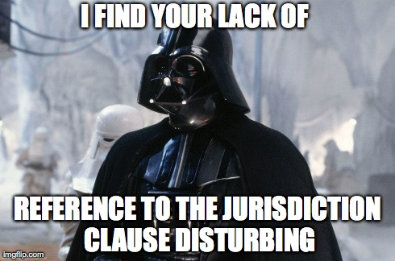
conclusion
The problem of exclusive jurisdiction and multiple international tribunals
ECJ’s protection of community law

