Slide 1
Chapter#8 Revising judgments in the light of new information

Slide 2
Introduction
Need to revise your initial probability estimate in light of new information (i.e., from a market research survey or consultancy).
Bayes’ theorem (Thomas Bayes, 1763). It means, “how we should revise our probability assessments when new information becomes available.
Prior Probability
New Information
Posterior Probability

Slide 3
Bayes’ theorem
Initial probability estimate is known as a prior probability and the “modified” probability is known as a posterior probability.
How a probability tree can be used to revise prior probabilities?
Ex: A batch of 1000 electronic components was produced last week and it was found that 30% of them were defective and 70% were “OK”. If all of them were mixed together in a large box what should you do?
If we conduct a quick test will be given some new information:
If the component is “OK” there is 80% of chance that it will pass the test and 20% chance that it will wrongly fail.
If the component is defective there is 10% chance that it will wrongly indicate “OK” and 90% chance that it will fail the test.
Notes:
Note that because the test is better at giving a correct indication when the component is defective, we say that it is biased

Slide 4
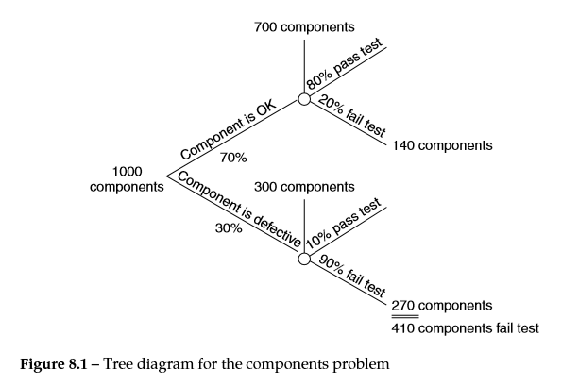
Bayes’ theorem
When you perform the quick test the component fails. How should you revise your prior probability in light of this result?
Notes:
From 1000 components we have 70% (700) OK and 20% of them fail the test (140)
From 1000 components we have 30% (300) defective and 90% of them fail the test (270)

Slide 5
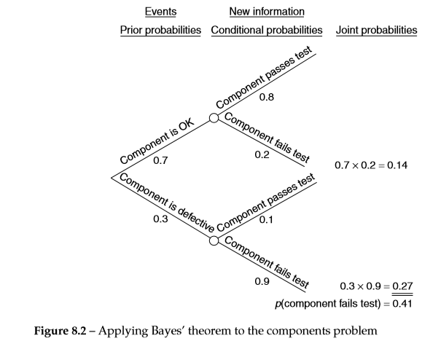
As a result we have 410 components in total which fail the test so:
p ( component OK/ failed test) = 140/410 = 0.341
The test result although not perfectly reliable has caused you to revise the probability of component being “OK” from 0.7 down to 0.341.
Now a component can fail either if it is “OK” or if it is defective, so we can join the probabilities to obtain p(fails test) = 0.14 + 0.27 = 0.41
Notes:
P (fails test/”OK”) = 0.2
P (OK and fails test) = 0.7 x 0.2 = 0.14
P (defective and fails test) = 0.3 x 0.9 = 0.27
P (fails test) = 0.14 + 0.27 = 0.41 then the posterior probability will be 0.14/0.41 = 0.341

Slide 6
Applying Bayes’ theorem
The steps:
Construct a tree with branches representing all the possible events which can occur and write the prior probabilities for these events on the branches.
Extend the tree by attaching to each branch a new one (represents the new information obtained). On each branch write the conditional probability relating the information given with the preceding branch.
Obtain the joint probabilities by multiplying each prior probability by the conditional probability which follows it on the tree.
Sum the joint probabilities.
Divide the “appropriate” joint probability by the sum of the joint probabilities to obtain the posterior probability.

Slide 7
Example
An engineer makes a cursory inspection of a piece of equipment and estimates that there is a 75% chance that it is running at peak efficiency. He then receives a report that the operating temperature of the machine is exceeding 80 Celsius.
Past records of operating performance suggest that there’s only a 0.3 probability of this temperature being exceeded when the machine is working at peak efficiency.
The probability of the temperature being exceeded if the machine is not working at peak efficiency is 0.8. What should be the engineer’s revised probability that the machine is operating at peak efficiency?

Slide 8
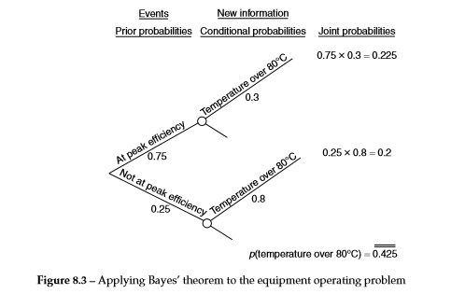
So, the required posterior probability is 0.225/0.425 = 0.529
Notes:
P (at peak efficiency and exceeds 80 C) = 0.75 x 0.3 = 0.225
P (not at peak efficiency and exceeds 80 C) = 0.25 x 0.8 = 0.2
Thus posterior probability is 0.225/0.425 = 0.529

Slide 9
Another example
A company’s sales manager estimates that there’s a 0.2 probability that sales in the coming year will be high, a 0.7 probability that they’ll be medium and a 0.1 probability that they’ll be low. She then receives a sales forecast suggesting that sales will be high. By examining the track records of the forecasts she’s able to obtain the following probabilities:
What should be then the sales manager’s revised estimates of the probability of (a) high sales, (b) medium sales and (c) low sales?
Notes:
To demonstrate a problem with more than 2 events

Slide 10
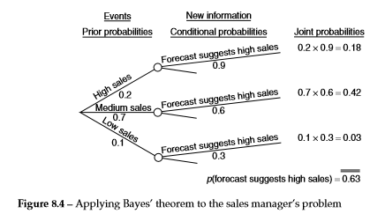
Notes:
P (high sales) = 0.18/0.63 = 0.2857
P (medium sales) = 0.42/0.63 = 0.6667
P (low sales) = 0.03/0.63 = 0.0476

Slide 11
Relative influence that prior probabilities and new information have on the resulting posterior probabilities
Suppose that a geologist is involved in a search for new sources of natural gas in southern England. He’s asked to estimate, on the basis of a preliminary survey, the probability that gas will be found in that location. Having made his estimate, he’ll receive new information from a test drilling.
Let’s assume that the geologist is not confident about his prior probabilities and the test drilling is very reliable.
The ‘vaguest’ prior probability he can put is 0.5 to the two events ‘gas exists at the location’ and ‘gas does not exist at the location’ . This indicates that gas is present and the result is 95% reliable (only 0.05 chance of misleading indication).
Notes:
Any other distribution (not 50%) would indicate he’s too confident, in the extreme 1 would indicate he’s perfectly confident about his predictions.
We are considering that the test drilling is unbiased (low chance to wrongly indicate gas when there’ isn’t, and wrongly indicate the absence of gas when it’s present).

Slide 12
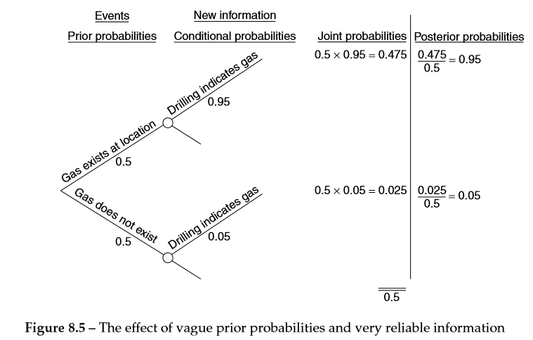

Slide 13
Insights
It can be seen that these probabilities are identical to the probabilities of the test drilling giving a correct or misleading result.
In other words, the posterior probabilities depend only upon the reliability of the new information. The ‘vague’ prior probabilities have had no influence on the result.

Slide 14
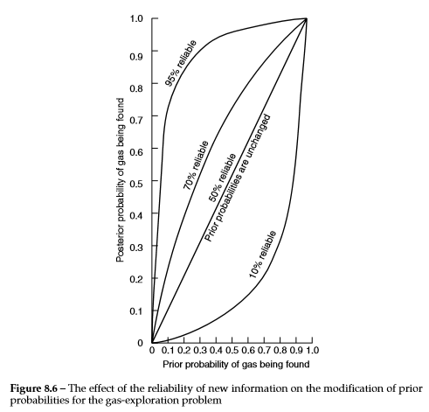
- if the prior probability is 0.4 and the result of the test drilling is 70% reliable then the posterior probability will be about 0.61.
Notes:
The graph shows that if the test drilling has only 50% probability of giving correct result then its result is not usefull (the posterior probability will be equal the prior, showed by the diagonal line). The more reliable the new information, the greater will be the modification of the prior probabilities.
However, for any given level of reliability this modification is small either the prior probability is high (the geologist believes there’s gas and also the test) or where the prior probability is very small (gas won’t be found).
If the test is certain to give wrong indication then you can be sure that the opposite is the true situation.

Slide 15
Applying Bayes’ theorem to a decision model
It involves the use of posterior probabilities, rather than the prior probabilities, in the decision model.
Ex: A retailer has to decide whether to hold a large or small stock of a product for the coming summer season. A payoff table for the courses of action and outcomes is shown below:

Slide 16
Applying Bayes’ theorem to a decision model
Also the retailer’s utilities for the above sums of money is known:
He estimates that there’s a 0.4 probability that sales will be low and a 0.6 probability that they will be high. What level of stock should he hold?
Notes:
Money is the only attribute which he’s concerned about

Slide 17
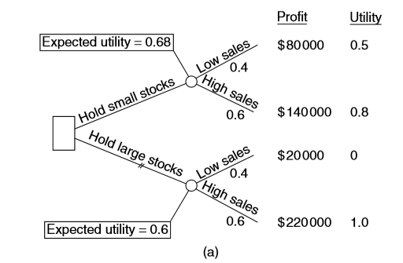
Decision tree based on prior probabilities
Notes:
His expected utility is maximized if he decides to hold a small stock

Slide 18
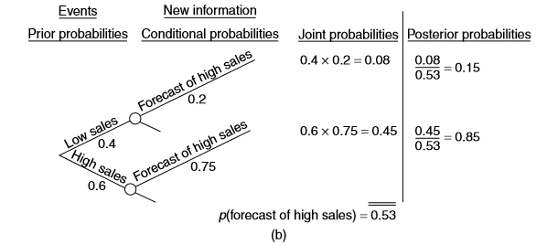
Applying Bayes’ theorem to the retailer’s problem
Before implementing his decision, the retailer receives a sales forecast that suggests that sales will be high. In the past, when sales turned out to be high, the forecast had correctly predicted high sales on 75% of occasions. However, in reasons when sales turned out to be low, the forecast had wrongly predicted high sales on 20% of occasions. Should the retailer change his mind in the light of the forecast?
Notes:
We applied Bayes to modify the retailer’s prior probabilities. The posterior probabilities of low sales and high sales are 0.15 and 0.85 (these replace the prior probabilities in the tree).
It can be seen that holding a large stock would now lead to the highest expected utility, so the retailer should change his mind due to the light of the sales forecast.

Slide 19
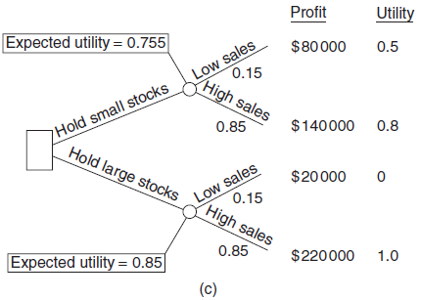
Decision tree based on posterior probabilities
Applying posterior probabilities to the retailer’s problem

Slide 20
Assessing the value of new information
New information can reduce the uncertainty involved in a decision and thereby increase the expected payoff (i.e. knowing the exact summer demand).
However, in many circumstances it may be expensive to obtain information. To decide whether it is worth obtaining the information we should consider if the information is perfectly reliable (i.e. it is certain to give a correct indication).

Slide 21
The expected value of perfect information (EVPI)
How can we measure the value of perfect information?
A major potato producer suffered serious losses when a virus affected the crop at the company’s North Holt farm. Since then, steps have been taken to eradicate the virus, and specialist estimates that there’s a 70% chance that the eradication program has been successful.
For the coming season there’s two options:
Notes:
Obs: the decision maker is neutral to risk (so that we can use the expect monetary value criterion).

Slide 22
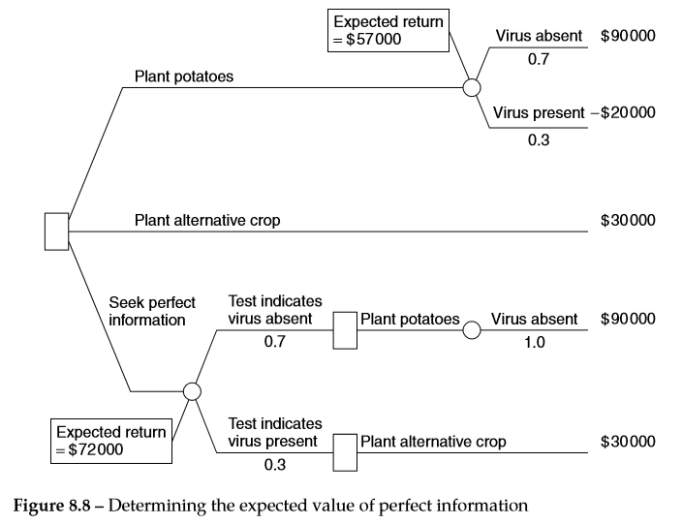
Determining the EVPI
Notes:
However, the manager is informed that Ceres Laboratories could carry out a test on the farm which will indicate whether or not the virus is still present in the soil. He doesn’t know if the test is reliable, but he assumes that it is (perfectly accurate). What is then the maximum amount that it would be worth paying Ceres for the test??
In the absence of info. From the test, he can plant potatoes since the expected return is 0.7 x 90.000 + 0.3 x -20.000 = 57.000

Slide 23
If we are considering the test results…
Calculating the EVPI
Test indication | Prob. | Best course of action | Pay off ($) | Prov. x payoff ($)
Virus is present | 0.7 | Plant potatoes | 90,000 | 63,000
Virus is absent | 0.3 | Plant alternative | 30,000 | 9,000
Expected payoff with perfect information |  |  |  | 72,000
Expected payoff without perfect information |  |  |  | 57,000
Expected value of perfect information (EVPI) |  |  |  | 15,000
Notes:
If the virus is absent then the manager would earn $90 000 by planting potatoes and $30 000 planting alternative crop (so the best decision is plant potatoes).
This means that his expected return with perfect info. will be $ 72 000 (if he didn’t know the info. he would plant potatoes anyway and earn $57 000)
However, we know now that if the test is perfectly accurate it would not be worth paying more than $15 000 (72 - 57).

Slide 24
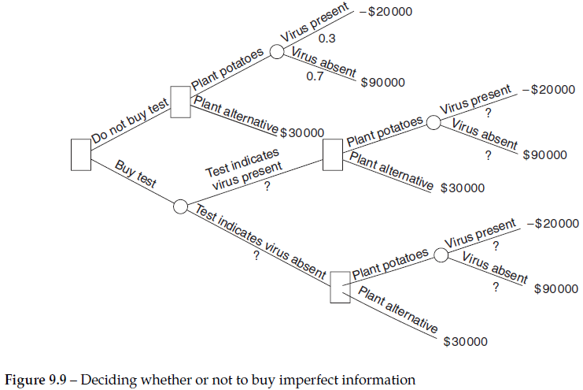
The expected value of imperfect information (EVII)
If the virus is still present in the soil the test has only a 90% chance of detecting it, while if the virus has been eliminated there’s a 20% chance that the test will fail (incorrectly indicate its presence). How much would it now be worth paying the test?
Notes:
If the manager decides not to buy the test the decision is the same as before: plant potatoes and earn $57 000.

Slide 25
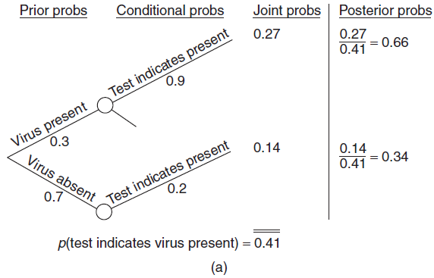
Revising the prior probabilities when the test indicates that the virus is present

Slide 26
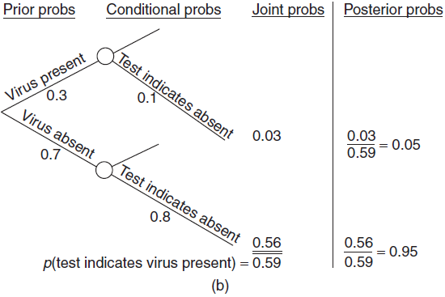
Revising the prior probabilities when the test indicates that the virus is absent

Slide 27
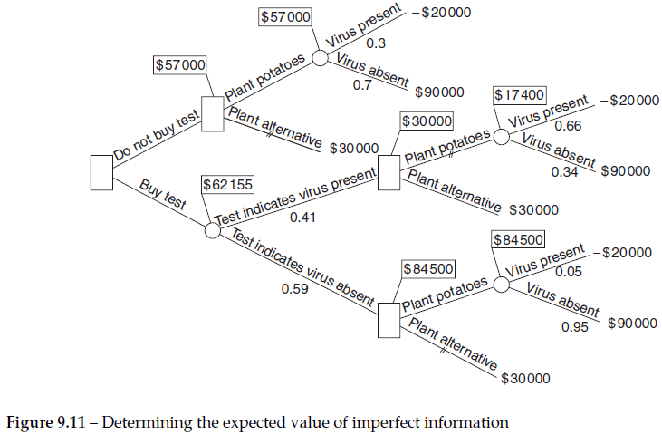
Notes:
Expected payoff:
If the test indicates the virus is present (p =0.41), the best decision is to plant alternative crop and earn $30 000.
If the test indicates the virus is absent (p = 0.59), the best decision is to plant potato crop and earn $84 500. (???)
In the case where the test indicates that the virus is present the expected payoff will be (30 000 – 17 400 = 12 600). Considering that if the virus is said to be absent and you won’t change your choice, the expected value of the imperfect info. is: 0.41 x $12 600 + 0.59 x $0 = $5166.

Slide 28
Expected payoff
So the expected payoff with the imperfect information is:
0.41 x $30 000 + 0.59 x $84 500 = $ 62 155.
If the expected payoff without the test is $57 000, it gives us a expected value of the imperfect information of $ 5 155.
It would not, therefore, be worth paying Ceres more than $ 5 155 for the test (i.e. Expected value of imperfect information ).
Notes:
The more reliable the new info. is, the closer its expected value will be to the EVPI.

Slide 29
Summary of main stages
(1) Determine the course of action which would be chosen using only the prior probabilities and record its expected payoff;
(2) Identify the possible indications which the new information can give;
(3) For each identification:
- Determine the probability that this indicator will occur;
Use Bayes’ theorem to revise the probabilities in the light of this indication;
Determine the best course of action (i.e. using the posterior probabilities) and its expected payoff;

Slide 30
Summary of main stages
(4) Multiply the probability of each indication occurring by expected payoff of the course of action chosen and sum the resulting products. This will give the expected payoff with imperfect information;
(5) The expected value of the imperfect information is equal to the expected payoff with imperfect information less the expected payoff of the course of action chosen using the prior probabilities.

Slide 31
Links
Fornecido pelo Éder: https://www.youtube.com/watch?v=X_BU8rPQpjM&t=2328s
Fornecido pelo Marcelo: https://www.youtube.com/watch?v=P9EMIy0v8A4

