Slide 1
Discourse Analysis vs. Content Analysis https://www.youtube.com/watch?v=EUeA0PEF_g4

Slide 2
Discourse Analysis in IR I
Post-structuralist discourse analysis
Anti-essentialist ontology.
Anti-foundationalist epistemology.
PDA argues that there is no pregiven, self-determining essence that is capable of determining and ultimately fixing all other identities within a stable and totalizing structure.
Discourse theory aims to draw out the consequences of giving up the idea of a transcendental center.
The result is not total chaos and flux, but playful determination of social meanings and identities within a relational system which is provisionally anchored in nodal points that are capable of partially fixing a series of floating signifiers.

Slide 3
Discourse Analysis in IR II
Post-structuralist discourse analysis
PDA fundamental premise - while there is a ‘real world’ of objects independent of our knowledge, it is only through meaning-making that these objects become real to us.
Ernesto Laclau and Chantel Mouffe call this articulatory nature of the social world discourse, and they contend that all social phenomena are encompassed by it.
Discourse is coextensive with the social, and that language is assumed to be the most elemental system of social interaction, and progenitor of the meaning-making.

Slide 4
Discourse Analysis in IR III
Post-structuralist discourse analysis
Rorty (1989) - while the world exists out there, truth does not. Truth is not a feature of externally existing reality, but a feature of language.
Truth is local and flexible, as it is conditioned by a discursive truth regime which specifies the criteria for judging something to be true or false.
Within a certain vocabulary we can assess the truth claim of different discursive statements in relation to the different states of affairs that we perceive.
However, reality does not determine the kind of vocabulary and truth regime that we will construct.

Slide 5
Discourse Analysis in IR IV
Post-structuralist discourse analysis
Discourse is not equivalent to “ideas” - discourse incorporates material as well as ideational factors.
Subjects, or their identities, are developed against an ‘other’.
Analysts are not concerned with causal social science in any meaningful sense, but with asking questions primarily about how discursive representations of the social constitute the identities of actors.

Slide 6
Discourse Analysis in IR V
Post-structuralist discourse analysis
PDA is about mapping discursive structures to show how they produce objects, and especially subjects — taking the form of deconstructing discursive totalities away from their ‘hegemonic’ status to open up what is perceived as a ‘closure’.
In deconstruction, the ahistorical or fixed constructions of objects or identities are exposed as contingent and relationally structured, and counter-discourses are proposed as possible ways a situation could have been.
Analysts may also seek to find some ‘blank spot’ or contradiction for which a particular discourse shows its weakness, or conduct a ‘genealogy’ which ‘traces the formation of a concept’.
Linguistics and discourse analysis:
https://www.youtube.com/watch?v=JZ8bkus3vis
How to write a paper using discourse analysis:
https://www.youtube.com/watch?v=pkwfJlNkRvw

Slide 7
Discourse Analysis in IR VI
The four key arguments of Laclau and Mouffe
“Hegemony and Socialist Strategy” (1985)
The first argument is that all forms of social practice take place against a background of historically specific discourses, which can be broadly defined as relational systems of signification.
Whatever we say, think, or do is conditioned by a more or less sedimented discourse which is constantly modified and transformed by what we are saying, thinking, and doing.
At an abstract level, discourse can be defined as a relational ensemble of signifying sequences that weaves together semantic aspects of language and pragmatic aspects of action.

Slide 8
Discourse Analysis in IR VII
The four key arguments of Laclau and Mouffe
The second argument is that discourse is constructed in and through hegemonic struggles that aim to establish a political and moral intellectual leadership through the articulation of meaning and identity.
This argument merely asserts that discourse is neither determined by structural pressures emanating from socioeconomic infrastructures nor a result of the dialectical unfolding of reason.
Discourse is always a result of political decisions (not necessarily conscious decisions).

Slide 9
Discourse Analysis in IR VIII
The four key arguments of Laclau and Mouffe
The third argument is that the hegemonic articulation of meaning and identity is intrinsically linked to the construction of social antagonism.
This antagonism involves the exclusion of a threatening Otherness that stabilizes the discursive system while, at the same time, preventing its ultimate closure.
Alternatively, we have to look for something outside the discourse in order to account for its limits.

Slide 10
Discourse Analysis in IR IX
The four key arguments of Laclau and Mouffe
The fourth argument is that a stable hegemonic discourse becomes dislocated when it is confronted by new events that it cannot explain, represent, or in other ways domesticate.
All discourses are finite and they will eventually confront events that they fail to integrate.
The failure to domesticate new events will disrupt the discursive system.
This will open a terrain for hegemonic struggles about how to heal the rift in the social order.
There will be political struggles about how to define and solve the problem at hand.
The political struggles lead to the articulation of a new hegemonic discourse, which is sustained through the construction of a new set of political frontiers.

Slide 11
Discourse Analysis in IR X
Content Analysis of Discourses
Content analysis differs from discourse analysis quite profoundly even though it is similarly concerned with the analysis of texts.
Most importantly, it adopts a positivistic approach – the fundamental activity is hypothesis testing using statistical analysis.
At a practical level, it involves the development of analytical categories that are used to construct a coding frame that is then applied to textual data.
Underlying this concern is the belief that the meaning of the text is constant and can be known precisely and consistently by different researchers as long as they utilize rigorous and correct analytical procedures.

Slide 12
Discourse Analysis in IR XI
Content Analysis
Content analysis as a mode of textual analysis is characterized by a concern with being objective, systematic, and quantitative:
objective in the sense that the analytic categories are defined so precisely that different coders may apply them and obtain the same results;
systematic in the sense that clear rules are used to include or exclude content or analytic categories;
quantified in the sense that the results of content analysis are amenable to statistical analysis.

Slide 13
Discourse Analysis in IR XII
Content Analysis
Content analysis is the study of the text itself not of its relation to its context, to the intentions of the producer of the text, or of the reaction of the intended audience.
While discourse analysis and content analysis are both interested in exploring social reality, the two methods differ fundamentally in their assumptions about the nature of that reality and of the role of language in particular.
Where discourse analysis highlights the precarious nature of meaning and focuses on exploring its shifting and contested nature, content analysis assumes a consistency of meaning that allows for occurrences of words (or other, larger units of text) to be assumed equivalent and counted.
Where discourse analysis focuses on the relation between text and context, content analysis focuses on the text abstracted from its contexts.

Slide 14
Discourse Analysis in IR XIII
Content Analysis
More qualitative forms of content analysis that do not assume highly stable meanings of words but, rather, include a sensitivity to the usage of words and the context in which they are used are compatible with discourse analysis.
As one moves from simple counting to more complex interpretation, the two forms of analysis become increasingly compatible, although at the expense of positivist objectives.
For content analysis to form part of a discourse analytic methodology, it is necessary to weaken the assumption that meaning is stable enough to be counted in an objective sense.
From a discourse analytic perspective, all textual analysis is an exercise in interpretation and while clear exposition of the methods used to arrive at a particular interpretation is a hallmark of good research, it cannot remove the necessity for interpretation.

Slide 15
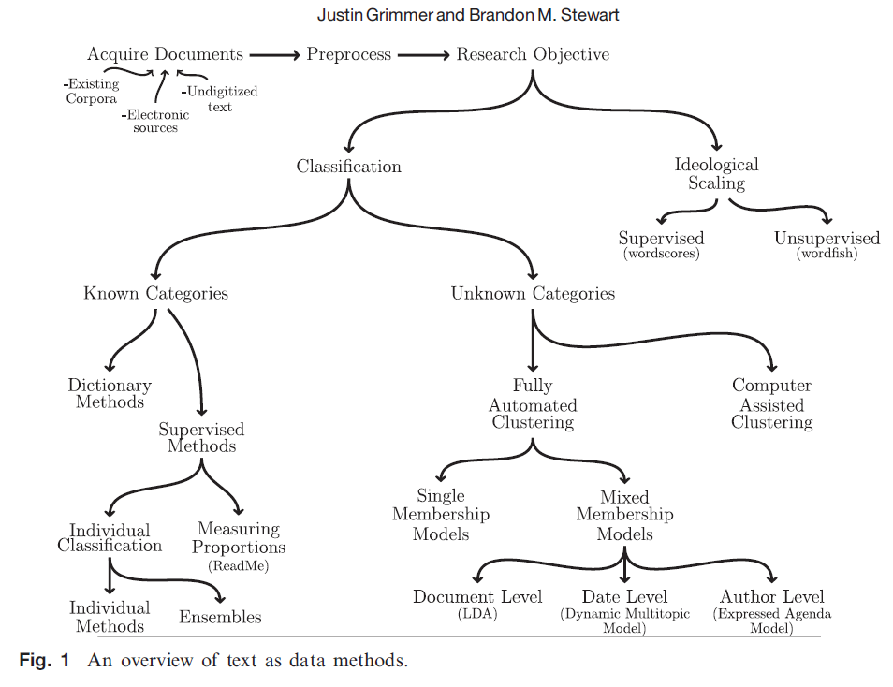
Discourse Analysis in IR XIII
Content Analysis

Slide 16
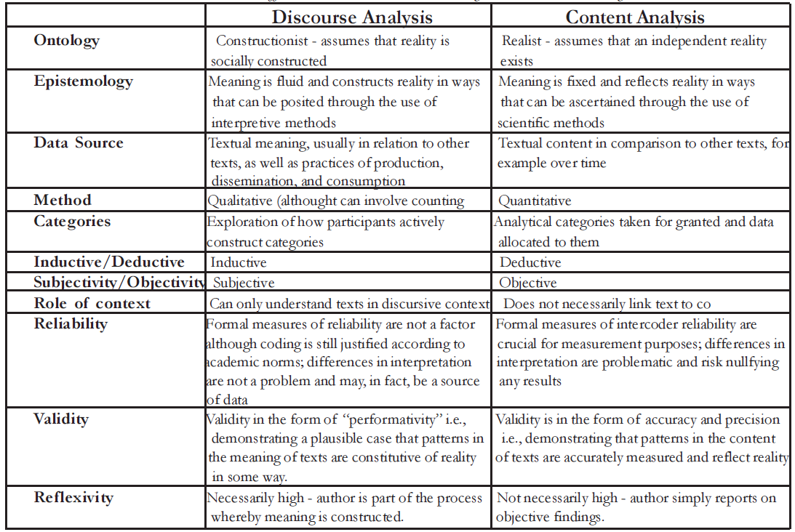
Discourse Analysis in IR XV

Slide 17
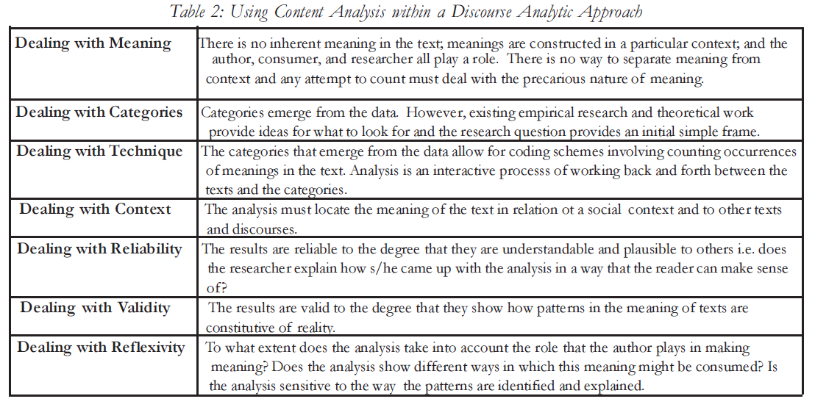
Discourse Analysis in IR XVI

Slide 18
Discourse Analysis in IR XVII
Practice tracing (Pouliot) - from an interpretive perspective, discourse and other forms of textual analysis may be required to generate additional data for the execution of what Pouliot calls practice tracing.
Since it involves moving across epistemological boundaries one begins interpretively, using textual methods inductively to recover the properties of a particular factor, country, or political system.
Then, in a second, positivist/scientific-realist step, the inductively generated data creates observable implications whose presence is measured by process tracing.

Slide 19
Discourse Analysis in IR XVIII
Practice tracing is a hybrid methodological form that rests on two relatively simple tenets: social causality is to be established locally, but with an eye to producing analytically general insights.
The first tenet, drawn primarily from interpretivism, posits the singularity of causal accounts: it is meaningful contexts that give practices their social effectiveness and generative power in and on the world.
The second tenet, in tune with process analytics, holds that no social relationships and practices are so unique as to foreclose the possibility of theorization and categorization.

