Slide 1
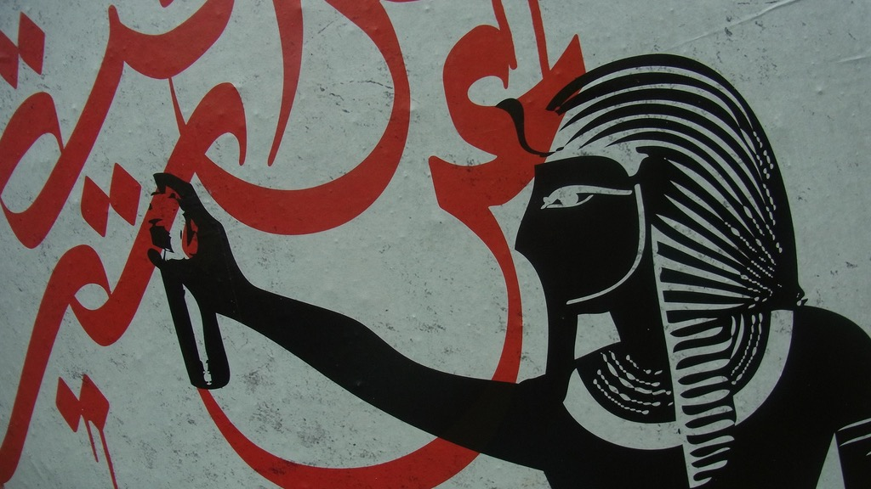
Major Themes in Contemporary Middle East
LECTURE 11.
THE KURDISH QUESTION

Slide 2
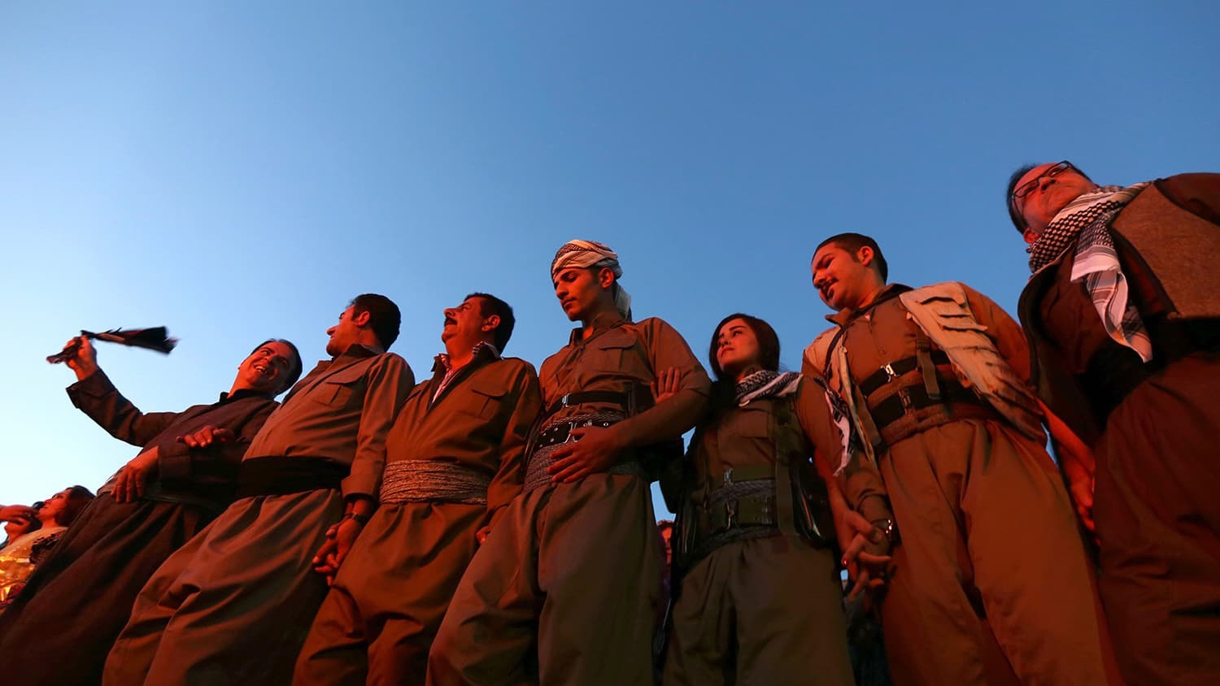
The Kurdish Question

Slide 3
Who are the Kurds?
“…an ethnic group of Western Asia, mostly inhabiting a contiguous area known as Kurdistan.” –Wikipedia
Speakers of Kurdish languages, a sub-category of Indo-Iranian language group.
“A tribal people ... whose desire for a nation-state of their own came too late, after the Middle East had been cut up into Persian, Turkish and Arab states.” – M. Van Bruinessen
“The largest stateless people” → est. 25 - 30 million but no state of their own.
Divided b/w Turkey, Iran, Iraq, Syria and Europe

Slide 4
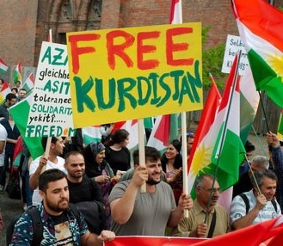
What is the Kurdish question?
Kurdish struggle for recognition, rights, autonomy or independence
Two overlapping stories:
Tribal resistance to central authority (a much older story)
&
Urban middle class push for modern national identity building and rights recognition (a modern story)

Slide 5
Why is it so difficult to achieve?
Clash of nationalisms…
Legacy of transformation from decentralised empires to modern, centralised nation-states
Local state actors resist Kurdish aspirations for autonomy or statehood
Kurds at best distrusted, at worst seen as traitors, foreign agents by Turkish, Iranian and Arab nationalists
Repression with periodic expansion of limited rights
Divisions & rivalries among the Kurds…
Difficult to unify as “a people”
Different political goals (adaptation to status quo, pursuit cultural rights or independence)
Exploited by regional actors

Slide 6
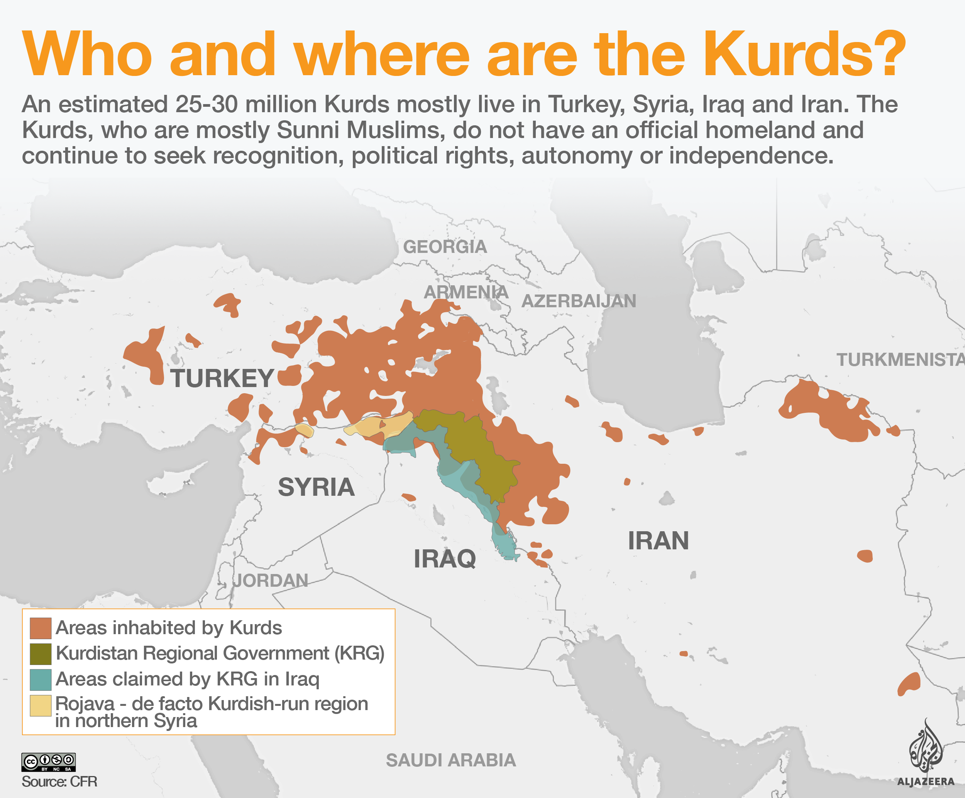
Geopolitical divisions
Divided between Turkey (est. 15m), Iran (6m), Iraq (5m), Syria (2m) + Diaspora (est. 2 million in Europe)
Separate/rival political representatives

Slide 7
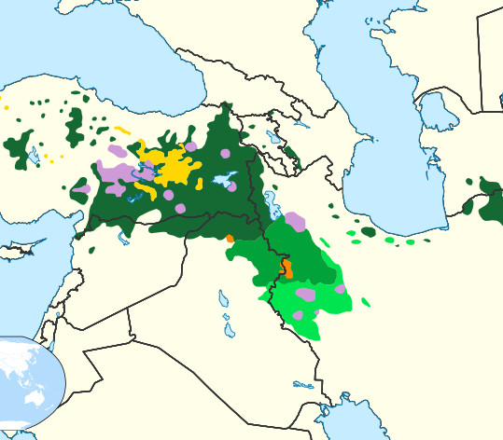
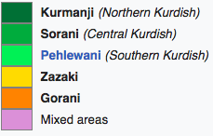
Linguistic divisions
Northern Kurdish (Kurmanji) + Central Kurdish (Sorani) + Southern Kurdish (Pehlewani) + Northwest Iranian languages (Zazaki & Gorani) + Non-Kurdish speaking Kurds (result of assimilationist policies)

Slide 8
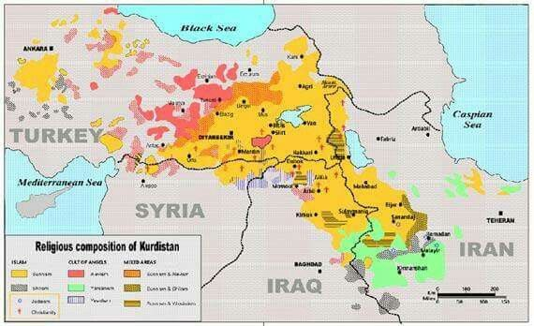
Religious divisions
Sunni (est. 75%)
Shia (est. 15%)
Alevism
Yazidism
Assyrians
Zoroastrianism
Judaism (mostly in Israel)
Secularism

Slide 9
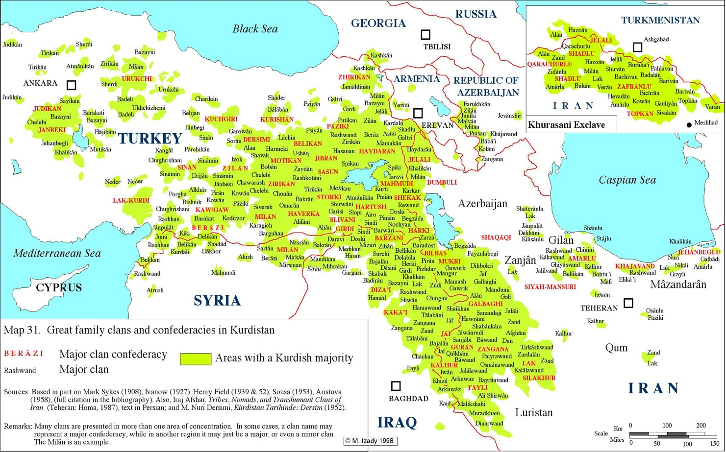
Tribal divisions
Historical allegiances & rivalries still very potent
Some tribes number in millions
Urbanisation weakens/challenges tribal links
Anti-feudal movements (PKK)

Slide 10
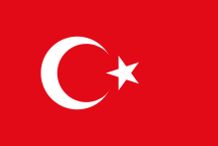
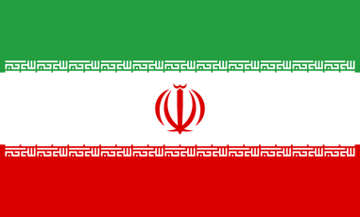
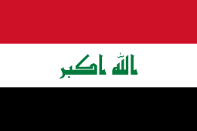
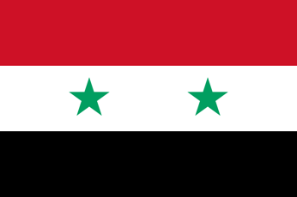
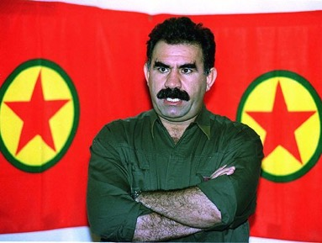
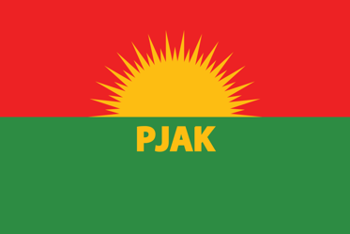
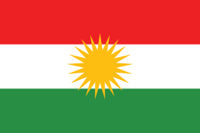
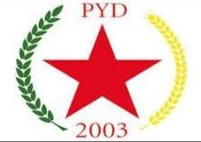
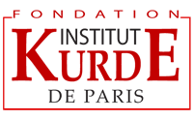
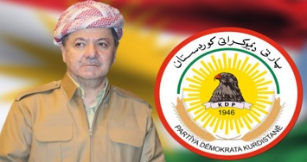
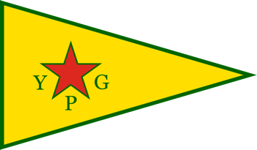
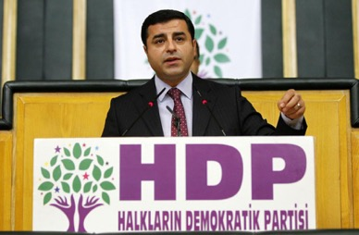
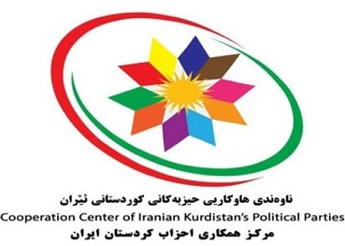
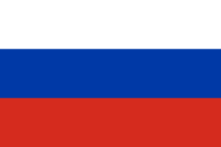
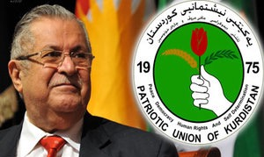
Who are the main actors?
Diaspora Organisations
Kurdistan Regional Government
PJAK (PKK affiliated)
PYD (linked to PKK)
PKK – Abdullah Öcalan
KDP – Masoud Barzani
YPG - People’s Protection Units
HDP – Selahattin Demirtas
Kurdish Islamist Movements
Kurdish Islamists
PUK – Jalal Talabani

Slide 11
Kurdish story in Turkey
Iran
Iraq
Syria

Slide 12
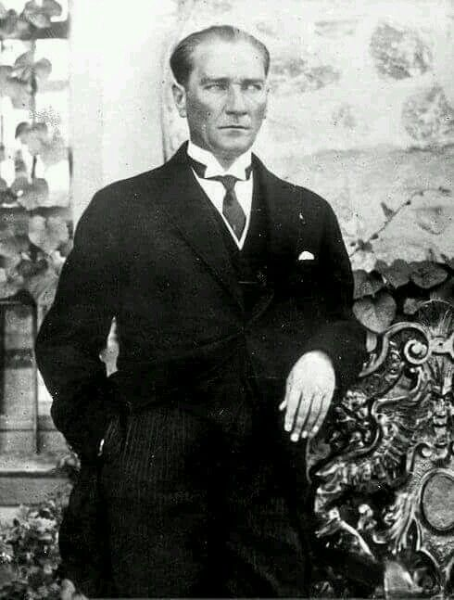
Kurdish story in Turkey
Mustafa Kemal Atatürk
Kurdistan... a geographic region in Ottoman Empire
Tribal resistance to central authority… but also tribes on state payroll
After WWI, Treaty of Sèvres 1920 makes a vague promise of a Kurdish homeland
Mustafa Kemal and Turkish nationalists appeal to Kurdish notables for support against occupation, promising respect for cultural and political rights.
After Republic is established (1923), these promises are not kept.

Slide 13
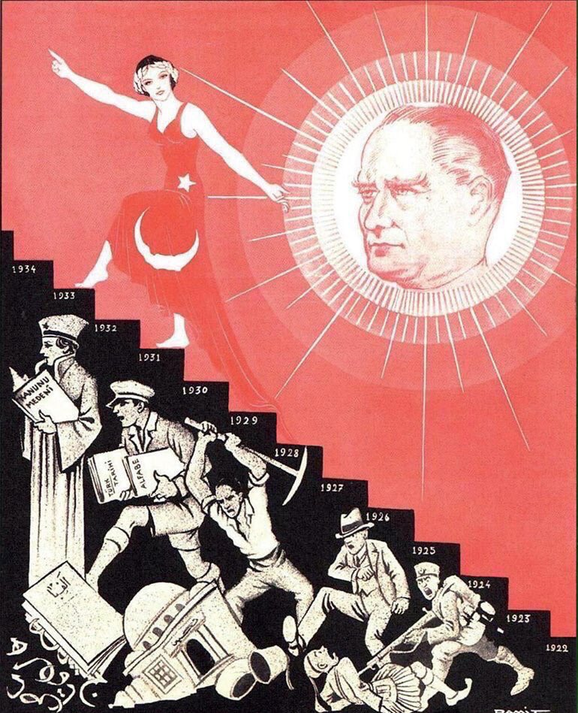
Kurdish story in Turkey
Early Republic sees Kurds as “future-Turks” that need to be assimilated into modern Turkey.
Kurdish rebellions in 1920s and 30s against modernisation, secularisation and Turkification attempts,
Suppressed by force + Resettlement Law (1934)
In 1950s & 60s: Kurdish issue seen from the lens of developmentalism
60s & 70s: Kurdish question absorbed into socialist struggles (and extreme nationalist reaction to it)

Slide 14
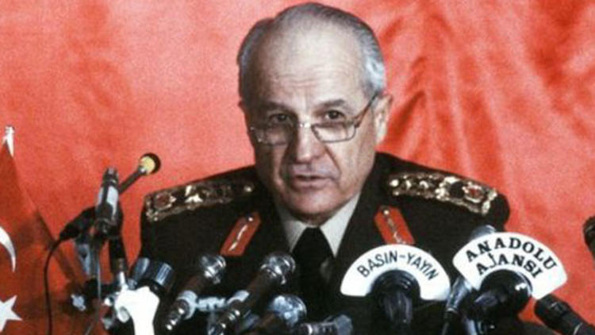
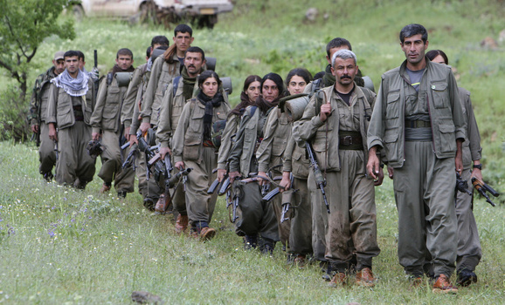
Kurdish story in Turkey
1980 military coup: brutal in Kurdish provinces.
Denial of political and cultural rights: Military junta calls Kurds “mountain Turks”.
Radicalisation of many Kurds and beginning of PKK’s armed struggle in 1984.
1984 – 1999: “Dirty War” → 40k+ people dead. Millions displaced. State sanctioned assassinations and rights abuses.
1999 – 2015: Ceasefire, sporadic peace processes + EU-supported liberal democratic reforms.
Since 2015: Turkey descends into populist authoritarianism under Erdogan’s AKP. A new phase of violence and repression, intensified by the Syrian conflict.

Slide 15
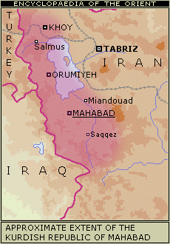
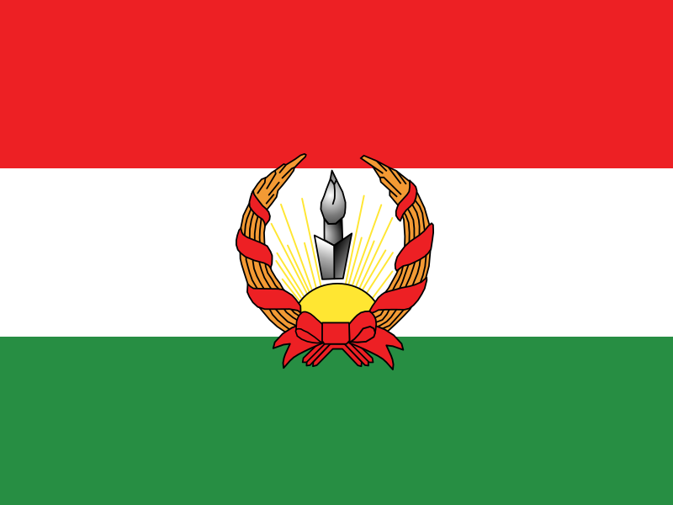
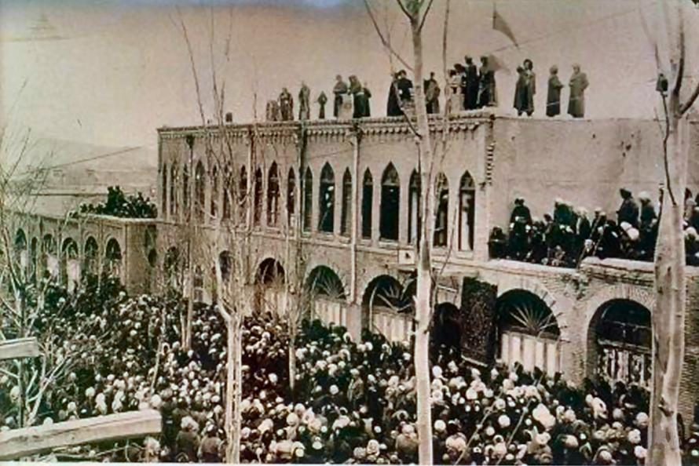
Kurdish story in Iran
Ethnic and linguistic kinship with Iranians
Mostly Sunni population in Shia majority Iran.
Soviet-backed Mahabad Republic (1946) – the first independent Kurdish state – survives for less than a year
1960s: Rebellion against repression by Pahlavi regime.
Islamic Revolution: Kurds support the revolution, but demands for autonomy unanswered.
1980 – 82: Civil war (10k+ dead, 200k displaced)
Sporadic unrest & ceasefires since.

Slide 16
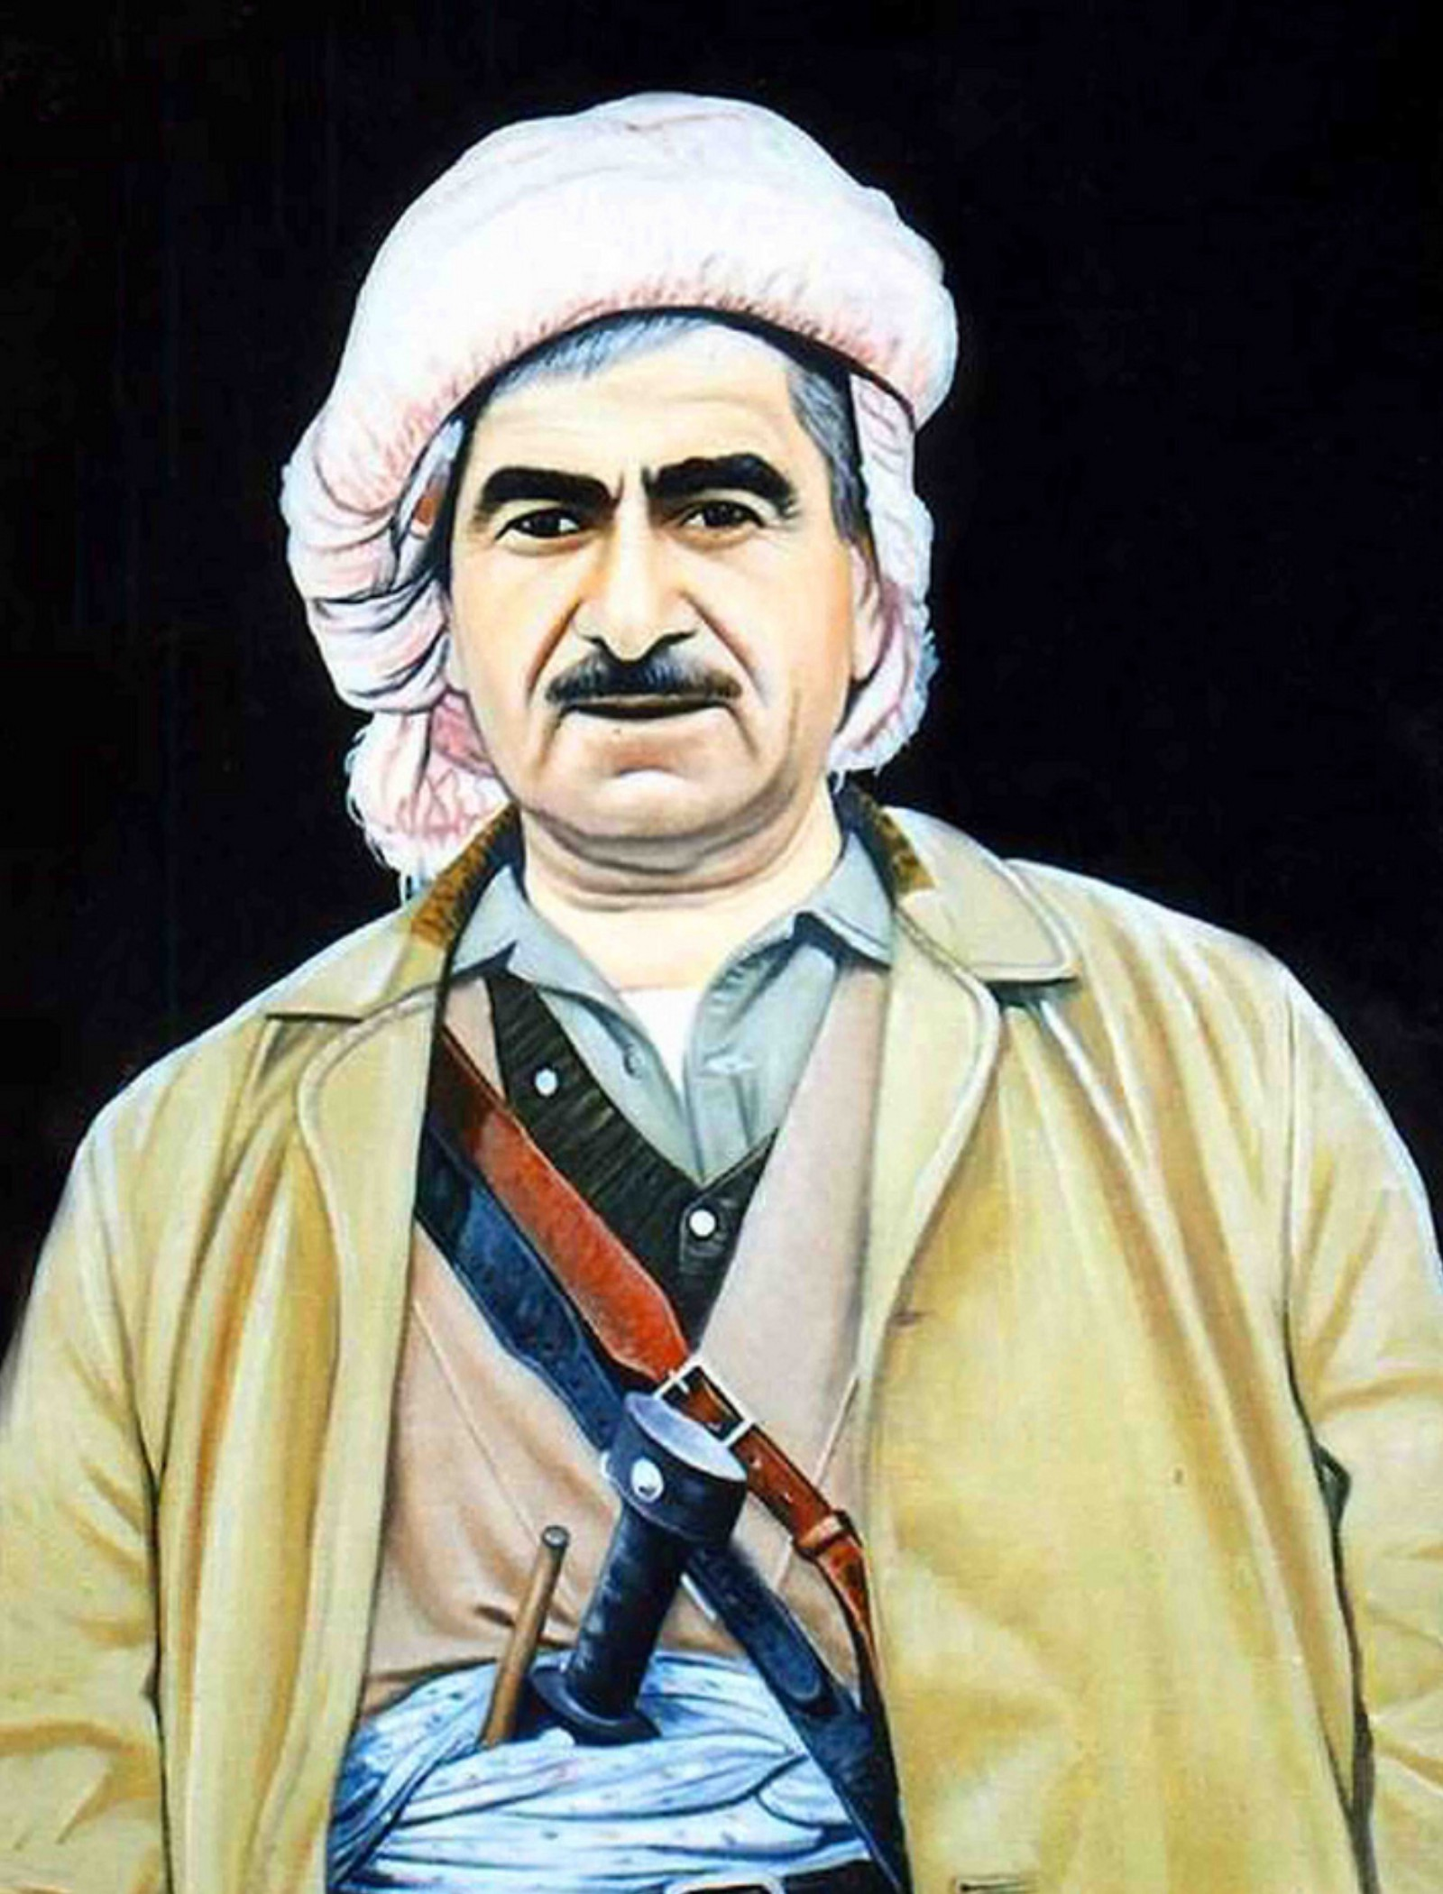
Kurdish story in Iraq
Molla Mustafa Barzani
Various uprisings against British and Iraqi authorities, demands for autonomy and rights ignored/crushed
1946: Kurdistan Democratic Party (KDP) established with Molla Mustafa Barzani president.
1958: Monarchy overthrown; new constitution recognises Kurdish “national rights”
1961 – 70: First Iraqi-Kurdish War
1975 – 78: Kurdish civil conflict: Erbil-based KDP vs. Damascus (later Suleymaniye)-based PUK
Iran-Iraq War: Iraqi Kurds support Iran
1988: Anfal Campaign/Genocide: Chemical attacks on civilians (5k dead in Halabja).

Slide 17
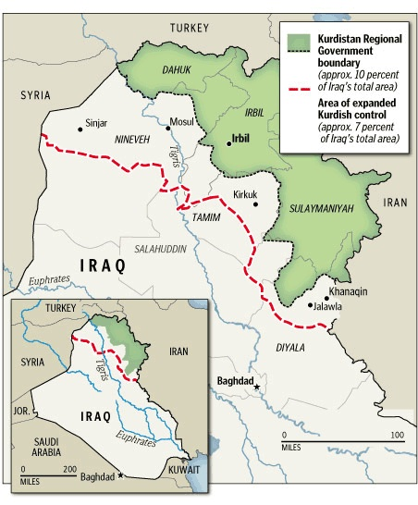
Kurdish story in Iraq
1991 Gulf War: Kurds support the US. Saddam seeks revenge, 1.5 million Kurds become refugees.
1990s: No fly zone over Northern Iraq, beginning of Kurdish autonomy.
2003: Kurdish support for US occupation
2005: New constitution recognises KRG autonomy. Major western oil investments.
2014: KRG expands its territorial control as Iraqi army crumbles in the face of ISIS.
2017: Independence referendum: Overwhelming local support BUT overwhelming international rejection.

Slide 18
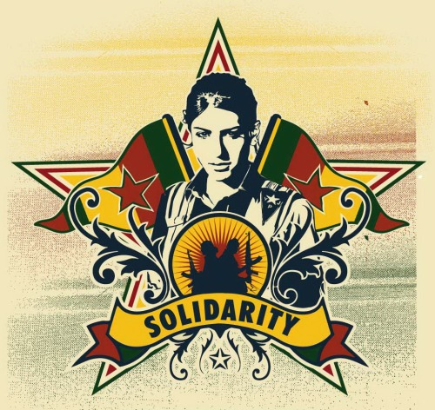
Kurdish story in Syria
7– 10% of population.
1960s: Syrian gov strips 20% of Kurdish population off citizenship. Many lack citizenship rights today.
1970s: Arabisation project (dispossession and resettlement of Kurds, bringing in Bedouin Arabs)
1990s: Syrian govt uses PKK against Turkey.
2003: PYD founded as a branch of PKK.
Syrian civil war and the “Rojava Revolution”
Autonomous region under Kurdish control. A radical democratic project.
Supported by US against ISIS. Opposed by Turkey.
Ambivalent relationship with the Assad regime.

Slide 19
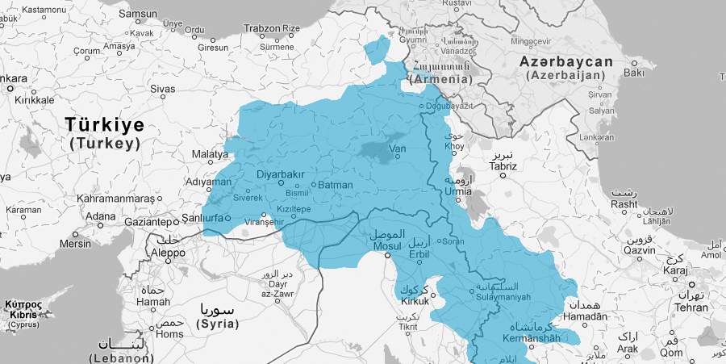
Homework:
“Kurds have achieved autonomy in Iraq and Syria, but not in Turkey and Iran... Why?”
One paragraph. Email by midnight Monday, 25 May.

Slide 20
Competing Kurdish nationalisms
The model of Iraqi Kurdistan (KRG)
The model of democratic autonomy (PKK/PYD)
Kurdish ‘Islamic Nationalism’ (Hizbullah/IS)

Slide 21
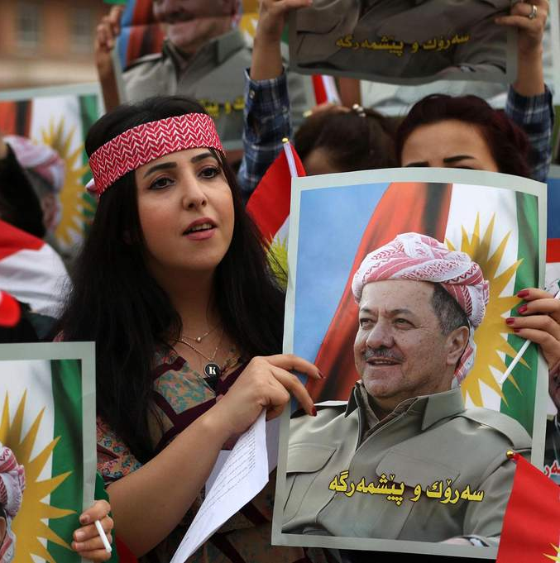
Competing Kurdish nationalisms
The model of Iraqi Kurdistan (KRG)
Most stable and prosperous part of Iraq.
Closest to independence of any Kurdish populated area.
Nominally democratic.
Conventional nationalism
Pragmatic (non-utopian) regional policy
Elements of rentierism
System based on patronage and access to Barzani and Talabani families
Extensive corruption and feudalism

Slide 22
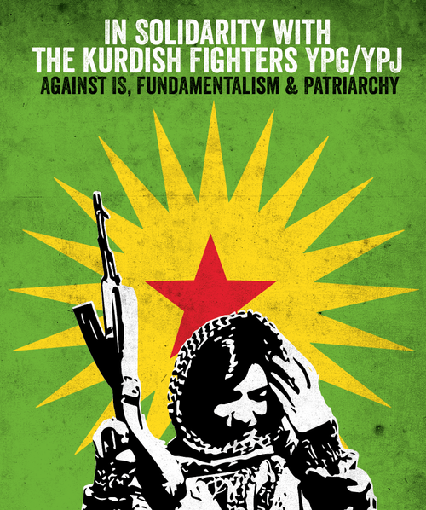
Competing Kurdish nationalisms
2. The model of democratic autonomy (PKK)
PKK’s evolution from Marxist-Leninist nationalism to post-nationalist social libertarianism
Öcalan influenced in prison by Murray Bookchin, a US anarchist and proponent ‘libertarian municipalism’
Bottom up self-governing municipalities forming voluntary confederations
Focus on economic self-sufficiency, gender equality and cultural inclusion.
Rojava in Syria and HDP in Turkey as experiments
Paradoxes: top-down imposition; relies on US-support in Syria.

Slide 23
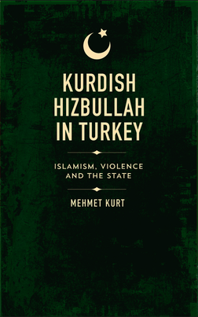
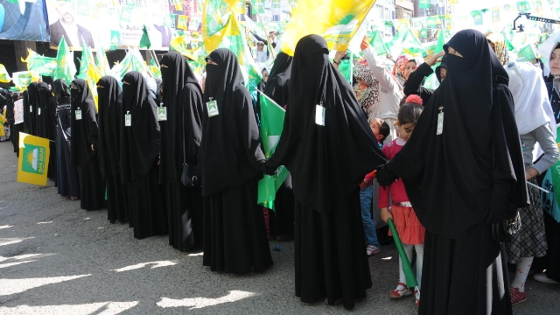
Competing Kurdish nationalisms
3. Kurdish ‘Islamic Nationalism’
Movements that emphasise both Kurdish and Islamic identity
Most notable: “Kurdish Hizbullah” in Turkey in 1990s (not to be confused w/ Lebanese Hezbullah)
Initially supported by Turkish state against PKK
Criminalised. Re-emerged as political party and civil society organisation
Islamic mobilisation in Kurdistan
High levels of Kurdish participation in Salafi jihadist groups like ISIS.

Slide 24
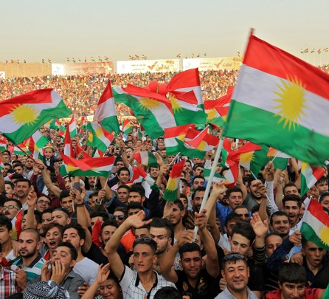
What’s the best way forward for the Kurds?
Seek rights within existing national frameworks?
Pursue an independent nation-state?
Be the vanguard for a post-nationalist new Middle East?

Slide 25
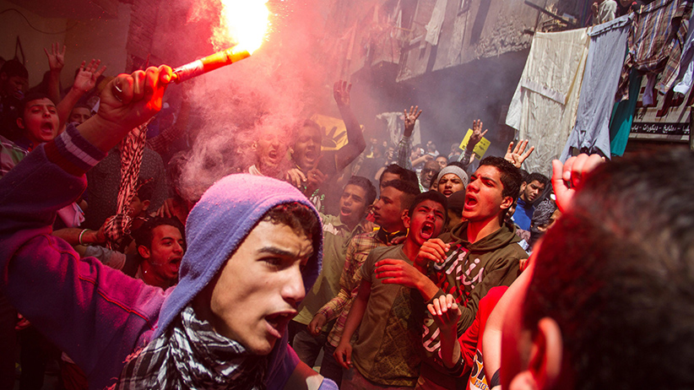
Next Week
From the ‘Arab Spring’ to the ‘Arab Winter’

