Slide 1
Ex-machina (2015)
aprendizado por reforço
MAC 425 / 5739
Inteligência Artificial

Slide 2
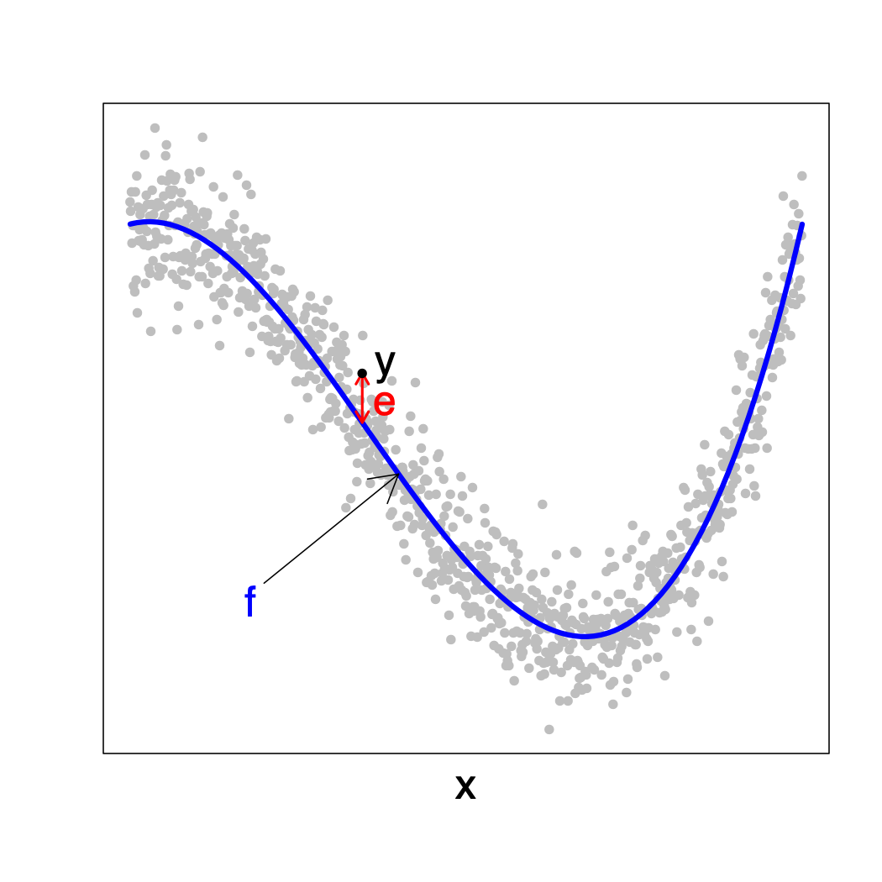
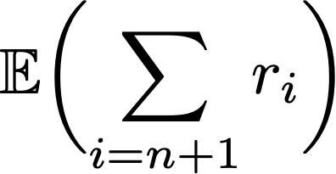
learning paradigms
Supervised learning
Unsupervised learning
Reinforcement learning
Given:
Learn:
so as to maximize

Slide 3
contexto
✔︎ Parte I - Busca em espaço de estados
✔︎ Parte 2 – Raciocínio Lógico︎
✔ Parte 3 – Raciocínio Probabilístico e Tomada de decisão sob incerteza
Parte 4 - Aprendizado de máquina
Aprendizado por reforço
Aprendizado supervisionado
Aprendizado profundo

Slide 4
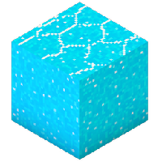
revisão: processos de decisão markovianos (MDP)
s
Conjunto de estados S
Conjunto de ações A
A(s): ações aplicáveis em s
Função de transição T(s,a,s’) = Pr(St+1=s’|St=s,At=a)
Função de “recompensa” R(s,a)
pode ser negativa
Estado inicial s0, estados terminais
Solução: Política ótima
a
s,a
s,a,s’
T(s,a,s’), R(s,a)
s’

Slide 5
s
markov decision process
a
s,a
s,a,s’
T(s,a,s’), R(s,a)
s’
Sequential decision making (t=1,2,…)
States S, Actions A
Transition model: T(s,a,s’) = Pr(s’|s,a)
Immediate Reward R(s,a) discounted by
Fully observable, stationary environment
agent behavior depends on current state:

Slide 6
markov decision process
Dynamic Programming: Value function computes expected utility from current state
Bellman Optimality Equation
Notes:
V_\pi(s) &= E\left( \sum_{t=0} \gamma^t R(S_t,\pi(s)) \biggm\vert S_0 = s \right) \\
& = R(s,\pi(s)) + \gamma \sum_{s'} T(s,\pi(s),s’) \times V_\pi(s’)
V^*(s) = \max_a \left[ R(s,a) + \gamma\sum_{s’} T(s,a,s’)V^*(s') \right]

Slide 7
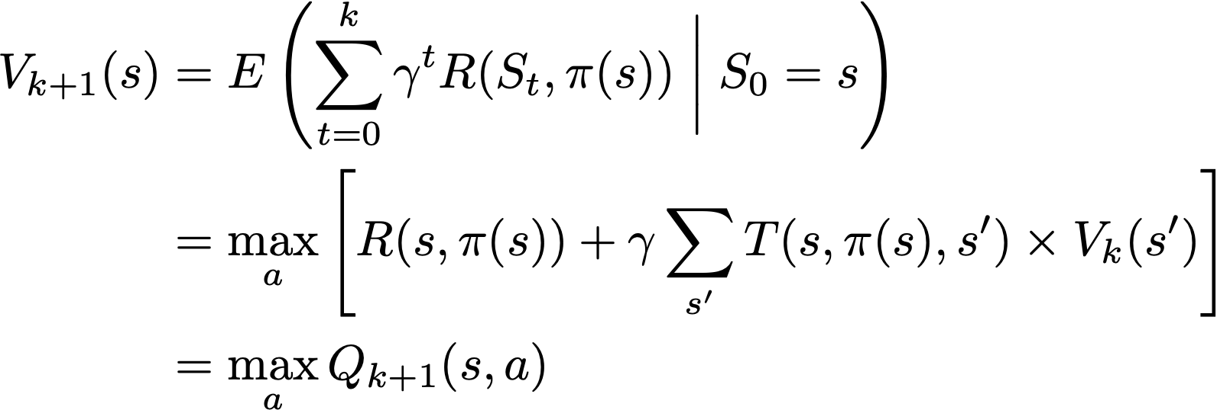
markov decision process
Bellman update:
Value Iteration (VI): Start with arbitrary V⁰ and apply Bellman update until convergence
Synchronous VI
Notes:
V_{k+1}(s) &= E\left( \sum_{t=0}^{k} \gamma^t R(S_t,\pi(s)) \biggm\vert S_0 = s \right) \\
& = \max_a \left[ R(s,\pi(s)) + \gamma \sum_{s'} T(s,\pi(s),s’) \times V_{k}(s') \right]\\
& = \max_a Q_{k+1}(s,a)

Slide 8
Optimum policy
Greedy policy for optimum value function
Greedy policy for optimum Q-value function
Notes:
\pi^*(s) = \arg\max_a \left[ R(s,a) + \gamma \sum_{s'} T(s,a,s') \times V^*(s') \right]

Slide 9
bandit
Idealized slot-machine makes for a pure game of chance
Pulling the lever starts the game
A matching combination of symbols rewards a known prize (Jackpot)
Non-matching combinations give no rewards
There is a fixed (but unknown to the gambler) probability of matching symbols independently of the initial configuration of the reels

Slide 10
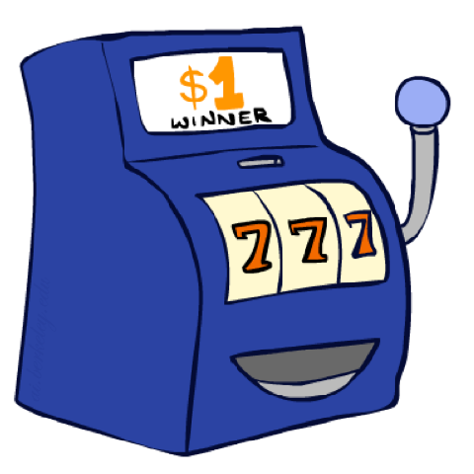
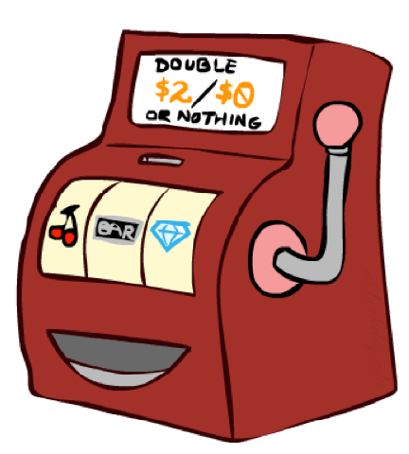
double bandit
Blue machine always gives you $1
Red machine gives you (each time you pull the lever)
$2 with probability 0.75
$0 with probability 0.25
or
images: Dan Klen (ai.berkeley.edu)

Slide 11
double bandit
start
States: start, win, lose
Actions: play blue, play red
No discount (𝛄 = 1)
10 episodes
1.0
$1
0.75
$0
$2
0.25
win
lose

Slide 12
double bandit
Reasonable Policies:
Play Blue
Expected Gain $10
Play Red
Expected Gain $15
Playing Red is optimal
start
1.0
$1
0.75
$0
$2
0.25
win
lose

Slide 13
double bandit
Now suppose you play red 5 times and receive $0+$2+$0+$2+$0=$4
We are then given the chance to change our policy
or
images: Dan Klein and Peter Abbeel (ai.berkeley.edu)

Slide 14
double bandit
Now suppose you play red 5 times and receive $0+$2+$0+$2+$0=$4
We are then given the chance to change our policy
Should we do it? No, expected value remains the same! (unless we believe the world has changed)
or
images: Dan Klein and Peter Abbeel (ai.berkeley.edu)

Slide 15
double bandit
Blue machine always gives you $1
Red machine gives you $2 with some unknown probability p and nothing with some unknown probability 1-p
You can change policy while playing
Online planning
start
$1
p
$0
$2
1-p
win
lose
or
images: Dan Klein and Peter Abbeel (ai.berkeley.edu)

Slide 16
double bandit
Suppose you start playing red and get $0+$2+$2+$2=$6
You estimate/learn that p is 3/4=0.75
Should you change policy?
No
or
images: Dan Klein and Peter Abbeel (ai.berkeley.edu)

Slide 17
double bandit
You get $0 $2 $2 $2 and then $0 $0 $2 $0 $0 $0
Total gain is $8, and you have won 4/10 plays
You revised your knowledge of p to 0.4
or
images: Dan Klein and Peter Abbeel (ai.berkeley.edu)

Slide 18
double bandit
You get $0 $2 $2 $2 and then $0 $0 $2 $0 $0 $0
Total gain is $8, and you have won 4/10 plays
You revised your knowledge of p to 0.4
Should you change policy? Yes, given current estimate
or
images: Dan Klein and Peter Abbeel (ai.berkeley.edu)

Slide 19
exploitation Vs exploration
Red machine is replaced
Again you start playing red and this time you get $0 $0 $0 $2
You learn that p is 0.25 and thus you decide to change to playing blue (reasonable given your current estimate of p)
It turns out that p was actually 0.75 (but you didn’t know)
So you got $8 which is less than the expected gain of playing red, and of playing blue

Slide 20
exploitation vs exploration
When the transition model is unknown, there is a dilemma between maximizing utility given current knowledge and exploring the world to improve knowledge
Acting greedily (w.r.t to current estimate) can lead to poor behaviour
Some randomness in action is advantageous
or
images: Dan Klein and Peter Abbeel (ai.berkeley.edu)

Slide 21
reinforcement learning
Solving partially specified Markov Decision Processes
Current state is known (observable)
Applicable actions in current state are known
State transition function (probabilities) is unknown
Rewards are observed or known
Data collection depends on agent’s policy (exploitation)
Agent’s policy depends on gathered data (exploration)

Slide 22
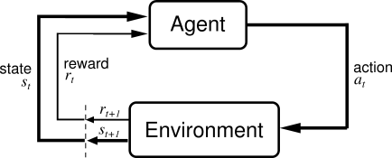
reinforcement learning
Online policy construction
Agent observes rewards and transition probabilities only by acting on world

Slide 23
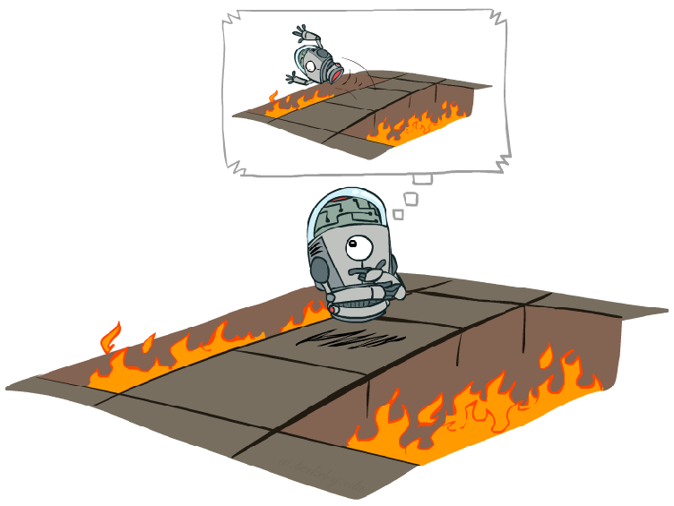
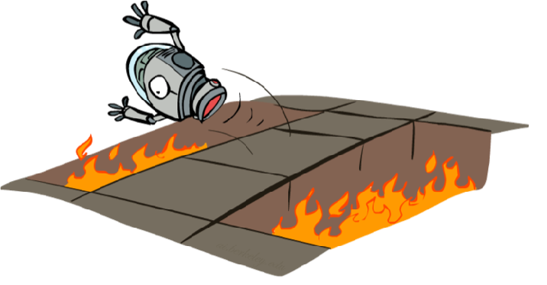
Offline (MDP) versus online (RL)
images: Dan Klein and Peter Abbeel (ai.berkeley.edu)

Slide 24
MODEL-BASED Reinforcement Learning
➔ One option:
Learn a model of the world
Estimate R(s,a) and T(s,a,s’) from interaction data
Solve it using known techniques
Use value iteration to compute a policy that is optimal for the world described by the estimated model
Take action using current estimate of world and repeat

Slide 25
model-based reinforcement learning
We don’t know probability of winning according to red machine
We play red 20 times and get $0 $2 $2 $0 $0 $2 $2 $2 $2 $2 $2 $0 $2 $2 $2 $2 $0 $2 $0 $2 $2 $0
Estimate p as
Therefore estimated expected gain of playing red is
Caveat: need to act “randomly” until have enough data to plan
Notes:
\hat{V}_\text{red} = \hat{p} \cdot \$2 + (1-\hat{p}) \cdot \$0 = \$1.5

Slide 26
model-free reinforcement learning
➔ Another option:
Estimate a value function directly from observations
It’s possible to find the optimal value function without ever estimating the state transition probabilities directly
Take action using current estimate of value function, and repeat

Slide 27
model-free reinforcement learning
We don’t know probability of winning according to red machine
We play red 20 times and get $0 $2 $2 $0 $0 $2 $2 $2 $2 $2 $2 $0 $2 $2 $2 $2 $0 $2 $0 $2 $2 $0
Estimate expected gain as
Each transition occurs with probability given by transition distribution, so expected utility converges in probability to true expected probability (as the number of episodes reaches infinity)
Notes:
\hat{V}_\text{red} = \frac{15 \cdot \$2 + 5 \cdot \$0}{20} = \$1.5

Slide 28
model-free reinforcement learning
Problem: How to extract policy from estimated value function V(s)?
Cannot use greedy policy since we don’t know transition (and possibly some rewards)
Notes:
\pi^*(s) = \arg\max_a \biggl[\underset{Q^*(s,a)}{\underbrace{ R(s,a) + \gamma \sum_{s'} T(s,a,s') \times V^*(s') }}\biggr]

Slide 29
model-free reinforcement learning
Q-Value Function: Expected reward if we start in state s, take action a and then continue optimally
Optimum policy is greedy for optimum Q-Value Function
Notes:
Q^*(s,a) = R(s,a) + \gamma \sum_{s'} T(s,a,s') \times \max_{a'} Q^*(s',a')

Slide 30
how to update The q-value function
Current guess Qk(s,a)
Suppose agent is in s, takes action a, which causes world to transit to s’ and generates reward R(s,a)
How to compute Qk+1(s,a) based on Qk(s,a) and T(s,a,s’)?
Qk+1(s,a) should approximately obey Bellman’s update
Qk+1(s,a) should not differ drastically from Qk(s,a) (since it is an sum of rewards)
Notes:
Q_{k+1}(s,a) \approx R(s,a) + \gamma \sum_{s'} T(s,a,s') \max_{a’}Q_k(s’,a')
Q_{k+1}(s,a) \approx R(s,a) + \sum_{t=1}^k \gamma^t R(s_t,a_t)

Slide 31
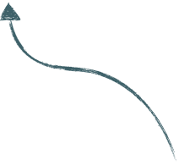
How to update the q-value function
Qk+1(s,a) should approximately obey Bellman’s update
Qk+1(s,a) should not differ drastically from Qk(s,a)
0 < alpha < 1
learning rate
Notes:
Q_{k+1}(s,a) &= (1-\alpha)Q_k(s,a) + \alpha\left[ R(s,a) + \gamma \max_{a'} Q_k(s',a') \right]\\
&= Q_k(s,a) + \alpha \left[ R(s,a) + \gamma \max_{a'}Q_k(s',a') - Q_k(s,a)\right]

Slide 32
Q-learning Algorithm
Estimates the Q* function directly, without estimating the transition probabilities
Initialize Q arbitrarily (usually Q=0)
Observe the current state s
repeat
select an action a and execute it in s
receive immediate reward R(s,a)
observe the new state s’
update Q(s,a) as follows:
Q(s,a) ← (1−α)Q(s,a) + α[R(s,a) + γ max_{a’} Q(s’,a’)]
s ← s’
α: learning rate

Slide 33
Example
3x3 grid world
Can move to adjacent cells
no moving to inexistent cell
Exits at flagged cell
No discount (𝛄 = 1)
R(s) =
-1 | -1 | -1
-1 | -1 | -1
-1 | -1 | 10

Slide 34
example
Agent starts at S=1
Learning rate 𝛼 = 0.5
Q(S,A)
0
0
0
0
0
0
0
0
0
0
0
0
0
0
0
0
0
0
0
0
0
0
0
Notes:
Q(s,a) \gets (1-\alpha)Q(s,a) + \alpha\left[ R(s,a) + \gamma \max_{a'} Q(s',a') \right]

Slide 35
example
Agent starts at S=1
Learning rate 𝛼 = 0.5
Q(S,A)
0
0
0
0
0
0
-0.5
0
0
0
-1
0
0
0
0
0
0
0
0
0
0
0
0
0
Notes:
Q(s,a) \gets (1-\alpha)Q(s,a) + \alpha\left[ R(s,a) + \gamma \max_{a'} Q(s',a') \right]

Slide 36
example
Agent starts at S=1
Learning rate 𝛼 = 0.5
Q(S,A)
0
0
0
0
0
0
-0.5
0
0
0
-1
0
0
0
0
-1
0
0
-0.5
0
0
0
0
0
0
Notes:
Q(s,a) \gets (1-\alpha)Q(s,a) + \alpha\left[ R(s,a) + \gamma \max_{a'} Q(s',a') \right]

Slide 37
example
Agent starts at S=1
Learning rate 𝛼 = 0.5
Q(S,A)
0
0
0
0
0
0
-0.5
0
0
0
-1
0
0
0
0
-1
-1
0
0
-0.5
0
0
0
0
-0.5
0
Notes:
Q(s,a) \gets (1-\alpha)Q(s,a) + \alpha\left[ R(s,a) + \gamma \max_{a'} Q(s',a') \right]

Slide 38
example
Agent starts at S=1
Learning rate 𝛼 = 0.5
Q(S,A)
0
0
0
0
0
0
-0.5
0
0
0
-1
-1
0
0
0
0
-1
-1
0
0
-0.5
0
-0.5
0
0
-0.5
0
Notes:
Q(s,a) \gets (1-\alpha)Q(s,a) + \alpha\left[ R(s,a) + \gamma \max_{a'} Q(s',a') \right]

Slide 39
example
Agent starts at S=1
Learning rate 𝛼 = 0.5
Q(S,A)
0
0
0
0
0
0
-1
-0.5
0
0
0
-1
-1
0
0
0
-0.5
-1
-1
0
0
-0.5
0
-0.5
0
0
-0.5
0
Notes:
Q(s,a) \gets (1-\alpha)Q(s,a) + \alpha\left[ R(s,a) + \gamma \max_{a'} Q(s',a') \right]

Slide 40
example
Agent starts at S=1
Learning rate 𝛼 = 0.5
Q(S,A)
0
0
0
0
0
0
-1
-0.5
-1
0
0
0
-1
-1
0
0
0
-0.5
-1
-1
0
-0.5
-0.5
0
-0.5
0
0
-0.5
0
Notes:
Q(s,a) \gets (1-\alpha)Q(s,a) + \alpha\left[ R(s,a) + \gamma \max_{a'} Q(s',a') \right]

Slide 41
example
Agent starts at S=1
Learning rate 𝛼 = 0.5
Q(S,A)
0
0
0
0
0
0
-1
-0.5
10
0
0
0
-1
-1
-1
0
0
0
-0.5
-1
-1
0
-0.5
-0.5
0
-0.5
0
-0.5
0
5
Notes:
Q(s,a) \gets (1-\alpha)Q(s,a) + \alpha\left[ R(s,a) + \gamma \max_{a'} Q(s',a') \right]

Slide 42
example
Agent starts at S=1
Learning rate 𝛼 = 0.5
Q(S,A)
0
0
0
0
0
0
-0.5
0
0
0
0
0
0
-0.5
0
-0.5
-0.5
0
-0.5
0
-0.5
0
5
Notes:
Q(s,a) \gets (1-\alpha)Q(s,a) + \alpha\left[ R(s,a) + \gamma \max_{a'} Q(s',a') \right]

Slide 43
example
Agent starts at S=1
Learning rate 𝛼 = 0.5
Q(S,A)
0
0
0
-0.5
0
0
-0.5
-1
0
0
0
0
0
0
-0.5
0
-0.5
-0.5
0
-0.5
0
-0.5
0
5
Notes:
Q(s,a) \gets (1-\alpha)Q(s,a) + \alpha\left[ R(s,a) + \gamma \max_{a'} Q(s',a') \right]

Slide 44
example
Agent starts at S=1
Learning rate 𝛼 = 0.5
Q(S,A)
0
0
0
-0.5
0
0
-1
-0.5
-1
0
-0.5
0
0
0
0
-0.5
0
-0.5
-0.5
0
-0.5
0
-0.5
0
5
Notes:
Q(s,a) \gets (1-\alpha)Q(s,a) + \alpha\left[ R(s,a) + \gamma \max_{a'} Q(s',a') \right]

Slide 45
example
Agent starts at S=1
Learning rate 𝛼 = 0.5
Q(S,A)
0
0
0
-0.5
0
0
-1
-0.5
-1
-1
0
-0.5
0
0
0
0
-0.5
-0.5
-0.5
-0.5
0
-0.5
0
-0.5
0
5
Notes:
Q(s,a) \gets (1-\alpha)Q(s,a) + \alpha\left[ R(s,a) + \gamma \max_{a'} Q(s',a') \right]

Slide 46
example
Agent starts at S=1
Learning rate 𝛼 = 0.5
Q(S,A)
0
0
0
-0.5
0
0
-1
-0.5
-1
-1
0
-0.5
0
-1
0
0
0
-0.5
-0.5
-0.5
-0.5
0
-0.5
-0.5
0
2
5
Notes:
Q(s,a) \gets (1-\alpha)Q(s,a) + \alpha\left[ R(s,a) + \gamma \max_{a'} Q(s',a') \right]

Slide 47
example
Agent starts at S=1
Learning rate 𝛼 = 0.5
Q(S,A)
0
0
0
-0.5
0
0
-1
-0.5
-1
-1
10
0
-0.5
0
-1
0
0
0
-0.5
-0.5
-0.5
-0.5
0
-0.5
-0.5
0
2
10
Notes:
Q = 5/2 + 1/2*(10 + 5) = 2.5 + 7.5 = 10

Slide 48
exercise
Agent starts at A
Initially Q = 0
Leaving maze rewards +1, any other transition rewards 0
Learning rate 𝛼 = 0.9
No discount
a
B
D
c
H
G
E
F
+1
What’s Q for episode A - B - C - G - H - G - C - D - E - F - Exit?

Slide 49
exercise
Agent starts at A
Initially Q = 0
Leaving maze rewards +1, any other transition rewards 0
Learning rate 𝛼 = 0.9
No discount
a
B
D
c
H
G
E
F
+1
What’s Q after 10 episodes A - B - C - G - H - G - C - D - E - F - Exit?

Slide 50
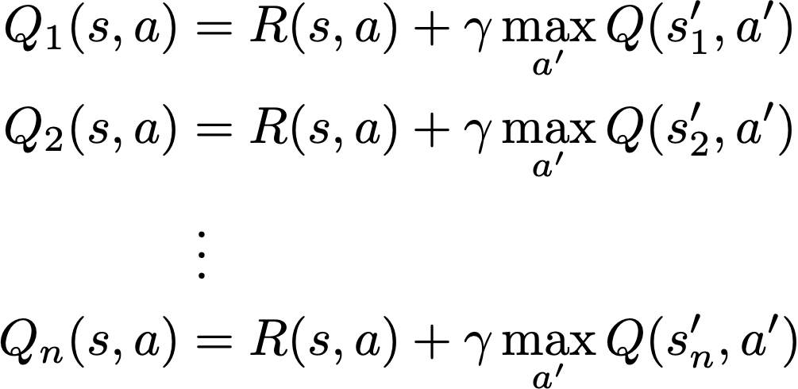
q-learning
Why does it work?
1st episode
s,a ↦ s1
2nd episode
_{average}
s,a ↦ s2
nth episode
s,a ↦ sn
Notes:
Q_1(s,a) &= R(s,a) + \gamma \max_{a'} Q(s_1',a')\\
Q_2(s,a) &= R(s,a) + \gamma \max_{a'} Q(s_2',a')\\
Q_3(s,a) &= R(s,a) + \gamma \max_{a'} Q(s_3',a')\\
&\; \vdots\\
Q_n(s,a) &= R(s,a) + \gamma \max_{a'} Q(s_n’,a')
\frac{1}{n}\sum_{k=1}^n Q_k(s,a) \approx R(s,a) + \sum_{s'} \left[ T(s,a,s') \times \gamma \max_{a'} Q(s',a')\right]

Slide 51
q-learning
Incremental running average
Updates estimate to weighted average of old estimate and new estimate
Decreasing learning rate ensures convergence
Constant learning rate ensures never-ending learning
Notes:
\frac{1}{n}\sum_{k=1}^n Q_k(s,a) &= \frac{n-1}{n}\sum_{i=1}^{n-1} Q_k(s,a) + \frac{1}{n} Q_n(s,a)\\
\\
Q(s,a) &\gets (1-\alpha) Q(s,a) + \alpha Q_n(s,a)
{\color[rgb]{0.690808,0.000000,0.014206}\underset{R(s,a) + \gamma\max_{a'} Q(s,a)}{\underbrace{\phantom{Q’(s,a)}}}}

Slide 52
Q-learning Algorithm
Two iterative processes:
One is the usual kind of averaging we do, when we collect a lot of samples and try to estimate their mean (using the learning rate)
The other is the dynamic programming done by value iteration, updating the value of a state based on the estimated values of its successors

Slide 53
q-learning
Off-policy
Algorithm learns from a different policy than the one actually used to produce interactions
On-policy?

Slide 54
Q-learning Algorithm
Guaranteed to converge to Q* even if we act suboptimally
The optimal Q function is achieved if the world is really an MDP, if we manage the learning rate correctly, and if we explore the world in such a way that we never completely ignore some actions/states
In other words, almost never
Even when these conditions are met convergence can be really really slow (most successful applications train first on a simulator)

Slide 57
exercise
Agent takes action go up in s_{1,} receives reward 0 and transits to s₂
Discount factor: γ = 0.9
Q =
Learning rate: α=1
Q(s1,up) = ?
s₂
73
100
10
s₁
66
70
81

Slide 58
exercise
Agent takes action go up in s_{1,} receives reward 0 and transits to s₂
Discount factor: γ = 0.9
Q =
Learning rate: α=1
s₂
73
100
10
s₁
66
70
81
Q(s₁, up)
= R(s1,up) + γ max_{a’} Q(s₂, a’)
= 0 + 0.9 max {66, 81, 100}
= 90

Slide 59
next class
How to select actions
∊-greedy policy versus exploration functions
How to cope with large state-spaces
Feature-based representation
Function approximations
How to generalize learning from current state to similar states
Feature-based representation

Slide 60
bibliography
Chapter 21 of AIMA Book
Notas de Aula da Prof. Anna Reali (EP-USP)
Notas de Aula da Prof. Leliane (IME-USP)
Notas de Aula do Prof. Edirlei de Lima (PUC-RJ)
Lecture notes at ai.berkeley.edu
Sutton & Barto. Reinforcement Learning, 2nd edition

