Slide 1
Reply to “Remarks on the Analytic Hierarchy Process” by J. S. Dyer

Slide 2
The Problem
The paper by J. S. Dyer (1990) presents two arguments against the use of the AHP: the axioms are “flawed” and the rankings which AHP produces are “arbitrary”. The authors then respond J. S. Dyer.

Slide 3
1. AHP Axioms [Bushan, N.; Rai, K.]
Theoretically the AHP is based on four axioms given by Saaty, these are:
The decision maker can provide paired comparisons a_{ij} of two alternatives i and j corresponding to a criterion/sub-criterion on a ratio scale which is reciprocal, i. e. a_{ji} = 1/a_{ij}
The decision maker never judges one alternative to be infinitely better then another corresponding to a criterion, i. e. a_{ij} ≠ ∞
The decision problem can be formulated as a hierarchy
All criteria/sub-criteria which have some impact on the given problem, and all the relevant alternatives, are represented in one way hierarchy

Slide 4
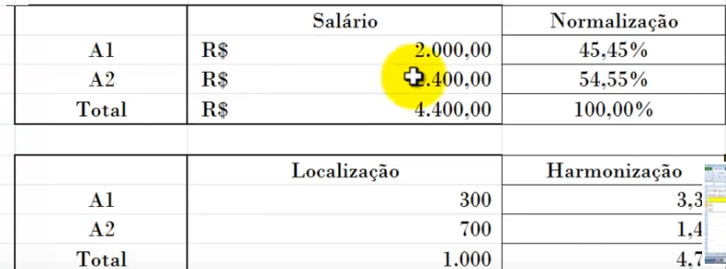
“Questions asked in AHP are ambiguous”
Dyer: Suppose a thoughtful person hears the question, “How much better is A_{i} then A_{j} on a criterion?”. His appropriate response would be, “Relative to what?”. This latter question expresses intuitively the need for the definition of the reference point.
Harker and Vargas: Thus, for example, if we’re comparing car A and car B with respect to cost, the appropriate question is: with respect to cost, which of the two cars (Ai or Aj) is preferred, and by how much?

Slide 5
“The 1-9 Scale Problem”
Dyer: A decision maker prefers A three times more than B and B five times more than C, which would imply that A be fifteen times more preferred than C [Transitivity Axiom]
Harker and Vargas: The alternatives A and C are not homogeneous (they are dissimilar) according to the 1-9 scale, so a different scale is necessary if 15 is to be permitted

Slide 6
“AHP Axioms follows primitive notions”
Dyer: AHP axioms do not follow basic axioms but, rather, primitive notions, which includes the assumption of a fundamental scale.
Harker and Vargas: Dyer fails to recognize that the axioms of utility theory (UT) also presumes the need of a scale for the set of lotteries (the probability scale).
Since both AHP and UT have non-ordinal scales associated with them then, in fact, the use of one scale or another is a question of belief.

Slide 7
“AHP Axioms follows primitive notions”
Dyer: AHP axioms do not follow basic axioms but, rather, primitive notions, which includes the assumption of a fundamental scale.
Harker and Vargas: The axioms 3 and 4 are designed to deal with multiple criteria.
[…] We sincerely doubt that the majority of people would find lotteries more intuitive than the concepts described by the axioms of the AHP

Slide 8
2. Rank Reversal
Dyer: AHP violates independence of irrelevant alternatives [rank reversal].
Harker and Vargas: Axiom 3 states what independence means in the AHP context, i. e. a level does not depend on the level above.
Also, all the concepts of independence both in UT and AHP are subjective and they are based on the following idea: do our preferences change when some criteria change?
In AHP the strength of preference of C_{i} over C_{j} must be preserved from alternative to alternative.
UT never discussed the idea of the independence of the criteria from the alternatives.

Slide 9
Rank Reversal
Dyer: The problem of the large number of required ratio comparisons is the compounded by the difficulty of responding to the question requiring that the criteria be compared with respect to the alternatives. […] The decision maker would be required to respond questions such as this, “does the Mercedes perform better on cost or on appearance, and by how much?”
Harker and Vargas: The proper question is: Given an alternative (e. g. Mercedes), which criterion (e.g. cost, appearance) is more important in overall choice of the best car?

Slide 10
Comments on Dyer proposed method
Dyer: A remarkable observation regarding this controversy about the phenomenon of rank reversal in the AHP is that a simple solution does exist… This solution is appropriate as long as the criteria used in application of AHP satisfy the property of difference independence…
Harker and Vargas: The method proposed by Dyer does not truly capture the ranking of alternatives when scales with a standard unit are available to measure alternatives according to criteria.

Slide 11
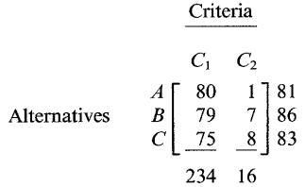
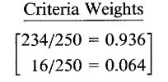
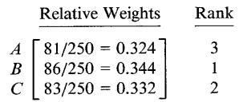
Comments on Dyer proposed method
What happens when no scale exist (and hence the AHP relative scales are used)?
The authors calculated the weights, for criteria and alternative, and obtained rank using the method given by AHP

Slide 12
Comments on Dyer proposed method
What happens when no scale exist (and hence the AHP relative scales are used)?
Then they calculated the utilities for each alternative, using the method proposed by Dyer.

Slide 13
Comments on Dyer proposed method
What happens when no scale exist (and hence the AHP relative scales are used)?
We can see that as utilities do not produce the same rank as the relative weights (which give the true rank for the alternatives). Dyer does not show us how to deal with cases like this, where the scales have no definite unity and we need to generate the relative weights. In this case, it is acceptable to use rank reversal because the result depends on those considered.

Slide 14
Summary about criticism on AHP
Scale :
Lack of reference point
Ambiguity (ratio scale)
Axiom: There is no Transitivity and use mathematical approach to check the consistence among responses. It is more a mathematical approach than decision that deal with behavioural sense. It is not base on rationality properly.
Criteria:
Lack of anchors (reference points)
Range sensitivity (MACBETH is an alternative)
Alternative: Rank Reversal in the presence of a new alternative.

Slide 15
MCDA
PREFERENCE + CHOICE = MCDA Methods
Attribute (Value/Utility)
Alternative (Behavioural)
ECONOMICS

Slide 16
References
BUSHAN, N.; RAI, K. The Analytic Hierarchy Process. In: ___. Strategic Decision Making: Applying the Analytic Hierarchy Process. Springer-Verlag London: 2004, 1 ed., IX, 172 p.
HARKER, P. T.; VARGAS, L. G. Reply to “Remarks on the Analytic Hierarchy Process” by J. S. Dyer. Management Science, v. 36, n. 3, p. 269-273, 1990. Disponível em: http://dx.doi.org/10.1287/mnsc.36.3.269. Acesso em: ago-2017.

