Slide 1
Princípios de Genética

Slide 2
Structure and Function of Genetic Material
Genotype: gene
Phenotype
Genome: Chromosome,
Plasmids

Slide 3
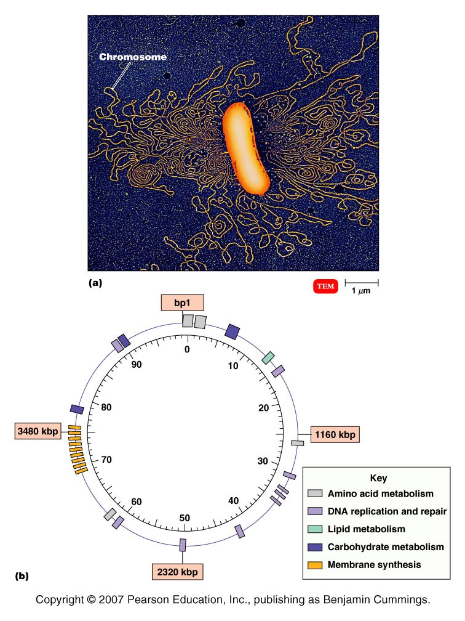
E. coli genome is 4.6 million base pairs= 4.6 Mb;
~ 1mm long (1000X cell),
10% cell volume= supercoiled or twisted
Figure 8.1 - Overview

Slide 4
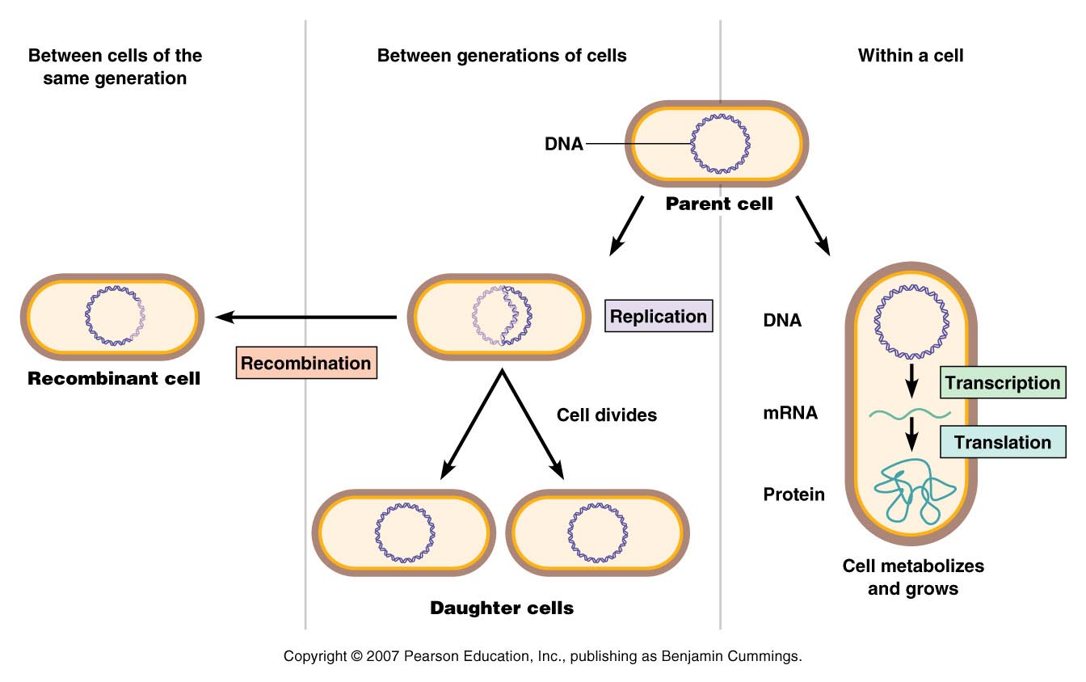
2) Flow of genetic information
DNA replication
RNA and protein synthesis: transcription and translation
Flow of genetic information
Figure 8.2

Slide 5
Table 8.1

Slide 6
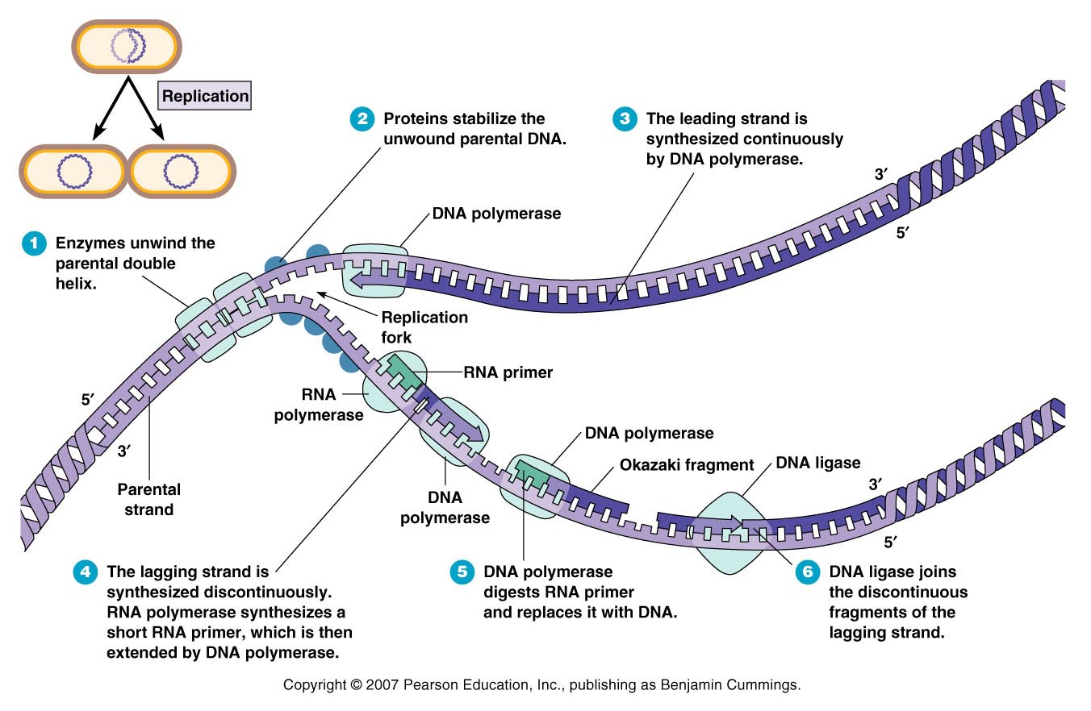
DNA replication
Figure 8.5

Slide 7
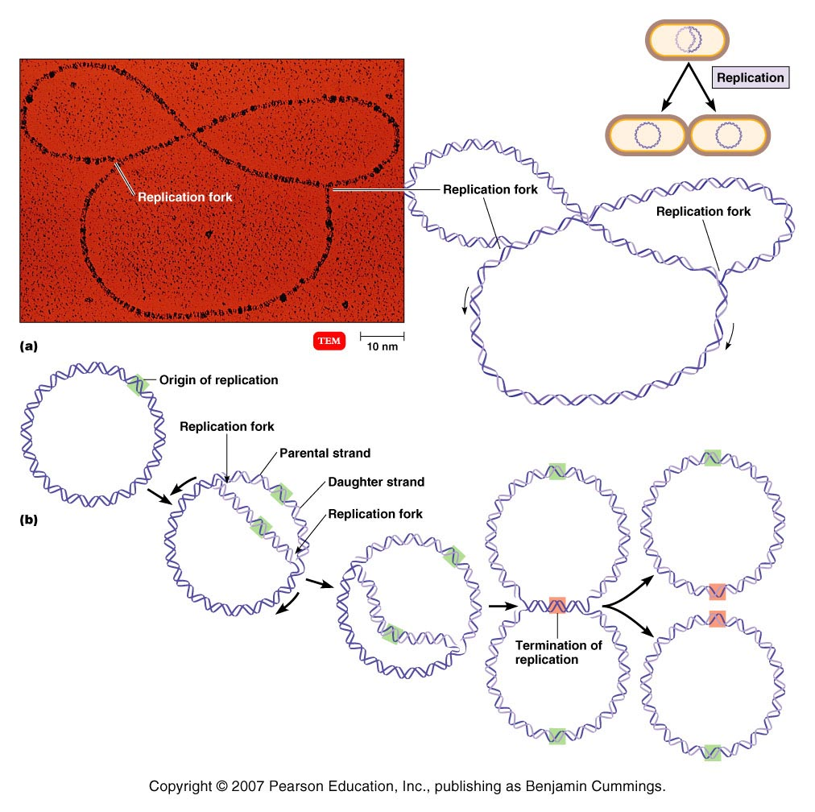
Bacterial DNA replication
Figure 8.6 - Overview

Slide 8
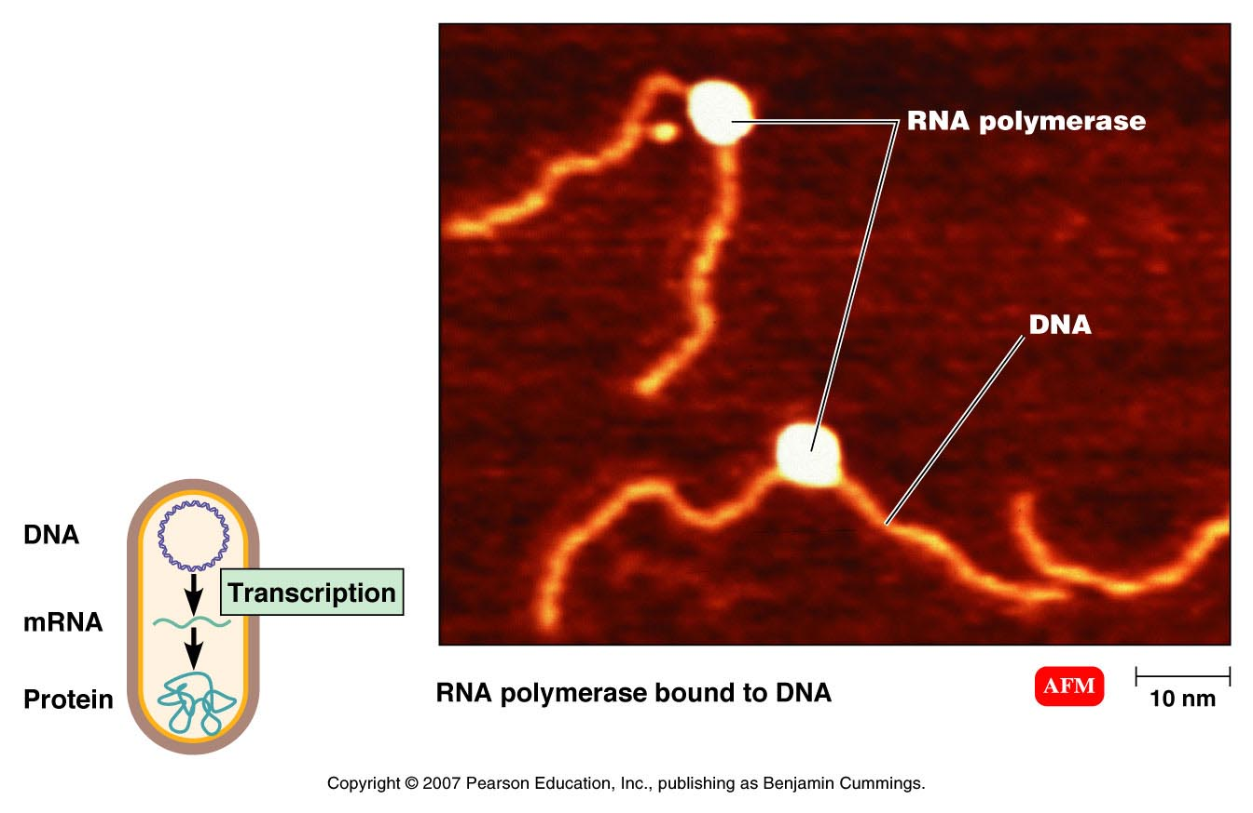
Figure 8.7 (2 of 7)

Slide 9
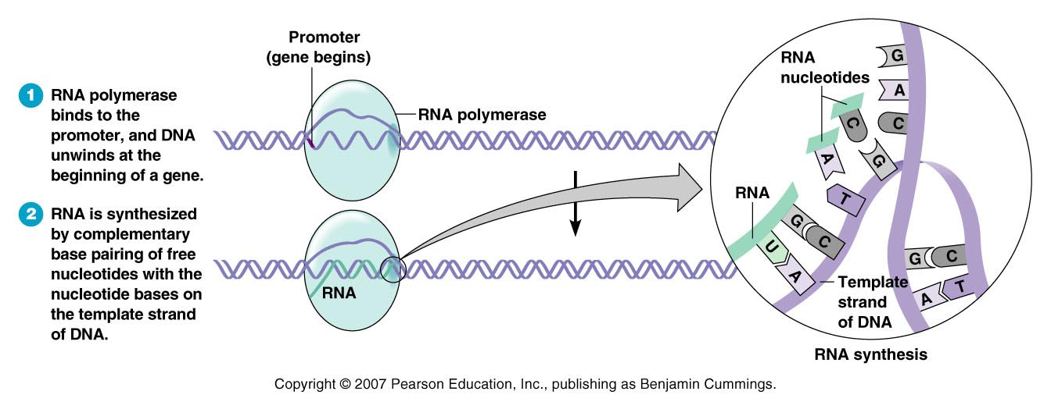
Figure 8.7 (3 of 7)

Slide 10
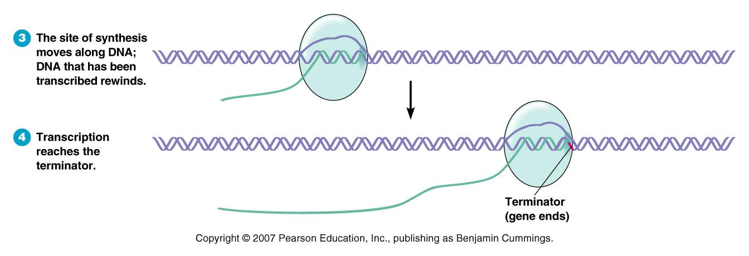
Figure 8.7 (4 of 7)

Slide 11
RNAm
Figure 8.7 (5 of 7)

Slide 12
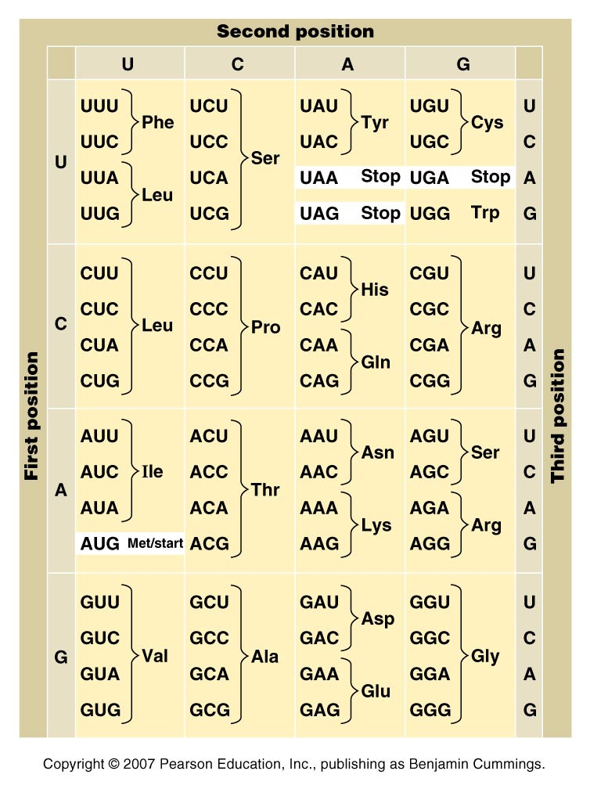
Figure 8.8

Slide 13
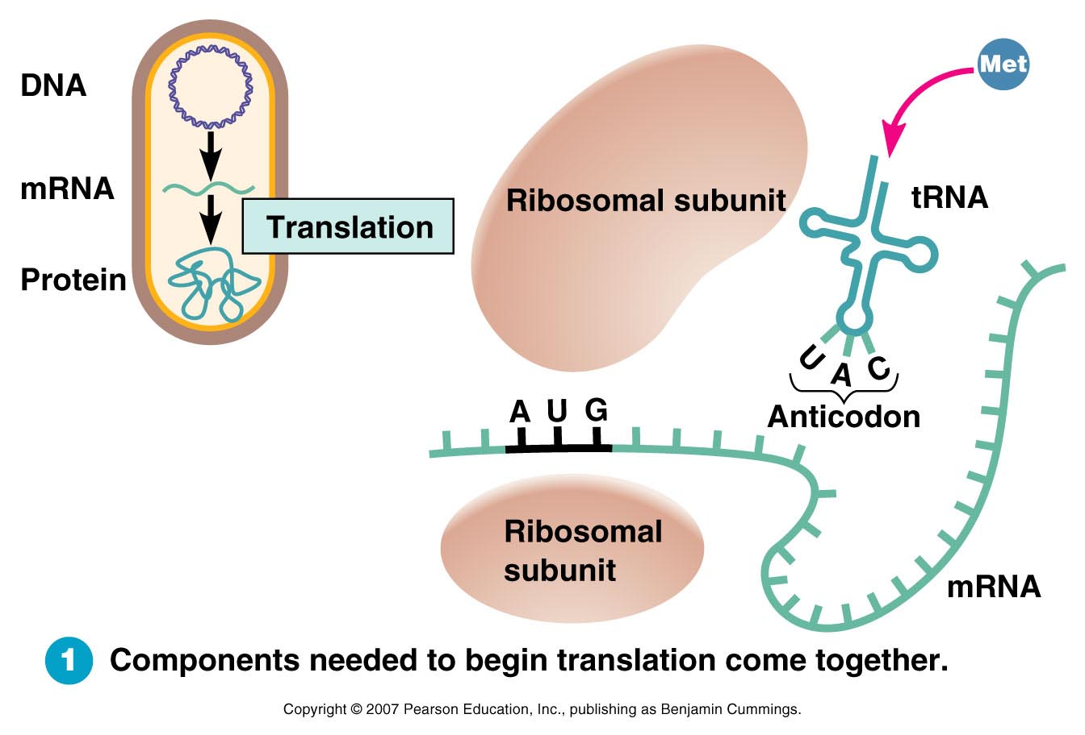
Figure 8.9, step 1

Slide 14
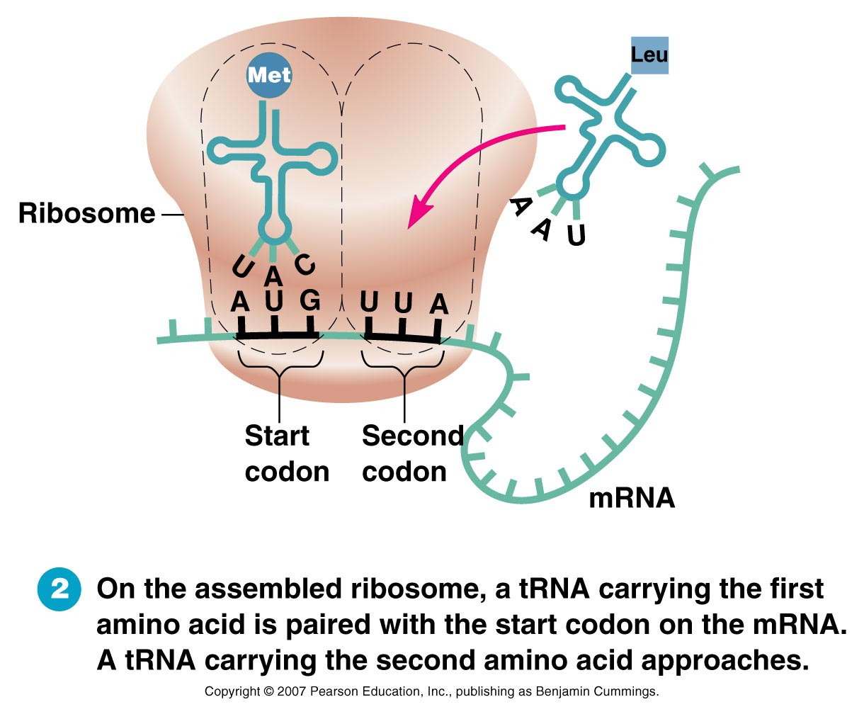
Figure 8.9, step 2

Slide 15
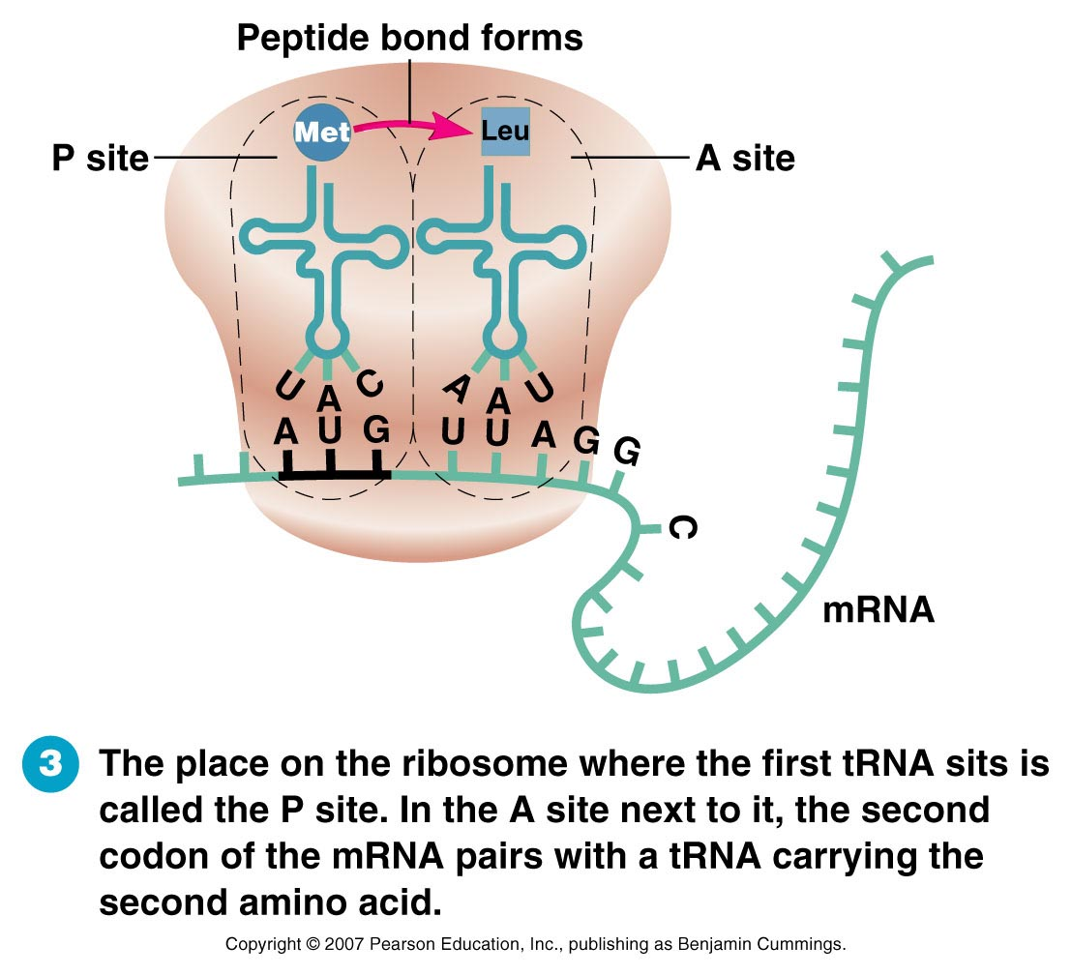
Figure 8.9, step 3

Slide 16
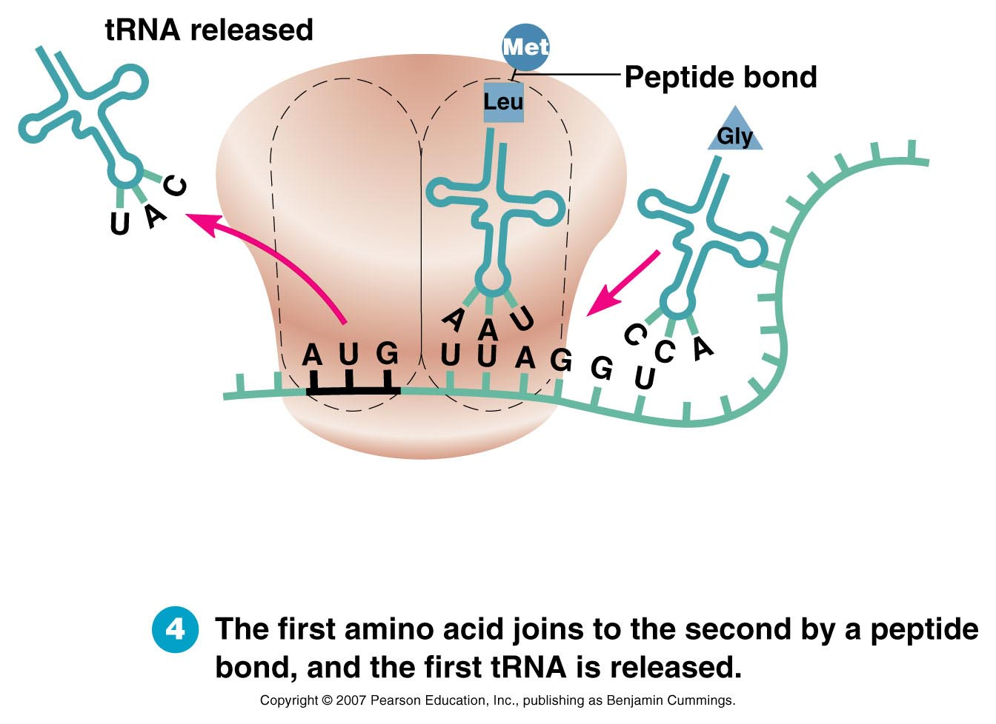
Figure 8.9, step 4

Slide 17
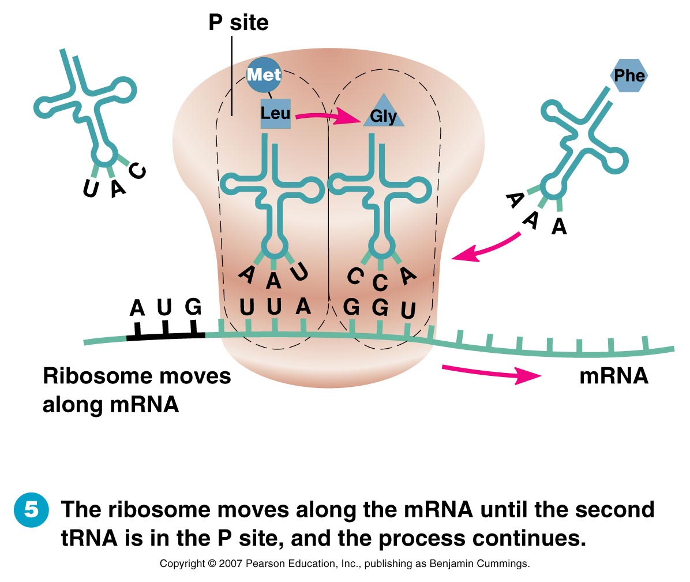
Figure 8.9, step 5

Slide 18
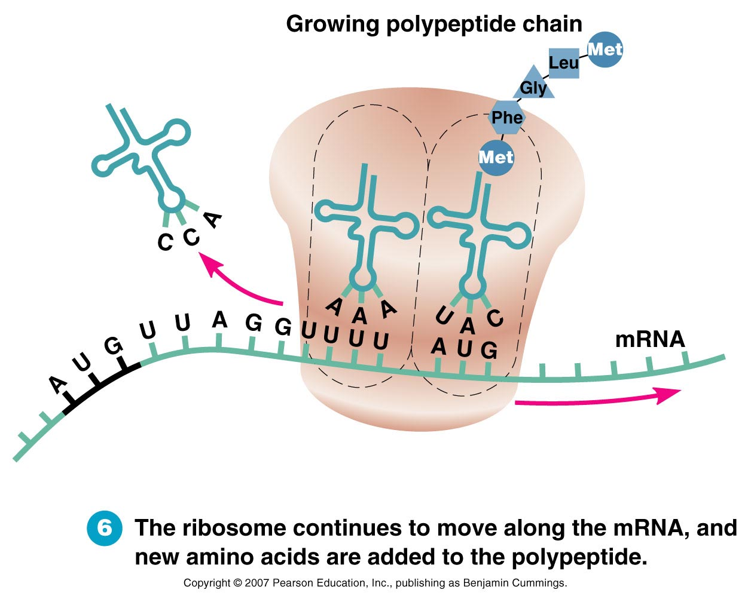
Figure 8.9, step 6

Slide 19
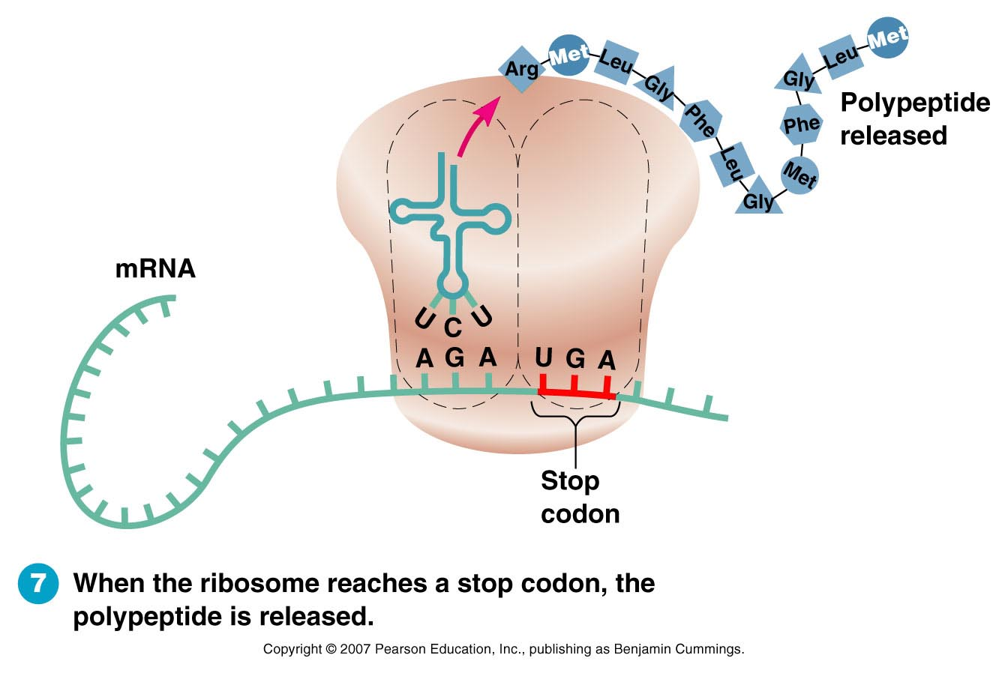
Figure 8.9, step 7

Slide 20
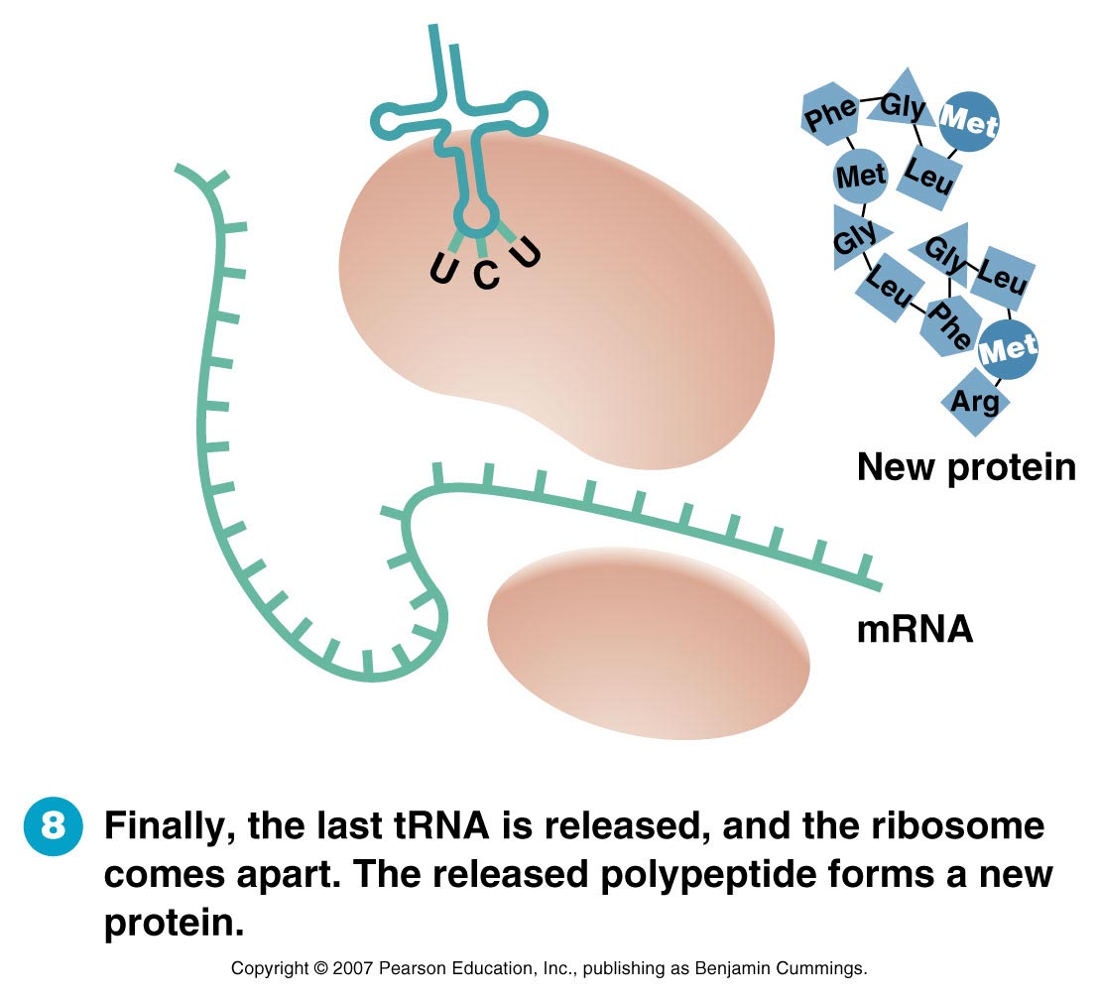
Figure 8.9, step 8

Slide 21
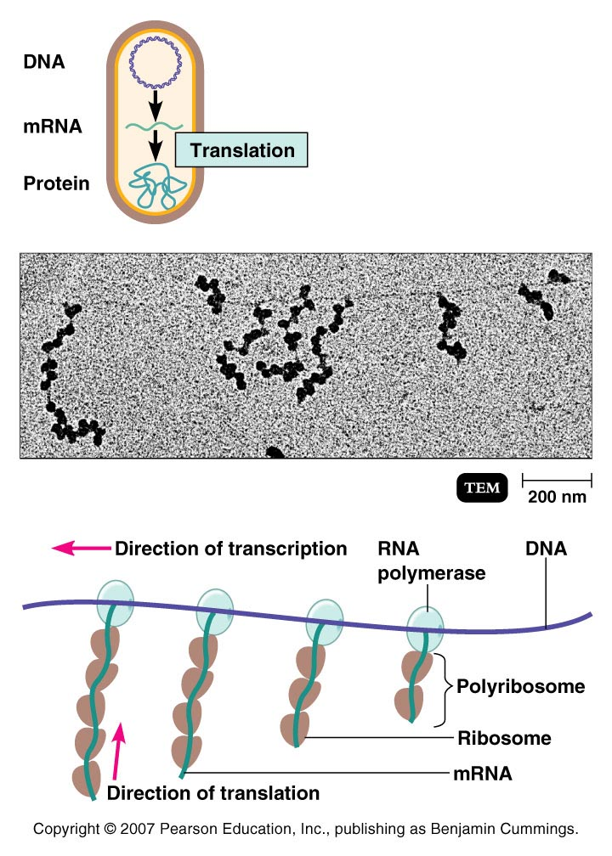
Figure 8.10 - Overview (1 of 4)

