Slide 1
Tourism in the Brazilian rural areas
Karina Solha
University of São Paulo, Brazil

Slide 2
Understanding Brazilian agritourism
Key questions
What are the Brazilian rural areas?
What is the trajectory of the agritourism in Brazil?
Which organizations make up agritourism?
Which companies specialize in agritourism?
What does the future hold?

Slide 3
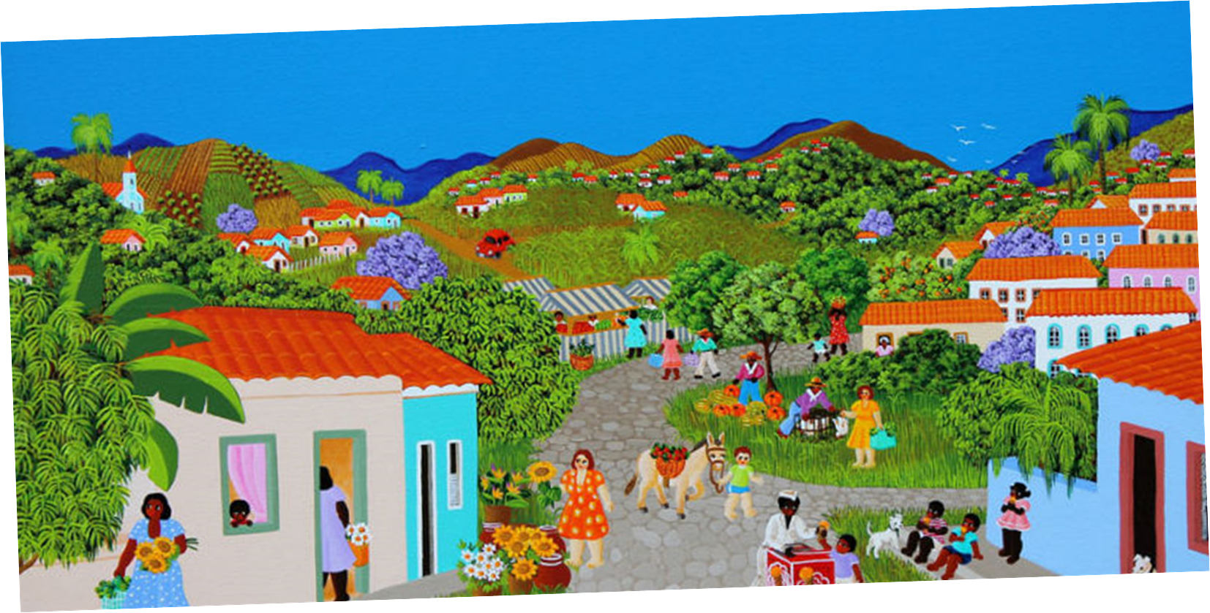
Rural, idyllic and nostalgic
Deixa a cidade formosa morena
Linda pequena
E volta ao sertão
Beber a água
Da fonte que canta
Que se levanta
Do meio do chão
Se tu nasceste cabocla cheirosa
Cheirando a rosa
Do peito da terra
Volta prá vida serena da roça
Daquela palhoça
Do alto da serra
E a fonte a cantá
Chuá, chuá
E as água a corrê
Chuê, chuê
[...]
Chuá Chuá, Cascatinha e Inhana
Composição: Pedro de Sá Pereira/Ari Pavão
An opportunity to maintain lifestyle and traditions...

Slide 4
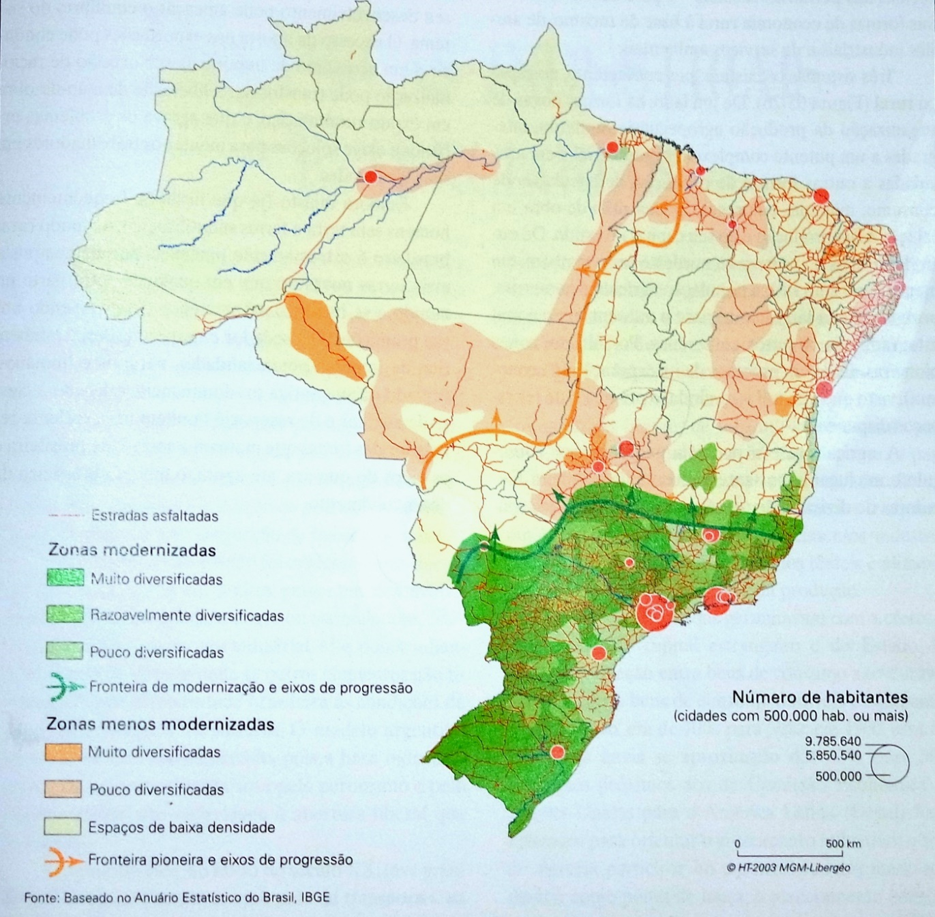
What are the Brazilian rural areas?
Agricultural population is numerous, but mainly aimed at self-consumption and barely integrated into commercial circuits
Pioneer zones, still in the process of incorporation into the economy
Modern farming production
Théry, H.; Mello, N.A. de. Atlas do Brasil. Disparidades e dinâmicas do território. São Paulo. Edusp. 2005, p.144

Slide 5
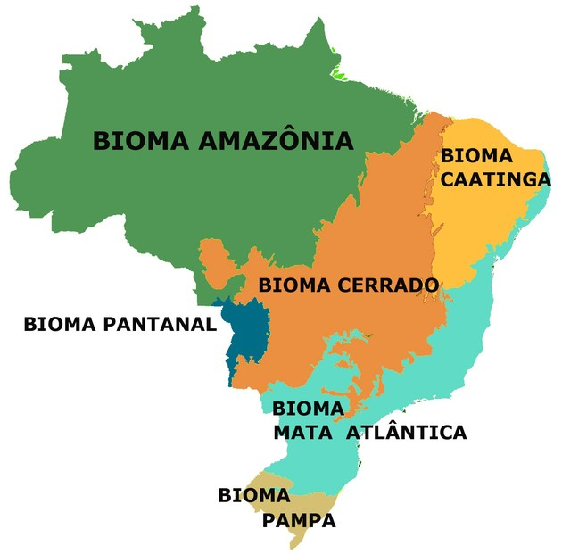

Slide 6
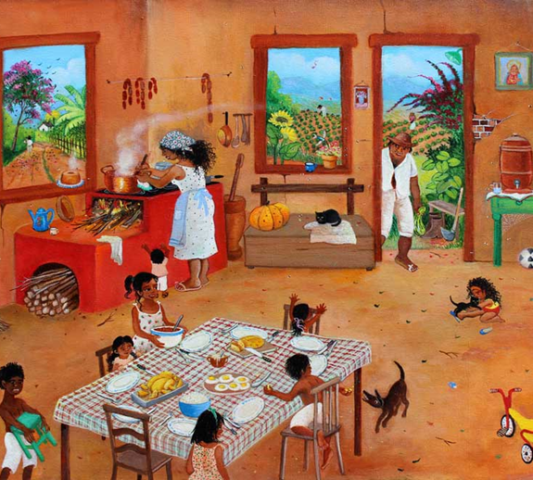
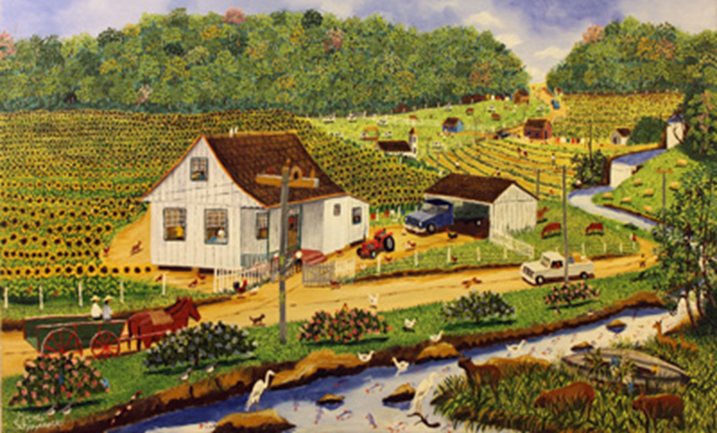
“A world of rural traditions in transit, immersed in a dramatic route of losses and new changes, in which the tourism appears as safeguard strategy”

Slide 7
Agritourism for Brazilians is Rural Tourism
“RURAL TOURISM is a set of touristic activities, tied to farming production, adding value to products and services, rescuing cultural and natural patrimony of the community”
(Tourism Ministry, 2008)

Slide 8
What is the trajectory of agritourism in Brazil?
From 1984 to 2000 From the first initiatives to the need for qualification of products and services
From 2011 to 2016 the route to the second generation of rural tourism
From 2001 to 2005 From the challenges of implementation to the organization of individual segments
From 2006 to 2010 From the need for planning to competitivity

Slide 9
Which organizations make up agritourism?
Government
Third sector organizations
Technical training
Interest protection
Study development
University
Research
Scientific events
Professional development
Legislation
National guidelines
Technical training
Political management

Slide 10
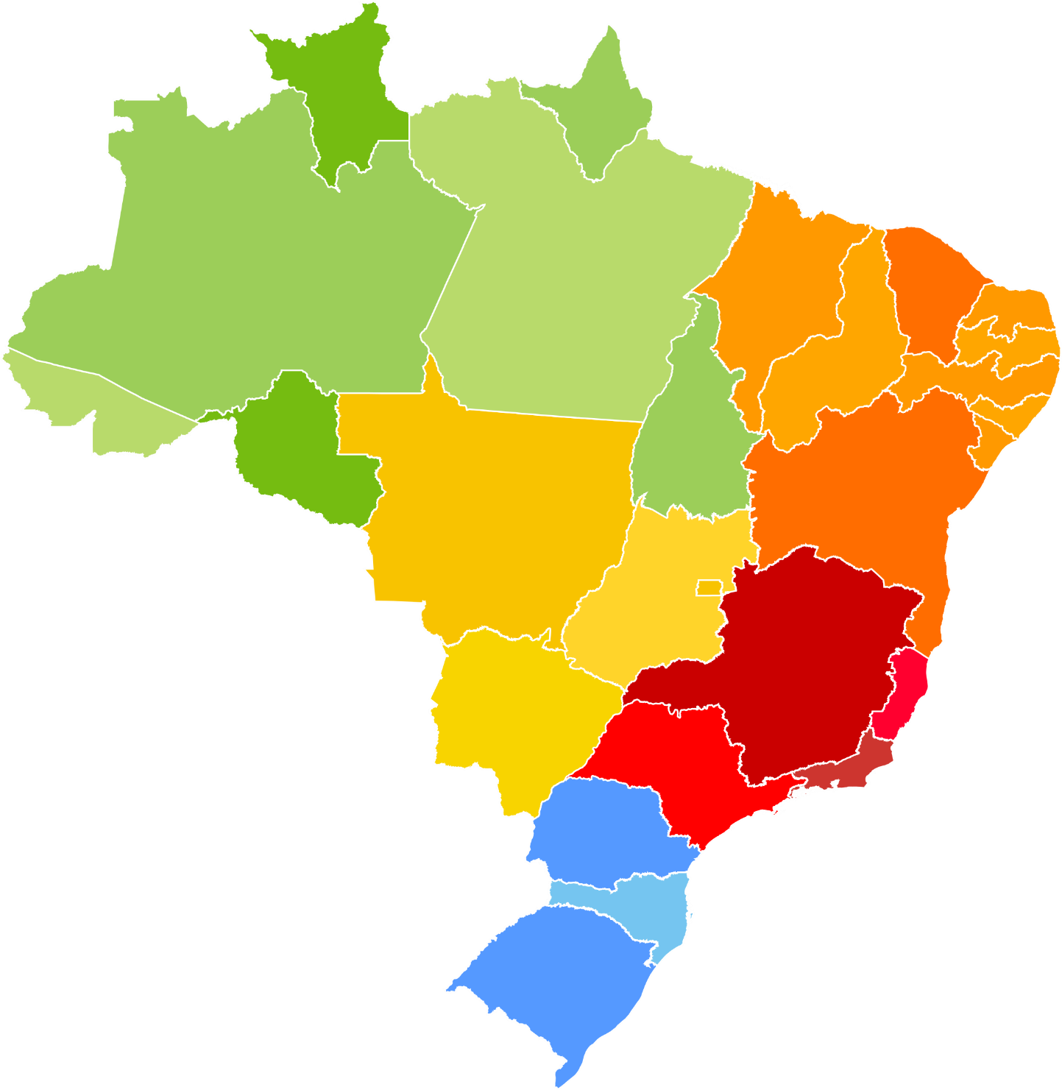
The enterprises

Slide 11
What does the future hold?
Public policy
Demand
Entrepreneurship, training, professionalization
Product
Transformation and inovation

Slide 12
To finish it up….
...it is not about offering conditions to implement new business, but to support, strenghten and enhance new entrepreneurs facing contemporary challenges.
For that to be possible, cooperation between different sectors is needed
And why not save and draw from old rural wisdom best represented by work chants such as “Brão”, sang in the days where farmers counted on the help of their neighbours to do grand activities like harvesting or the clearing of the land.

Slide 13
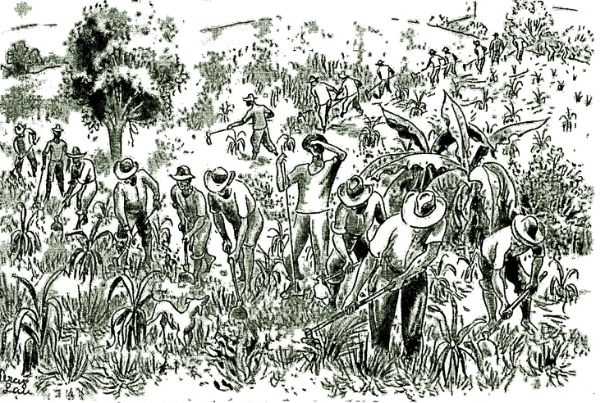
To finish it up….
“The ‘brão’ is a chant without instruments that is sung during work. It is always sung in doubles, it demands that it’s artists work together to, at every moment, they get together and, in a break of working with the grubber, they perform voice work”
(Brandão, 1983, O caipira Paulista, p. 83)

Slide 14
Professor Karina Solha, PhD
University of São Paulo
São Paulo
Brazil
T +55 11 982927685
kasolha@usp.br
Brazil

Slide 15
Regional Development

