Slide 1
Chapter 1:
Mechanics of Materials, 8th Edition SI Gere & Goodno
Tension, Compression, and Shear

Slide 2
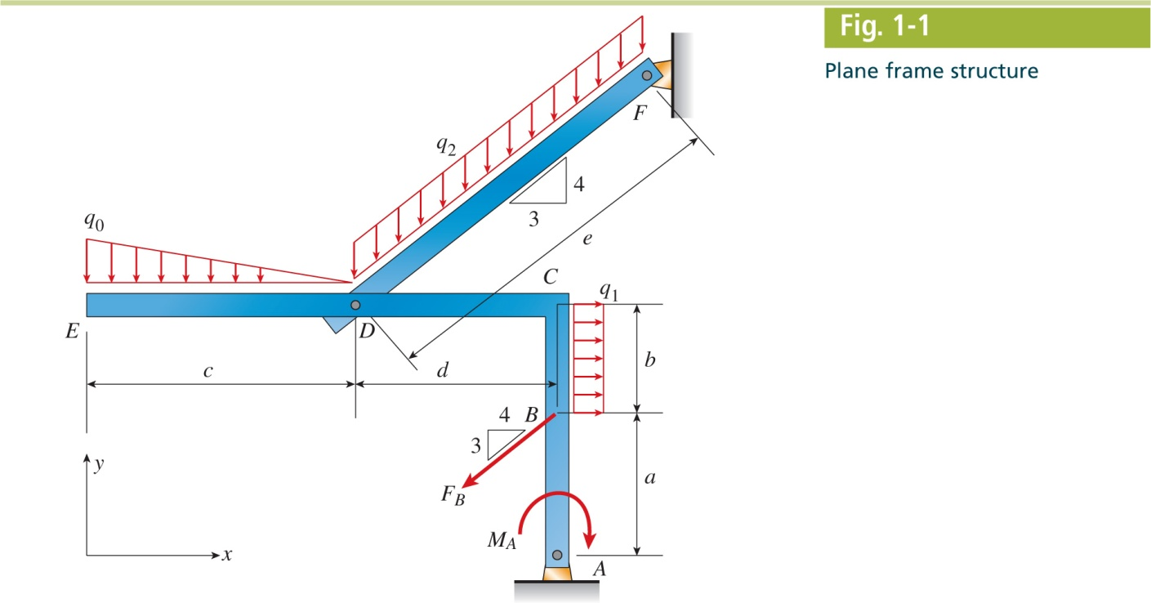
Mechanics of Materials, 8th Edition SI Gere & Goodno

Slide 3
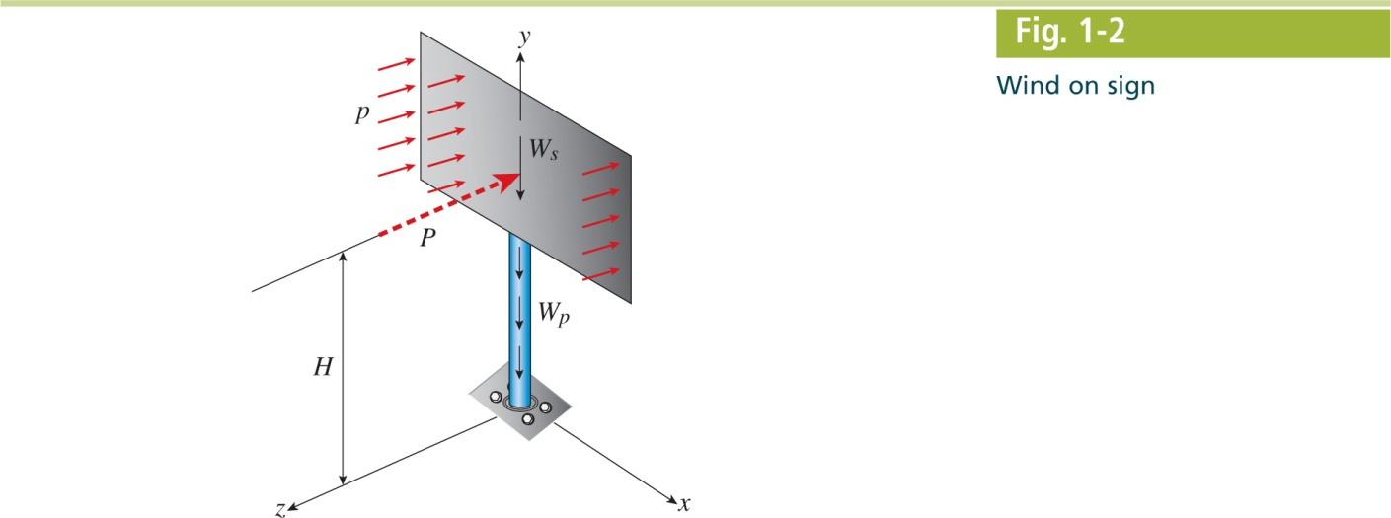
Mechanics of Materials, 8th Edition SI Gere & Goodno

Slide 4
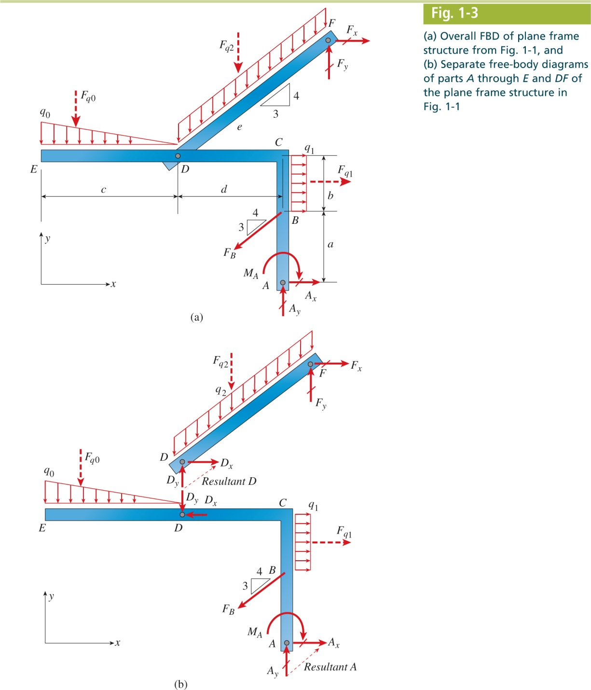
Mechanics of Materials, 8th Edition SI Gere & Goodno

Slide 5
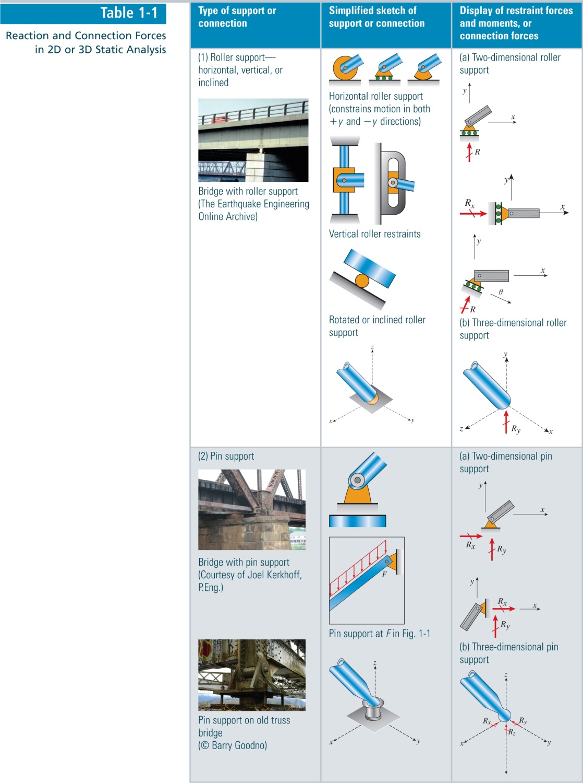
Mechanics of Materials, 8th Edition SI Gere & Goodno

Slide 6
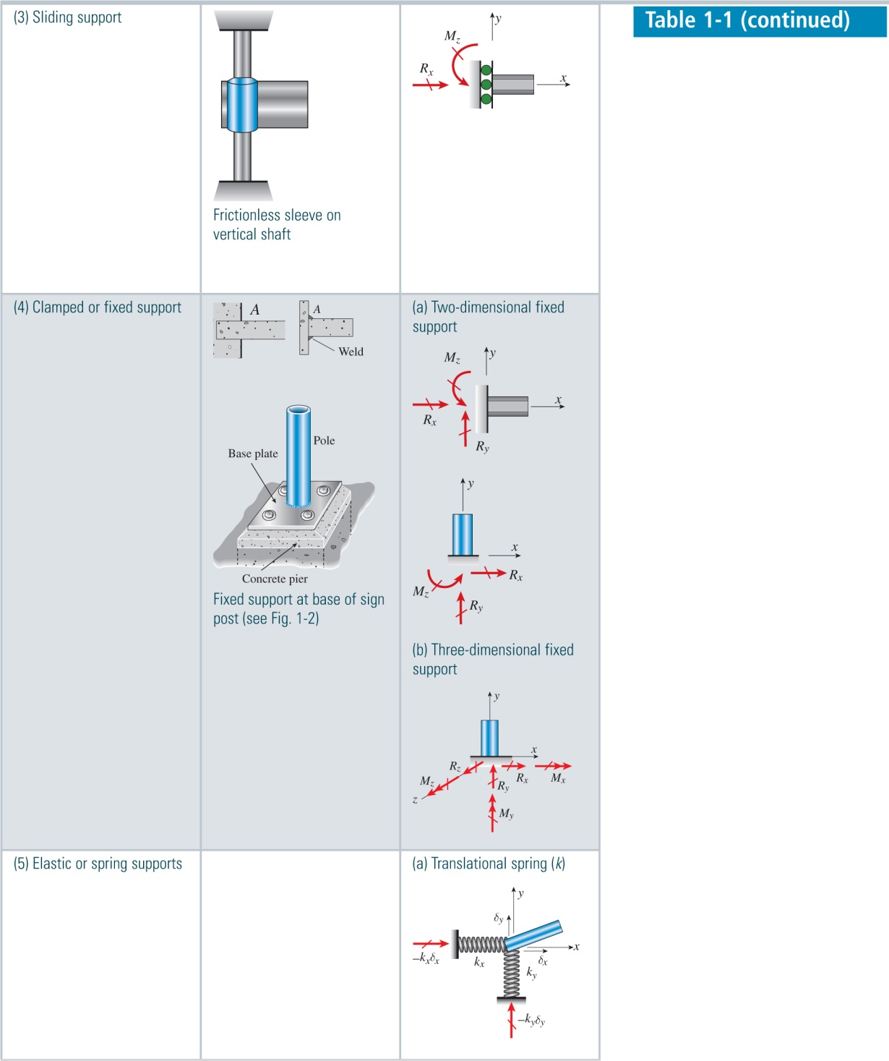
Mechanics of Materials, 8th Edition SI Gere & Goodno

Slide 7
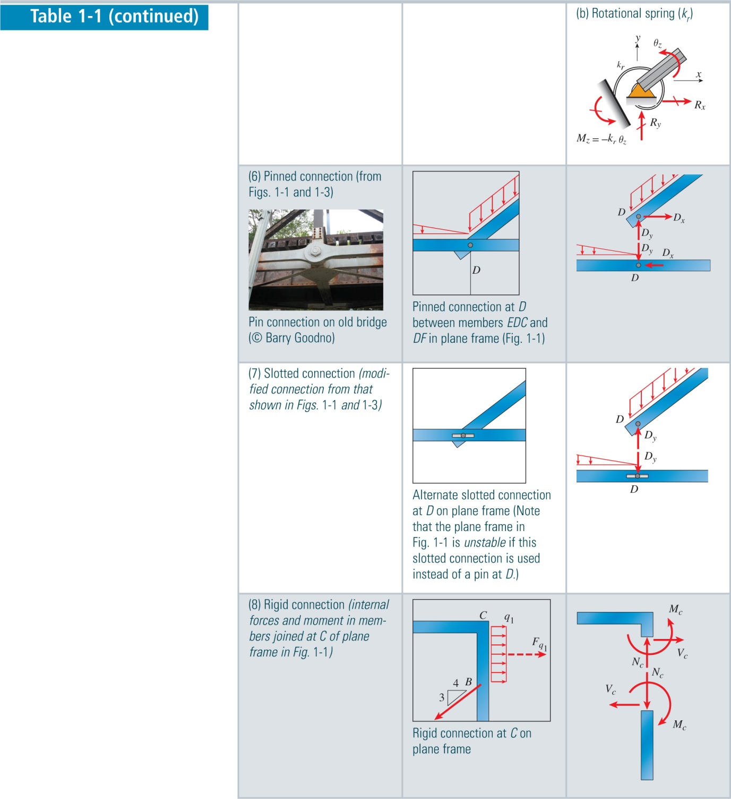
Mechanics of Materials, 8th Edition SI Gere & Goodno

Slide 8
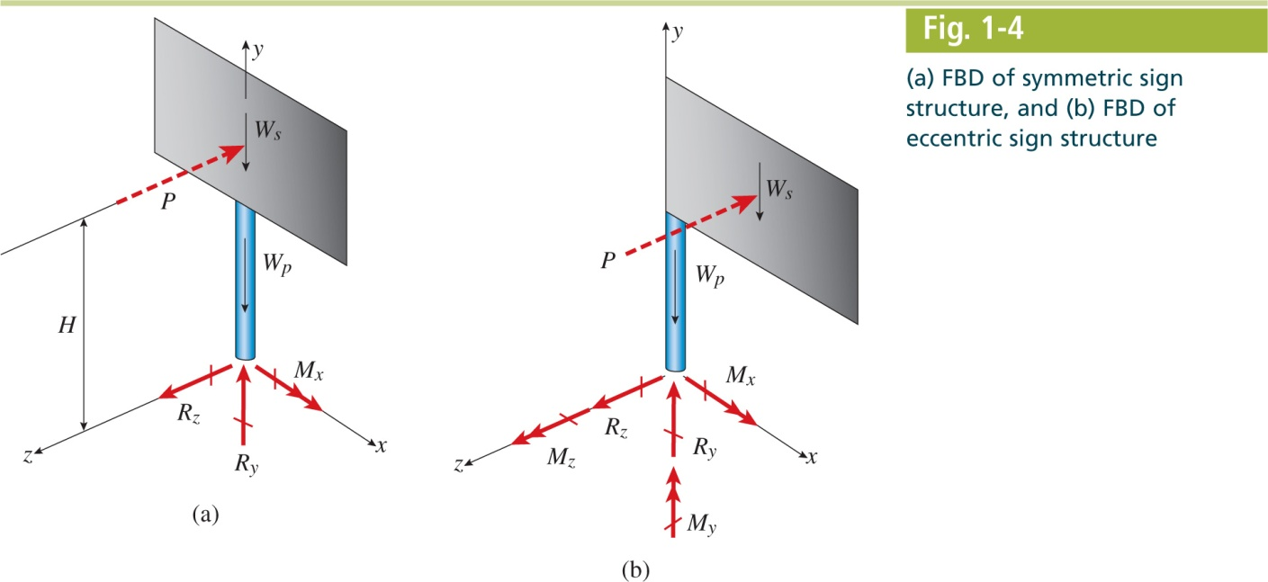
Mechanics of Materials, 8th Edition SI Gere & Goodno

Slide 9
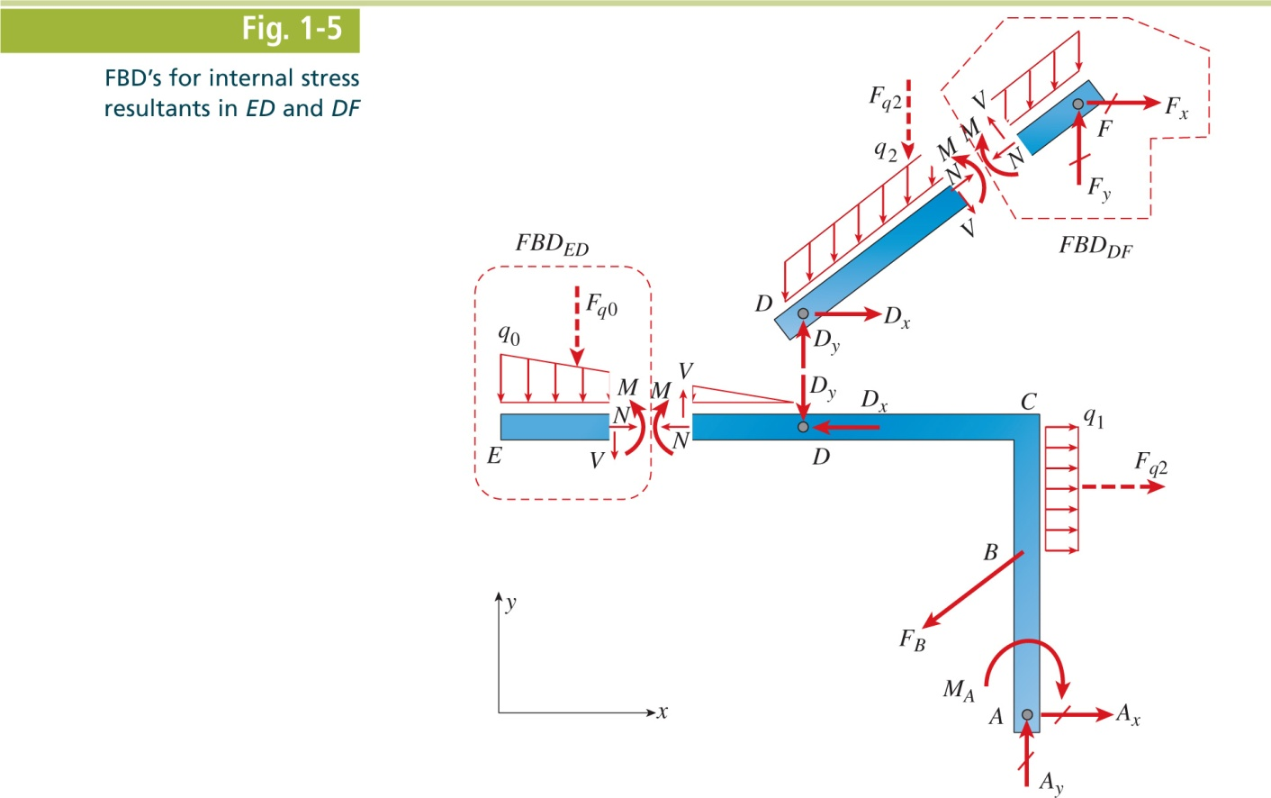
Mechanics of Materials, 8th Edition SI Gere & Goodno

Slide 10
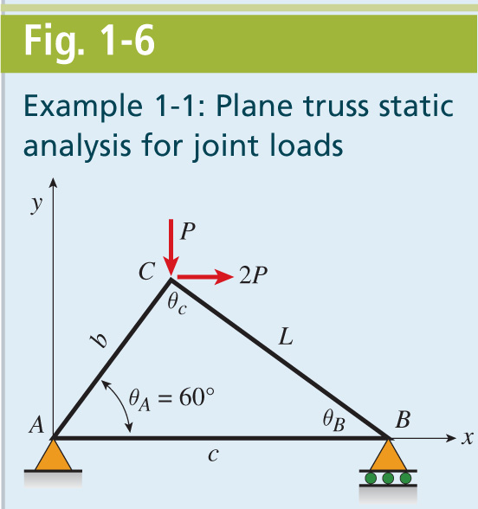
Mechanics of Materials, 8th Edition SI Gere & Goodno

Slide 11
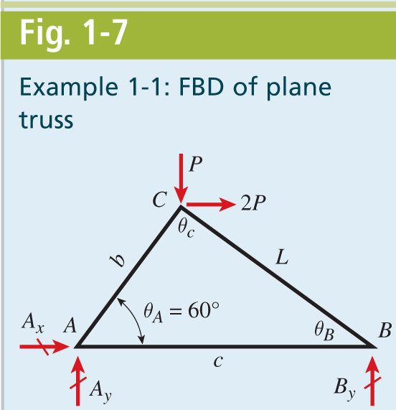
Mechanics of Materials, 8th Edition SI Gere & Goodno

Slide 12
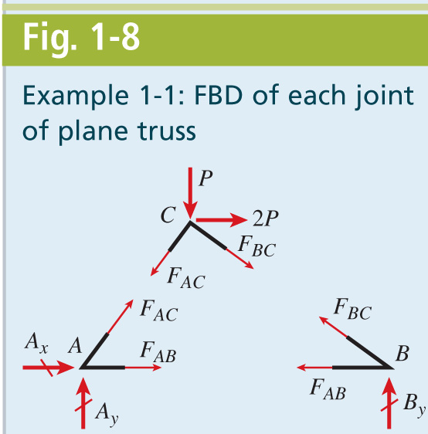
Mechanics of Materials, 8th Edition SI Gere & Goodno

Slide 13
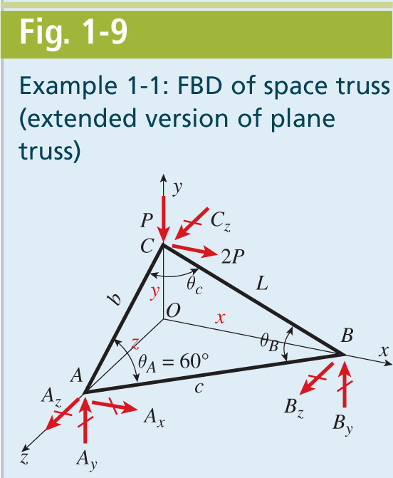
Mechanics of Materials, 8th Edition SI Gere & Goodno

Slide 14
Mechanics of Materials, 8th Edition SI Gere & Goodno

Slide 15
Mechanics of Materials, 8th Edition SI Gere & Goodno

Slide 16
Mechanics of Materials, 8th Edition SI Gere & Goodno

Slide 17
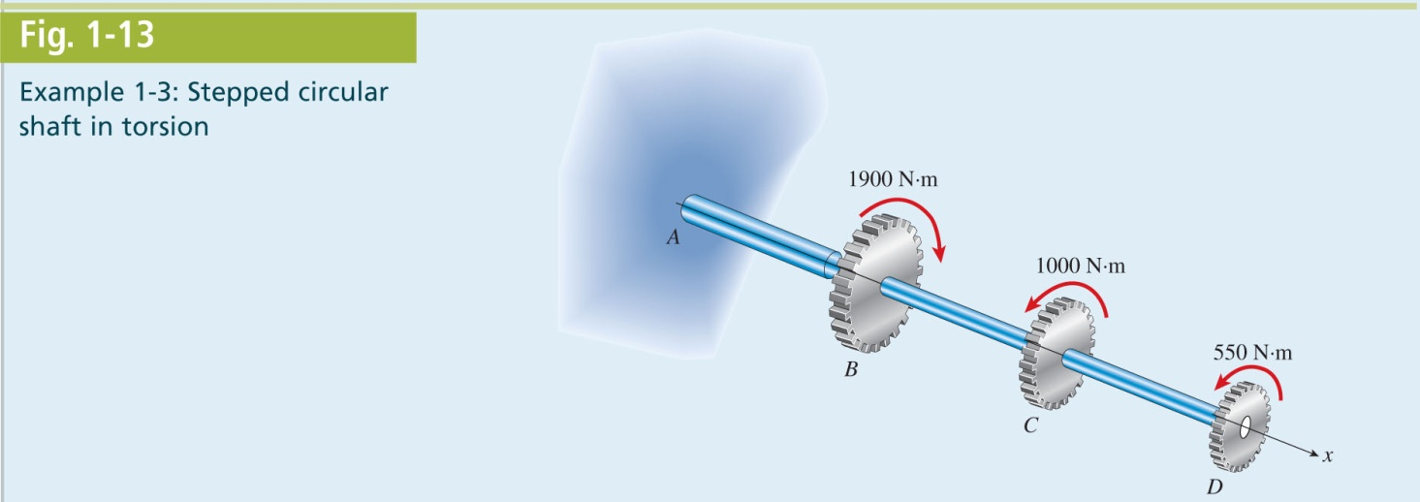
Mechanics of Materials, 8th Edition SI Gere & Goodno

Slide 18
Mechanics of Materials, 8th Edition SI Gere & Goodno

Slide 19
Mechanics of Materials, 8th Edition SI Gere & Goodno

Slide 20
Mechanics of Materials, 8th Edition SI Gere & Goodno

Slide 21
Mechanics of Materials, 8th Edition SI Gere & Goodno

Slide 22
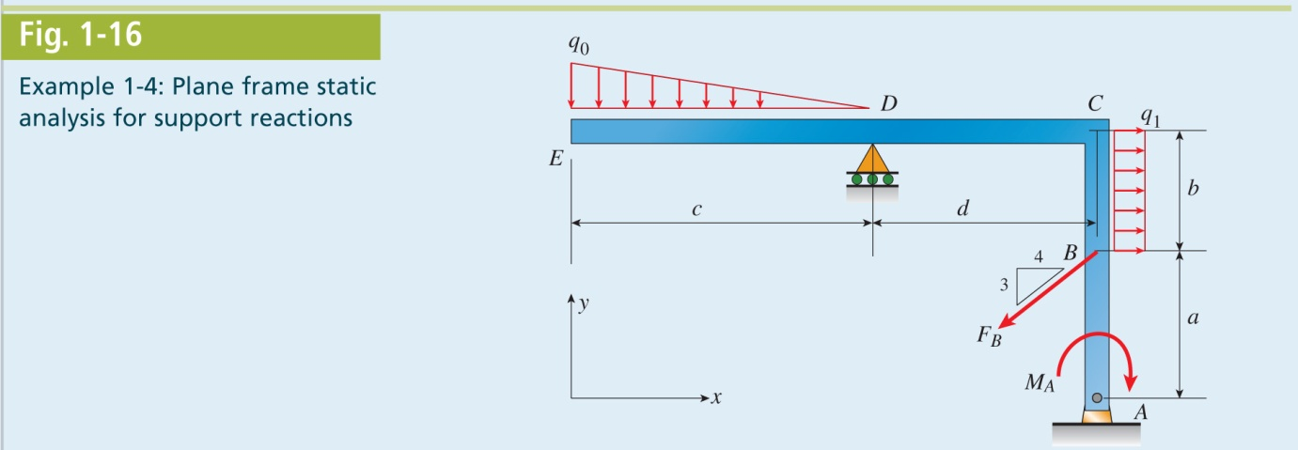
Mechanics of Materials, 8th Edition SI Gere & Goodno

Slide 23
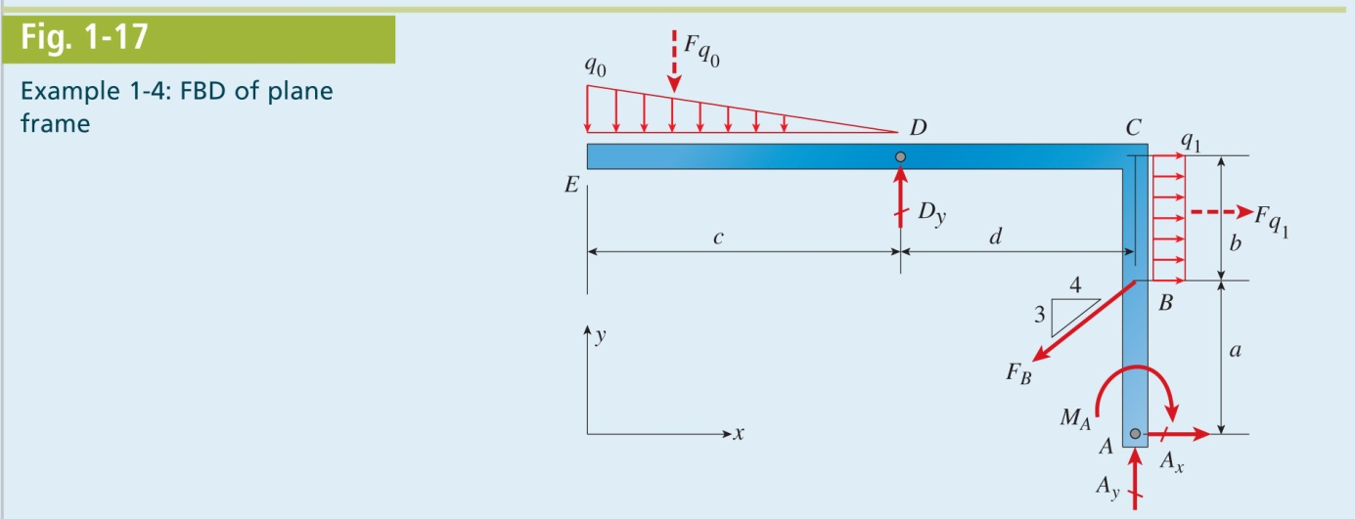
Mechanics of Materials, 8th Edition SI Gere & Goodno

Slide 24
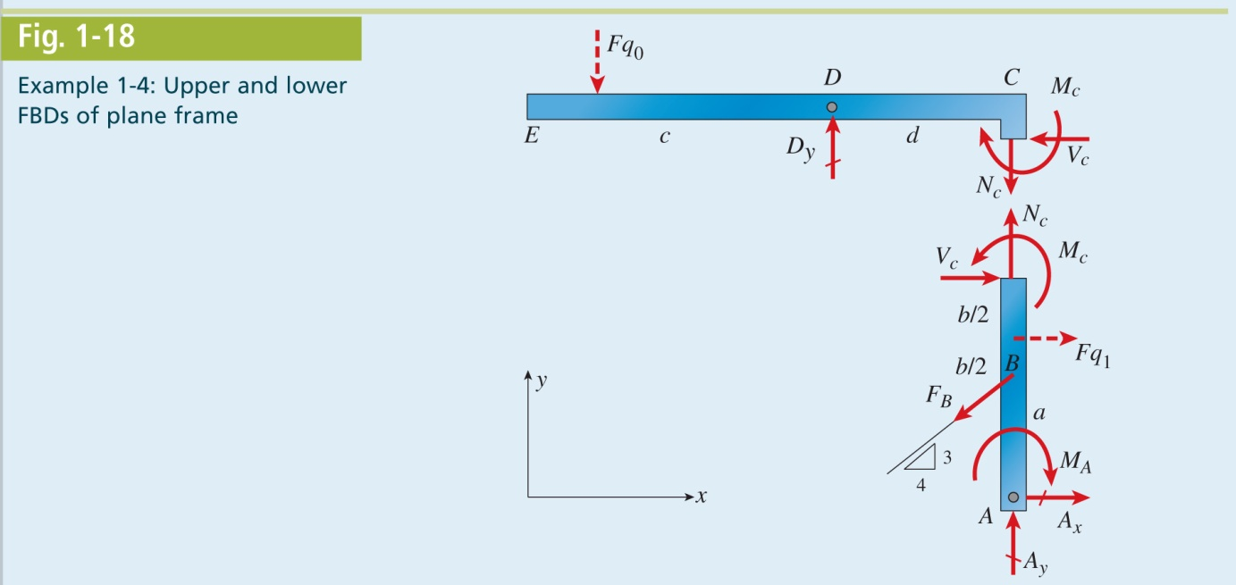
Mechanics of Materials, 8th Edition SI Gere & Goodno

Slide 25
Mechanics of Materials, 8th Edition SI Gere & Goodno

Slide 26
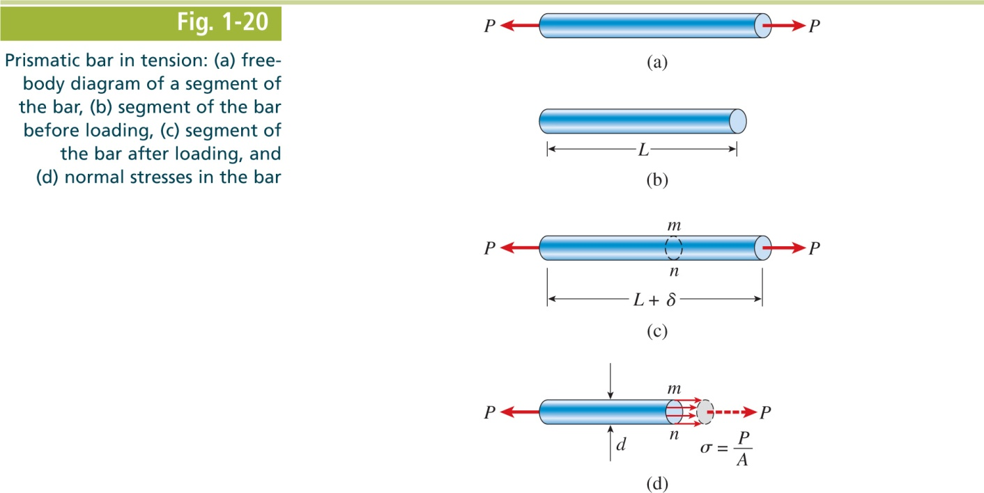
Mechanics of Materials, 8th Edition SI Gere & Goodno

Slide 27
Mechanics of Materials, 8th Edition SI Gere & Goodno

Slide 28
Mechanics of Materials, 8th Edition SI Gere & Goodno

Slide 29
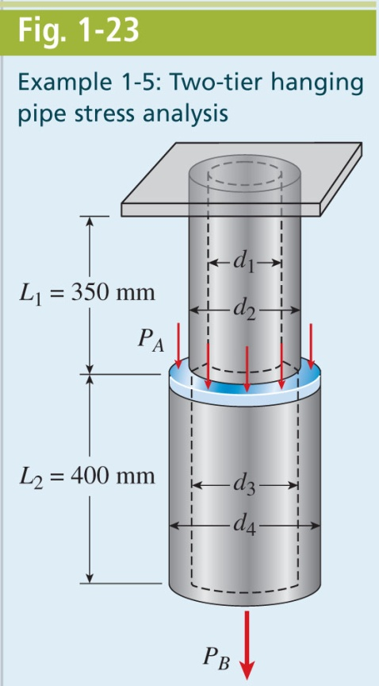
Mechanics of Materials, 8th Edition SI Gere & Goodno

Slide 30
Mechanics of Materials, 8th Edition SI Gere & Goodno

Slide 31
Mechanics of Materials, 8th Edition SI Gere & Goodno

Slide 32
Mechanics of Materials, 8th Edition SI Gere & Goodno

Slide 33
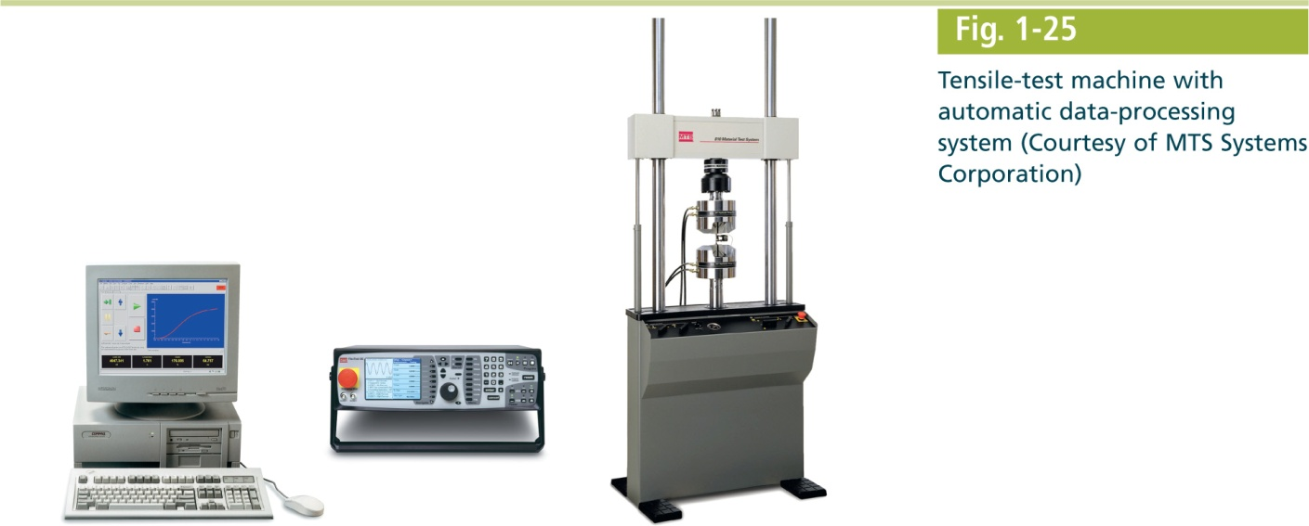
Mechanics of Materials, 8th Edition SI Gere & Goodno

Slide 34
Mechanics of Materials, 8th Edition SI Gere & Goodno

Slide 35
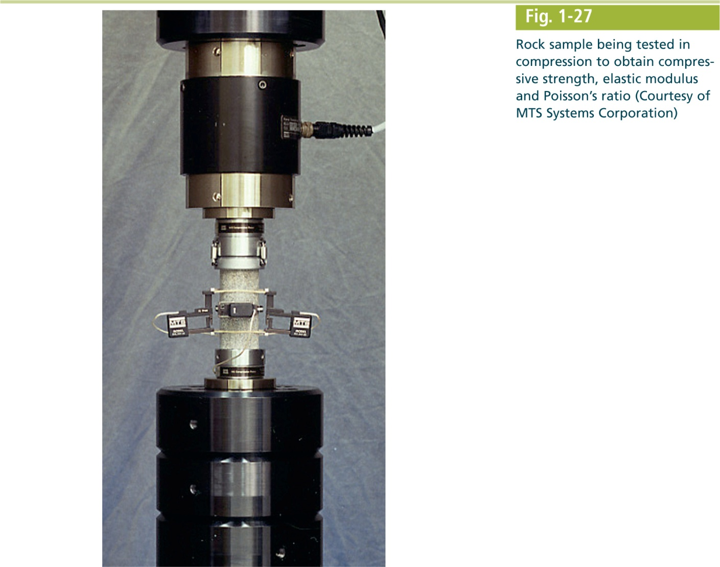
Mechanics of Materials, 8th Edition SI Gere & Goodno

Slide 36
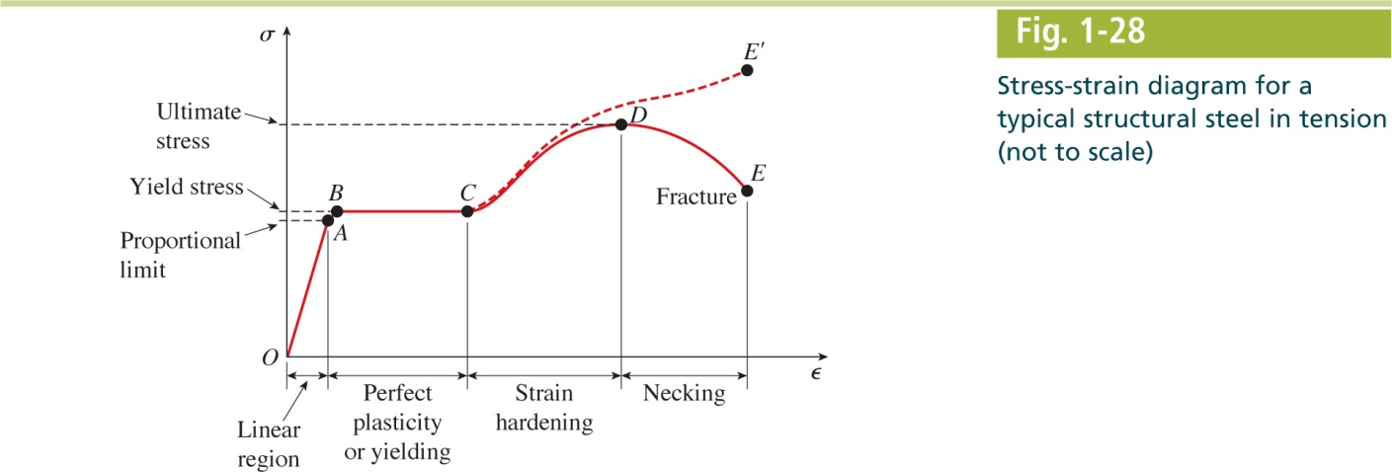
Mechanics of Materials, 8th Edition SI Gere & Goodno

Slide 37
Mechanics of Materials, 8th Edition SI Gere & Goodno

Slide 38
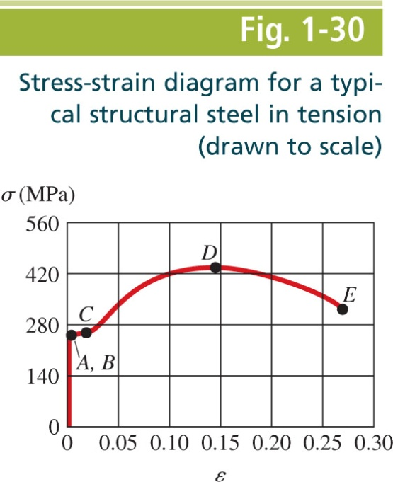
Mechanics of Materials, 8th Edition SI Gere & Goodno

Slide 39
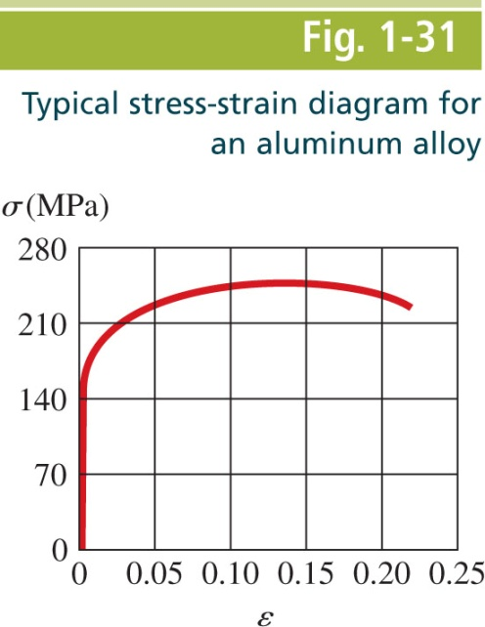
Mechanics of Materials, 8th Edition SI Gere & Goodno

Slide 40
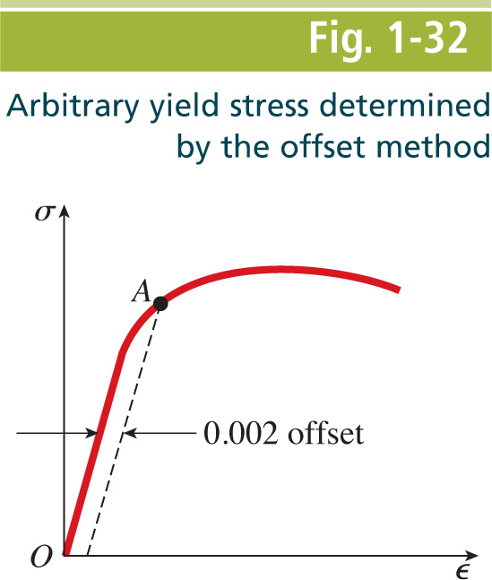
Mechanics of Materials, 8th Edition SI Gere & Goodno

Slide 41
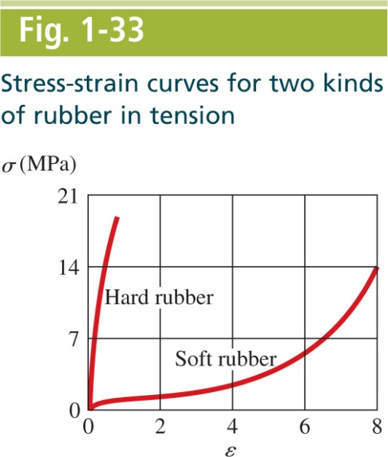
Mechanics of Materials, 8th Edition SI Gere & Goodno

Slide 42
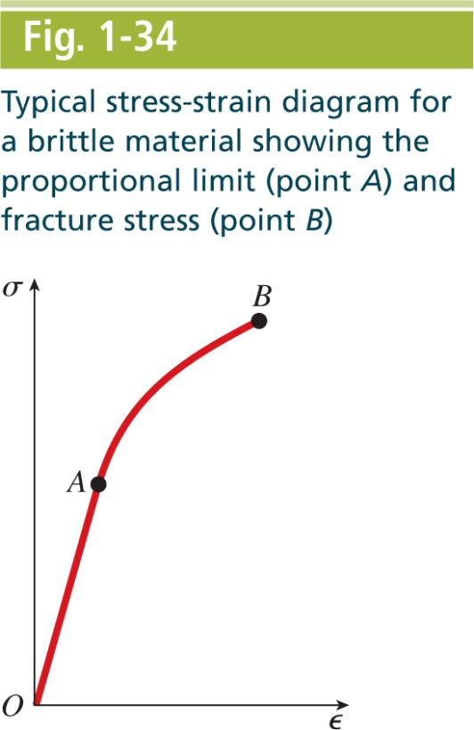
Mechanics of Materials, 8th Edition SI Gere & Goodno

Slide 43
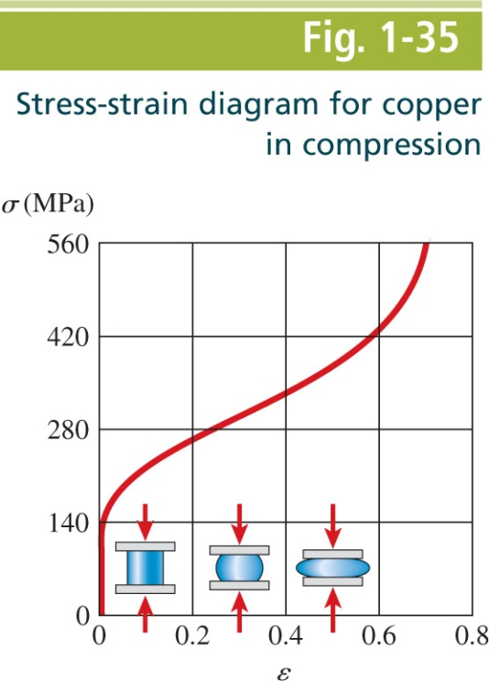
Mechanics of Materials, 8th Edition SI Gere & Goodno

Slide 44
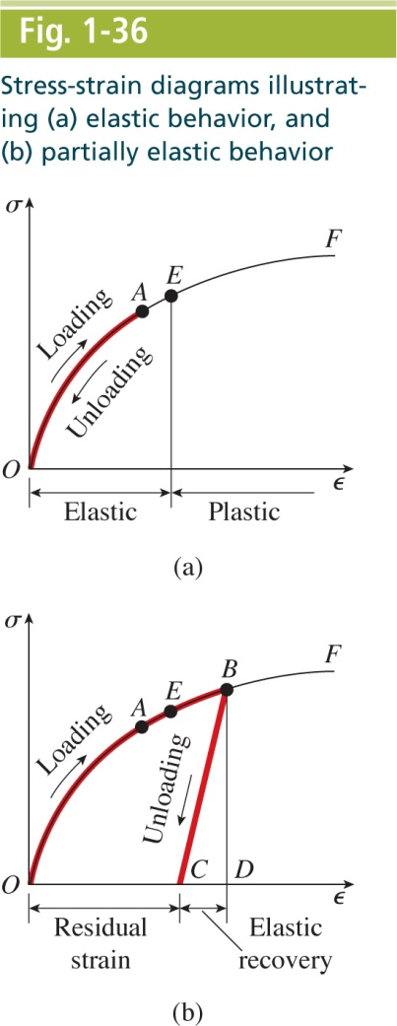
Mechanics of Materials, 8th Edition SI Gere & Goodno

Slide 45
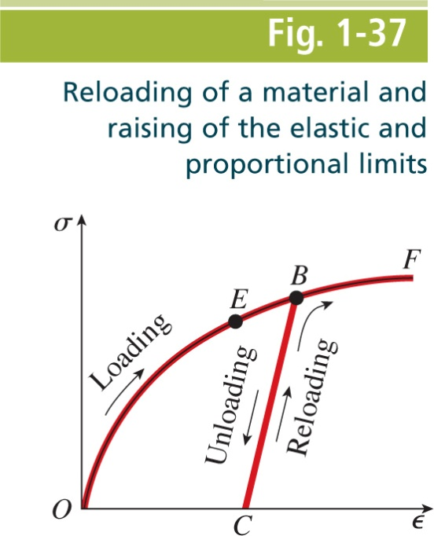
Mechanics of Materials, 8th Edition SI Gere & Goodno

Slide 46
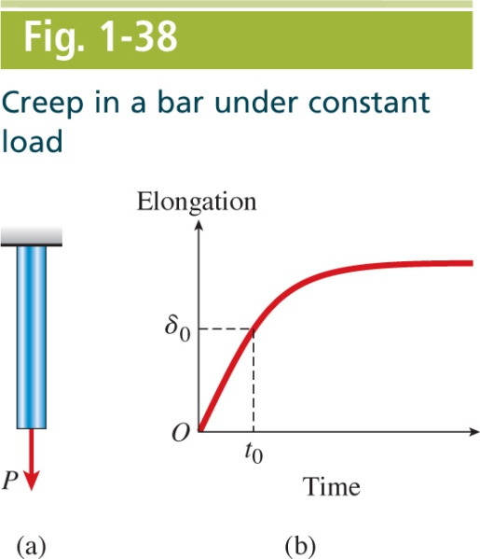
Mechanics of Materials, 8th Edition SI Gere & Goodno

Slide 47
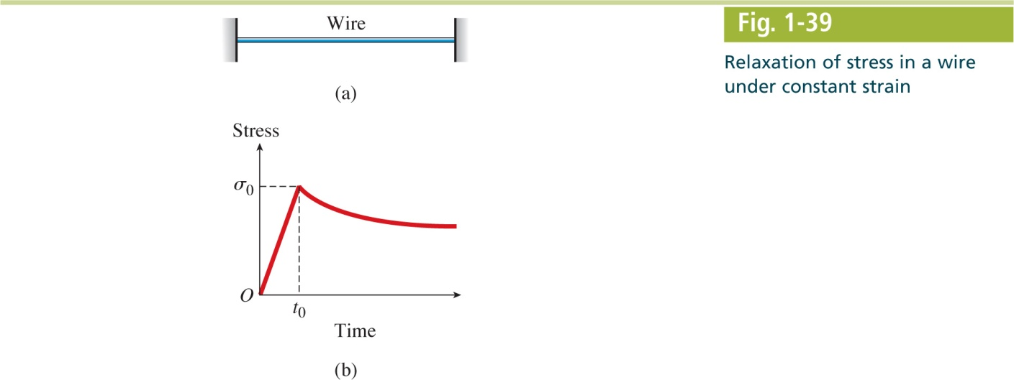
Mechanics of Materials, 8th Edition SI Gere & Goodno

Slide 48
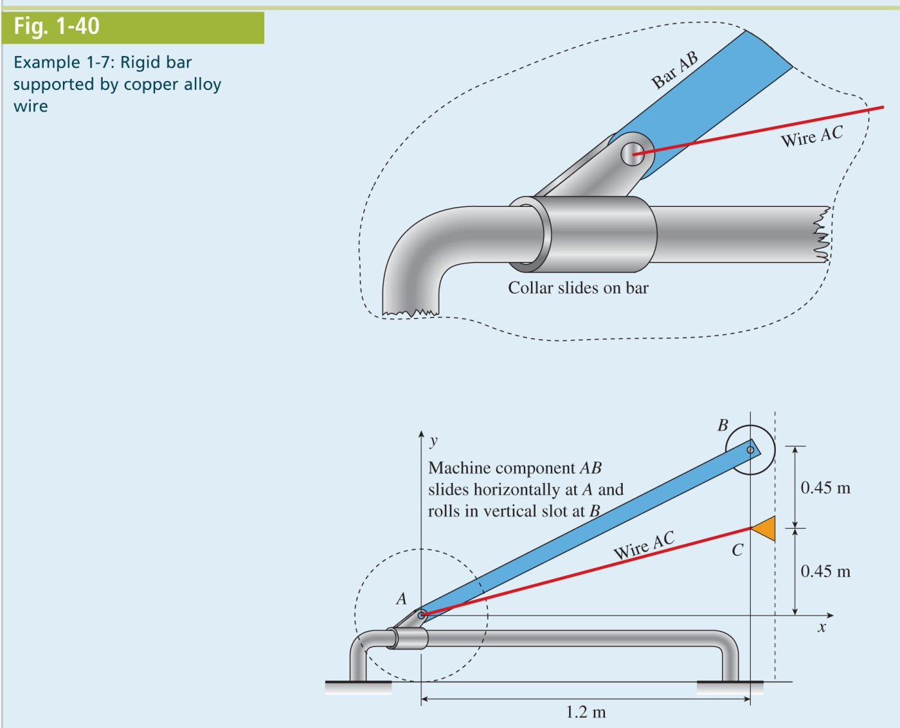
Mechanics of Materials, 8th Edition SI Gere & Goodno

Slide 49
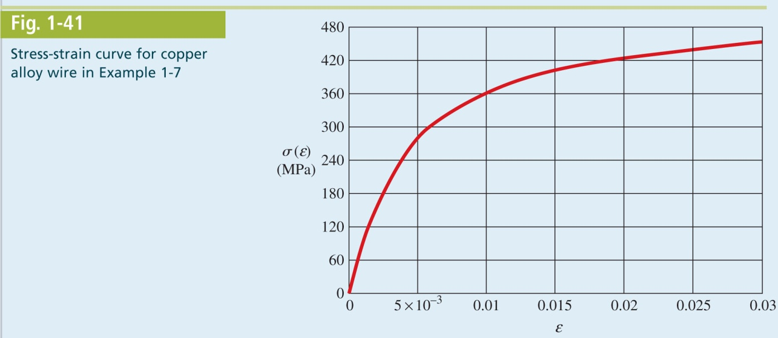
Mechanics of Materials, 8th Edition SI Gere & Goodno

Slide 50
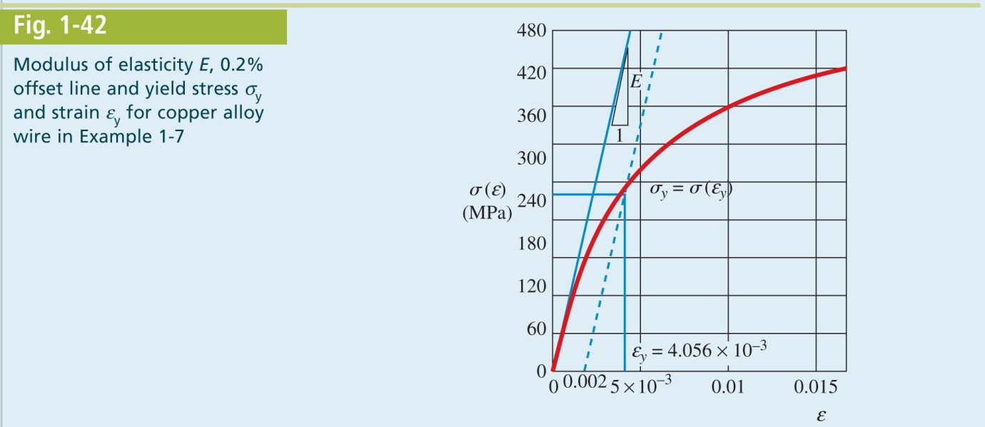
Mechanics of Materials, 8th Edition SI Gere & Goodno

Slide 51
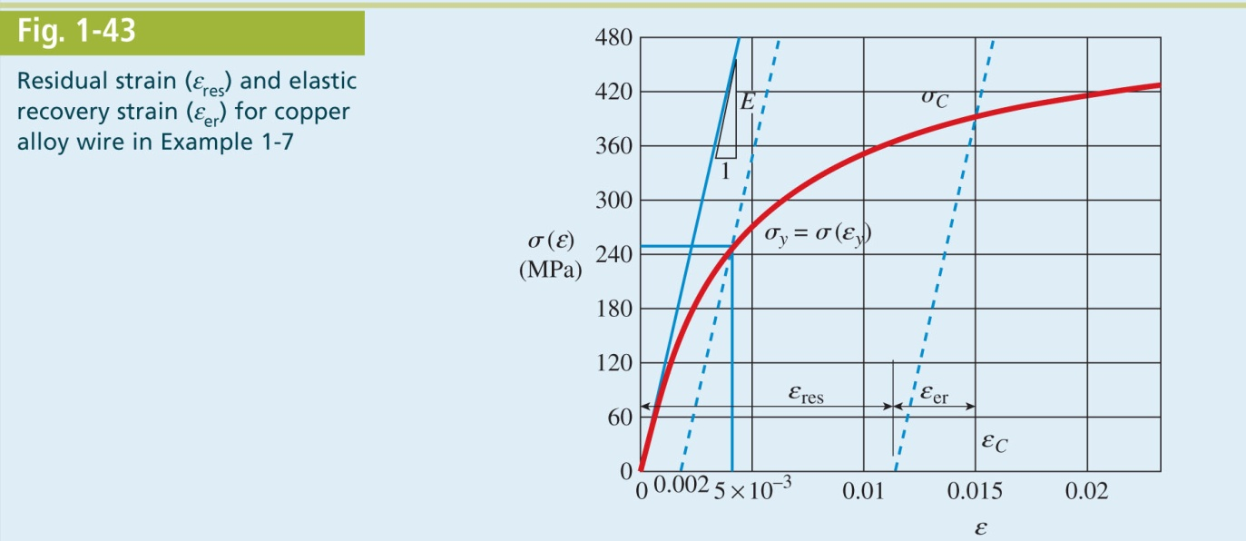
Mechanics of Materials, 8th Edition SI Gere & Goodno

Slide 52
Mechanics of Materials, 8th Edition SI Gere & Goodno

Slide 53
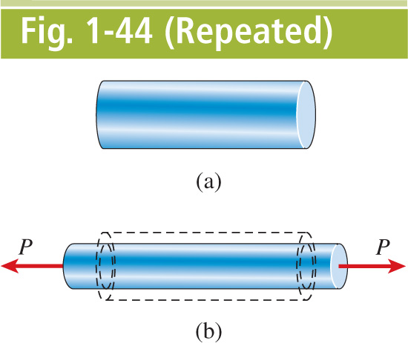
Mechanics of Materials, 8th Edition SI Gere & Goodno

Slide 54
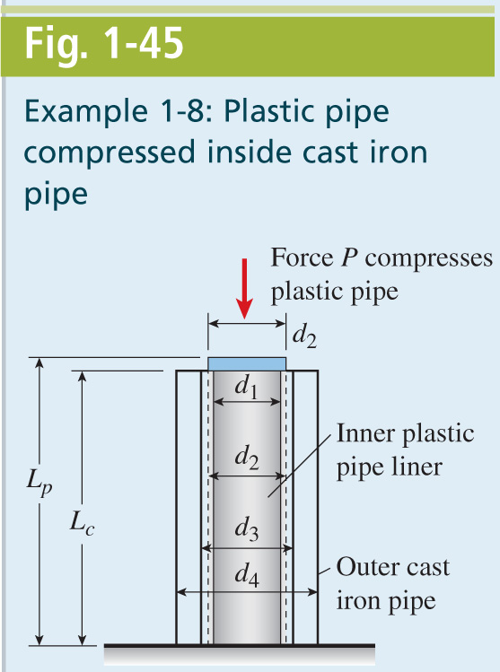
Mechanics of Materials, 8th Edition SI Gere & Goodno

Slide 55
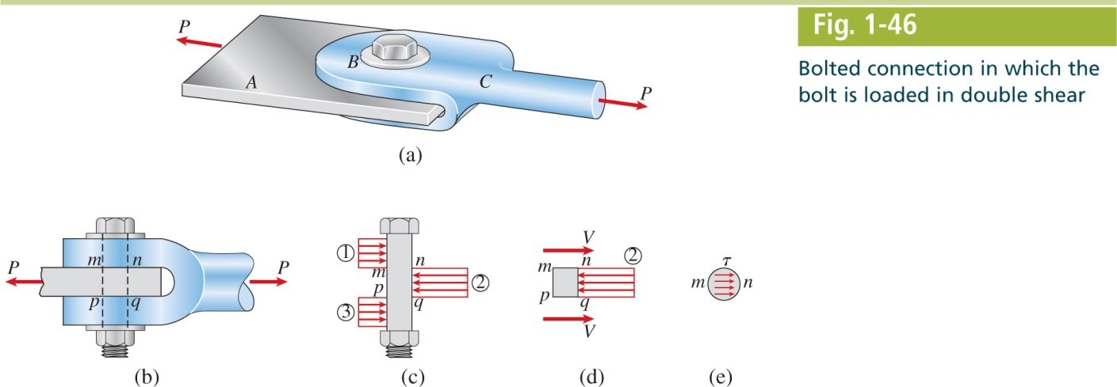
Mechanics of Materials, 8th Edition SI Gere & Goodno

Slide 56
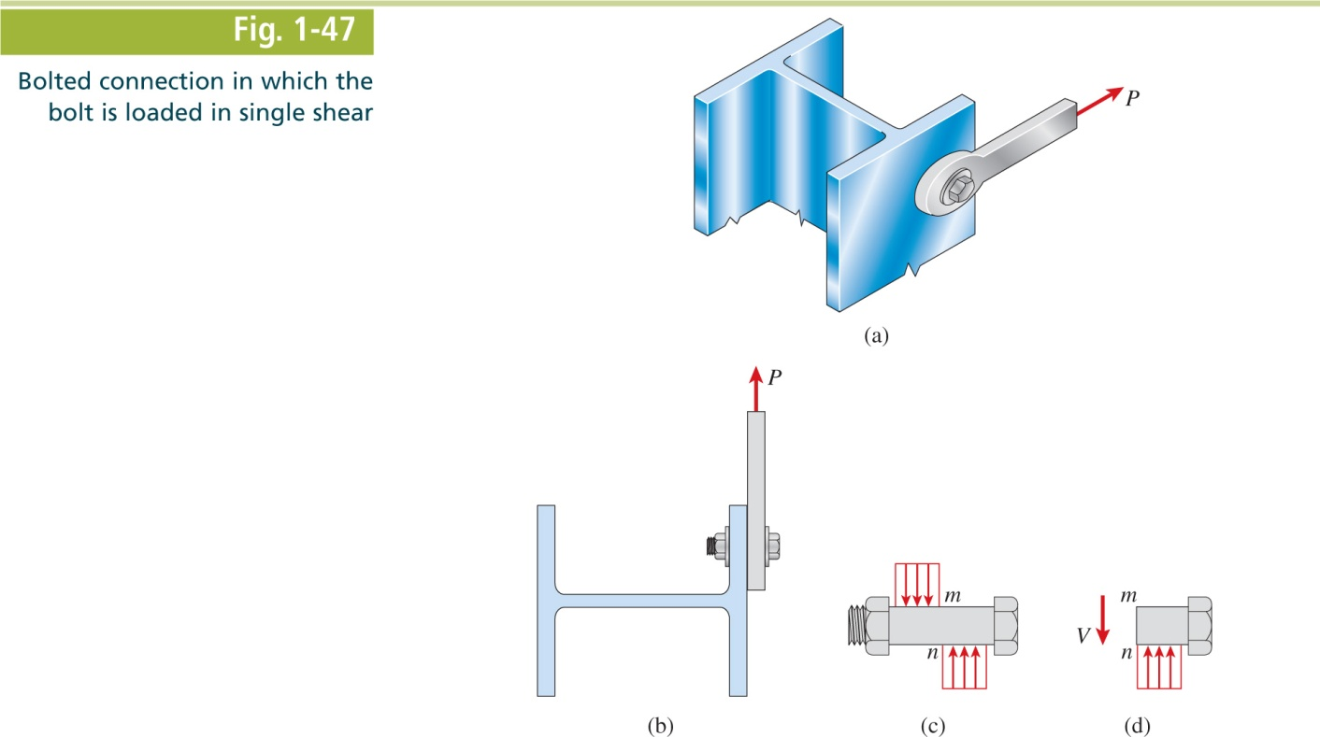
Mechanics of Materials, 8th Edition SI Gere & Goodno

Slide 57
Mechanics of Materials, 8th Edition SI Gere & Goodno

Slide 58
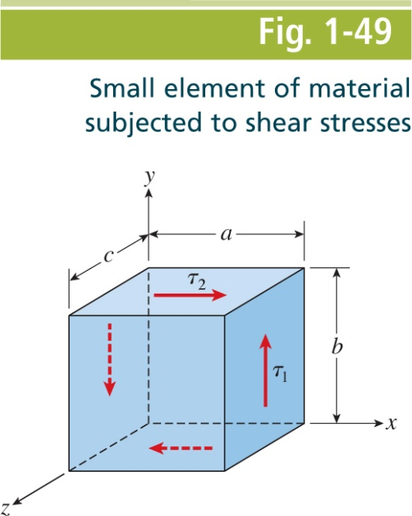
Mechanics of Materials, 8th Edition SI Gere & Goodno

Slide 59
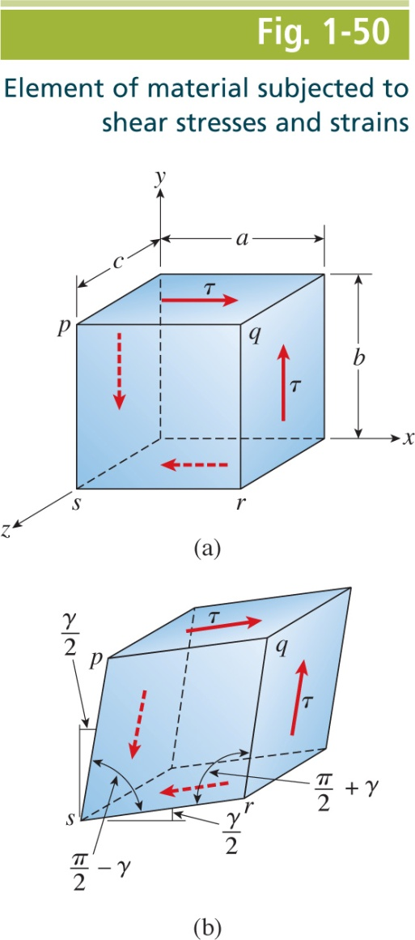
Mechanics of Materials, 8th Edition SI Gere & Goodno

Slide 60
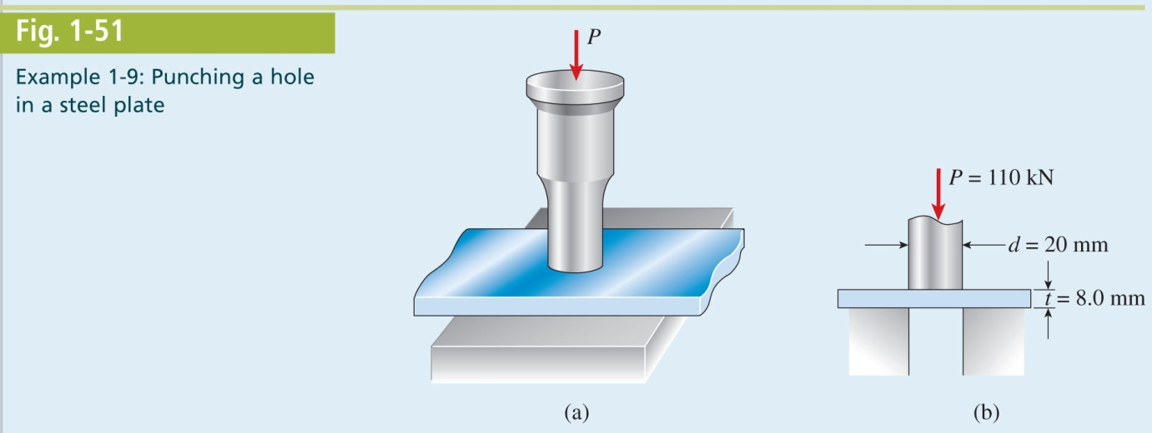
Mechanics of Materials, 8th Edition SI Gere & Goodno

Slide 61
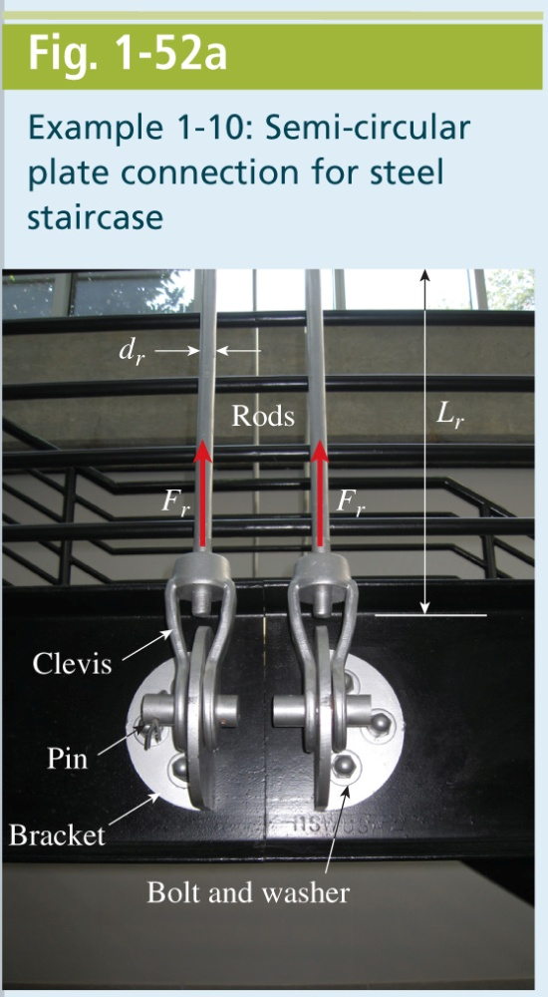
Mechanics of Materials, 8th Edition SI Gere & Goodno

Slide 62
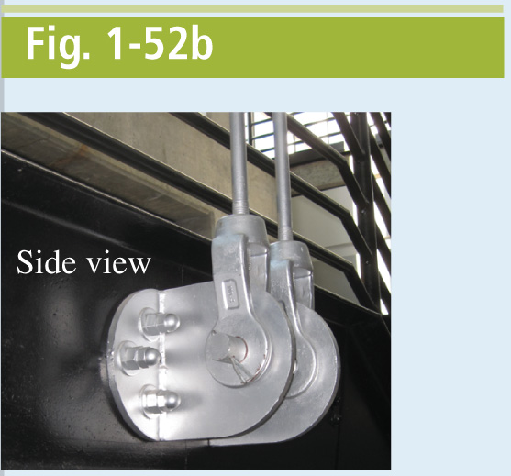
Mechanics of Materials, 8th Edition SI Gere & Goodno

Slide 63
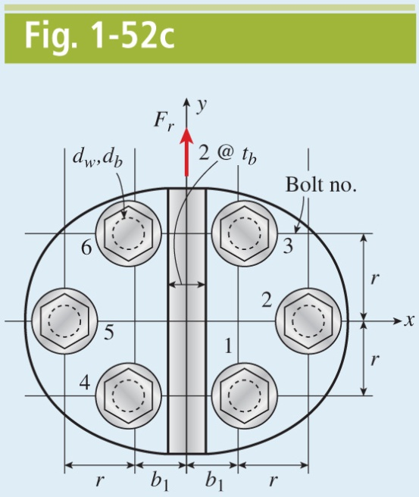
Mechanics of Materials, 8th Edition SI Gere & Goodno

Slide 64
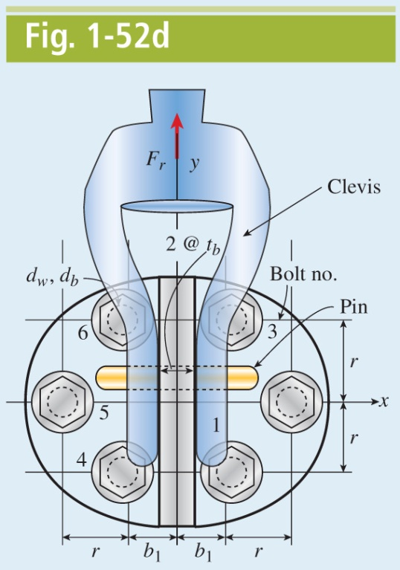
Mechanics of Materials, 8th Edition SI Gere & Goodno

Slide 65
Mechanics of Materials, 8th Edition SI Gere & Goodno

Slide 66
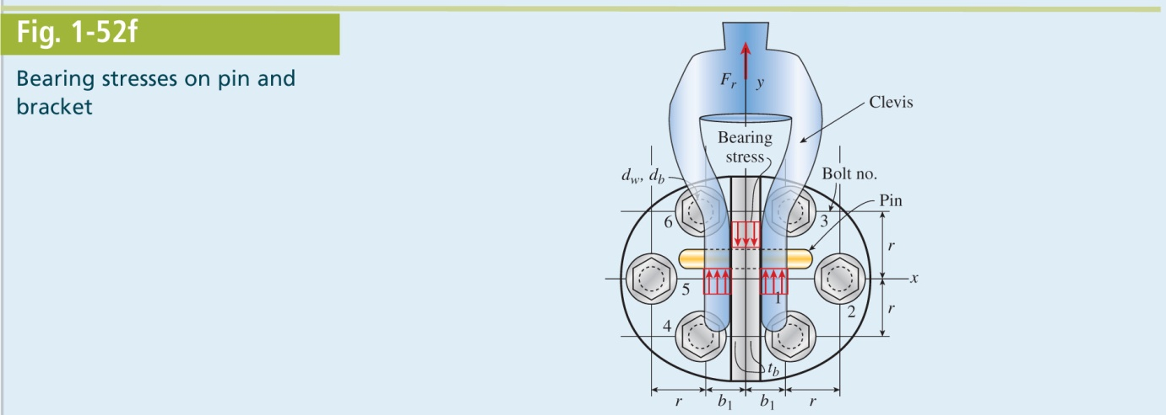
Mechanics of Materials, 8th Edition SI Gere & Goodno

Slide 67
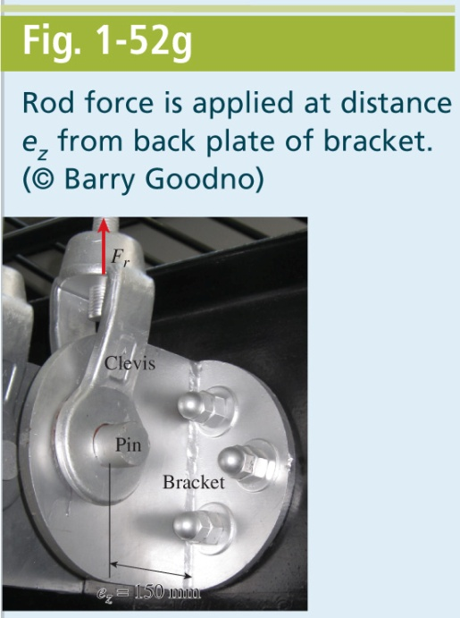
Mechanics of Materials, 8th Edition SI Gere & Goodno

Slide 68
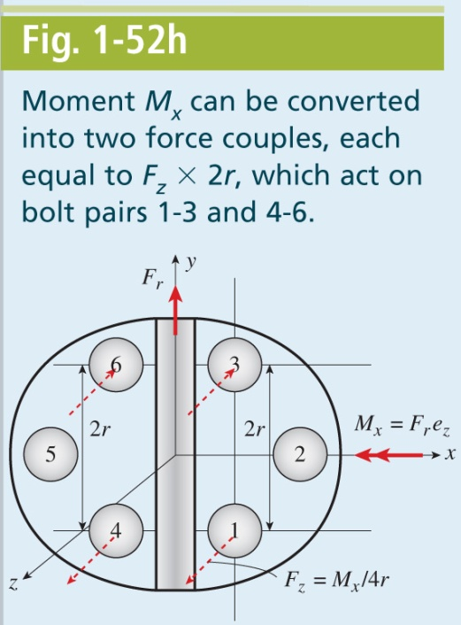
Mechanics of Materials, 8th Edition SI Gere & Goodno

Slide 69
Mechanics of Materials, 8th Edition SI Gere & Goodno

Slide 70
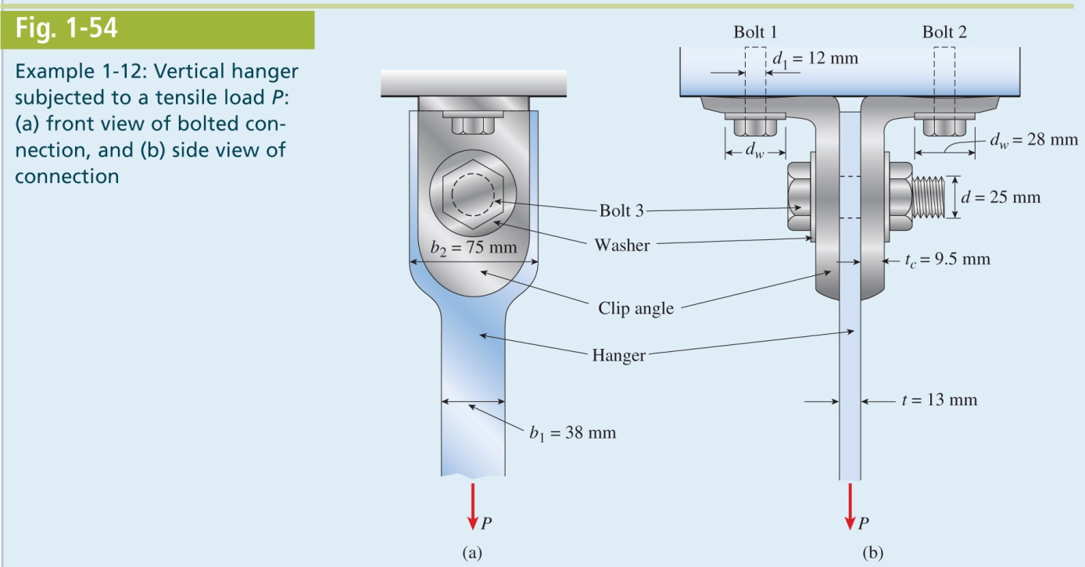
Mechanics of Materials, 8th Edition SI Gere & Goodno

Slide 71
Mechanics of Materials, 8th Edition SI Gere & Goodno

Slide 72
Mechanics of Materials, 8th Edition SI Gere & Goodno

Slide 73
Mechanics of Materials, 8th Edition SI Gere & Goodno

Slide 74
Mechanics of Materials, 8th Edition SI Gere & Goodno

Slide 75
Mechanics of Materials, 8th Edition SI Gere & Goodno

Slide 76
Mechanics of Materials, 8th Edition SI Gere & Goodno

Slide 77
Mechanics of Materials, 8th Edition SI Gere & Goodno

Slide 78
Mechanics of Materials, 8th Edition SI Gere & Goodno

Slide 79
Mechanics of Materials, 8th Edition SI Gere & Goodno

Slide 80
Mechanics of Materials, 8th Edition SI Gere & Goodno

Slide 81
Mechanics of Materials, 8th Edition SI Gere & Goodno

