Slide 1
The Rebirth of U.S. White Nationalism
Mariana de Moraes Olivio
Eduardo Rocca Batista
Guilherme Spaolonzi
Rafael Sant’Ana

Slide 2
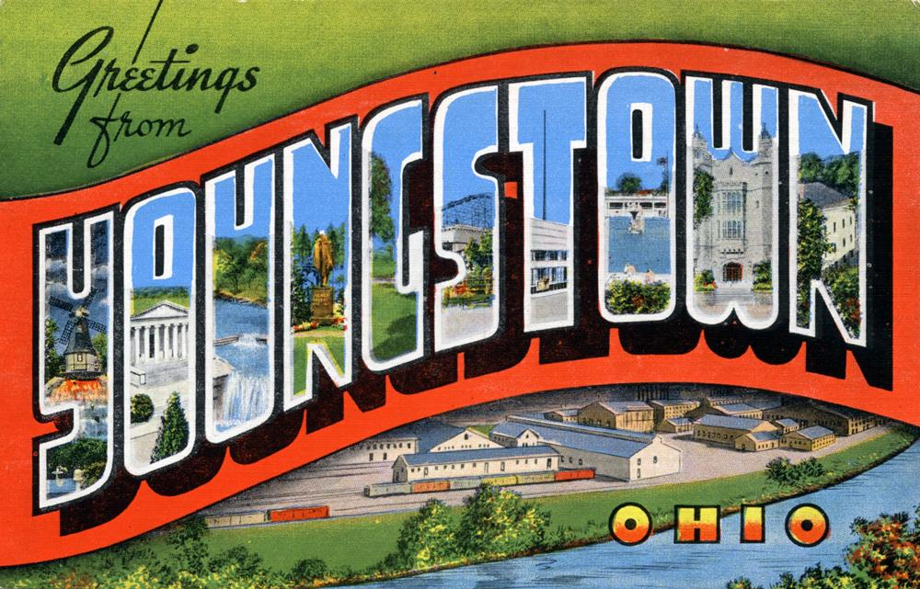

Slide 7
Gary,
Indiana
Population:
1960: 178,360
2016: 76,424

Slide 8
Flint,
Michigan
Population
1960: 196,940
2016: 96,985
Financial Emergency
2002-2004
2011-2015
Water Crisis
Lead Contamination
One of the most dangerous cities in the US

Slide 9
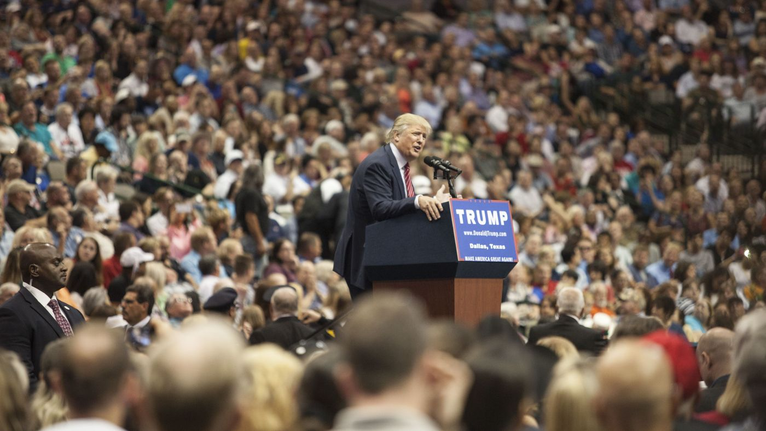
The rise of Donald Trump
“I would build a great wall, and nobody builds walls better than me, believe me, and I’ll build them very inexpensively, I will build a great, great wall on our southern border. And I will have Mexico pay for that wall.”

Slide 10
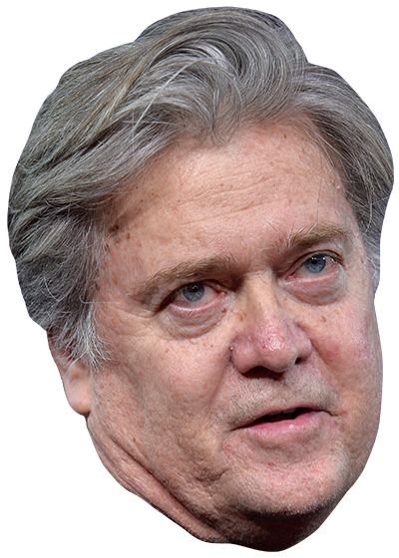
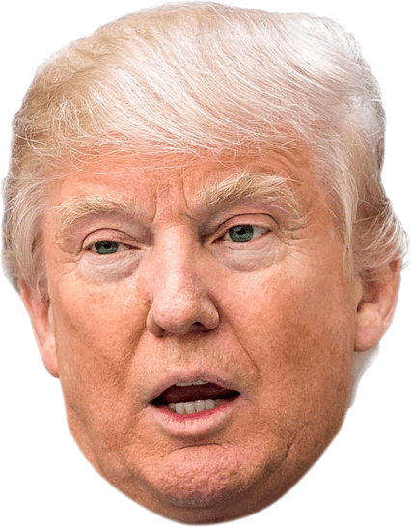
Steve Bannon
Pre - Trump
Post - Trump
Chief executive of Trump’s Campaign
Capitalism, nationalism and “Judeo-Christian values”
Appointed as Chief Strategist
Left the White House on August 18, 2017
Co-Founder of Breitbart News.
Executive Chair in 2012
“The platform for the Alt-Right”
“Virulently Anti-Establishment”

Slide 11
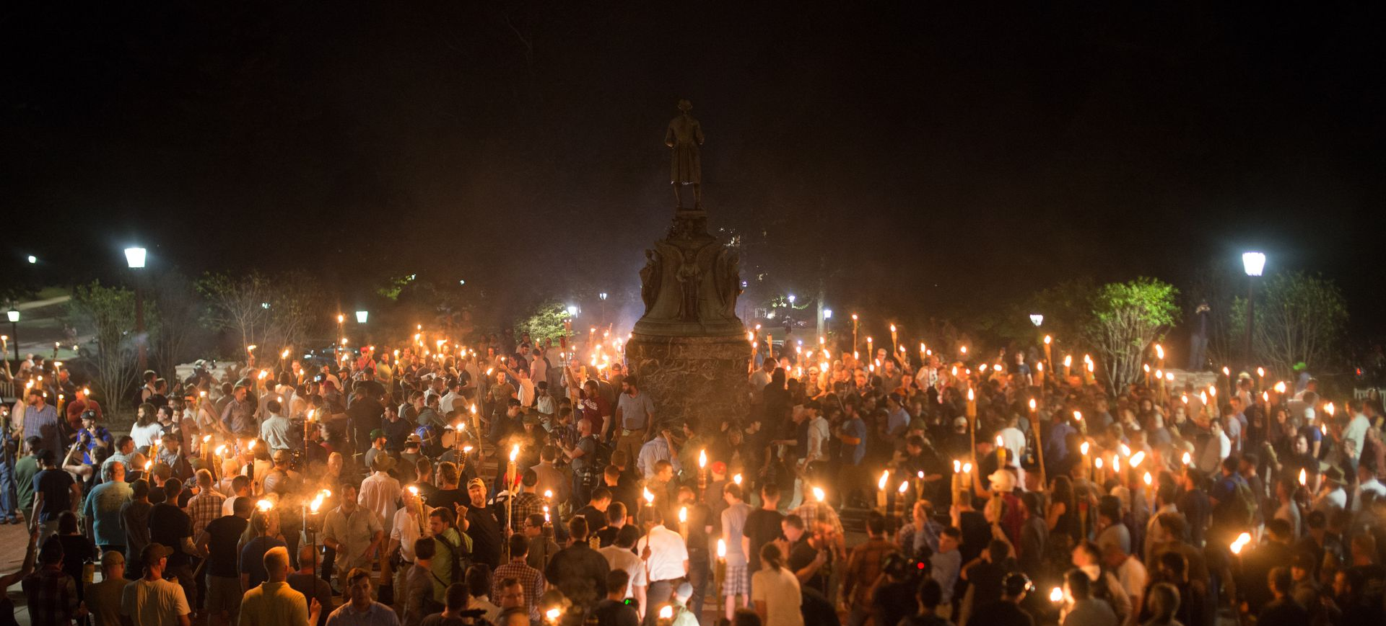
The Resurgence of White Supremacy

Slide 12
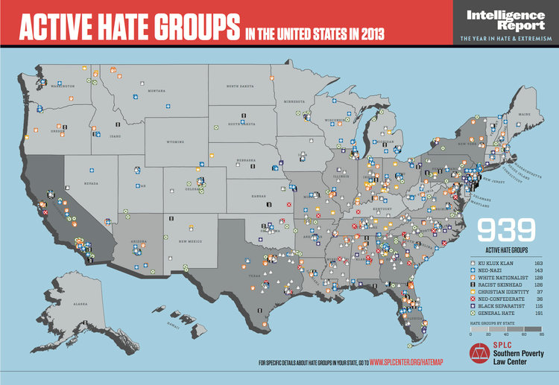
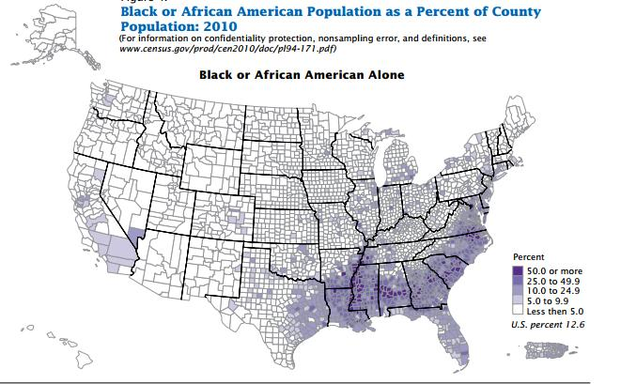
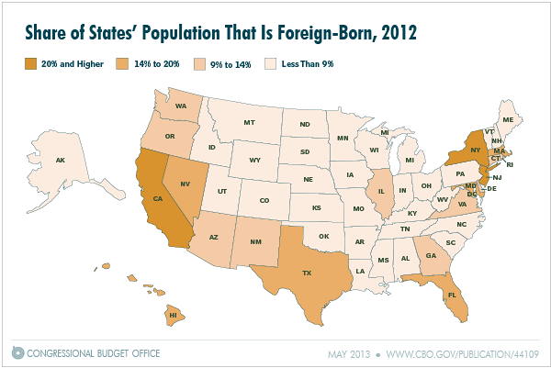

Slide 13
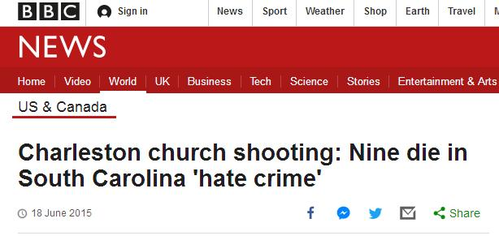
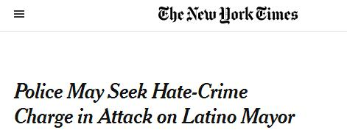
Notes:
Questionamento do direito de livre expressão quando a mesma incita comportamentos de ódio
Charlottesville inflamed two of the most urgent free-speech questions in the US. Should the law tolerate extreme forms of hate speech, which seek to deny people human dignity on the basis of characteristics such as race, sex, sexual orientation or religion? And who in the US – given its legacies of oppression and its growing inequality – is really free to speak?
Though many countries enacted hate-speech laws in the decades after the second world war, the US did not.
One important part of the free-speech consensus that now appears to be breaking down is the belief that the KKK and other white supremacist organisations are operating within the bounds of acceptable political discourse – rather than as, say, terrorist organisations – and therefore have a moral right to be heard.

Slide 14
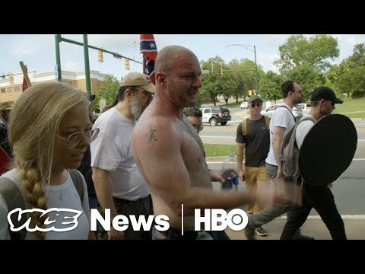

Slide 15
The Proud Boys: Far-Right, Male-Only organization created by VICE Media co-founder Gavin McInnes
“I Am A Western Chauvinist And I Refuse To Apologize For Creating The Modern World.”
“Being proud of Western culture today is like being a crippled, black, lesbian communist in 1953.”
“Our group is and will always be MEN ONLY(born with a penis if that wasn’t clear enough for you leftists)!”
Four degrees of initiation: public declaration, no masturbation, tattoo and engaging in a major conflict.

Slide 16
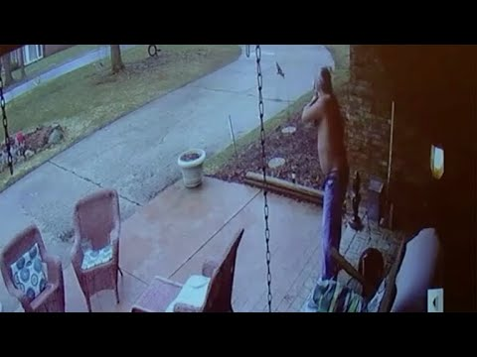

Slide 17
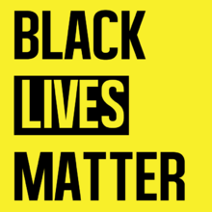
Mission: To build local power and to intervene in violence inflicted on Black communities by the state and vigilantes.
Created in 2013 as a response to the decision to free the killer of Trayvon Martin
National recognition in 2014 after the deaths of Michael Brown and Eric Garner
Ferguson Unrests - Reaction the the police shooting of Michael Brown
Backlash: “All Lives Matter”, “Blue Lives Matter”, “White Lives Matter”

