Slide 1
Chapter 10 Competitive Advantage in Mature Industries
Prof. Luciano Thomé e Castro

Slide 2
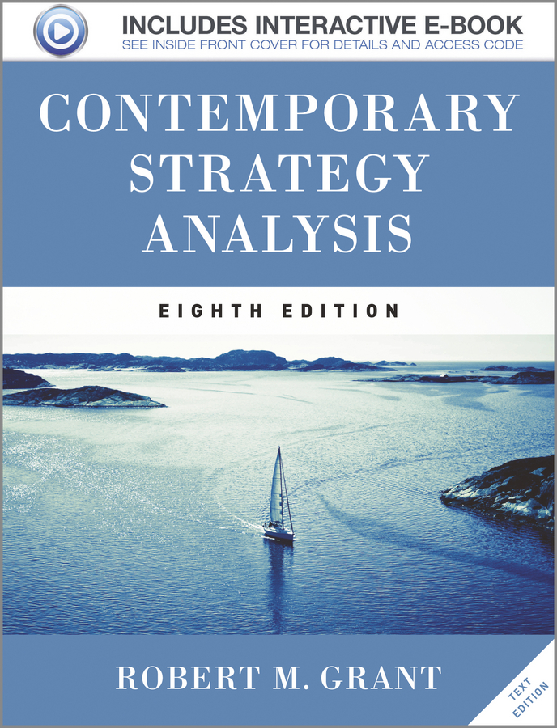
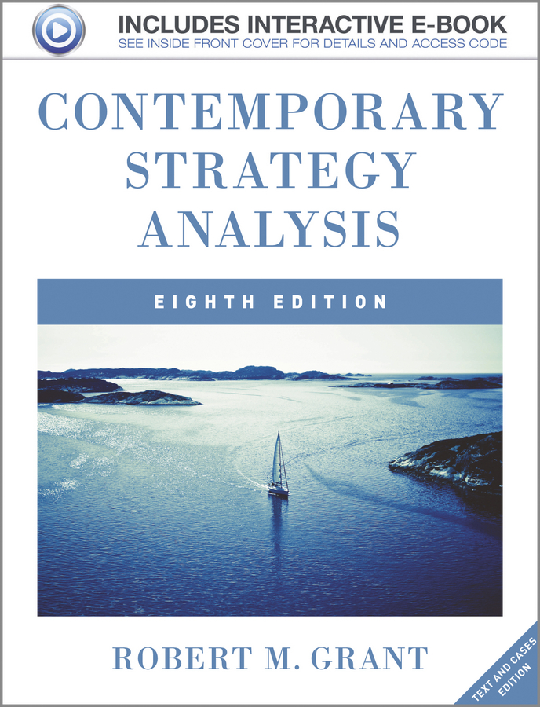
© 2013 Robert M. Grant
www.contemporarystrategyanalysis.com

Slide 3
Competitive Advantage in
Mature Industries
OUTLINE
Competitive advantage in mature industries
Strategic implementation in mature industries: Structure, Systems, Style
Strategies for declining industries
© 2013 Robert M. Grant
www.contemporarystrategyanalysis.com

Slide 4
Key Success Factors in Mature Industries
Opportunities for sustainable competitive advantage are limited
Limited potential for differentiation
technology stable and well diffused
ease of entry due to well developed industry structure
Sources of cost advantage
Economies of scale
Low-cost inputs
Low overheads
Segment and customer selection
As overall industry profitability declines, important to focus on attractive segments and customers
Source of differentiation advantage
Emphasis on image differentiation and differentiation through complementary services
Sources of innovation
Even if scope for product and process innovation limited, potential for strategic innovation

Slide 5
Sources of Strategic Innovation in Mature Industries
Embracing new customer groups:
Harley-Davidson in motorcycles
Nintendo in video games consoles (Wii)
Augmenting, bundling and theming:
Barnes & Noble bookstores
Amazon in online book & music retailing
Themed restaurants (Hard Rock Café)
Customer solutions:
Alstom in rail transport
Liberation from the maturity mind-set
Virgin in air travel
Nestle’s Nespresso in home coffee makers
© 2013 Robert M. Grant
www.contemporarystrategyanalysis.com

Slide 6
Sources of Strategic Innovation in Mature Industries
Who are the strategic innovators?
New entrants:
CNN in news broadcasting
Dyson in domestic appliances
Existing firms on the periphery:
Sun Records in rock ’n’ roll music
Firms from adjacent industries:
Fuji Film in cosmetics
Why not leading incumbents? They are constrained by conventional thinking (“industry recipes”), relationships with existing customers, resources & capabilities that support past strategies
© 2013 Robert M. Grant
www.contemporarystrategyanalysis.com

Slide 7
Product, Process and Strategic Innovation over the Life Cycle
Product
innovation
Strategic
innovation
RATE OF INNOVATION
Process
innovation
TIME
© 2013 Robert M. Grant
www.contemporarystrategyanalysis.com

Slide 8
Strategy Implementation in Mature Industries: The Traditional Model
Strategy - Cost advantage through scale economies & capital-intensive production of standardized products
Structure - Functional departments ; line and staff distinction; clearly defined job roles
Controls - Quantitative , short-term performance targets , hierarchically monitored, formalized reporting. Emphasis on financial controls—budgets and profit targets
Incentives - Financial incentives linked to individual targets
Communication - Primarily vertical for the purposes of delegation and reporting
Leadership - Top management responsible for control and strategic direction. Typical CEO profiles: the administrator (e.g., Alfred Sloan of General Motors), the autocrat (e.g. Lee Iacocca of Chrysler , Al Dunlap of Sunbeam);, and the strategic leader (John Browne at BP, Carlos Ghosn at Nissan, Jack Welch at GE)
© 2013 Robert M. Grant
www.contemporarystrategyanalysis.com

Slide 9
Strategy Implementation in Mature Industries: The Traditional Model
Features of declining industries | Excess capacity Lack of technological change Consolidation (but some new entry as new firms exit) - Old machines and employees
Smooth adjustment of capacity depends upon | Predictability of decline Barriers to exit -Strategies of surviving firms
{
Durable assets
Cost of closure
Management
commitment
© 2013 Robert M. Grant
www.contemporarystrategyanalysis.com

Slide 10
Strategy Options in Declining Industries
Leadership
Establish dominant market position by acquiring capacity and takeovers of rivals
Encourage exit of rivals by demonstrating commitment, dispelling optimism about the industry’s future, and raising the stakes
Niche
Identify an attractive segment and dominate it
Harvest
Maximize cash flow from existing market position
Divest
Get out while it is still possible to find a buyer for the business
© 2013 Robert M. Grant
www.contemporarystrategyanalysis.com

Slide 11
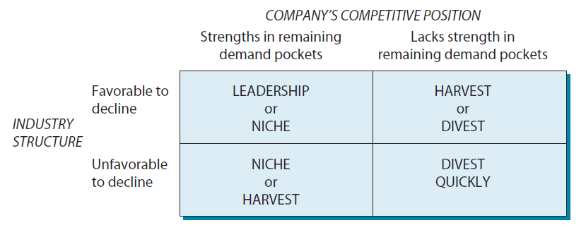
Strategy Alternatives for a
Declining Industry
© 2013 Robert M. Grant
www.contemporarystrategyanalysis.com

