Slide 1
estado anômalo
de informação
O conceito de “Anomalous State of Knowledge”
segundo Nicholas J. Belkin: bases teóricas, testes empíricos

Slide 2
Nicholas J. Belkin
Professor da Rutgers School of Communication and Information. PhD em Information Studies pela University of London; master em Information Science pela University of Washington; bacharel em Russian Language and Literature. Pesquisa comportamento informacional, recuperação da informação e interação com a informação.
https://comminfo.rutgers.edu/directory/belkin/index.html
http://www.researchgate.net/profile/Nicholas_Belkin

Slide 3
Retomando Ingwersen
Visão Cognitiva
Estado de Conhecimento: mediação com o Mundo
Informação: o que altera um estado de conhecimento
Brookes Fundamental Equation: K(S) + δI = K(S + δS)

Slide 4
Retomando Ingwersen
Desire for Information: deficiência percebida no EC
Wersig: “State of Uncertainty”
Mackay: “A certain incompleteness in his (the user’s) picture of the world, an inadequacy”
Belkin: Anomalous State of Knowledge (ASK)
*** “It points to reasons for requiring information through communication with external sources (...)”

Slide 5
Ingwersen/Belkin
*** Belkin apud Ingwersen: “Because both the information and the recipient’s state of knowledge are considered as structures, and because the information structure is derived from a knowledge structure, the effect of information associated with any particular text can be predicted, given some idea of the recipient’s state of knowledge and some means for representing state of knowledge.” (pg.30)
*** Ingwersen: “However, is it possible to have an idea of a state of knowledge and representative means?”
*** Ingwersen: “What is not possible is to have an exact idea of several states of knowledge, nor to predict individual effects. This is a problem of uncertainty inherent in the cognitive approach to information”.

Slide 6
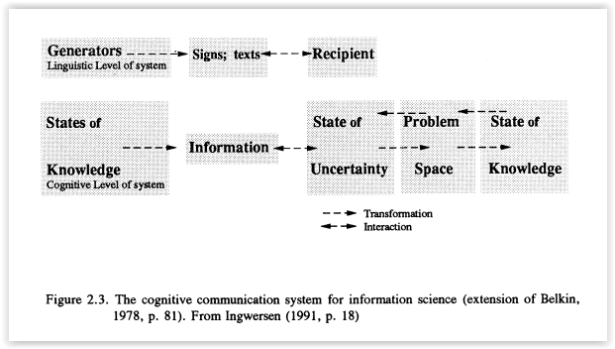
Ingwersen/Belkin
.

Slide 7
Estudo sobre Belkin
“Anomalous States of Knowledge as a Basis for Information Retrieval” (1980)
“Ask for Information Retrieval: Part. I. Background and Theory” (1982)
“Ask for Information Retrieval: Part. II. Results of a Design Study” (1982)
“Using Structural Representations of Anomalous States of Knowledge for Choosing Document Retrieval Strategies” (1986)
*** Artigos acessíveis com o VPN da USP

Slide 8
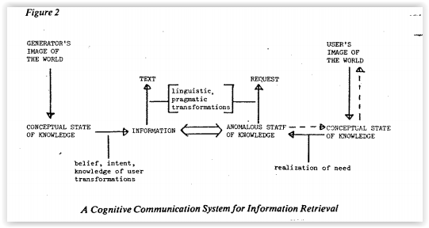
O Modelo de Belkin
.

Slide 9
O Problema de Belkin
Desenvolvimento de sistemas de information retrieval
Limitações da best-match strategy
“Non-Speciability of Information Need”
*** “The typical IR system now available, either operational or experimental, depends on what we call the ‘best-match’ principle. (...) one can identify two assumptions basic to the best-match principle: that it is possible for the user to specify precisely the information that she/he requires; and, that information needs (or at least expressions of them) are functionally equivalent to document texts.”

Slide 10
Necessidade Não-Especificada
*** “It seems to me that the typical case in IR is that need are non-specifiable at least to some extent, and therefore that the general problem resides initially at the cognitive level. If this is indeed the case, then a number of phenomena can be explained, or at least examined, within one framework. For instance, we can understand why there is almost always a distinction between user and system relevance and why the reference interview is such a difficult task. We can also see why, even given complete freedom of language, the question presented to an IR system is usually only an approximation to what might be necessary to resolve the need which gave rise to the question.”

Slide 11
A Proposta de Belkin
Representação em rede do ASK
Representação em rede dos documentos
Representação por análise da frequência das palavras
Documentos recuperados por semelhança estrutural
Sistema Interativo e Dinâmico

Slide 12
Sistema Dinâmico e Interativo
*** “Whether an anomaly is resolved or not is evaluated in terms of the problem. It should be noticed that the problem determines not oly the conceptual requirements of an appropriate response, but also the situational requirements such as for instance, source of information, mode of information etc. It should also be noted that the anomaly, and the user perception of the problem, will probablu change with each instance of communication between user and mechanism.”
Tipos de ASK

Slide 13
Representação em Rede
*** “There is no question that this sort of representation of a state of knowledge (or of the information structure underlying a text) is simplistic and naive. (...) On the other hand, it has the advantages of being fairly easily determined and reasonably machine-manipulable, important considerations in IR research (...) there is no ‘real’ or ‘true’ representation of knowledge or information, but rather many possible representations, each appropriate to particular problems.”

Slide 14
Fases de Busca
User’s Problem Statement
Structural Analysis of Problem Statement
Choice of Retrieval Strategy According to Type of Ask
Abstract presented to user simultaneously with explanation of why text was chosen (strategy and significant features)
Structured Dialogue Between System and User for System to Infer User’s Evaluation of: a) Method of Choice; b) Suitability of Document to Problem; c) Wheter Need has Changed
Modifications According to Evaluation of Finish
Return to 2 or 3 as Necessary

Slide 15
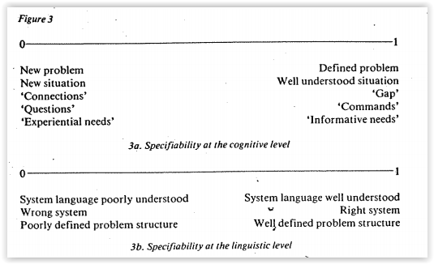
Continuum dos Buscadores

Slide 16
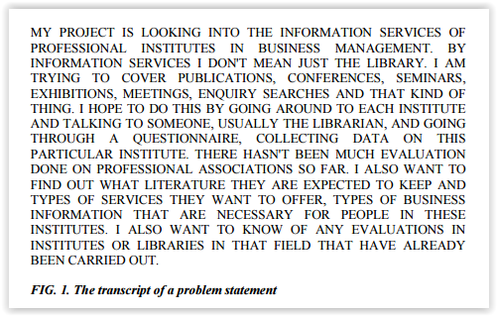
Statement

Slide 17
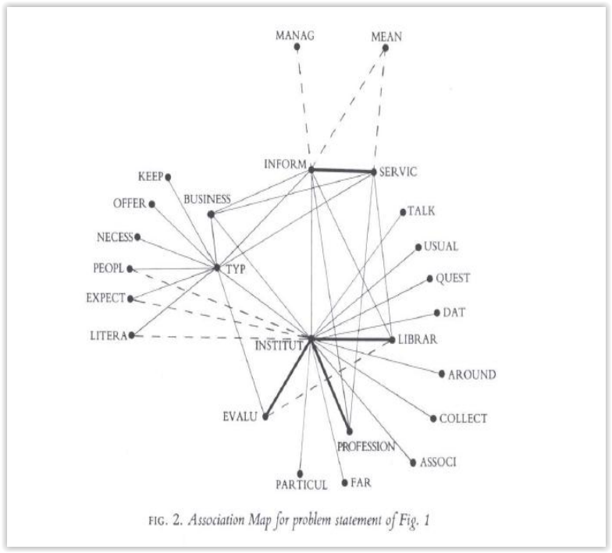
Rede

Slide 18
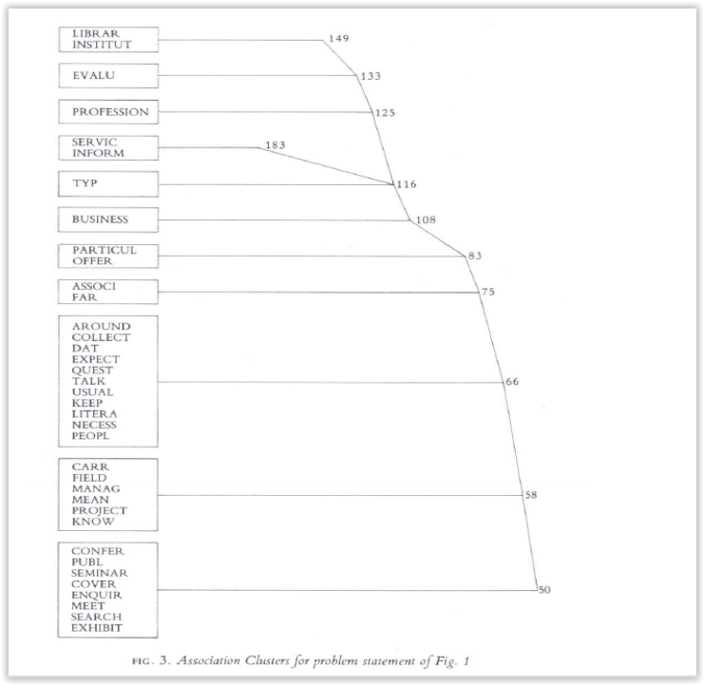
Representação Alternativa

Slide 19
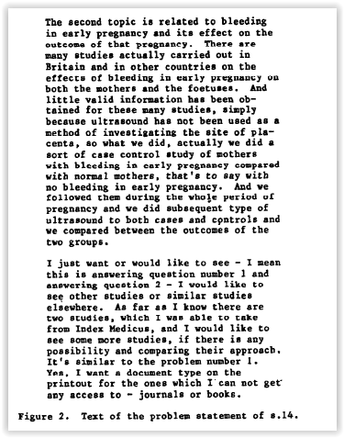
Statement
.

Slide 20
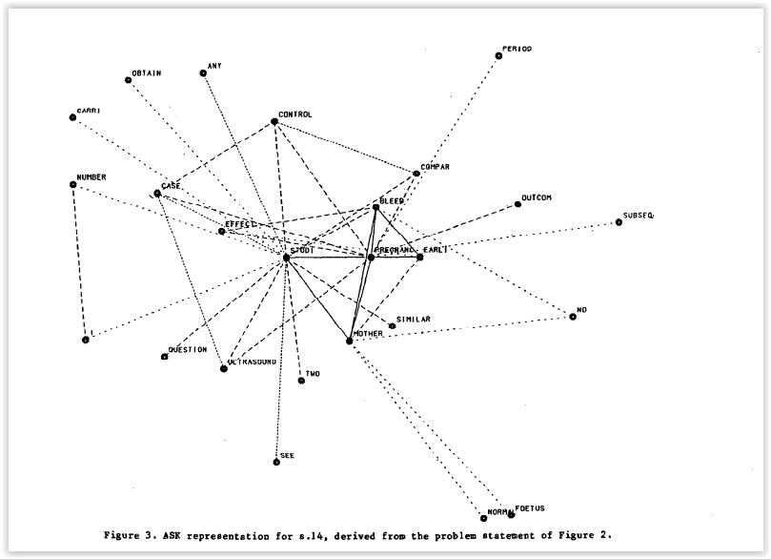
Rede

Slide 21
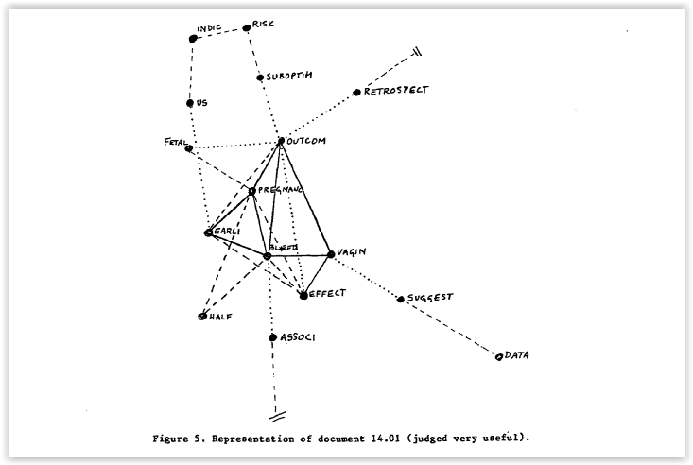
Útil

Slide 22
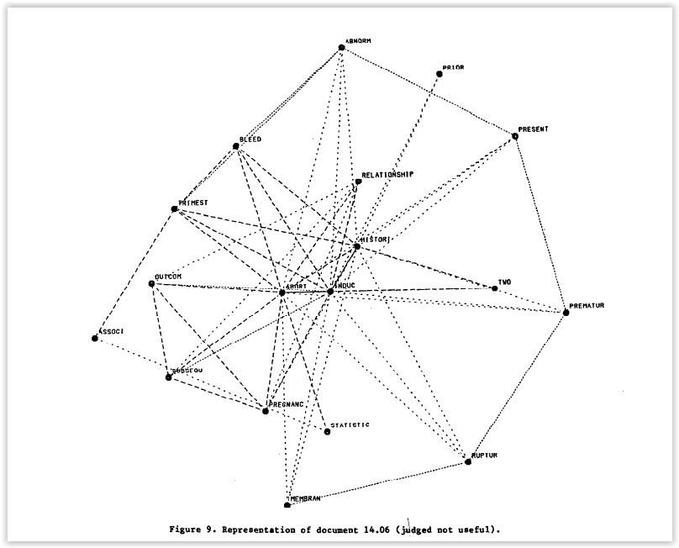
Inútil

Slide 23
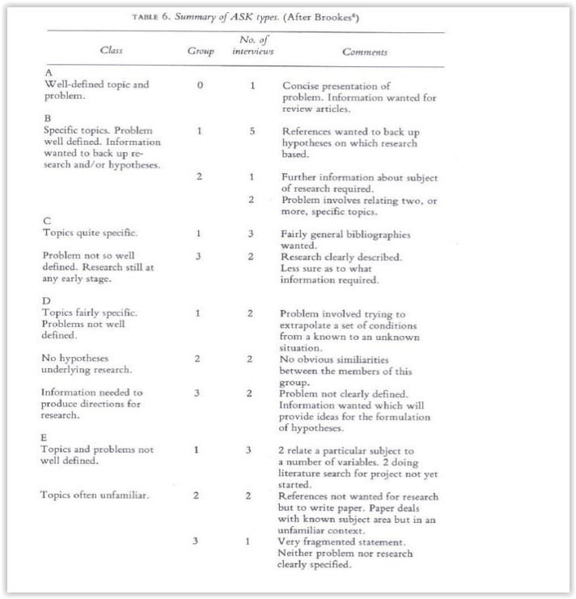
Tipos de ASK

Slide 24
Resultados
Representação de resumos e dos problemas teve funcionamento razoável.
Perguntas de avaliação precisavam ser melhoradas; usar gradações.

Slide 25
Possíveis Desenvolvimentos
Avanço das pesquisas de Belkin
Críticas:
“Death of the User: Reconceptualizing Subjects, Objects, and Their Relations”, Ronald E. Day
“Psychological Relevance and Information Science”, Stephen P. Harter

