Slide 1
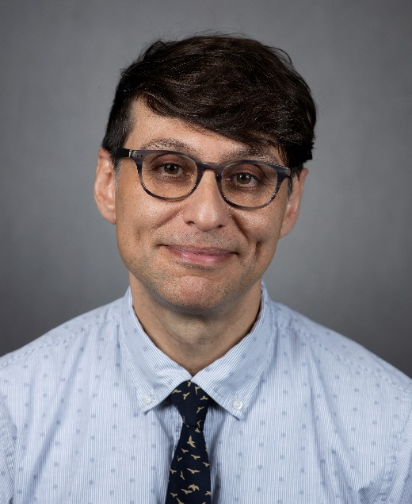
Nemat Oliver Keyhani Dept. of Microbiology and Cell Science, University of Florida "Mechanisms of fungal mutualism: the hidden lifestyle”
Anfiteatro da Parasitologia, ICB II 4 de outubro às 10h30
https://scholar.google.com/citations?hl=en&user=LoKcaLEAAAAJ&view_op=list_works&sortby=pubdate

