Slide 1
Antibiotics
What are antibiotics?
Who are the main producers?
Biological functions?
Resistance
New developments

Slide 2
First antimicrobial aproaches
Louis Pasteur (1822-1895):
“pasteurization”
Fermentation: wine contamination
Germ theory: silkworn disease
Vaccine: anthrax, fowl cholera
Rabies

Slide 3
First antimicrobial drugs
Paul Ehrilch (1854-1915):
- Methylene blue: malaria
Toxin and antitoxin
Salvarsan: magic bullet
against syphilis, Treponema
pallidum

Slide 4
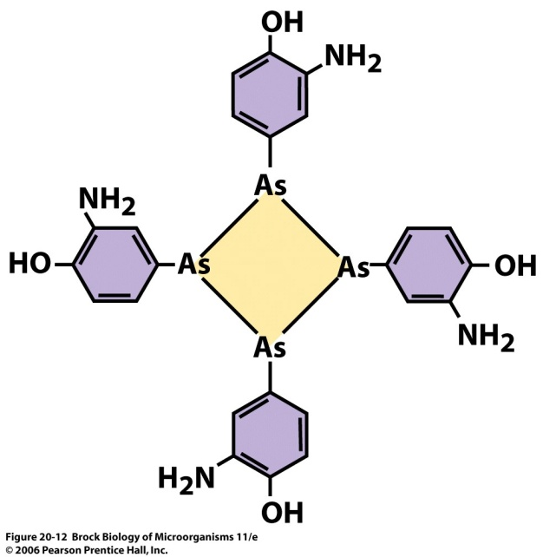
First antimicrobial drugs
Gerhard Domagk (Nobel Prize 1939)
Sulfa drugs
Prontosil
Sulfanilamide, analog of p-aminobenzoic acid
(part of folic acid, precursor of nucleic acids)
Development of antituberculosis compounds thiosemicarbasone and isoniazid

Slide 5
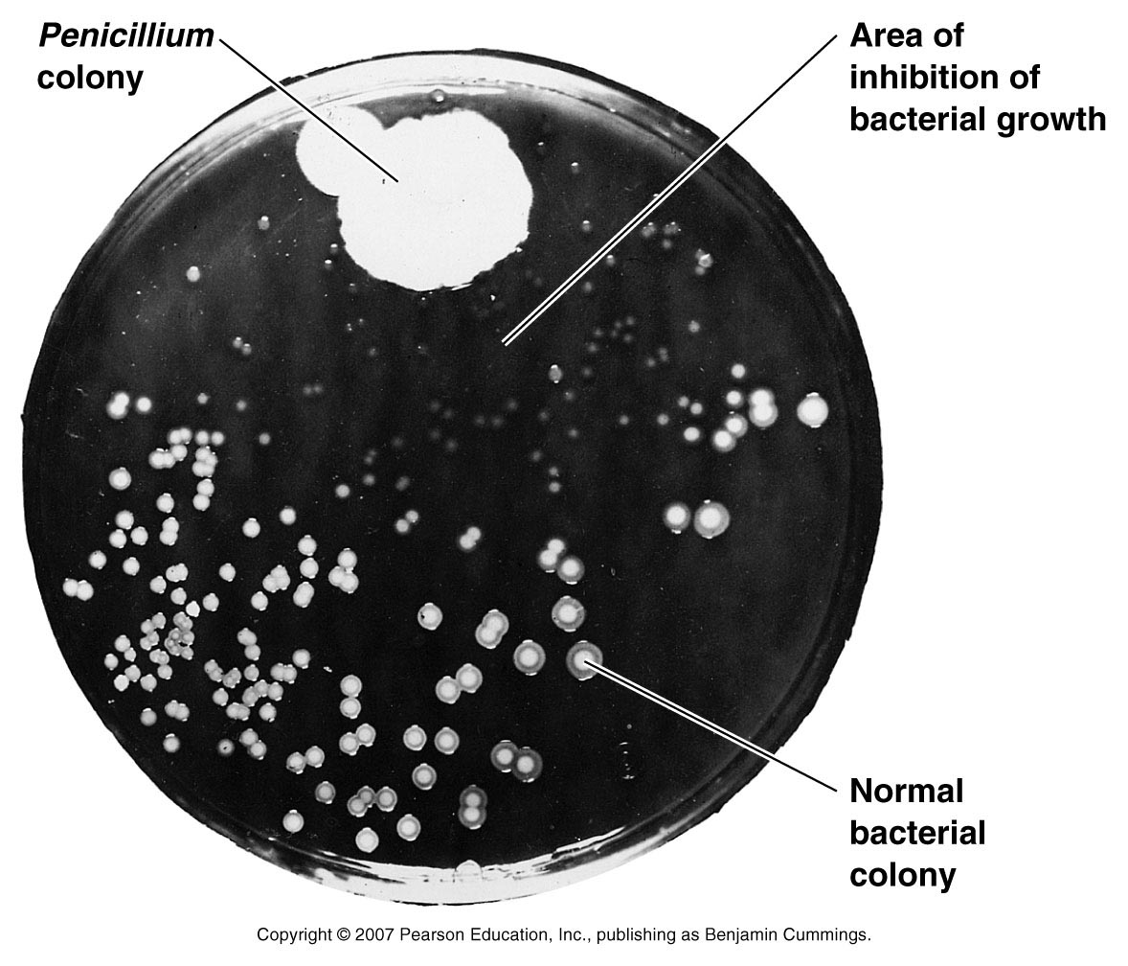
1928 Alexander Fleming
1940 Howard Florey Ernst Chain
1954 Cephalosporin C
Staphylococcus aureus
Figure 20.1

Slide 6
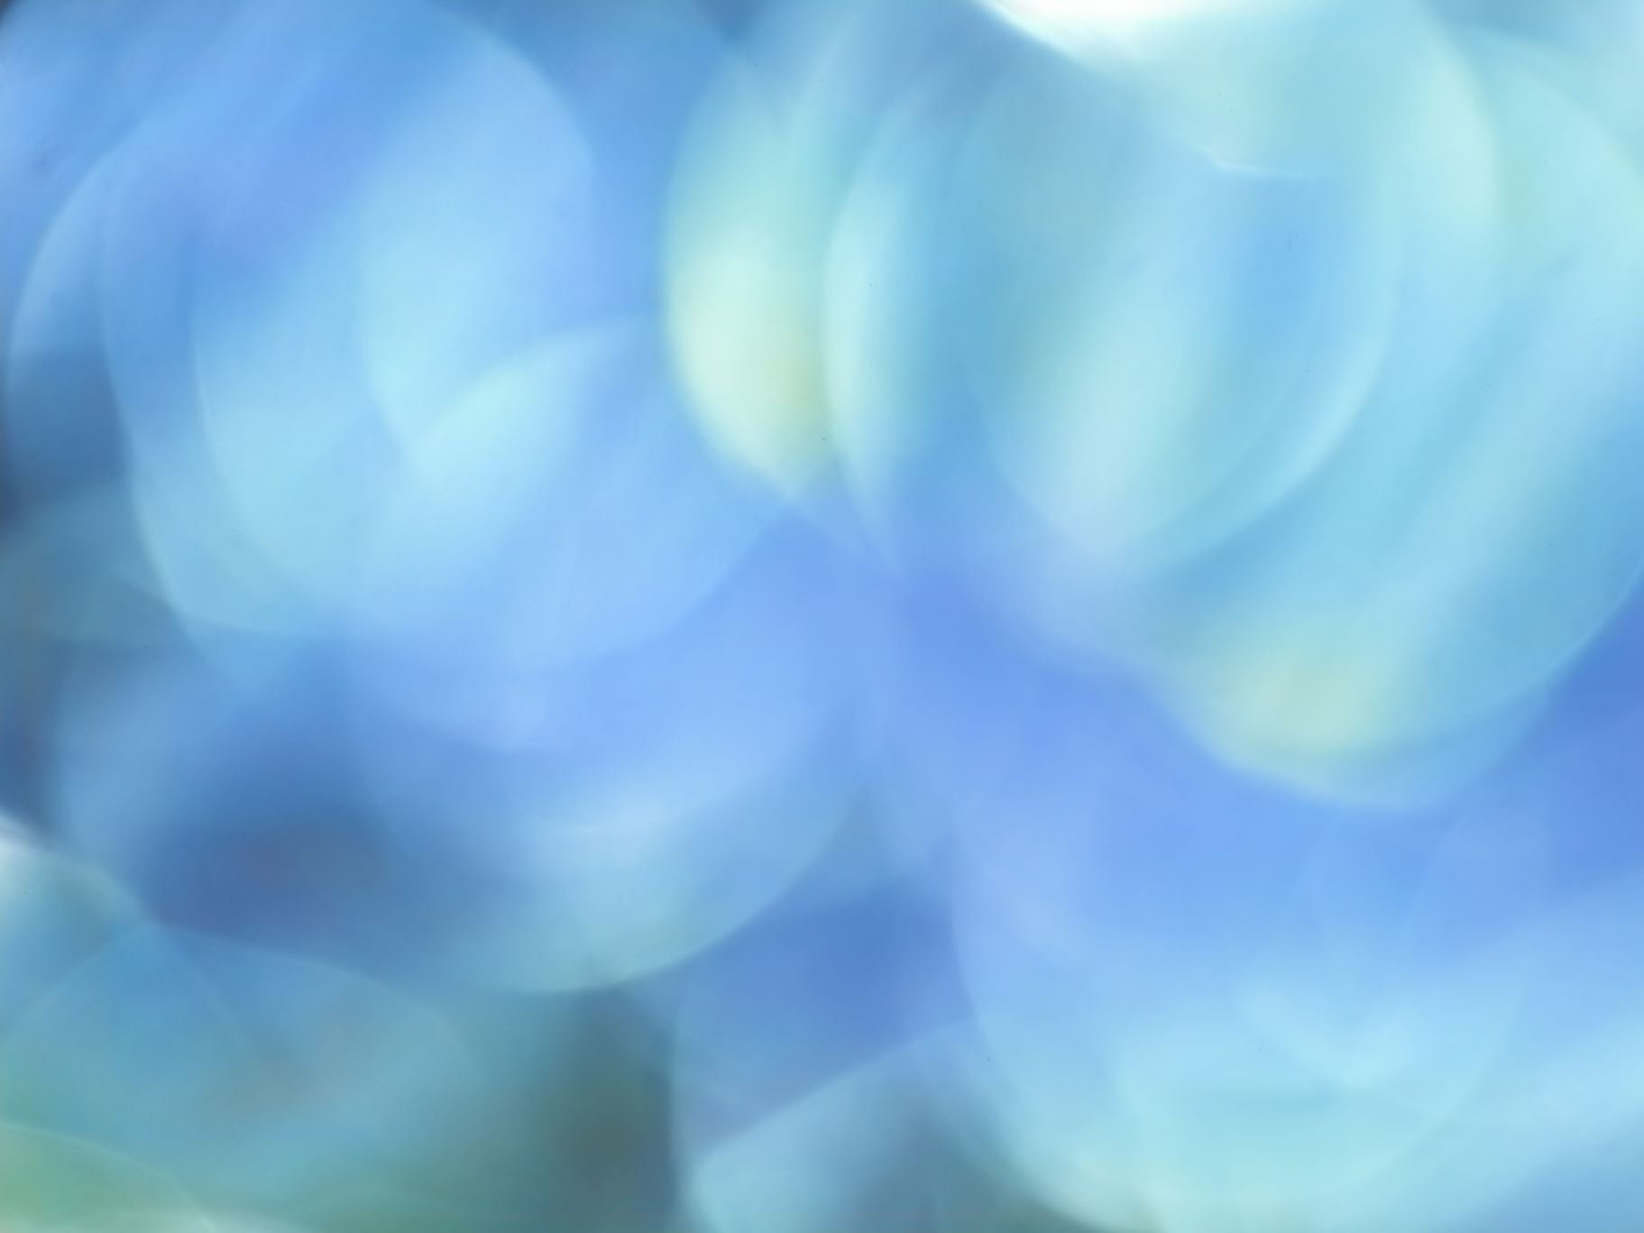
Salman Waksman, Albert Schatz
Antibiotics produced by Streptomyces filamentous bacteria
1943. Actinomycin
Streptomycin

Slide 7
Diminishing returns in finding natural products: Genetics to the rescue?

Slide 8
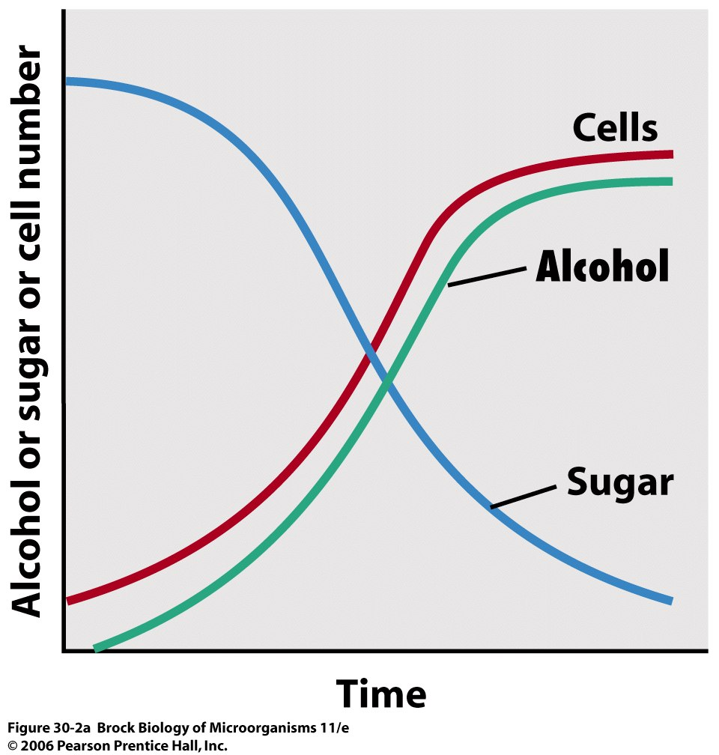
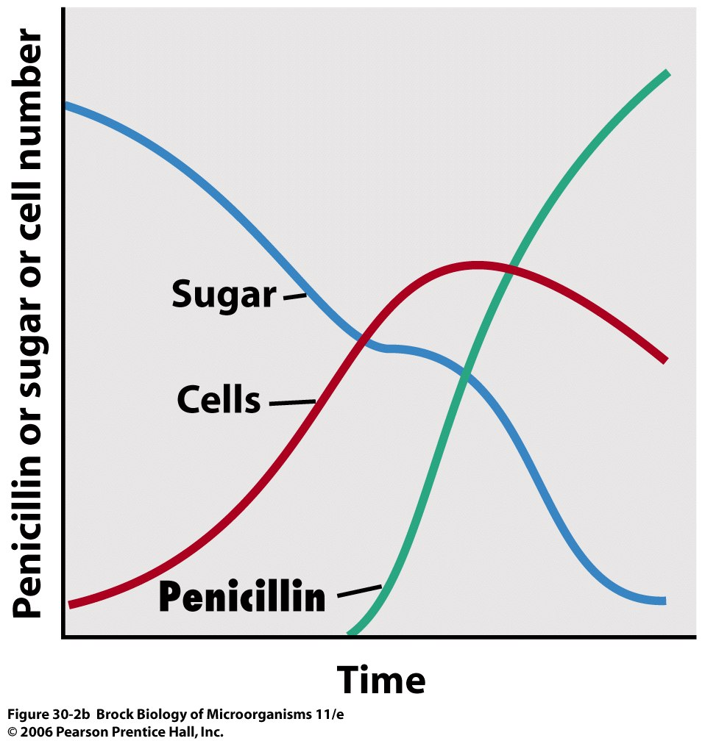
Nucleic acids, proteins
Primary and secondary metabolism

Slide 9
What are antibiotics?
Secondary metabolites synthesized by some microorganisms

Slide 10
Who are the main producers
Bacteria
Gram positive Streptomyces
Fungi
Other bacteria

Slide 11
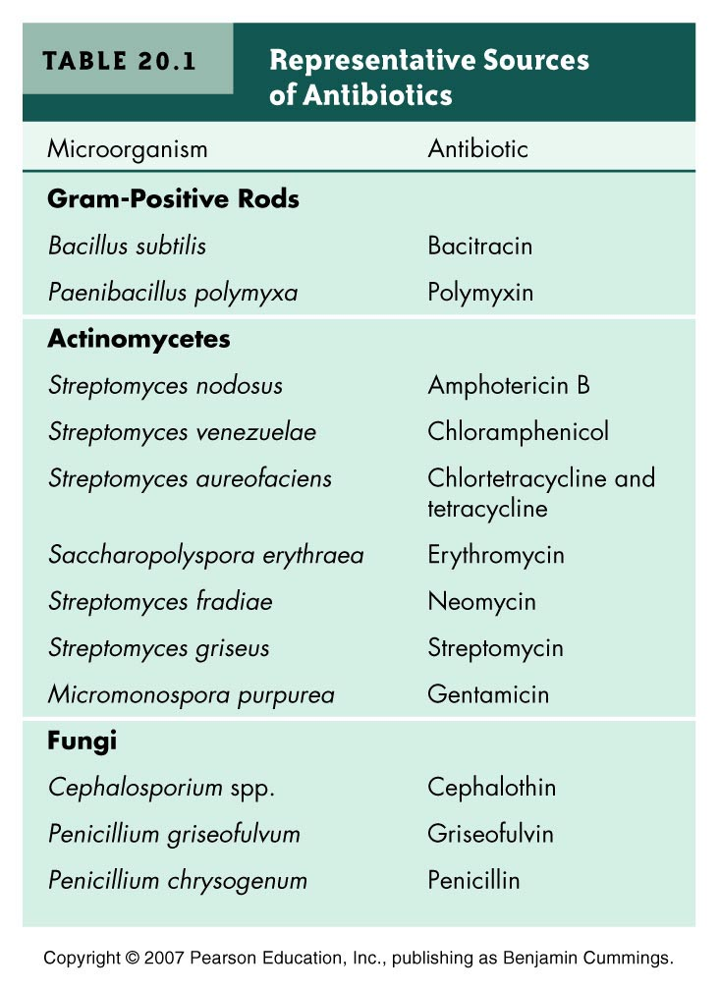
Actinobacteria
Table 20.1

Slide 12
MICROORGANISMS and BIOACTIVE COMPOUNDS
Bacteria
Fungi
1%
6%
Bacteria
Bacteria
8%
6%
Fungi
Fungi
30%
32%
Actinobacteria
Actinobacteria
Actinobacteria
93%
60%
64%
Antitumorals
Antifungals
Bioactives

Slide 13
BIOACTIVE COMPOUNDS SYNTHESIZED
BY ACTINOBACTERIA
ANTIBACTERIALS
ANTIFUNGALS
ANTIPARASITICS
Erythromycin
Tetracycline
Gentamicin
Amphotericin B
Nystatin
Avermectins
ANTITUMORALS
IMUNOSUPRESSANTS
Doxorubicin
Mitramycin
Bleomycin
Rapamycin
FK506
INSETICIDES
HERBICIDES
Espinosin
Bialaphos

Slide 14
LIFE CYCLE OF Streptomyces
Spores
Aerial
mycelium
Substrate
mycelium
Production of secondary metabolites
(antibiotics, fungicides, antitumorals,..)

Slide 15
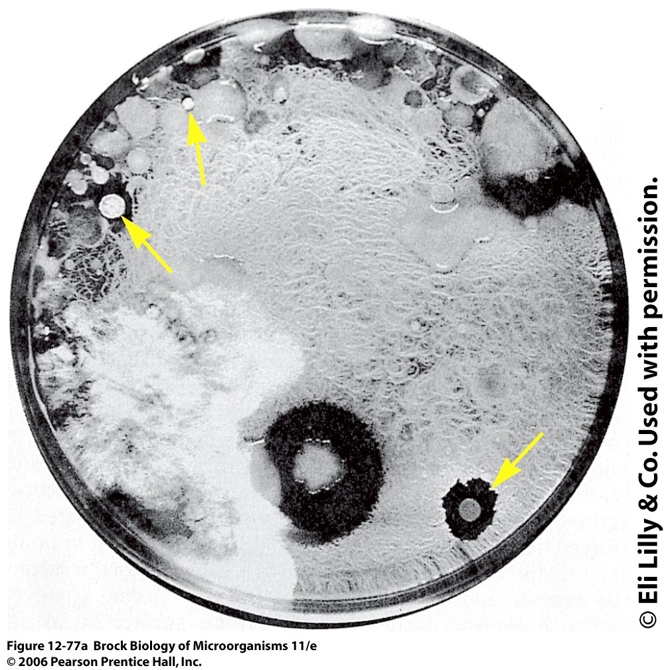
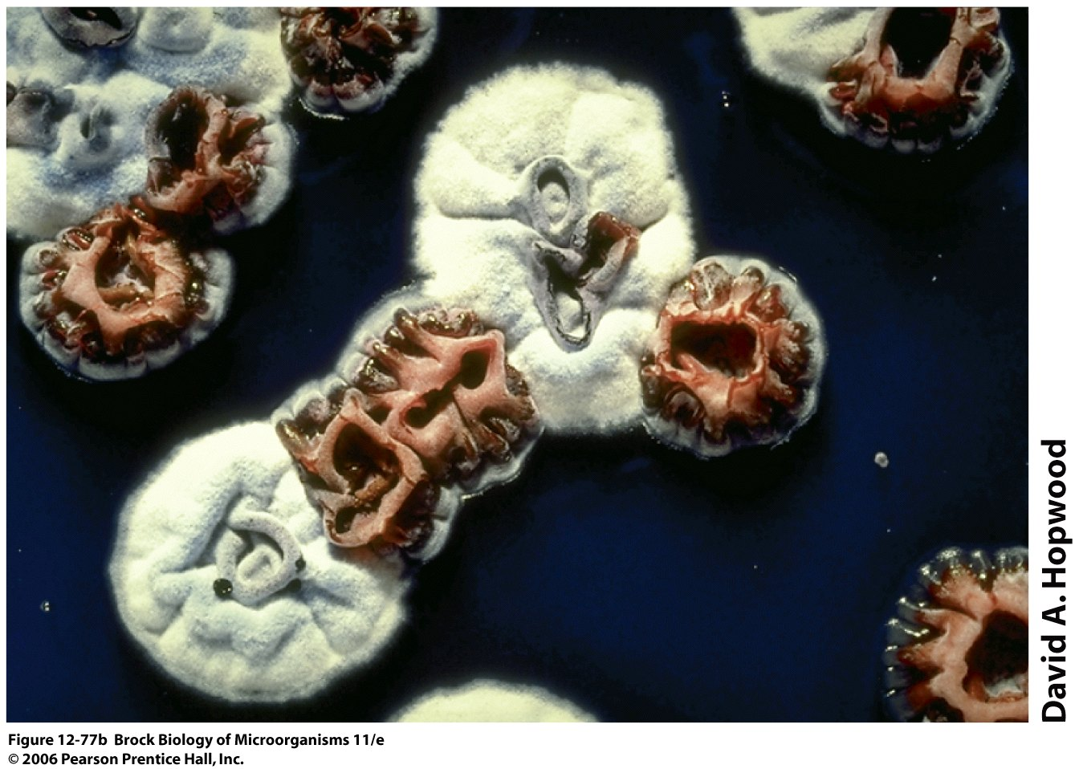
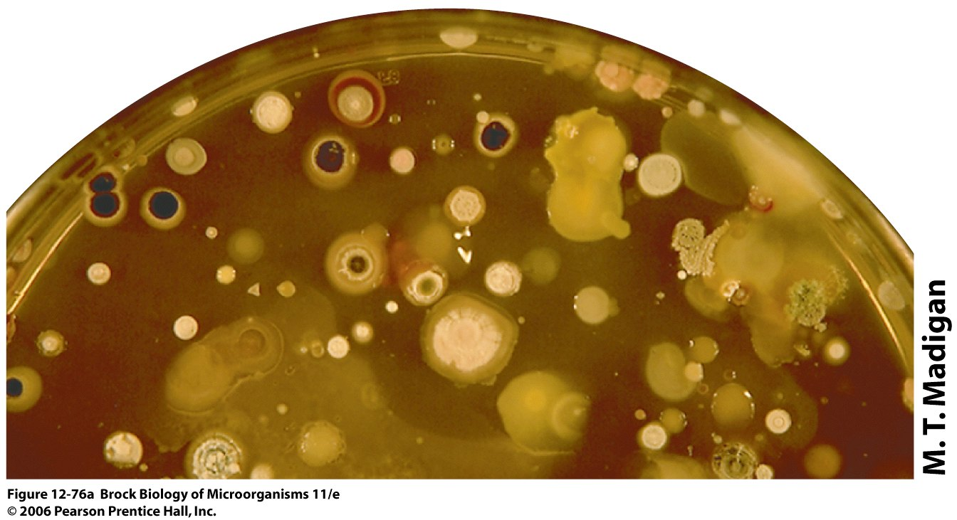
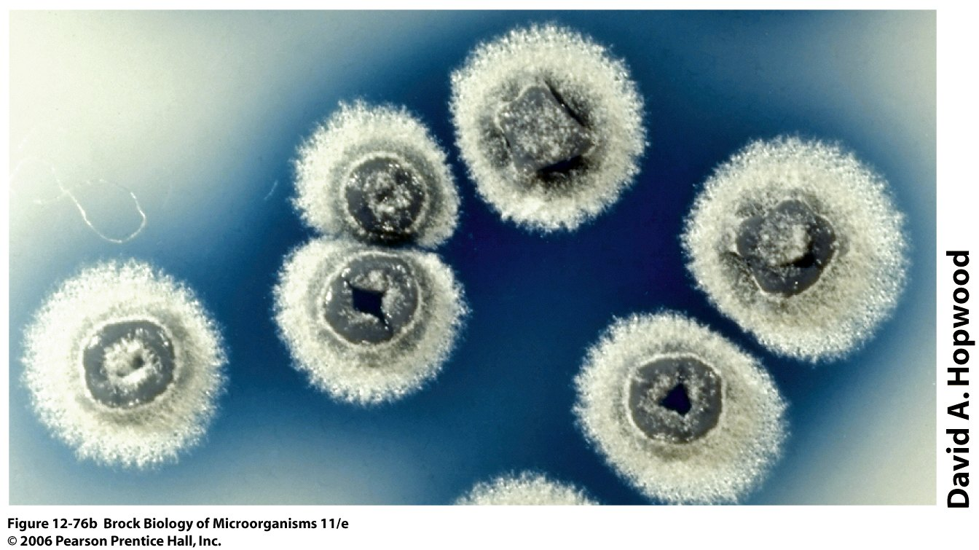

Slide 16
Biological functions of antibiotics?
In the producer:
Activators of morphological differentiation, UV protector, communication
In the target microorganism:
Toxicity

Slide 17
Antibiotic classification
- Biological Activity
- Chemical Structure
- Celular Target
- Target Organism

Slide 18
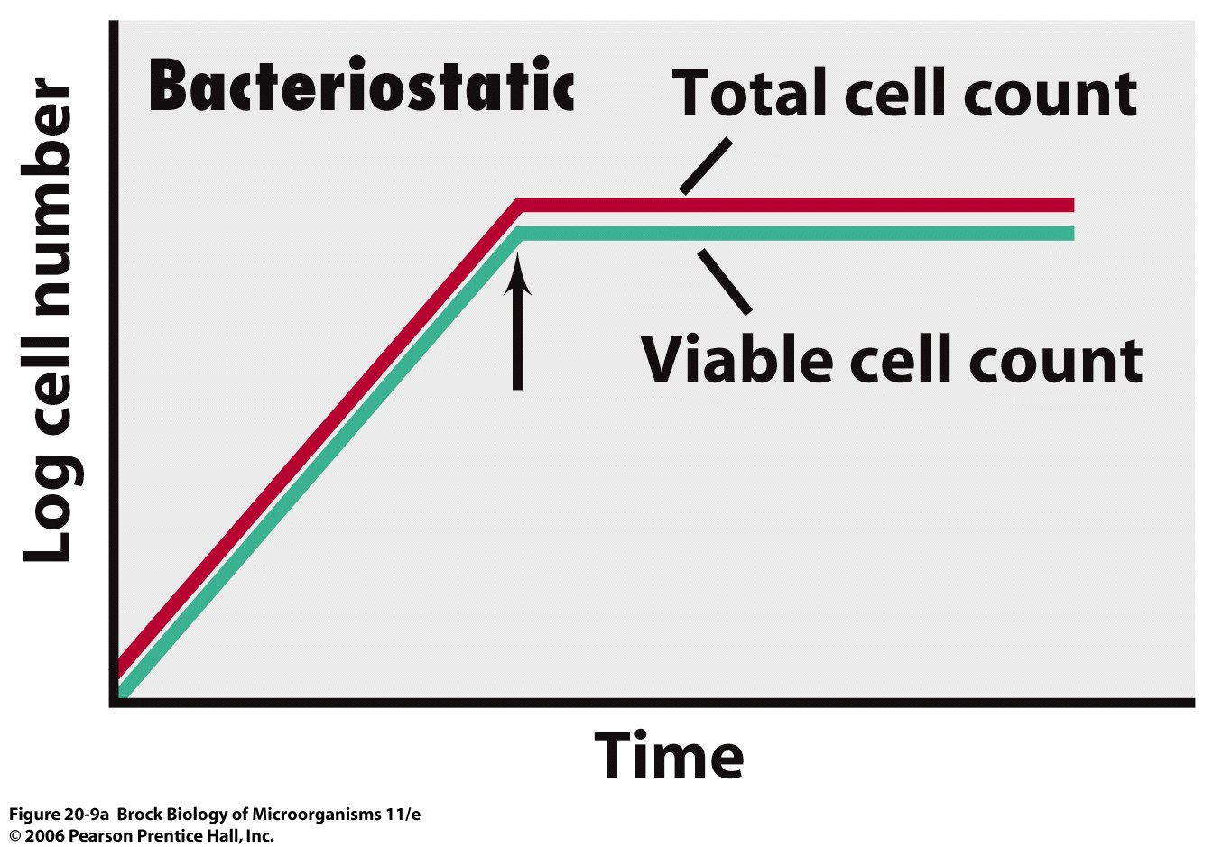

Slide 19
Total cell count
Viable cell count

Slide 20
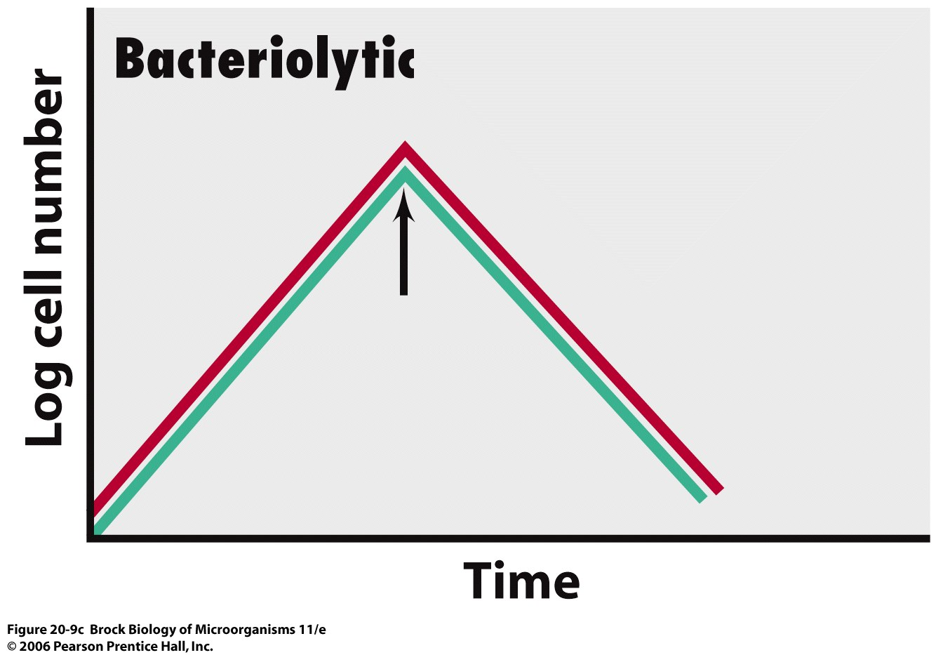
Total cell count
Viable cell count

Slide 21
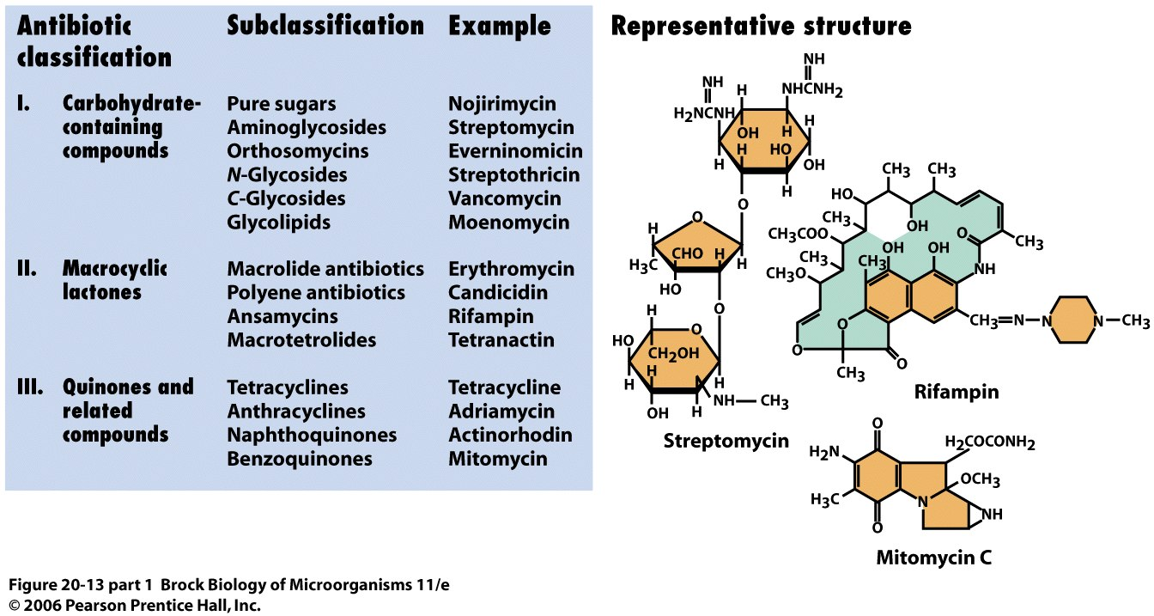

Slide 22
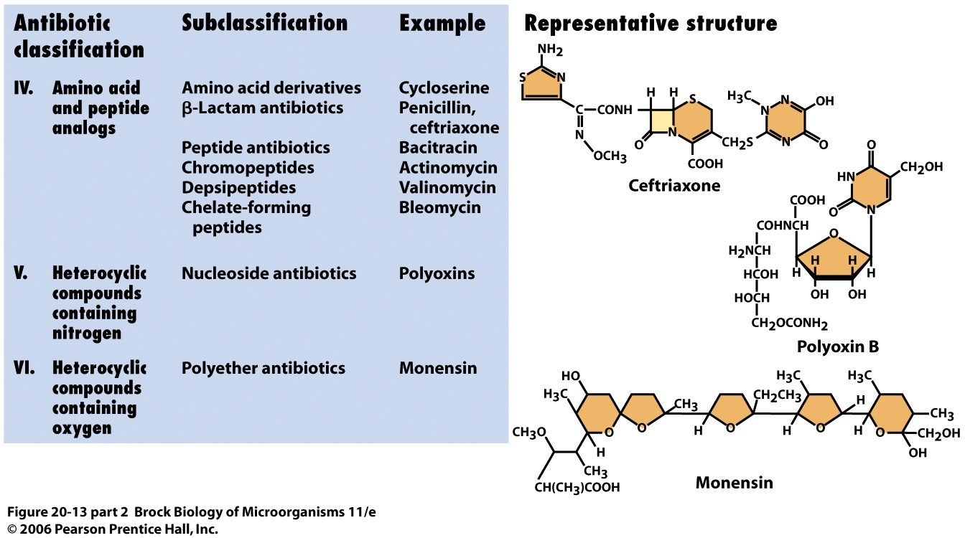

Slide 23
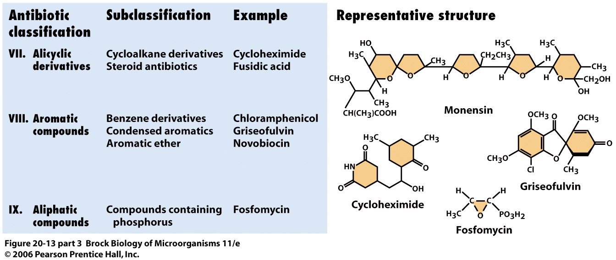

Slide 24
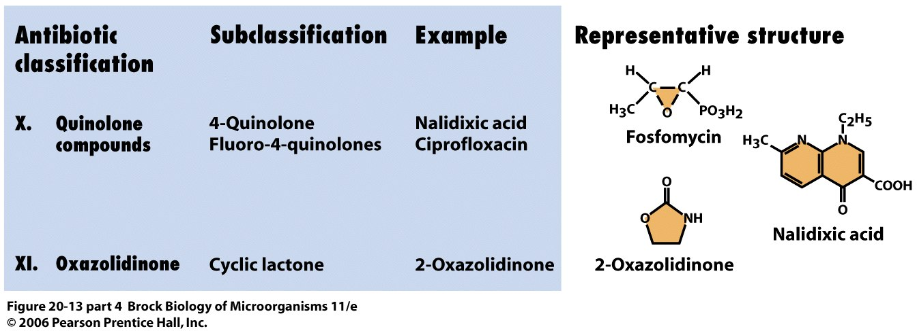

Slide 25
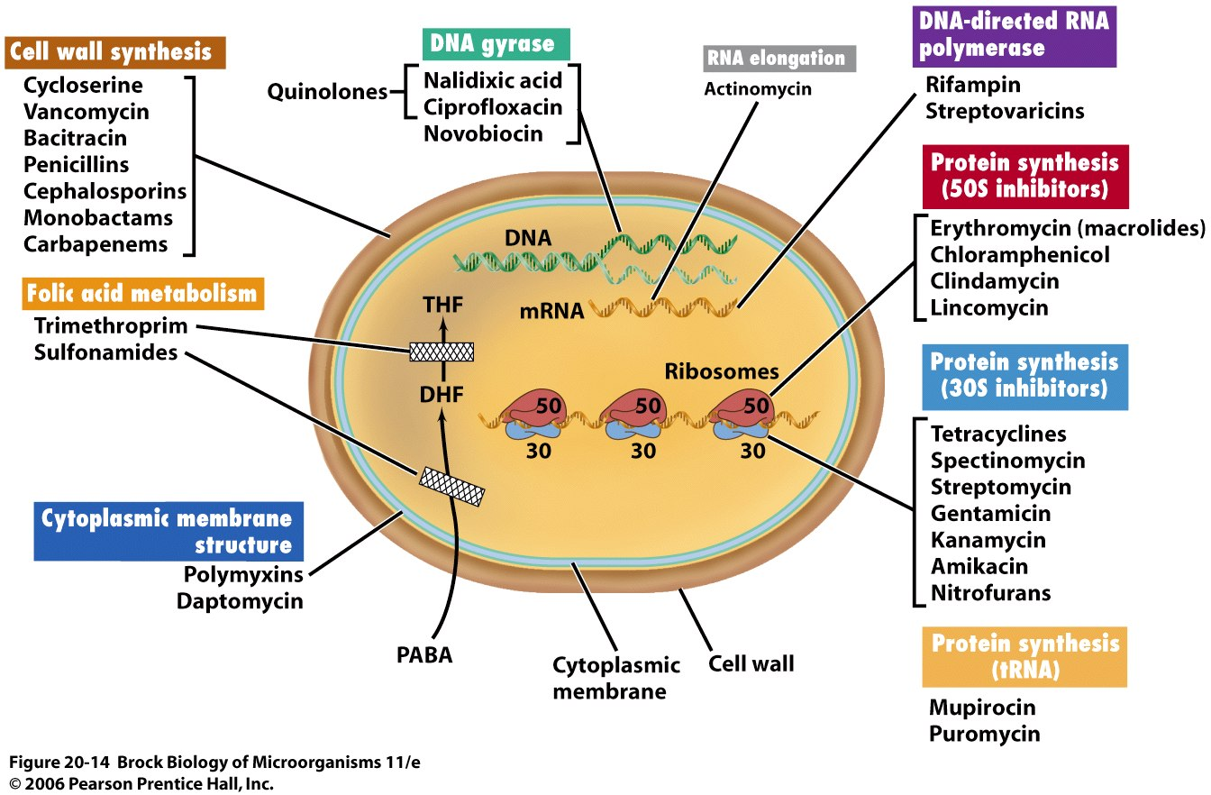

Slide 26
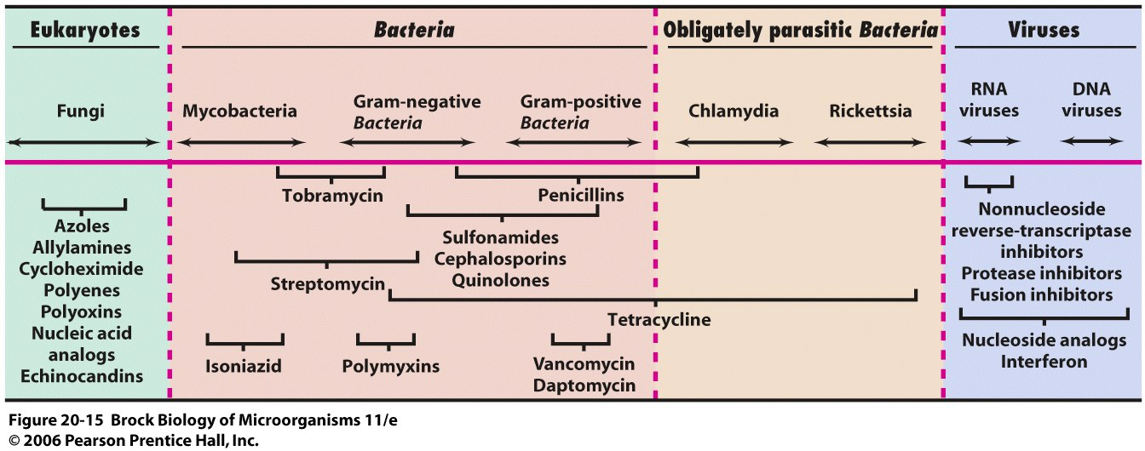

Slide 27
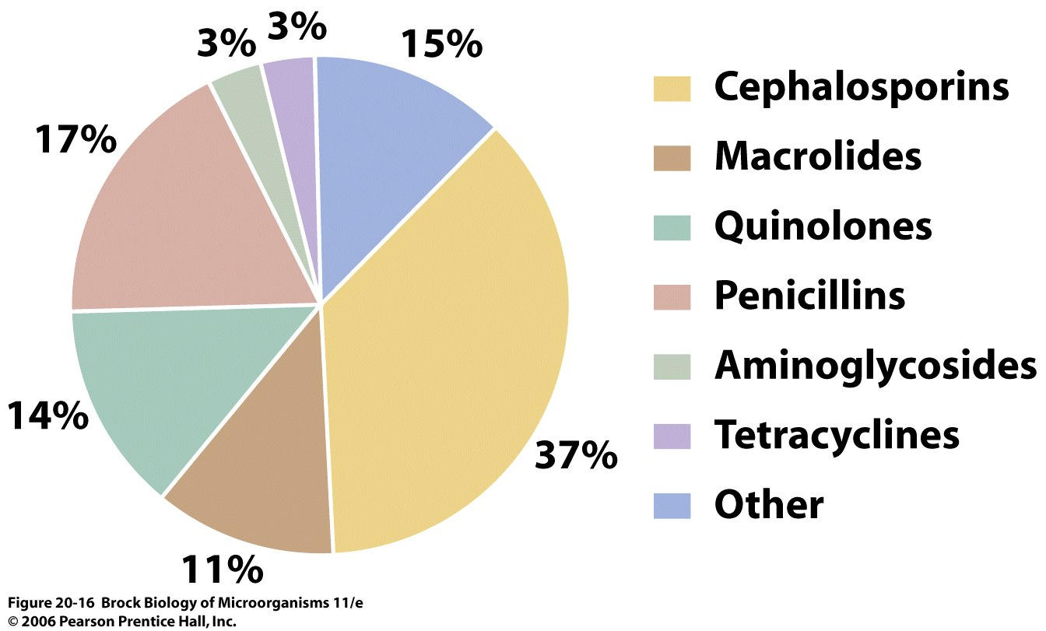

Slide 28
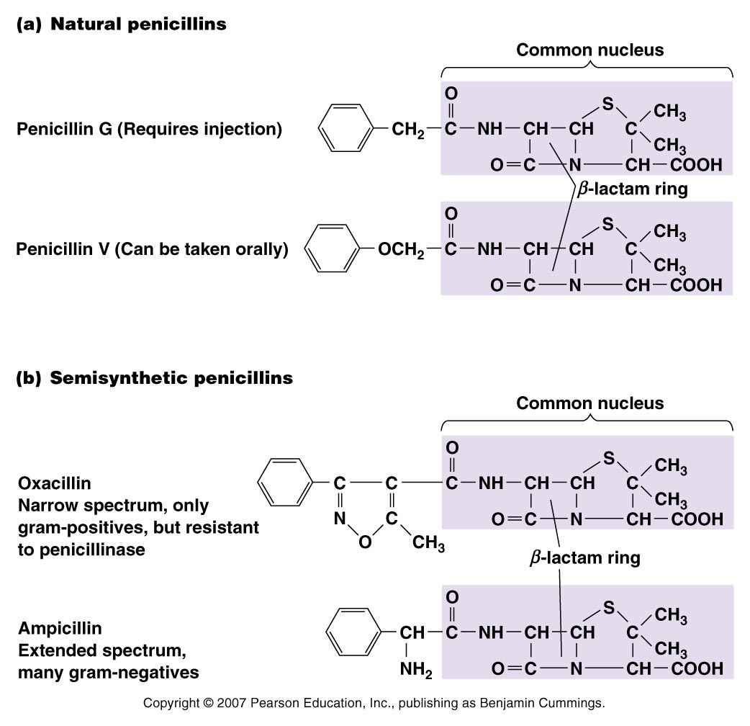
Narrow spectrum of microbial activity
Broad spectrum antibiotic
Figure 20.6 - Overview

Slide 29
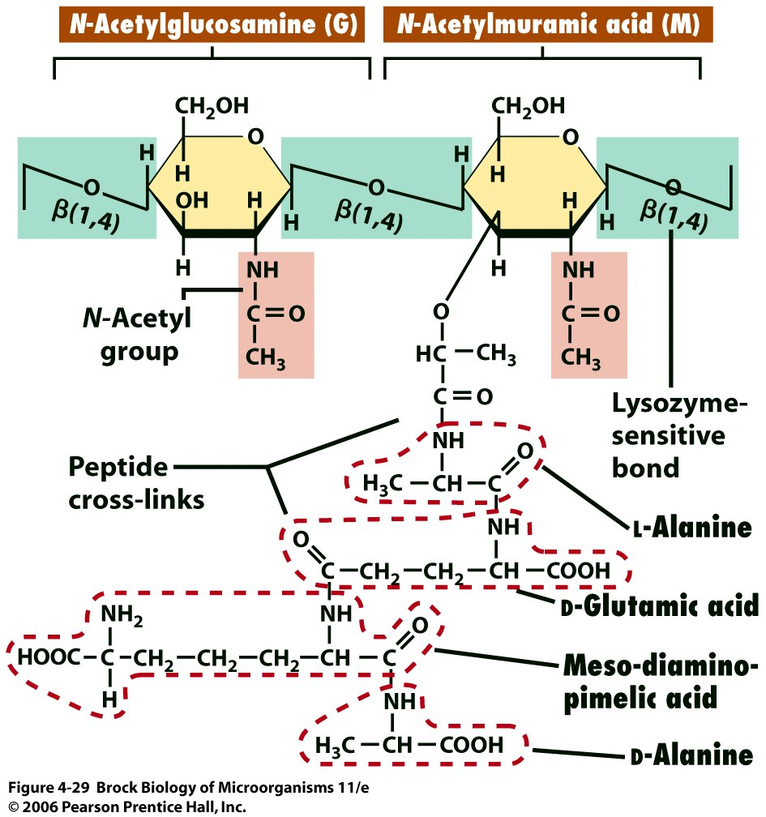
Structure of peptidoglycan
glycan tetrapeptide

Slide 30
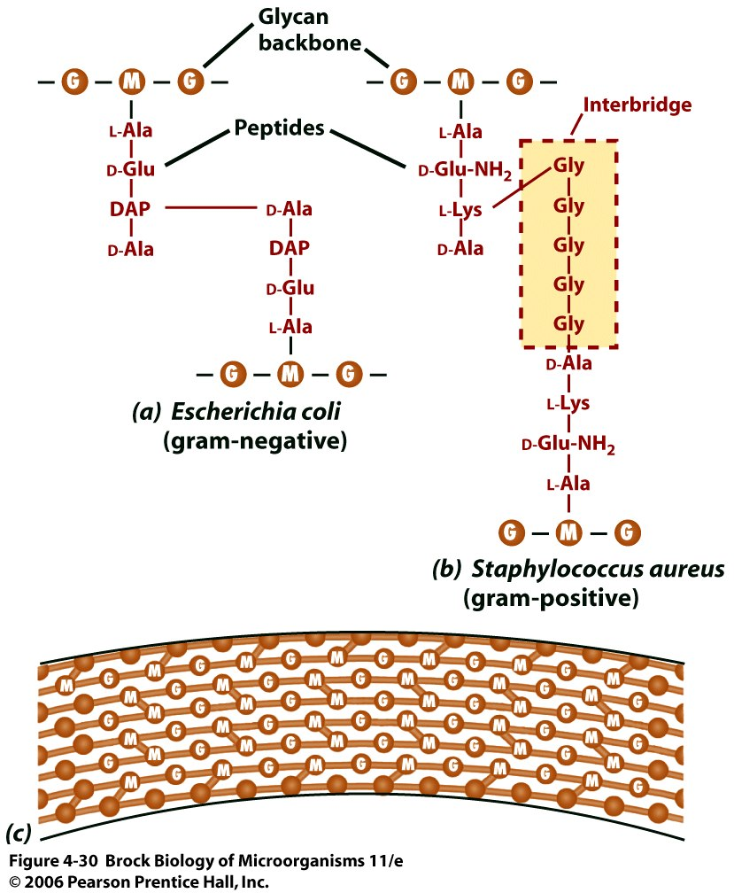
Peptidoglycan sheet in Escherichia coli and Staphylococcus aureus
Glycine interbridge in S. aureus

Slide 31
Figure 20.3a

Slide 32
Figure 20.3b

Slide 33
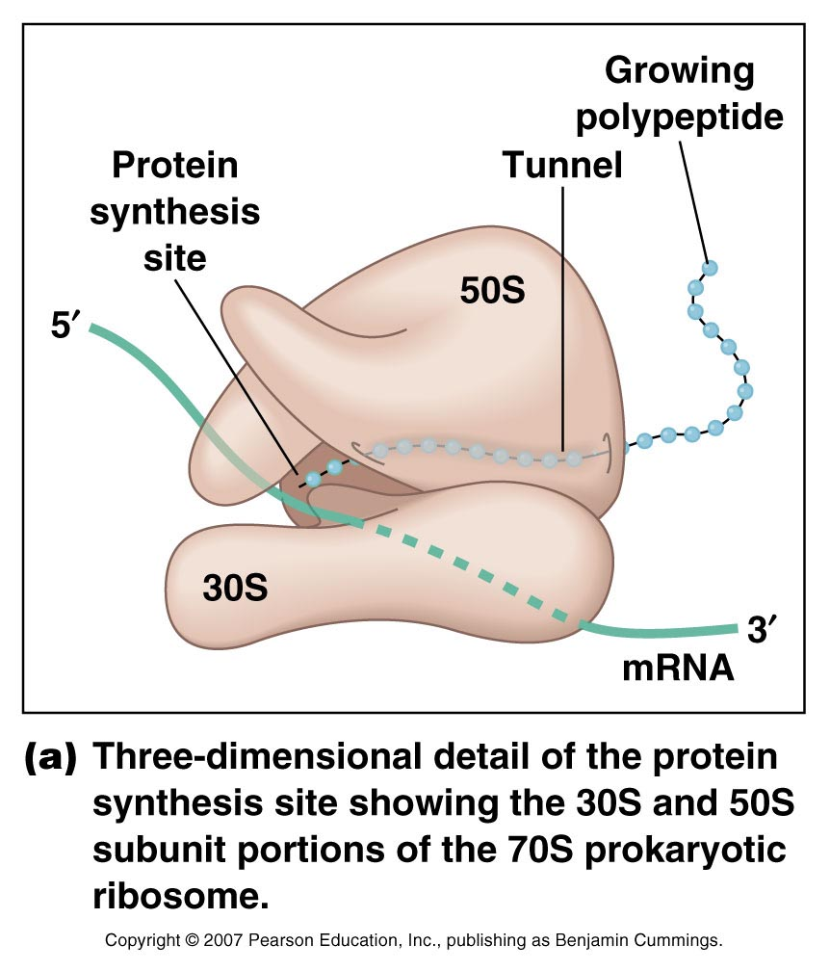
Figure 20.4a

Slide 34
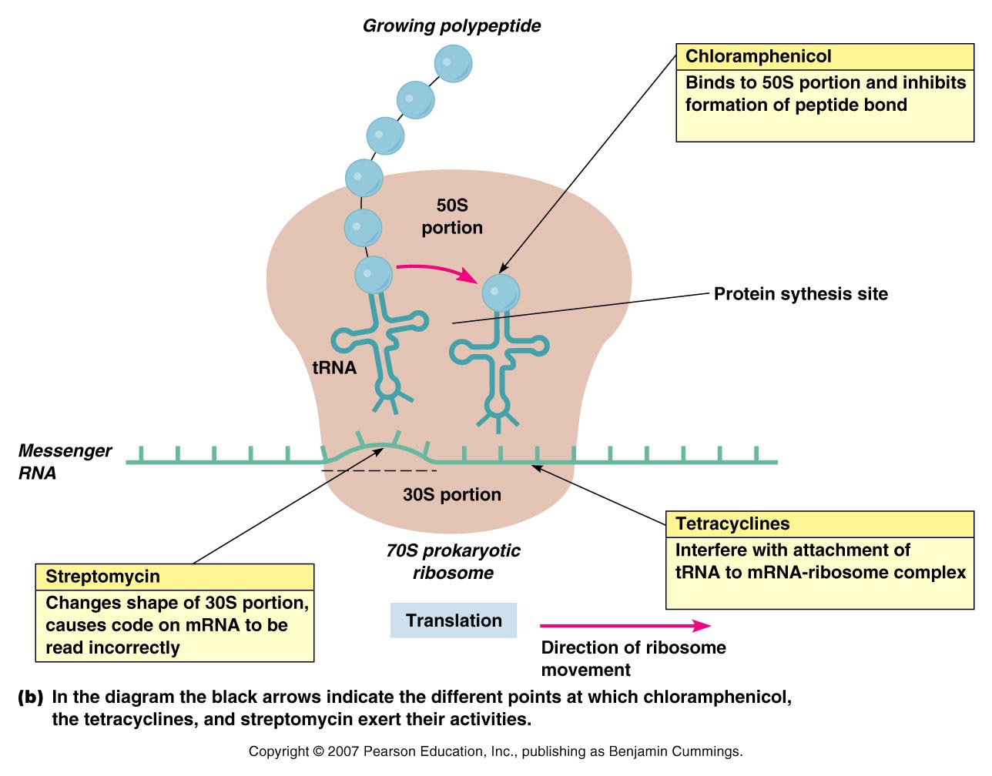
Figure 20.4b

Slide 35
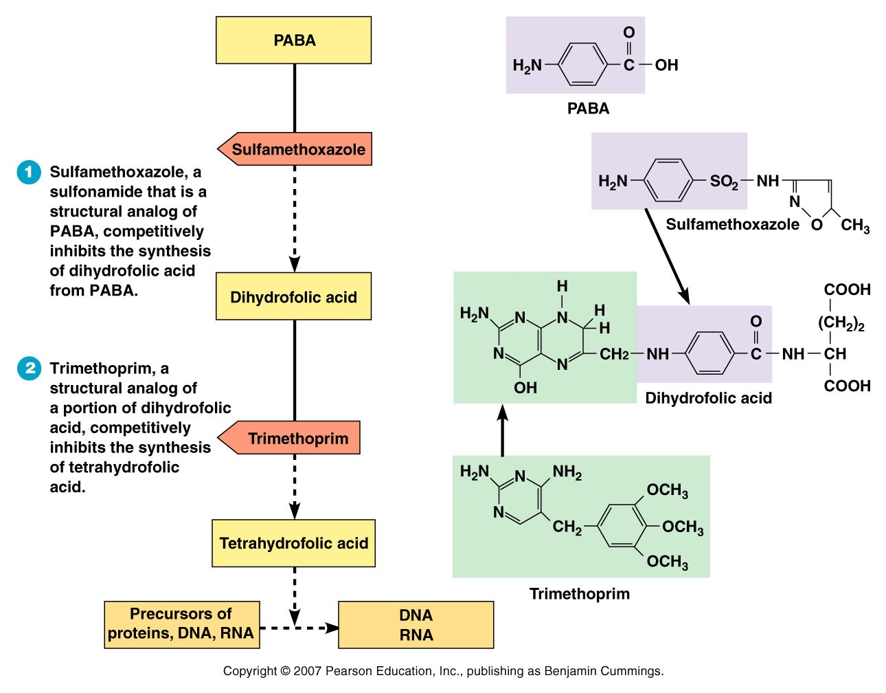
Figure 20.13 - Overview

Slide 36
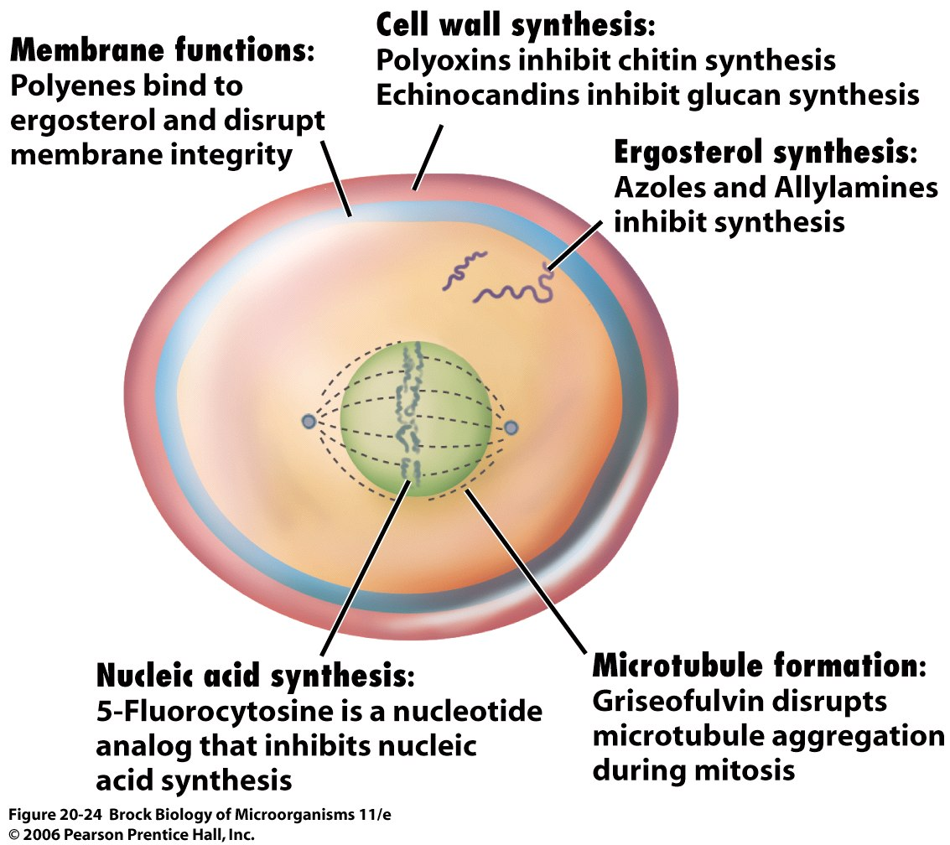

Slide 37
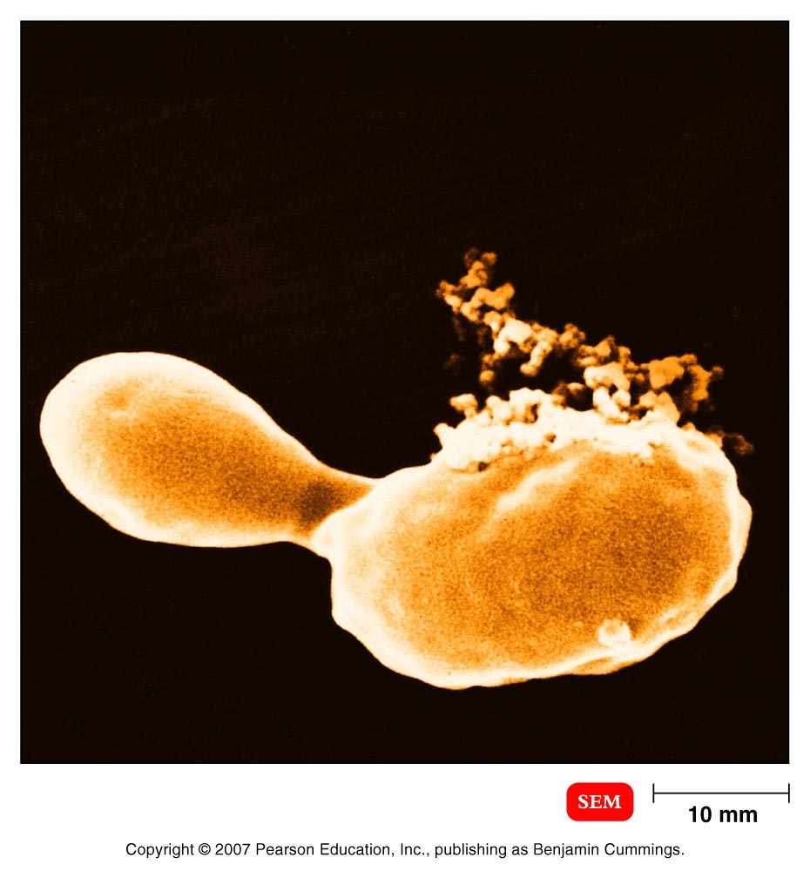
Injury of plasma membrane of a yeast caused by antifungal drug
Figure 20.5

Slide 38
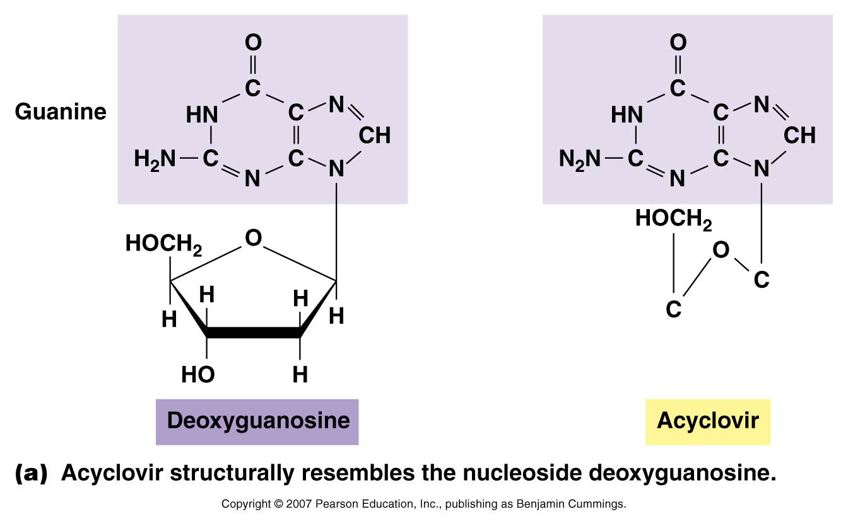
Figure 20.16a

Slide 39
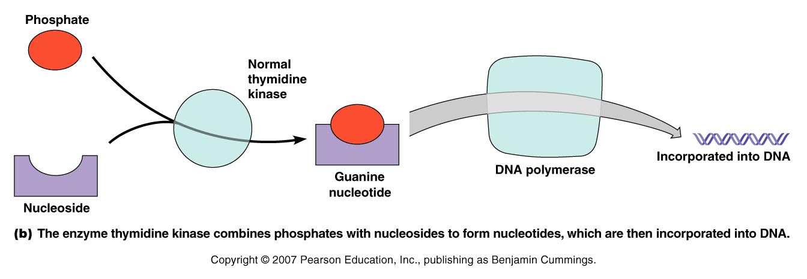
Figure 20.16b

Slide 40
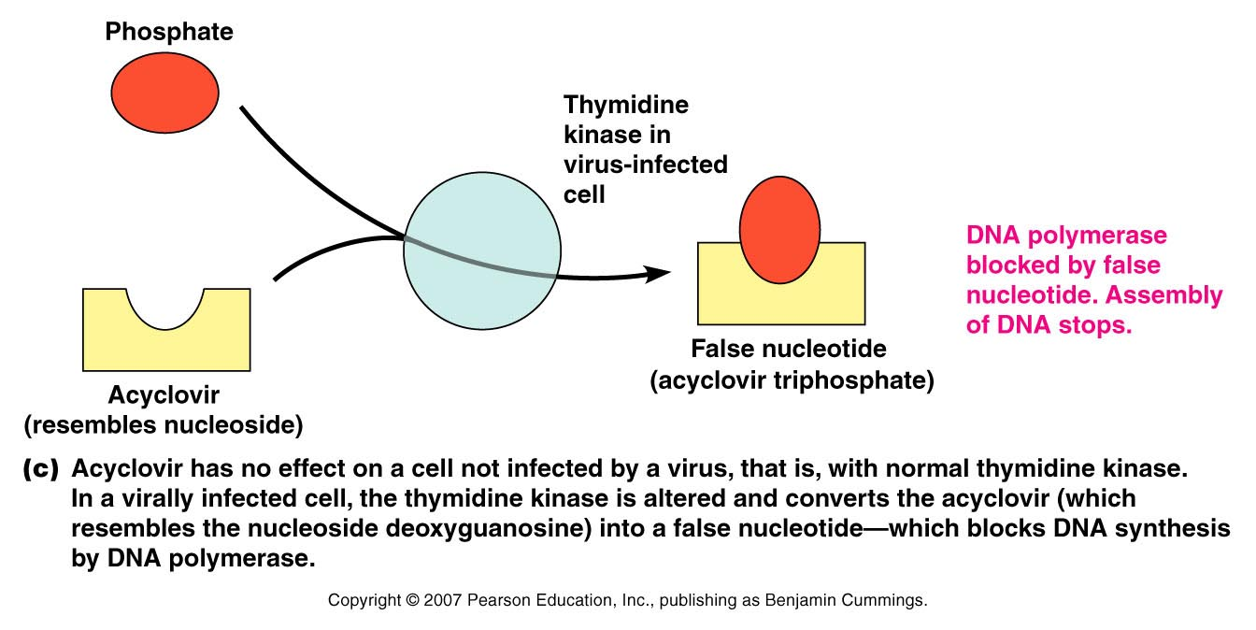
Figure 20.16c

Slide 41
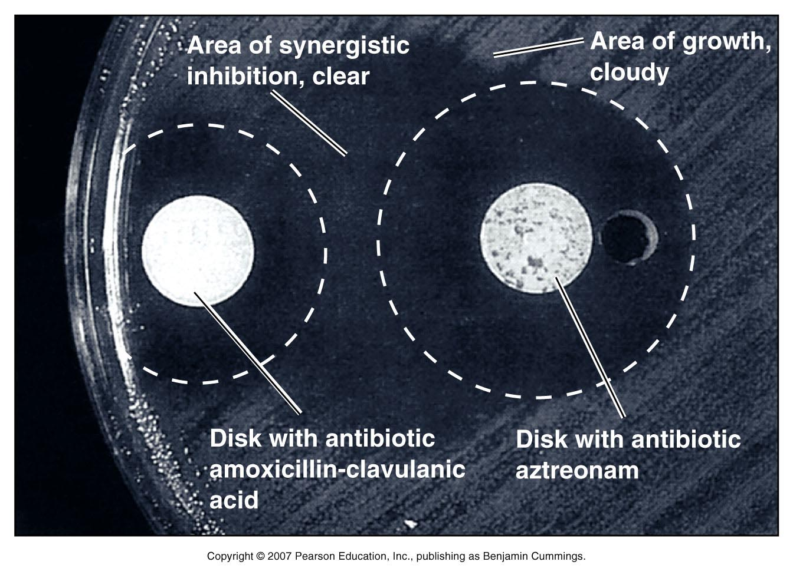
Figure 20.22

