Slide 1
Preventing Conflicts in the Brazilian Cooperation and Facilitation Investment Agreement (CFIAs)
Vivian Rocha
PhD Candidate
Legal Researcher at the Center for Global Trade and Investment Studies at Getúlio Vargas´s Foundation (CCGI-EESP/FGV)
1° BRAZIL-GERMANY INTERNATIONAL INVESTMENT LAW SEMINAR

Slide 2
BRAZIL AND THE INTERNATIONAL INVESTMENT REGIME
The Cooperation and Facilitation Investment Agreement (CFIAs)
Joint efforts of the Brazilian government and the private sector - represented by the National Industry Confederation (CNI) and State of São Paulo Industries Confederation (FIESP)
The Presence of the Private Sector – To report the main difficulties

Slide 3
DIFFICULTIES FACED BY THE BRAZILIAN INVESTORS ABROAD
Difficulties:
(1) the mitigation of speciﬁc problems,
(2) the diﬃculty of access to information about foreign countries,
(3) the need for thematic agendas, and
(4) the strengthening of institutional dialogue.
The need of a focal point to centralize all the claims from investors and help them to solve the problems in a prior stage.
Change the gravitational center of investment protection, from litigation to dispute prevention

Slide 4
Institutional Governance
One of the Pillars of the CFIAs
It represents a desire to oversee the implementation of the agreement, improve communication among the parties, and resolve complaints peacefully in order to avoid future disputes and restrict frivolous disputes.
Preventive proceedings are divided into two phases
Institutional governance => strengthen investment and prevent disputes through the creation of focal points or ombudsmen and a joint committee
Preventive proceedings are divided into two phases.

Slide 5
Focal Points or Ombudsman
The ombudsman serves as a one-stop-shop system for complaints
Institutional interlocutor for investors and an oﬃcial channel to address issues and problems at an early stage
“this is not a provision typically seen in investment agreements”
The ombudsman was inspired mainly by the South Korean Oﬃce of the Foreign Investment Ombudsman
In South Korea, the ombudsman is appointed by the president and has extensive knowledge of and experience in investment and international trade

Slide 6
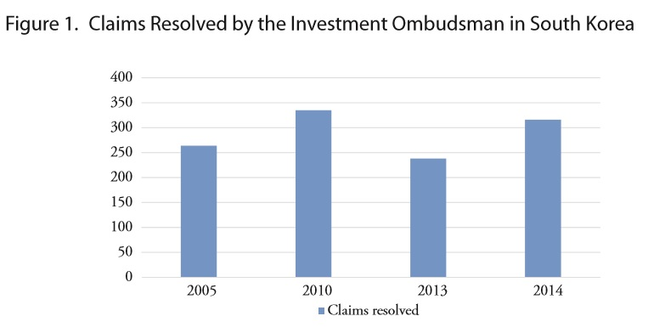
The Ombudsman on Investments in South Korea
The ombudsman has a rage of experts is various fields to collect and analyze investor´s concerns
Recommendations -> policies to improve the investment promotion and solve the concerns raised
3,748 cases were submitted to the ombudsman from 2005 to 2014 and the preventive system has achieved success in the 2,866.

Slide 7
Focal Points or Ombudsman
Each party designate a focal point or ombudsman
In Brazil -> the Foreign Chamber of Commerce (CAMEX)
The other ombudsman authority varies according to the contracting party
They act within a mandate and pre-established obligations and may propose speciﬁc actions seeking to improve the way that investments are governed

Slide 8
Focal Points or Ombudsman
“ managing inquiries and complaints and making suggestions in order to ﬁnd solutions to the issues raised, later informing stakeholders of the results of their suggestions;”
“ preventing or mitigating disputes and facilitating their resolution in coordination with government authorities and in cooperation with private entities;
“ providing timely and useful information to parties;

Slide 9
Focal Points or Ombudsman
The ombudsman promotes negotiations between the parties, taking the interests of both into account
It makes suggestions to resolve the problem and can contribute effectively to avoiding that complaints raised by foreign investors escalate into international arbitration
Criticisms:
The limitation that only governments and investors can make complaints to the agency
Proposal: To expand the range of stakeholders to the local community and civil society, taking into account the social impacts of these investments

Slide 10
Joint Committee
If the preventive approach of the ombudsman or focal points is unsuccessful, the issue will be sent to the joint committee
BITs and free trade agreements (FTAs) have already established a joint committee – US-Korea; CETA; Asian Countries – Cambodia, China, South Korea, Japan, etc.
The joint committee aims to administer and manage the agreements, advising on trade relations between parties and settle any controversies on investments amicably.
The committee consists of government representatives from both states. Parties are appointed by their respective governments, meetings are intended to occur periodically (at least once a year).

Slide 11
Joint Committee
It is not yet clear how this procedure will take place
Preventive mechanism that seeks a negotiated solution, taking into account the interest of the parties
Basic Idea:
the investor must persuade its state of origin to embrace the claim
The party must submit the request in writing
The bilateral dialogue and consultation between the Parties will take place

Slide 12
Joint Committee
* Just government representatives will discuss and review the implementation and operation of the treaty and promote the prevention of disputes to avoid progressing to future disputes.
Peculiarity: the CFIAs also state that parties may establish working groups to deal with relevant issues concerning the investments
The private sector may be invited to join these groups
Example. CFIA with Angola - article 4, paragraph 7, allows the joint committee to invite NGOs on certain issues.

Slide 13
Joint Committee
Criticism:
The investor cannot make claims directly at this stage
The representatives are able to attend the meeting, but the investor has no right to access the committee
CFIA with Colombia: adds the task of analyzing when Parties not backed by public interest or social interests, adopts a measure that has a serious economic impact on a foreign investment

Slide 14
Final Remarks
Both the Joint Committee and the Ombudsman were created with the purpose of providing greater support to Brazilian investors abroad and to foreign investors in Brazil
The real motivation of these frameworks is to avoid the opening of frivolous disputes, which could be dissuaded at an early stage, more quickly and less costly
More support to the investors of each Party of the agreement
But, if this institutional framework fails to promote agreement between the legitimized parties, there remains the option for state-state arbitration.

Slide 15
Thank you very much!
Contact: vivian.d.rocha@usp.br

