Slide 1
Anticorpos: Estrutura e Função
Antígenos
Reações entre Antígenos e Anticorpos
Aplicações
Profa. Isabel Santos
imsantos@fmrp.usp.br
r. 153267

Slide 2
A Natureza dos Anticorpos
Pesquisadores injetavam coelhos com diferentes antígenos
proteínas solúveis, bactérias, hemácias heterólogas....
Obtinham:
Precipitinas
Lisinas
Aglutininas
Opsoninas
Perguntas
Estruturas diferentes para
cada função?
X
Teoria Unitária?

Slide 3
Desenvolvimento do Modelo da Imunoglobulina de Quatro Cadeias
Rodney Porter tratou anticorpos com a enzima papaína e obteve três fragmentos, dois dos quais se ligavam a antígenos, cada um contendo um único sítio de ligação, e o outro fragmento se cristalizou
George Edelman tratou anticorpos com agente redutor que quebra pontes de dissulfeto e obteve indícios de que os anticorpos continham ao menos dois tipos de cadeia
Nisonoff tratou tratou anticorpos com a enzima pepsina e obteve um fragmento com dois sítios de ligação com antígenos e vários peptídeos pequenos

Slide 4
Proteolytic fragments of an IgG molecule
Unraveling structure and function

Slide 5
Structure of an antibody molecule.

Slide 6
The hinge region of the immunoglobulin molecule allows flexibility in binding to multiple antigens.
Adiante: Classes e subclasses de Igs

Slide 7
immunoglobulin-like domains: present in many proteins of the immune system (KIRs of NK cells; involved in cell–cell recognition and adhesion. Together with the immunoglobulins and the T-cell receptors, these proteins make up the extensive immunoglobulin superfamily

Slide 8
O sítio de ligação com antígenos

Slide 9
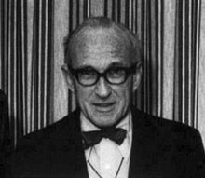
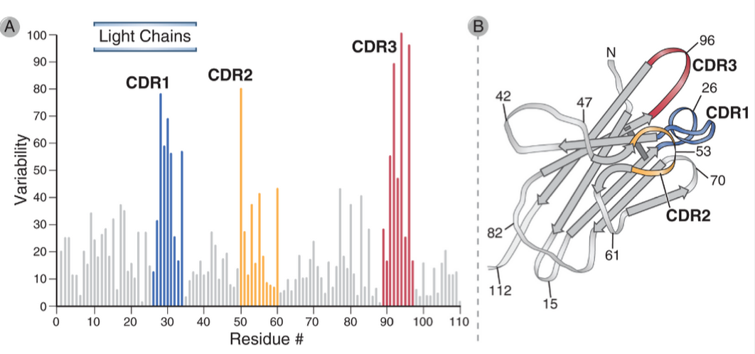
The interaction of the antibody molecule with specific antigen.
Hypervariable regions in Ig molecules
Wu-Kabat Plots

Slide 10
The hypervariable regions lie in discrete loops of the folded structure.

Slide 11
Binding of an antigen by an antibody
Structure of an Ig domain

Slide 12
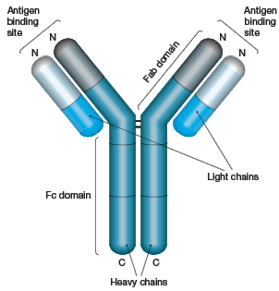
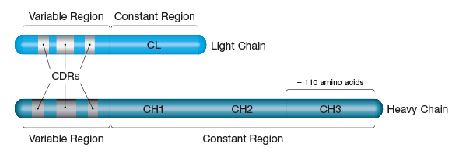
The constant region confers functional specialization on the antibody.

Slide 13
Human Antibody Isotypes

Slide 15
Human Antibody Isotypes

Slide 16
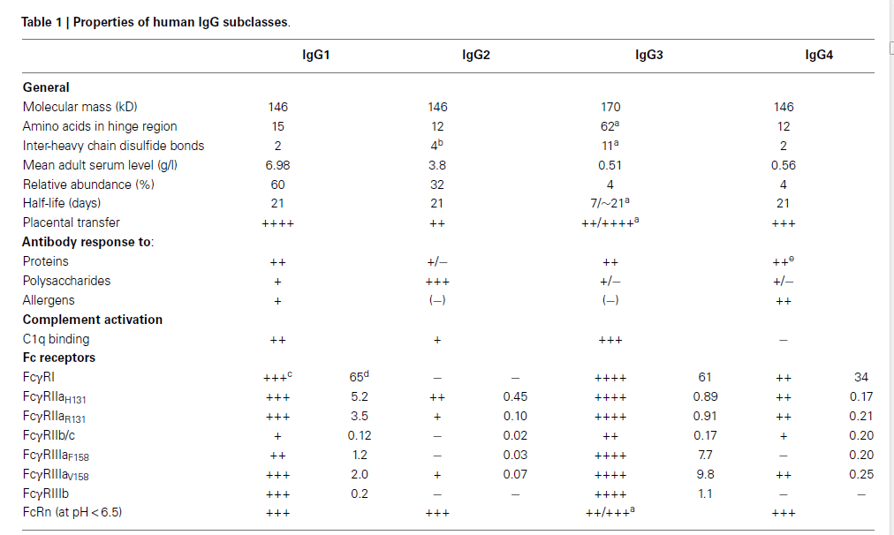
*
ªDepends onallotype.
^{b}ForA/Aisomer.
^{c}Multivalent binding to transfected cells. Adapted from Bruhnsetal.(2).
^{d}Association constant (X 10⁶ M⁻¹) for monovalent binding (2).
^{e}After repeated encounters with protein antigens, often allergens.

Slide 18
IgG facts and figures
Heavy chains: γ 1 γ 2 γ3 γ4 - Gamma 1 - 4
Half-life: IgG1 21 - 24 days IgG2 21 - 24 days IgG3 7 - 8 days IgG4 21 - 24 days
Serum level (mgml⁻¹): IgG1 5 - 12 IgG2 2 - 6 IgG3 0.5 - 1 IgG4 0.2 - 1
% of Ig in serum: IgG1 45 - 53 IgG2 11 - 15 IgG3 3 - 6 IgG4 1 - 4
Complement activation: IgG1 +++ IgG2 + IgG3 ++++ IgG4 No
Interactions with cells: All subclasses via IgG receptors on macrophages and phagocytes
Transplacental transfer: IgG1 ++ IgG2 + IgG3 ++ IgG4 ++

Slide 19
FcRn contributes to the long half-life of IgG molecules

Slide 20
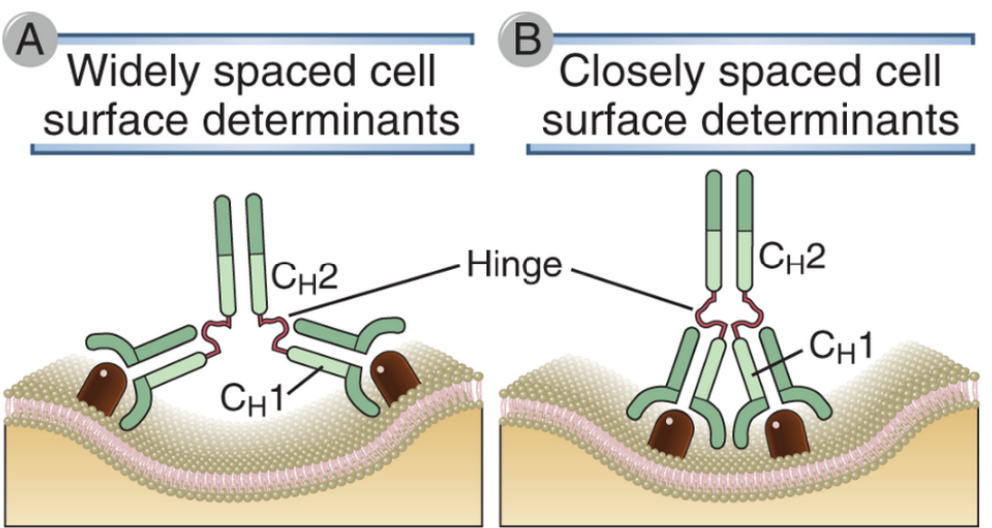
Flexibility of antibody molecules

Slide 21
Membrane and secreted forms of Ig heavy chains

Slide 22
Idiotype network: a form of immunoregulation?

Slide 23
Antibodies bind to conformational shapes on the surfaces of antigens using a variety of noncovalent forces.

Slide 24
Antigens can bind in pockets, or grooves, or on extended surfaces in the binding sites of antibodies.

Slide 25
The nature of antigenic determinants

Slide 26
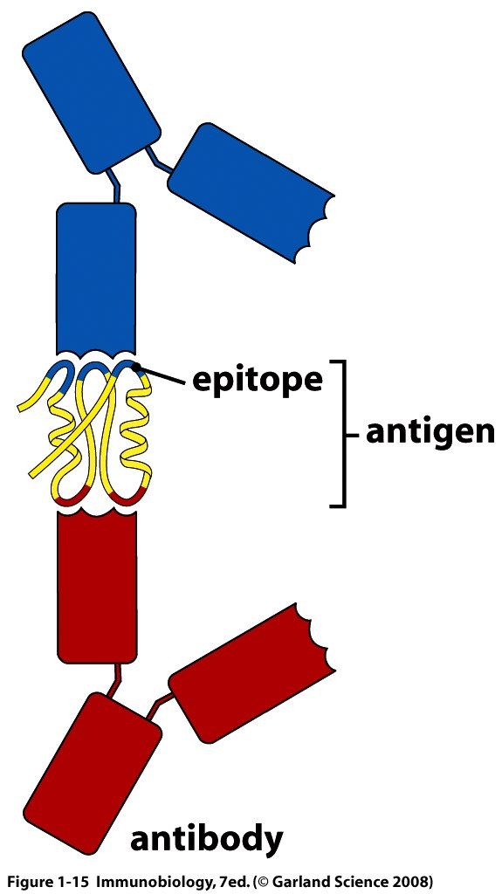

Slide 27
The dose of antigen used in an initial immunization affects the primary and the secondary antibody response.
Antibodies can be elicited by small chemical groups called haptens only when the hapten is linked to an immunogenic protein carrier.

Slide 28
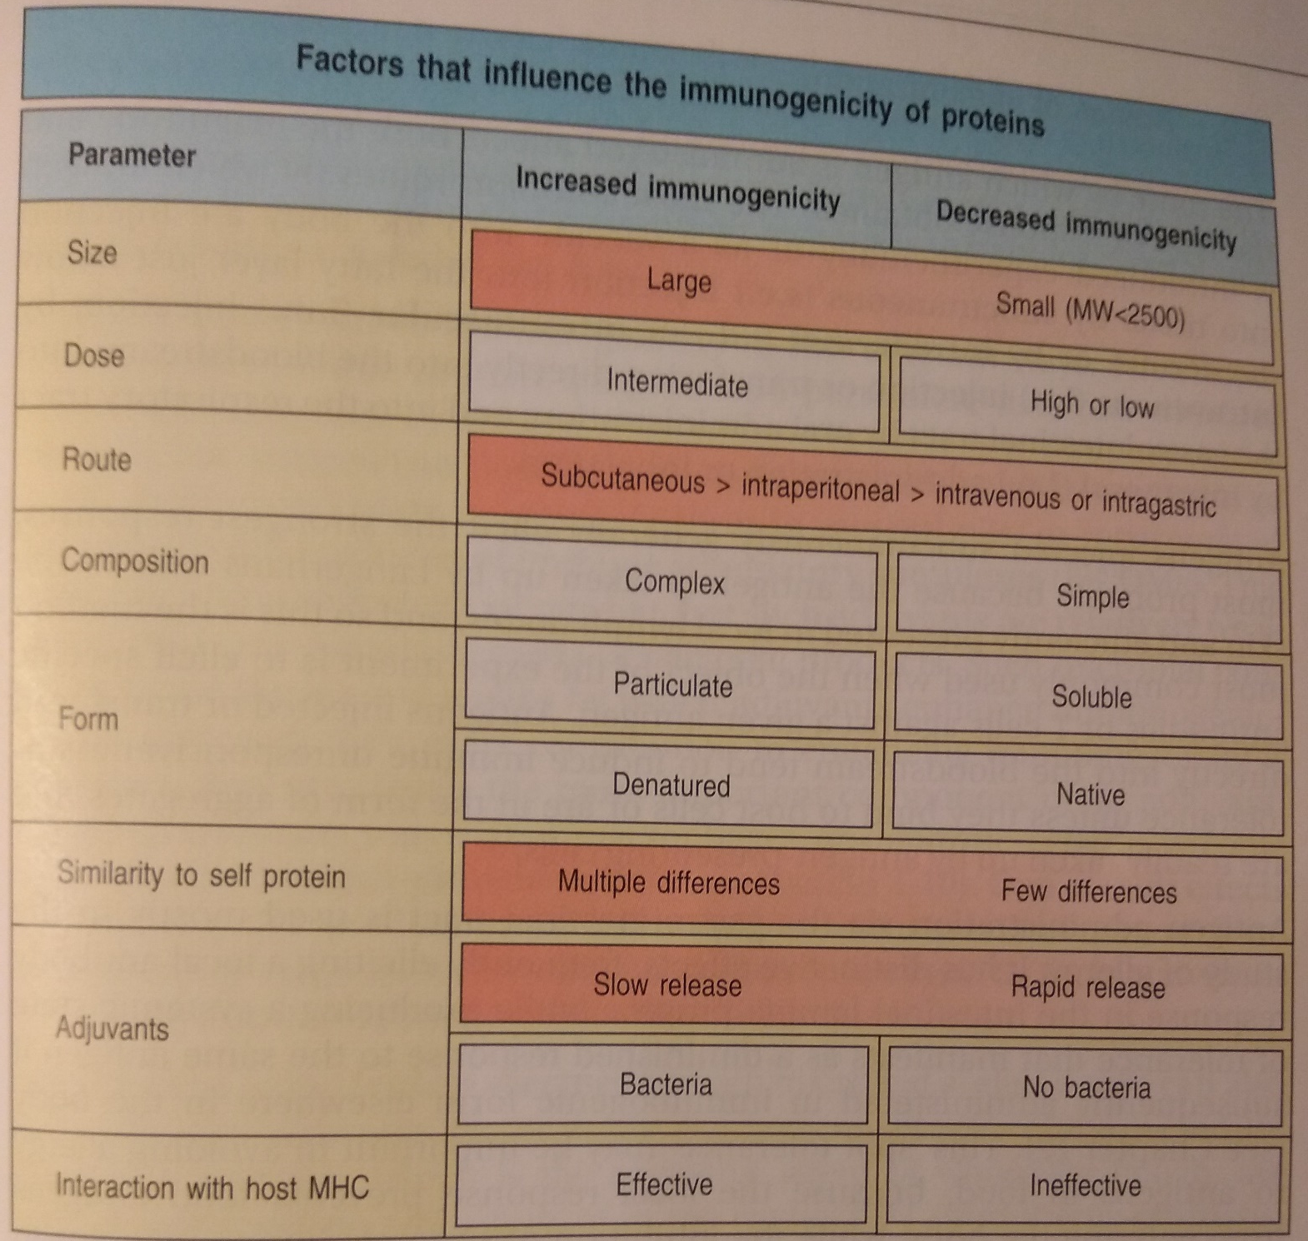

Slide 29
Valency and avidity of antibody-antigen interactions

Slide 30
Antigen-antibody complexes
The basis of immunopathology of immune-mediated diseases

Slide 31
Changes in antibody structure during humoral immune responses

Slide 32
Ig expression during B lymphocyte maturation

Slide 33
Propriedades das Igs dependem do tipo e nível de glicosilação

Slide 34
Crystal structure of na human IgG1 molecule viewed from two different angles, demonstrating theflexibility of the two Fab fragments with respect to each other and the Fc tail.
The N-linked glycan found at position 297 can be found as a core structure, common to all IgG found in human beings and rodents (core structure indicated with a red dashed line)

Slide 36
Propriedades das Igs dependem do tipo e nível de glicosilação

Slide 37
University of Texas Southwestern Medical Center, Dallas, Texas, USA
Type 2 diabetes mellitus is a common complication of obesity
Activation of the IgG receptor FcgRIIB in endothelium by hyposialylated IgG has a role in obesity-induced insulin resistance
Despite becoming obese on a high-fat diet, mice lacking FcgRIIB globally or selectively in endothelium were protected from insulin resistance (insulin delivery to skeletal muscle and resulting maintenance of muscle glucose disposal)
IgG transferred from patients with T2DM but not from metabolically healthy subjects caused insulin resistance in IgG-deficient mice via FcgRIIB
IgG from T2DM patients was hyposialylated.
In HFD-fed mice, supplementation with a sialic acid precursor restored IgG sialylation and preserved insulin sensitivity without affecting weight gain.

Slide 38
N-acetil-D-manosamina (ManNAc) é precursor de ácido siálico

Slide 39
Some species generate antibodies with alternative structures.

Slide 40
Editorial Summary - Milking cows for their antibodies
HIV infection gives rise to the generation of broadly neutralizing antibodies in a subset of infected subjects. However, it has been difficult to induce such antibodies through vaccination in humans and a variety of animal models. Four cows were immunized with a recombinant HIV envelope protein and broadly neutralizing antibodies developed rapidly after repeated immunization. For example, one cow developed cross-neutralizing activity just 42 days after a vaccine boost.

Slide 41
Effector functions of antibodies

Slide 43
Como detectar e medir Anticorpos e suas interações com Antigenos?

Slide 44
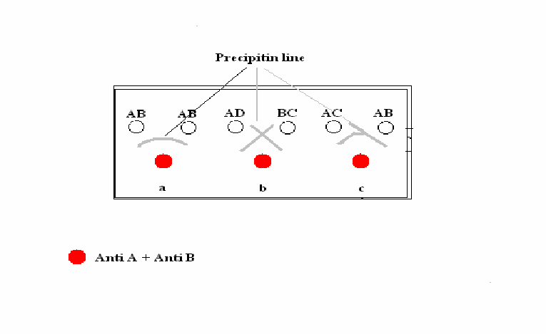
Antígenos particulados - Aglutinação
Antígenos solúveis - Precipitação
The Ouchterlony reaction:
Detect, identify, and quantify antibody and antigen
Test the similarity between antigens
For disease diagnosis
Antígenos solúveis - Precipitação

Slide 46
The Coombs direct and indirect anti-globulin tests for antibody against red blood cell antigens.

