Slide 1
Digitalization of work. Trends, chances and dangers
15.6.2018, University of São Paulo
Martin Krzywdzinski

Slide 2
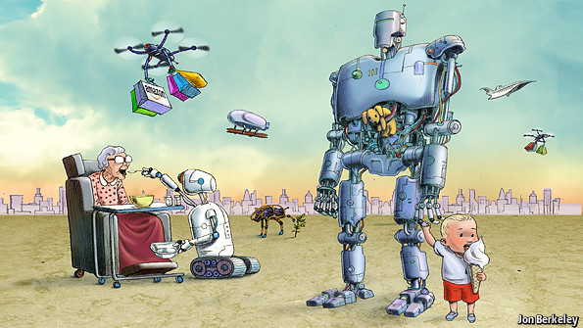
Future of work and the role of humans
Source: The Economist (29.3.2014), Rise of the Robots.

Slide 3
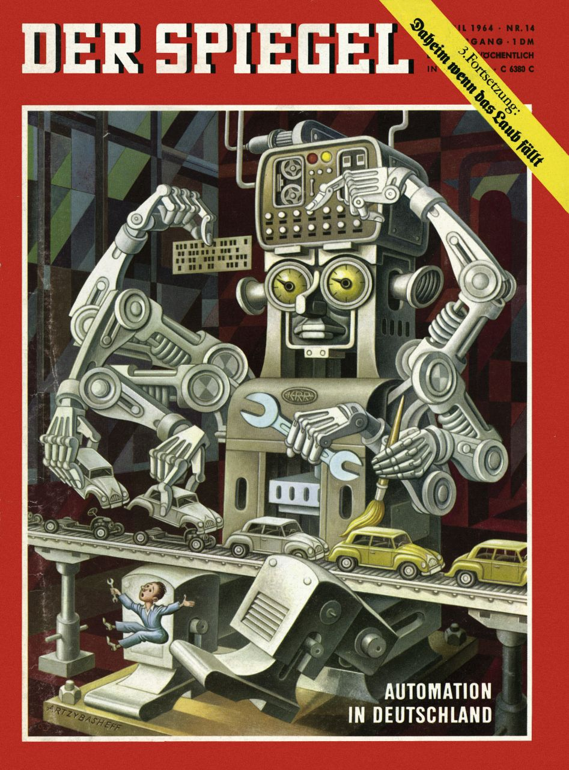
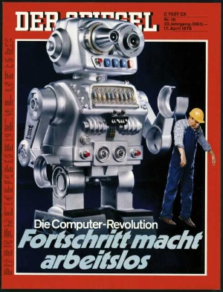
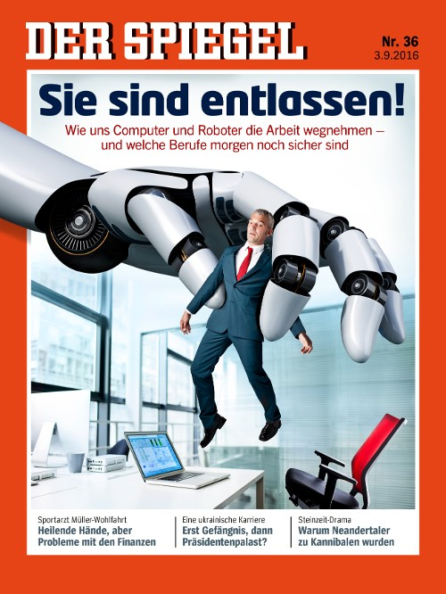
How new are the “new” technologies?
1966
1978
2016

Slide 4
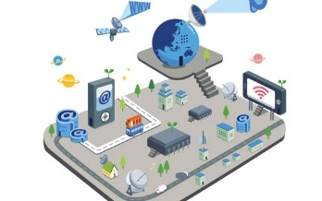
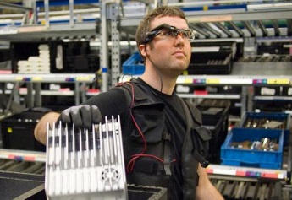
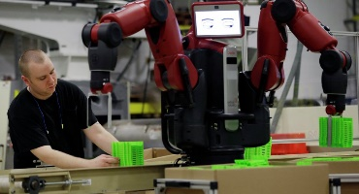
Industrie 4.0: a technology bundle
Internet of Things, Big Data
Digital assistance systeme
New automation concepts

Slide 5
Industrie 4.0 and platform economy

Slide 6
Frey and Osborne…
Source: Frey/Osborne (2013), The Future of Employment: How Susceptible Are Jobs to Computerisation?, University of Oxford.

Slide 7
… emphasize upskilling trends …
Quelle: Frey/Osborne (2013), The Future of Employment: How Susceptible Are Jobs to Computerisation?, University of Oxford.

Slide 8
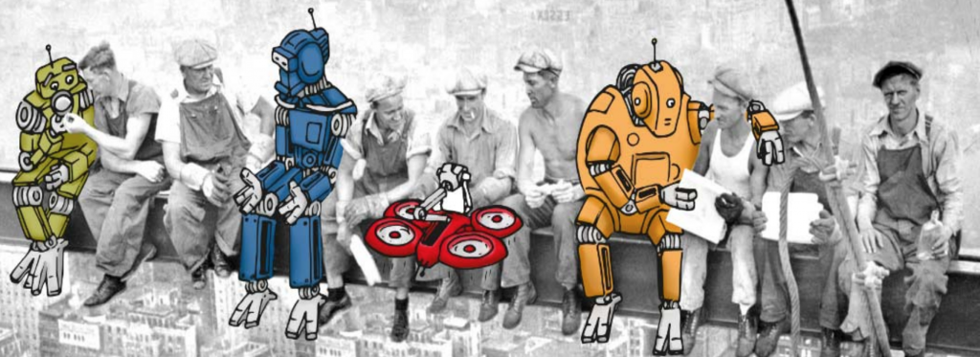
… but their approach faces criticism.
ZEW (2015): - Methodological problems of an approach based on occupational statistics
- Technical possibilities overestimated
Pfeiffer/Suphan - Importance of subjective, experiential knowledge underestimated
(2015):
Quelle: https://netzoekonom.de/2015/09/04/maschinen-werden-kollegen-sein-25-thesen-zur-zukunft-der-arbeit/

Slide 9
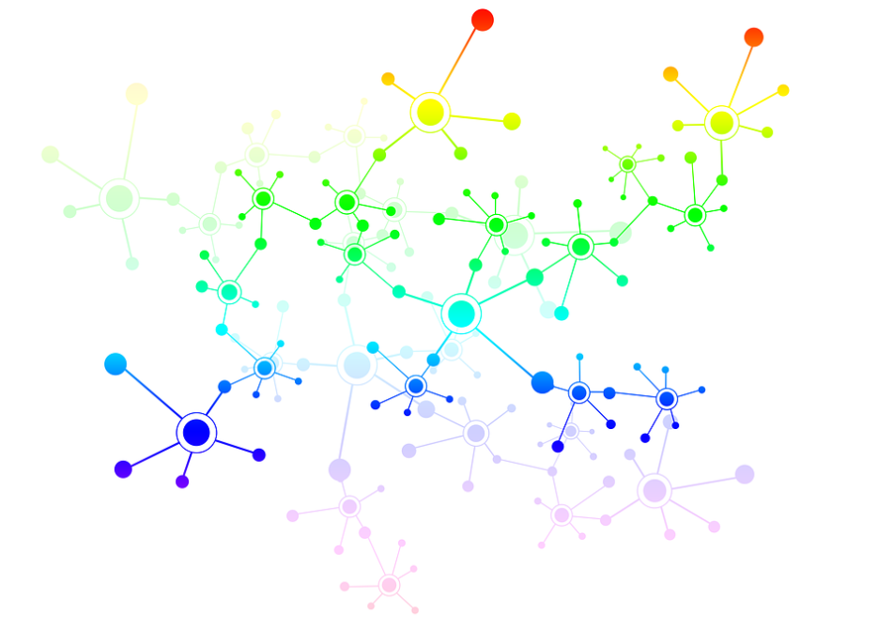
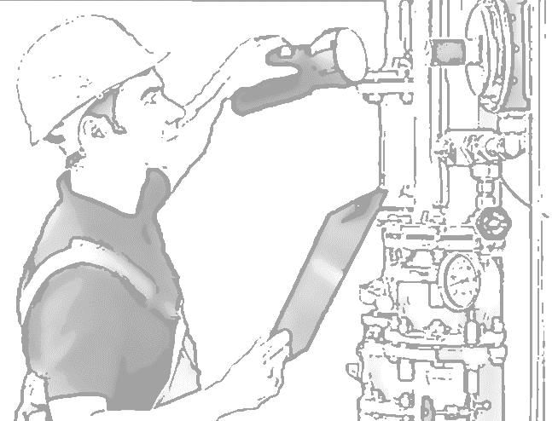
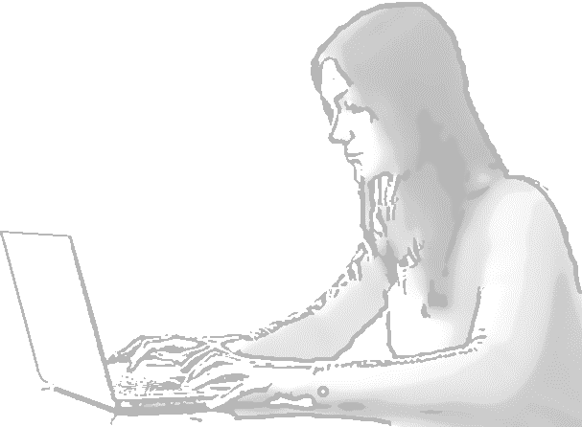
Variety of different worlds of work

Slide 10
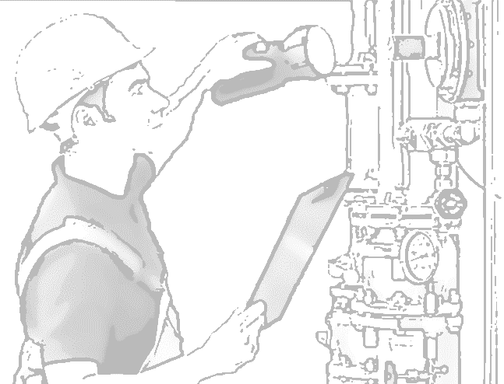
Maintenance: skilled work facing changes
Skilled work as an important pillar of German manufacturing; around 50% of all industrial workers in skilled trades
Example of maintenance work: - high self-regulation of workers, - high importance of experience, professional knowledge and problem-solving capabilities, - Coping with unforeseen problems
Frey/Osborne (2013): Probabilities of automation in maintenance occupations of 67% to 86%.

Slide 11
Changes in maintenance work
Knowledge management
Digital Assistance Systems
Predictive Maintenance

Slide 12
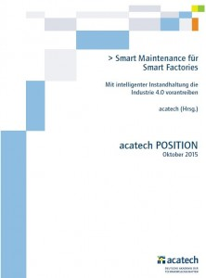
Smart Maintenance
„The central maintenance office has the task to guide the operative maintenance workers who have received a basic qualification. Together with the implementation of assistance systems, the guidance by the central office can compensate for the lack of experience or specialist knowledge of maintenance workers and assure that they can be deployed flexibly in all areas.“ (Acatech 2015: 24)

Slide 13
Routine work facing changes: Logistics
Strongly increasing employment in logistics sector, typically in unskilled/semi-skilled tasks
Work in logistics characterized by: - strong rationalization pressure, - high control and low job discretion
Frey/Osborne (2013): Probabilities of automation of blue-collar occupations in logistics above 90%

Slide 14
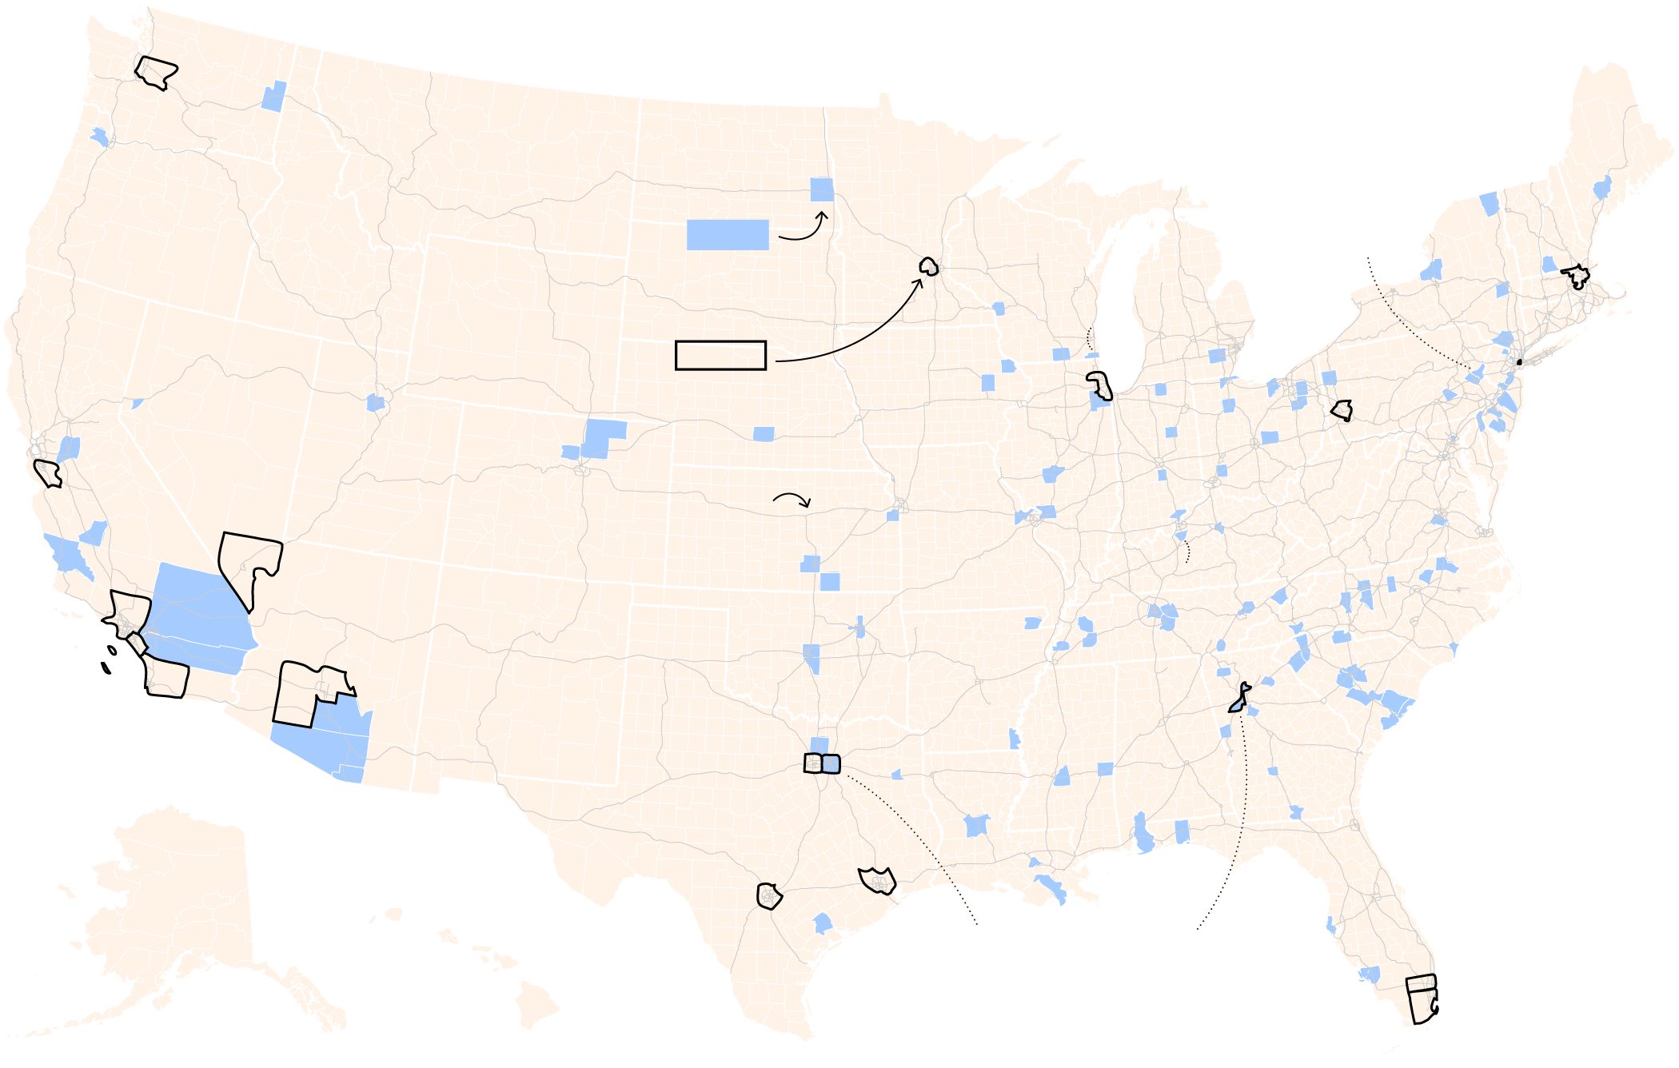
Increasing employment in the logistics sector
Counties where warehouse jobs
have doubled, or more, since 2010
Lehigh and
Northampton
Counties, Pa.
blue
Top 20 counties with
the largest labor markets
Kenosha Co., Wis.
outlined
Bullit Co., Ky.
Only two counties in the top 20
labor markets had big gains in
warehouse jobs: Dallas, Tex. and
Fulton, Ga., where Atlanta is.
Quelle: New York Times (22.10.2017), Where Internet Orders Mean Real Jobs, and New Life for Communities.

Slide 15
Routine work: Continuing rationalization
https://www.youtube.com/watch?v=OrYHJaSAxis
https://www.youtube.com/watch?v=3UxZDJ1HiPE

Slide 16
Online work: the example of crowdwork
More than 1 million registered crowdworkers in Germany, but „only“ around 100,000-200,000 actually active
Different types of work: micro tasks and macro tasks
In the long term, automation of micro tasks expected

Slide 17
Crowdwork: interest representation issues

Slide 18
Crowdwork: competition for reputation
Reputation system (example):
Ranking of crowdworkers based on:
Activity (logging in at least all 3 days; longer absences lead to points losses)
Won competitions
Engagement (participation in competitions, communication with clients etc.)
Profile: all information available, data verifeid?

Slide 19
Conclusions
Employment losses less dramatic than expected?
Increasing rationalization, control and work intensity?
Deskilling threats?
Regulation needed for platform work
Quelle: https://netzoekonom.de/2015/09/04/maschinen-werden-kollegen-sein-25-thesen-zur-zukunft-der-arbeit/

Slide 20
Thank you very much for your attention!
https://www.youtube.com/watch?v=HUC1w38DJQw&noredirect=1

