Slide 1
LIÇÕES DE LIDERANÇA EXTRAÍDAS DE CENAS DE FILMES EXPLORAR AS CINCO PRÁTICAS DE LIDERANÇA NOS FILMES. Livro: Kouzes e Posner

Slide 2
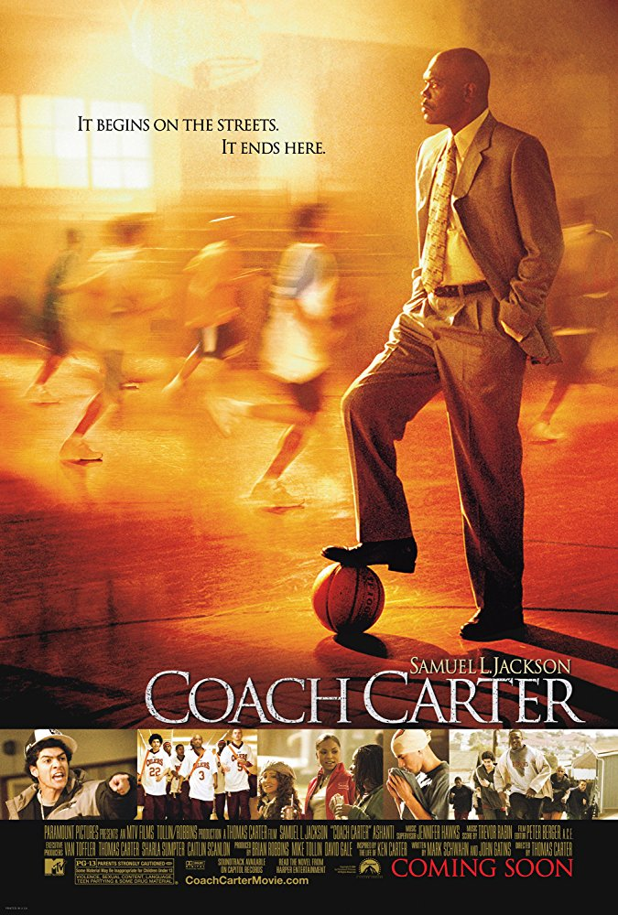
COACH CARTER – TREINO PARA A VIDA
Model the Way
Inspire a Shared Vision
Challenge the Process
Enable Others to Act

Slide 3
THE LION KING
Model the Way (ou a falta de honestidade, integridade e valores)
Inspire a Shared Vision (ou a falta de visão)
Challenge the Process
Enable Others to Act (ou não...)
Encourage the Heart

Slide 4
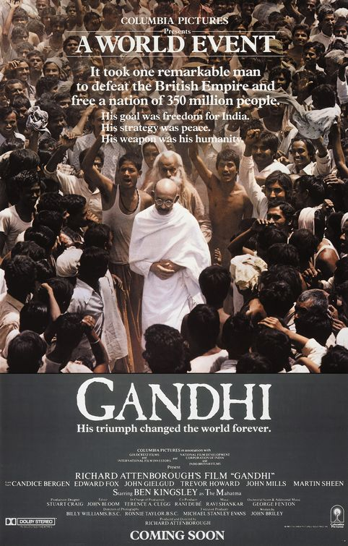
GHANDI -
Model the Way
Inspired a Shared Vision
Challenge the Process
Enable Others to Act
Encourage the Heart

Slide 5
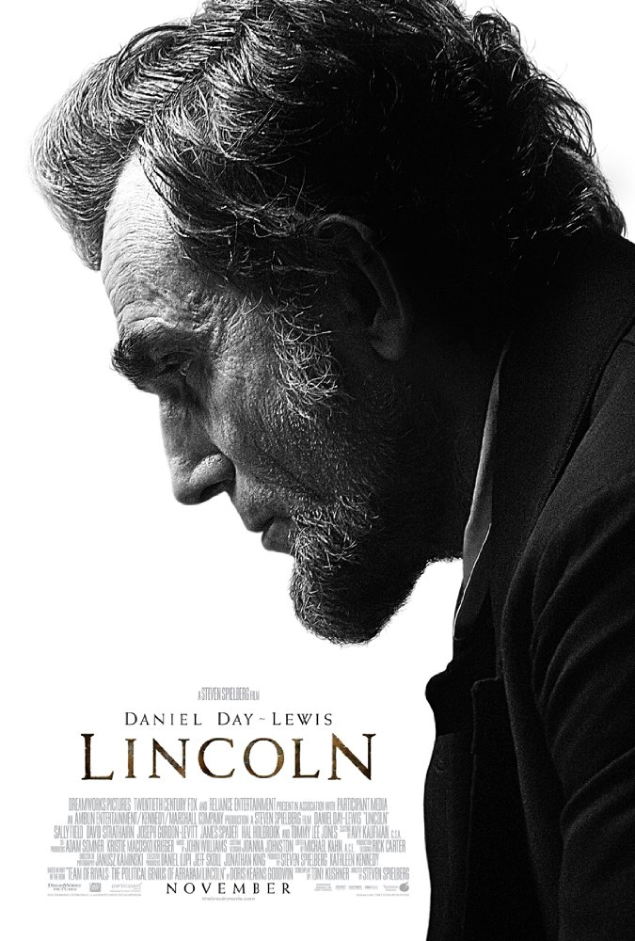
LINCOLN
Model the Way
Inspire a Shared Vision
Challenge the Process
Enable Others to Act

Slide 6
AMAZING GRACE – Jornada pela Liberdade
Model the Way
Inspire a Shared Vision
Challenge the Process
Enable Others to Act

Slide 7
SOUL SURFER
Model de Way
Challenge the Process
Enable Others to Act
Encourage the Heart

Slide 8
MONEYBALL – O Homem que mudou o jogo
Inspire a Shared Vision
Challenge the Process
Enable Others to Act

Slide 9
THE GREAT DEBATERS - O GRANDE DEBATE
Inspire a Shared Vision
Challenge the Process
Enable Others to Act

