Slide 1
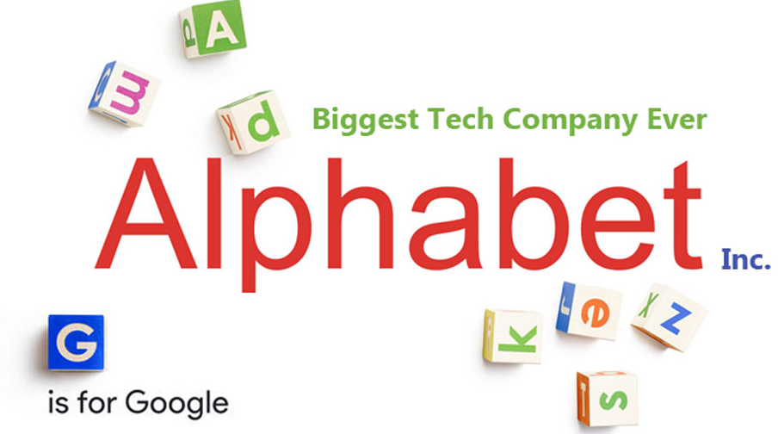
Marina Lourenção
João Lucas Hana Frade
Zhamilya Yerkenova

Slide 2
THE HISTORY OF THE COMPANY
What is Alphabet? Alphabet is mostly a collection of companies
Appeared in 2015 replacing Google inc.
Plan of having a strong CEO running each business
Famous google things and internet related topics will be allocated with Google
All shares of Google will automatically convert into the same number of shares of Alphabet, with all of the same rights
Most of its revenues comes from advertising
Number of employees: 103 459

Slide 3
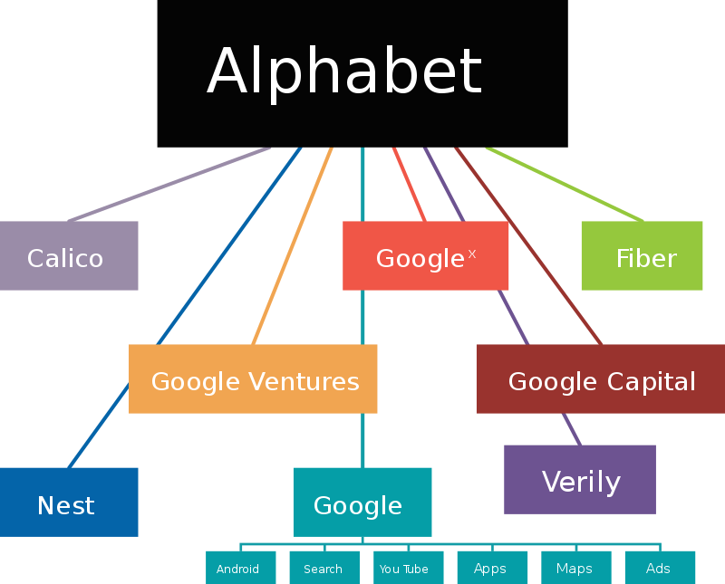
THE HISTORY OF THE COMPANY

Slide 4
THE HISTORY OF THE COMPANY
Calico: fight against aging and associated diseases
Fiber: high speed internet provider
Verify (Google Life Sciences): research organization devoted to the study of life sciences. Ex: smart contact lenses
Nest: smart home products, including thermostats, smoke detectors, and security systems, including smart doorbells and smart locks
Google Ventures and Google Capital: investment funds and capital
Google X: make great technological advances. Ex: Google's self-driving car

Slide 5
EXTERNAL ANALYSIS - Industry attractiveness (The Five Forces Model)
Competition from substitutes
Changes in law (monopoly charges, usage of information)
Usage of social media power (getting informations...)
Advantages and prohibitions from the State
The threat of new entrants
High technology
Patents
Powerfull brand
Market dominance (sometimes monopoly)
Products diffusion
Huge barrier for new entrants
Competitors
Each product has a competitor (Google Play and Apple Store; YouTube Music and Spotify; Search and Bing; Chrome and Edge...)
Facebook is the biggest competitor due to social media advertising and costumer related data
Supplier power
Lots of suppliers worldwide
Top company (attracts high quality suppliers)
Examples: Nvidia, Qualcomm and Accenture
Low supplier power
Buyers power
High need for Google products
Absence of many competitors for products (high technology products) except for Fiber
Companies can choose to advertise in social media instead of google related advertisements
Low buyers power except for social media advertising

Slide 6
EXTERNAL ANALYSIS - The STEP Structure for the Macroenvironmental Analysis
Political and Legal Factors | Social and Cultural Factors
New markets (Issues regarding the release in China and Venezuela becoming a Market again if democracy wins) Charges for monopoly in Europe (same can happen in other places) Government's requirements for Changes in Android agreements The political and law issues regarding personal data protection (Facebook recent problem) Possibility of new internet taxes | Increase in internet usage worldwide (1.024 billions in 2005 →3.578 billion in 2017 Increase in internet usage in LDCs countries (35 millions in 2010 → 172 millions in 2017) Increased desire for convenience Need for faster internet (Fiber) World population getting older (Calico)

Slide 7
EXTERNAL ANALYSIS - The STEP Structure for the Macroenvironmental Analysis
Economic and Natural factors | Technological Factors
Increase in education levels → increase in the usage of more technological products Changes in credit and inflation (B2B products can be affected) Low chances of being affected by restrictions of environmental raw-materials | Constant need of R&D (High Independence of government investments) Digitalization of the world (Running leader) Smartphone usage (Operational System leader) Need of biology related technology (Calico and Verify) Smart devices and homes (Nest and X) Internet of things (Chance of achieving new markets)

Slide 8
INTERNAL ANALYSIS - THE BUSINESS MODEL CANVAS

Slide 9
1 – Value proposition
INTERNAL ANALYSIS
To provide information organization and solutions
To provide life sciences research
To provide investment advises
Diversification
Innovation

Slide 10
2 - Customer segments - Alphabet
INTERNAL ANALYSIS
Who are the customers?
Calico: Biotechnologies cooperatives, University researchers;
Google: internet users
Google Fiber: internet users and television subscribers
Google Ventures: New technology companies in areas such as: internet, software, hardware, biotechnology and health care.
Capital IG: leading companies entrepreneurs
Nest: Smart home products buyers
Verily: Pharmaceutical companies, Biotechnologies companies

Slide 11
3 – Channels
INTERNAL ANALYSIS
How the company communicates with and reaches its customer segments to deliver a value proposition?
Calico: website; e-mail; building at South San Francisco
Google: website and apps
Google Fiber: website, call center and physical stores
Google Ventures: website and social media (Facebook and Twitter).
Capital IG: website, twitter and LinkedIn .
Nest: e-commerce, apps, sales force and retails
Verily: website, e-mail and blog

Slide 12
4 – Customer relationship
INTERNAL ANALYSIS
How will we get, keep and grow customers?
Calico: co-creation between the customer and the company
Google: automated services and personal assistance
Google Fiber: automated services and personal assistance
Google Ventures: personal assistance and co-creation
Capital IG: personal assistance and co-creation
Nest: automated services and personal assistance
Verily: co-creation between the customer and the company advisers

Slide 13
5 – Key resources
INTERNAL ANALYSIS
What key resources do our value propositions require?
Research centers
Patents
Biotechnology and software experts
Branding

Slide 14
6 – Key activities
INTERNAL ANALYSIS
What key activities do our value propositions require?
R&D: new product and market research; improving existing products and services
Production: quality and cost control
Marketing: market research; sales support; services and products communication.
Sales & customer service: acquiring new customers to the new businesses

Slide 15
7 – Key partners
INTERNAL ANALYSIS
Who are our key partners?
Calico: Biotechnologies cooperatives, University researchers;
Google: software developers
Google Fiber: city leaders, engineers, installation service force
Google Ventures: New technology companies, investing team, operating teams, engineering, marketing and communication advisers, human resources advisers.
Capital IG: Google experts as advisers.
Nest: Smart home products developers, distributors and sales force.
Verily: Software engineers, biotechnology researchers and biotechnology companies.

Slide 16
8 – Revenue streams
INTERNAL ANALYSIS
The cash generated from each customer segment through transaction revenue
Calico: sponsored academic research; licensing and collaboration agreements
Google: communication activities fees
Google Fiber: internet and television subscribers fees
Google Ventures: funding and advises fees on engineering challenges, deliver product feedback, marketing strategies and build valuable relationships.
Capital IG: advices fees on product, engineering, marketing, sales, operations, and other essential areas to help companies scale effectively
Nest: smart home products sales
Verily: sales of research projects to enable health data collection

Slide 17
9 - Cost Structure
INTERNAL ANALYSIS
What are the most important costs in our model?
Cost to retain talents
To invest in R&D
To invest in sales and marketing

Slide 18
INTERNAL ANALYSIS
Value
proposition
Customer
relationship
Customer
segments
Key partners
Key activities
Biotechnologies cooperatives, University researchers;
Software developers
City leaders, engineers, installation service force
New technology companies,
Google experts
Smart home products developers
Distributors and sales force
New product and market research; improving products and services
Quality and cost control
Sales support; communication.
Getting new customers
Biotechnologies cooperatives, university researchers;
Internet users
Television subscribers
New technology companies
Leading companies entrepreneurs
Smart home products buyers
Pharmaceutical companies
Co-creation
Automated Services
Personal Assistance
To provide information organization and solutions
To provide life sciences research
To provide investment advises
Diversification
Innovation
Key resources
Channels
Research centers
Patents
Biotechnology and software experts
Branding
Website, apps, e-mail; physical store, call centers, social media; e-commerce, sales force and retails
Cost structure
Cost to retain talents
To invest in R&D
To invest in sales and marketing
Revenue streams
Sales of research projects
home products sales
Internet and television subscribers fees
Sponsored academic research;
Communication activities fees
Funding and advises fees

Slide 19
Financial Position Analysis
INTERNAL ANALYSIS
1) Google
Google generates revenues mainly from advertising; sales of apps, in-app purchases, digital content products, and hardware
Other Bets –
Other Bets is a combination of multiple operating segments
Mainly the revenues from the Other Bets came from the sales of internet and TV services as well as licensing and R&D services through Verily.

Slide 20
Financial Position Analysis
INTERNAL ANALYSIS
Executive Overview of Results
• Google segment revenues of $36.2 billion with revenue growth of 17% year over year
Other Bets revenues of $170 million with revenue growth of 13% year over year
Income from operations was $6.6 billion
Operating cash flow was $12.0 billion

Slide 21
THE CORE STRATEGY FOR SUCCESS AND GROWTH IN THE MARKET
H
I
G
R
Resources
Wellness
Growth
Value
Spaces
Mobility
Leisure
Community
Maker
E
F
D
Q
C
O
P
W
B
N
Z
A
Y
M
X
ecosystem
L
W
G
K
J
V
U
S
T
V
R
S
M
L
C
M

Slide 22
THE CORE STRATEGY FOR SUCCESS AND GROWTH IN THE MARKET
ALPHABET
A
B
C
D
Q
E
F
G
H
I
J
K
L
M
N
O
P
R
S
T
V
W
X
Y
Z

Slide 23
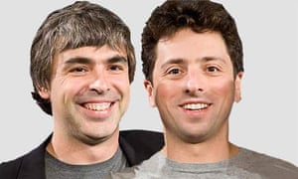
THE CORE STRATEGY FOR SUCCESS AND GROWTH IN THE MARKET
Investments
Ventures and Capital
X lab
Wing, our drone delivery effort
Extraordinary opportunities inside of Google

Slide 24
RECOMMENDATIONS FOR ALPHABET
Arising of new players in social media
Improve the communication channels for the new players
Improve the visual identity of Alphabet
Improve the Alphabet communication by making more clear that the other bets are from the same company as Google, because Google is already a strong brand which can help to improve the other ones
Expand the other bets services to other countries

Slide 25
LIST OF REFERENCES
https://abc.xyz/
http://www.thenextevolution.com/2015/08/28/the-ecosystem-of-you-infographic/
https://csimarket.com/stocks/competition2.php?supply&code=GOOG
https://abc.xyz/investor/
https://abc.xyz/investor/static/pdf/20190429_alphabet_10Q.pdf?cache=7afe0eb
https://www.gv.com/team/
https://verily.com/projects/sensors/study-watch/
https://nest.com/contact/partners/
https://www.calicolabs.com/partnering/
https://fiber.google.com/about/
https://capitalg.com/

