Slide 1
Chapter 14 Implementing Corporate Strategy: Managing the Multibusiness Firm
Prof. Luciano Thomé e Castro

Slide 2
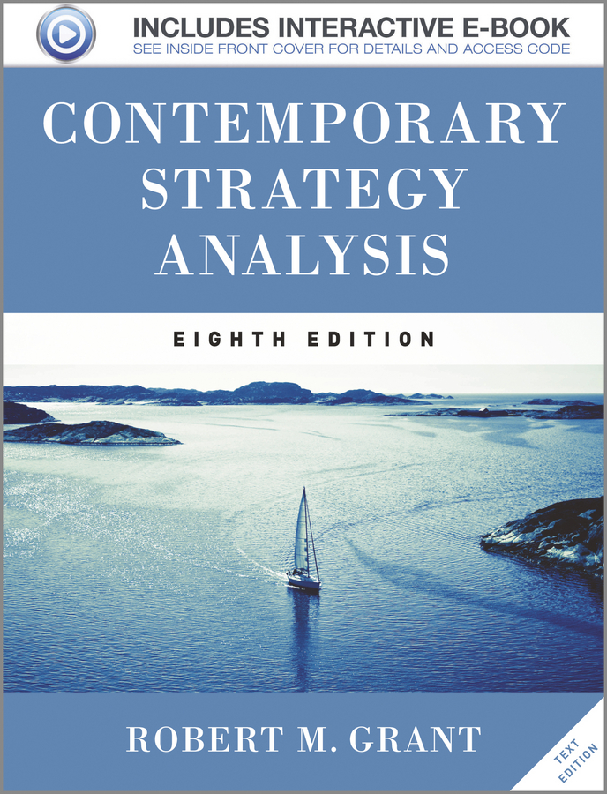
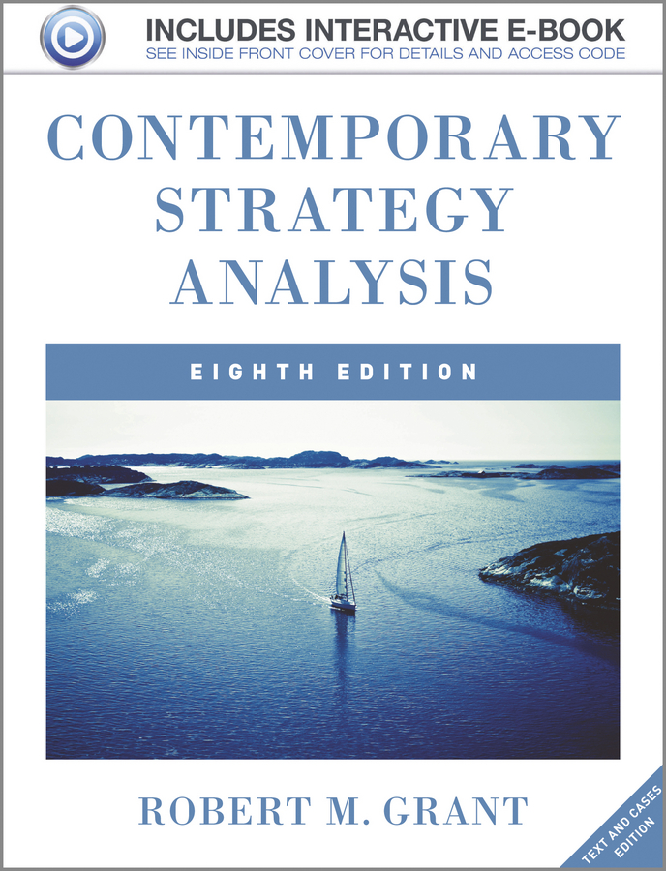
© 2013 Robert M. Grant
www.contemporarystrategyanalysis.com

Slide 3
Implementing Corporate Strategy: Managing the Multibusiness Firm
OUTLINE
The role of corporate management
Managing the corporate portfolio
Managing individual businesses
Managing linkages between businesses
Managing change in the multibusiness corporation
Governance of multibusiness corporations
© 2013 Robert M. Grant
www.contemporarystrategyanalysis.com

Slide 4
The Role of Corporate Management
How does corporate management add value to its individual business?
Managing the overall corporate portfolio, including acquisitions, divestments, and resource allocation
Managing each individual business
Managing linkages among businesses
Managing change
© 2013 Robert M. Grant
www.contemporarystrategyanalysis.com

Slide 5
The Role of General Electric in Developing Techniques of Corporate Strategy During the 1970’s
Late 1960’s: GE encounters problems of direction, coordination, control, and profitability
Corporate planning innovations include:
Portfolio Planning Models – Matrix frameworks for evaluating business unit performance, formulating business strategies, and allocating resources
Strategic Business Units – GE organizes its strategic planning system around SBUs. An SBU is a business that comprises a strategically-distinct group of closely-related products
PIMS – A database which quantifies the impact of strategy on performance. Used to appraise SBU performance and guide business strategy formulation
© 2013 Robert M. Grant
www.contemporarystrategyanalysis.com

Slide 6
Portfolio Planning Models:
Their Uses in Strategy Formulation
Allocating resources – Indicating both the investment requirements of different businesses and their likely returns
Formulating business-unit strategy – A generic strategy recommendations (e.g.: “build”, “hold”, or “harvest”)
Setting performance targets – Indicating likely performance outcomes in terms of cash flow and ROI
Portfolio balance – Guiding business portfolio changes in order to achieve corporate goals such as a balanced cash flow by combining mature and growing businesses
© 2013 Robert M. Grant
www.contemporarystrategyanalysis.com

Slide 7
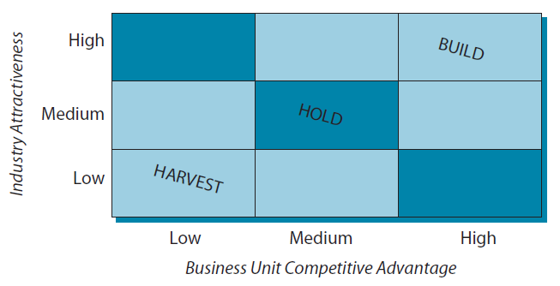
Portfolio Planning Models:
The GE/McKinsey Matrix
Industry Attractiveness Criteria Business Unit Position
- Market size - Market share (domestic,
- Market growth global, and relative)
- Industry profitability - Competitive position
- Inflation recovery - Relative profitability
- Overseas sales ratio
© 2013 Robert M. Grant
www.contemporarystrategyanalysis.com

Slide 8
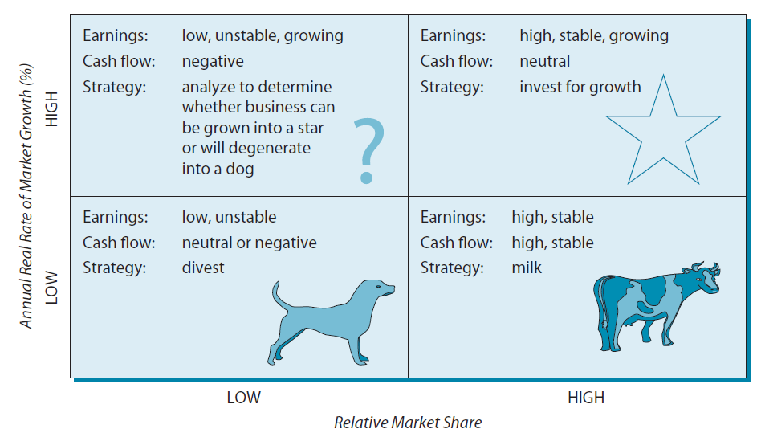
Portfolio Planning Models:
The BCG Growth-Share Matrix
© 2013 Robert M. Grant
www.contemporarystrategyanalysis.com

Slide 9
Applying the BCG Matrix to Time Warner Inc.
Cable TV
Networks
Cable
Film
production
-8 -4 0 4 8 12
Annual real rate of market growth
Magazine
Publishing
Bakery division
Music
AOL
Relative market share
Position in 2006 Position in 2000. (Area of circle proportional to $ sales)
© 2013 Robert M. Grant
www.contemporarystrategyanalysis.com

Slide 10
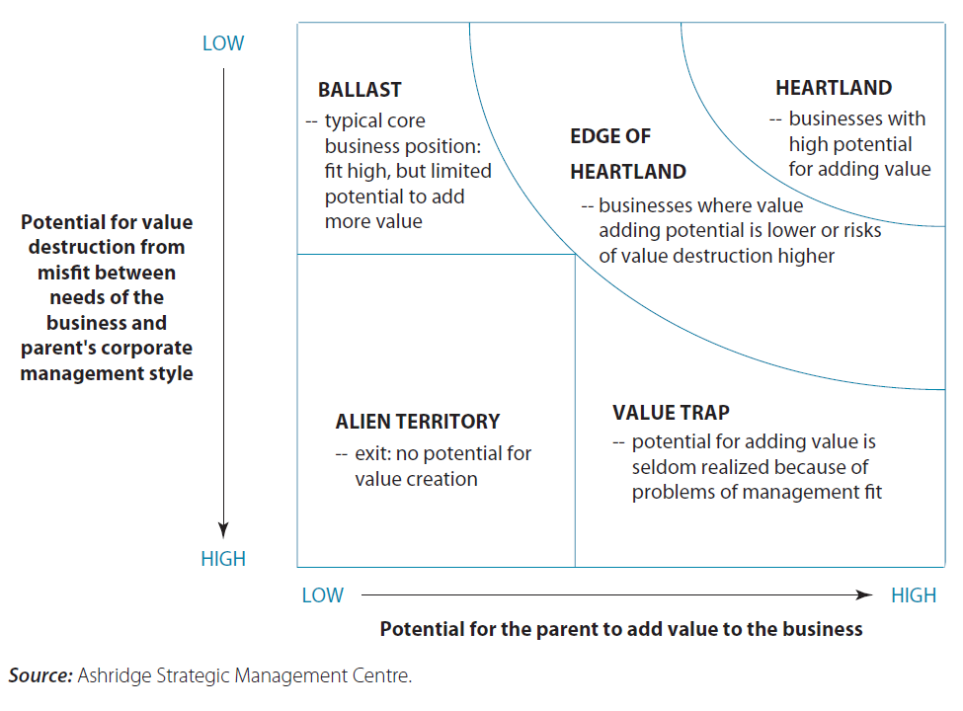
Ash bridge Portfolio Display:
The Potential for Parenting Advantage
© 2013 Robert M. Grant
www.contemporarystrategyanalysis.com

Slide 11
The Ashbridge Portfolio Display Applied to a Diversified Leisure Company
LOW
BALLAST
HEARTLAND
EDGE OF HEARTLAND
Restaurant
chain A
Restaurant
chain C
Pubs and
bars
Potential for value destruction from misfit between needs of the business and patent’s corporate management style
Coffee
chain
Restaurant
chain D
Restaurant
chain B
Liquor
chain
Spas
Tennis
clubs
Hotels
HIGH
ALIEN TERRITORY
VALUE TRAP
LOW
HIGH
Size of circle represents sales
Potential for parent to value added to the business
© 2013 Robert M. Grant
www.contemporarystrategyanalysis.com

Slide 12
Do Portfolio Planning Models Help or Hinder Corporate Strategy Formulation?
ADVANTAGES
Simplicity: Quick and easy to prepare
Big picture: Permits one page representation of the corporate portfolio and strategic positioning of each business
Analytically versatile: Applicable to businesses, products, countries, distribution channels
Can be augmented: A useful point of departure for more sophisticated analysis
DISADVANTAGES
Simplicity: Oversimplifies the factors determining industry attractiveness and competitive advantage
Ambiguous: The position of a business depends critically upon how a market is defined
Ignores synergy: The analysis takes no account of any interdependencies between businesses
© 2013 Robert M. Grant
www.contemporarystrategyanalysis.com

Slide 13
Managing Individual Businesses Within the Multibusiness Firm: Modes of Corporate Control
Two basic approaches
Input Control
Output Control
Monitoring & approving business level decisions
Setting performance targets and monitoring their achievement
Primarily through strategic planning system and capital expenditure approval system
Primarily through performance management system, including operating budgets, scorecards,
milestones, and HR appraisals
© 2013 Robert M. Grant
www.contemporarystrategyanalysis.com

Slide 14
Exxon’s Strategic Planning Process
Approved by Management Committee
Economic Review
Energy Review
Business Plans
Business Plans
Stewardship Review
Stewardship Basis
Financial Forecast
Corporate Plan
Investment Reappraisals
Annual Budget
© 2013 Robert M. Grant
www.contemporarystrategyanalysis.com

Slide 15
Rethinking Strategic Planning
Critiques of Strategic Planning:
Strategic planning systems don't make strategy – Strategic planning a ritualistic process, but most strategic decisions are made outside the system
Weak execution – Procedures for converting plans into actions are weak. Proposals for improving execution include:
Strategic milestones
Strategy maps
Replacing strategic planning units by “offices of strategy management”
© 2013 Robert M. Grant
www.contemporarystrategyanalysis.com

Slide 16
Performing Management &
Financial Control
Multibusiness companies have a dual planning process:
Strategic planning: medium and long term
Financial planning : short-term
The two are closely linked. Strategic plan is a basis for:
Operating budget
Capital expenditure budget
Annual performance plans
Strategic milestones
Balance between strategic and financial control varies by firm and sector
© 2013 Robert M. Grant
www.contemporarystrategyanalysis.com

Slide 17
Different Corporate Management Styles
 | Strategic Planning | Financial Control
Business Strategy Formulation | Businesses and corporate HQ jointly formulate strategy. HQ coordinates business unit strategies | Strategy formulated at business unit level. Corporate HQ largely reactive, offering little coordination.
Controlling Performance | Primarily strategic goals with medium- to long-term horizon. | Financial budgets set annual targets for ROI and other financial variables with monthly/quarterly monitoring.
Advantages | Effective for exploiting (a) linkages among businesses, (b) innovation, (c) long-term competitive positioning. | Business unit autonomy supports initiative, responsiveness, efficiency, and development of business leaders.
Disadvantages | Loss of divisional autonomy and initiative. Conducive to unitary strategic view. Tendency to persist with failing strategies. | Short-term focus discourages innovation and long-term development. Limited sharing of resources and capabilities among businesses.
Style suited to | Companies with few closely-related businesses. Works well in competitive, technology-intensive sectors where investment projects are large and long term. | Highly diversified companies with low relatedness among businesses. Works well in mature, low-tech sectors where investment projects are relatively small and short term.
© 2013 Robert M. Grant
www.contemporarystrategyanalysis.com

Slide 18
Managing Linkages Across Boundaries
Value from exploiting linkages within the multibusiness firm result mainly from exploiting resource and capability linkages:
At the corporate level – Shared corporate services
At the business level – Sharing resources, transferring capabilities
Michael Porter identifies types of corporate strategy based on the nature and extent of internal linkages:
Portfolio management – Parent creates value by operating an internal capital market
Restructuring - Parent creates value by acquiring and revitalizing inefficiently-managed businesses
Transferring skills - Parent creates value by transferring capabilities between businesses
Sharing activities - Parent creates value by sharing resources between businesses
The role of dominant logic – “The way in which managers conceptualize the business”” determines the identity of the business and the perception of its appropriate boundaries
© 2013 Robert M. Grant
www.contemporarystrategyanalysis.com

Slide 19
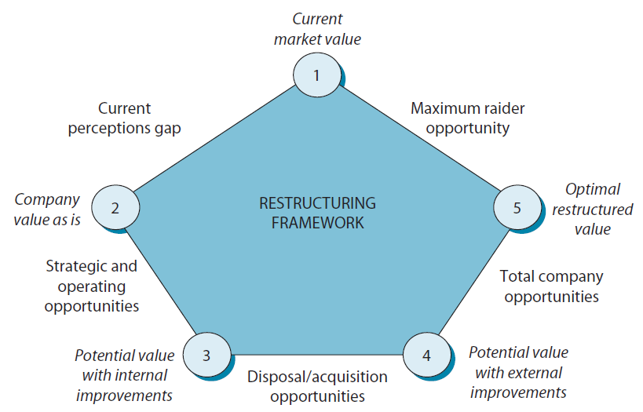
Managing Change in the Multibusiness Firm: The McKinsey Pentagon for Corporate Restructuring
© 2013 Robert M. Grant
www.contemporarystrategyanalysis.com

Slide 20
The Challenge of Corporate Governance
What are the rights of shareholders?
To transfer shares, access company information, elect directors, share in the profits of the firm, vote on key strategic decisions
Despite potential for divisions to develop distinctive strategies and structures—corporate systems may impose uniformity
What are the responsibilities of Company Boards?
To act in the best interests of the company and its shareholders
To oversee strategy, budgets, management performance, etc.
What’s gone wrong?
Failure by boards to prevent managers pursuing their interests rather than those of shareholders (e.g. excessive compensation)
Failure of the board to take account of social/national interest
What other problems do multidivisional corporations face?
Lack of decentralization of decision making to divisional managers
Standardization of management systems across divisions
© 2013 Robert M. Grant
www.contemporarystrategyanalysis.com

Slide 21
Highest Earning CEOs of US Companies, 2011
Rank | CEO | Company | Total Pay | Change on 2010
1 | David Simon | Simon Property Group | $137.2m | +458 %
2 | Leslie Moonves | CBS | $68.4m | +20 %
3 | David Zaslav | Discovery Communications | $52.4m | +23 %
4 | Sanjay K. Jha | Motorola Mobility | $47.2m | +262 %
5 | Philippe P. Dauman | Viacom | $43.1m | -49 %
6 | David M. Cote | Honeywell International | $35.7m | +135 %
7 | Robert A. Iger | Walt Disney | $31.4m | +12 %
8 | Clarence P. Cazalot Jr | Marathon Oil | $29.9m | +239 %
9 | John P. Daane | Altera | $29.6m | +278 %
10 | Alan Mulally | Ford Motor | $29.5m | +11 %
11 | Gregory Q. Brown | Motorola Solutions | $29.3m | +113 %
12 | Richard C. Adkerson | Freeport-McMoRan | $28.4m | -19 %
13 | Ian M. Cumming | Leucadia National | $28.2m | +531 %
14 | Brian L. Roberts | Comcast | $26.9m | -13 %
15 | Jeffrey L. Bewkes | Time Warner | $25.7m | -2 %
16 | Rex W. Tillerson | Exxon Mobil | $25.2m | +17 %
17 | Samuel J. Palmisano | IBM | $24.2m | -4 %
18 | William C. Weldon | Johnson & Johnson | $23.4m | +1 %
19 | James Dimon | JPMorgan Chase | $23.1m | +11 %
20 | Louis R. Chenevert | United Technologies | $22.2m | +17 %
© 2013 Robert M. Grant
www.contemporarystrategyanalysis.com

Slide 22
The Multidivisional Structure: Theory of the M-Form
Efficiency advantages of the multidivisional firm:
Adapted to bounded rationality – Decentralized decision-making acknowledges managers’ cognitive limits
Efficient allocation of decision-making:
High-frequency operating decisions at divisional level
low-frequency strategic decisions at corporate level
Reduces coordination costs: frees corporate management from continual involvement in business level decisions
Limits goal conflict: divisions pursue profit, not functional goals
Hence multidivisional structure solves 2 central problems of corporate governance:
Allocation of resources: internal capital market allocates resources by financial and strategic criteria, not internal politics
Resolution of agency problems: corporate head office can act as an effective agent of the shareholders
© 2013 Robert M. Grant
www.contemporarystrategyanalysis.com

