Slide 1
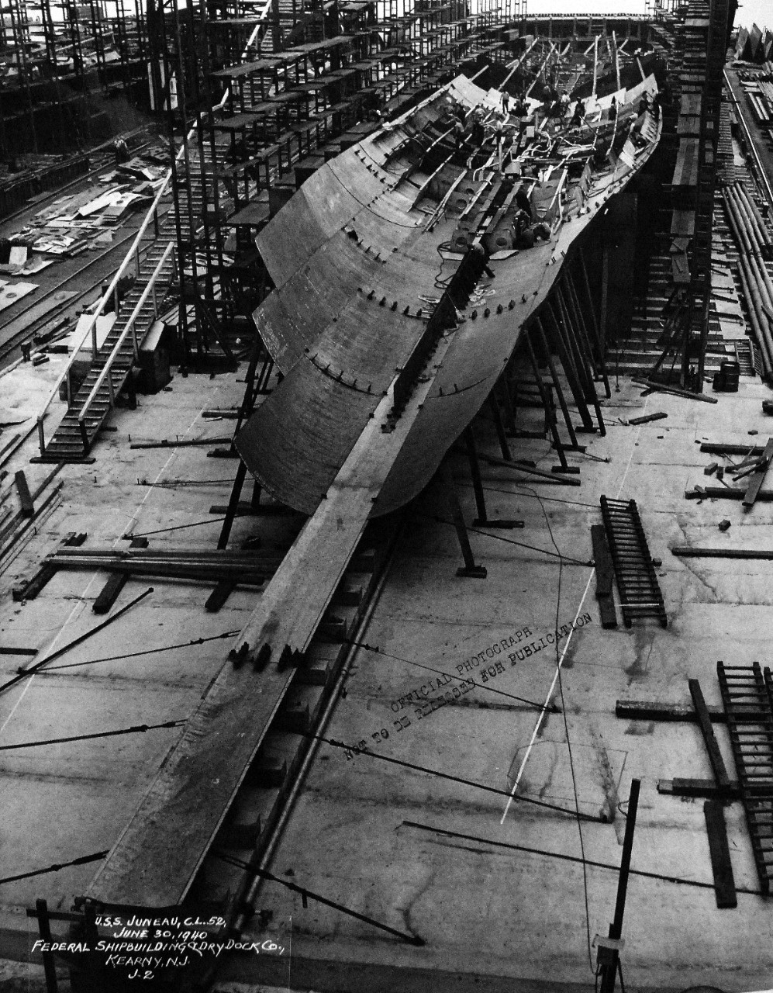
Construção em diferentes épocas
1940 - https://www.youtube.com/watch?v=uyCbUj9CH1s rebites
1950 - https://www.youtube.com/watch?v=nt7dbvKsEf8 primeiras soldas
https://www.youtube.com/watch?v=tpjwNrR9GM0
1960 - https://www.youtube.com/watch?v=keOnm_qHAmc
2020
https://www.youtube.com/watch?v=XqCLkE2ILBM
https://www.youtube.com/watch?v=-dh1AfR6Z9o

