Slide 1
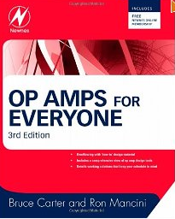
OP AMPs for Everyone Newnes, 2009

Slide 2
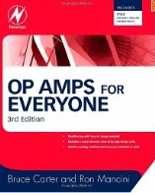
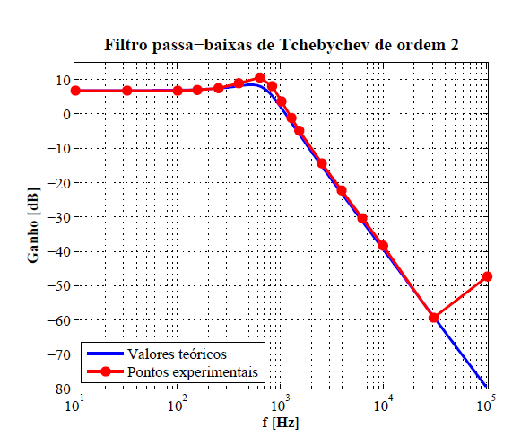
Active Filters
Active Filters : Theory x Experimental

Slide 3
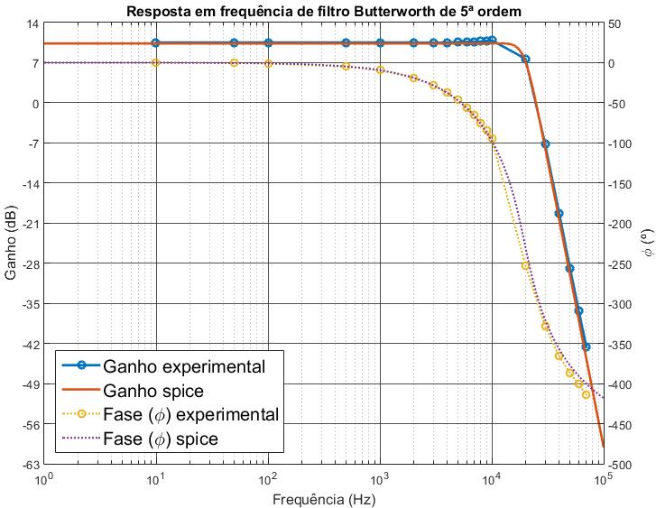
Active Filters
Active Filters : Theory x Experimental
Filtro Passa Baixa Butterwork, ordem n=5, f_{c}= 19.8KHz

Slide 4
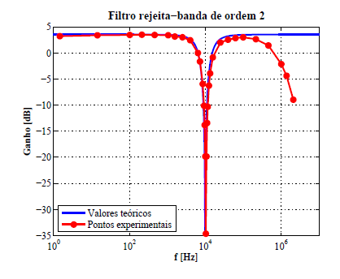
Active Filters
Active Filters : Theory x Experimental

Slide 5
Introduciton
Active Filters
Applications (few examples):
In the field of telecommunications band pass filters are used in the audio frequency range (0 – 20 KHz)
High frequency band-pass filters (several hundreds MHz) are used for channell selection in telephone centrals).
There are filters that do not filter any frequencies of a complex input signal, but just add a linear phase shift to each frequency component, thus contributing to a constant time delay. These are called all-pass filters.

Slide 6
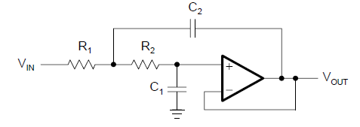
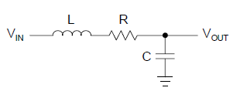
Introduction
Active Filters
At high frequencies (> 1 MHz), all of these filters usually consist of passive components such as inductors (L), resistors (R), and capacitors (C). They are then called LRC filters.
In the lower frequency range (1 Hz to 1 MHz), however, the inductor value becomes very
large and the inductor itself gets quite bulky, making economical production difficult.
Active filters are circuits that use an operational amplifier (op amp) as the active device in combination with some resistors and capacitors to provide an LRC-like filter performance at low frequencies.

Slide 7
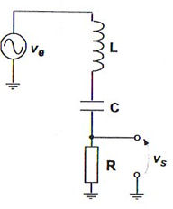
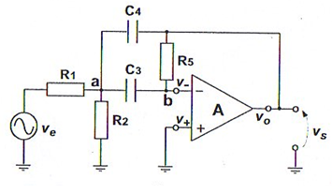
Active Filters
Os filtros abaixo apresentam a mesma função de transferência !
Filtro Passivo
Filtro Ativo

Slide 8
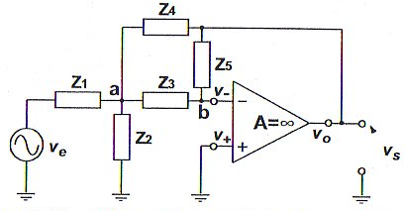
Filtro Ativo Genérico na Configuração Realimentação Múltipla
O ganho de tensão deste circuito pode ser facilmente obtido utilizando-se a LCK nos nós a e b, supondo que o amp op é ideal e aplicando-se a técnica de terra virtual.
Nó a:

Slide 9
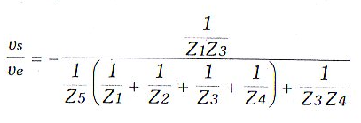
Filtro Ativo Genérico na Configuração Realimentação Múltipla
Nó b:

Slide 10
O ganho de tensão do circuito ativo, como demonstrado, é dado por:
Z₁ = R₁ , Z₂ = R₂
Z₃= 1/jwC₃ , Z₄= 1/jwC_{e}
Z₅ = R₅
Se C₃ = C₄ = C e R₅ = 2R₁

Slide 11
O ganho de tensão do circuito passivo é dado por:
sendo

Slide 12
Active Filters
Contents: Active Filters
Rather than resembling just another filter book, the individual filter sections are written
in a cookbook style, thus avoiding tedious mathematical derivations. Each section
starts with the general transfer function of a filter, followed by the design equations to calculate the individual circuit components.
Introduction to three main filter optimizations (Butterworth, Tschebyscheff, and Bessel).
Description of the most common active filter applications:
low-pass
high-pass
band-pass
band-rejection
all-pass filters

Slide 13
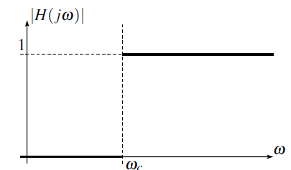
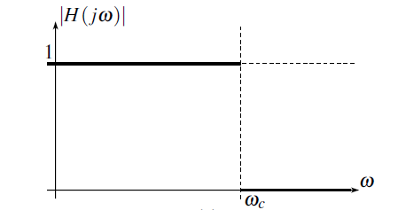
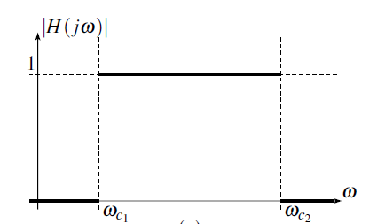
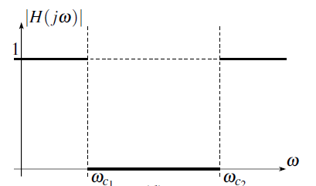
Active Filters
filtro passa-baixa
filtro passa-alta
filtro passa-faixa
filtro rejeita-faixa

Slide 14
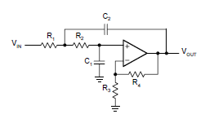
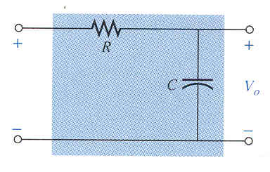
Active Filters
Active Filter
Sallen-Key Topology
filtro passa-baixa
Passive Filter

Slide 15
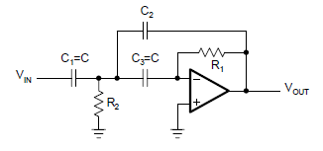
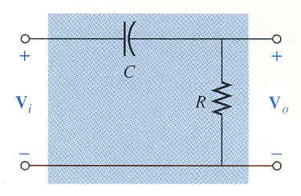
Active Filters
Active Filter
Multiple Feedback Topology
filtro passa-alta
Passive Filter

Slide 16
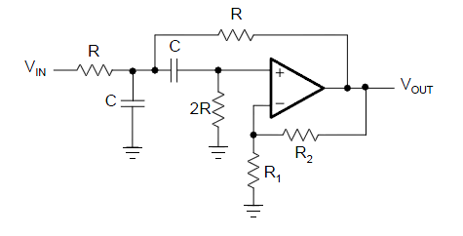
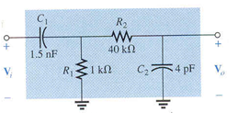
Active Filters
Active Filter
Sallen-Key Topology
filtro passa-faixa
Passive Filter

Slide 17
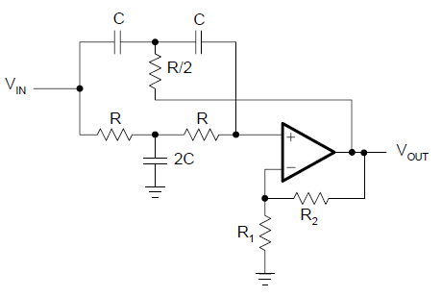
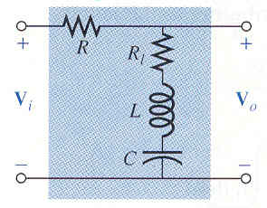
Active Filters
Active Filter
Twin-T Topology
filtro rejeita-faixa
Passive Filter

Slide 18
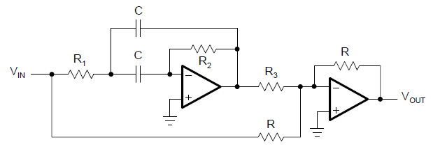
Active Filters
filtro passa-tudo
banda de passagem é todo o espectro de frequências
mas com defasagens diferentes ao longo do espectro

Slide 19
Active Filters
Low Pass Filters

Slide 20
Active Filters
Low Pass Filter
Butterworth
Tchebysheff
Bessel

Slide 21
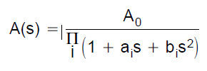
Active Filters
Low Pass Filter
General Transfer Function
The filter coefficients a_{i} and b_{i} distinguish between Butterworth, Tschebyscheff, and Bessel filters. The coefficients for all three types of filters are tabulated.
n determines the gain rolloff above f_{C} (n·20 dB/decade)
a_{i} and b_{i} determine the gain behavior in the passband

Slide 22
Active Filters
Low Pass Filter
General Transfer Function
The Butterworth coefficients optimizes the passband for maximum flatness
The Tschebyscheff coefficients sharpes the transition from passband into the stopband
The Bessel coefficients linearizes the phase response up to f_{C}

Slide 23
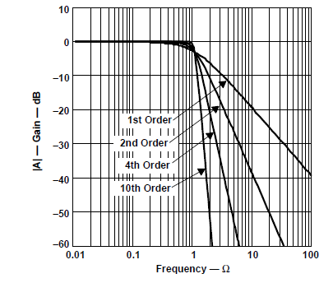
Active Filters
Butterworth Low Pass Filter
The Butterworth low-pass filter provides passband flatness.

Slide 24
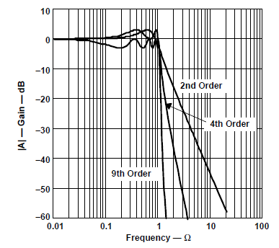
Active Filters
Tchebysheff Low Pass Filter
The Tschebyscheff low-pass filters provide an even higher gain rolloff above f_{C}. However, the passband gain is not monotone, but contains ripples of constant magnitude instead. For a given filter order, the higher the passband ripples, the higher the filter’s rolloff.

Slide 25
Active Filters
Tchebysheff Low Pass Filter
For a given filter order, the higher the passband ripples, the higher the filter’s rolloff.
Each ripple accounts for one second-order filter stage.
Filters with even order numbers generate ripples above the 0-dB line
Filters with odd order numbers create ripples below 0 dB.

Slide 26
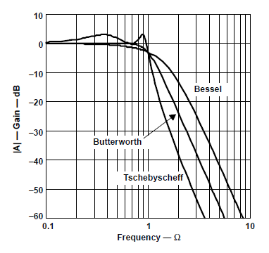
Active Filters
Bessel Low Pass Filter
The passband gain of a Bessel low-pass filter is not as flat as that of
the Butterworth low-pass
The transition from passband to stopband is by far not as sharp as that of a Tschebyscheff low-pass filter

Slide 27
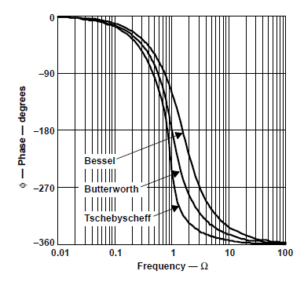
Active Filters
Bessel Low Pass Filter
The Bessel low-pass filters have a linear phase response over a wide frequency range

Slide 28
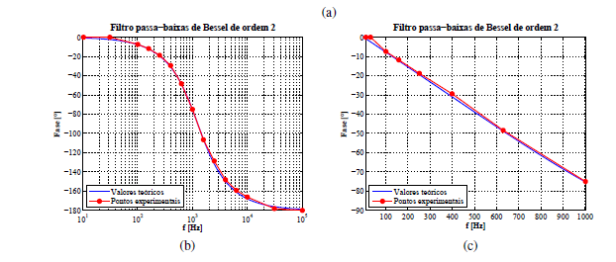
Active Filters
Bessel Low Pass Filter
The Bessel low-pass filters have a linear phase response over a wide frequency range

Slide 29
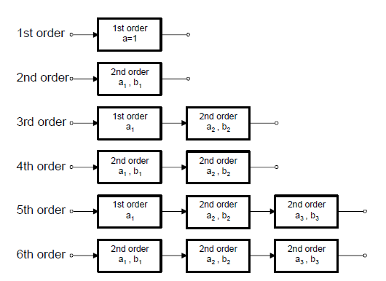
Active Filters
Cascade Filters
The first-order and second-order filter stages are the building blocks for higher-order filters.

Slide 30
Active Filters
Quality Factor
Band Pass
Filters
Low and High Pass Filters

Slide 31
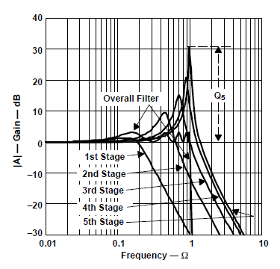
Active Filters
Quality Factor
Example: low pass filter with 5 stages
Q₅(dB) = 20 logQ₅

Slide 32
Designing Low Pass Filter
Active Filters
Filters Coefficients

Slide 33
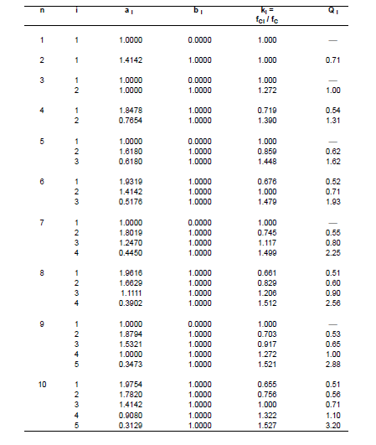
Designing Low Pass Filter
Active Filters
Butterworth Coefficients

Slide 34
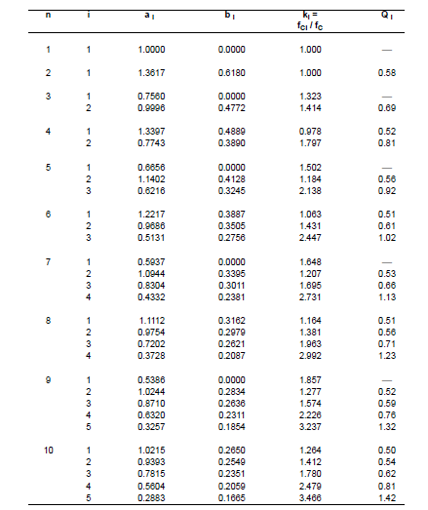
Designing Low Pass Filter
Active Filters
Bessel
Coefficients

Slide 35
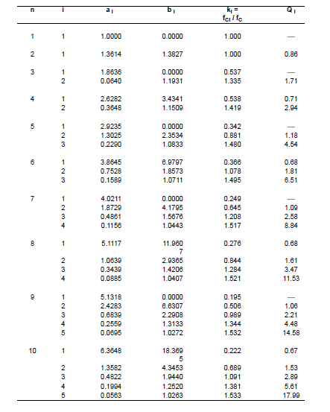
Designing Low Pass Filter
Active Filters
Tschebyscheff Coefficients
(0.5 dB Passband ripple)

Slide 36
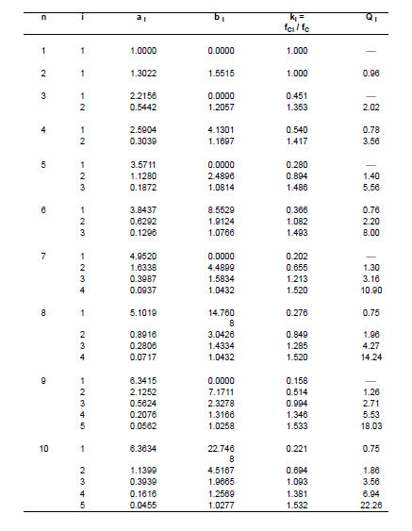
Designing Low Pass Filter
Active Filters
Tschebyscheff Coefficients
(1 dB Passband ripple)

Slide 37
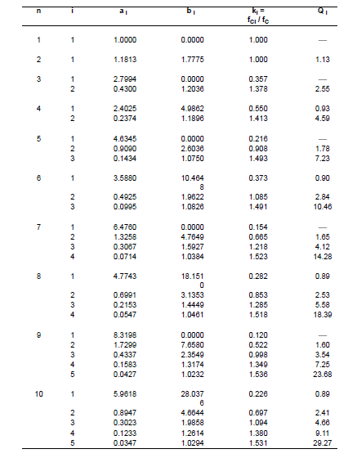
Designing Low Pass Filter
(Second Order)
Active Filters
Tschebyscheff Coefficients
(2 dB Passband ripple)

Slide 38
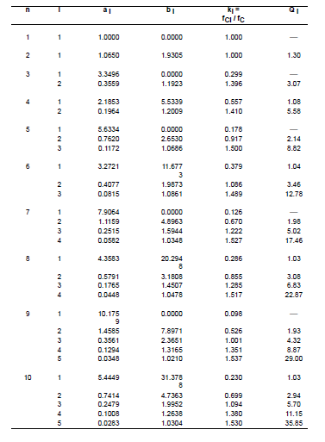
Designing Low Pass Filter
(Second Order)
Active Filters
Tschebyscheff Coefficients
(3 dB Passband ripple)

Slide 39
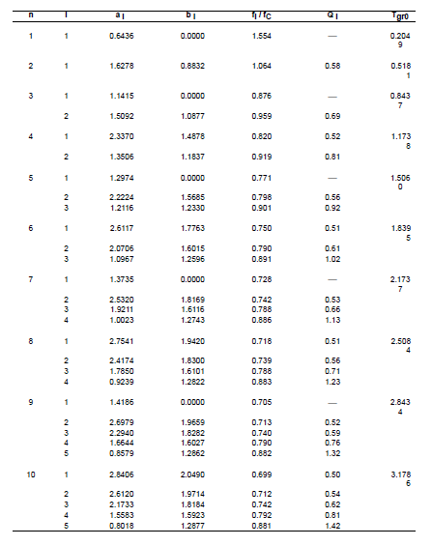
Designing Low Pass Filter
(Second Order)
Active Filters
All Pass

Slide 40
Active Filters
Cascade Filters
First order filter
Second order filter

Slide 41
Active Filters
Low Pass Filters
(First Order Topology)

Slide 42
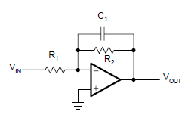
Active Filters
Low Pass Filter
(First Order)
Inverting
a₁
(DC gain)

Slide 43
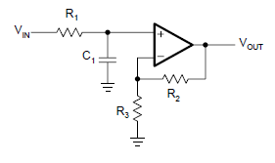
Active Filters
Low Pass Filter
(First Order)
Noninverting
a₁
(DC gain)

Slide 44
Active Filters
Designing Low Pass Filters
(First Order Topology)

Slide 45
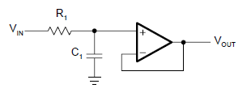
Designing Low Pass Filter
(First Order)
Active Filters
Inverting
Noninverting
(Ganho = 1)
(Ganho ≠ 1)
1
Specify f_{C}, A₀ , C₁
1
1
Specify f_{C}, C₁
Specify f_{C}, A₀, C₁
2
2
2
3
3

Slide 46
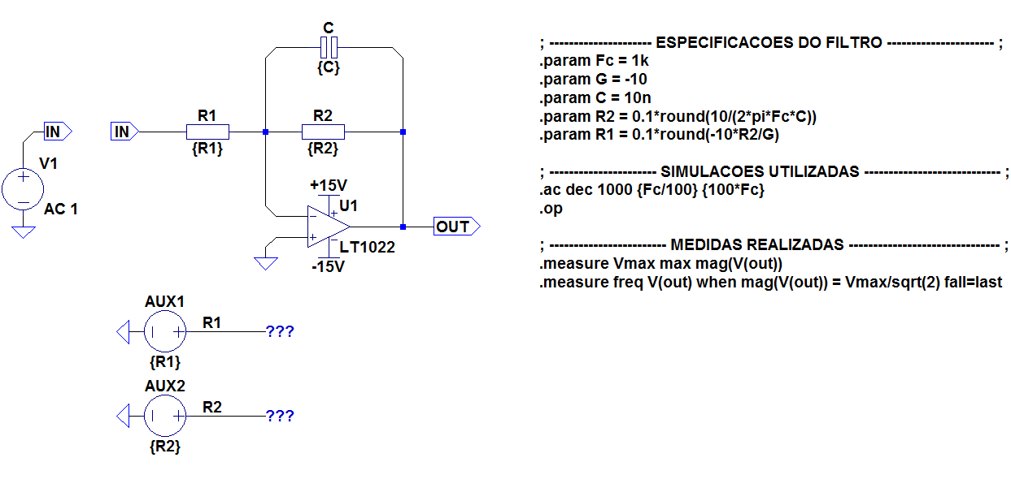
Designing Low Pass Filter
(First Order)
Active Filters
Filtro Passa-Baixa Sallen-Key Genérico de Ordem 1 Inversor

Slide 47
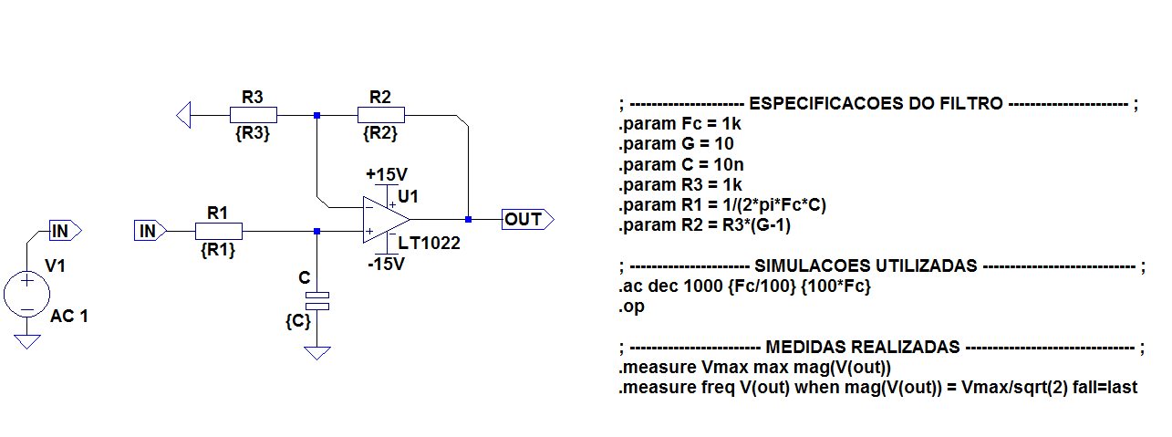
Designing Low Pass Filter
(First Order)
Active Filters
Filtro Passa-Baixa Sallen-Key Genérico de Ordem 1 Não-Inversor

Slide 48
Active Filters
Low Pass Filters
(Second Order Topology)

Slide 49
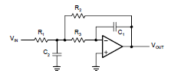
Designing Low Pass Filter
(Second Order)
Active Filters
Sallen-Key Topology
General Sallen-Key Topology
Multiple Feedbak Topology

Slide 50
Designing Low Pass Filter
(Seconder Order)
Active Filters
Sallen-Key Topology (G≠1)
The SK topology is commonly used in filters
General Sallen-Key Topology

Slide 51
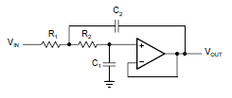
Designing Low Pass Filter
(Seconder Order)
Active Filters
Sallen-Key Topology (G=1)
Sallen-Key Topology with unit gain
a₁
b₁

Slide 52
Designing Low Pass Filter
(Second Order)
Active Filters
Multiple Feedbak Topology
The MFB topology is commonly used in filters that have high Qs and require a high gain
a₁
b₁

Slide 53
Active Filters
Designing Low Pass Filters
(Second Order)
Sallen-Key Topology

Slide 54
Designing Low Pass Filter
(Second Order)
Active Filters
Sallen-Key Topology
(G=1)
1
Pick C₁
2
Determine filter coefficients a₁ e b₁
3
In order to obtain real values under the square root, C2 must satisfy the following condition:
4
Calculate R₁ and R₂
22

Slide 55
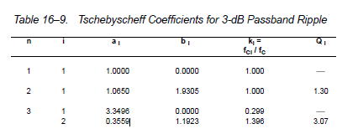
Designing Low Pass Filter
(Second Order)
Active Filters
Sallen-Key Topology
(G=1)
Exemple 1:
Design a second order unity gain Tschebyscheff low pass filter with a corner frequency of 3KHz and a 3dB passband ripple
1
Pick C₁ =22nF
2
Get the Tschebyscheff filters coefficient tables: a₁ = 1.0650 and b₁ = 1,9305

Slide 56
Designing Low Pass Filter
(Second Order)
Active Filters
Sallen-Key Topology
(G=1)
Exemple 1:
Design a second order unity gain Tschebyscheff low pass filter with a corner frequency of 3KHz and a 3dB passband ripple
3
3
4
Calculate R₁ and R₂

Slide 57
Designing Low Pass Filter
(Second Order)
Active Filters
Sallen-Key Topology
(G=1)
Exemple 1:
Design a second order unity gain Tschebyscheff low pass filter with a corner frequency of 3KHz and a 3dB passband ripple

Slide 58
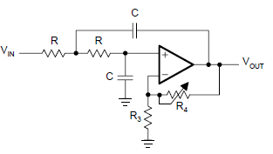
Designing Low Pass Filter
( Second Order)
Active Filters
Sallen-Key Topology
(G≠1)
R₁ = R₂ = R and C₁ = C₂ = C

Slide 59
Active Filters
Designing Low Pass Filter
(Second Order)
Sallen-Key Topology
(G≠1)
1
Get a_{n} and b_{n}
2
Pick C and get R
3
Calculate A₀ and R₄ /R₃
e
4
Calculate Q

Slide 60
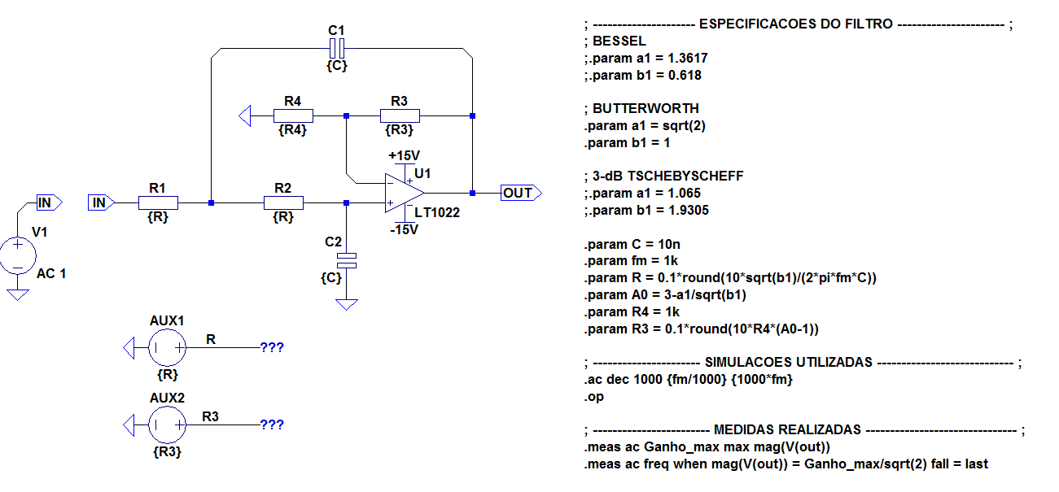
Designing Low Pass Filter
(First Order)
Active Filters
Filtro Passa-Baixa Sallen-Key Genérico de Ordem 2

Slide 61
Active Filters
Designing Low Pass Filters
(Higher Order)
Sallen-Key Topology

Slide 62
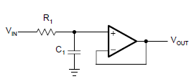
Designing Low Pass Filter
(Higher Order)
Active Filters
Exemple 1:
Design a fifth order unity gain Butterworth low pass filter with a corner frequency of 50KHz.

Slide 63
Designing Low Pass Filter
(Higher Order)
Active Filters
Exemplo
Design a fifth order unity gain Butterworth low pass filter with a corner frequency of 50KHz
Get Butterworth Coefficients

Slide 64
Designing Low Pass Filter
(High Order)
Active Filters
Exemplo
Design a fifth order unity gain Butterworth low pass filter with a corner frequency of 50KHz
First Filter: first order
1
Pick C₁ = 1nF
2
Get R₁

Slide 65
Designing Low Pass Filter
(High Order)
Active Filters
Exemplo
Design a fifth order unity gain Butterworth low pass filter with a corner frequency of 50KHz
Second Filter: Sallen-Key second order
1
Pick C₁ = 820pF
2
$R_{1}=\frac{a_{1C_{2}} − \sqrt{a_{1}^{2}C_{2}^{2}−4b_{1}C_{1}C_{2}}}{4πf_{c}C_{1}C_{2}}$ = 1.87K Ω
3
With C₁ = 820pF and C₂ = 1.5nF calculate R₁ and R₂
$R_{2}=\frac{a_{1C_{2}}+ \sqrt{a_{1}^{2}C_{2}^{2}−4b_{1}C_{1}C_{2}}}{4πf_{c}C_{1}C_{2}}$ = 4.42 KΩ

Slide 66
Designing Low Pass Filter
(High Order)
Active Filters
Exemplo
Design a fifth order unity gain Butterworth low pass filter with a corner frequency = 50KHz
Third Filter: Sallen-Key second order
1
Pick C₁ = 330pF
2
$R_{1}=\frac{a_{1C_{2}} − \sqrt{a_{1}^{2}C_{2}^{2}−4b_{1}C_{1}C_{2}}}{4πf_{c}C_{1}C_{2}}$ = 1.47K Ω
3
With C₁ = 330pF and C₂ = 4.7nF calculate R₁ and R₂
$R_{2}=\frac{a_{1C_{2}}+ \sqrt{a_{1}^{2}C_{2}^{2}−4b_{1}C_{1}C_{2}}}{4πf_{c}C_{1}C_{2}}$ = 4.53 KΩ

Slide 67
Designing Low Pass Filter
(High Order)
Active Filters
Exemplo
Design a fifth order unity gain Butterworth low pass filter with a corner frequency = 50KHz

Slide 68
Active Filters
Designing Low Pass Filters
(Second Order)
Multiple Feedback Topology

Slide 69
Designing Low Pass Filter
(Second Order)
Active Filters
Multiple Feedbak Topology
The MFB topology is commonly used in filters that have high Qs and require a high gain

Slide 70
Designing Low Pass Filter
(Second Order)
Active Filters
Multiple Feedbak Topology
1
Choose C₁ , C₂
2
Calculate R₁, R_{2,} R₃

Slide 71
Active Filters
Simulação LTSpice
Butterwork
Bessel
Tchebysheff (3dB)

Slide 72
Active Filters
High Pass Filters

Slide 73
Active Filters
High Pass Filter
By replacing the resistors of a low-pass filter with capacitors, and its capacitors with resistors a high-pass filter is created
General Sallen-Key Low Pass Topology
General Sallen-Key High Pass Topology
Unit Gain Sallen-Key Low Pass Topology
Unit Gain Sallen-Key High Pass Topology

Slide 74
Active Filters
High Pass Filter
To plot the gain response of a high-pass filter mirror the gain response of a low-pass filter replacing Ω with 1/Ω and S with 1/S
A(s) =

Slide 75
Active Filters
High Pass Filters
First Order Topology

Slide 76
High Pass Filter
(First Order)
Active Filters
Inverting
-

Slide 77
High Pass Filter
(First Order)
Active Filters
Noninverting

Slide 78
Active Filters
Designing
High Pass Filters
First Order Topology

Slide 79
Designing High Pass Filter
(First Order)
Active Filters
Inverting
Noninverting
1
Specify f_{C}, A∞, C₁
1
Specify f_{C}, A∞, C₁
2
2
3
3

Slide 80
Active Filters
High Pass Filters
Second Order Topology

Slide 81
Designing High Pass Filter
(Second Order)
Active Filters
Sallen-Key Topology
General Sallen-Key Topology
α = 1
Unit Gain Sallen-Key Topology

Slide 82
Designing High Pass Filter
(Second Order)
Active Filters
Multiple Feedbak Topology
The MFB topology is commonly used in filters that have high Qs and requirea high gain

Slide 83
Active Filters
Designing
High Pass Filters
Second Order Topology

Slide 84
Designing High Pass Filter
(Second Order)
Active Filters
Sallen-Key Topology
(unit gain)
1
Get the filter coefficients
2
Specify C
Unit Gain
3
4

Slide 85
Designing High Pass Filter
(Second Order)
Active Filters
Multiple Feedbak Topology
1
Get the filter coefficients
2
Pick C and C₂
3
4

Slide 86
Active Filters
Designing
High Pass Filters
Higher Order Topology

Slide 87
Designing High Pass Filter
(Higher Order)
Active Filters
Exemple 1:
Design a third-order Sallen-Key unity-gain Bessel high-pass filter with the corner frequency f_{C} = 1 kHz.
1
Get the Bessel coefficients

Slide 88
Designing High Pass Filter
(Higher Order)
Active Filters
Exemple:
Design a third-order Sallen Key unity-gain Bessel high-pass filter with the corner frequency f_{C} = 1 kHz.
First Filter: first order non-inverting with unit gain
C₁
R₁
1
Bessel coefficientes: a₁= 0.756, b₁ = 0
2
Pick C₁
C₁ = 100nF
3
Get R₁

Slide 89
Designing High Pass Filter
(Higher Order)
Active Filters
Exemple:
Design a third-order Sallen Key unity-gain Bessel high-pass filter with corner frequency f_{C} = 1 kHz.
Second Filter: second order SK with unit gain
1
Bessel coefficientes: a₂ = 0.996, b₂ = 0.472
2
Pick C
C = 100nF
3
4

Slide 90
Designing High Pass Filter
(Higher Order)
Active Filters
Exemple:
Design a third-order Sallen Key unity-gain Bessel high-pass filter with the corner frequency f_{C} = 1 kHz.

Slide 91
Active Filters
Band Pass Filters

Slide 92
Active Filters
Band Pass Filter
The passband characteristic of a low-pass filter is transformed into the upper passband half of a band-pass filter. The upper passband is then mirrored at the mid frequency, f_{m} (Ω=1), into the lower passband half

Slide 93
Active Filters
Band Pass Filter
Normalized bandwith
Normalized mid bandwith
Q factor

Slide 94
Active Filters
Band Pass Filter
The simplest design of a band-pass filter is the connection of a high-pass filter and a lowpass filter in series, which is commonly done in wide-band filter applications.
A first order high-pass and a first-order low-pass provide a second-order band-pass,
A second-order high-pass and a second-order low-pass result in a fourth-order band-pass response.
Narrow-band filters of higher order consist of cascaded second-order band-pass filters that use the Sallen-Key or the Multiple Feedback (MFB) topology.

Slide 95
Active Filters
Band Pass Filter
To develop the frequency response of a second-order band-pass filter, apply the
Transformation to a first-order low-pass transfer function:
s
s

Slide 96
Active Filters
Band Pass Filter
When designing band-pass filters, the parameters of interest are the gain at the mid frequency (A_{m}) and the quality factor (Q), which represents the selectivity of a band-pass filter. Therefore, replace A₀ with A_{m} /Q and ΔΩ with 1/Q (Equation 16–7) to obtain:

Slide 97
Active Filters
Band Pass Filter
Normalized gain response of a second order bandpass filter

Slide 98
Active Filters
Band Pass Filters
Second Order Topology

Slide 99
Designing Band Pass Filter
(Second Order)
Active Filters
Sallen-Key Topology
Multiple Feedbak Topology

Slide 100
Designing Band Pass Filter
(Second Order)
Active Filters
Sallen-Key Topology
G= 1 + R₂ /R₁

Slide 101
Designing Band Pass Filter
(Second Order)
Active Filters
Sallen-Key Topology
The Sallen-Key circuit has the advantage that the quality factor (Q) can be varied via the
inner gain (G) without modifying the mid frequency (f_{m}).
A drawback is that Q and A_{m} cannot be adjusted independently.
Care must be taken when G approaches the value of 3 because A_{m} becomes infinite.

Slide 102
Designing Band Pass Filter
(Second Order)
Active Filters
Multiple Feedback Topology

Slide 103
Active Filters
Designing
Band Pass Filters
Second Order Topology

Slide 104
Designing Band Pass Filter
(Second Order)
Active Filters
Sallen-Key Topology
1
Specify f_{m} and C
2
3a
Specify A_{m}, calculate G and R₂ / R₁
3b
Specify Q, calculate G and R₂ / R₁
G= 1 + R₂ /R₁
G= 1 + R₂ /R₁

Slide 105
Designing Band Pass Filter
(Second Order)
Active Filters
Multiple Feedback Topology
1
Specify f_{m} , Q, A_{m} and C
$R_{2}$=$\frac{Q}{πf_{m}C}$
2
$$R_{1 }=\left|\frac{R_{2}}{−2A_{m}}\right|$$
3
$$R_{3 }=\left|\frac{{−A}_{m}R_{1}}{Q^{2}+A_{m}}\right|$$
4

Slide 106
Designing Band Pass Filter
(Second Order)
Active Filters
Exemple 1:
Design a second-order MFB band-pass filter with a mid frequency of f_{m}= 1 kHz, a quality factor of Q = 10, and a gain of A_{m}= –2. Assume a capacitor value of C = 100 nF.

Slide 107
Active Filters
Band Pass Filters
Higher Order Topology

Slide 108
Higher Order Band Pass Filter
Active Filters
Replacing the s term with the transformation
in a second order low pass transfer function gives the general transfer function of a fourth-order band-pass:

Slide 109
Active Filters
Band Pass Filter
This equation represents the connection in series of two second-order band-pass filters where:
b

Slide 110
Active Filters
Band Pass Filter
Factor α needs to be determined through successive approximation, using equation:
Values of α For Different Filter Types and Different valures of Q:

Slide 111
Active Filters
Band Pass Filter
In a fourth-order band-pass filter with high Q, the mid frequencies of the two partial filters differ only slightly from the overall mid frequency. This method is called staggered tuning. A flat gain response shows up as well as a sharp pass-band to stop-band transition.

Slide 112
Active Filters
Band Pass Filter
Example: Gain response of a fourth-order Butterworth band-pass filter with staggered tuning where with Q = 1. Its partial filters are shown as well as the gain of a non staggered tuning filter with Q = 10.

Slide 113
Active Filters
Designing
Band Pass Filters
Higher Order Topology

Slide 114
Active Filters
Band Pass Filter
Exemple:
Design a fourth-order Butterworth band-pass with f_{m} = 10KHz, Q = 10 and A_{m} = 1 using a second order multiple feedback topology.
1
From table: a₁ = 1.4142, b₁ = 1, α = 1,036

Slide 115
Active Filters
Band Pass Filter
Exemple:
Design a fourth-order Butterworth band-pass with f_{m} = 10KHz, Q = 10 and A_{m} = 1 using a second order multiple feedback topology.
2
Calculate f_{m1} and f_{m2}
3
Calculate Q_{i}

Slide 116
Active Filters
Band Pass Filter
Exemple:
Design a fourth-order Butterworth band-pass with f_{m} = 10KHz, Q = 10 and A_{m} = 1 using a second order multiple feedback topology.
4
Calculate A_{mi}
b₁
5
Calculate the MF resistance components for filter 1 and filter 2 using C = 10nF
$R_{2i}$= $\frac{Q_{i}}{πf_{mi}C}$
$$R_{1i }=\left|\frac{R_{2}}{−2A_{mi}}\right|$$
$$R_{3i }=\left|\frac{{−A}_{mi}R_{1}}{{2Q}^{2}+A_{mi}}\right|$$

Slide 117
Active Filters
Band Pass Filter
Exemple:
Design a fourth-order Butterworth band-pass with f_{m} = 10KHz, Q = 10 and A_{m} = 1 using a second order multiple feedback topology and C=10nF.
5
Calculate the MF resistance components using C = 10nF
+
+

Slide 118
Active Filters
Simulação - LTSpice
Os valores dos componentes foram medidos !

Slide 119
Active Filters
Band Rejection Filters

Slide 120
Band Rejection Filter
Active Filters
A band-rejection filter is used to suppress a certain frequency rather than a range of
frequencies.
The passband characteristic of the low-pass filter is transformed into the lower passband of the band-rejection filter. The lower passband is then mirrored at the mid frequency, f_{m} (Ω=1), into the upper passband half.

Slide 121
Band Rejection Filter
Active Filters

Slide 122
Band Rejection Filter
Active Filters
To generate the transfer function of a second-order band-rejection filter, replace the s
term of a first-order low-pass response with the transformation
A_{o} é o ganho na banda de passagem.

Slide 123
Band Rejection Filter
Active Filters
Two of the most popular band-rejection filters are the active twin-T and the active Wien-Robinson circuit, both of which are second-order filters.
active twin-T
active Wien-Robinson

Slide 124
Active Filters
Band Rejection Filters
Função de Transferência

Slide 125
Active Filters

Slide 126
Active Filters
Função de Transferência H(s)
Filtro de ordem 2 com dois zeros e dois pólos

Slide 127
Active Filters
Ganho (A_{v}=A_{o})
Para obtenção do ganho não é necessário resolver (H(s):
Nota-se que quando w 0 os capacitores se tornam circuitos abertos e nessa situação v₁=v₂=v_{i}, tornando o circuito um amplificador não inversor, cujo ganho é:

Slide 128
Active Filters
Frequência Central (w_{c})
Como s=jw: então:
A frequência central é o valor w_{c} que minimiza |H(s)|. Os valores de C, R,R₁ e R₂ são constantes positivas e o numerador de |H(s)| é uma parábola com concavidade para baixo que cruza o eixo das ordenadas acima do zero, ou seja, essa parábola passa por zero. Sendo assim, para encontrar a frequência central basta encontrar w_{c} tal que |H(s)| = 0, então:

Slide 129
Active Filters
Frequência Central (w_{c})

Slide 130
Active Filters
Fator de Qualidade (Q)
Substituindo A_{v} _{e} w_{c} em |H(s)|:

Slide 131
Active Filters
Fator de Qualidade (Q)
Para obter w₂ sabemos que w_{c} < w₂ portanto:
Para obter w₁ sabemos que w_{c} > w₁ portanto:

Slide 132
Active Filters
A função de transferência de um filtro rejeita banda é:

Slide 133
Active Filters
Design
Band Rejection Filters

Slide 134
Band Rejection Filter
Active Filters
Active Twin-T Filter

Slide 135
Designing Rejection Pass Filter
Active Filters
Active Twin-T Filter
1
Specify f_{m} , A_{o} =G and C
2
Calculate R
3
Calculate R₂ / R₁
4
Pick R₁ and calculate R₂
5
Cálculo de Q:

Slide 136
Designing Rejection Pass Filter
Active Filters
Exemple:
Design a rejection pass filter using the Twin-T topology with f_{m} = 10KHz, A_{o} = 1,5 . Pick C=10nF.
1
Calculate R
= 1,6KΩ
2
Calculate R₂ / R₁
R₂ / R₁ = 0,5
3
Pick R₁ and calculate R₂
R₁ = 2,2KΩ and R₂ = 1,1KΩ

Slide 137
Designing Rejection Pass Filter
Active Filters
Exemple:
Design a rejection pass filter using the Twin-T topology with f_{m} = 10KHz, A_{o} = 1,5 . Pick C=10nF.

Slide 138
Band Rejection Filter
Active Filters
Wien-Robinson Filter

Slide 139
Designing Rejection Pass Filter
Active Filters
Win-Robinson Filter
1
Define f_{m} and C, Q and A_{o}
2
Calculate R
3
Determine α
4
Determine β
5
Define R₂ and calculate R₃ and R₄

Slide 140
Active Filters
Simulação - LTSpice
LM318
LM351
LM741

Slide 141
Active Filters
Simulação - LTSpice
LM318
LM351
LM741

Slide 142
Active Filters
All Pass Filters

Slide 143
All Pass Filters
Active Filters
All-pass filter has a constant gain across the entire frequency range, and a phase response that changes linearly with frequency.
All-pass filters are used in phase compensation and signal delay circuits.
Similar to the low-pass filters, all-pass circuits of higher order consist of cascaded first-order and second-order all-pass stages.
(a_{i} and b_{i} being the coefficients of a partial filter)

Slide 144
All Pass Filters
Active Filters
The transfer function expressed by magnitude and phase yields:
Magnitude :
(módulo 1)
Phase:

Slide 145
All Pass Filters
Active Filters
Group Delay
It is te time by which the all pass filter delays each frequency within a band.
The normalized group delay is calculated by the equations:

Slide 146
All Pass Filters
Active Filters
The frequency at which the group delay drops to $\frac{1}{\sqrt{2}}$ times its initial value is the corner
frequency, f_{C}.
The T_{gro} is the value of T_{gr} when Ω < 1.

Slide 147
Designing Low Pass Filter
(Second Order)
Active Filters
All Pass

Slide 148
All Pass Filters
Active Filters
First Order Topology
Second Order Topology

Slide 149
All Pass Filters
Active Filters
The T_{gro} is the value of T_{gr} when Ω < 1.
$t_{gro}$= 2RC
(ordem 1 )
$t_{gro}$= 4RC
(ordem 2)

Slide 150
Active Filters
Designing
All Pass Filters
(First Order Topology)

Slide 151
All Pass Filters
Active Filters
First Order Topology
1
Specify f_{C} and C
2
Calculate R
3
Delay group

Slide 152
Active Filters
Designing
All Pass Filters
(Second Order Topology)

Slide 153
All Pass Filters
Active Filters
Second Order Topology
1
Specify f_{C} , R and C
2
Calculate R
3
Calculate R₁ , R_{2 ,} R₃
4
Maximum delay group

Slide 154
All Pass Filters
Active Filters
Exemple:
A signal with the frequency spectrum, 0 < f < 1 kHz, needs to be delayed by 2 ms. To keep the phase distortions at a minimum, the corner frequency of the all-pass filter must be f_{C} ≥ 1 kHz. Design a 2-ms delay all-pass filter
1
The figure below shows a seventh-order all-pass is needed to accomplish the desired delay.
e tgro = 2ms

Slide 155
All Pass Filters
Active Filters
Exemple:
A signal with the frequency spectrum, 0 < f < 1 kHz, needs to be delayed by 2 ms. To keep the phase distortions at a minimum, the corner frequency of the all-pass filter must be f_{C} ≥ 1 kHz. Design a 2-ms delay all-pass filter

Slide 156
All Pass Filters
Active Filters
Exemplo:
Implemente em um protoboard um filtro passa tudo de ordem 1 com frequência de corte 1KHz. Utilize C=10nF.
Simulação - LTSpice

Slide 157
All Pass Filters
Active Filters
Exemplo:
Implemente em um protoboard um filtro passa tudo de ganho unitário e ordem 1 com frequência de corte 1KHz. Utilize C=10nF.
Ɵ
Simulação - LTSpice
escala
linear
f(Hz)
1KHz

Slide 158
All Pass Filters
Active Filters
Exemplo:
Implemente em um protoboard um filtro passa tudo de ordem 1 com frequência de corte 1KHz. Utilize C=10nF.
G(dB)
Simulação - LTSpice
f(Hz)

