Slide 1
《The Rise and Fall of American Growth: The U.S. Standard of Living Since the Civil War.》
——Robert gordon
Chapter 17
Innovation: Can the Future Match the Great Inventions of the Past?
Xu Kunwei

Slide 2
Part I Innovation through history: the ultimate risk-takers
Total factor productivity (TFP)
reflect the role of innovation and technological
Technological chang raises outout directly and induces capital accumulation, also are the source of improvements of the capital quality.
Technological leaves education and realocation as the remaining source od growth beyond innovation itself.
Every source od growth can be reduced back to innovation and technological change.

Slide 3
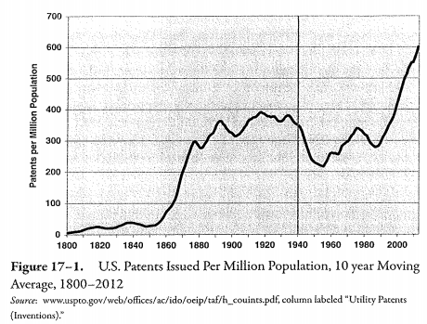
Part I Innovation through history: the ultimate risk-takers
U-Shaped
individual entrepreneurs
VS
large corporate

Slide 4
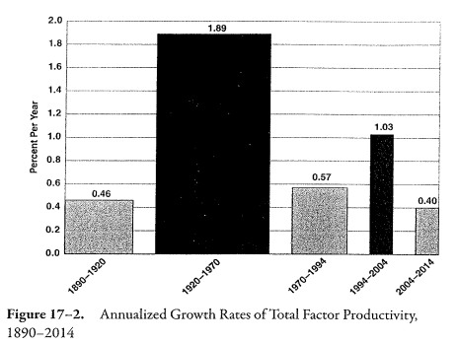
Part II The historical record: the growth of total factor productivity
The great surge in the level of TFP was achieved primarily between 1920 and 1970 ( IR #2)
The brief revival of TFP growth in 1994-2004 reflect the contribution of IR #3

Slide 5
UESTIONS
Q
1
Why was the main effect of IR #3 on TFP so short-lived that is duration was limited to the 1994-2004 decade?
2
Why was the TFP growth so slow in the most recent 2004-2014 decade?
3
What are the implications of slow recent TFP growth for the future evolution of TFP and labor productivity the next quarter century?

Slide 6
Part III Achievement to date of the third industrial revolution
Comunications
· Mobile phone
· System
Apple iphone
Google Android
Information technology
I&T
·Computer
·Internet

Slide 7
Part III Achievement to date of the third industrial revolution
“We can see the computer age everywhere but in the productivity statistics.”
——Solow
Although IR#3 was revolutionary, its effect was felt in a limited sphere of human activity, in contrast to IR#2, which changed everything.
Should the 0.4% growth rate of the most recent 2004-2014 decade be considered the most relevant basis for the future growth? Or should our projection for the future be partly or largely based on the 1.03% average TFP growth achieved by the decade of 1994-2004?

Slide 8
Part IV Could the third industrial revolution be almost over?
Most of the economy has already benefited from the Internet and web revolution.
1. A Slowing Transformation of Business Practices.
The digtal revolution centered on I970-2000 utterly changed the way offices function. ( personal computers, flat screens, broadband service, electronic catalog....)
In the past decade business practices, while relatively unchanged in the office, because the equipment used in office wrok and the productivity of the office employees closely resembles that of a decade ago. But it have steadily improved outside of the office. So that's why the near-ubiquity of smatphones and tablets has been accompanied by such slow economy-wide productivity growth, particularly since 2009. Because they are used in the office for personal activities.

Slide 9
Part IV Could the third industrial revolution be almost over?
2. Stasis in retailing.
Since the development of “big-box” retailers in the 1980s and 1990s, the conversion of checkout aisles to barcode scanners, little has changed in the retail secor, especially steping into the computer age. The main impact on retail productivity growth of big-box stores and warehouse clubs had largely occurred by a decade ago.
3. A Plateau of Activity in Finace Banking.
Both ATM and billion-shared trading days are created in the 1980s and 1990s. Nothing much has changed in more than a decade.

Slide 10
Part IV Could the third industrial revolution be almost over?
4. The Home and Consumer Electronics.
In contrast to the decade or so of stability in procedures at work, life inside the home has been stable not for a single decade, but for nearly a hafe century. For the past decade, homes have had access to entertainment and information through fast brodband connections to the web, and smartphones have made the web portable, but now that smartphones and tablets have saturated their potential market, further advance in consumer electronics have become harder to achive.
5. Decline in Business Dynamism.
Both ATM and billion-shared trading days are created in the 1980s and 1990s. Nothing much has changed in more than a decade.

Slide 11
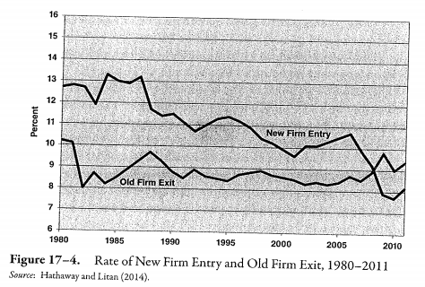
Part IV Could the third industrial revolution be almost over?
5. Decline in Business Dynamism.
Related research on labor market dynamics points to a decline in “fluidity” .

Slide 12
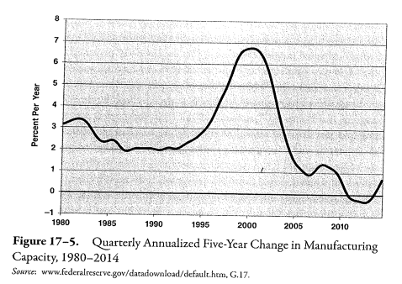
Part V Objective measure of slowing economic growth
1. Manufacturing Capacity.

Slide 13
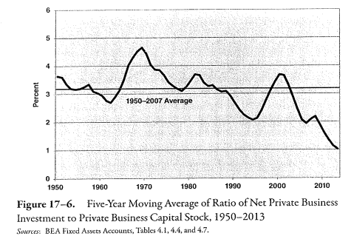
Part V Objective measure of slowing economic growth
2. Net Ivestment.

Slide 14
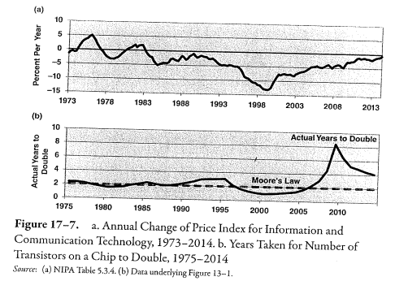
Part V Objective measure of slowing economic growth
3. Computer Perfotmance.
4. Moore's Law.

Slide 15
Part VI Can future innovation be predicted?
The usual stance of economic historians scoff at any attempt to forecast the future: any pessing gazing into the future is condemned for a lack of imagination and doomed to repeat the mistakes of past pessimists.
But there are historical preceds of correct predictions made as long as fifty or 100 years in advance.
Paris in the Twentieth century (Jules Verne's, 1893)
Ladies Home Journal (Dec.1990)
1931940 World's Fair
Nobert Wiener and Dick Tracy

Slide 16
Part VII The inventions that are now forecastable
Medical and Pharmaccutical Advances.
Small Roborts and 3D Printing
Big Data and Artificial Intelligence.
Driverless Cars
Nobert Wiener and Dick Tracy

Slide 17
Conclusion
The rate of advance of labor productivity and TFP over the next quarter century will resemble the slow pace of 2004-2005, not the faster growth rate of 1994-2004, much less the even faster growth rate achieved long ago during 1920-1970.

Slide 18
THANK YOU FOR INVOLVING

