Slide 1
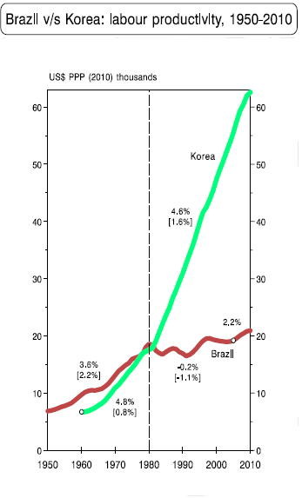

Slide 3
The Political Economy of Nationalism
Class 6
Which are the Limits of State-Led Development?
Dr. Vinícius Rodrigues Vieira (IRI-USP)
September 19, 2018

Slide 4
Core characteristics of ISI in Brazil
According to Alston et al (2016, 57)
“The belief in developmentalism started after the 1930 revolution but intensified in the early 1950s Vargas era”;
“This belief formed the basis of the Import Substitution Industrialization (ISI) model driven by state-led industrialization associated with foreign indebtedness and populist incorporation of diverse sectors of the society, in particular workers and middle classes”;
“Developmentalism established growth, economic might, and industrial progress as imperatives, leaving issues of democracy and combating inequality and poverty as secondary and subservient objectives”.
→ A STRATEGY OF DEPENDENT DEVELOPMENT

Slide 5
Has ISI worked in the long term?
How to assess it?

Slide 7
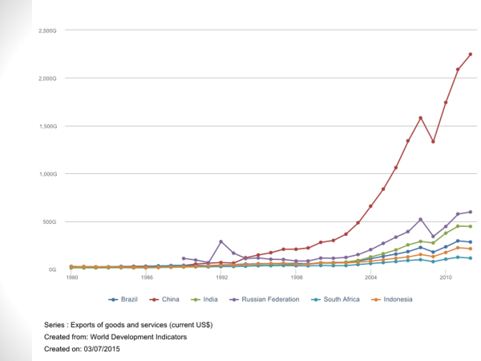

Slide 9
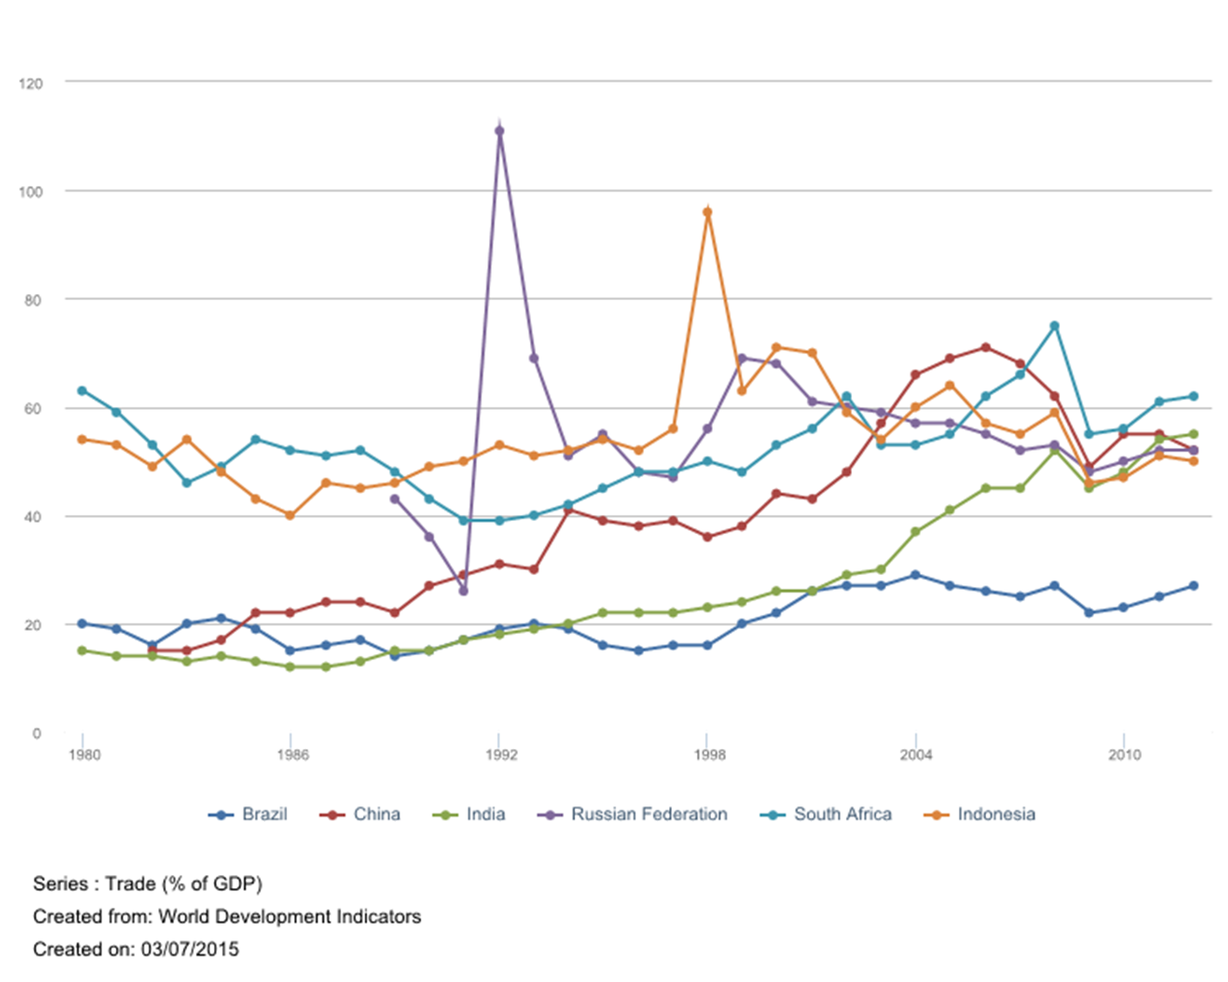

Slide 10
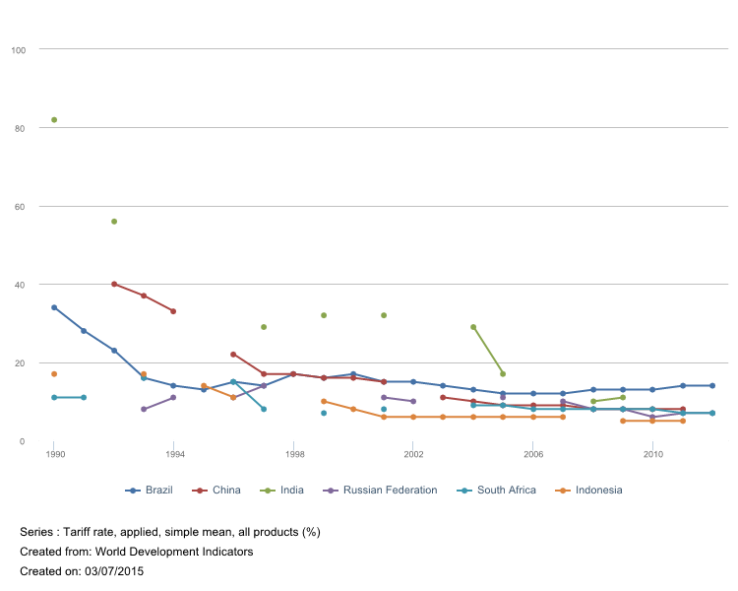

Slide 11
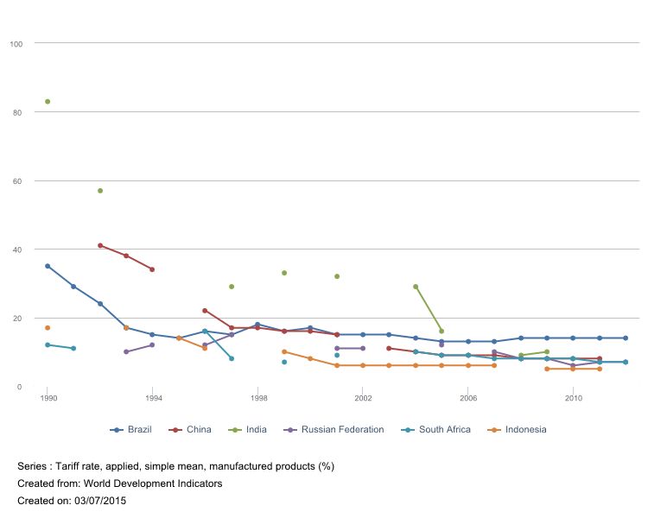

Slide 12
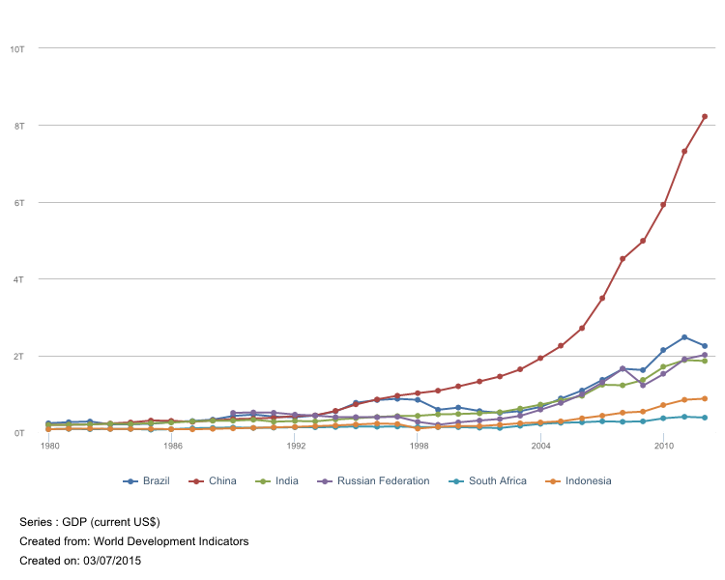

Slide 13
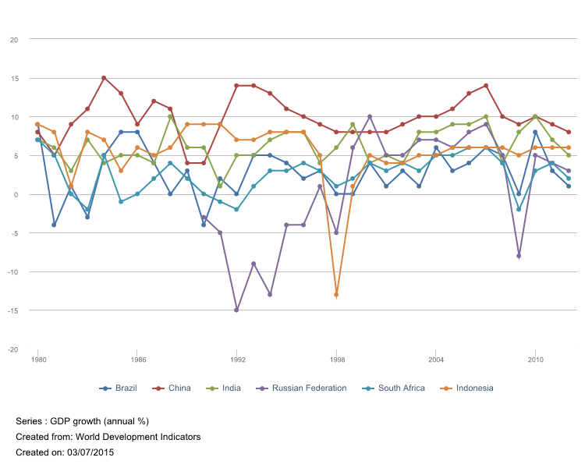

Slide 15
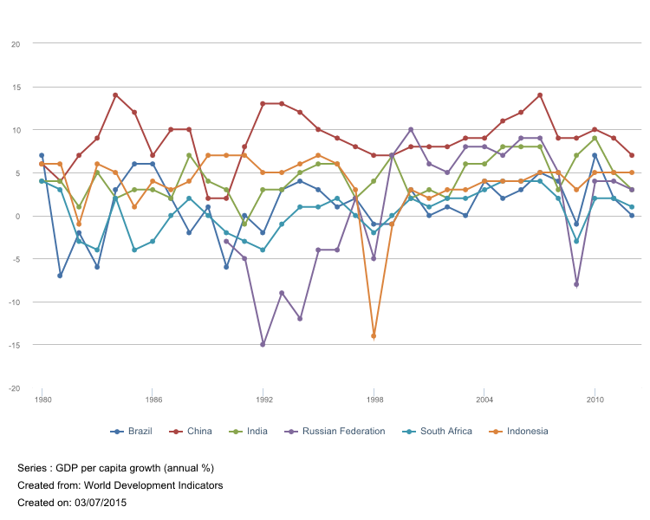

Slide 17
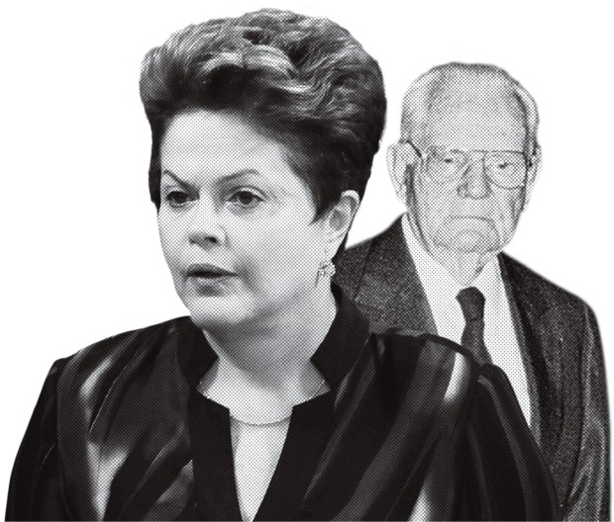
The shadow of the past...

Slide 19
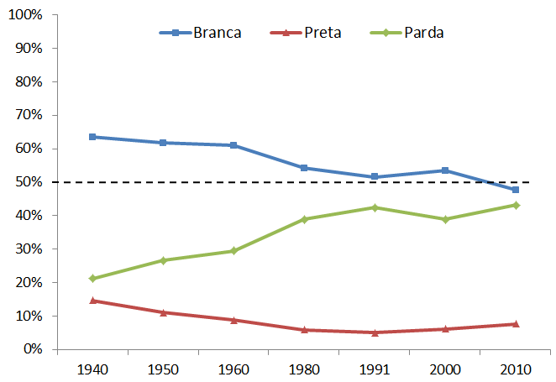

Slide 20
Is Brazil a Racial Democracy?

Slide 21
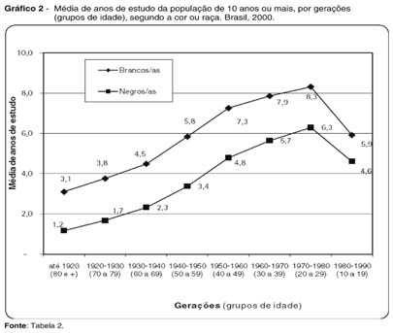

Slide 23
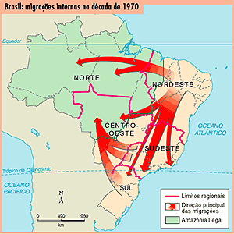

Slide 24
The economic miracle ended in…
“The Brazilian Miracle of high growth was short- lived and ended in early 1973 with an oil shock that brought external indebtedness and rekindled inflation. Instead of adjusting to the new reality by slowing down the economy, the government chose to go ahead with import substitution in the hope of reducing Brazilian dependence on imported products. The strategy still retained substantial economic growth (6– 7 percent a year) but at the expense of increased public spending, unbalanced government accounts, foreign debt, and inflation” (Alston et al. 2016, p. 57)

Slide 25
… inflation, which brings more inequality…
“Geisel’s plans failed to materialize, in part because the international economic environment deteriorated further in the late 1970s with the second oil shock, which led to massive increases in the value of imports. Unfazed, the government maintained the policy of pursuing accelerated growth without further concerns for inflation, which shot from 15 to 35 percent” (Alston et al. 2016, p. 57)

Slide 26
… and more dependent development
“The easy availability of foreign capital allowed Geisel to pursue his strategy, but it ran the country deeper into debt. Geisel undertook a new vigorous wave of import substitution. Now, the government extended the dominant network to include producers of sugarcane and ethanol, steel, iron, cellulose, petrochemicals, and other raw materials. The government directly and heavily invested in electricity, transportation, and communication.” (Alston et al. 2016, p. 57)
NOT TO MENTION INEQUALITY BEYOND CLASS!!!

Slide 27
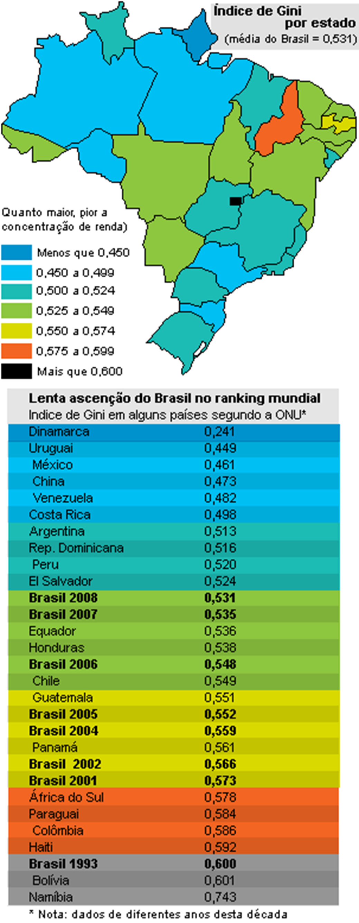

Slide 28
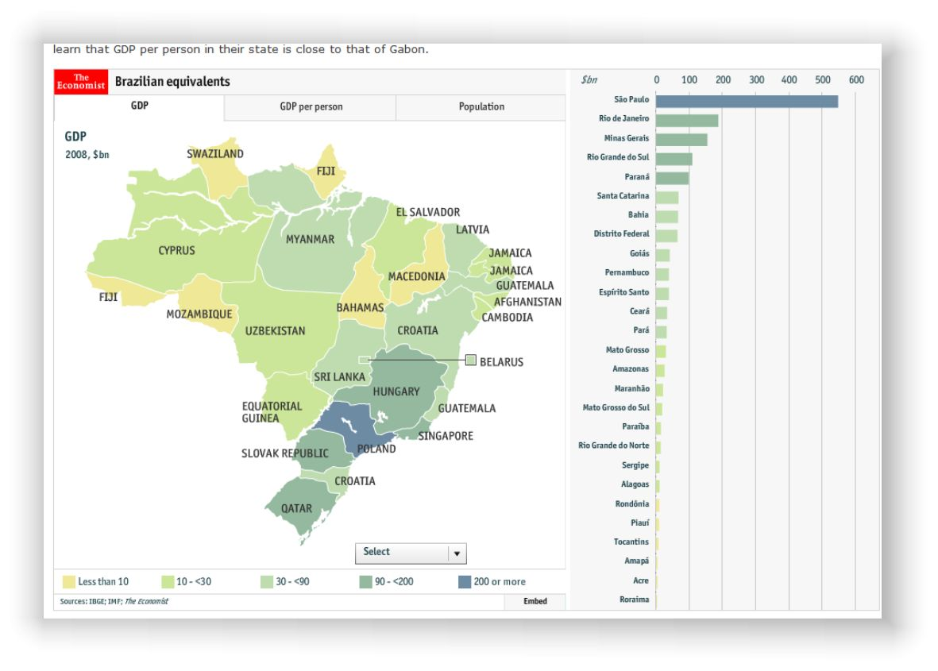

Slide 29
To avoid this...

Slide 30
… seek this
More domestic savings
Less foreign debt
→ India since the 1980s fits those patterns…

Slide 31
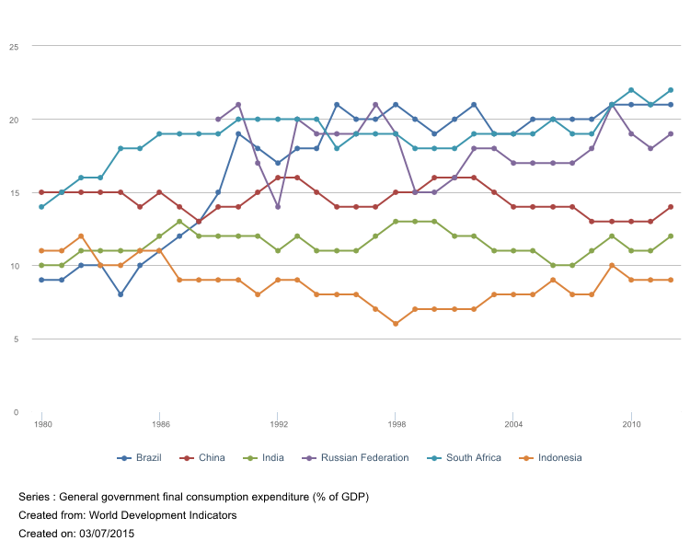

Slide 33
Yet, that has not been always the case…
1950-1980: low rates of growth;
Secularist ideology → like racial democracy in Brazil, ignored inequalities and discrimination.

Slide 34
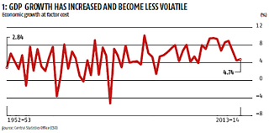
Before: Hindu rate of growth

Slide 35
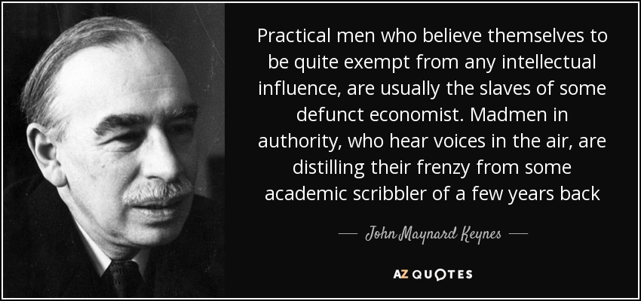
The “Danger”— Keynes (and his ideas) “died”

Slide 36
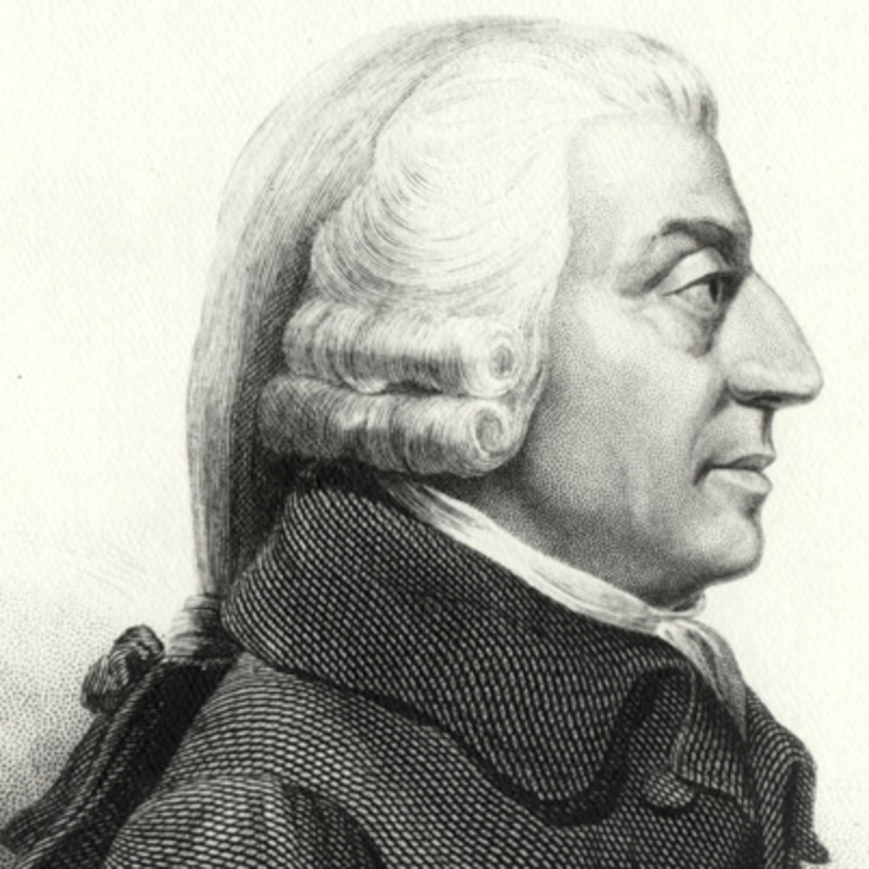
Back to Economic Liberalism → Neoliberalism
The role of the state comprised:
Defence;
Justice;
Certain public works (and not always!!!)
Yet, which ones?
To facilitate trade
To educate the young

