Slide 1
How to write your essay …

Slide 2
The Puzzle
Revealing the hidden secrets of
the working mechanisms of
global politics.

Slide 3
The research question
What do I want to know?
How can I relate the question to the more general puzzle?
Why is the question relevant?
How can I convince my reader of the importance of the question?

Slide 4
The theoretical approach
Find a theoretical underpinning which forms the point of departure of your argument
Are there theoretical concepts / ideas in the literature?
Are there rivalling theories?
Which theory may answer your question most adequately?

Slide 5
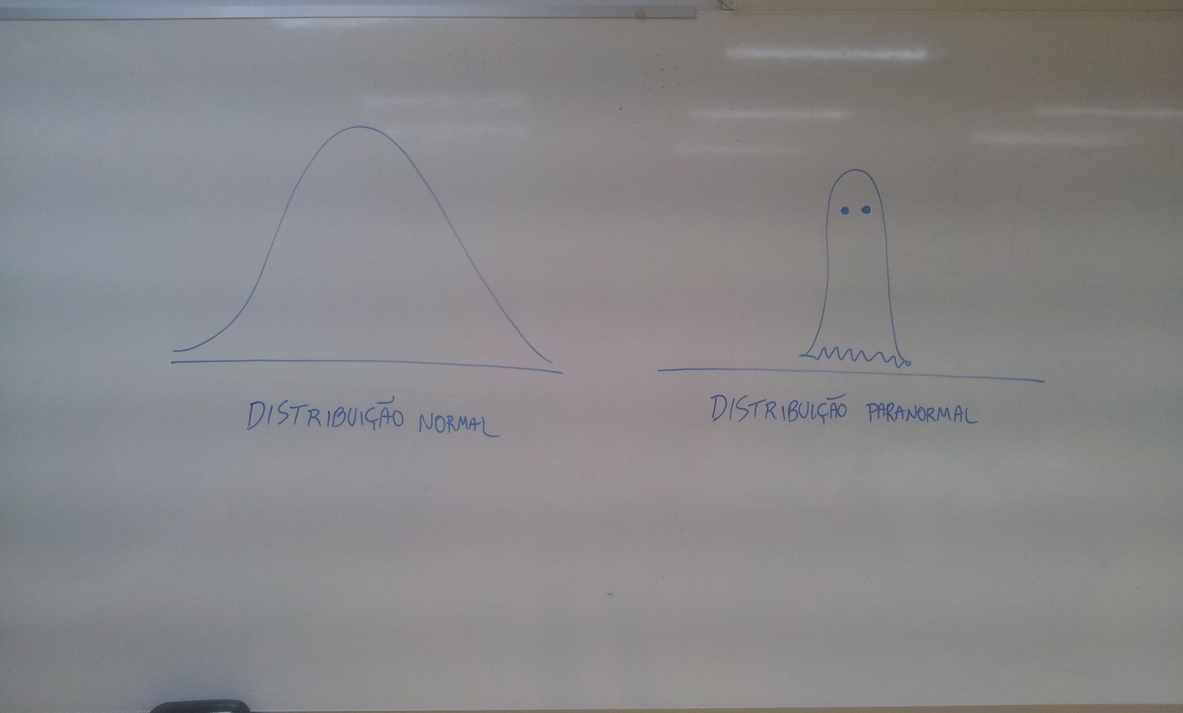
The empirical case study
Use an appropriate empirical case to answer your question
Apply your theory to the case study /
Explain your case study by relying on your theory

Slide 6
Puzzle (Introduction)
Research question
Theoretical approach
Empirical case study
Conclusion (Summary of your argument / findings)
Argument

