Slide 1
Ferramentas
Bancos de dados
NCBI - https://www.ncbi.nlm.nih.gov/
Arabidopsis (TAIR) - https://www.arabidopsis.org/
Phytozome - https://phytozome.jgi.doe.gov/
TF db - http://planttfdb.gao-lab.org/
UniProt - https://www.uniprot.org/
Alinhamento e reconstrução filogenética
https://tcoffee.crg.eu/apps/tcoffee/index.html
https://www.hiv.lanl.gov/content/sequence/PHYML/interface.html
http://www.atgc-montpellier.fr/phyml/usersguide.php
https://ngphylogeny.fr/

Slide 2
Ferramentas
Elementos nas sequências
Motivos em promotores - http://plantpan.itps.ncku.edu.tw/
Domínios em proteínas:
Interpro - https://www.ebi.ac.uk/interpro/search/sequence/ Prosite - https://prosite.expasy.org/scanprosite/
Peptídeo sinal - https://services.healthtech.dtu.dk/services/SignalP-5.0/
Interação PxP - https://www.expasy.org/resources/string

Slide 3
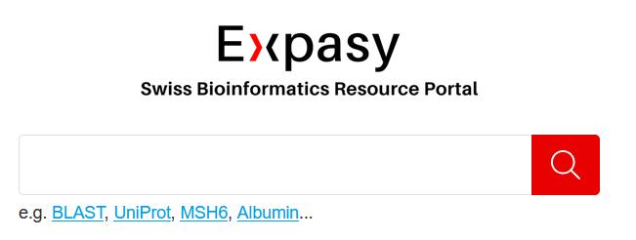
Ferramentas
Portal de recursos – Expasy

Slide 4
Ferramentas
Desenho de estruturas
Gene - http://wormweb.org/exonintron
Gene/Proteína (IBS) - https://mybiosoftware.com/ibs-illustrator-of-biological-sequences.html
Proteína - https://prosite.expasy.org/mydomains/

