Slide 1
TECHNOLOGIAL INNOVATION AND ORGANIZATIONS
PIERRE AZOULAY & JOSH LERNER (2013)
FABIO E. FARAGO

Slide 2
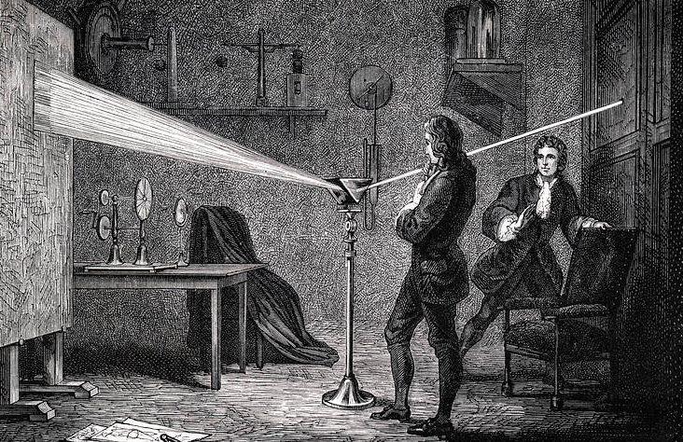
AN INTRODUCTION
Since 1950, technological innovation has been recognized by economists as being at the core of economic growth
The importance of technological change has been generally understood since the works of Abramowitz (1956) and Sollow (1957)
Innovation is essential to understand organizational economics

Slide 3
R&D PRODUCTIVITY AND INTERNAL ORGANIZATION
WHAT MAKES AN ORGANIZATION MORE OR LESS INNOVATIVE?
The literature focused mostly on firm size, following Schumpeter’s (1942) idea
Schumpeterian hypothesis did not stood the test of time
Casual empirism in several industries (medical devices, communications, semiconductors) ; (Intel, Microsoft, apple)
Cohen & Levin (1989) review of literature failed to uncover a relationship
WHAT EXPLAINS THE RELATIVE FAILURE OF EMPIRICAL PROGRAM SET UP BY SCHUMPETER’S?

Slide 4
BEYOND FIRM SIZE: OPENING THE INNOVATION BLACK BOX
Internal organization – become relevant when it was realized that R&D intensity is dependent on firm effects
The literature begin to focus on three broad features of organizations:
(i) the design of incentive systems
(ii) firm’s abilities to manage spillovers of knowledge
(iii) firm’s choice of organizational structure

Slide 5
MOTIVATING INNOVATION: THE ROLE OF INCENTIVE SYSTEMS
Broad set of firm incentives
In innovation, theres three problens:
Projects are risky and unpredictable
Long term and multistage and a team activity
Might not be clear what is the correct path
Idiosyncratic and dificult to compare to other Project
Recomendations:
Tolerance for early failures
Reward for good performance over the long term
Incentives both for and aplied output in balance
(publications and patents)
Give freedom to scientists choose their own Project (15%)

Slide 6
SPILLOVERS OF KNOWLEDGE AND INTERNAL ORGANIZATION
Knowledge is not a public good
Distance between transmitter and receiver matters. There’s a high degree of localization (rsc)
Technological space: R&D of a focal firm is positive correlated with neighboors
Social distance also impenge on the extant of spillovers
Absortive capacity: firms can absorb spillovers from other firms
Firms can absorb outside knowledge, beyond performing basic R&D by working closely with competitors stakeholders (IBM)

Slide 7
MOBILITY OF ENGINNERS AND HUMAN CAPITAL EXTERNALITIES
A seminal study Saxenian (94) explained the sucess of Silicon Valley firms due to rapid movement of technical workers
A broad literature documented that job hopping is a good source of knowledge spillovers, and these tend to be localized
Our knowledge of the practices to manage outgoing and incoming knowledge is fragmented
The best know evidence is the Zucker et al (98) paper with document a correlation between rates of new biotechnology firms and proximity to scientists who are leaders in biology subfields

Slide 8
ORGANIZATIONAL STRUCTURE
In the search for characteristics that impringe the innovation process on firms, economists focused mainly on three aspects:
(i) Corporate R&D laboratories VS Descentralized Innovation
Centralized: better to engage in nonlocal search activities and long term projetcts
Decentralized: better to prevent technologies to lose sight of the market
(ii) Takeovers, M&A
Japan M&A rise prompted studies in the link between restructuring and R&D intensity
Studies find no difference in R&D investment pattern between M&A firms and not
(iii) Performance of R&D Project teams: the role of social structure
The Structure of a social network were the team menbers belong

Slide 9
CONTRACTING AND INNOVATION
Contracting is one of the most dominant feature in many high-tech industries
In many cases, is better for a company to license Technologies to their peers rather than going head to head
The cooperative Strategy is more likely in two cases :
When intelectual property rights are stronger (better bargaining position)
When intermediates who can facilitate and reduce the costs of such transactions are presente

Slide 10
SPIN-OFFS AND FIRM BOUNDARIES
Agency problems in firms
Jensen (1986)
Scharfstein and Stein (2000) (ws)
Trade-off between undertaking an innovative Project in a major Corporation and in a startup firm
More radical innovations are more likely in startup firms
Established firms may be incapable of
responding to radical technological changes
Open Source Innovation
Motivation of contributors

Slide 11
THE FINANCING OF INNOVATION
Capital constraints and Innovation
Financial intermediaries and Innovation
Venture capital

Slide 12
THANKS FOR THE ATTENTION!!

