Slide 1
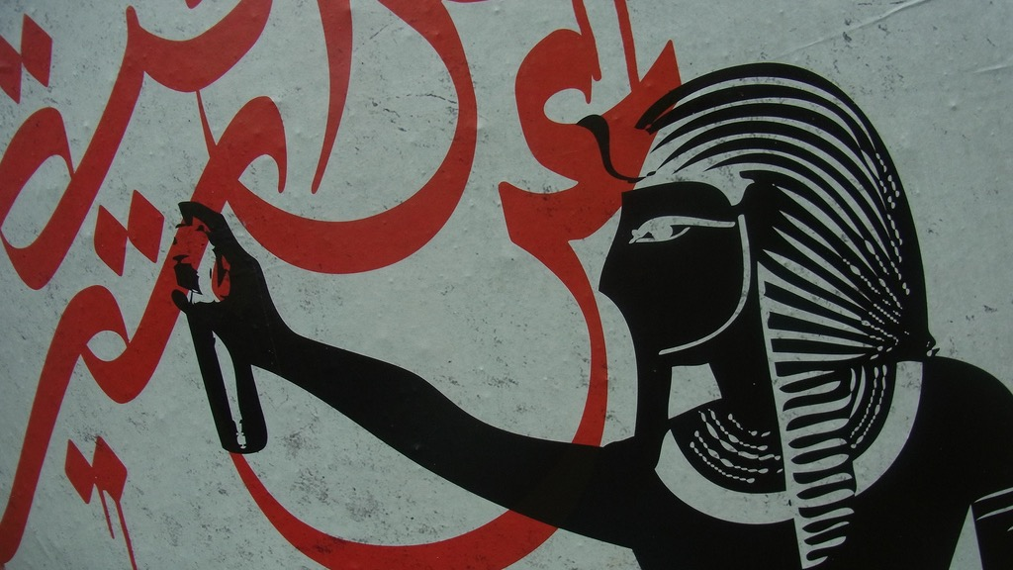
Major Themes in Contemporary Middle East
LECTURE 9.
WOMEN’S AND LGBTQ+ STRUGGLES

Slide 2
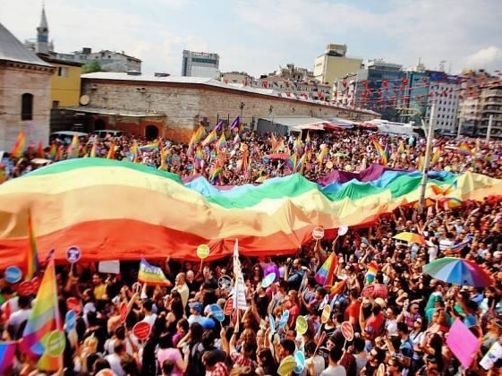
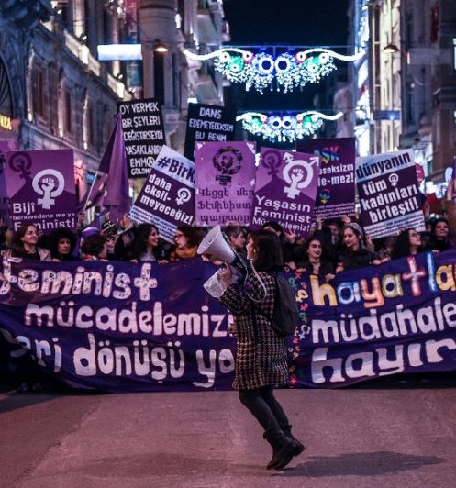
Women’s & LGBTQ+ struggles

Slide 3
1. Women’s Struggles

Slide 4
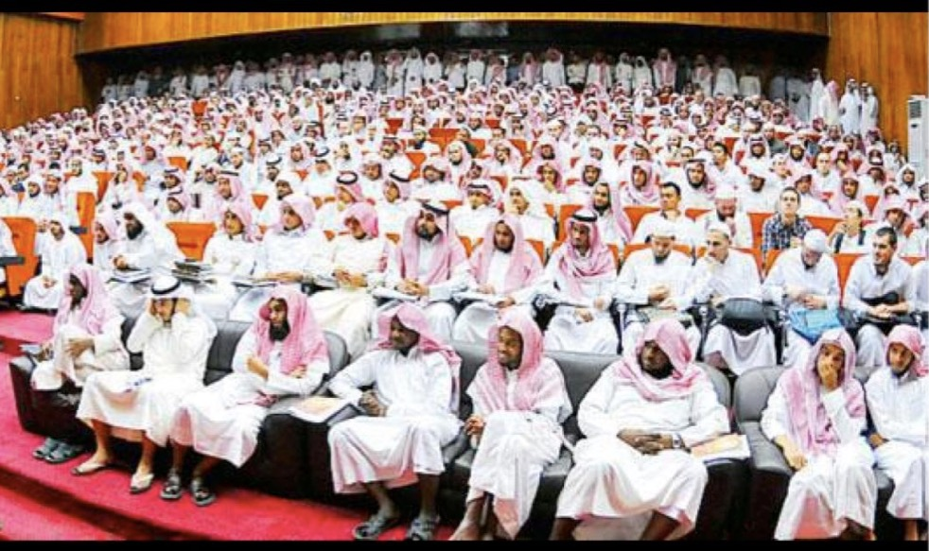
The Images

Slide 5
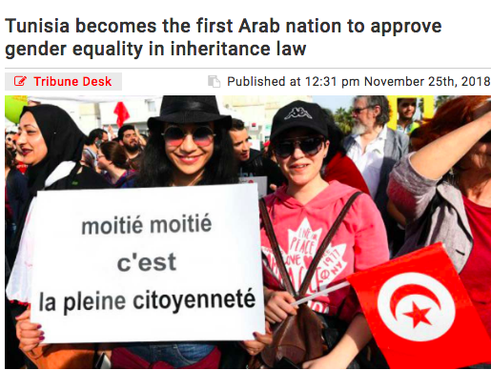
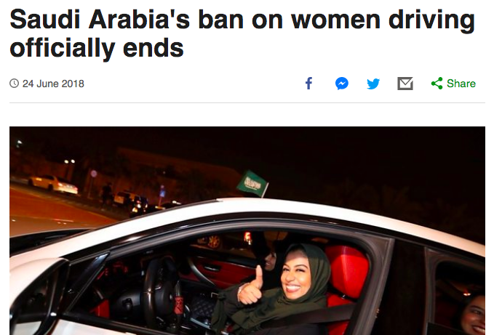
The News:
“The Rights”

Slide 6
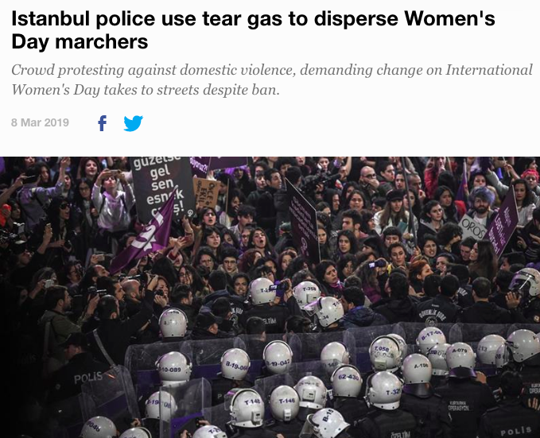
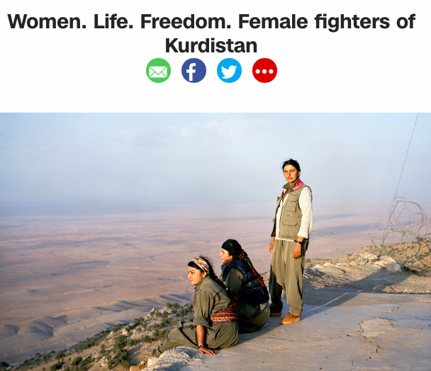
The News:
“The Fights”

Slide 7
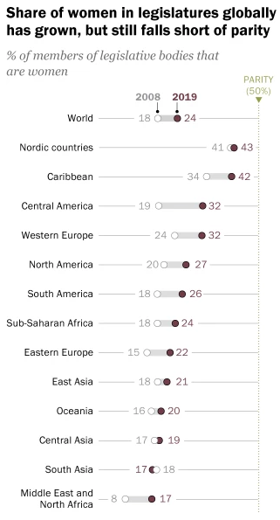
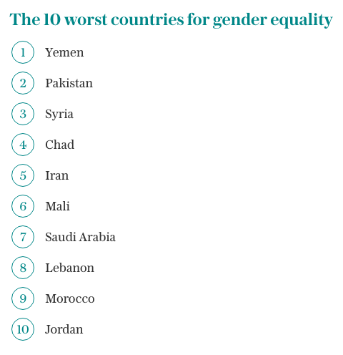
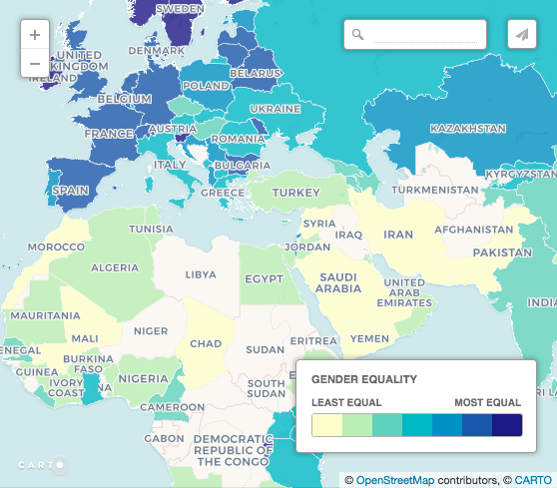
The Numbers
World Economic Forum (WEF) Global Gender Gap Report 2017

Slide 8
 | HDI | GII | Maternal Mortality (Deaths per 100k births) | % of Seats held in Parliament | % Women w/ Secondary education | % Women in Labour Force
Israel | 22 | 21 | 5 | 27.5 | 87.8 | 59
UAE | 42 | 49 | 6 | 22.5 | 78.8 | 41
Qatar | 37 | 44 | 13 | 9.8 | 71 | 58
S. Arabia | 39 | 50 | 12 | 19.9* | 67.8 | 16.8
Kuwait | 59 | 57 | 4 | 3.1 | 54.8 | 47.4
Iran | 60 | 109 | 25 | 5.9 | 65.8 | 16
Turkey | 64 | 69 | 16 | 14.6 | 44.9 | 32.4
Brazil | 79 | 94 | 44 | 11.3 | 61 | 53.2
Lebanon | 80 | 85 | 15 | 3.1 | 53 | 23.2
Algeria | 85 | 100 | 140 | 21.3 | 37.5 | 15.2
Tunisia | 95 | 63 | 62 | 31.3 | 41.2 | 24.3
Egypt | 125 | 101 | 33 | 14.9 | 58.2 | 22.2
Iraq | 120 | 123 | 50 | 25.3 | 38.7 | 18.7
Morocco | 123 | 119 | 121 | 18.4 | 28 | 25
Syria | 155 | 136 | 68 | 13.2 | 37.1 | 11.9
Yemen | 178 | 160 | 385 | 0.5 | 18.7 | 6
The Numbers
Gender Inequality Index (GII) of the UNDP
An aggregate of three dimensions: Health, Empowerment and Labour market
http://hdr.undp.org/en/content/gender-inequality-index-gii
* Since 2013, Saudi Arabia has a 20% quota for women in its Consultative Assembly (Shura). Since 2015, women can take part in municipal elections.

Slide 9
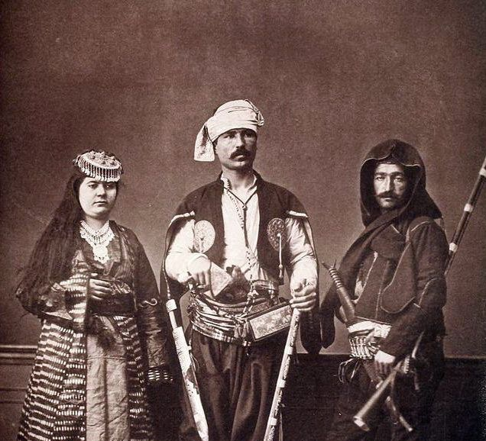
Women’s Rights in the Middle East
Historical Background
Medieval & early modern O.E. & Iran
Patriarchal societies.
Men above women in eyes of the law.
Polygamy is legal for men.
Women have limited public visibility (especially in urban, wealthy families).
Different story in the countryside
19th century: Socio-political transformation
Emergence of new urban middle-classes; decline in polygamy.
Secular reforms (Tanzimat) limiting scope of Sharia law
New education opportunities, greater engagement in public life
First struggles for women’s emancipation simultaneously with Western counterparts

Slide 10
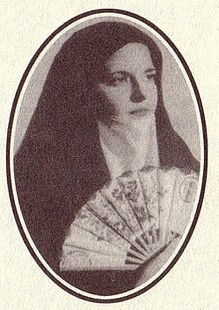
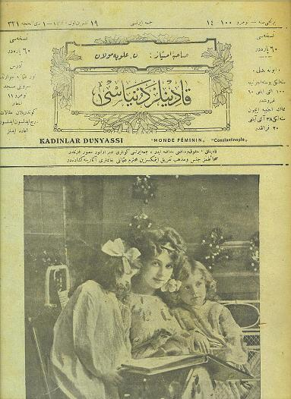
Women’s Rights in the Middle East
Historical Background
Turn of the 20th century
Iranian (1905) and Ottoman (1908) Constitutional Revolutions
Women’s rights activists in cities like Istanbul, Tehran, Cairo
Advocating for suffrage, equality before the law, education, work place
Growing number of women’s journals and women’s clubs
In the Ottoman Empire…
1914: Women admitted to universities
1915: Allowed to work in factories and public service (WWI)
1917: “Family law” limits polygamy
1919: Suffrage becomes ”the” public issue
Zaynab Fawwaz (1860 – 1914)
Lebanese poet and advocate of women’s rights in Cairo
“Women’s World” magazine published in Istanbul
(1913 – 1921)

Slide 11
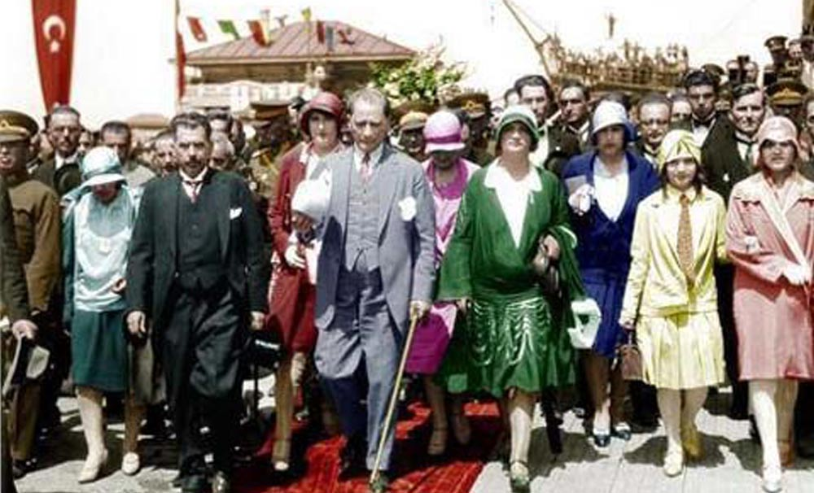
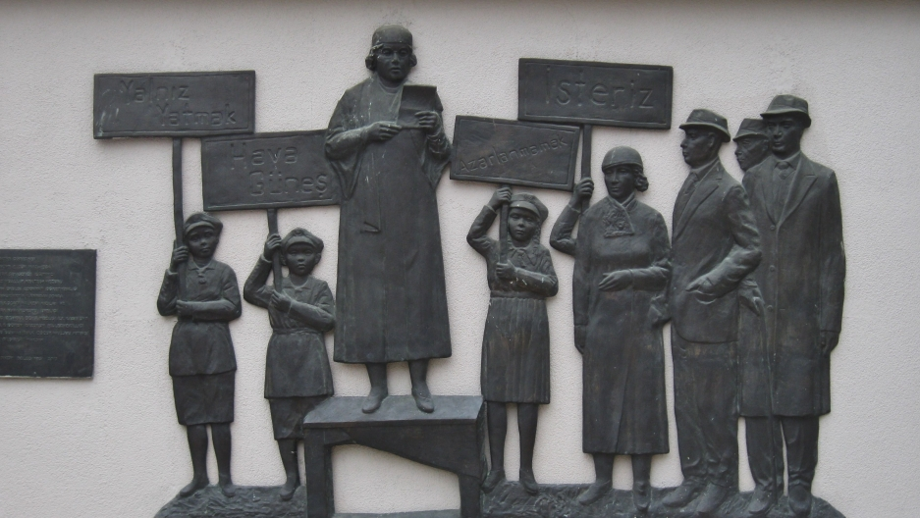
Women’s Rights in the Middle East
Historical Background
Early-mid 20th Century: The Secular Age
Turkey’s Kemal Atatürk a leading champion of women’s rights
1926: New Civil Code granting women equality before law
1934: Full women’s suffrage
1935: 18 women elected to Turkish parliament
Kemalist reforms inspire secular rules in the Middle East
Reza Shah of Iran in the 1930s
Habib Bourguiba of Tunisia in the 1950s and 60s
Secularising reforms of Arab Socialism (less bold than Kemalists)

Slide 12
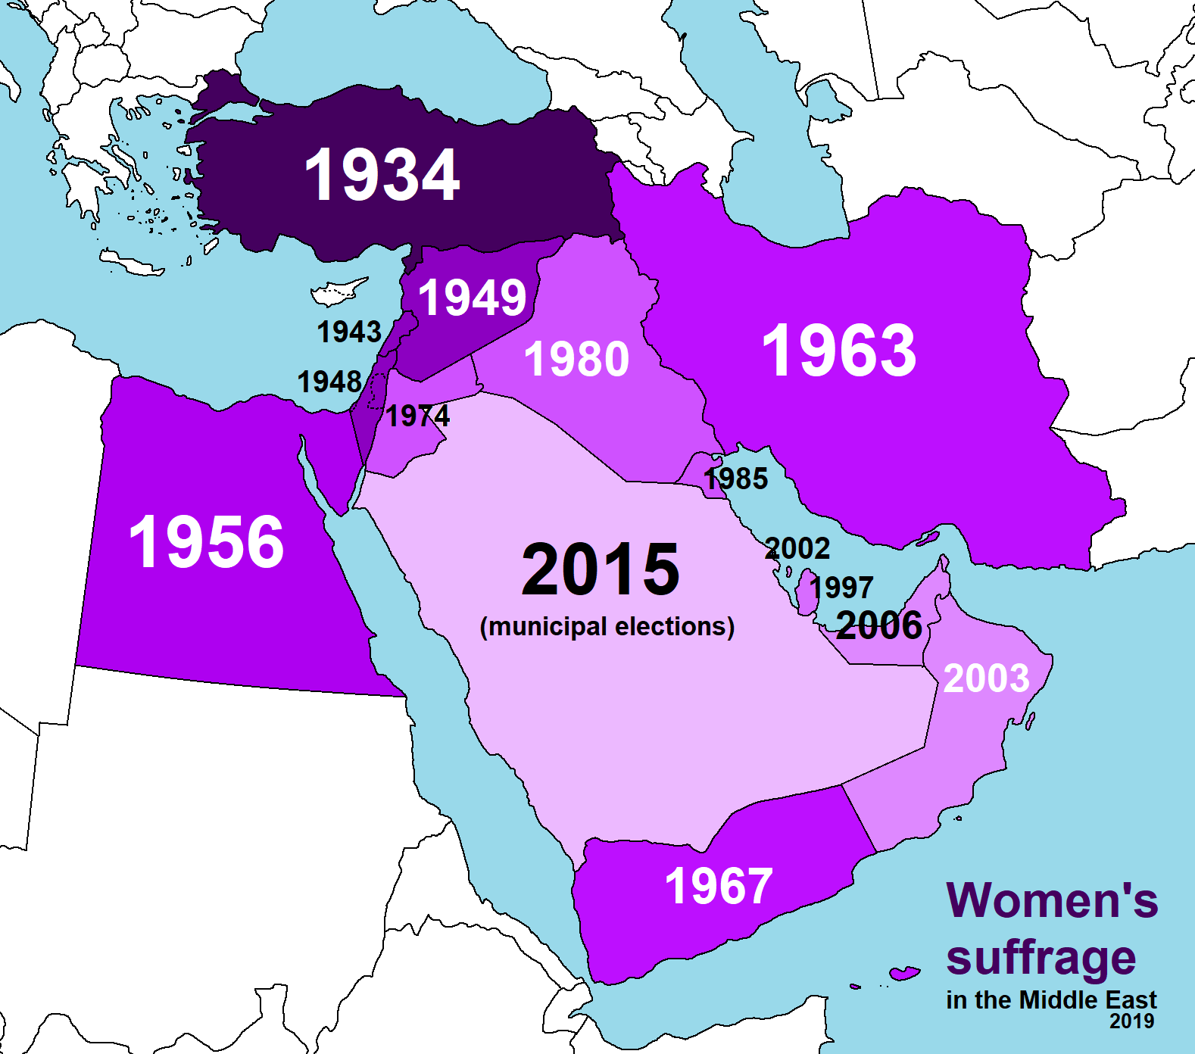
Women’s Suffrage
New Zealand → 1893
Brazil → 1932
Tunisia → 1959
Algeria → 1962
Morocco → 1963
Libya → 1964
France → 1965 (1944 only literate women can vote)
Switzerland → 1971

Slide 13
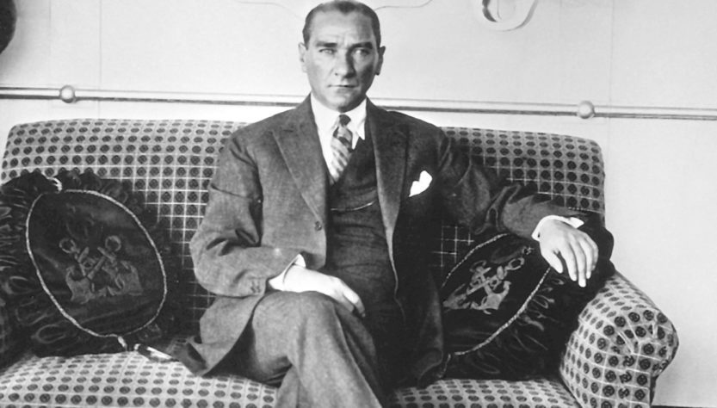
Paradoxes of top-down secularisation
Women’s “emancipation” in the hands of patriarchal leaders
Granting rights on the one hand, closing space for independent civil society on the other
Turkish Women’s Union (TWU) shut down in 1935 as there was “no more need for it”.

Slide 14
Paradoxes of top-down secularisation
Women’s “emancipation” in the hands of patriarchal leaders
Granting rights on the one hand, closing space for independent civil society on the other
Turkish Women’s Union (TWU) shut down in 1935 as there was “no more need for it”.
Transformative for urban middle and upper classes… BUT limited impact or intense reaction among the conservative majority in the countryside…
Populist backlash with rural to urban migration & the rise of Islamism
Iranian Revolution
The AKP in Turkey
Arab Spring Revolutions?
Iranian women protest mandatory veil in 1979
“In societies based on communal, kinship and patronage allegiances ‘democracy’ is never liberalism. Are we witnessing the effects of this principle in present day situations?”
– Sami Zubaida

Slide 15
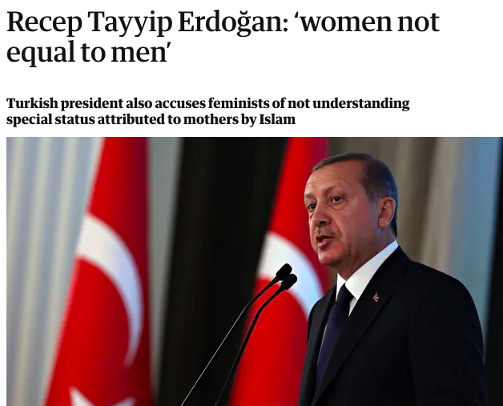
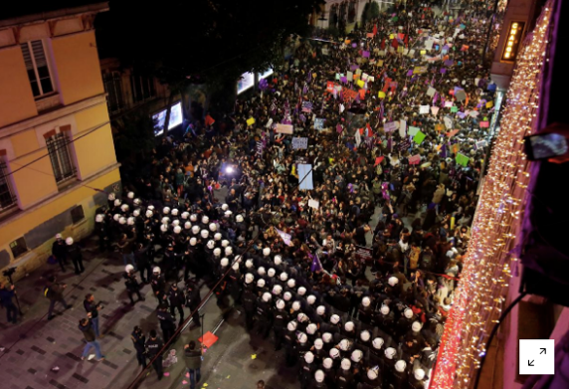
Religious populism in the neo-liberal age
The Case of Turkey under the AKP
Promotion of women’s role as home-maker and child bearer
Erdogan: “I do not believe men and women were created equal”
Feminists seen as inauthentic or anti-women, imitators of the “immoral” West.
Violence against women in Turkey skyrockets: 1400% increase in murder rates b/w 2002 and 2011.

Slide 16
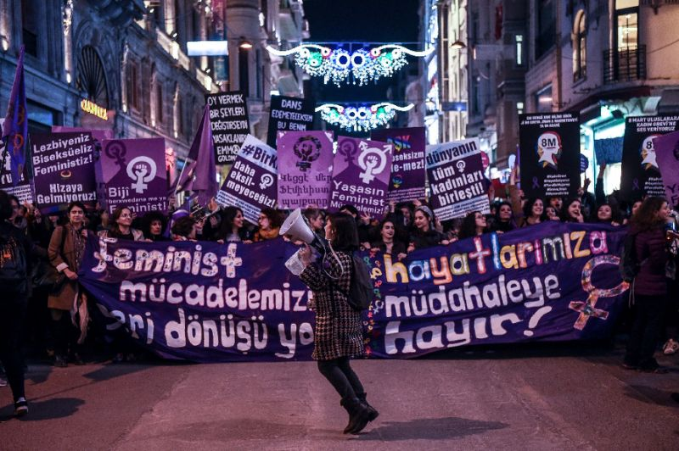
Religious populism in the neo-liberal age
The Case of Turkey under the AKP
Prof. Deniz Kandiyoti (SOAS) on Turkey’s new “gender regime”:
Gender roles play a key function in delineating the authentic/national “us” from inauthentic/anti-national “them”.
They also link neo-liberalism with religious populism, wherein responsibility for social protection is transferred from the state to the family or private (religious) foundations.
Women can enjoy citizenship rights in this new “gender regime” so long as they “know their place” and show gratitude to male benefactors. Violence against those who reject this “gender regime” is thus normalised.
Violence is a sign of “patriarchy in crisis” - not hegemony! “Masculinist restoration” against women’s resistance.
Patriarchal Bargain

Slide 17
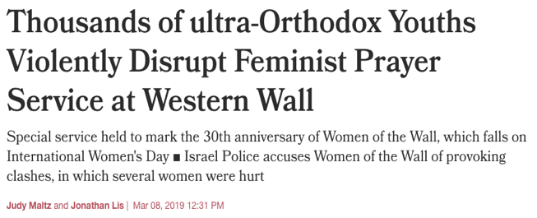
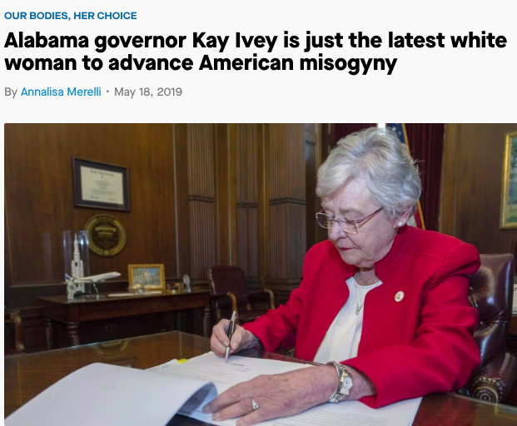
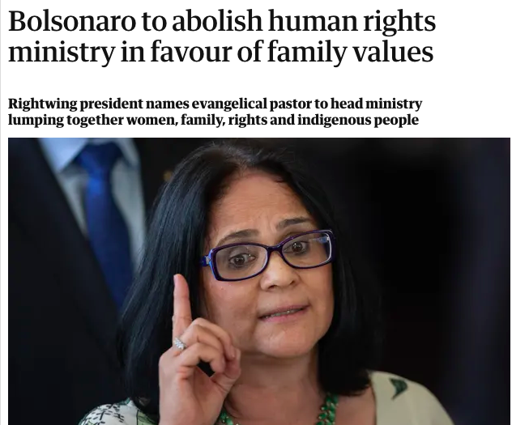
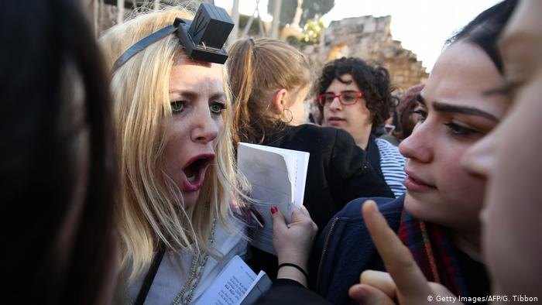
Religious populism in the neo-liberal age
Patriarchal Bargain
“Patriarchal Bargain”
Only in majority Muslim countries?
United States
Brazil
Israel
Nor is patriarchy only produced by religious populists
Militarism is the embodiment of authoritarian heteronormativity

Slide 18
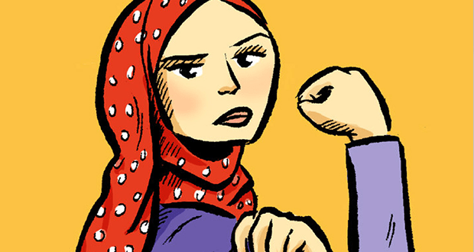
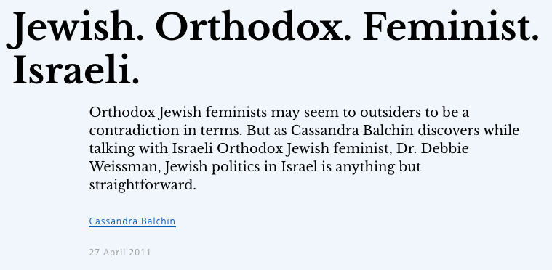
Paradoxes of religious populism
Forced imposition of religious restrictions creates societal tensions and reaction against conservative norms and values
Fuel for the feminist movement
Often empowers conservative women, some of whom eventually stop accepting the limits of the “patriarchal bargain”
Educated Iranian women from the provinces at the first lines of protest against the Islamic Republic
Muslim (not Islamist) feminism?
Orthodox feminism in Israel?
WHY NOT?
IDENTITIES ARE NOT FIXED
OR SINGULAR!

Slide 19
2. LGBTQ+ Struggles

Slide 20
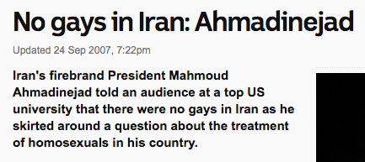
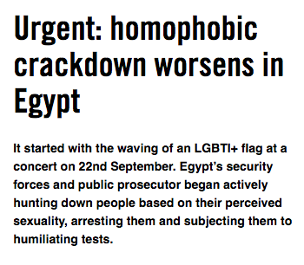
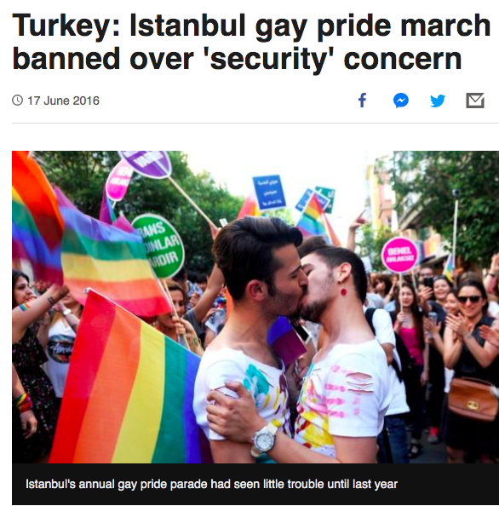
In the News

Slide 21
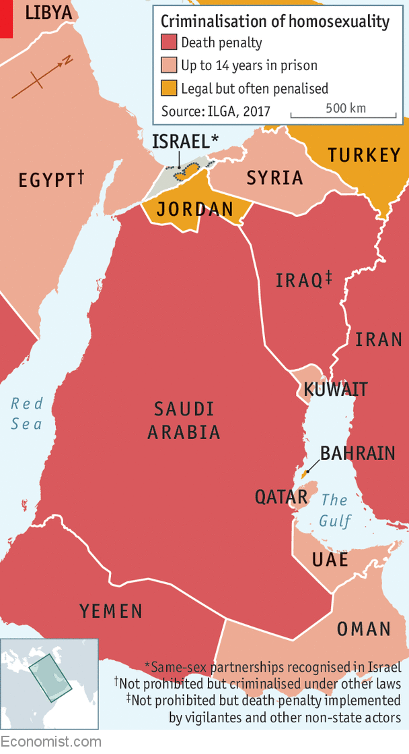
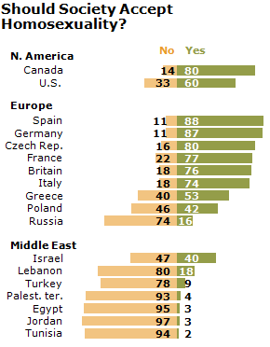
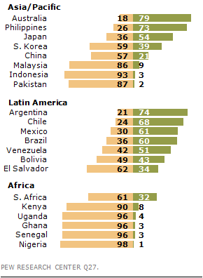
The Numbers
Pew Research “The Global Divide on Homosexuality” 2013

Slide 22
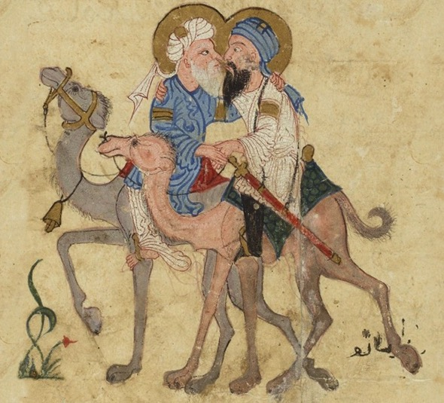
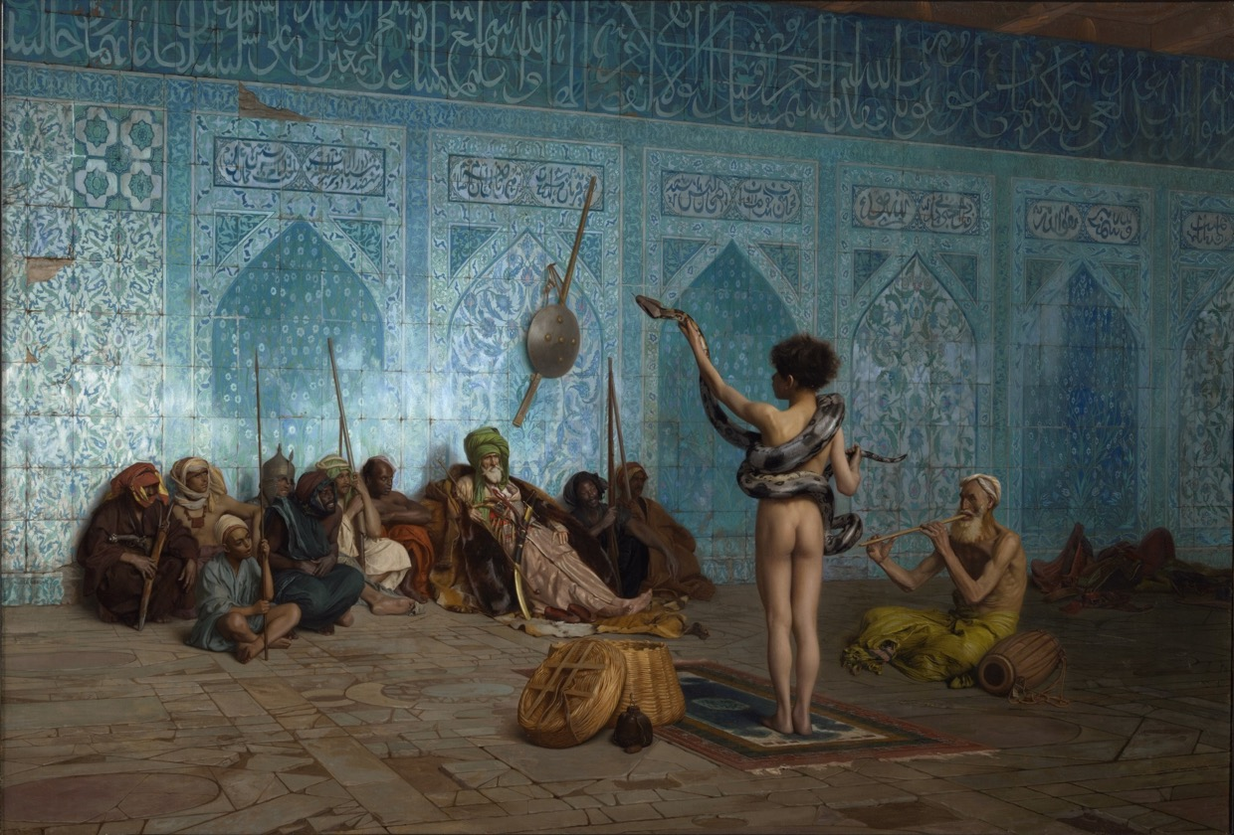
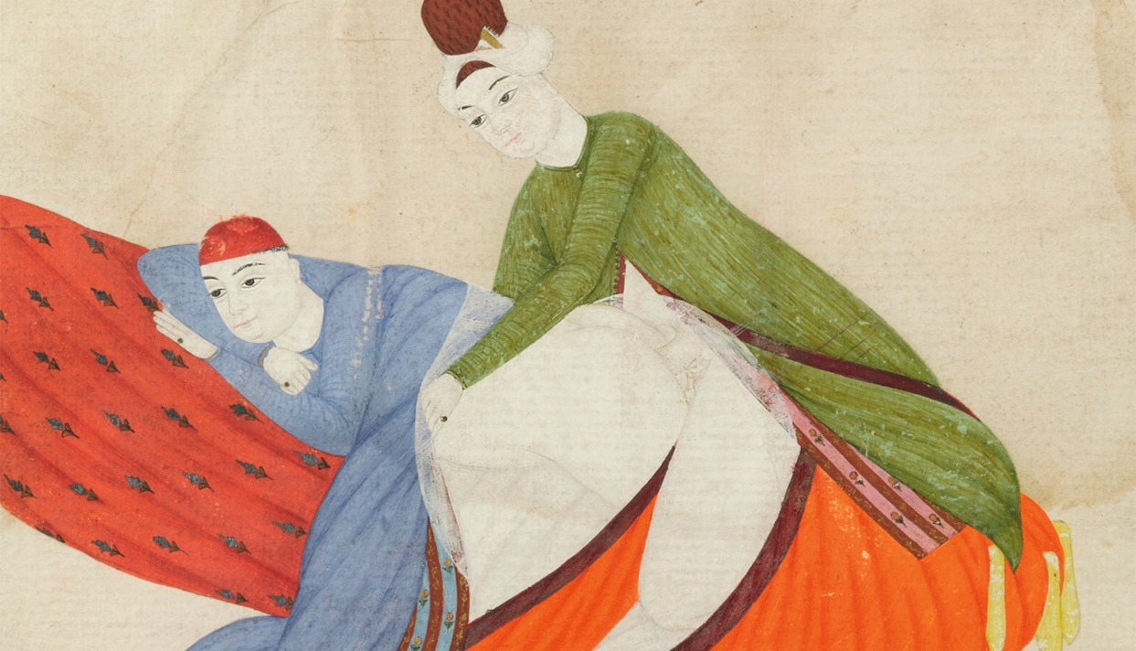
The History
Things weren’t always this way!
In Islam “sodomy” is considered a sin…
…But since medieval times, “homoeroticism” – esp. in poetry and literature – was very common, even seen as sophisticated, urbane.
Fluid identities: No binary definition of sexes (hetero and homo)
Many “Oriental” cultures implicitly recognised a third gender
Eunuchs (transgender) earned a living looking after children, or singing and dancing in public(as women couldn’t)
Relationships between older men and young boys more socially acceptable than b/w unmarried men and women.
Snake Charmer - Jean-Léon Gérôme, 1880
Istanbul, 18th century. An erotic scene, ascribed to Abdullah Bukhari. 1743 CE.

Slide 23
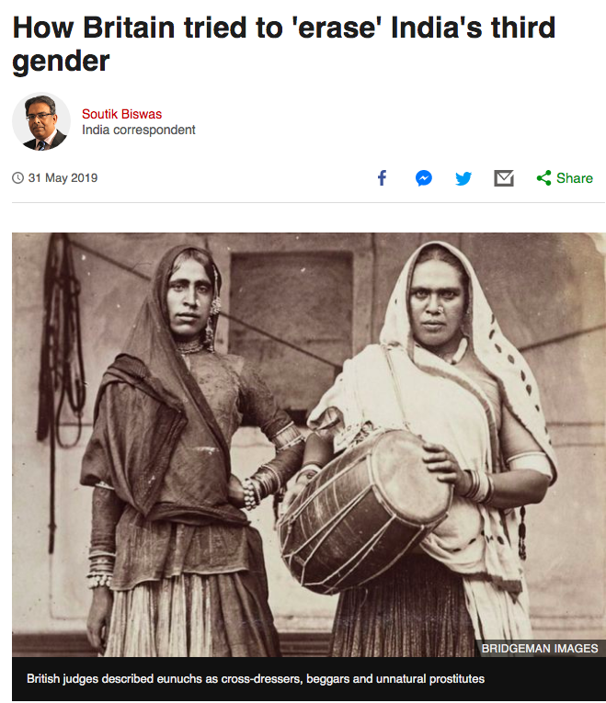
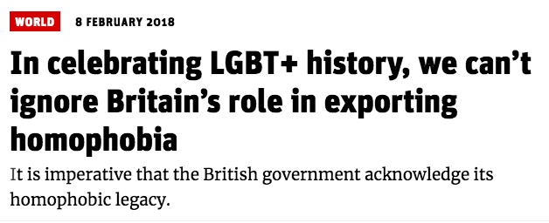
The History
What happened??
Legacy of Colonialism
Victorian Britain criminalises homosexuality at home and in colonies from 1890s onwards.
Laws defended on moral and religious grounds (“to protect Christianity”)
Many former colonies maintained these laws after independence
British-educated “westernised elites” came to see homosexuality as sign of “Oriental weakness” – linking nationalism with heteronormativity.

Slide 24
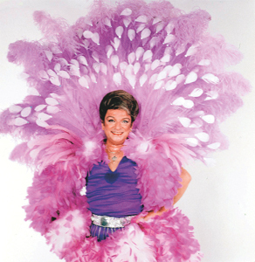
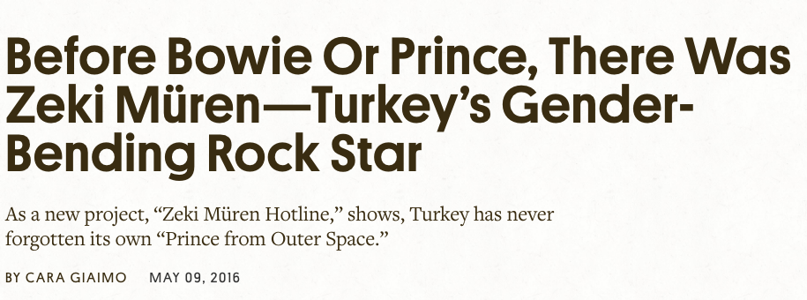
The History
What happened??
Still, in many Middle Eastern societies sexual identities remained relatively fluid until the 1980s.
Ex. Zeki Müren, a.k.a. ”The Sun of Art”, the Turkish David Bowie
An effeminate cross-dresser, arguably the most popular and respected Turkish artist from the 1960s to the 90s.
Regularly performed on state television singing classical Turkish songs
https://www.bbc.com/news/world-europe-30942013

Slide 25
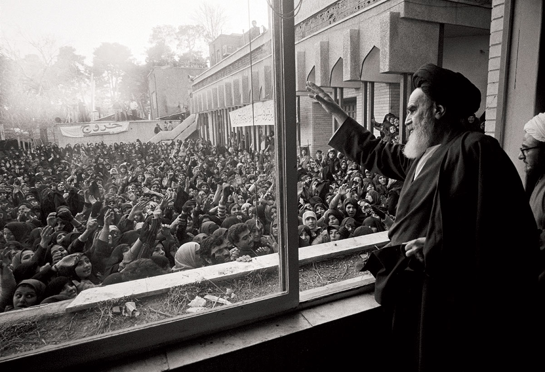
The History
What happened??
Rise of Islamism in the 1980s
Coincides with the AIDS epidemic & the rise of gay-rights movements in the West.
Seen as example of Western immorality and cultural imperialism
Accusations of “exporting homosexuality”
Militarists & nationalists embrace the same portrayal to appeal to masses

Slide 26
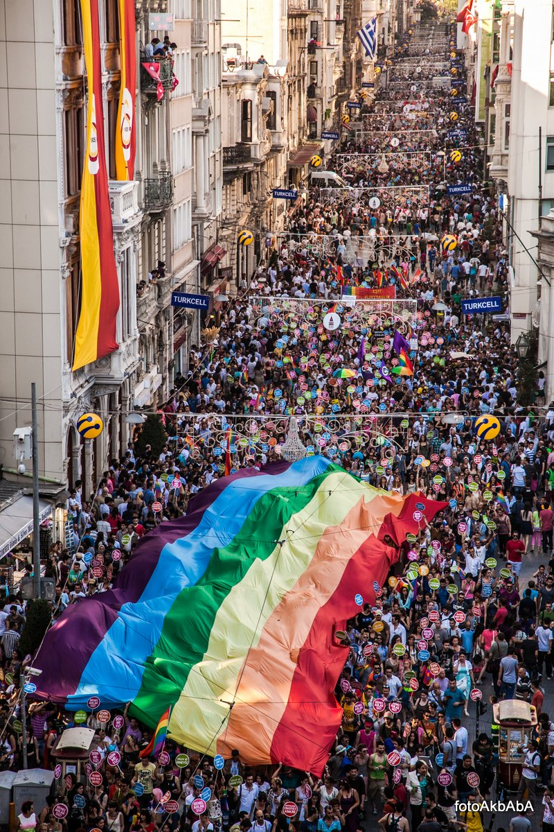
Today
Struggle continues with LGBT movements better organised and mobilised
Until banned by government in 2015, Turkey had the largest Pride Parades in the Muslim world.
Lebanese courts consistently refuse to punish homosexual acts despite the constitution and conservative pressure.
In 2014, Iraq accepted UN recommendation to fight discrimination, inc. sexual discrimination
+ Mobilisation beyond the region as LGBT+ rights are threatened from Asia to Africa, from Russia to the USA.

Slide 27
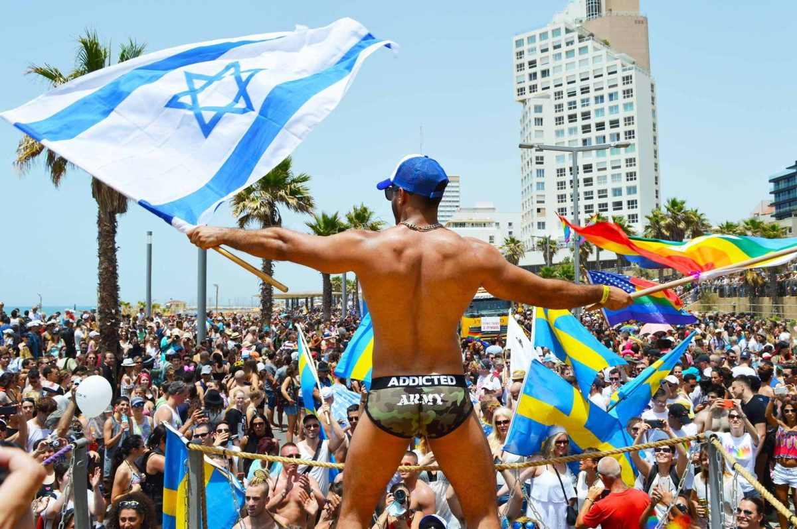
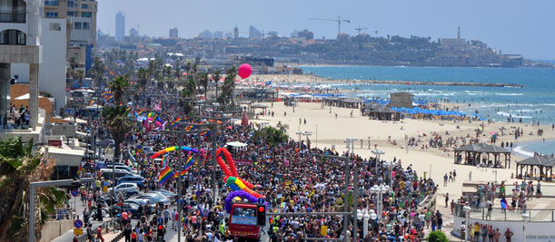
Israel
A regional exception…
The most tolerant in the region
Same sex couples gained legal rights and protection in the 1990s. They can adopt children since 2008.
Tel Aviv one of the most ’gay-friendly’ cities in the world.

Slide 28
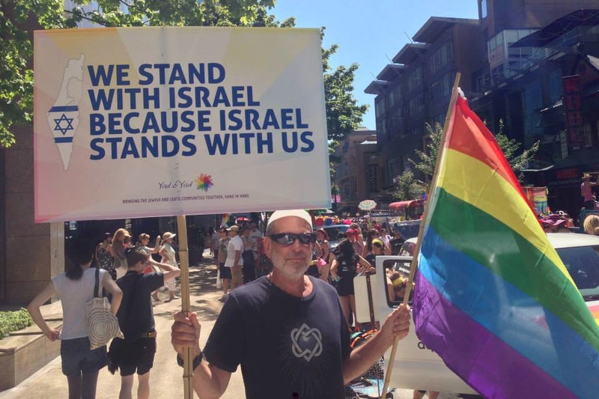
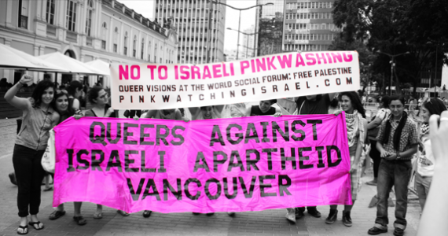
Israel
Pinkwashing
Coined from “whitewashing”
Using Israel’s LGBT+ friendly laws and culture…
To present it as an open, progressive society,
Gain LGBT+ support worldwide,
Cover up its human rights abuses and treatment of (backward, Muslim) Palestinians.

Slide 29
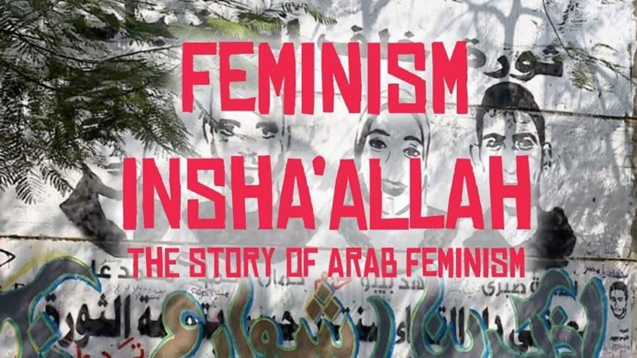
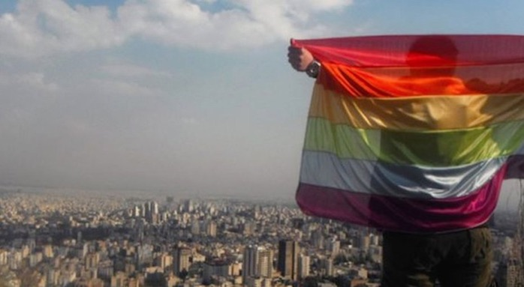
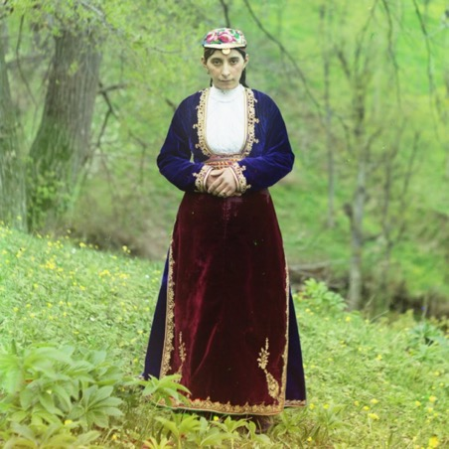
Recommended material:
Documentary:
Feminism Inshallah: The Story of Arab Feminism (2014) Podcasts:
Gay in Iran
Ottoman History Podcast: Women, Gender, and Sex in the Ottoman World

Slide 30
NEXT WEEK - 15 May
Movie Screening: Persepolis (2007) https://vimeopro.com/urbanschool/english-1b/video/97764879
Discussion Forum Google Meet @15h00 (Link will be emailed and put on Moodle 10 mins before meeting)
2nd Response Paper Due “In conservative societies, democracy can pose a threat to women’s rights.” Do you agree? Discuss in the context of the history and politics of the Middle East. Email to karabekir.akkoyunlu@uni-graz.at by 13h00 on 15/05

