Slide 1
OP AMPs for Everyone Newnes, 2009

Slide 2
Active Filters

Slide 3
Band Pass Filters

Slide 4
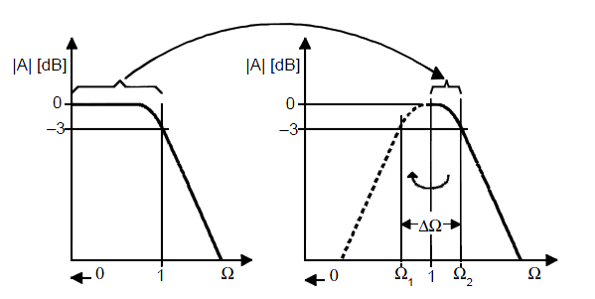
The passband characteristic of a low-pass filter is transformed into the upper passband half of a band-pass filter. The upper passband is then mirrored at the mid frequency, f_{m} (Ω=1), into the lower passband half

Slide 5
Normalized bandwith
Normalized mid bandwith
Q factor

Slide 6
1
The simplest design of a band-pass filter is the connection of a high-pass filter and a lowpass filter in series, which is commonly done in wide-band filter applications.
2
A first order high-pass and a first-order low-pass provide a second-order band-pass,
3
A second-order high-pass and a second-order low-pass result in a fourth-order band-pass response.
4
Narrow-band filters of higher order consist of cascaded second-order band-pass filters that use the Sallen-Key or the Multiple Feedback (MFB) topology.

Slide 7
To develop the frequency response of a second-order band-pass filter, apply the
Transformation to a first-order low-pass transfer function:
s
s

Slide 8
When designing band-pass filters, the parameters of interest are the gain at the mid frequency (A_{m}) and the quality factor (Q), which represents the selectivity of a band-pass filter.
Therefore, replace A₀ with A_{m} /Q and ΔΩ with 1/Q (Equation 16–7) to obtain:

Slide 9
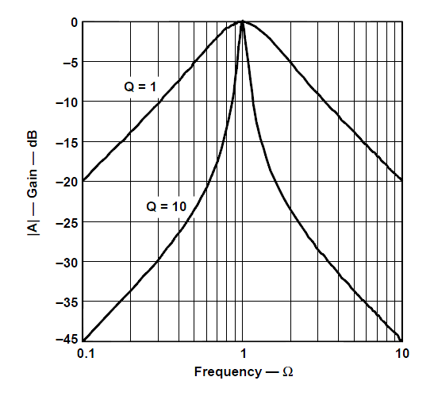
Normalized gain response of a
second order bandpass filter

Slide 10
Band Pass Filters
Second Order Topology

Slide 11
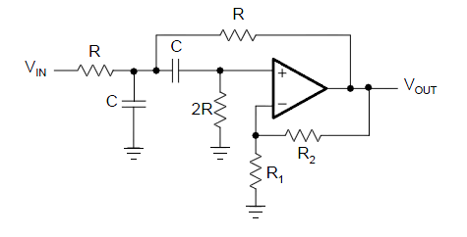
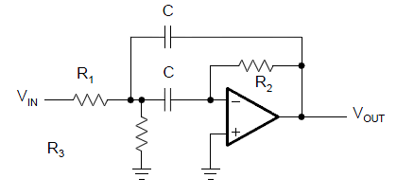
Sallen-Key Topology
Multiple Feedbak Topology

Slide 12
Sallen-Key Topology
G= 1 + R₂ /R₁

Slide 13
1
The Sallen-Key circuit has the advantage that the quality factor (Q) can be varied via the
inner gain (G) without modifying the mid frequency (f_{m}).
2
A drawback is that Q and A_{m} cannot be adjusted independently.
3
Care must be taken when G approaches the value of 3 because A_{m} becomes infinite.

Slide 14
Multiple Feedback Topology

Slide 15
Designing a Band Pass Filters
Second Order Topology

Slide 16
Sallen-Key Topology
1
Specify f_{m} and C
2
3a
Specify A_{m}, calculate G and R₂ / R₁
3b
Specify Q, calculate G and R₂ / R₁
G= 1 + R₂ /R₁
G= 1 + R₂ /R₁

Slide 17
Multiple Feedback Topology
1
Specify f_{m} , Q, A_{m} and C
2
$R_{2}$=$\frac{Q}{πf_{m}C}$
$$R_{1 }=\left|\frac{R_{2}}{−2A_{m}}\right|$$
3
$$R_{3 }=\left|\frac{{−A}_{m}R_{1}}{Q^{2}+A_{m}}\right|$$
4

Slide 18
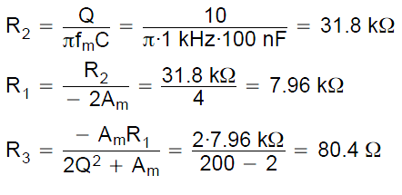
Exemple 1:
Design a second-order MFB band-pass filter with a mid frequency of f_{m}= 1 kHz, a quality factor of Q = 10, and a gain of A_{m}= –2. Assume a capacitor value of C = 100 nF.

Slide 19
Band Pass Filters
Higher Order Topology

Slide 20
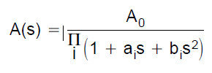
Replacing the s term with the transformation
in a second order low pass transfer function gives the general transfer function of a fourth-order band-pass:

Slide 21
This equation represents the connection in series of two second-order band-pass filters where:
1
b
2

Slide 22
3
Factor α needs to be determined through successive approximation, using equation:
4
Values of α For Different Filter Types and Different valures of Q:

Slide 23
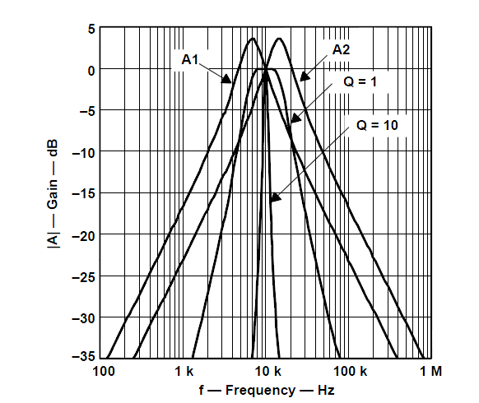
5
In a fourth-order band-pass filter with high Q, the mid frequencies of the two partial filters differ only slightly from the overall mid frequency. This method is called staggered tuning. A flat gain response shows up as well as a sharp pass-band to stop-band transition.
Example: Gain response of a fourth-order Butterworth band-pass filter with staggered tuning where with Q = 1. Its partial filters are shown as well as the gain of a non staggered tuning filter with Q = 10.
staggered tuning

Slide 24
Designing a
Band Pass Filters
Higher Order Topology

Slide 25
Exemple:
Design a fourth-order Butterworth band-pass with f_{m} = 10KHz, Q = 10 and A_{m} = 1 using a second order multiple feedback topology.
1
From table: a₁ = 1.4142, b₁ = 1, α = 1,036

Slide 26
2
Calculate f_{m1} and f_{m2}
3
Calculate Q_{i}

Slide 27
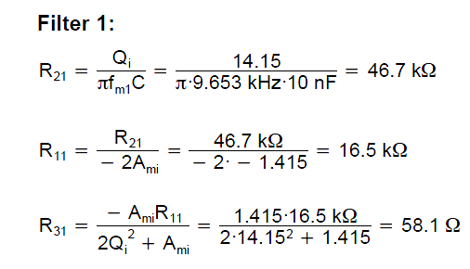
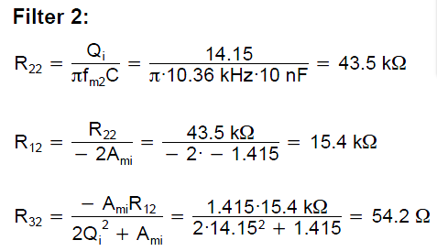
4
Calculate A_{mi}
b₁
5
Calculate the MF resistance components for filter 1 and filter 2 using C = 10nF
$R_{2i}$= $\frac{Q_{i}}{πf_{mi}C}$
$$R_{1i }=\left|\frac{R_{2}}{−2A_{mi}}\right|$$
$$R_{3i }=\left|\frac{{−A}_{mi}R_{1}}{{2Q}^{2}+A_{mi}}\right|$$
+
+

Slide 28
Simulação LTPice

Slide 29
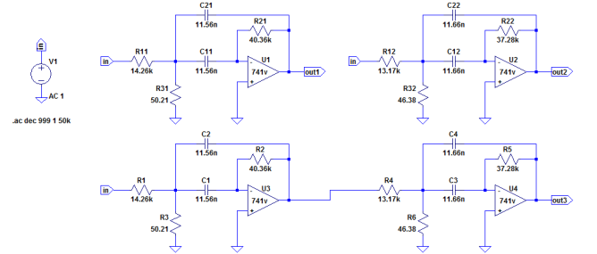
Os valores dos componentes foram medidos !

