Slide 1
BUSINESS AND HUMAN RIGHTS
Fevereiro, 26
2024
Cristiane Lucena (IRI)
João Paulo Veiga (DCP)

Slide 3
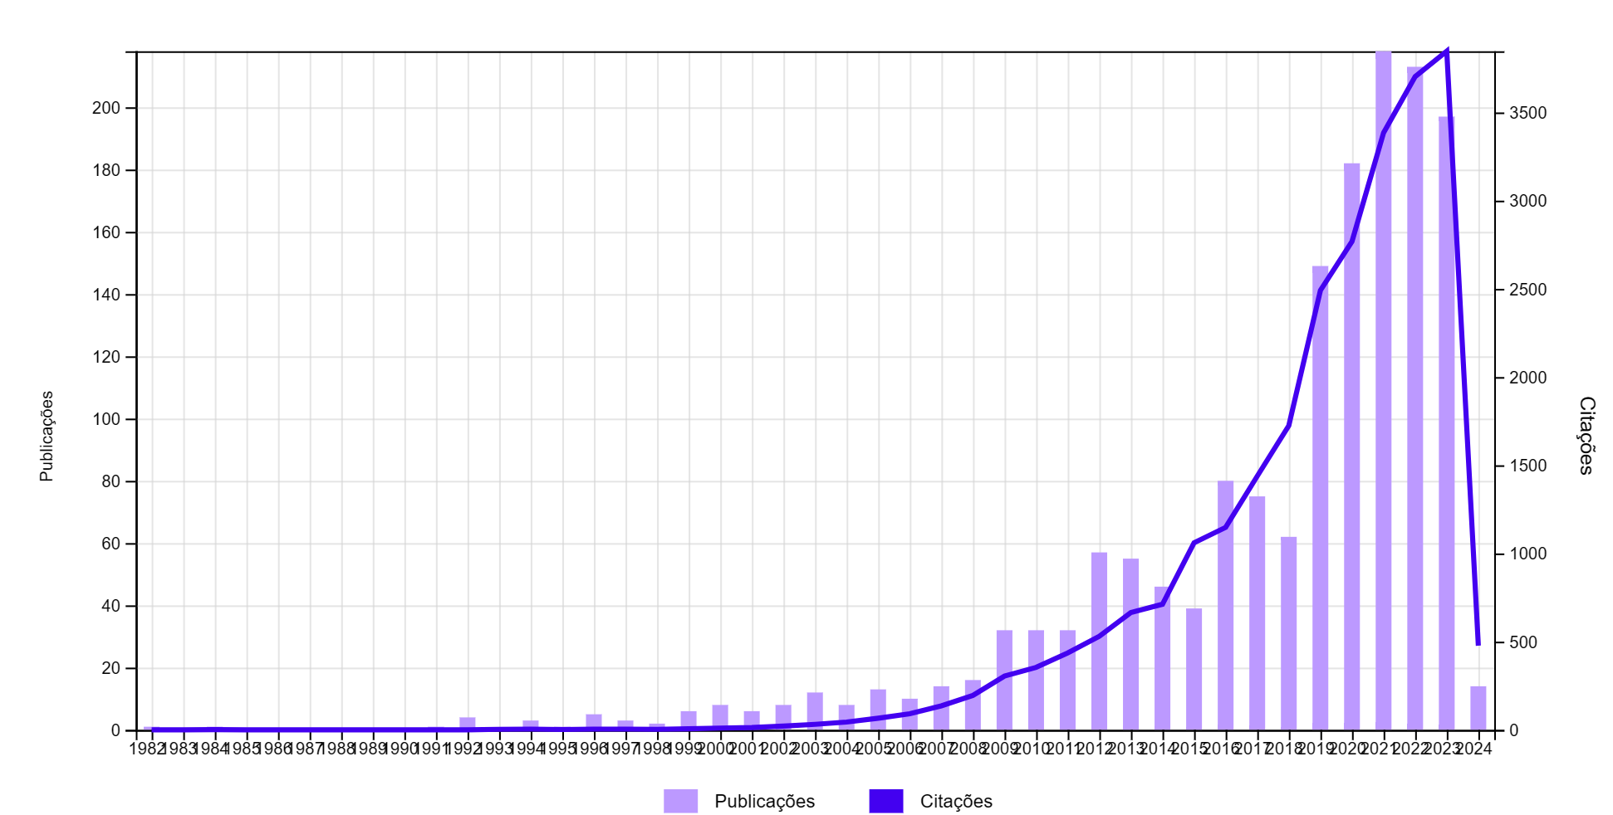

Slide 4
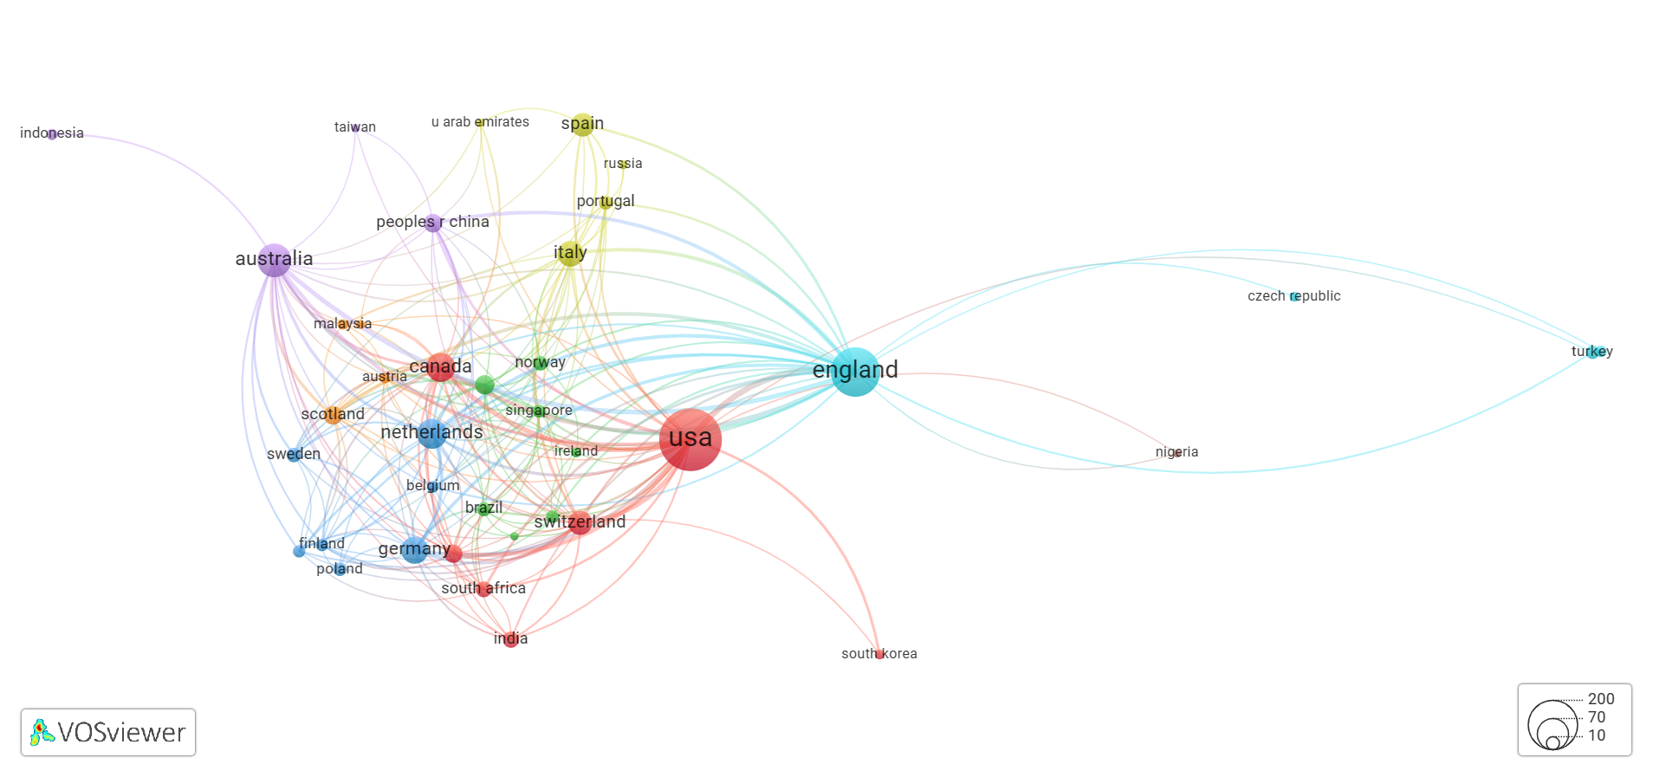

Slide 5
