Slide 1
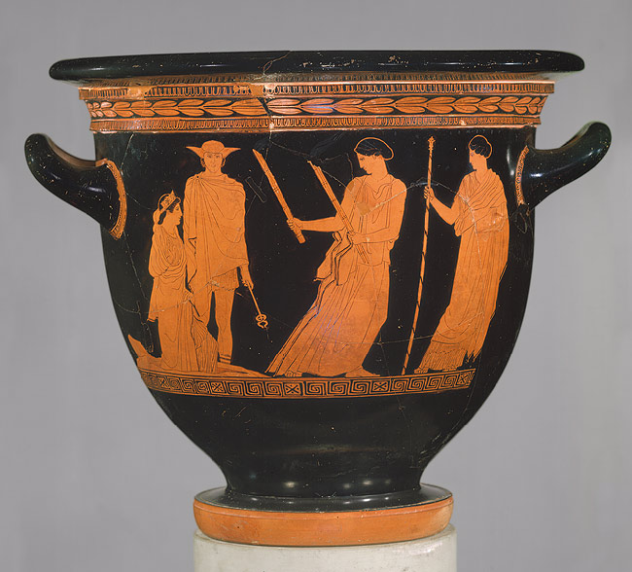
Thou still unravish’d bride of quietness,
Thou foster-child of silence and slow time,

Slide 2
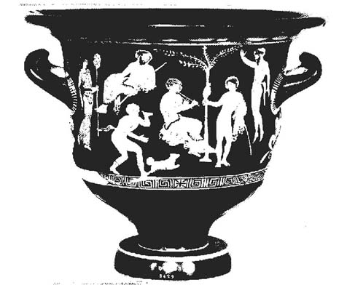
Sylvan historian, who canst thus express
A flowery tale more sweetly than our rhyme:

Slide 3
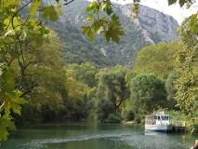
What leaf-fring’d legend haunts about thy shape Of deities or mortals, or of both, In Tempe
The Vale of Tempe is a gorge in northern Thessaly, located between Olympus to the north and Ossa to the south

Slide 4
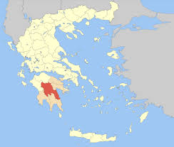
or the dales of Arcady?

Slide 5
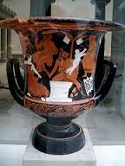
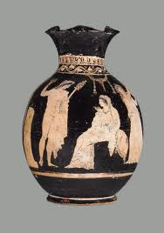
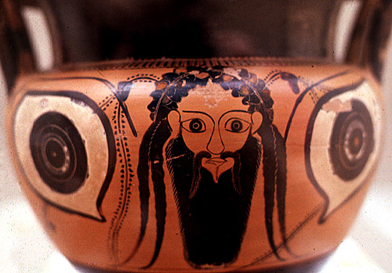
What men or gods are these?
What maidens loth?

Slide 6
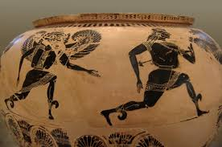
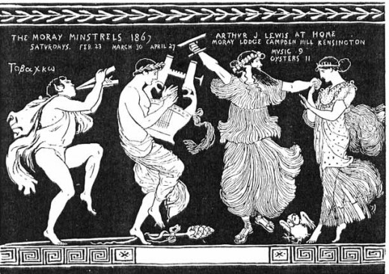
What mad pursuit? What struggle to escape?
What pipes and timbrels?
What wild ecstasy?
What wild ecstasy?

Slide 7
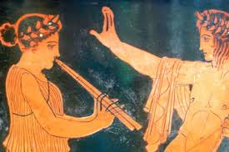
Heard melodies are sweet, but those unheard Are sweeter; therefore, ye soft pipes, play on;

Slide 8
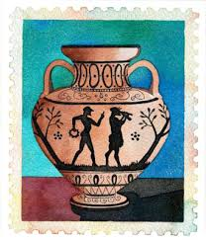
Not to the sensual ear, but, more endear’d, Pipe to the spirit ditties of no tone:

Slide 9
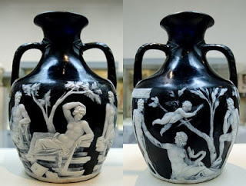
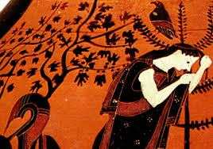
Fair youth, beneath the trees, thou canst not leave Thy song,
nor ever can those trees be bare;

Slide 10
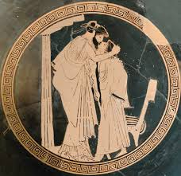
Bold Lover, never, never canst thou kiss,
For ever wilt thou love, and she be fair!

Slide 11
