Slide 1
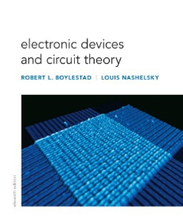
Chapter 1 Semiconductor Diode
Referência Bibliográfica
Capítulo 3

Slide 3
Introduction

Slide 4
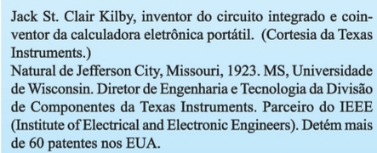
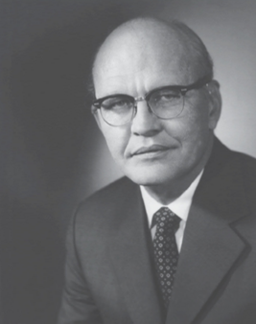
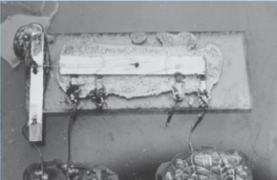
The first IC was developed by Jack Kilby while working at Texas Instruments in 1958.

Slide 5
The miniaturizaiton that has ocurred in recent years leaves us to wonder about its limits. Complete systems now appear on wafers thousands of times smaller than the single element of earlier networks.
Today the Intel core i7 Extreme edition processor has 731 million transistor in a package that is only slightly larger than 1.67 square inches.
Dr. Gordon E Moore presented a paper prediciting that the transitor count in a single IC would double every two years. Now we find that his prediction is amazingly accurate and expected to continue to the next few decades.
1965

Slide 6
Semiconductor Materials
Ge, Si, GaAs

Slide 7
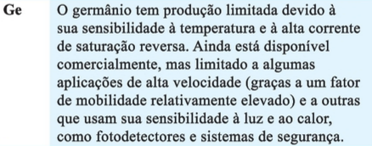
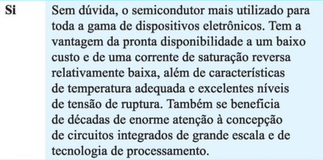

Slide 8
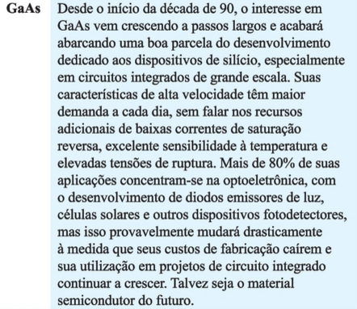

Slide 9
Semiconductors are a special class of elements having a conductivity between that a good conductor and that of na insulator.
Single Crystal: they have a repetitive crystal structure.
Si
Ge
GaAs
CdS
GaN
GaAsP
Compound: they are constructed of two or more semiconductor
material of different atomic structure
1930
Diode discovery
Ge
Relatively easy to refine and obtain very high levels of purity by suffered from low levels of reliability due to sensitivity to changes in temperature.
1947
Transistor discovery
1954
1st Si transistor was introduced
Si
Less temperature sensitivity, very abundant on Earth and cheaper to manufacture.
GaAs
Up to five times the speed of operations with Si.
1970
1st GaAs transistor was introduced
Si is still the fundamental building block for Intel´s processors.

Slide 10
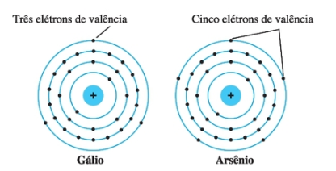
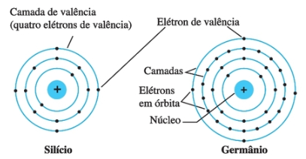
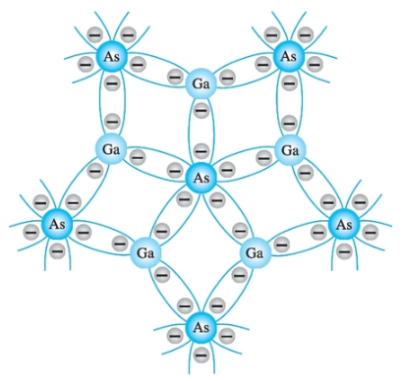
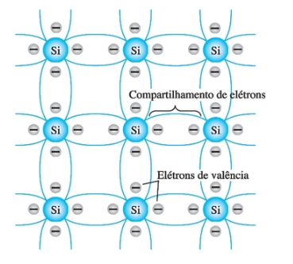
n=31
n=33
n=14
n=32
cristal composto
singular cristal
ligação covalente - Si
ligação covalente - GaAs

Slide 11
Although the covalent bond will result in a stronger bond between the valence electrons and their parent atom, its possible for the valence electron to absorb sufficient kinetic energy from external causes (light energy in the form of photons and thermal energy (heat) to break the covalent bond and assume “free” state. The free electrons are very sensitive to any electric fields shuch as established by voltage sources .
At room temperature there are 15 billion electrons /cm³ in a silicon material.

Slide 12
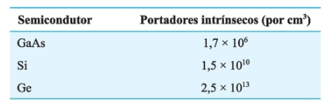
Intrinsic carriers n_{i}
(free e⁻ in the material)
Intrinsic: means any semicondutor material that has beden carefully refined to reduce the numbero of impurities to a very low level.
Note: impurity levels of 1 part in 10 billion are common today.
μ_{n} : ability of the free carriers to move throughtout the material.
Relative mobility factor μ_{n} (cm²/V.s)
(free e⁻ in the material)

Slide 13
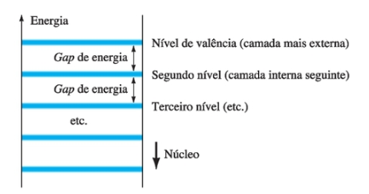
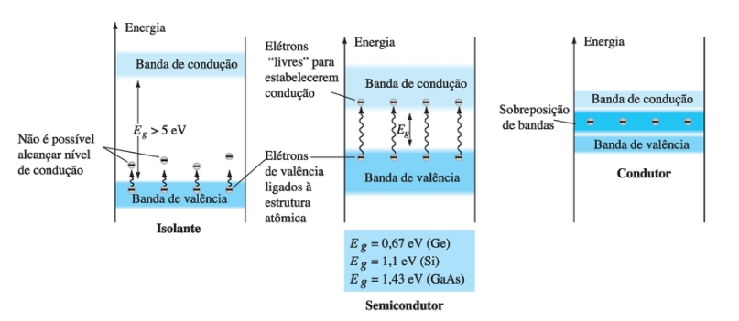
níveis específicos discretos de energia
Bandas de valência e de condução de um isolante,
um semicondutor e um condutor

Slide 14
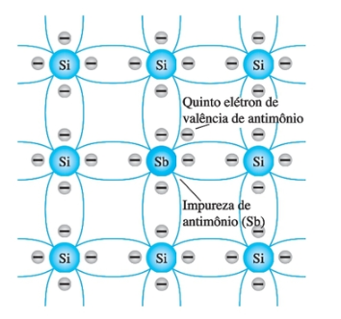
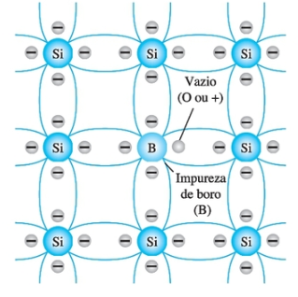
Impurity: At room termperature in an intrinsic Si there is about one free eletron for every 10¹² atoms. The dosage level is 1 part in 10⁷ and so the ration 10¹² / 10⁷ = 10⁵ indicates that in a n-type material the carrier concentration has increased by a ratio 100.000:1.
(extrinsic material)
Five valence electrons
Three valence electrons
Sb (or Ar, P)
imputurity in n-type material
B (or Ga, In)
imputurity in p-type material

Slide 15
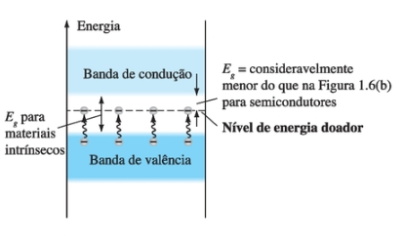
A discrete energy level (donor level) appears in the forbidden band with an E_{g} significantly less that of the intrinsic material. The result is that at room temperature, there are a large number of carriers (electrons) in the conduciton level, and the conductivity of the material is increases significantily.

Slide 16
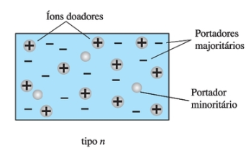
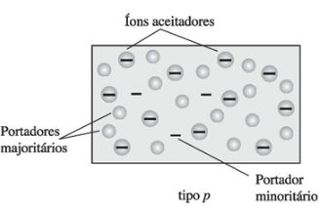
Electrons X hole flow
Building blocks of semiconductor devices

Slide 17
Diode

Slide 18
Junção é o contato íntimo entre dois materiais que possuem estruturas energéticas internas diferentes.
Podem ser executadas entre dois metais, entre um metal e um semicondutor, entre dois semicondutores ou através do contato íntimo entre dois cristais dopados com impurezas de polaridades opostas, embora pertencentes ao mesmo semicondutor intrinsico. Neste último caso o dispositivo é chamado de junção pn, parte básica da eletrônica moderna de estado sólido.
Junções pn formam um componente eletrônico denominado diodo.

Slide 19
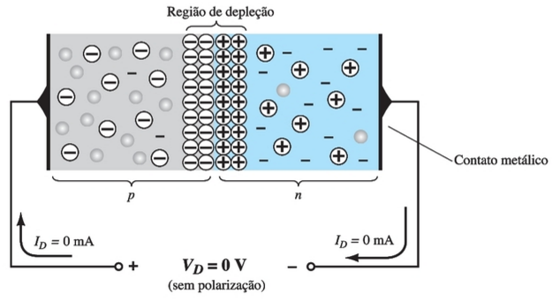
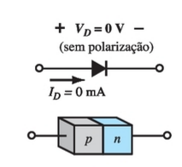
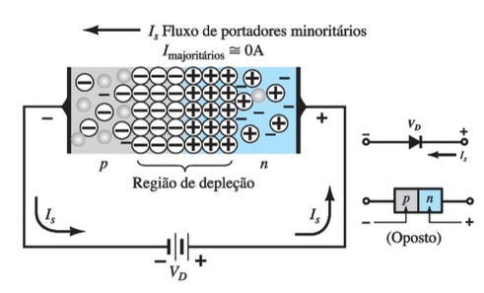
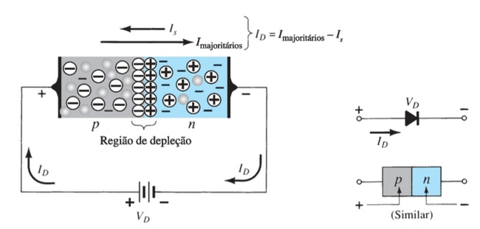
A diode has three operating conditions:
No Applied Bias (V_{D}=0)
Reverse-Bias (V_{D} < 0)
Forward-Bias (V_{D} > 0)

Slide 20
No Applied Bias (V=0)
Bias: refers to the application of an external voltage across the two terminals of the device to extract a response.
Any minority carrier (holes) in the n-type material within the depletion region will pass quickly into the p-type material.
The closer the hole is to the junction, the greater is the attraction for the layer of negative ions and the less is the oposition offered by the positive ions in the depletion region of the n-type material.
The same will happen with the minority carrier (electrons) in the p-type material.

Slide 21
No Applied Bias (V=0)
The majority carriers (electrons) of the n-type material must overcome the attractive forces of the layer of positive ion in the n-type material and the shield of negative ions in the p-type material to migrate into the área beyond the depletion region of the p-type material.
The number of majority carriers is so large in the n-type material that there will invariably be a small number of with suficiente kinetic energy to pass through the depletion region into the p-type material.
The electrons and holes in the region of the junction will combine resulting in a lack of free carriers in the region near the junction.

Slide 22
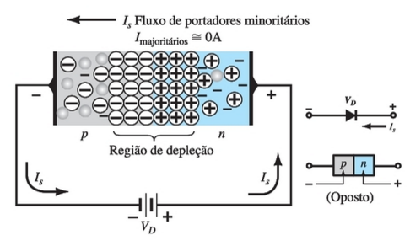
Reverse-Bias (V_{D} < 0)
The number of positive ions in the depletion region of the n-type material will increase due to the large numbers of free electrons drawn to the positive potential of the applied voltage.
For similar reasons, the number of negative ions will increase in the p-type material
The net effect, therefore, is a widening of the depletion region.

Slide 23
Reverse-Bias (V_{D} < 0)
This widening of the depletion region will establish a barrier for the majority carriers to overcome, efectively reducing the majority carrier flow to zero.
The number of minority carriers, however, entering the depletion region will not change.
The current that exists under reverse-bias conditions is called reverse saturation curve (I_{s})
The I_{s} is seldom more than a few μA and typically nA. The term saturation comes from the fact that it reaches its maximum level quickly and does not change significantly with increases in the reverse bias potential.

Slide 24
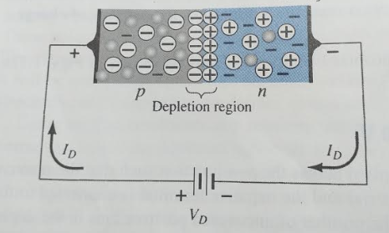
Forward-Bias (V_{D} > 0)
The application of a forwarded-bias will “pressure” eléctrons in the n-type material and holes in the p-type material to recombine with the ions near the boundary and reduce the width of the depletion region.
A electron of the n-type material now “sees” a reduced barrier at the junction due to reduced depletion region and a strong atraction for the positive potential applied to the p-type material.
As the applied bias increases, the depletion region will continue to decrease in width until a flood of electrons can pass through the junction, resulting in a exponential rise in current.

Slide 25
Resumo

Slide 26
Doping
The electrical characteristics of silicon and germanium are improved by adding materials in a process called doping. There are just two types of doped semiconductor materials:
n-type p-type
n-type materials contain an excess of conduction band electrons.
p-type materials contain an excess of valence band holes.

Slide 27
p-n Junctions
One end of a silicon or germanium crystal can be doped as a p-type material and the other end as an n-type material.
The result is a p-n junction

Slide 28
Majority and Minority Carriers
Two currents through a diode:
Majority Carriers
The majority carriers in n-type materials are electrons.
The majority carriers in p-type materials are holes.
Minority Carriers
The minority carriers in n-type materials are holes.
The minority carriers in p-type materials are electrons.

Slide 29
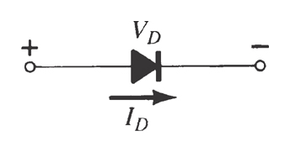
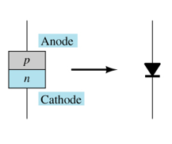
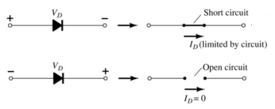
Diodes
The diode is a 2-terminal device.
A diode ideally conducts in only one direction.
The anode is abbreviated A The cathode is abbreviated K

Slide 30
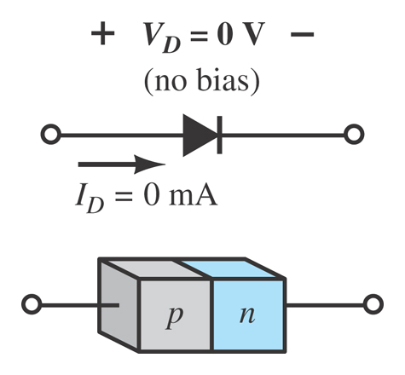
Diode Operating Conditions
No Bias
No external voltage is applied: V_{D} = 0 V
There is no diode current: I_{D} = 0 A
Only a modest depletion region exists

Slide 31
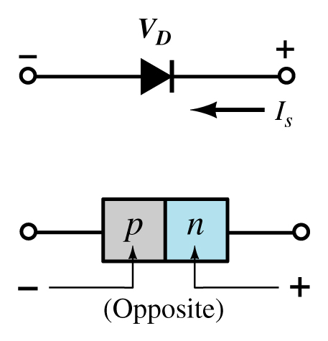
Diode Operating Conditions
Reverse Bias
External voltage is applied across the p-n junction in the opposite polarity of the p- and n-type materials.

Slide 32
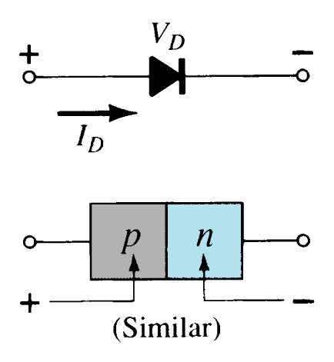
Diode Operating Conditions
Forward Bias
External voltage is applied across the p-n junction in the same polarity as the p- and n-type materials.

Slide 33
Equação de Schokley
(polarização direta)
(thermal voltage)
1<n<2 is an ideally factor which a function of the operating conditions and physical construction

Slide 34
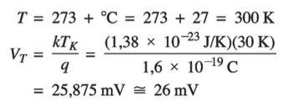
(Thermal Voltage)
n=1 is na idelly factor which a function of the operating conditions and physical construction

Slide 35
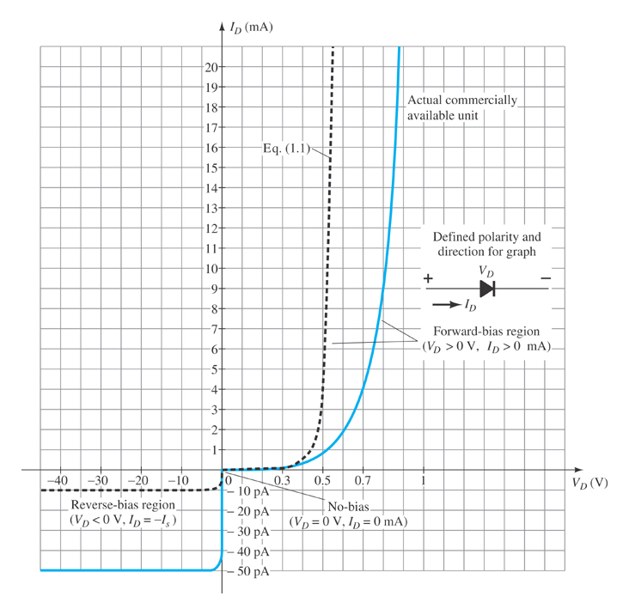
Actual Diode Characteristics
Note the regions for no bias, reverse bias, and forward bias conditions.
Note the scale for each of these conditions.

Slide 36
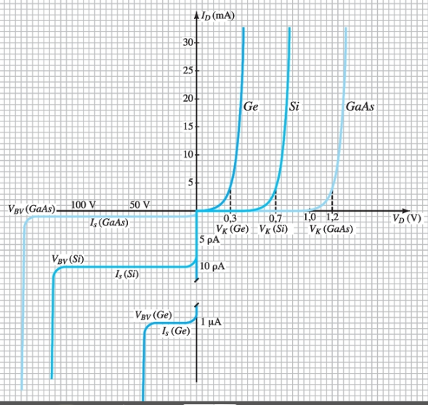
Ge, Si and GaAs
Knee Voltages (V_{K})
center of the knee

Slide 37
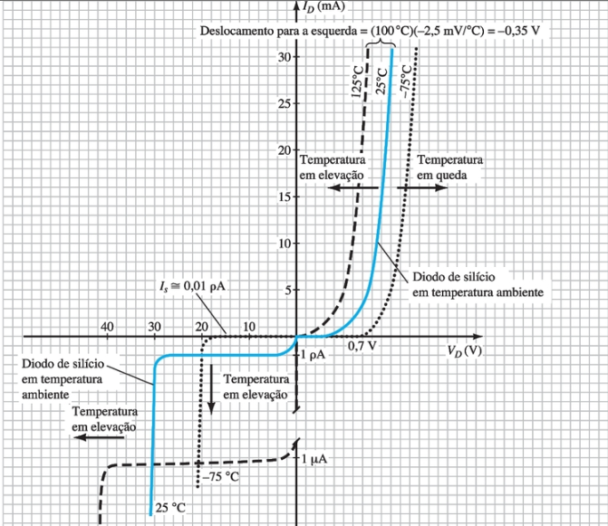
Temperature Effects
Germanium diodes are more sensitive to temperature variations than silicon or gallium arsenide diodes.
125 ºC

Slide 38
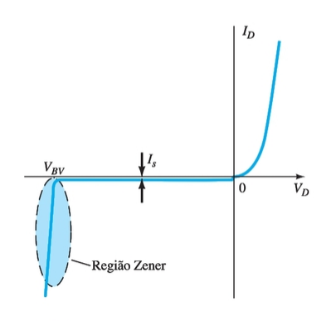
Breakdown Voltage (B_{V})
As the voltage across the diode increases in the reverse-bias region, the velocity of the minority carriers responsible for the reverse saturation current (I_{s}) will also increase. Eventually their velocity and associated kinetic energy will be sufficient to release additional carriers through colitions with otherwise stable atomic structures. That is, an ionization process will result whereby valence electrons absorb suficiente energy to leave the parent atom. The additional carriers can the aid the ionization process to the point where a high avalanche current is establishied and the avalanche breakdown region determined.

Slide 39
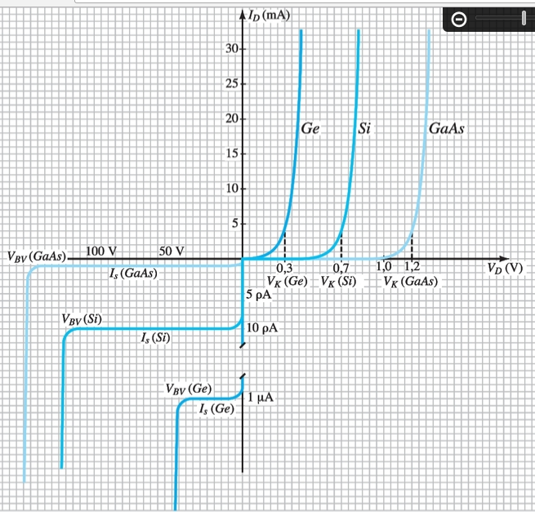
Breakdown Voltage (B_{V})
GaAs typically has maximum B_{V} levels that exceed those of Si of the same power level by about 10%. Both have 50V < B_{V} < 1KV.
There are Si power diodes with breakdown voltages as high as 20KV.
Ge typically has breakdown voltage of less than 100V with maximum around 400V.

Slide 40
Diode Symbol and Packaging
The anode is abbreviated A The cathode is abbreviated K

Slide 41
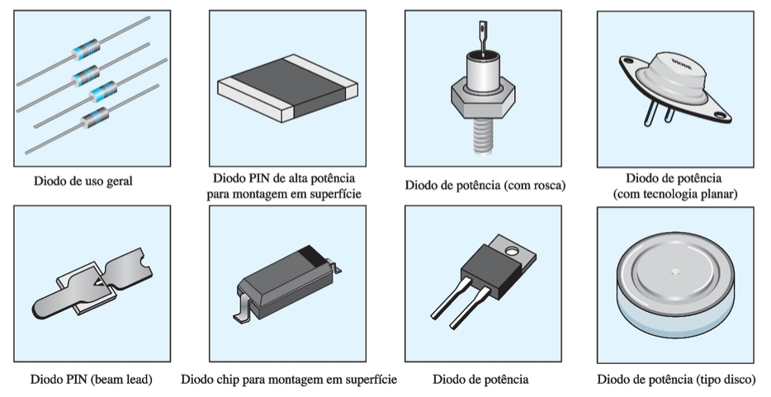
Types of Diodes

Slide 42
Applications

Slide 43
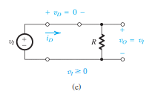
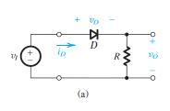
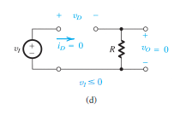
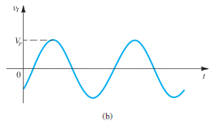
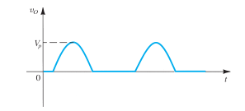
Retificador de ½ onda

Slide 44
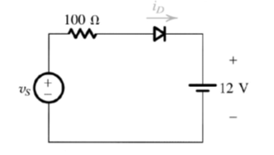
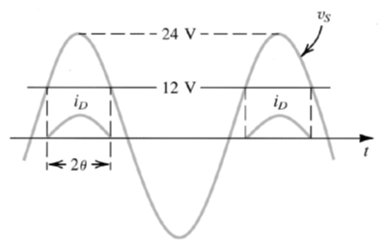
Carregador de Bateria

Slide 45
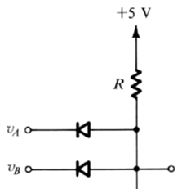
Porta OR
Porta AND
v_{o}
v_{o}
v_{A} (V) | v_{B} (V) | v_{O} (V)
0 | 0 | 0 (baixo)
0 | 5 | 1 (~4,3V)
5 | 0 | 1 (~4,3V)
5 | 5 | 1 (~4,3V)
v_{A} (V) | v_{B} (V) | v_{O} (V)
0 | 0 | 0 (0,7 V)
0 | 5 | 0 (0,7 V)
5 | 0 | 0 (0,7 V)
5 | 5 | 1 (5V)

Slide 46
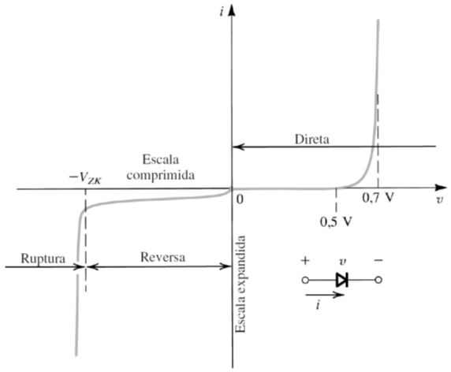
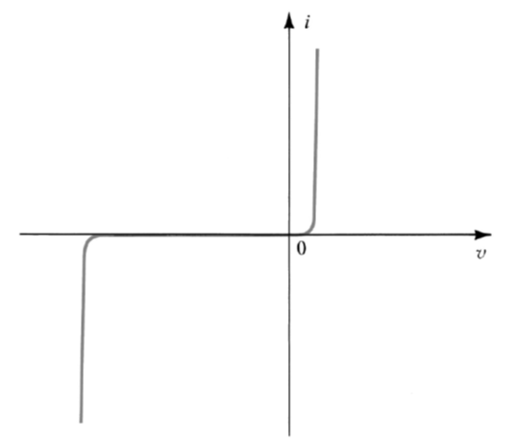
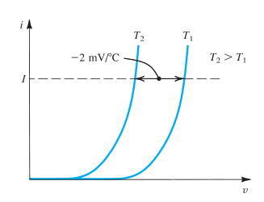
Características Corrente - Tensão
Temperature dependence of the diode forward characteristic. At a constant current, the voltage drop decreases by approximately 2 mV for every 1°C increase in temperature.

Slide 47
Características Corrente - Tensão
n = 1 - integrated circuits diode
n = 2 - discrete diodes
at 27º C
V_{T} = 25,875mV

Slide 48
Características Corrente - Tensão
Se i >> I_{S} e n=1:

Slide 49
Exercício:
A silicon diode said to be a 1-mA device displays a forward voltage of 0.7 V at a current of 1 mA. Evaluate the junction scaling constant I_{S}.
$$i=I_{S}e^{v/{nV}_{T}}$$
$$I_{S}=ie^{−v/{nV}_{T}}$$
Se n=1:
I_{s} = 6,9 x 10⁻¹⁶ ≈ 10⁻¹⁵A
Se n=2:
I_{s} = 8,3 x 10⁻¹⁰ ≈ 10⁻⁹A

Slide 50
Resistance Levels
Semiconductors react differently to DC and AC currents.
There are three types of resistance:
DC (static) resistance AC (dynamic) resistance Average AC resistance

Slide 51
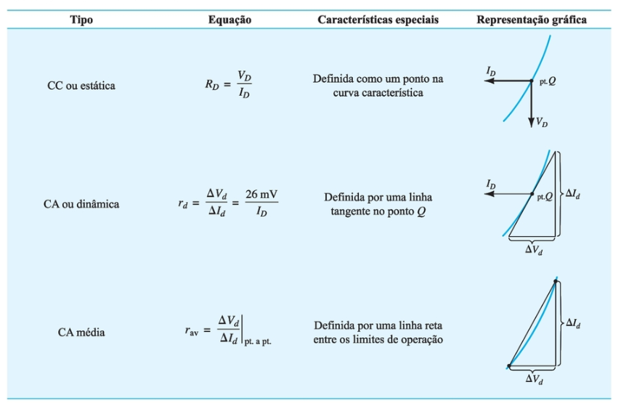
Resistance Levels

Slide 52
DC (Static) Resistance
For a specific applied DC voltage (V_{D}) the diode has a specific current (I_{D}) and a specific resistance (R_{D}).

Slide 53
Exemplo:

Slide 54
AC (Dynamic) Resistance
A straight line drawn tangent to the curve through de Q-point will define a particular change in voltage and current that can be used to determine the ac or dynamic resistance for this section of the diode characteristic.
An effort should be made to keep the change in voltage and current as small as possible and equidistante to either side of the Q-point.

Slide 55
Exemplo:
Fig. 27

Slide 56
Exemplo:

Slide 57
Exemplo:

Slide 58
AC (Dynamic) Resistance
(due to pn junction)
r_{B} is the resistance of the semiconductor material itself (body resistance) + the resistance introduced by the connection between the semiconductor material and the external metallic conductor (contact resistance)

Slide 59
AC (Dynamic) Resistance
In the forward bias region:
The resistance depends on the amount of current (I_{D}) in the diode.
The voltage across the diode is fairly constant (26 mV for 25°C).
r_{B} ranges from a typical 0.1 Ω for high power devices to 2 Ω for low power, general purpose diodes. In some cases r_{B} can be ignored.
In the reverse bias region:
The resistance is effectively infinite. The diode acts like an open circuit.

Slide 60
AC (Dynamic) Resistance
There is no need to worry about sketching tangente lines as defined for AC resistance.. It is important to keep in mind, however, that the equation of r_{d} is accurate only for values of I_{D} in the vertical-rise section of the curve.
For lesser values of I_{D} , the value of r_{d} obtained must be multplied by a fator of 2 (Si). For small values of I_{D} below the knee of the curve, the equation of r_{d} becomes inappropriate.
Exemplo
In the example saw the ac resistance at 25 mA was calculated to be 2Ω. Using the r_{d} equation:
The difference of about 1Ω could be treated as the contribution of r_{B} .

Slide 61
AC (Dynamic) Resistance
Exemplo
In the example saw the ac resistance at 2 mA was calculated ato be 27.5Ω. Using the r_{d} equation but multipling by a factor of 2 for this region (knee):
The difference of about 1.5Ω could be treated as the contribution of r_{B} .

Slide 62
Average AC Resistance
If the input signal is sufficiently large to produce a broad swing the resistance for this region is called Average AC resistance.

Slide 63
Average AC Resistance
Exemplo:
For the situation shown in the curve below calculate r_{av} .
If the AC resistance (r_{d} ) were calculated at I_{D} = 2mA its value would be more than 5Ω and if calculated at 17 mA it would be less. The between, the AC resistance would make the transition from the high value at 2mA to the lower value at 17mA.
The r_{av} defines a value that is considered the average of the ac values from 2mA to 17 mA.

Slide 64
Diode Capacitance
When reverse biased the depletion layer is very large. The diode’s strong positive and negative polarities create capacitance (C_{T} , transition capacitance). The amount of capacitance depends on the reverse voltage applied.
C(0) is the capacitance under no-bias conditions.
V_{R} is the applied reverse bias potencial
V_{K} is the junction potential with no bias
n is 1/2 or 1/3 depending on the manufacturing process.

Slide 65
Diode Capacitance
When forward biased storage capacitance or diffusion capacitance (C_{D}) exists as the diode voltage increases.
Ԏ_{T} is the minority carrier life time. For example, the time for a minority carrier such as a hole to recombine with an electron in the n-type material
For low or mid-frequency applications (except in the power area), however, the capacitor is normally not included in the diode symbol.

Slide 66
Reverse Recovery Time (t_{rr})
In the forward-bias state it was shown earlier that there are a large number of electrons from the n-type material progressing through the p-type material and a large numbers of holes in the n-type material – a requirement for conduction.
The electrons in the p-type material and holes progressing through the n-type material establish a large number o minority carriers in each material In each material.
If the applied voltage should be reversed to establish a reverse bias situation, we would ideally like to see the diode change instantaneously frm the conduction state to the nonconduction state.
However because of the large number of minority carriers in each material, the diode current will simply reverse as shown in the figure and stay at this measurable level for the period of time t_{s} (storage time) required for the minority carriers to return to their majority-carrier state in the opposite material.
Eventually, when this storage phase has passed, the current will be reduced in leve to that associated with the nonconduction state. This second period of time is the t_{t} (transition time). The (t_{rr}) = t_{s} + t_{t}.

Slide 67
Reverse Recovery Time (t_{rr})
Reverse recovery time is the time required for a diode to stop conducting when switched from forward bias to reverse bias.

Slide 68
Diode Specification Sheets

Slide 69
Diode Specification Sheets

Slide 70
Diode Specification Sheets

Slide 71
Diode Specification Sheets
Diode data sheets contain standard information, making cross-matching of diodes for replacement or design easier.
Forward Voltage (V_{F}) at a specified current and temperature
Maximum forward current (I_{F}) at a specified temperature
Reverse saturation current (I_{R}) at a specified voltage and temperature
Reverse voltage rating, PIV or PRV or V_{(BR)}, at a specified temperature
Maximum power dissipation at a specified temperature
Capacitance levels
Reverse recovery time, t_{rr}
Operating temperature range

Slide 72
Diode Specification Sheets
A
B
B

Slide 73
Diode Specification Sheets
D
E

Slide 74
Diode Specification Sheets
F

Slide 75
Diode Specification Sheets
G
H

Slide 76
Diode Testing
Diodes are commonly tested using one of these types of equipment:
Diode checker
Ohmmeter
Curve tracer

Slide 77
Diode Checker
Many digital multimeters have a diode checking function. The diode should be tested out of circuit.
A normal diode exhibits its forward voltage:
Gallium arsenide ≅ 1.2 V
Silicon diode ≅ 0.7 V
Germanium diode ≅ 0.3 V

Slide 78
Ohmmeter
An ohmmeter set on a low Ohms scale can be used to test a diode. The diode should be tested out of circuit.

Slide 79
Curve Tracer
A curve tracer displays the characteristic curve of a diode in the test circuit. This curve can be compared to the specifications of the diode from a data sheet.

Slide 80
Rectifier Circuits

Slide 81
Half-Wave Rectification
The diode conducts only when it is forward biased, therefore only half of the AC cycle passes through the diode to the output.
Half-wave: V_{dc} = 0.318V_{m}

Slide 82
Full-Wave Rectification
Bridge Rectifier
A full-wave rectifier with four diodes that are connected in a bridge configuration
V_{DC} = 0.636V_{m}

Slide 83
Center-Tapped Rectification
Center-Tapped
Transformer Rectifier
Requires two diodes and a
center-tapped transformer
V_{DC} = 0.636V_{m}

Slide 84
Summary of Rectifier Circuits
In the center tapped transformer rectifier circuit, the peak AC voltage is the transformer secondary voltage to the tap.
Rectifier | Ideal V_{DC} | Realistic V_{DC}
Half Wave Rectifier | V_{DC}= 0.318V_{m} | V_{DC} = 0.318V_{m} – 0.7
Bridge Rectifier | V_{DC} = 0.636V_{m} | V_{DC} = 0.636V_{m} – 2(0.7 V)
Center-Tapped Transformer Rectifier | V_{DC} = 0.636V_{m} | V_{DC} = 0.636V_{m} – 0.7 V
V_{m} = the peak AC voltage

Slide 85
Links Úteis
Videos - pn junctions
Animation | How a P N junction semiconductor works | forward reverse bias |
diffusion drift current (6:36 min)
https://www.youtube.com/watch?v=OyC02DWq3mI
The PN Junction. How Diodes Work? (10:36 min)
https://www.youtube.com/watch?v=JBtEckh3L9Q
Formation and Properties of Junction Diode (2:44 min)
https://www.youtube.com/watch?v=4SlfaocMfdA
p-n-Juction-And-Diodes (4:07min)
https://www.youtube.com/watch?v=W6QUEq0nUH8

Slide 86
Links Úteis
Videos - pn junctions
Zener Diode Fully Explained (11:29 min)
https://www.youtube.com/watch?v=d4zO39K_ce8
How Does a Diode Work? Intro to Semiconductors (p-n Junctions in the Hood)
(23:32min)
https://www.youtube.com/watch?v=b3xys6rYM_Q
P-N junction solar cells (2>32min)
https://www.youtube.com/watch?v=2AX0qvnjSnM
Light Emitting Diode (LED) (7:53min)
https://www.youtube.com/watch?v=GodkGafZsh4

