Slide 1
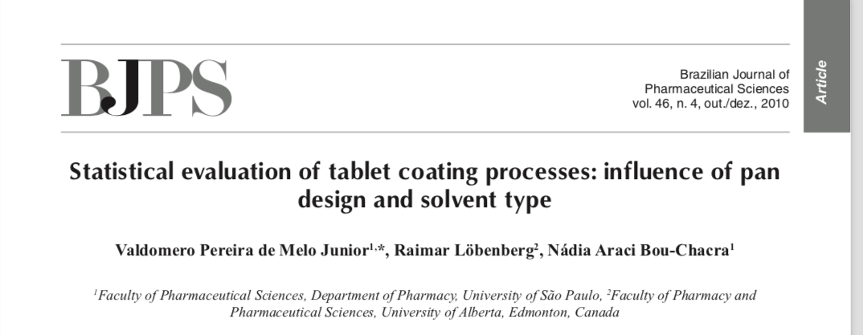

Slide 2
https://www.freund-vector.com/products/ldcs-micro-hi-coater/

Slide 3
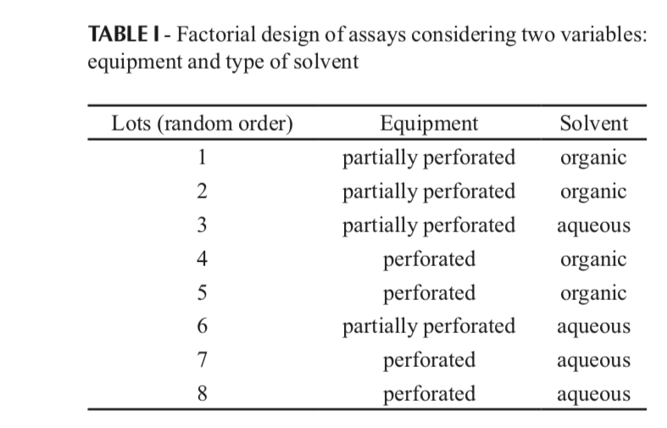

Slide 5
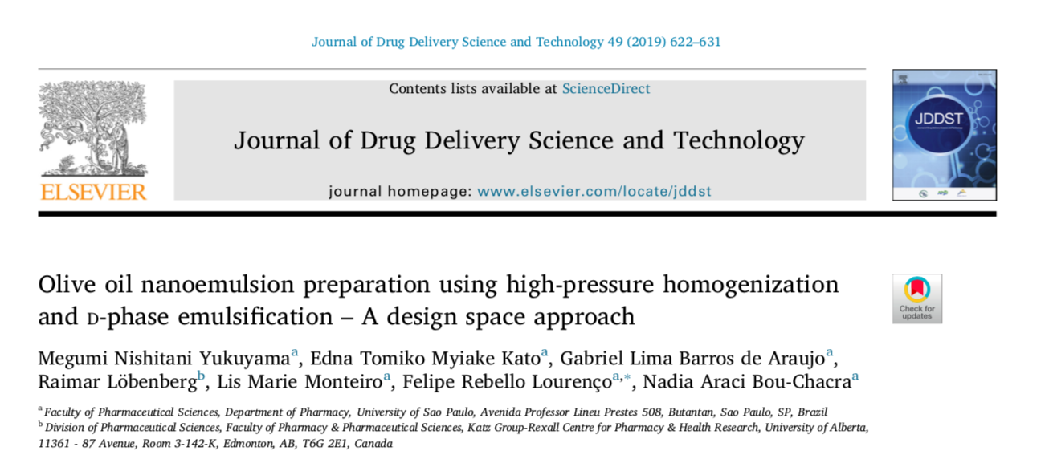

Slide 6
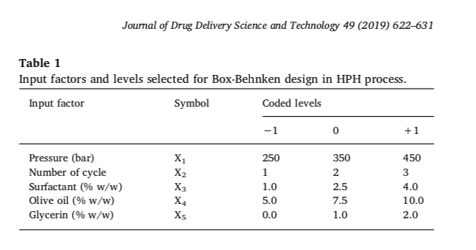

Slide 7
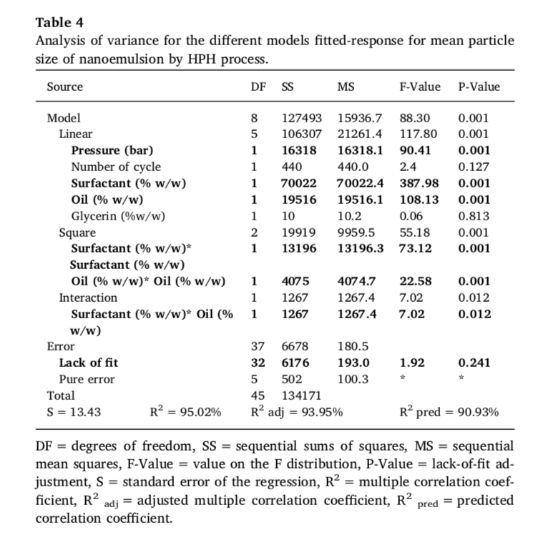

Slide 8
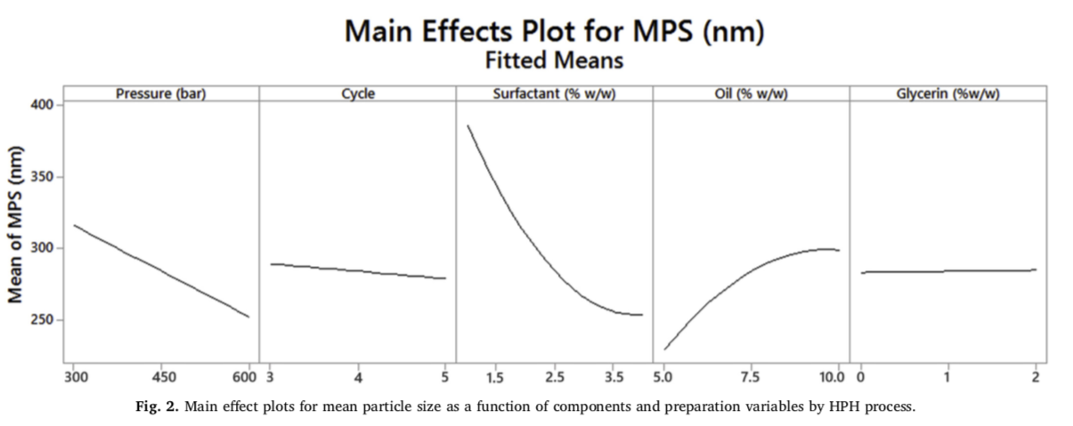

Slide 9
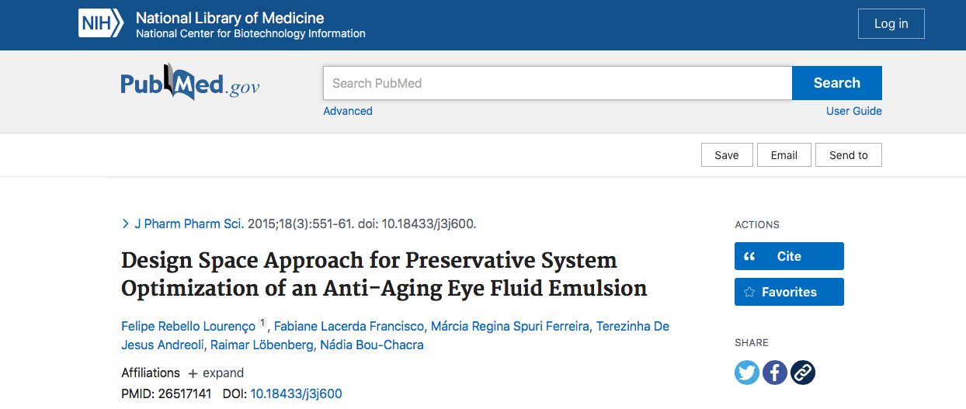

Slide 10
Table 2. Augmented Simplex Centroid Design Matrix.
Run | Run Order | Center point | A | B | C | D
15 | 1 | 0 | 0.250 | 0.250 | 0.250 | 0.250
5 | 2 | 1 | 0.500 | 0.500 | 0 | 0
7 | 3 | 1 | 0.500 | 0 | 0 | 0.500
18 | 4 | 1 | 0.250 | 0 | 0.625 | 0.125
9 | 5 | 1 | 0 | 1.00 | 0 | 0
1 | 6 | 1 | 0.125 | 0.625 | 0.125 | 0.125
A: imidazolidinyl urea B: methylparaben C: propylparaben D: EDTA

Slide 11
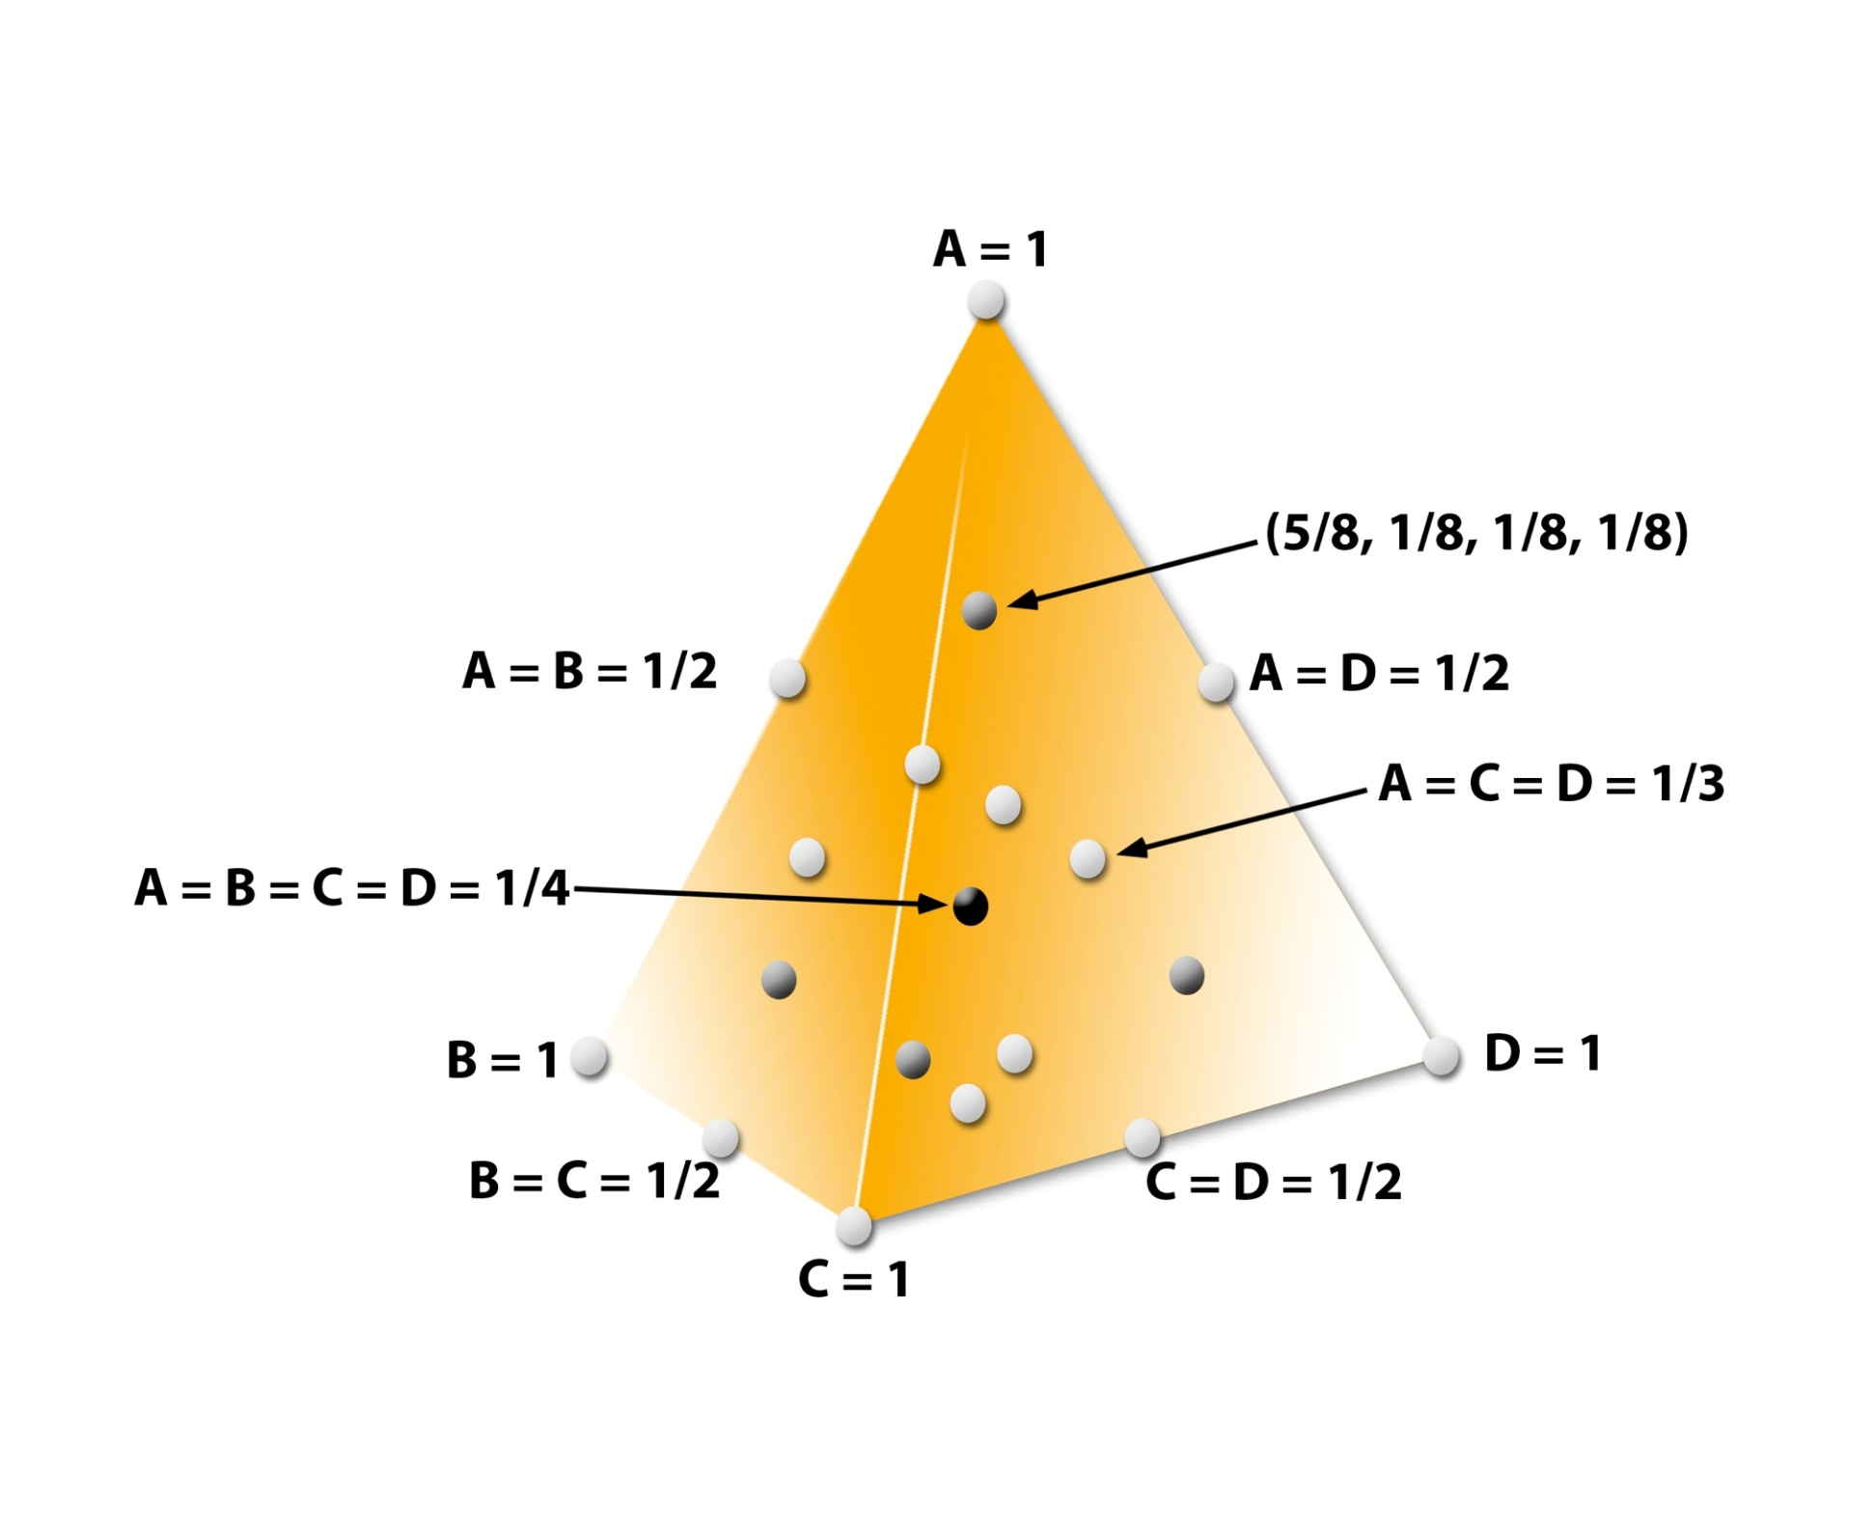

Slide 12
Table 3. Challenge test: time intervals and organisms
Organisms | Time (hours)
Burkholderia cepacia | T0 | T2 | T4 | T8 | - | T24 | T48 | -
Pseudomonas aeruginosa | T0 | T2 | T4 | - | - | T24 | T48 | -
Staphylococcus aureus | T0 | T2 | T4 | - | T12 | T24 | T48 | -
Candida albicans | T0 | T2 | T4 | - | - | T24 | T48 | T168
Aspergillus niger | T0 | T2 | T4 | - | - | T24 | T48 | T168
T0: immediately after the inoculation
Time (hours) | CFU/g | Log CFU/g | Detection Time (hours)
0 | 10⁶ | 6 | 0.5
2 | 10⁵ | 5 | 1.0
4 | 10⁴ | 4 | 1.5
24 | 10² | 2 | 2.0
48 | 10⁰ | 1 | 3.0
Detection Time (DT): Inversely proportional to the number of organisms in the fluid emulsion

Slide 13
Product
F1
F2
-37.5%
-87.5%
-87.5%
-87.5%

