Slide 2
“Edição Gênica com Crispr-Cas9”
Geraldo A. Passos
Grupo de Imunogenética Molecular
Universidade de São Paulo
Faculdade de Odontologia de Ribeirão Preto
E
Faculdade de Medicina de Ribeirão Preto
sites.usp.br/imunogenetica
passos@usp.br

Slide 3
CRISPR / Cas9: metodologia e aplicações
Prof. Dr. Geraldo Aleixo Passos, FORP e FMRP USP
passos@usp.br
Prof. Dr. Tiago Campos Pereira, FFCLRP USP
tiagocampospereira@ffclrp.usp.br

Slide 4
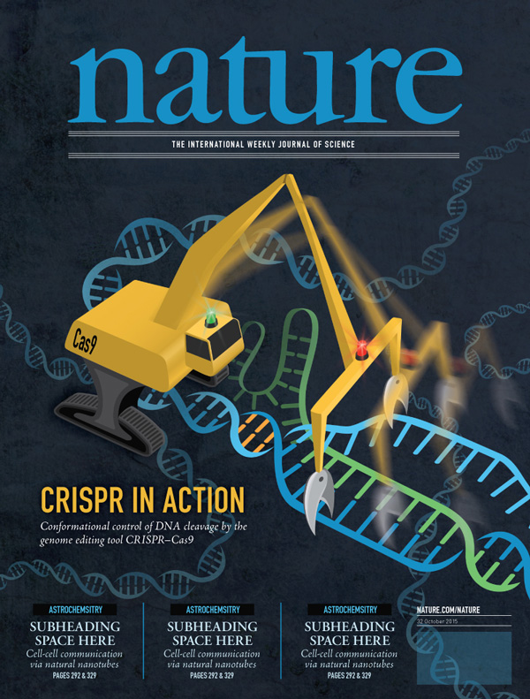
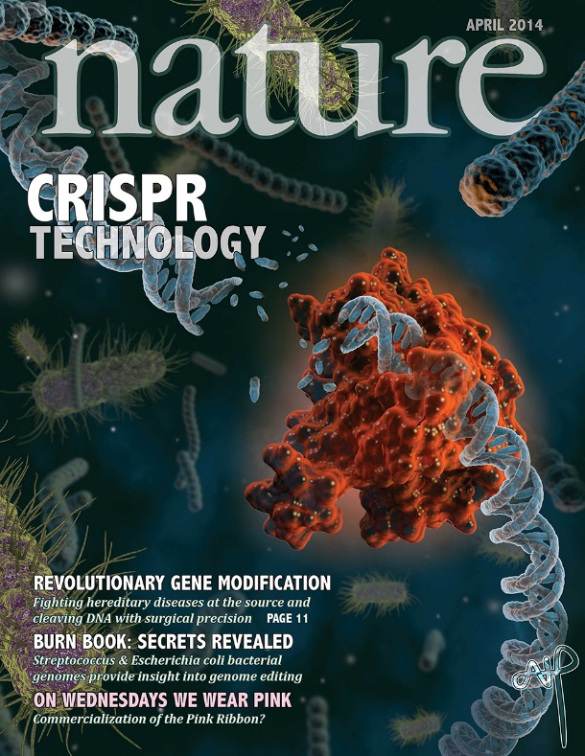

Slide 5
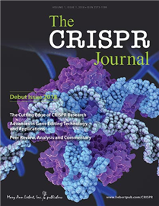
Em 2017 surgiu uma revista científica específica em CRISPR:

Slide 6
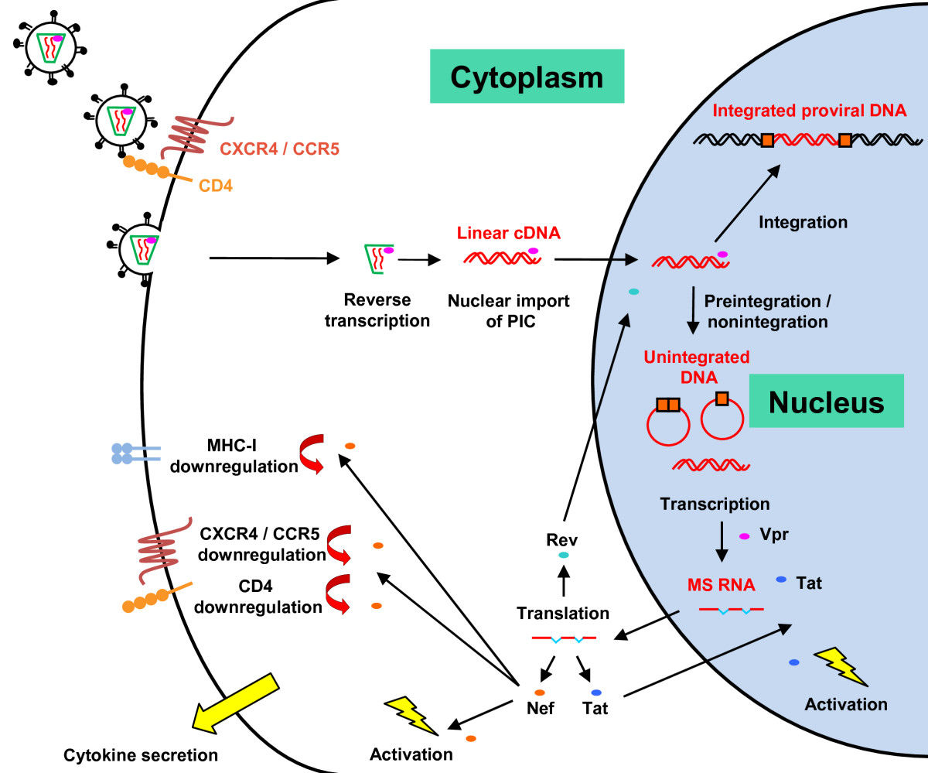
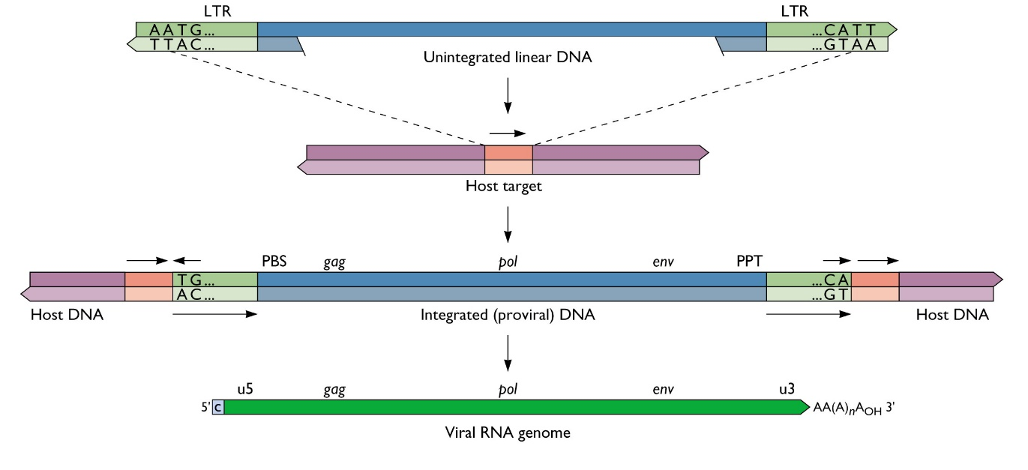
Ciclo de replicação do HIV-1
e integração do DNA proviral

Slide 7
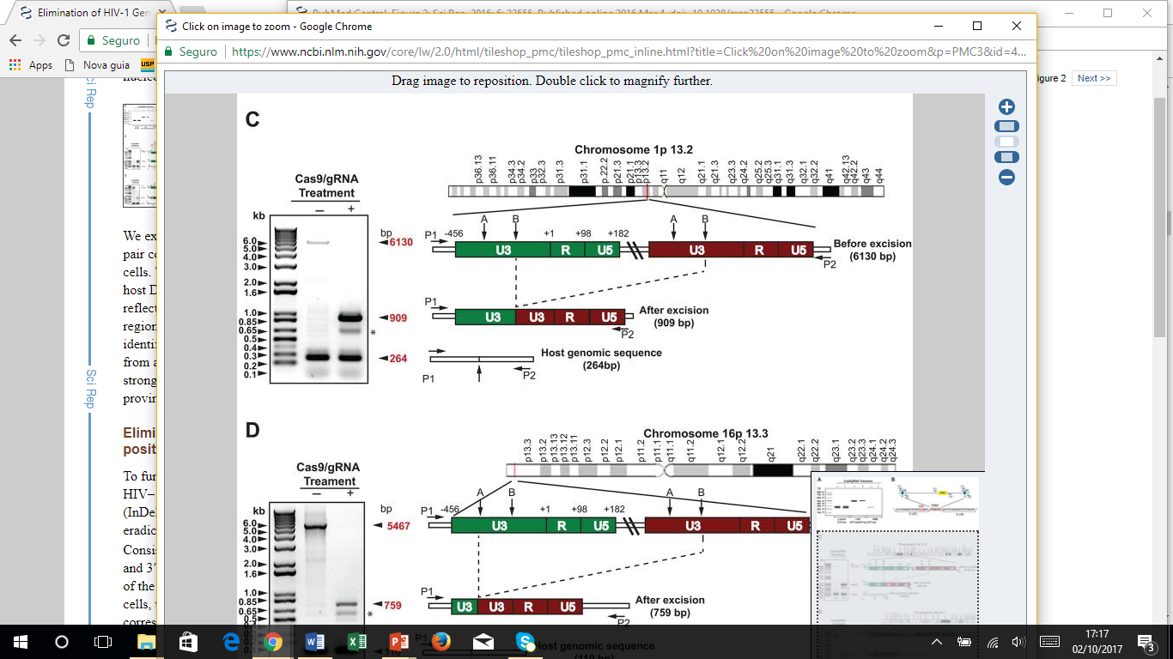
Elimination of HIV-1 Genomes from Human T-lymphoid Cells by CRISPR/Cas9 Gene Editing
Kaminski R et al (2016) Sci Rep 6: 22555

Slide 8
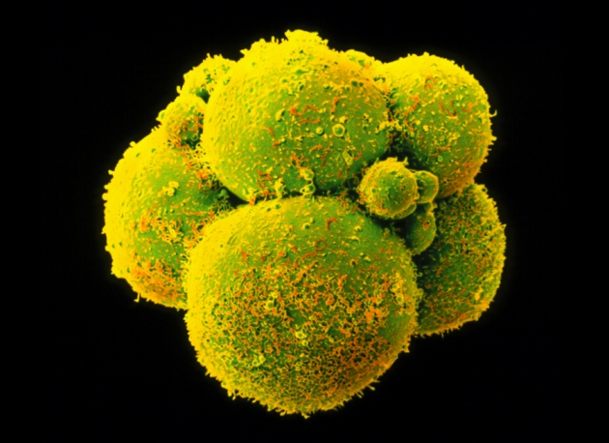
Gene correction in S-phase-injected human embryos

Slide 9
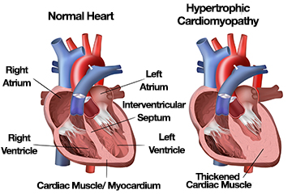
Gene (MYBPC3) correction in S-phase-injected human embryos Myosin binding protein C3 gene → mutation → Hypertrophic Cardiomyopathy
Chromosome 11p11.2

Slide 10
Gene (MYBPC3) correction in S-phase-injected human embryos
H Ma et al. Nature 1–7 (2017) doi:10.1038/nature23305

Slide 11
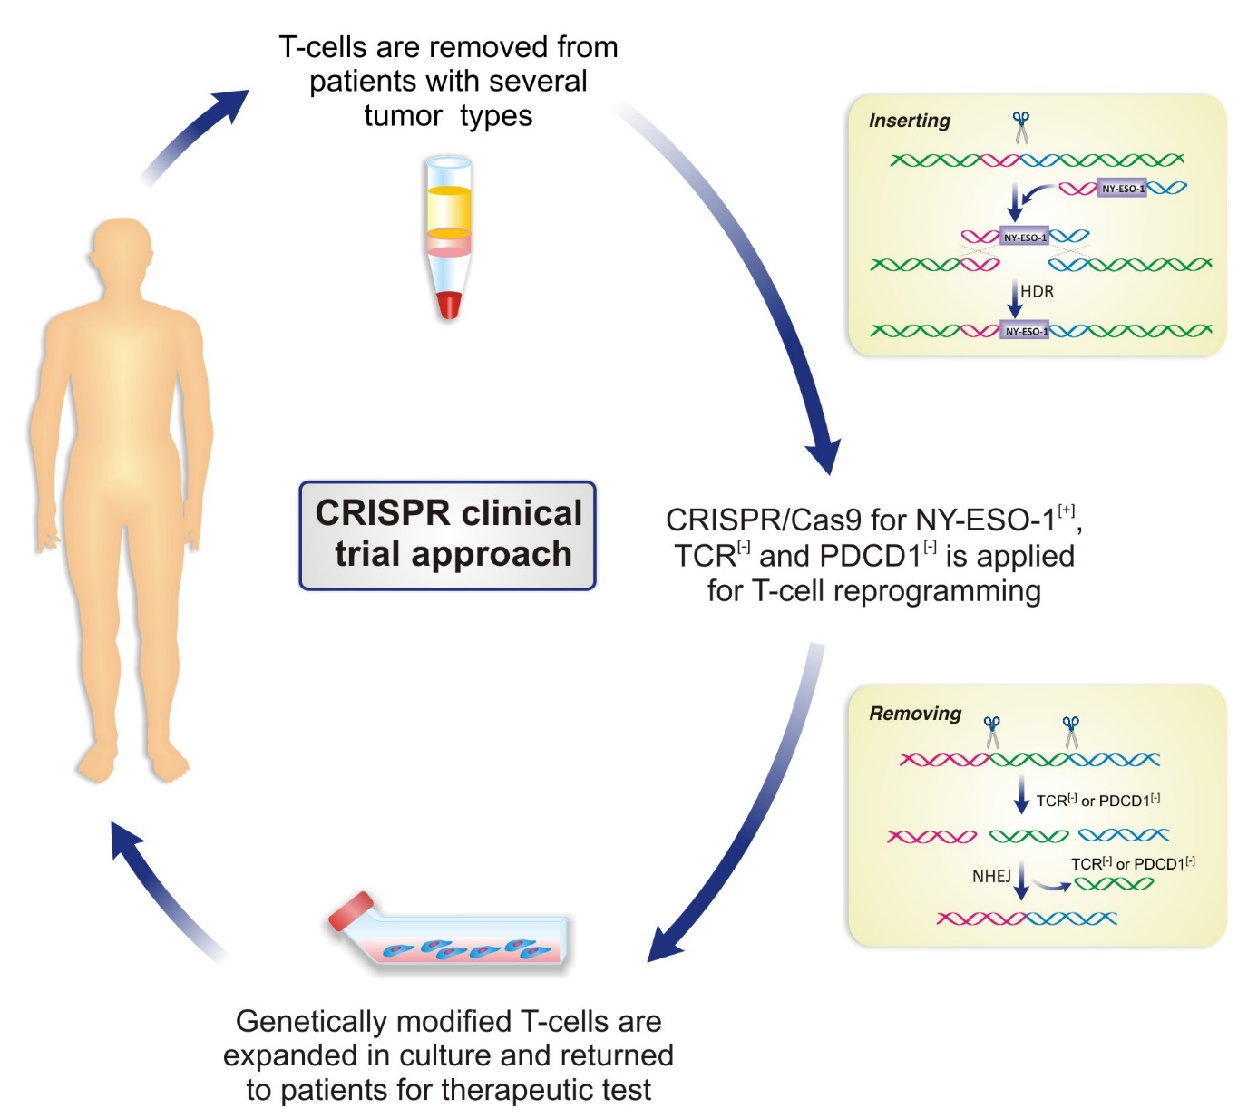
Reprogramação de linfócitos com Crispr-Cas9 no tratamento do câncer
Assis AF et al 2017 submetido para publicação

Slide 12
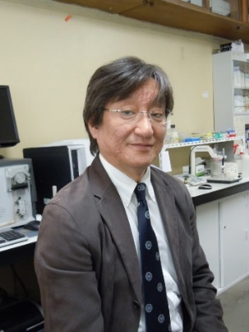
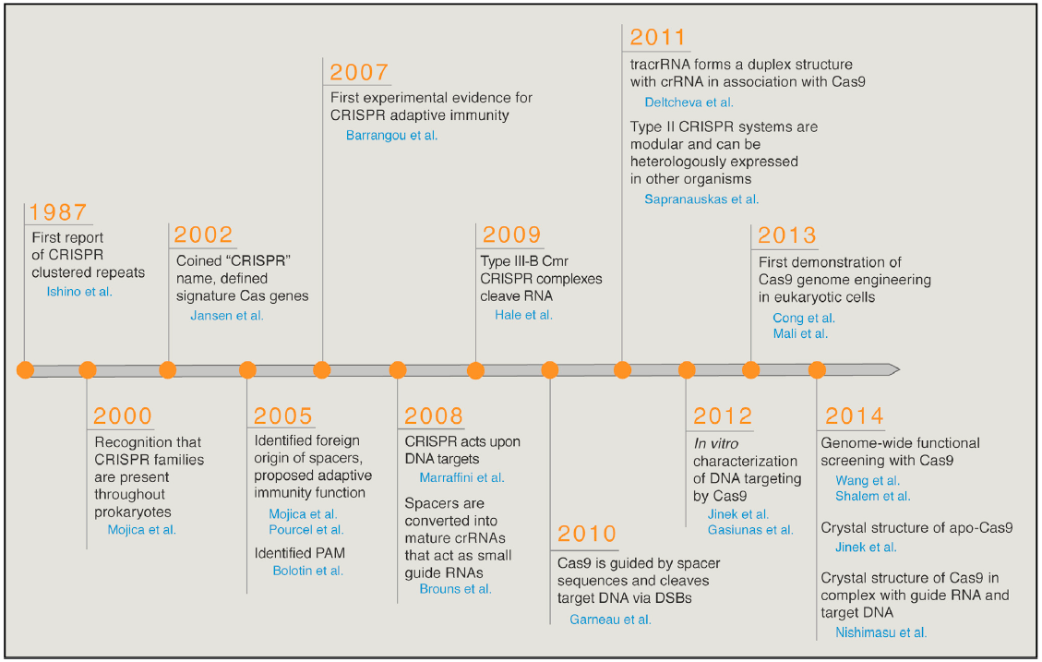
1. Introduction - history
Jennifer Doudna Emmanuele Charpentier Feng Zhang

Slide 13
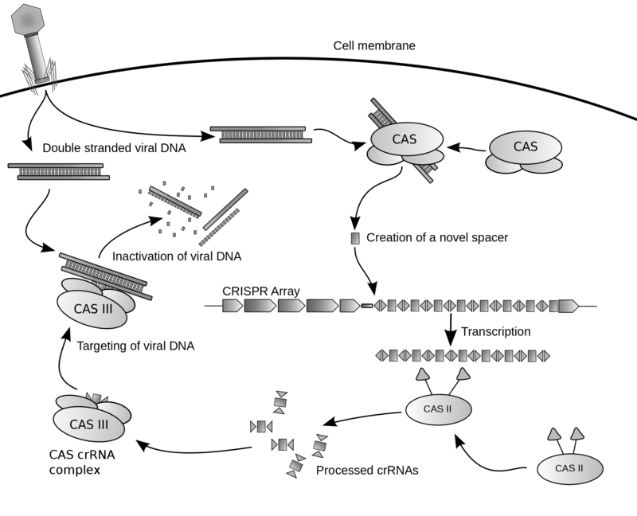
Crispr é um locus envolvido na resistência de bactérias aos fagos
By James atmos - Own work, CC BY-SA 3.0, https://commons.wikimedia.org/w/index.php?curid=7821536

Slide 14
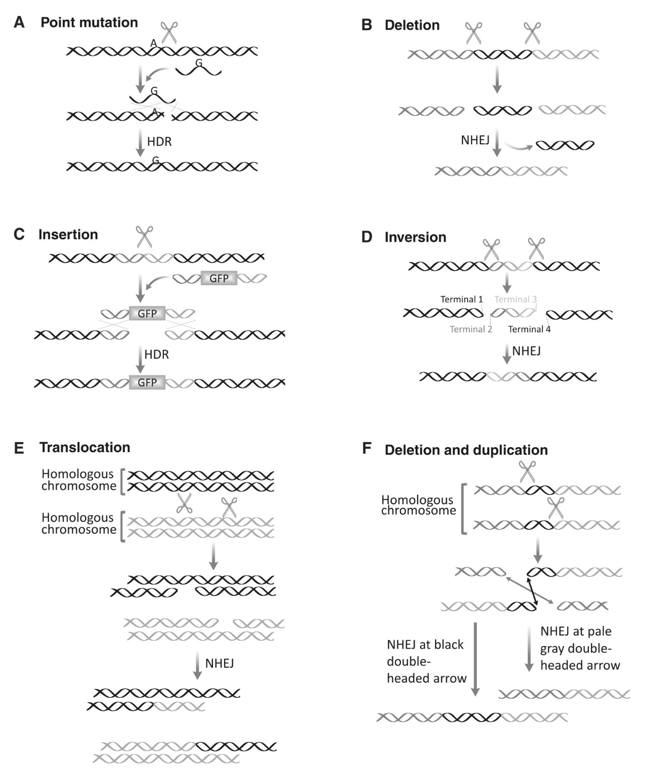
Indução dos diferentes
tipos de mutações com
CRISPR-Cas9
Assis AF et al 2017 submetido para publicação

Slide 15
1. Introduction - definition
CRISPR is a technique for gene editing (just like TALEN and ZFN), i.e., a tool able to modify the nucleotide sequence in a precise manner.
Elements: Cas9 (RGN, RNA-guided nuclease) and guide RNA.
This modification may be of several kinds:
- deletion, insertion or substitution of one or a few nucleotides;
- deletion of genetic elements;
- integration of genetic elements (e.g., transgenes), among others.
However, it is important to highlight that CRISPR may be used for other purposes (see CRISPR’s versatility). This multifunctional set of CRISPR-derived techniques is known as CRISPR toolbox (caixa de ferramentas da CRISPR).

Slide 16
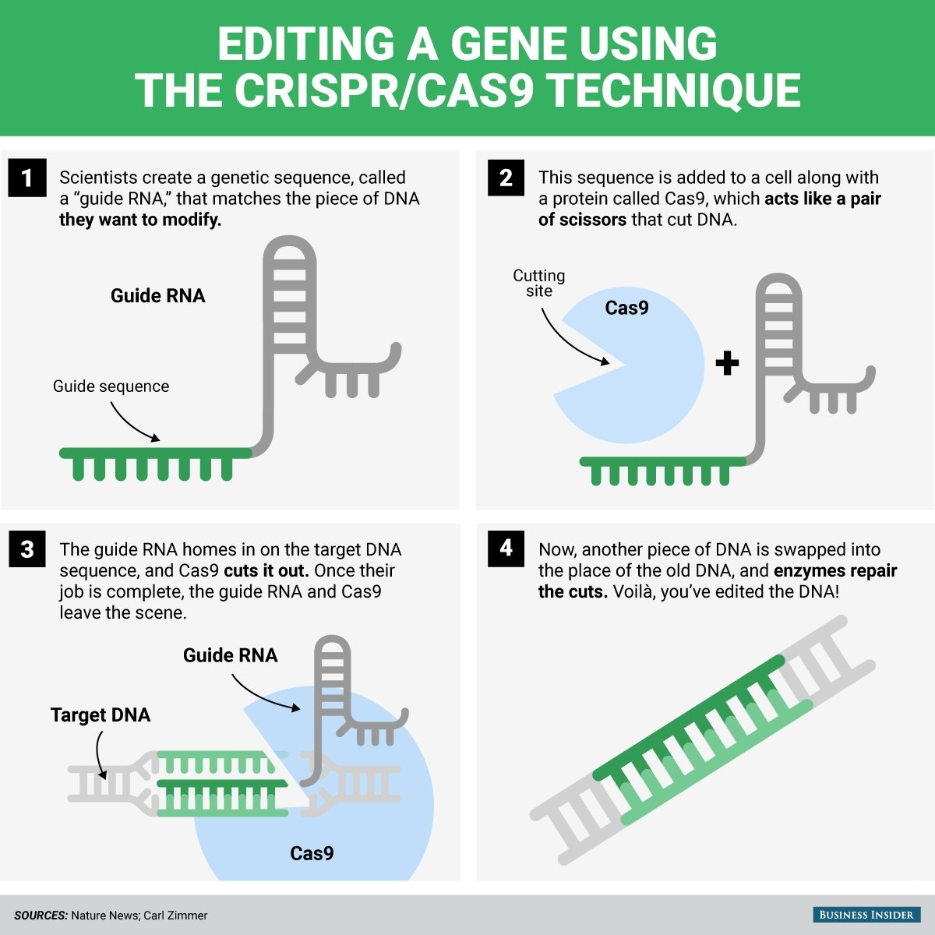

Slide 17
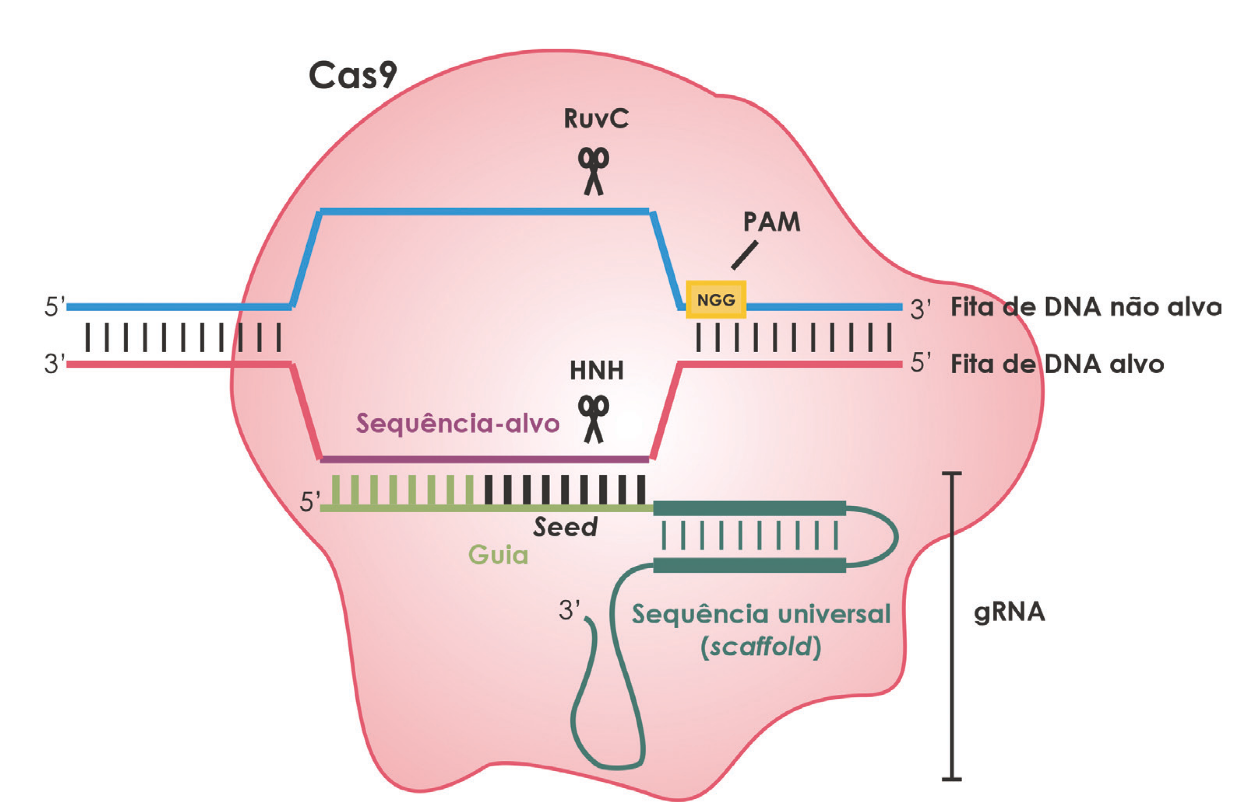
2. Molecular mechanism - components
COMPONENTS
- Cas9 nuclease
- Single Guide RNA (sgRNA, ∼100 nt)
Guide (20 nt), contains seed
Scaffold (80 nt)
- Target DNA
Target sequence (20 nt)
PAM (NGG)

Slide 18
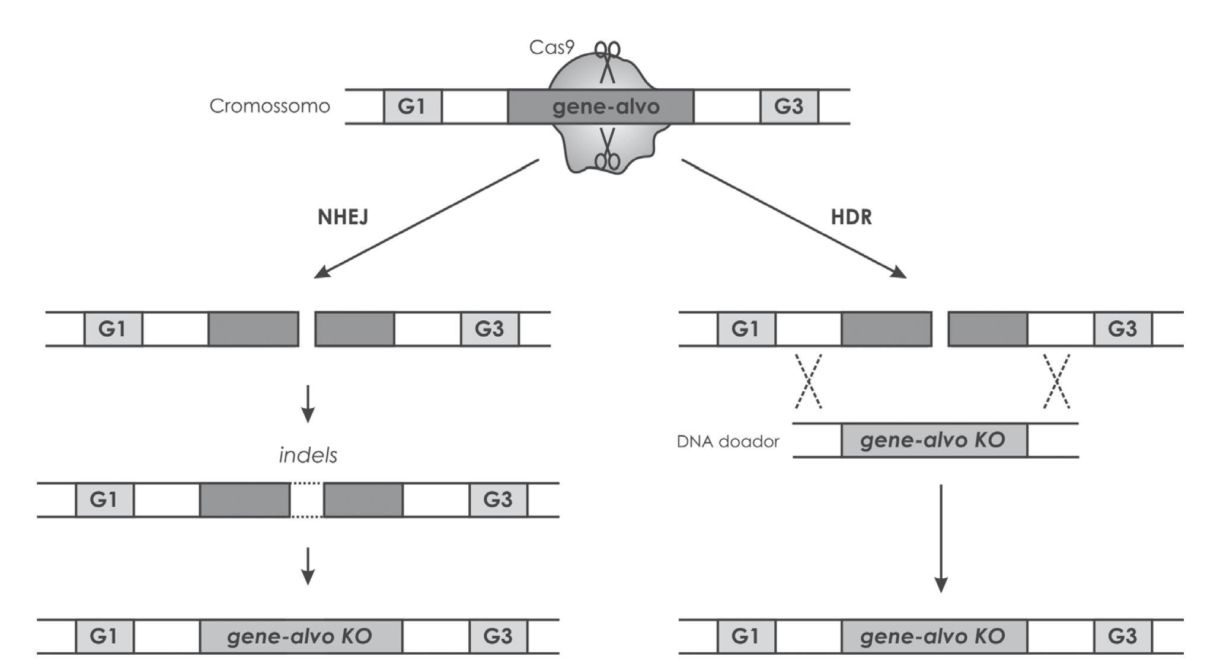
2. Molecular mechanism - cleavage effects

Slide 19
3. CRISPR TOOLBOX - VERSATILITY

Slide 20
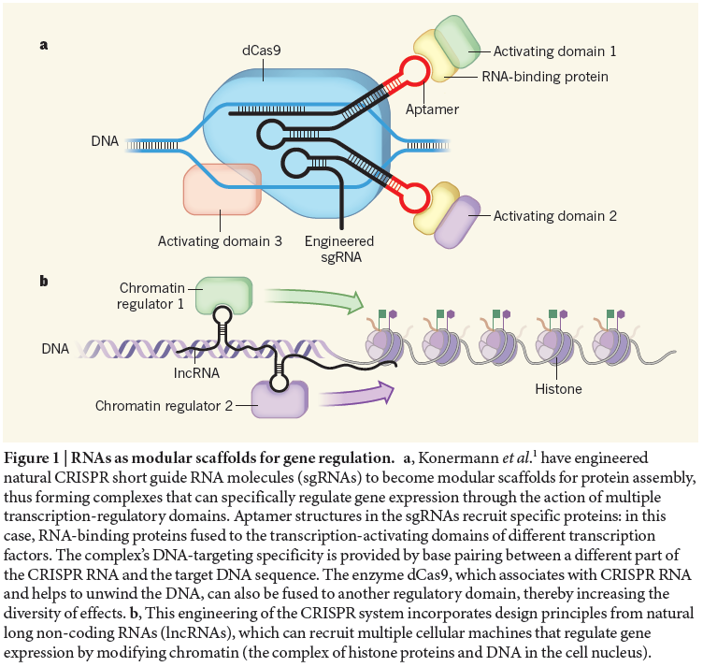
3. Versatility - regulation of gene expression

Slide 21
3. CRISPR toolbox - overview
KO: knock out
KI: knock-in
AS: allelic replacement
GD: gene deletion

Slide 22
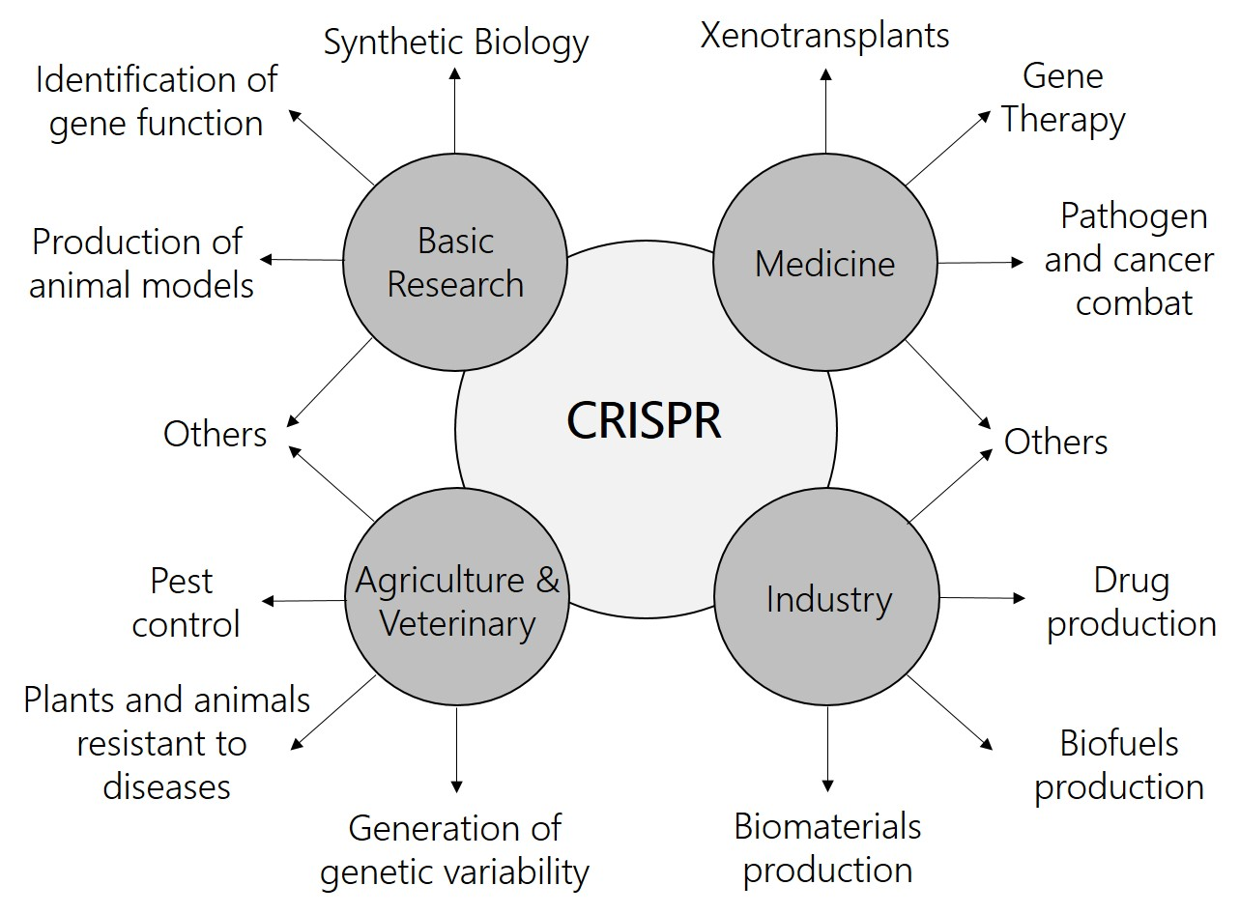
4. APPLICATIONS

Slide 23
5. NATURAL AND ARTIFICIAL VARIANTS
OF Cas9

Slide 24
5. Cas9 variants - nickases

Slide 25
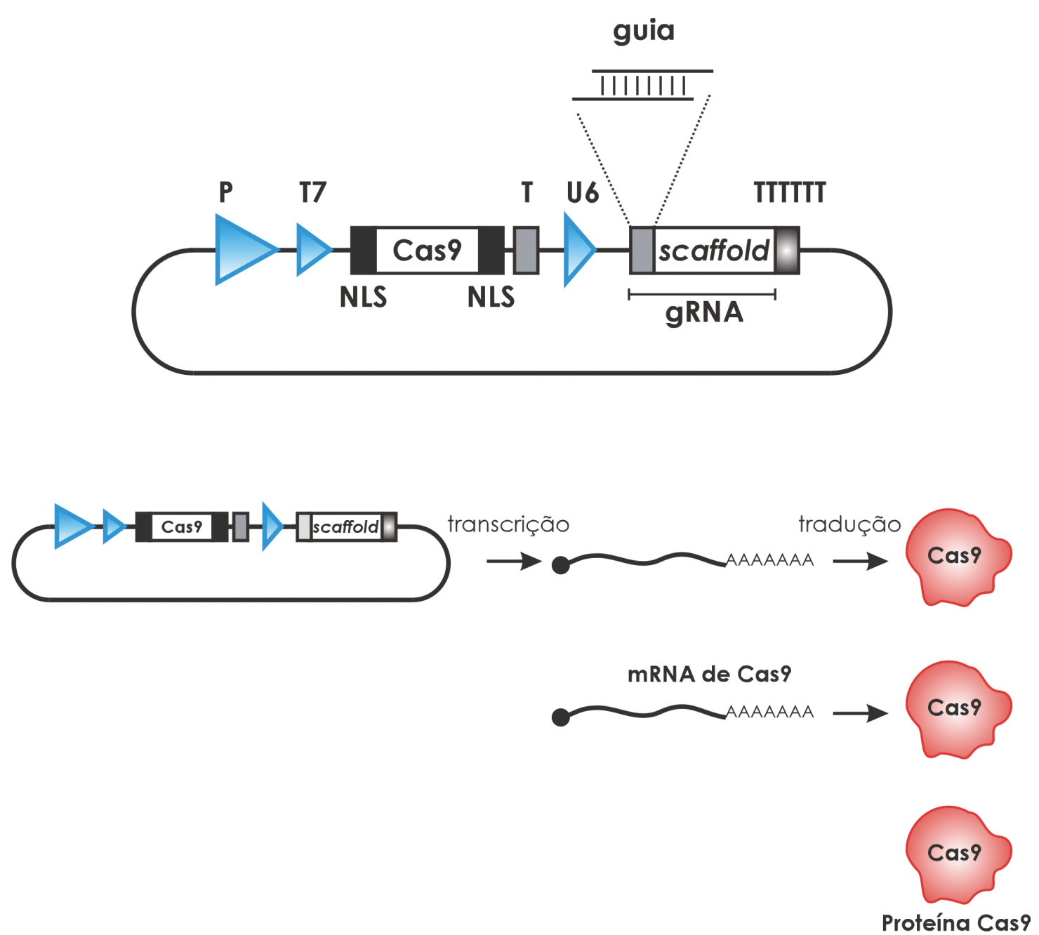
6. Obtaining Cas9 and gRNAs
Academic way
Commercial purchase
Synthesis
DNA (vectors)
RNA (mRNA and gRNA)
Protein (Cas9)

Slide 26
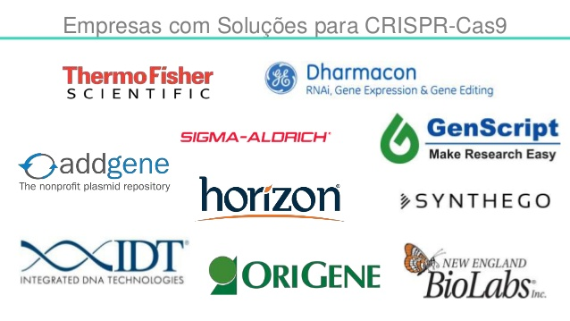

Slide 27
6. Obtaining the molecules - commercial purchase

Slide 28
6. Rational design of gRNAs
NNNNNNNNNNNNNNNNNNNN NGG
↓
GC 50%
Secundary structures (Gene Runner)
Specificity (Blast)

Slide 29
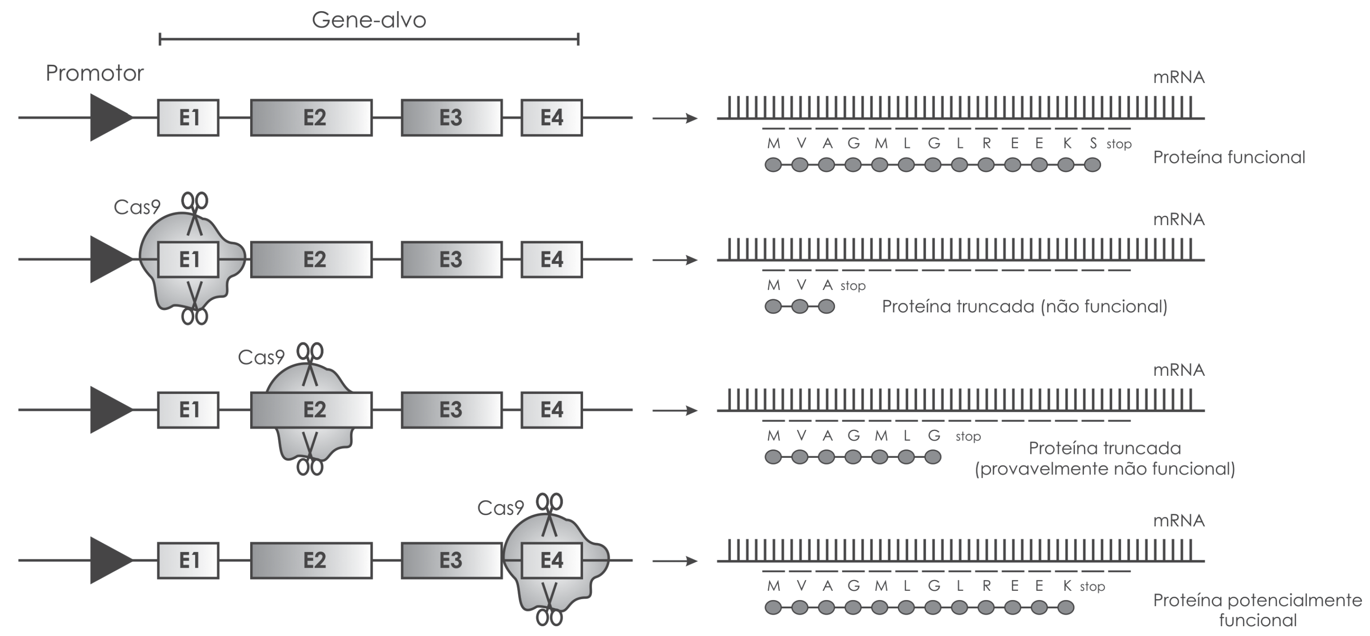
6. Rational design of gRNAs - position within the gene

Slide 30
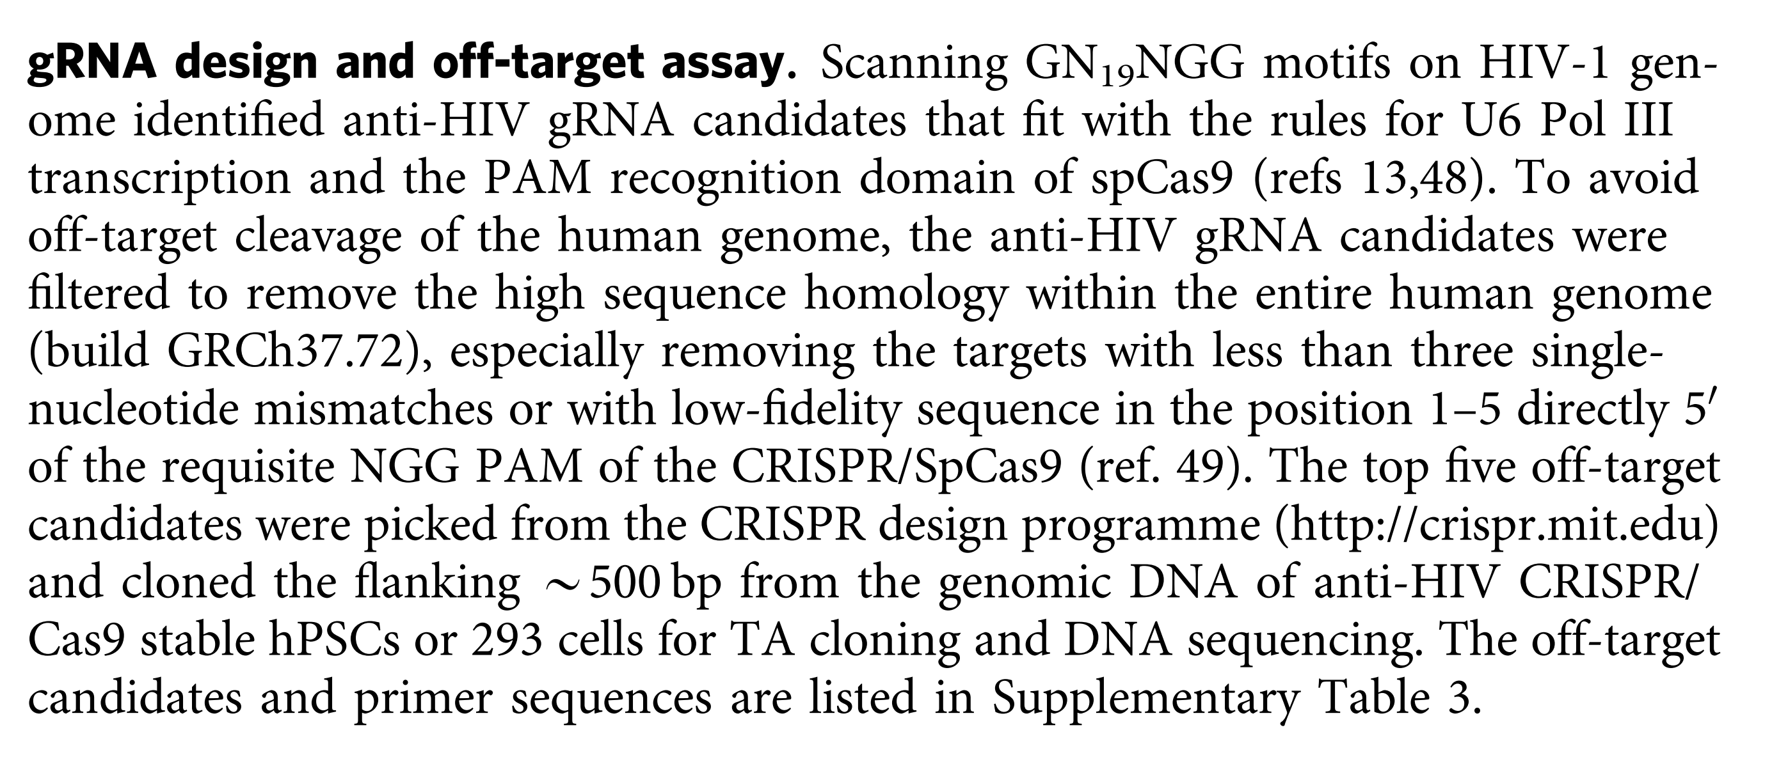
7. Analysis of specificity (off-target assessment)
Cas9/sgRNA against HIV in human cells
in silico identification of possible off-targets, followed by PCR and sequencing

Slide 31
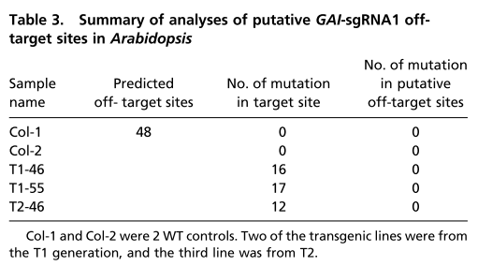
7. Analysis of specificity (off-target assessment)
Whole-genome sequencing (60x coverage) of wild type plant (WT) and transformed (T1 e T2).
Potencial off-target sites analysed:
presenting sequence similarity to 20 nt of gRNA and PAM
presenting sequence similarity to critical 12 nt* of sgRNA and PAM
*Cong L, et al. (2013) Multiplex genome engineering using CRISPR/Cas systems. Science. 339(6121):819–823.
*Pattanayak V, et al. (2013) High-throughput profiling of off-target DNA cleavage reveals RNA-programmed Cas9 nuclease specificity. Nat Biotechnol 31(9):839–843.
*Fu Y, et al. (2013) High-frequency off-target mutagenesis induced by CRISPR-Cas nucleases in human cells. Nat Biotechnol 31(9):822–826.
*Hsu PD, et al. (2013) DNA targeting specificity of RNA-guided Cas9 nucleases. Nat Biotechnol 31(9):827–832.

Slide 32
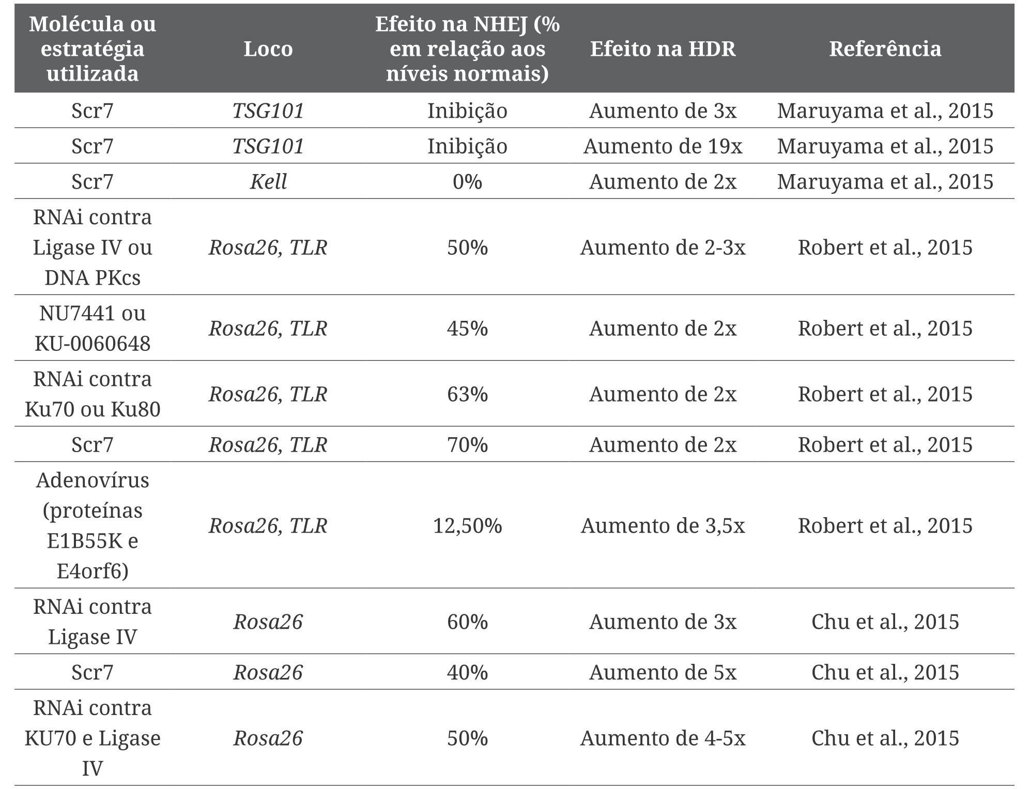
8. Optimizations - NHEJ inhibition

Slide 33
9. Strategies - general aspects
Cas9/sgRNA administration can be done in any of the several in vitro or in vivo strategies to introduce nucleic acids:
electroporation
cell transfection
viral transduction
viral vectors
plasmids
biolistics
genetic transformation
agroinfiltration
microinjection
local injection
stereotaxic surgery
etc
Variations:
tissue-specific promoters; conditional promoters
concentration of Cas9/sgRNA

Slide 34
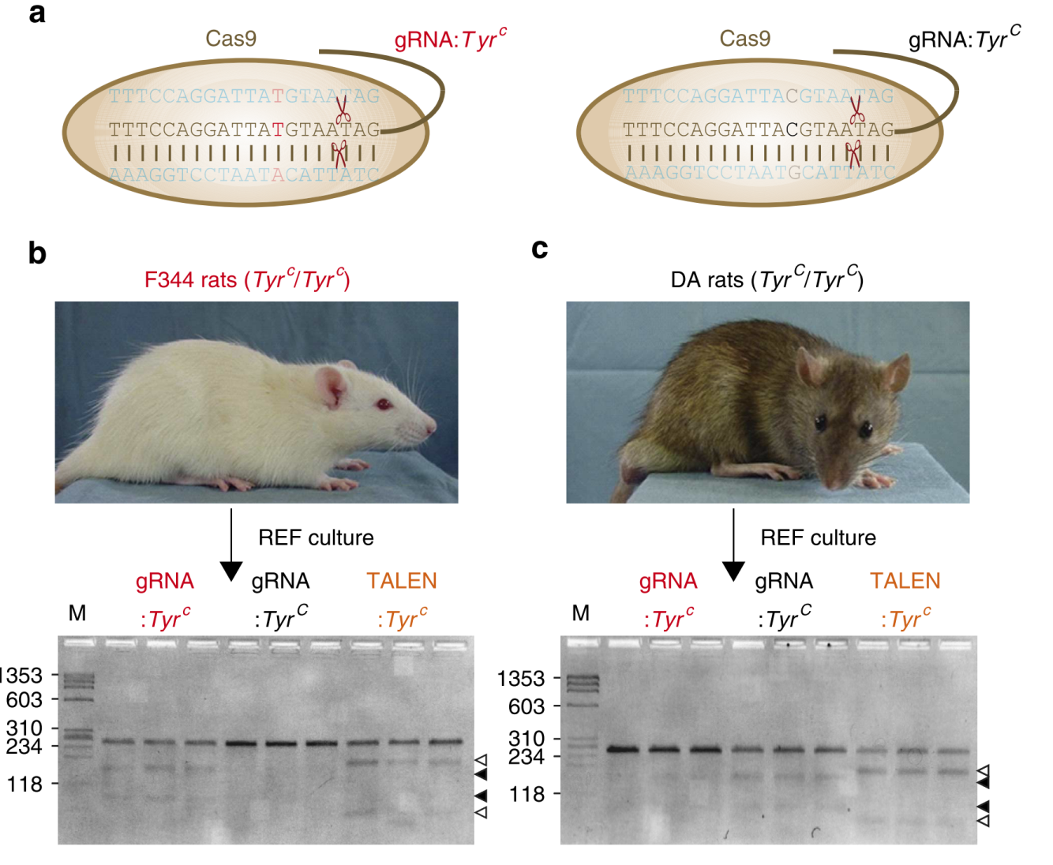
9. Strategies - Microinjection in rat zygotes
Correction of a genetic disturb - albinism
Gene Tyr: tyrosinase (melanine)
Use of HDR pathway (ssODN) 80pb
Allele-specificity
Temporary effect
REF: rat embryonic fibroblast
SURVEYOR Mutation Detection
Kit (“CEL” family nuclease)
Embryo editing
- Heterozygotes (brown ones)
- Mosaics
- Homozigotes (white ones)

Slide 35
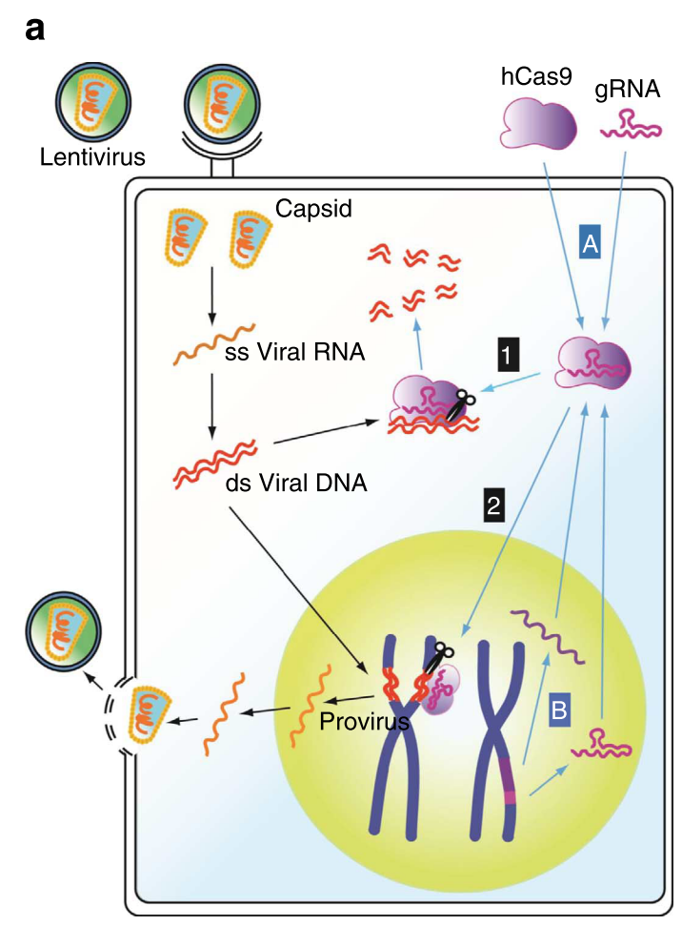
9. Strategies - Stable expression of cassettes in cells
Combat againt a virus (HIV – in vitro)
Integration of the expression cassette
Cas9/sgHIV via transposon-mediated
genome engineering.
Multiplexing (2 sgRNAs)
Módulos
A e B

Slide 36
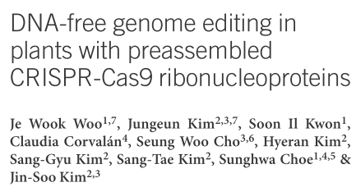
9. Strategies - Plant modification
Editing plant genomes without introducing foreign DNA into cells may alleviate regulatory concerns related to genetically modified plants.
We transfected preassembled complexes of purified Cas9 protein and guide RNA into plant
protoplasts of Arabidopsis thaliana, tobacco, lettuce and rice and achieved targeted mutagenesis in regenerated plants at frequencies of up to 46%.
The targeted sites contained germline-transmissible small insertions or deletions that are
indistinguishable from naturally occurring genetic variation.

Slide 37
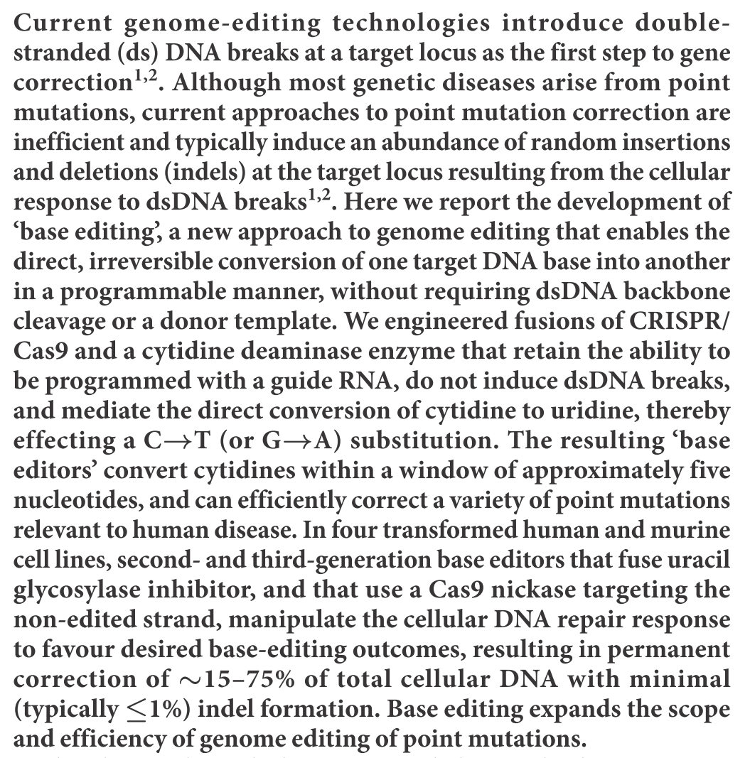
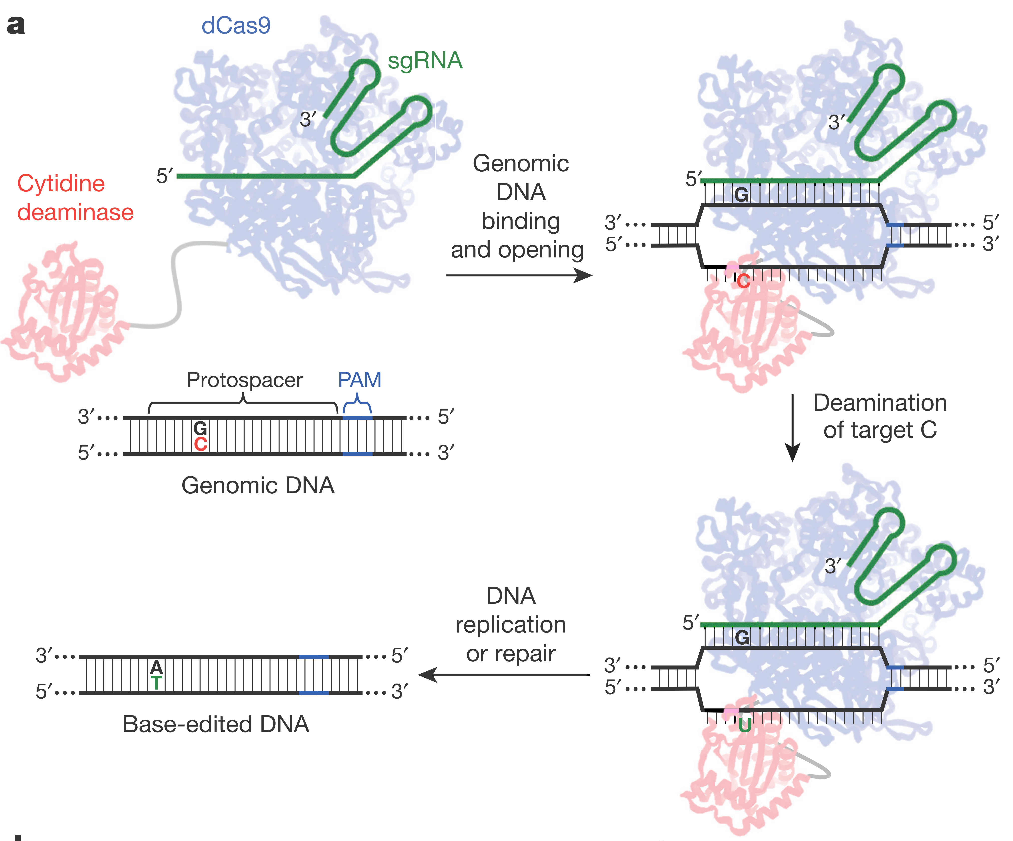
10. Perspectives

Slide 38
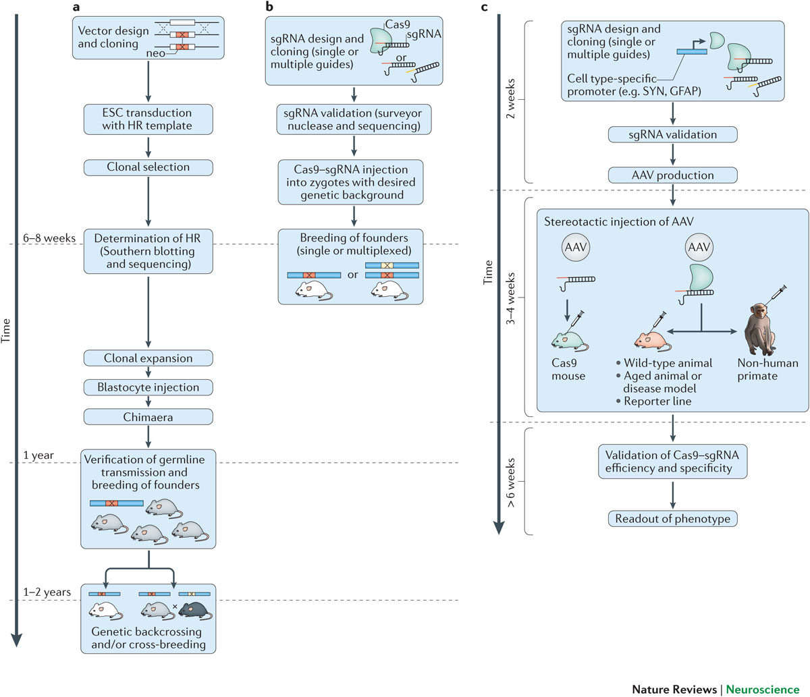

Slide 39
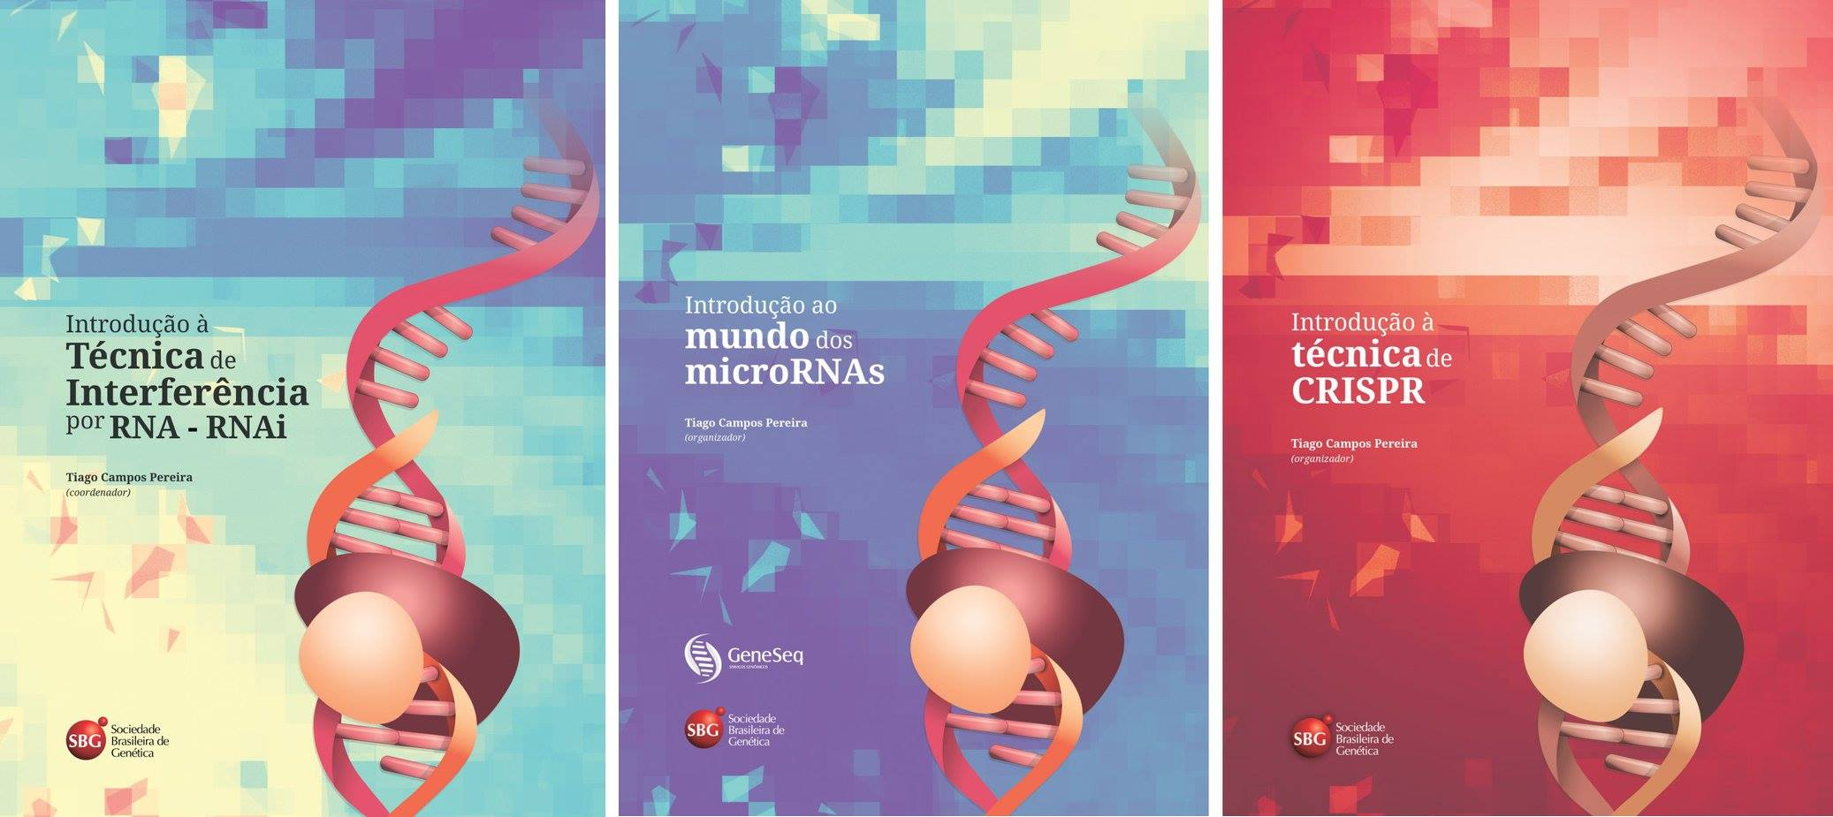
THANK YOU!
E-mail tiagocampospereira@ffclrp.usp.br
Non-coding RNAs
2017
RNAi - 2013
miRNAs - 2015
CRISPR - 2016
Introdução ao universo
dos ncRNAs

