Slide 1
Eixo Imune-Pineal
Relação Melatonina e Sistema Imune
Giulia, Ivone, Laura e Viviane

Slide 2
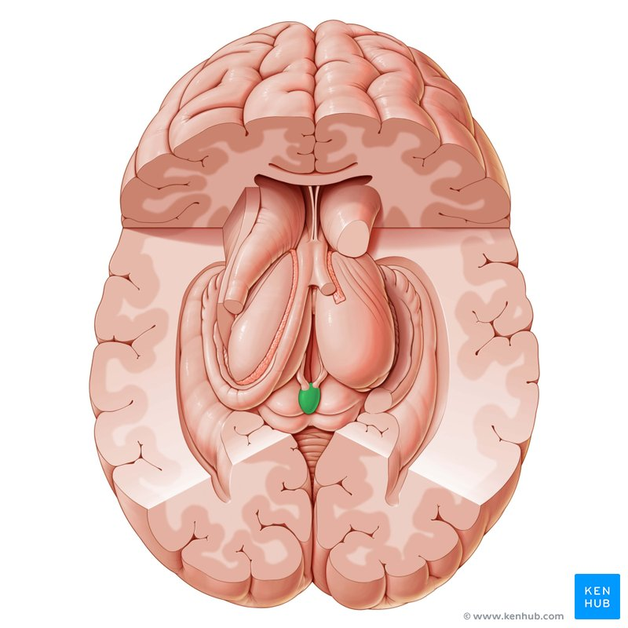
Melatonina- hormônio do escuro
PINEALÓCITOS
SEROTONINA
CÉLULAS GANGLIONARES- MELANOPSINA
AA-NAT
Receptor acoplado à Proteína G
Interação Ca²+/calmodulina
Redução no stress oxidativo
interfere a ativação do NF-κB
MELATONINA

Slide 3
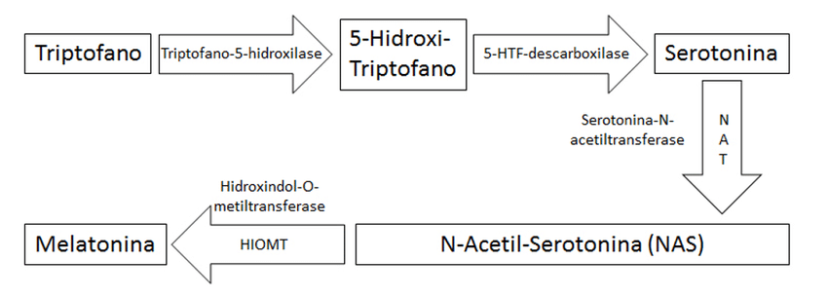
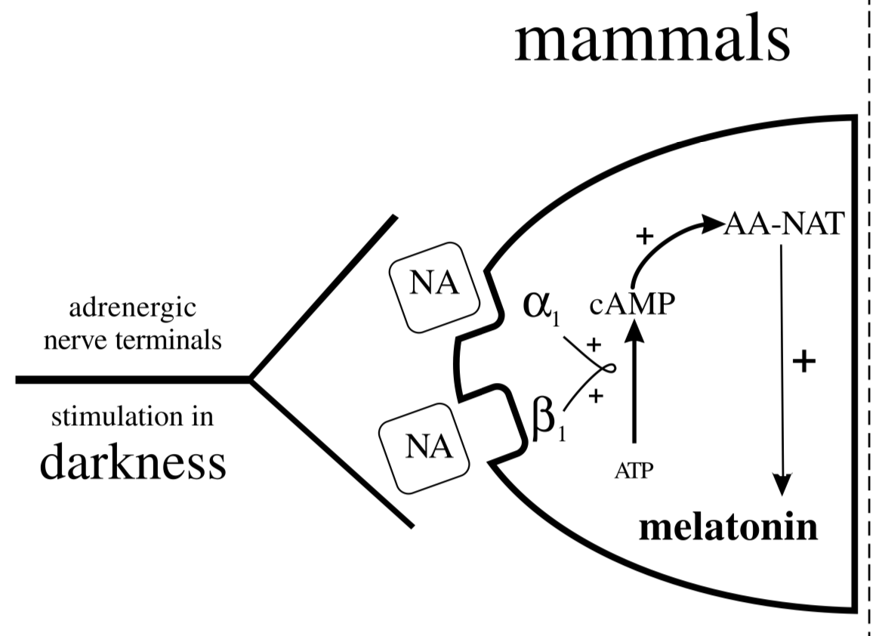
SÍNTESE DE MELATONINA
AA-NAT
NAS
(Simonneaux V, Ribelayga C; 2003)
(Adaptado de Dias, Fagundes et al., 2013)
O aumento da AA-NAT depende da ativação de receptores β-adrenérgicos pela noradrenalina (NA)

Slide 4
GLÂNDULA PINEAL E A CONSTRUÇÃO DA RESPOSTA INATA
Neural
DEFESA DO ORGANISMO
Endócrina
Parácrina
Autócrina
-Defesa contra patógenos e injúrias
-Limitação do dano tecidual
PRÓ-
INFLM.
ANTI-
INFLM

Slide 5
MELATONINA- Modulador da Migração Celular na Inflamação
ROLAMENTO
ADESÃO
DIAPEDESE
Biomedicina Surreal
MELATONINA
AUMENTO DA PERMEABILIDADE CELULAR
Melatonina interferindo na formação de uma resposta inflamatória no período de escuro
Melatonina ajudando a evitar uma montagem desnecessária dos mecanismos de defesa
ROLAMENTO E ADESÃO DE NEUTRÓFILOS

Slide 6
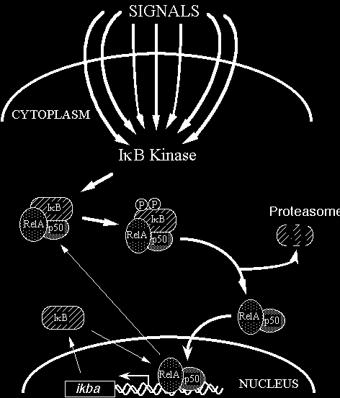
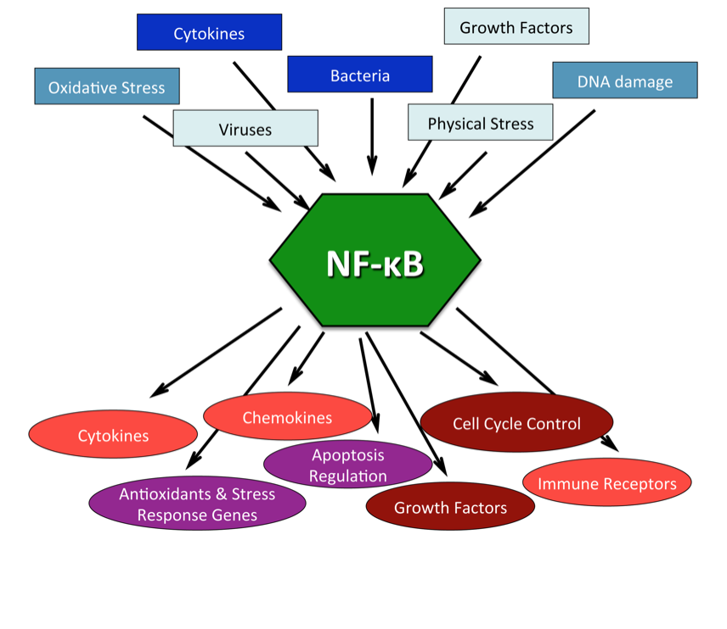
O NF-kB: mecanismo de ação e funções
(Jeremy S. Tilstra, Cheryl L. Clauson, Laura J. Niedernhofer, et al. NF-κB in Aging and Disease[J]. 2(6): 449-465)
(http://www.bu.edu/nf-kb/)
Notes:
NF-κB is a central regulator in stress response
The NF-κB signaling pathway can be activated by numerous stimuli as listed in the blue boxes (summarized in Subsection entitled:Activation of NF-κB). In response to these different stimuli NF-κB transcriptionally regulates hundreds of genes, the generalized categories of which are listed in the red circles (summarized in subsection entitled:Genes under NF-κB transcriptional control). A compilation of citations with regards to NF-κB activators and transcriptionally regulated genes can be found at (www.nf-kb.org) [7].
eremy S. Tilstra, Cheryl L. Clauson, Laura J. Niedernhofer, et al. NF-κB in Aging and Disease[J]. 2(6): 449-465

Slide 7
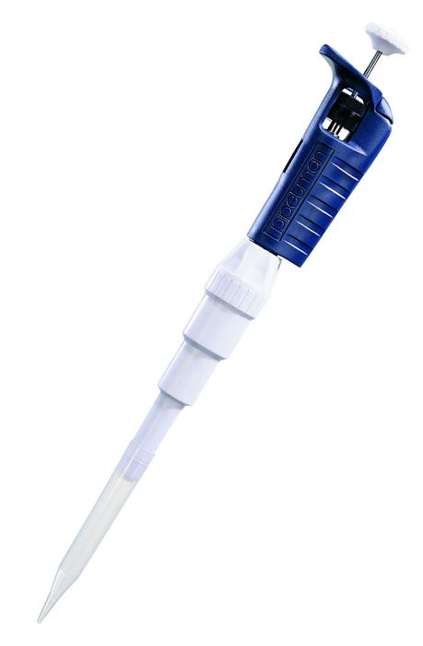
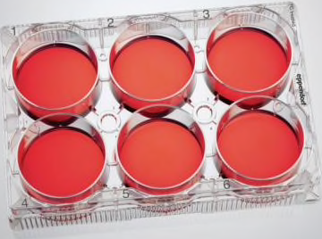
Mecanismo molecular: O papel fundamental do NF-kB e do TNF-a
TNF-a
EM 30 MIN INIBE:
-Aa-nat gene
-NAS synthesis
-Melatonina
30 min até 48 horas
Células da pineal de ratos (expressam NK-kB)
TNF-a + cicloheximida
Impede a recuperação da transcrição do gene Aa-nat
Células da pineal de ratos (expressam NK-kB)
(Com base em Fernandes PACM, Cecon E, Markus RP, Ferreira ZS, 2006)
Notes:
In this study, we show that the transcription of AA-NAT, a key enzyme in melatonin synthesis, is regulated by the proinflammatory cytokine TNF-a and the anti-inflammatory hormone corticosterone.

Slide 8
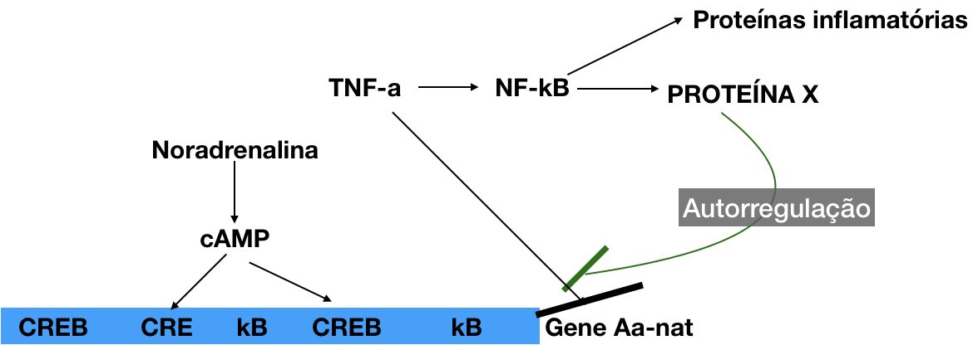
Mecanismo molecular: o shutdown da inibição da via de síntese da melatonina pela autorregulação do TNF-a
(Com base em: Baler R, Covington S, Klein DC; 1997 e Baler R, Covington S, Klein DC, 1999)

Slide 9
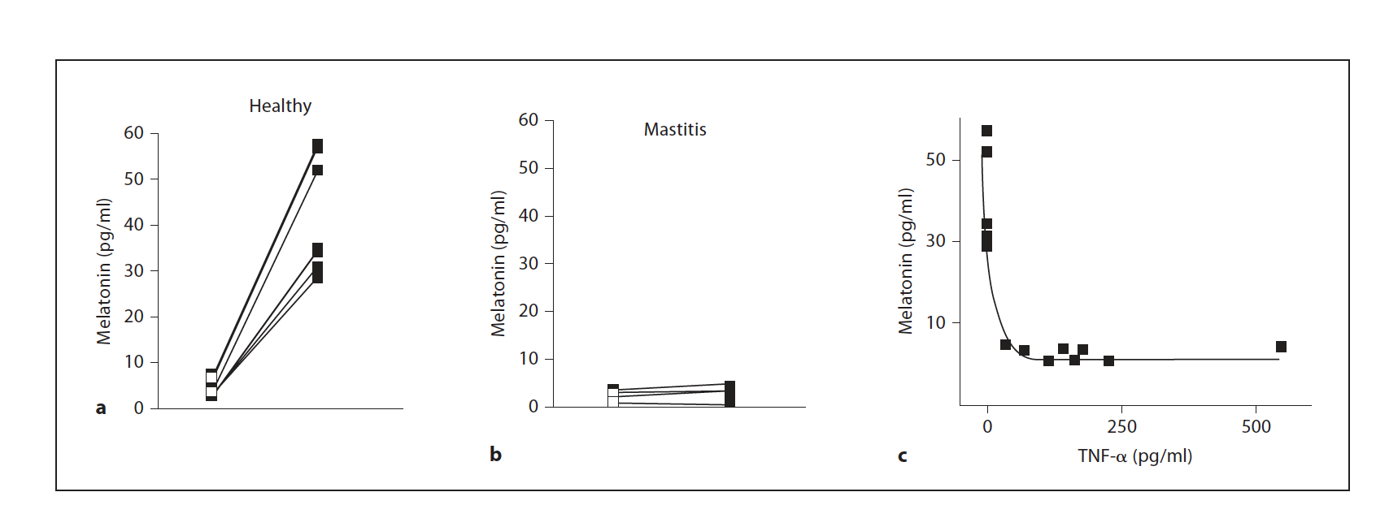
Montagem da resposta inflamatória e a conversa entre Pineal e o SI
(Pontes GN, Cardoso EC, Carneiro-Sampaio MMMS, Markus RP, 2006)

Slide 10
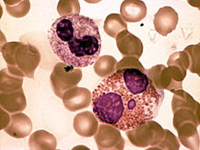
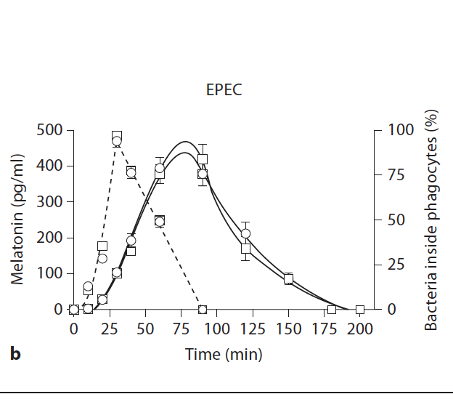
O novo papel da melatonina: do endócrino para o parácrino
Melatonina
Desliga resposta imune
AFMK
AMK
Células polimorfonucleares
(Pontes GN, Cardoso EC, Carneiro-Sampaio MMMS, Markus RP, 2006)
Notes:
In summary, the shuttle of melatonin production from
the pineal gland to immune-competent cells results in a
transient change in melatonin function; the hormone of
darkness is now produced at the site of injury, independent
of the hour of day, and contributes to ending the inflammatory
response.

Slide 11
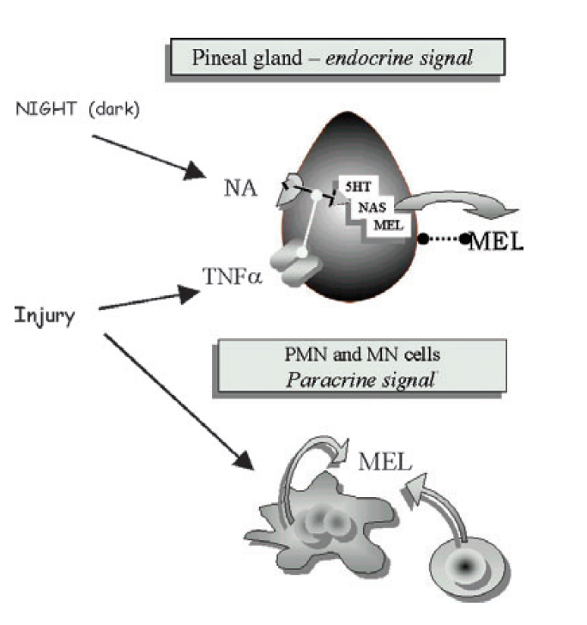
O novo papel da melatonina: do endócrino para o parácrino
(Pontes GN, Cardoso EC, Carneiro-Sampaio MMMS, Markus RP, 2006)

Slide 12
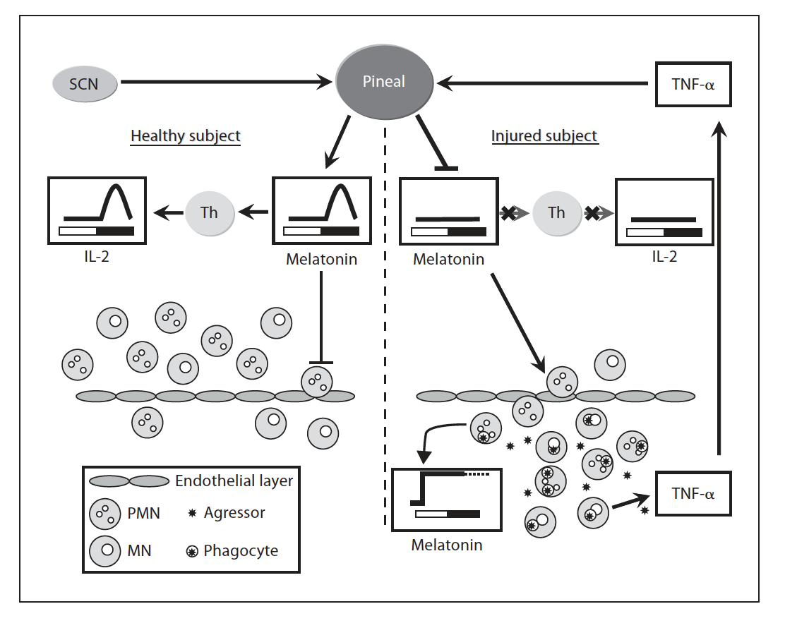
Resumo final
( Markus RP, Ferreira ZS, Fernandes PACM, Cecon E, 2007)

Slide 13
Referências bibliográficas
Markus RP, Ferreira ZS, Fernandes PACM, Cecon. The Immune-Pineal Axis: A Shuttle between Endocrine and Paracrine Melatonin Sources. Neuroimmunomodulation 2007; 14:126-133.
Baler R, Covington S, Klein DC: The rat arylalkylkyamine N-acetyltransferase gene promoter cAMP activation via a Camp-response element-CCAAT complex. J Biol Chem 1997; 272: 6979–6985
Baler R, Covington S, Klein DC: Rat arylalkylamine N-acetyltransferase gene: upstream and intronic components of a bipartite promoter. Biol Cell 1999; 91: 699–705.
Carrillo-Vico A, Calvo JR, Abreu P, Lardone PJ, Garcia- Maurino S, Reiter RJ, Guerrero JM: Evidence of melatonin synthesis by human lymphocytes and its physiological significance: possible role as intracrine, autocrine, and/or paracrine substance. FASEB J2004; 18: 537–539.
Fernandes PACM, Cecon E, Markus RP, Ferreira ZS: Effect of TNF- on the melatonin synthetic pathway in the rat pineal gland: basis for a ‘feedback’ of the immune response on circadian timing. J Pineal Res 2006; 41:344–350.
Pontes GN, Cardoso EC, Carneiro-Sampaio MMMS, Markus RP: Injury switches melatonin production source from endocrine (pineal) to paracrine (phagocytes) – melatonin in human colostrums and colostrums phagocytes. J Pineal Res 2006; 41: 136–141.
Simonneaux V,Ribelayga C: Generation of the melatonin endocrine message in mammals: a review of the complex regulation of melatonin synthesis by norepinephrine, peptides, and other pineal transmitters.Pharmacol Ver 2003; 55: 325–395.

