Slide 1
Constantin Guys [1802-1892]
Ernest-Adolphe-Hyacinthe-Constantin, (December 3, 1802 – December 13, 1892) was a Dutch-born Crimean War correspondent, water color painter and illustrator for British and French newspapers. Baudelaire called him the "painter of modern life," and wrote a long essay on Guys in which he extensively praised his works, under the pseudonym "Monsieur G".

Slide 2
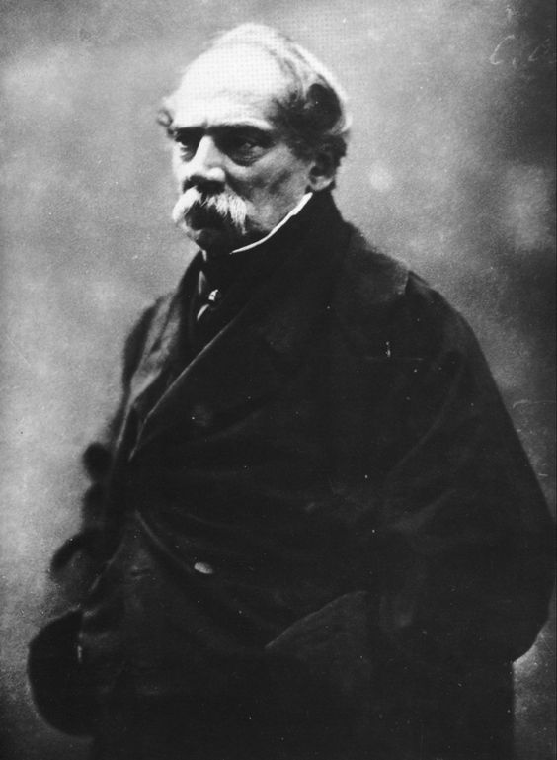
GUYS: PHOTOGRAPHIE DE FELIX NADAR

Slide 3
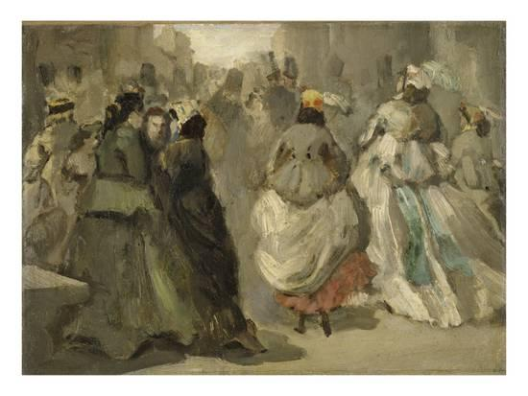
Dans la rue

Slide 4
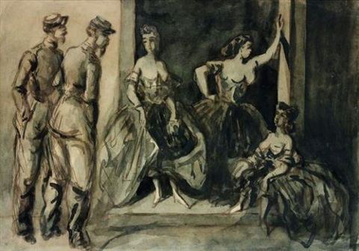
Deux millitaires et trois femmes

Slide 5
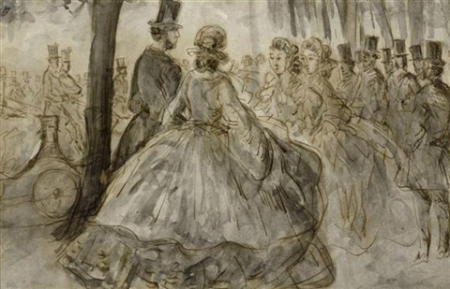
Les promeuneurs aux bois

Slide 6
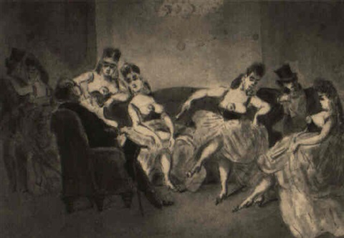
Scene dans la maison close

Slide 7
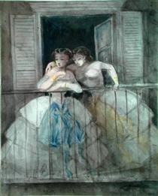
Girls at the balcony

Slide 8
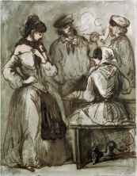
Grisettes and workers

Slide 9
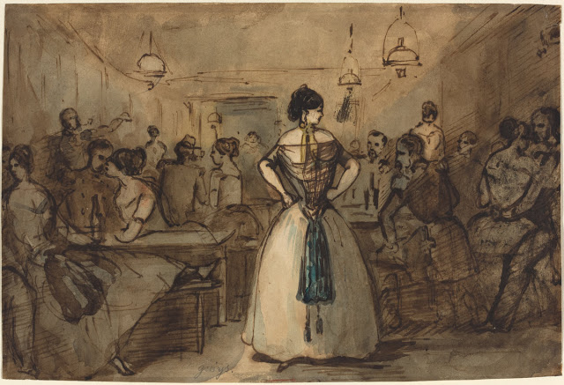
Officers in brothel

Slide 10
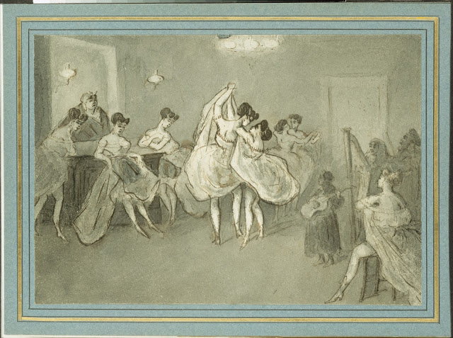
Women dancing in brothel

Slide 11
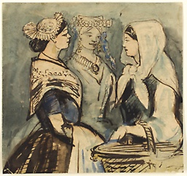
Three servant women

Slide 12
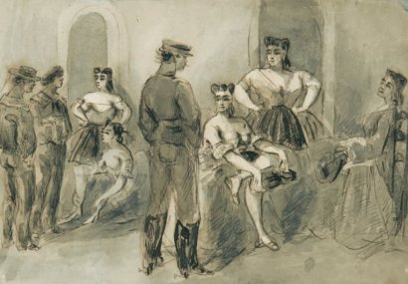
Ventes aux enchères Paris

