Slide 1
Diodos
SEL313 - Programa 2020
Conceito de Diodo
Aplicações de Diodos: Ceifadores e Grampeadores, Multiplicadores de Tensão
Junção pn sem polarização
Polarização Reversa
Polarização Direta
Aplicação do Diodo como Retificador: Meia-Onda, Onda-Completa
Fontes de Alimentação DC com Filtro Capacitivo (Uso dos Gráficos de Schade)
Outros Tipos de Diodos e suas Aplicações
Eletrônica Física do Diodo

Slide 2
Bibliografia
Apostila do Prof. Veronese
(Moodle SEL313)
Modelagem de diodos no LTSPice. pdf
Modelos linearizados de diodos. pdf

Slide 3
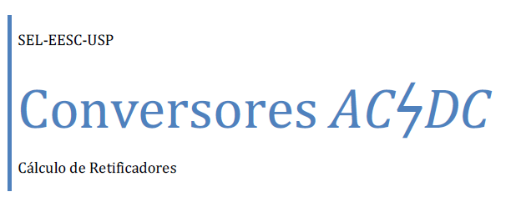
Bibliografia
Apostila do Prof. Veronese
(Moodle SEL313)
Gráficos de Schade. pdf

Slide 4
Transistores Bipolares de Junção (BJT)
SEL313 - Programa 2019
Estruturas Internas npn e pnp
Análise DC: Circuitos de Polarização
Análise AC
Características IC × VCE × VBE
Modelagem: Ebers-Moll e Gummel
Amplificadores Básicos: Resposta DC e AC
Emissor-Comum
Base Comum
Coletor Comum
Reguladores de Tensão, e Amplificadores Diferenciaisoutros circuitos
Resposta em Frequência

Slide 5
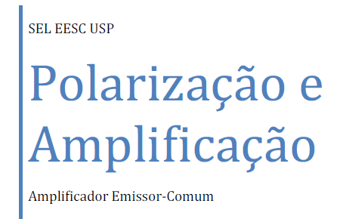
Bibliografia
Apostila do Prof. Veronese
(Moodle SEL313)
BJT - Amplificadores Básicos.pdf

Slide 6
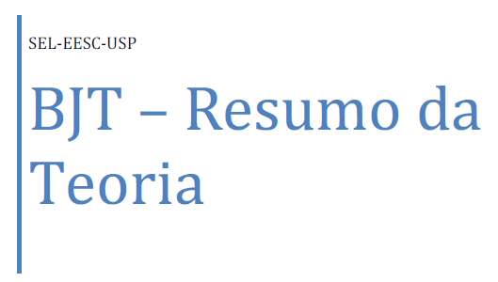
Bibliografia
Apostila do Prof. Veronese
(Moodle SEL313)
BJT - Modelos de Gummel-Poon.pdf
BJT - Exemplo de Polarização.pdf

Slide 7
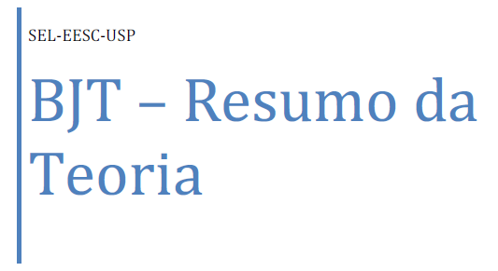
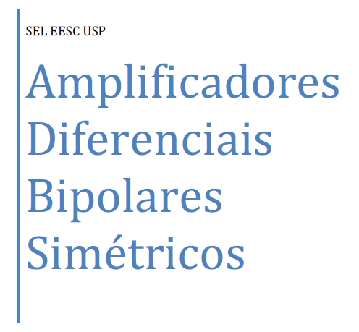
Bibliografia
Apostila do Prof. Veronese
(Moodle SEL313)
BJT - Modelos de Gummel-Poon.pdf
BJT - Exemplo de Polarização.pdf

Slide 8
Amplificadores Operacionais
SEL313 - Programa 2019

Slide 9
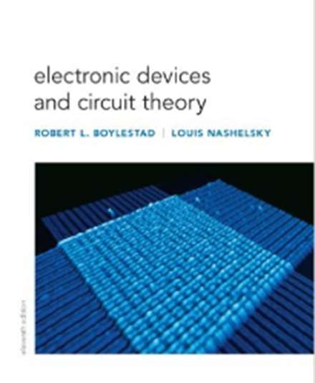
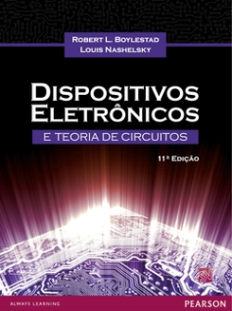
Bibliografia
Prentice Hall, 11th edtion, 2012
Pearson Education, 11ª edição, 2013

Slide 10
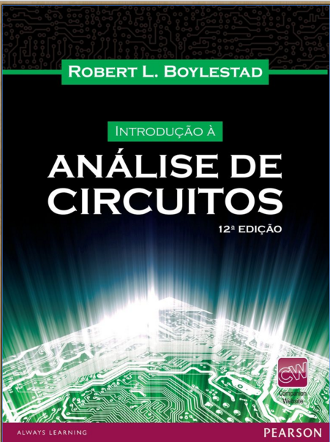
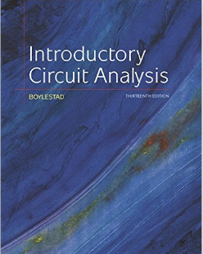
Bibliografia
Pearson Education, 12ª edição, 2010
Prentice Hall, 13th edtion, 2015

Slide 11
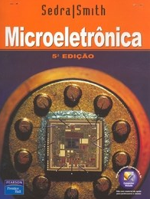
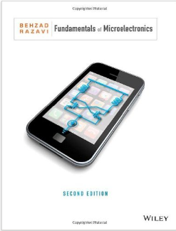
Bibliografia
Pearson, 2007
Wiley, 2016

Slide 12
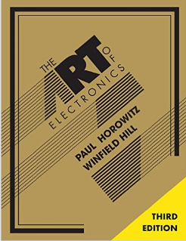
Bibliografia
At long last, here is the thoroughly revised and updated third edition of the hugely successful The Art of Electronics. It is widely accepted as the best single authoritative book on electronic circuit design. In addition to new or enhanced coverage of many topics, the third edition includes 90 oscilloscope screenshots illustrating the behavior of working circuits, dozens of graphs giving highly useful measured data of the sort that is often buried or omitted in datasheets but which you need when designing circuits, and 80 tables (listing some 1650 active components), enabling intelligent choice of circuit components by listing essential characteristics (both specified and measured) of available parts. The new Art of Electronics retains the feeling of informality and easy access that helped make the earlier editions so successful and popular. It is an indispensable reference and the gold standard for anyone, student or researcher, professional or amateur, who works with electronic circuits.
Cambridge University Press, 2015

Slide 13
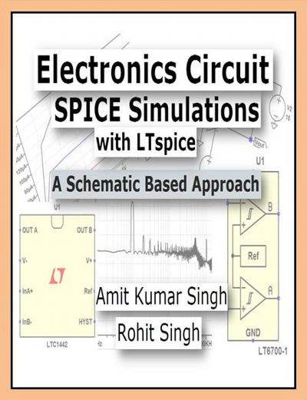
Bibliografia
LTSpice (Linear Technology)
(Moodle SEL313)
LTSpice - Apostila Rodrigo T Machado e Paulo R Veronese
Análise do Comando .Meas do LTSpice.doc
Createspace Independent Publishing, 2015

Slide 14
LTSpice (Linear Technology)
SPICE stands for Simulation Program with Integrated Circuit Emphasis. SPICE is a software which takes circuit description as input (which may be provided either in the form of a text file or a schematic file) and it gives output in the form of text or waveforms.
SPICE was developed at the University of California at Berkeley in 1975. There are a plethora of software tools available currently in the markets that do SPICE analysis. Some of the available SPICE tools are ORCAD PSpice, NgSpice, HSPICE, XSPICE, TSPICE. Various other SPICE simulators are available in the market. Some of these simulators are freely available for download.
Why LTspice? LTspice is available free from Linear Technology. LTspice is perhaps one of the most widely used free simulators. It is a powerful simulator with a simple interface to handle. Many other SPICE Simulators are costly and beyond the reach of many students.
LTspice IV can be easily downloaded from the Linear Technology’s Website, www.linear.com.

Slide 15
Bibliografia
Links Úteis
Videos - pn junctions
Animation | How a P N junction semiconductor works | forward reverse bias |
diffusion drift current (6:36 min)
https://www.youtube.com/watch?v=OyC02DWq3mI
The PN Junction. How Diodes Work? (10:36 min)
https://www.youtube.com/watch?v=JBtEckh3L9Q
Formation and Properties of Junction Diode (2:44 min)
https://www.youtube.com/watch?v=4SlfaocMfdA
p-n-Juction-And-Diodes (4:07min)
https://www.youtube.com/watch?v=W6QUEq0nUH8
p-n-Juction-And-Diodes (4:07min)
https://www.youtube.com/watch?v=W6QUEq0nUH8

Slide 16
Bibliografia
Links Úteis
Videos - pn junctions
Zener Diode Fully Explained (11:29 min)
https://www.youtube.com/watch?v=d4zO39K_ce8
How Does a Diode Work? Intro to Semiconductors (p-n Junctions in the Hood)
(23:32min)
https://www.youtube.com/watch?v=b3xys6rYM_Q
P-N junction solar cells (2>32min)
https://www.youtube.com/watch?v=2AX0qvnjSnM
Light Emitting Diode (LED) (7:53min)
https://www.youtube.com/watch?v=GodkGafZsh4
Light Emitting Diode (LED) (7:53min)
https://www.youtube.com/watch?v=GodkGafZsh4

Slide 17
Bibliografia
Videos - Transistors
Transistors (6:29m)
https://www.youtube.com/watch?v=FODFowmDfvY
Working of a PNP Transistor (3:39min)
https://www.youtube.com/watch?v=YsdPjY58Go8
How Transistors Work - The MOSFET (8:28min)
https://www.youtube.com/watch?v=QO5FgM7MLGgce8
Transistor (bipolar) - How it works! (4:55min)
https://www.youtube.com/watch?v=9CrcRabTQ0s

