Slide 1
The Political Economy of Nationalism
American Hegemony Vanishes
Fukuyama, F. (2016) US against the world? Trump's America and the new global order

Slide 2
A brief summary

Slide 3
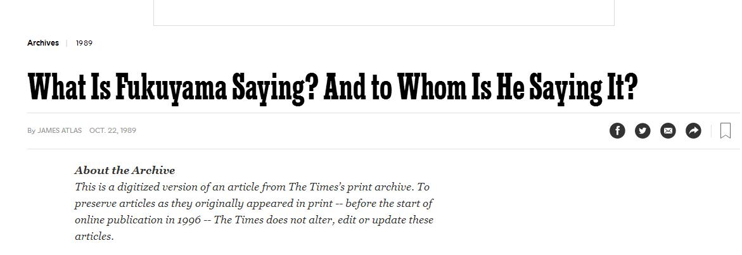
Fukuyama and the End of History

Slide 4
Any competitors to modern democracy

Slide 5
Social class and the social fracture

Slide 6
From liberal Internationalism to populist nationalism

Slide 7
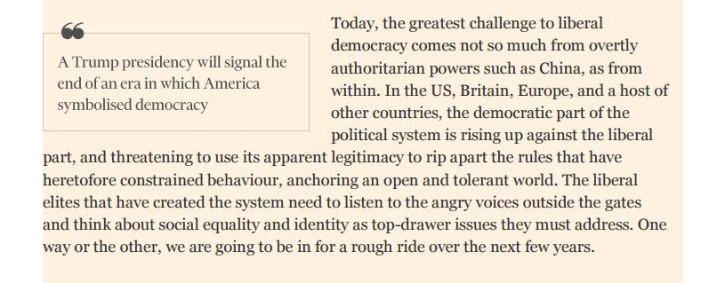
The greatest challenge

Slide 8
Trump voting analysis

Slide 9
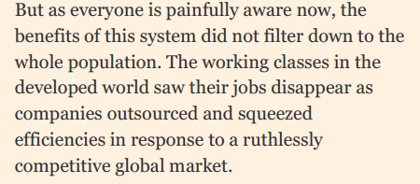
Who voted for Trump?
The economic inequality thesis: the left behinds of globalization
Rising economic insecurity and social deprivation among the left behinds of Globalization;
Low waged unskilled workers, long term unemployed, households dependent on social benefits, resident of public housing, single-parent families, and poorer white population living in inner city areas with concentration of immigrants: were exploited by populist movements

Slide 10
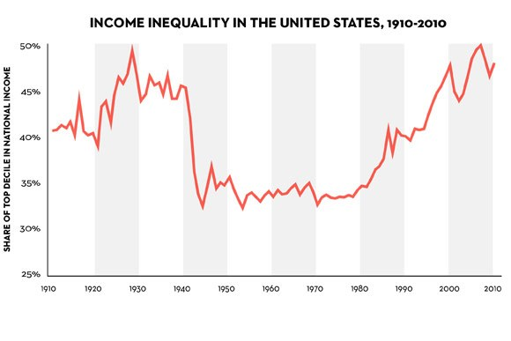
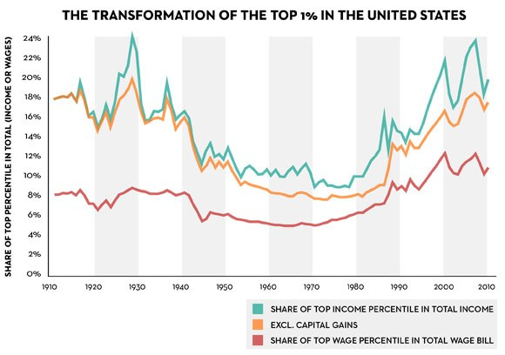
The economic inequality thesis: the left behinds of globalization
Source: Piketty’s Inequality Story in Six Charts, New Yorker, 2014.

Slide 11
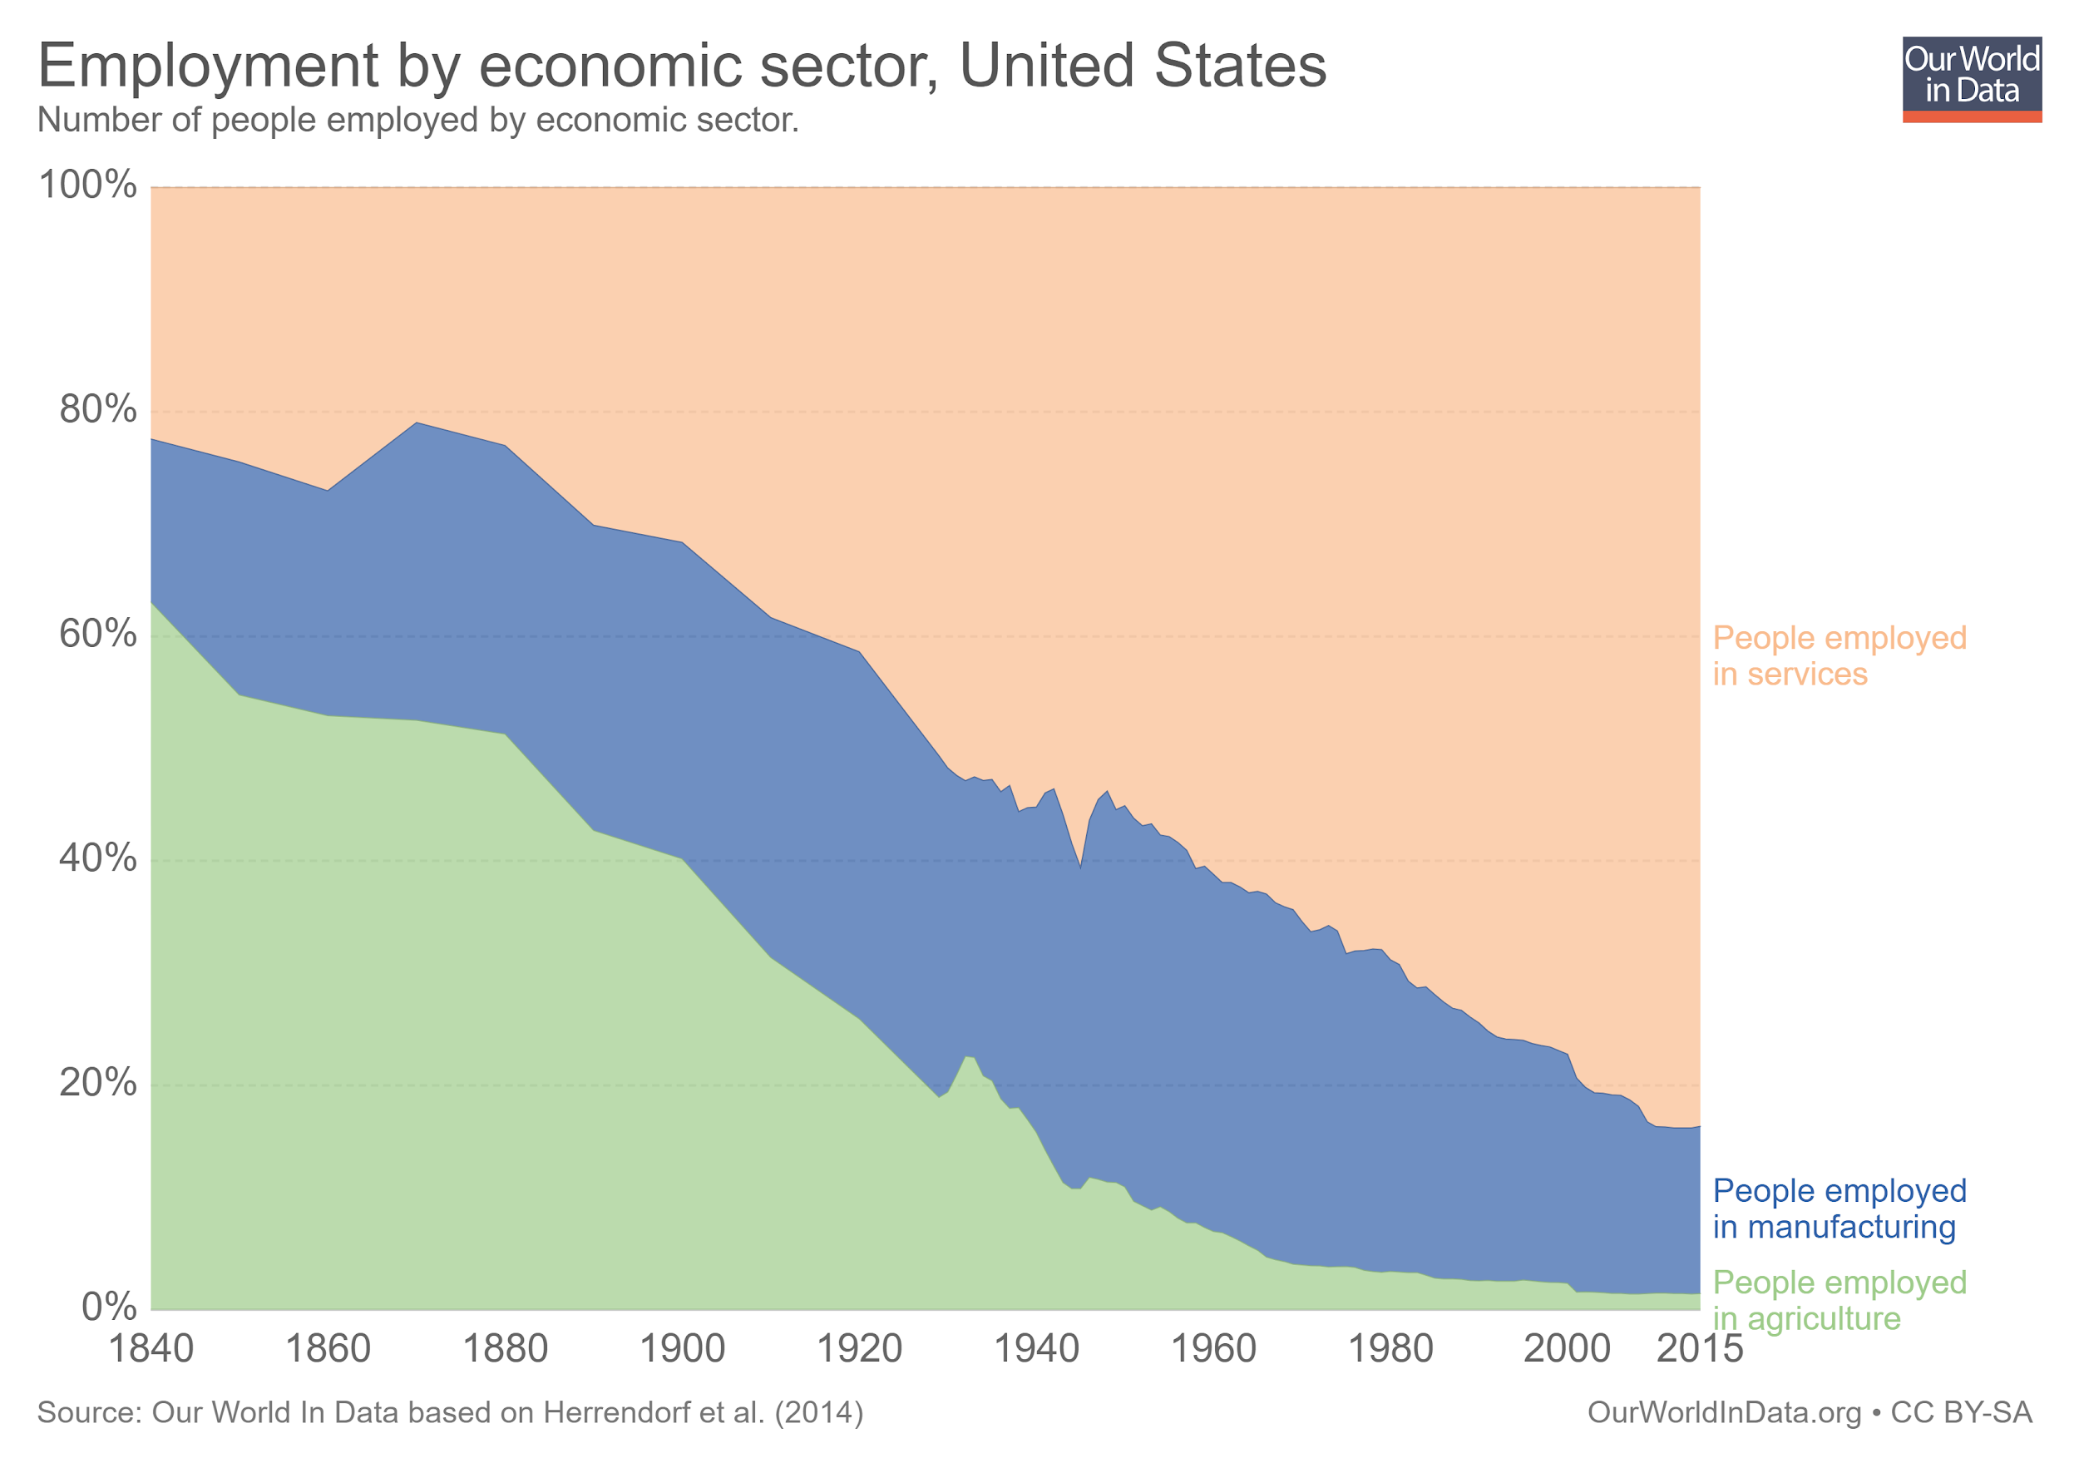
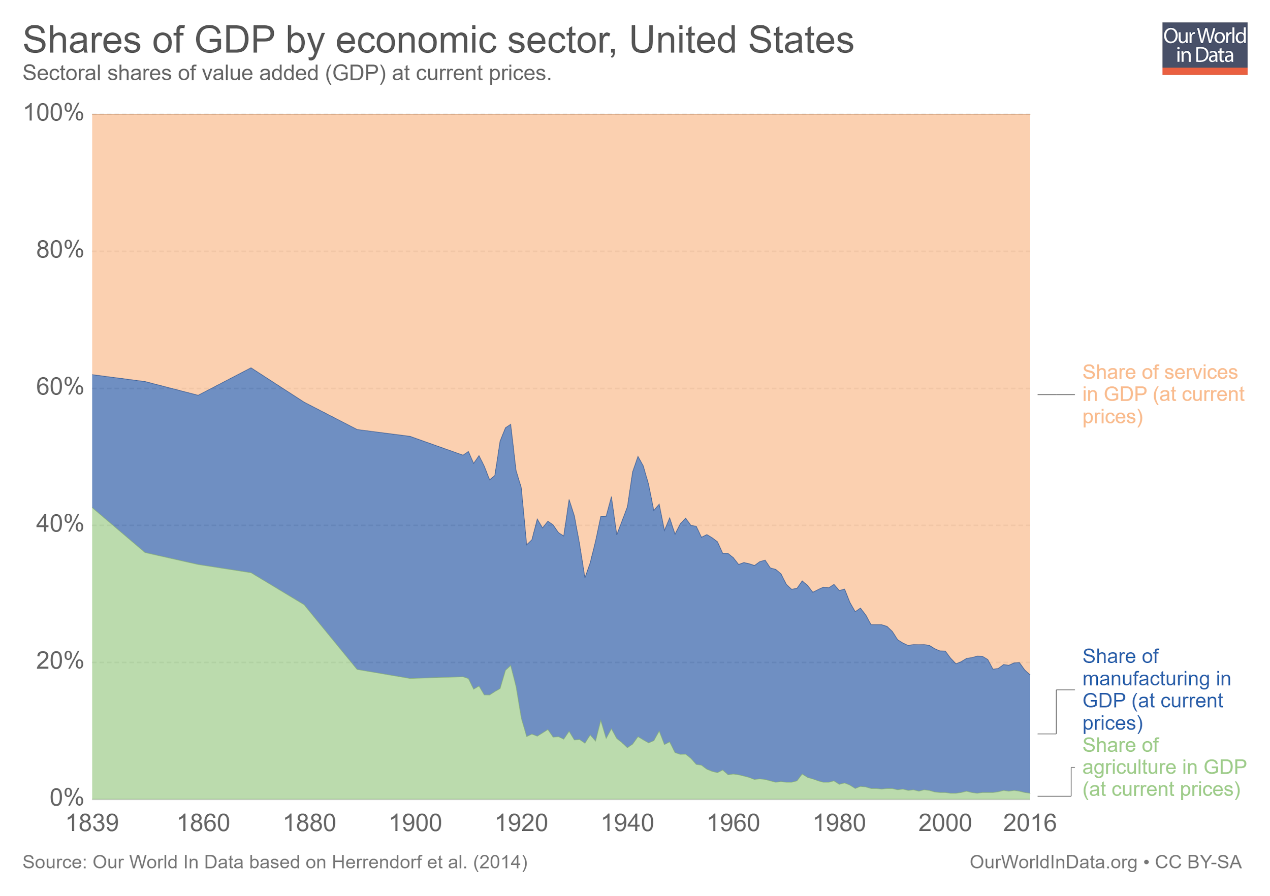
The economic inequality thesis: the left behinds of globalization
The post industrial economies: US

Slide 12
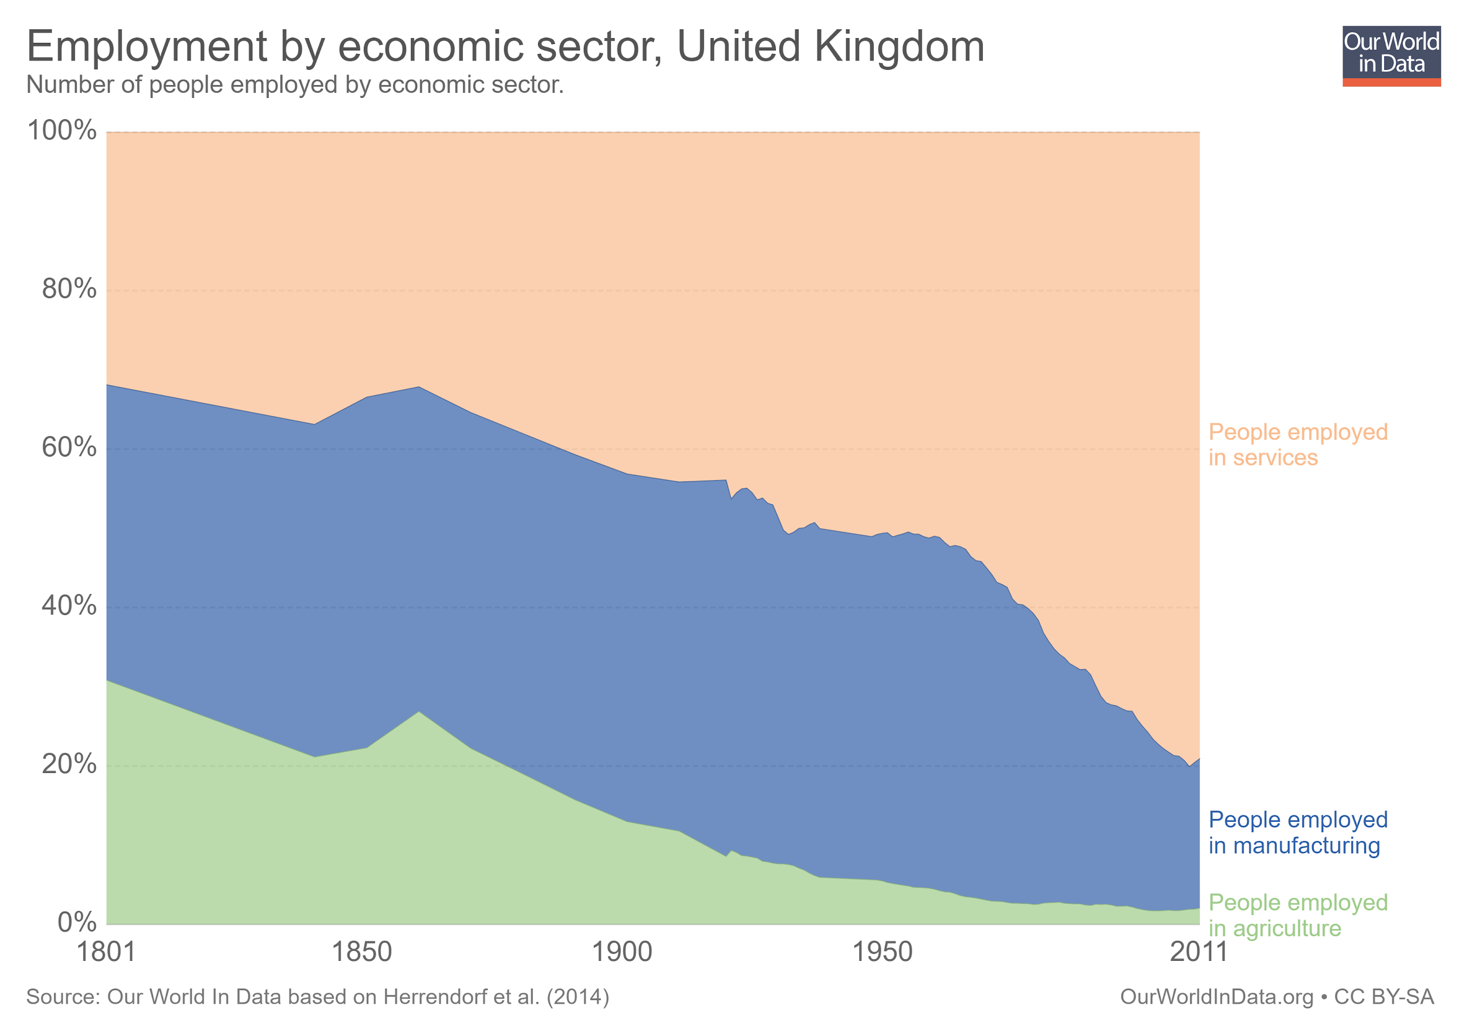
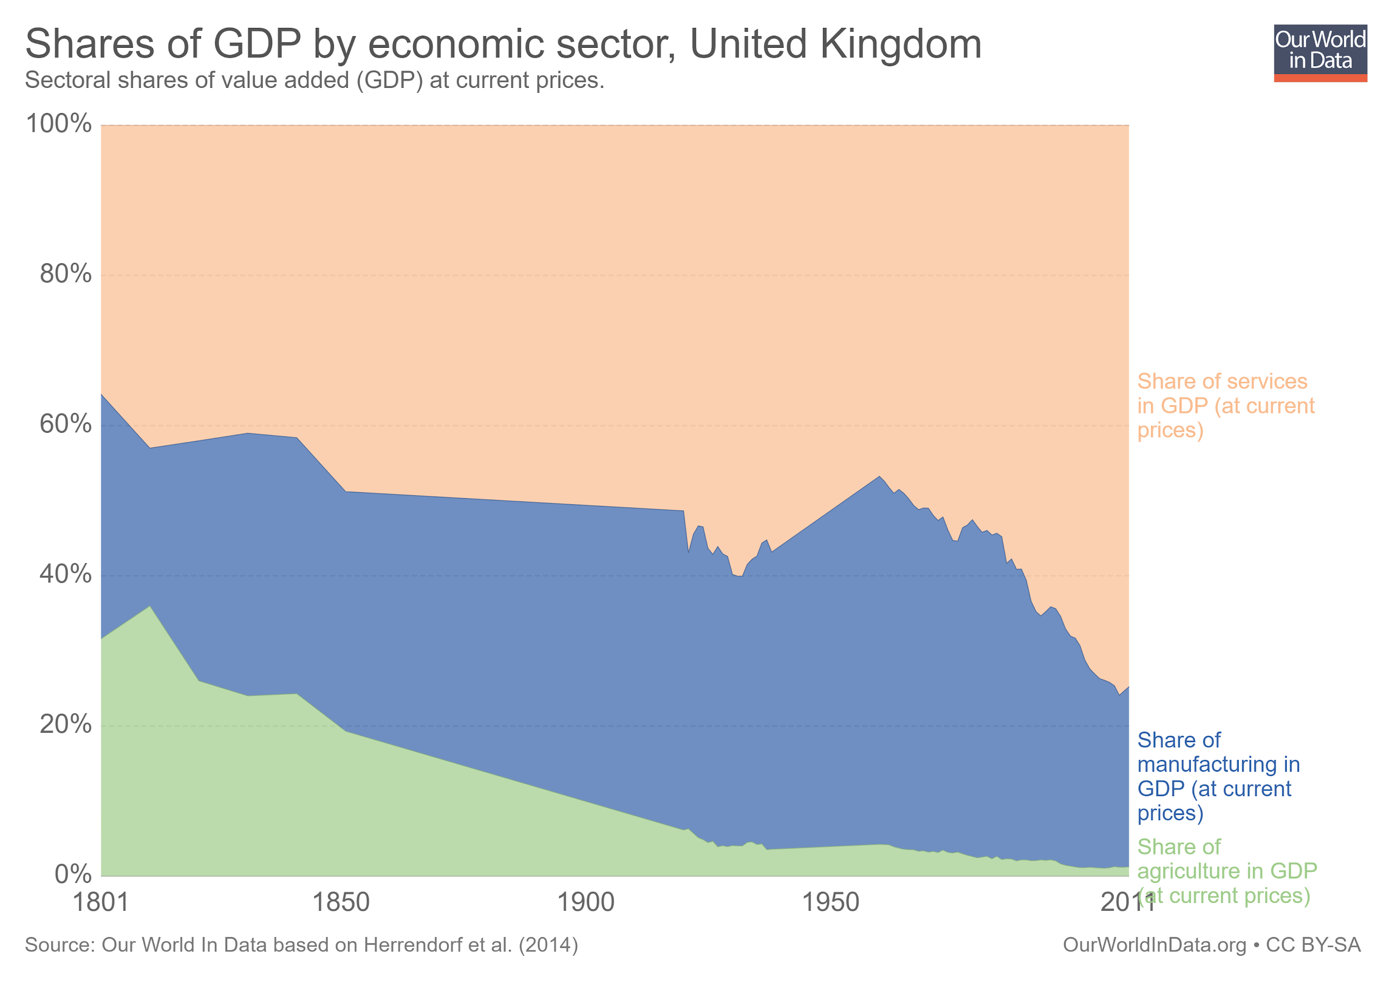
The economic inequality thesis: the left behinds of globalization
The post industrial economies: UK

Slide 13
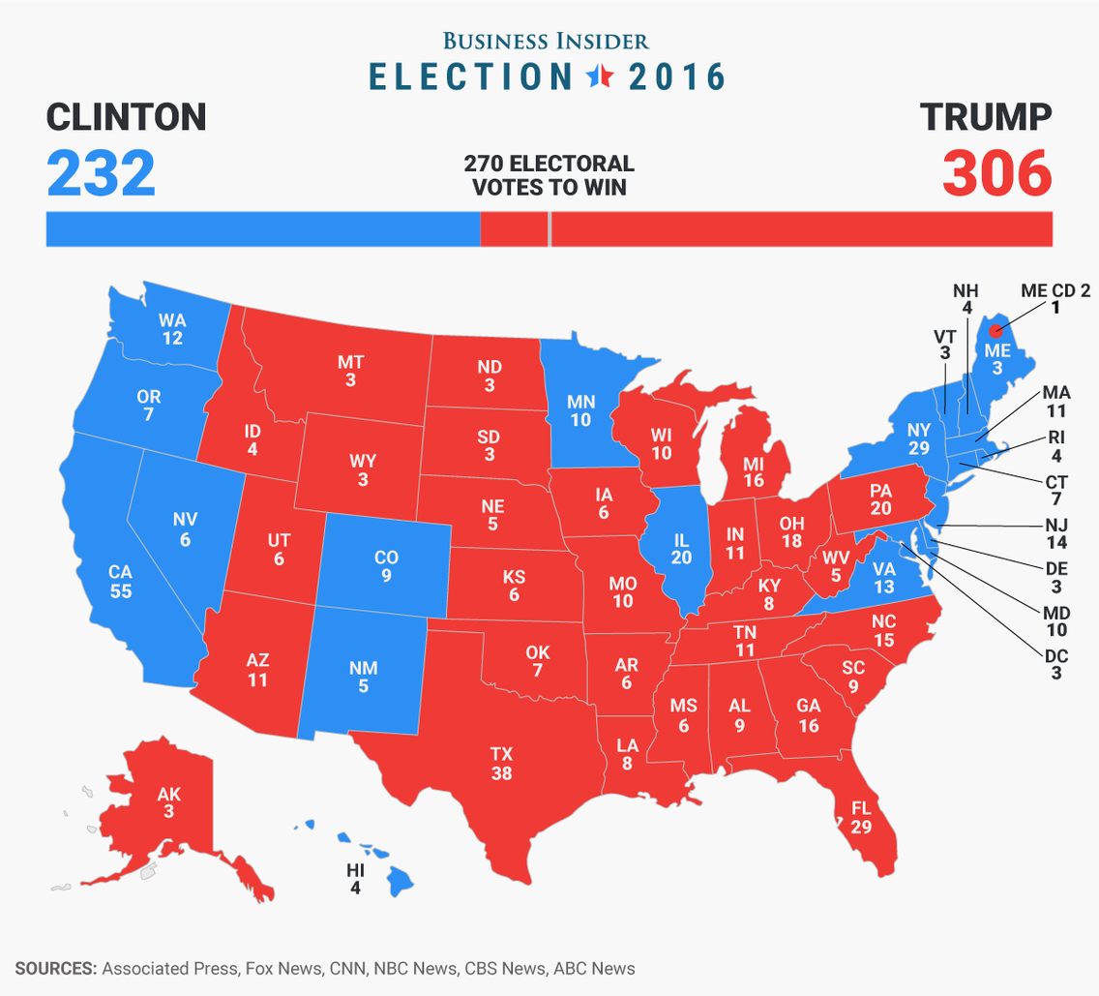
The economic inequality thesis: the left behinds of globalization
The rust belt: the swing states
The race was close in: New Hampsire, Minnesota, Michigan, Florida, Wisconsin, Pennsylvania and Michigan;
Wisconsin, Pennsylvania and Michigan were traditionally Democratic;
Trump also won in Ohio e Iowa, states that voted for Obama in 2008 and 2012

Slide 14
The racial and cultural backlash thesis: beyond economy

Slide 15
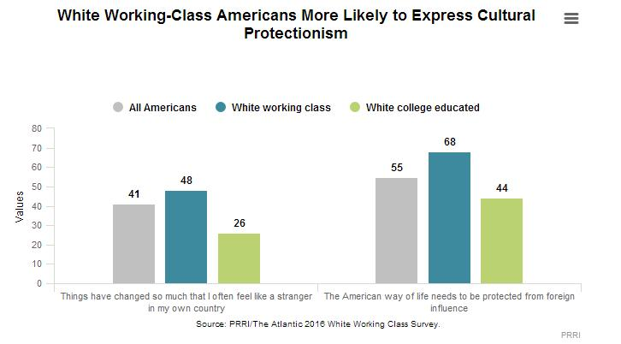
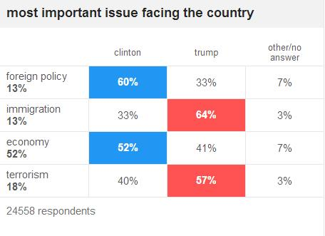
The racial and cultural backlash thesis: beyond economy
Souce: https://edition.cnn.com/election/2016/results/exit-polls

Slide 16
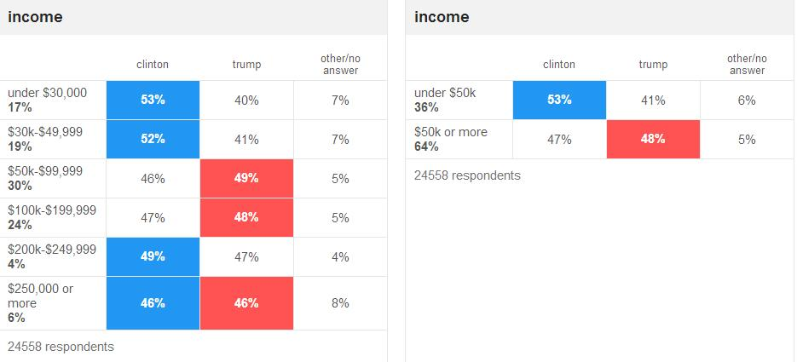
The racial and cultural backlash thesis: beyond economy

Slide 17
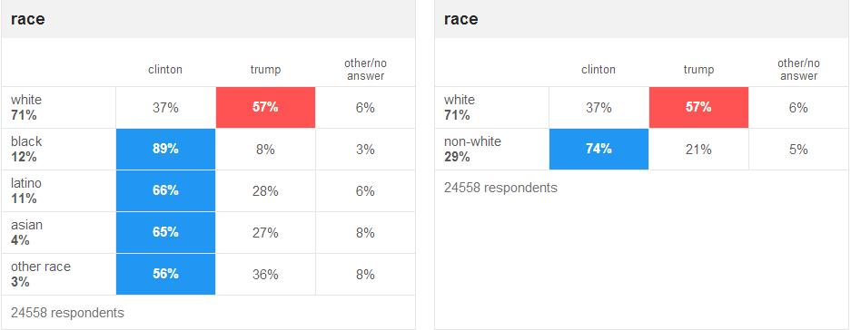
The racial and cultural backlash thesis: beyond economy

Slide 18
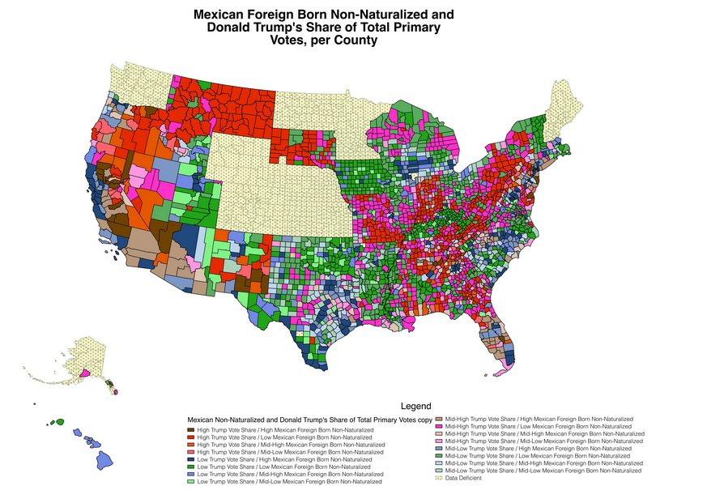
The racial and cultural backlash thesis: beyond economy
Raul Hinojosa’s (2016) study conclude that only 2% of US counties have high concentration of Trump’s primary voters and high immigration or trade;
Rothwell (2016) has a similar conclusion: support for Trump’s nativism has a lot to do with ignorance about immigrants and minorities, which in turn has a lot to do with residential segregation

Slide 19
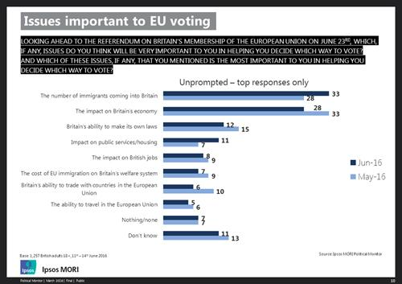
The racial and cultural backlash thesis: beyond economy
52% of those likely to vote to leave in the referendum mention immigration, compared with 14% of those likely to vote to remain;
41% remain voters say the economy is an important issue compared with 18% of leave voters;
Kaufmann (2014) highligts the fact the cities with below average white population in 2001 became even more diverse in 2011, alongside with the growing number of ethnic diverse communities in the same period

Slide 20
The new minority
White Working Class Politics in Age of Immigration and Inequality
Justin Gest

Slide 21
Political marginality in the post-traumatic city - Introduction
White Working class perplexed and frustrated with the loss of power and that produces an radicalization
economic narrative ⇒ Technology, lost social power moral narrative ⇒ refuse to change status quo from unfair advantage demographic narrative ⇒ class sub mobilized
US and UK research - Advantage from white workWWC feel a sense of deprivation and consumed by their lost of power
Wish to return to a post-traumatic pa feel as victims of discrimination

Slide 22
Chapter 2
Marginalization and minorization may be experienced in different ways, and simultaneously, by different people -
WWC: displacement and disempowerment 1. Systemic forces 2. Rhetorical and Psycological forces 3. Political forces a. Active anti-system individual b. Passive anti-system individual

Slide 23
POLANYI’s Theory and Trump's Election

Slide 24
Globalization ⇒ Outsourcing of company's ⇒ unemployment of WWC
⇒ Labor as a commodity
⇒ Damage to the fabric of society
⇒ Countermovement

Slide 25
Can society be seen as a single group?
Racist movements
Ethnic minorities
Is it a homogeneous concept? Who belongs?

Slide 26
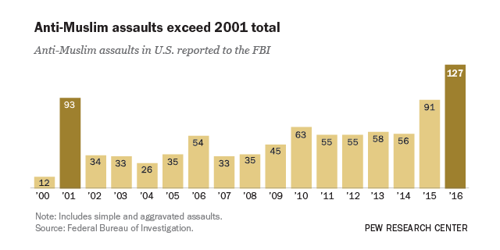
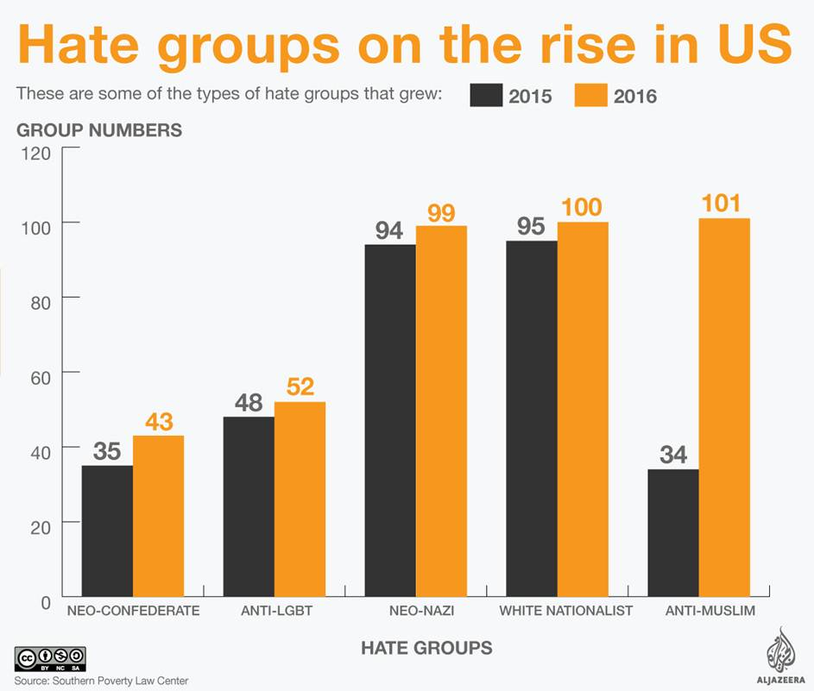
A graphical analysis

Slide 27
Trump and the International System

Slide 28
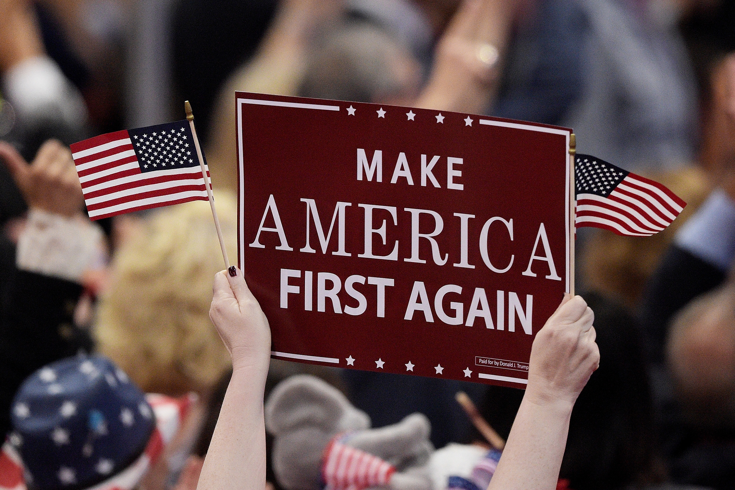
Trump’s policy towards the world
Fukuyama: Trump is a nationalist on economic policy and in relation to the global political system
‘’He has clearly stated that he will seek to renegotiate existing trade agreements such as Nafta and presumably the WTO, and if he doesn’t get what he wants, he is willing to contemplate exiting from them’’
Trump’s modus operandi: threaten to do something catastrophic, so people are relieved when things get only a little bit worse (Frankel, 2018)

Slide 29
Consequences of Trump’s foreign policy: NAFTA
Trump’s criticism: NAFTA as the ‘’worst trade deal ever signed’’ by the US
Main points of criticism: job losses and trade deficit
Renegotiation to increase US’ gains or withdrawal
Consequence: USMCA
USMCA most significant changes
Auto industry
75% of automobile’s content has to be originated in North America
By 2023, 40-45% of production has to come from workers who are paid more than US$16/hour
Agricultural concession: Canada to US
Investor-state dispute settlement dropped (US & Canada)
Sunset clause: treaty has to be renegotiated after 16 years
Source: 1. https://www.thebalance.com/donald-trump-nafta-4111368
2. https://www.theguardian.com/business/2018/oct/09/donald-trump-nafta-trade-usmca

Slide 30
Consequences of Trump’s foreign policy: WTO
Trump: "If they don't shape up, I would withdraw from the WTO"
The treasury secretary, Steven Mnuchin, later dismissed the idea as “an exaggeration”, while the commerce secretary, Wilbur Ross, said he considered talk of withdrawing from the WTO “a little premature”
In July, the US launched five World Trade Organization dispute actions challenging retaliatory tariffs imposed by China, Turkey, Canada, Mexico and the European Union
Source: 1. https://www.theguardian.com/us-news/2018/aug/30/trump-world-trade-organization-tariffs-stock-market
2. https://www.cnbc.com/2018/07/17/us-launches-five-wto-challenges-to-retaliatory-tariffs.html

