Slide 1
Escoamentos Turbulentos Reativos/ Turbulent Reactive Flows
Aula 1

Slide 2
1.0 Introdução
Por que estudar combustão Turbulenta?
É a mais velha “tecnologia” da humanidade
90% do suprimento de energia mundial ainda é combustão
Ocorre em combustíveis fósseis, renováveis ou sintéticos
Problema: Aquecimento Global e Emissões
Novas tecnologias como: oxyfuel, flameless, combustão catalítica e em meios porosos ampliarão o campo de aplicação

Slide 3
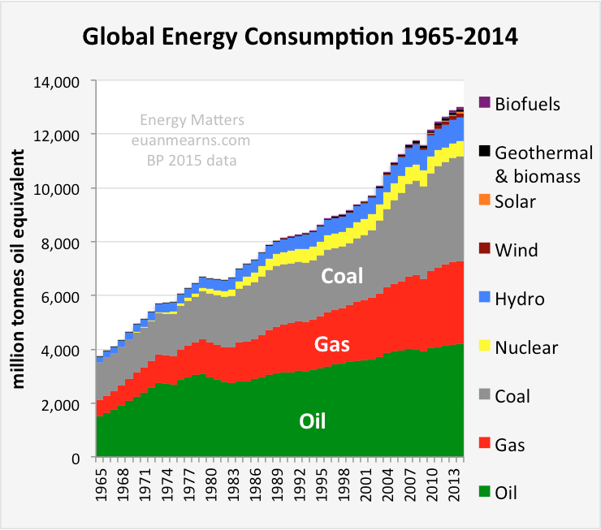
1.0 Introduction

Slide 4
1.0 Introdução
Chamas básicas
Pré-misturada Laminar/Turbulenta
Não Pré-misturada – Difusão- Laminar/Turbulenta
Parcialmente Pré-Misturadas – Laminar/Turbulenta

Slide 5
1.0 Introdução
Chamas Pré-misturada Laminar/Turbulenta
Combustível já na forma gasosa e completamente misturado ao oxidante (ar) antes do início do processo de combustão
Escoamento Laminar ou Turbulento
Exemplos: Motores com Port Fuel Injection e Turbinas a gás com queimadores “Lean-Premixed

Slide 6
1.0 Introdução

Slide 7
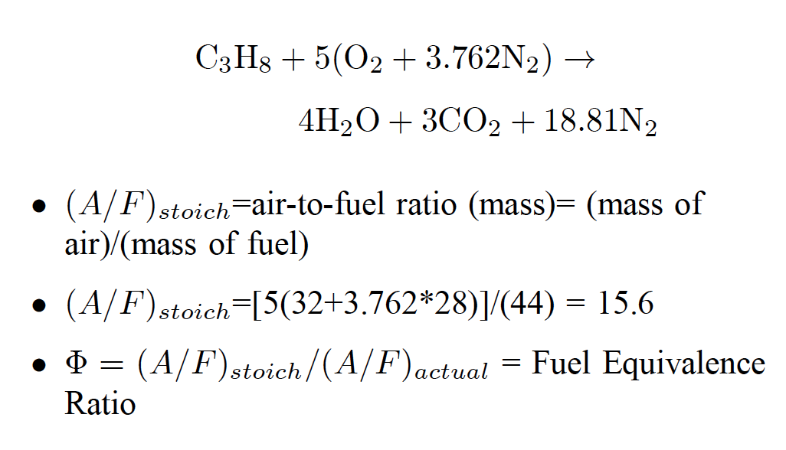
1.0 Introdução
Premixed Flames – Equivalence Ratio Parameter

Slide 8
1.0 Introdução
Premixed Flames – Equivalence Ratio Parameter

Slide 9
1.0 Introduction
Premixed Flames – Equivalence Ratio Parameter
Premixed Flames – Air ratio is defined as

Slide 10
1.0 Introduction
Non Premixed or Diffusion Flames
Gaseous fuel and air are mixed/come into contact during the combustion process
Examples:
A candle
Diesel Engines
Conventional aero gas turbines
Liquid Bipropellant rocket engines
Cement kilns, furnaces
Flares in refineries, oil burners
Fires
Coal and biomass combustors

Slide 11
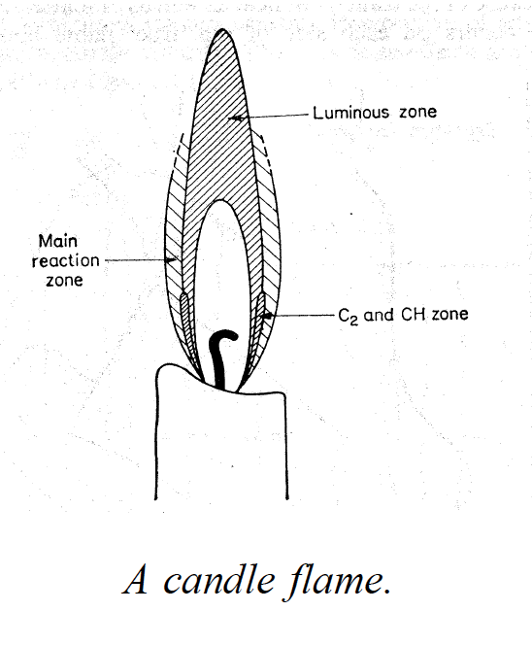
1.0 Introduction
Non Premixed or Diffusion Flames

Slide 12
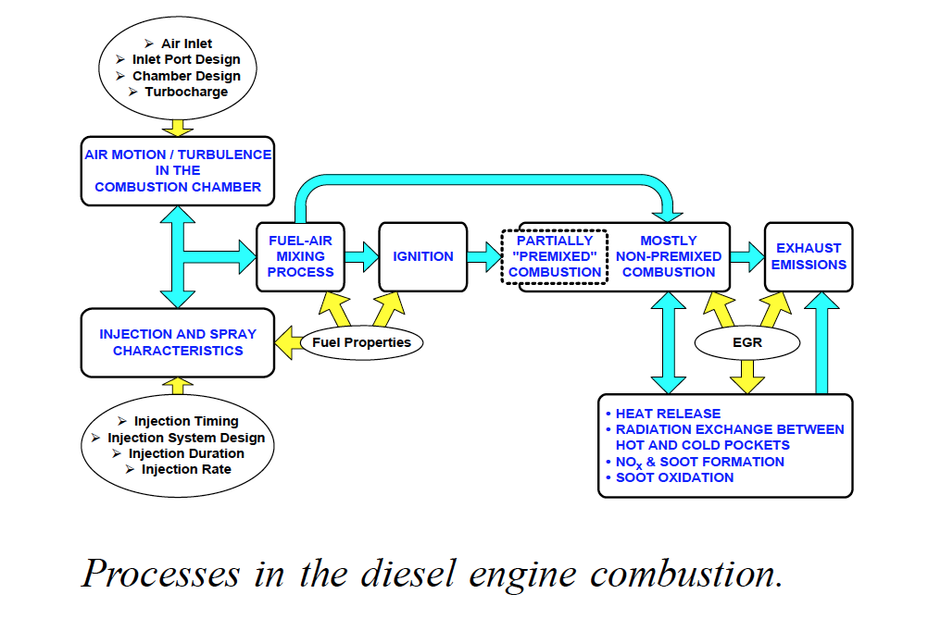
1.0 Introduction
Non Premixed or Diffusion Flames

Slide 13
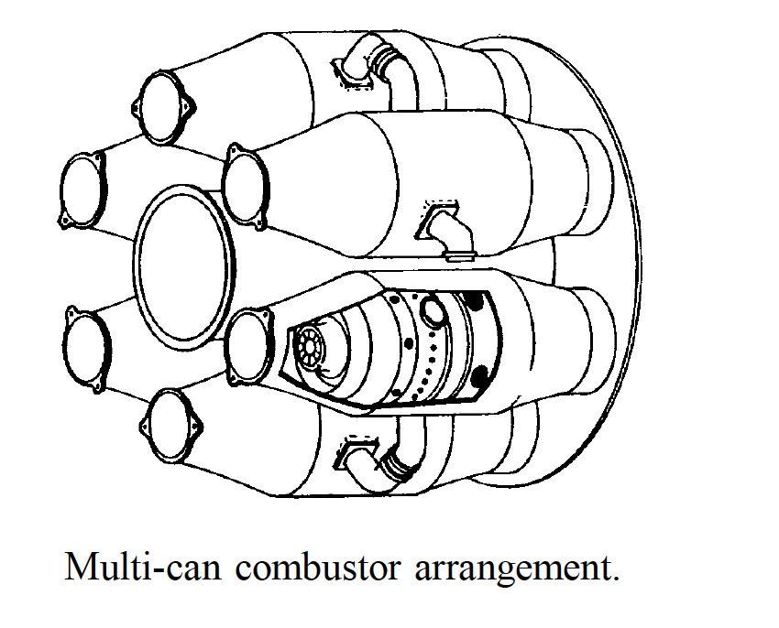
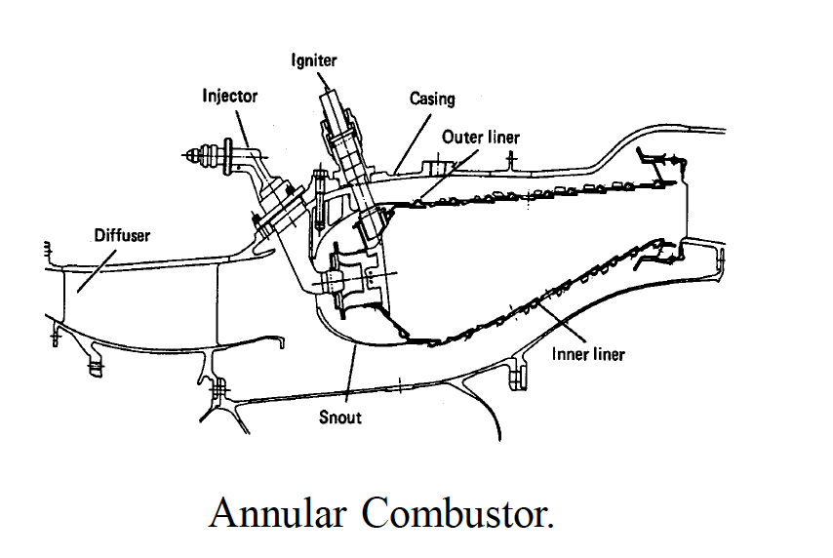
1.0 Introduction
Non Premixed or Diffusion Flames

Slide 14
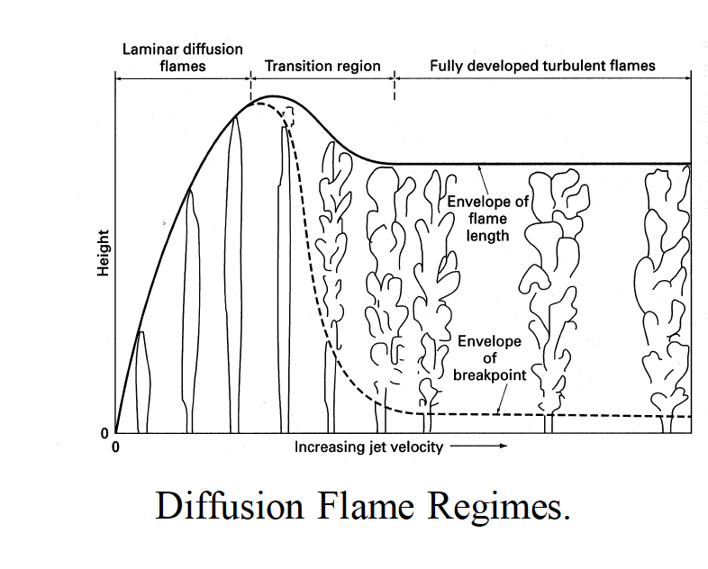
1.0 Introduction
Non Premixed or Diffusion Flames

Slide 15
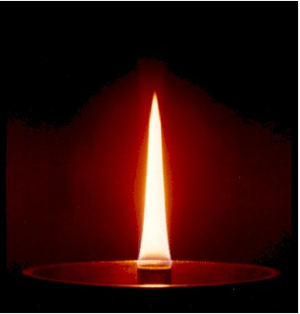
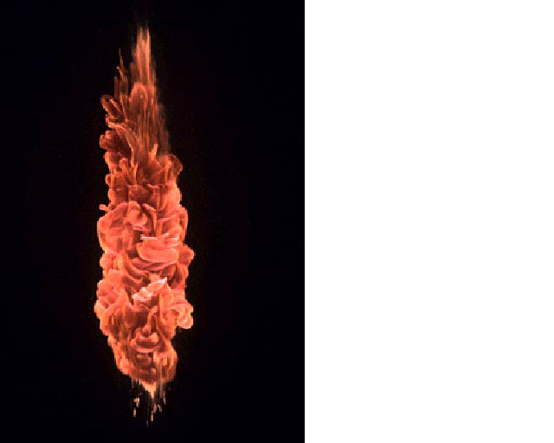
1.0 Introduction
Non Premixed or Diffusion Flames
Laminar
Turbulent
C2H4

Slide 16
1.0 Introduction

Slide 17
1.0 Introduction
Some of the issues the combustion designer has to deal with are:
Combustion intensity and efficiency
Flame stability
Flame size and shape
Heat Transfer
Pollutant formation

Slide 18
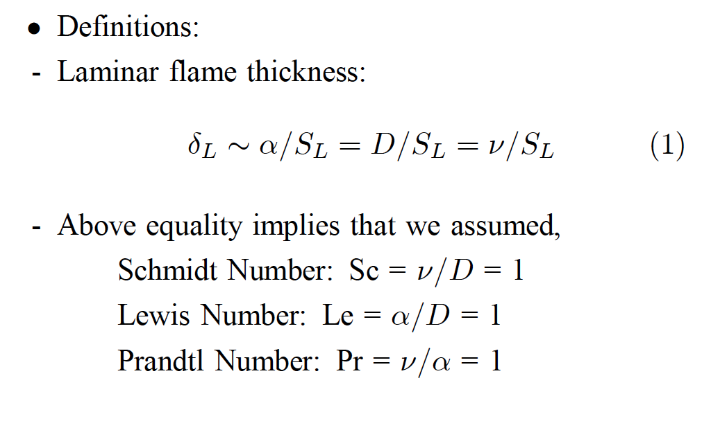
2.0 Elementary Descriptions of Turbulence
Interaction between chemical and flow time scales – Damköhler Number

Slide 19
2.0 Elementary Descriptions of Turbulence
Interaction between chemical and flow time scales – Damköhler Number

Slide 20
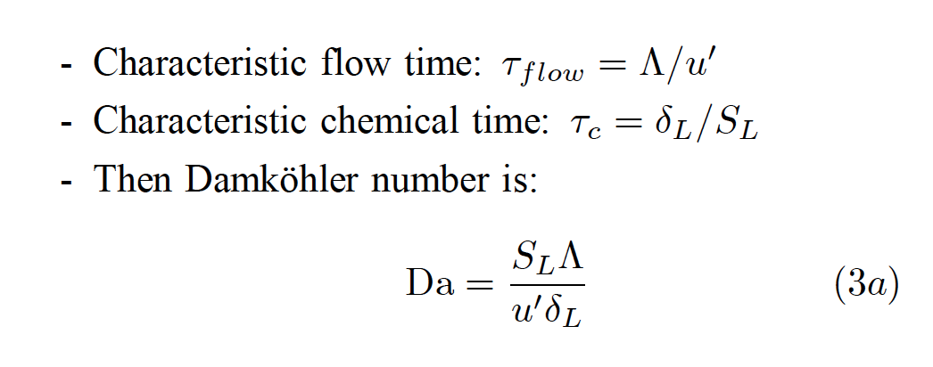
2.0 Elementary Descriptions of Turbulence
Interaction between chemical and flow time scales – Damköhler Number

Slide 21
2.0 Elementary Descriptions of Turbulence
Any property f can be splited into mean and fluctuation as
Turbulence strength is generally characterized by the turbulence Intensity

Slide 22
2.0 Elementary Descriptions of Turbulence
Turbulence descriptors: lenght and time scales
Integral length scale – related to the characteristic size of the flow
Kolmogorov length scale – the smallest one
The Reynolds Number is constructed for each lenght scales
100 to 2000 in combustion devices

Slide 23
2.0 Elementary Descriptions of Turbulence
For homogeneous isotropic turbulence, the energy of the large scales flows to the smaller scales through the Kolmogorov cascade. The energy flux from one scale to another is constant and given by the dissipation rate as
At the Kolmogorov scales, from the unity Re, one has

Slide 24
2.0 Elementary Descriptions of Turbulence
The Kolmogorov length scales reads then
The ratio of the integral to the Kolmogorov length scales is

Slide 25
2.0 Elementary Descriptions of Turbulence
The Integral length scales can be evaluated from the correlation coefficient as
Integrated over a distance between two points

Slide 26
2.0 Elementary Descriptions of Turbulence
For statistically stationary process ( what does it mean ?)
The Integral time scales can be evaluated from the auto-correlation as
The normalized autocorrelation coefficient is

Slide 27
2.0 Elementary Descriptions of Turbulence
The Integral time scale can be evaluated from the integration over the time interval
The Integral time scale gives the rough measure of the interval over which u(t) is correlated with itself.

Slide 28
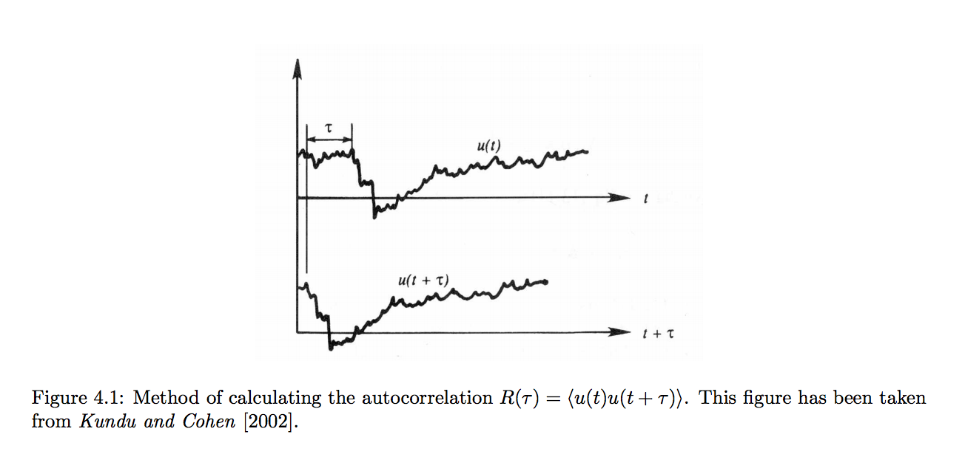
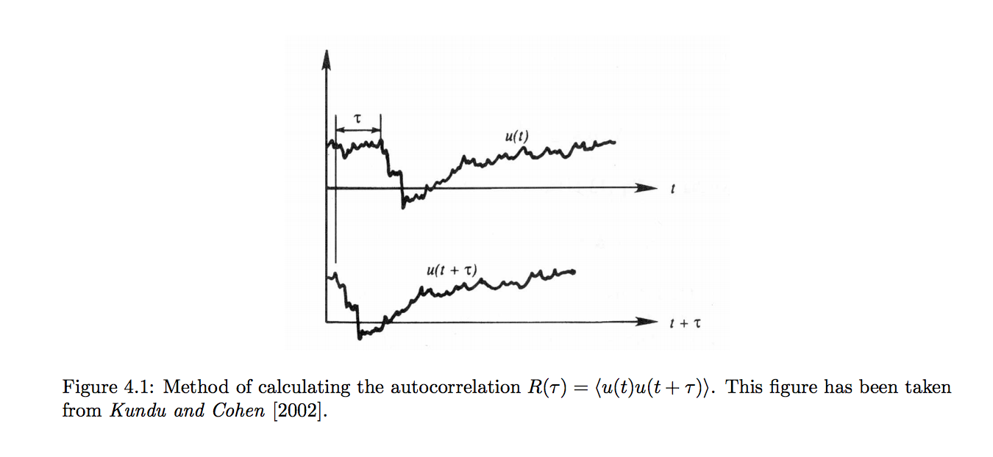
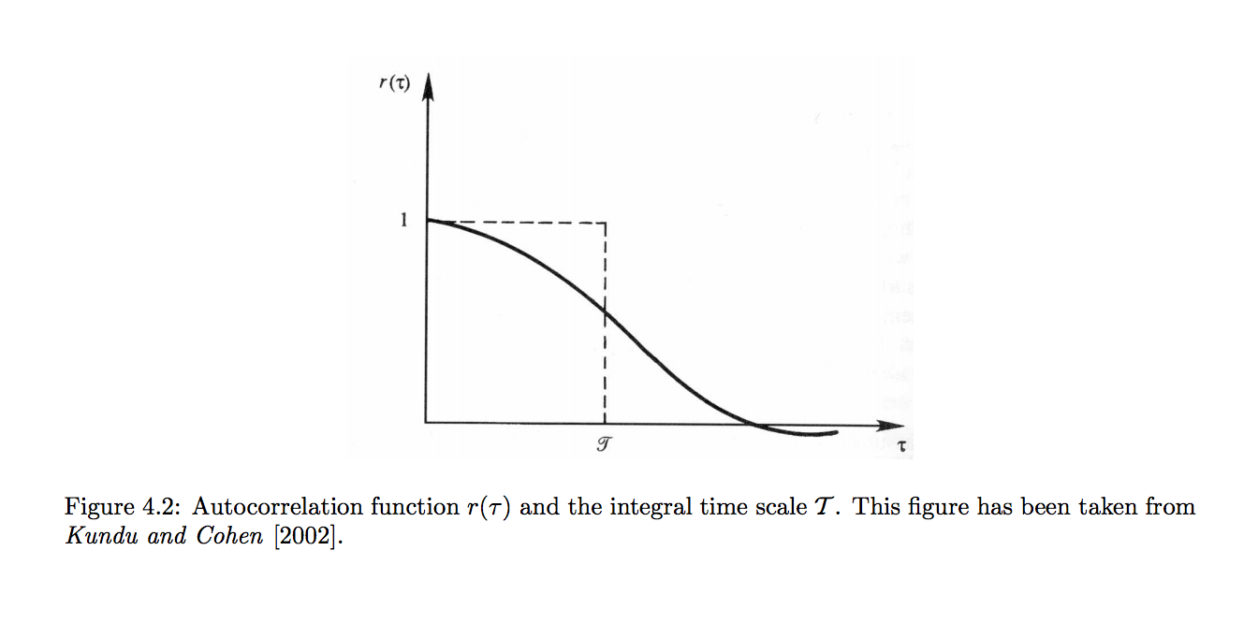
2.0 Elementary Descriptions of Turbulence

