Slide 1
CLASS #3
Chapter 3- Decisions involving multiple objectives: SMART
Decision Analysis for Management Judgment
Goodwin e Wright (2005)

Slide 2
Multiple Criteria approach
In general, the multiple criteria approach is inserted in the type of NOT STRUCTURED problems, with some of the following characteristics:
The criteria are at least two and conflicting;
Criteria and solution alternatives are not clearly defined and the consequences of choosing a given alternative with respect to at least one criterion are not clearly understood;
The criteria and the alternatives can be interconnected, in such a way that one criterion seems to partially reflect another criterion, while the effectiveness of the choice of an alternative depends on whether another alternative has been chosen or not, in which the alternatives are not mutually exclusive;
Solution for the problems depends on a group of people, with different points of view and culture, often with conflicting ideas;
The restrictions of the problem are not well defined, and there may even be some doubt about what is a criterion and what is a restriction;
Some criteria are quantifiable while others are based on value judgments made on a scale;
The scale for a given criterion can be cardinal, verbal or ordinal.

Slide 3
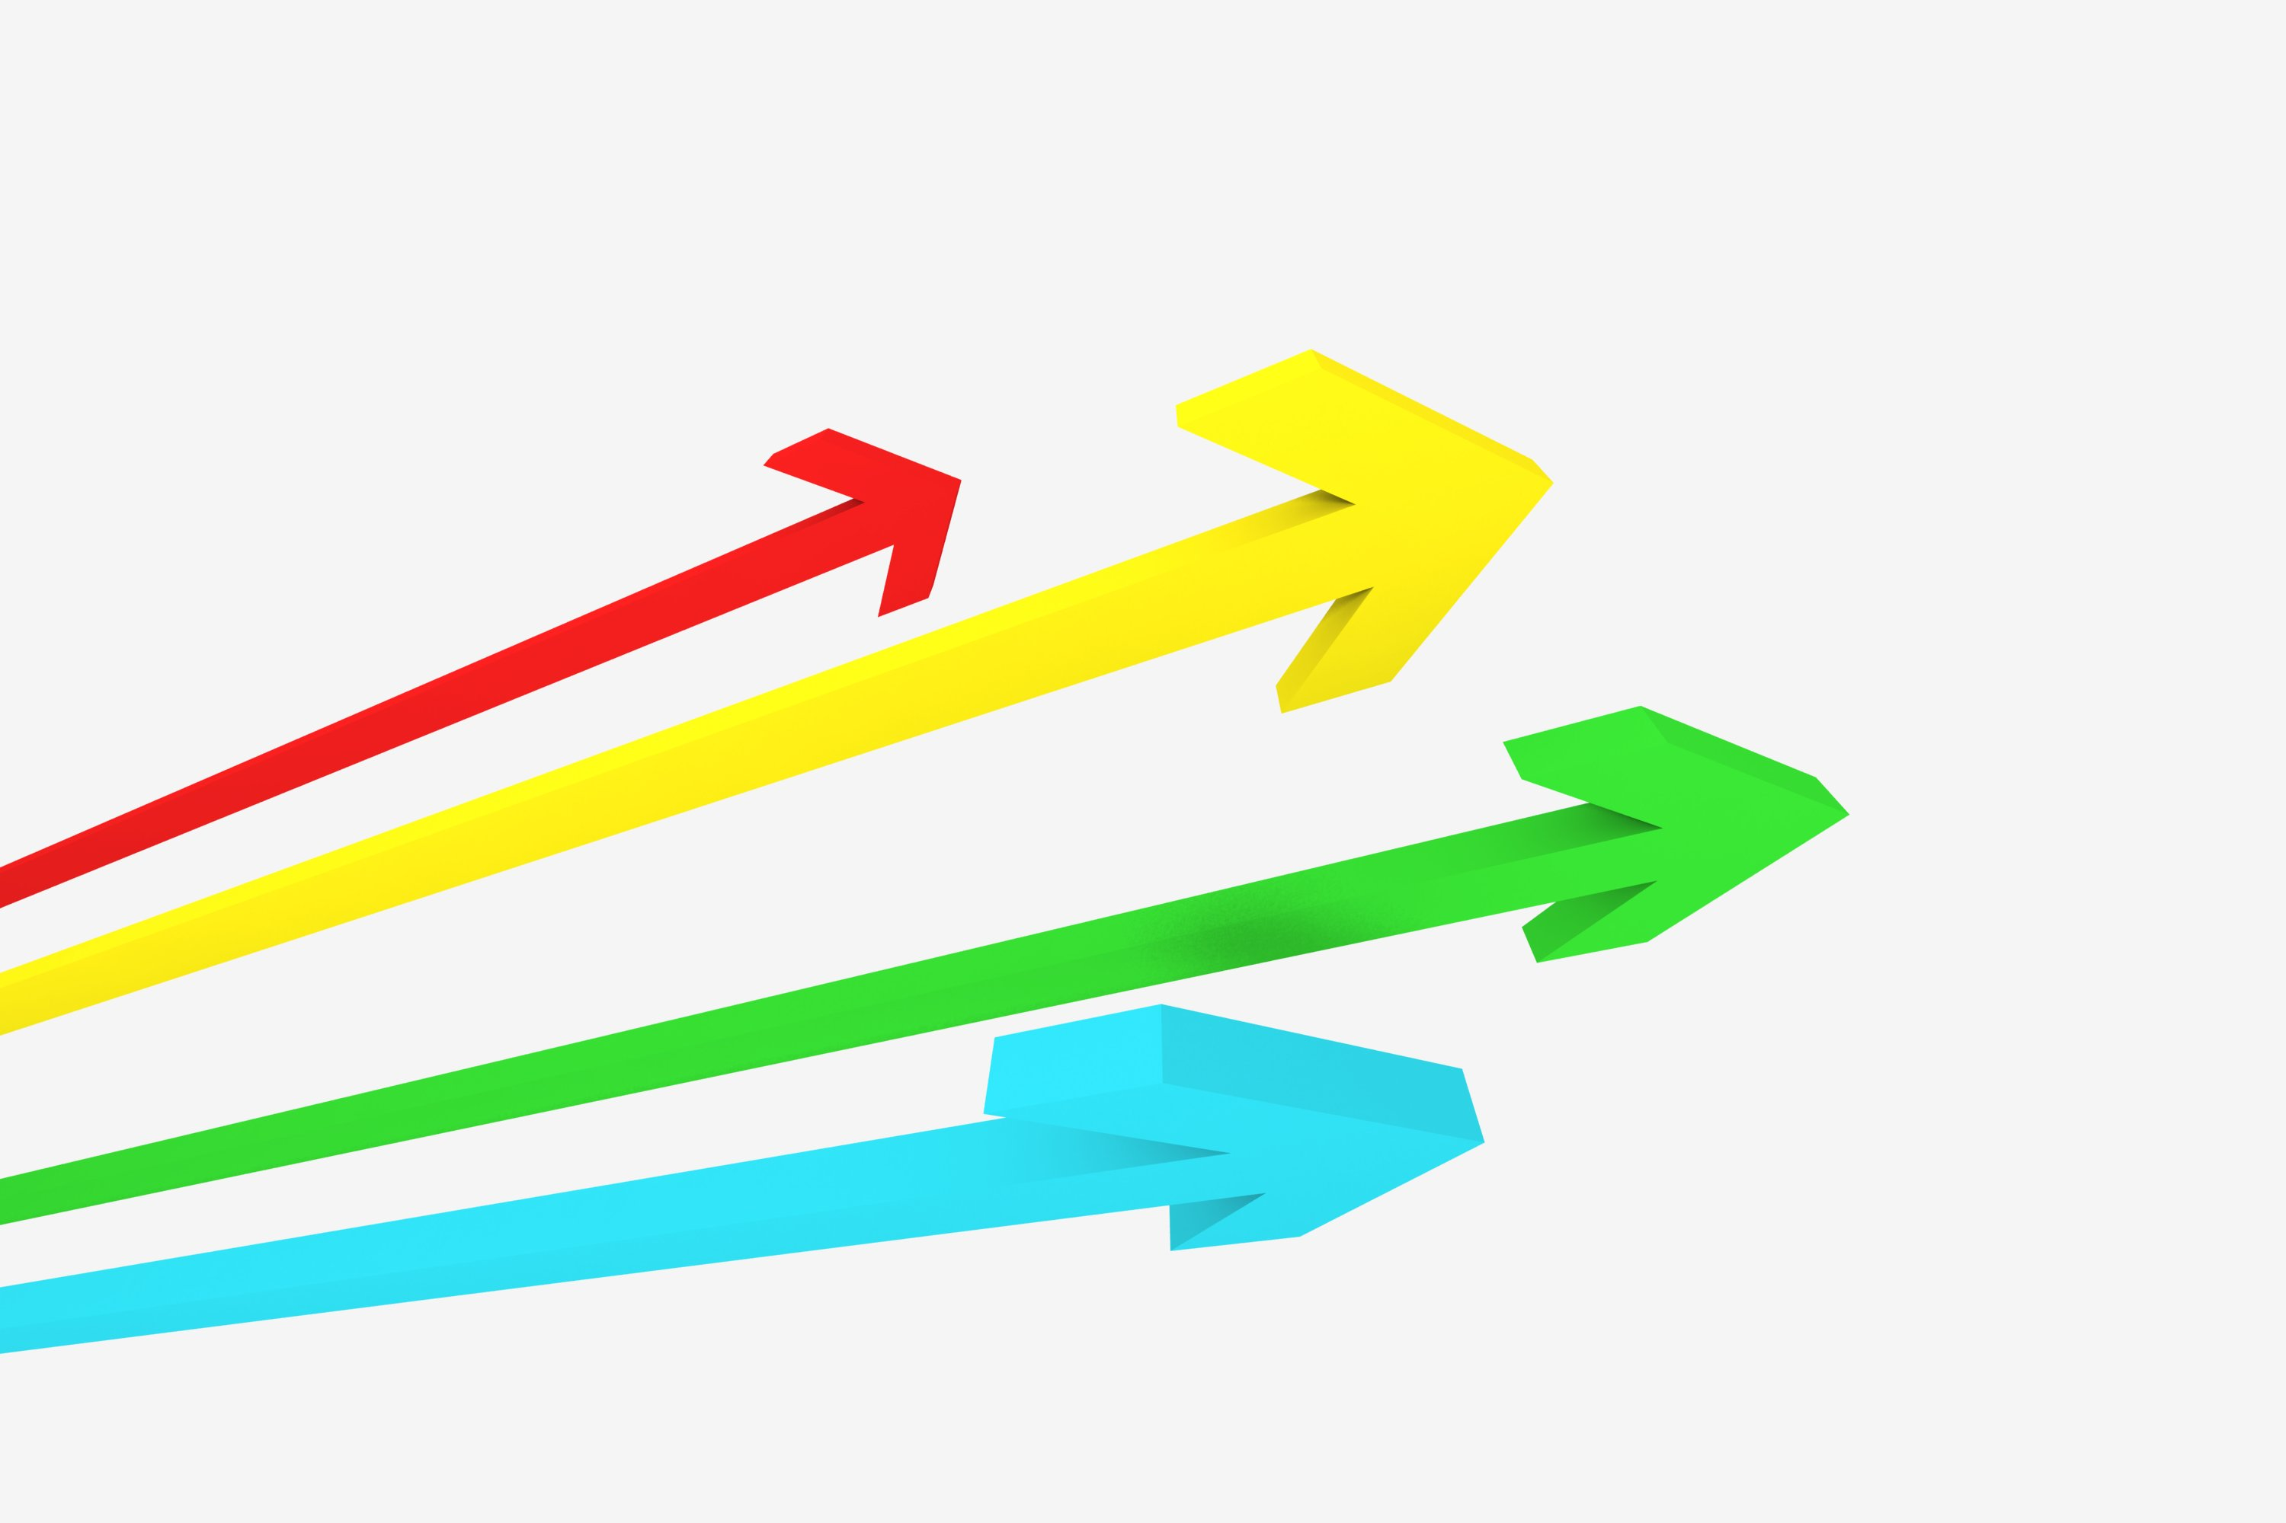
Decisions involving multiple objectives
This chapter will explore how decision analysis can be used to support decision makers who have multiple objectives. The idea is to split the problem into small parts focusing on each part separately
The method explained here is normally applied in situation where a particular course of action is regarded as certain. If decision maker acts consistently with his or her stated preferences, the alternatives will be chosen following the prescriptive analysis, which are based on axioms.

Slide 4
Basic terminology
Objectives: An objective is an indication of preferred direction of movement. i.e: buy a safe house.
Attribute: It is used to measure performance in relation to an objective, i.e: number of times this house was stolen.
Value versus Utility: If the decision involves no elements of risk and uncertainty for each course of action, we will refer to this score as the value; otherwise, we will refer to this score as a utility.

Slide 5
An office location problem
A small printing business must move from its existing office.
The owner is considering seven new possibilities.
However, the owner has a lot of factors to consider.
Addison Square (A)
Bilton Village (B)
Carlisle Walk (C)
Denver Street (D)
Elton Street (E)
Filton Village (F)
Gorton Square (G)
Decision to move to a new office

Slide 6
SMART – Simple Multi Attribute Rating Technique
The main stages are the following
1) Identify the decision maker: business owner
2) Identify the alternative course of action: 7 offices
3) Identify the attributes which are relevant to the decision problem. Building the value tree.
4) Assign values to measure the performance of alternatives on that attribute.
5) Determine a weight for each attribute.
6) For each alternative, take a weighted average of the values assigned to that alternative.
7) Make a provisional decision
8) Perform sensitivity analysis to check how robust the decision is facing the problems

Slide 7
3. Constructing the Value tree

Slide 8
Is the value tree an accurate and useful representation of the decision maker’s concerns?
Completeness
Operationality
3. Decomposibility
4. Absence of redundancy
5. Minimum size

Slide 9
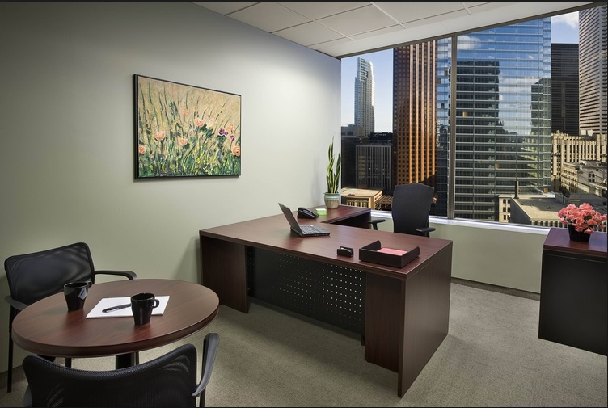
4. Measuring how well the option perform on each attribute
Costs are values
Measuring the benefit attributes is a little bit difficult.
Variables to represent those attributes, i.e.: size.

Slide 10
Direct Rating
Attributes such as “comfort” or “image” will be more difficult to find a variable which can be quantify.
Starting with the attribute “image”: the owner is first asked to rank the locations in terms of their image from the most preferred to the least preferred.
Addison Square: best location 100
Carlisle Walk: worst location 0

Slide 11
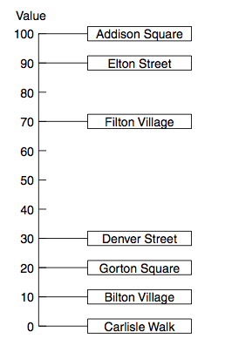
Direct Rating
The owner is now asked to rate the others locations
This is a interval scale, like temperature!
Appropriate question:
Are you happy that the improvement in Image
between Carlisle Walk and Denver Street is less
preferable then that between Denver Street
and Elton Street? How much?

Slide 12
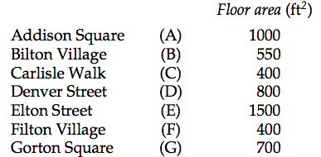
Bisection- Value functions
Let us now consider the attributes which can be represented by easily quantified variables.

Slide 13
Bisection - Value functions
Larger office more attractiveness
OFFICE | AREA (ft²) | VALUE
Elton Street | 1500 | 100
Carlisle Walk | 400 | 0
Filton Village | 400 | 0
The owner agrees that 700 ft² has the midpoint, 500 ft² is the quarter point and 1000 ft² represents the value 75
AREA VALUE
700 ft² 50
500 ft² 25
1000 ft² 75

Slide 14
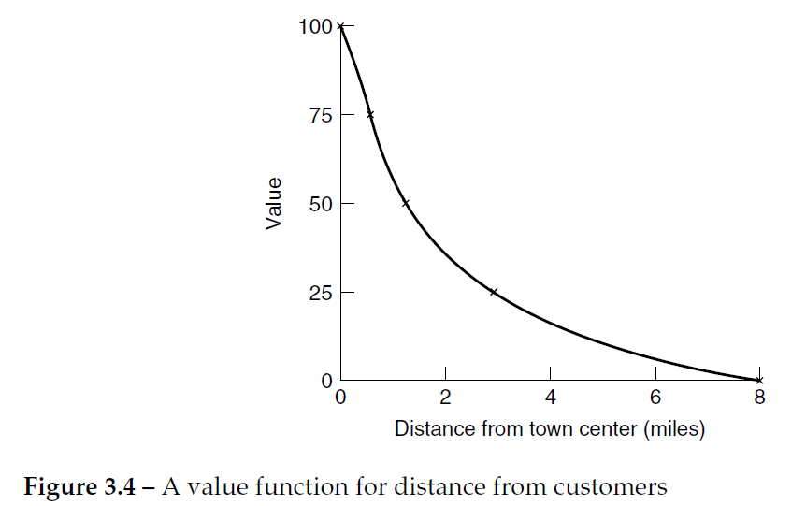
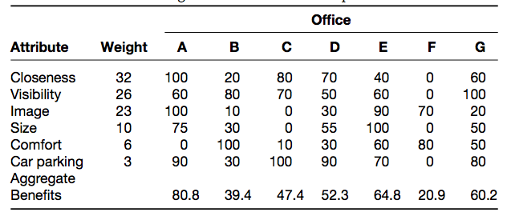
Value functions

Slide 15
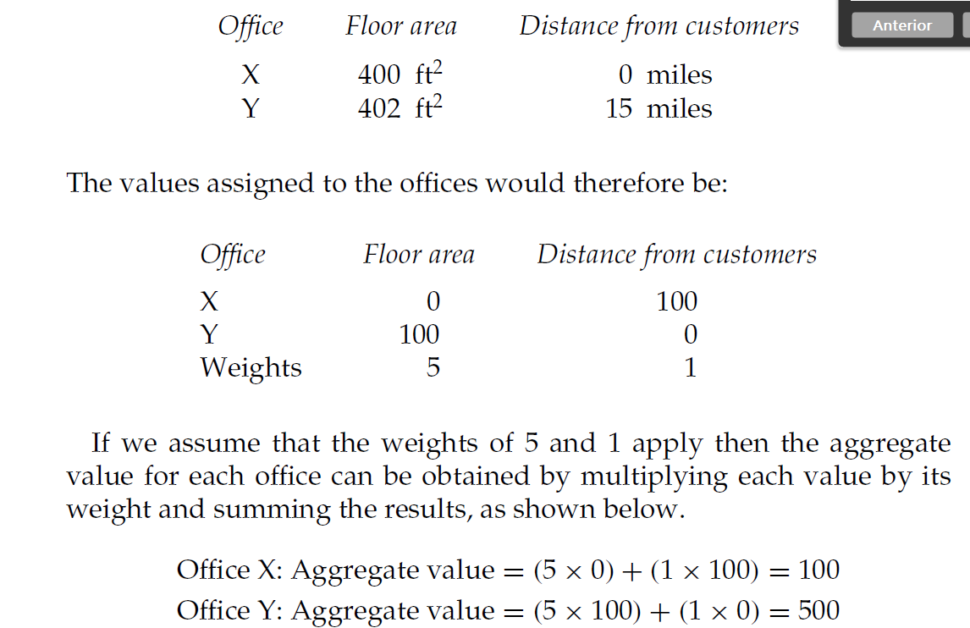
5. Determining the weights of the attributes
If the options perform very similarly on a particular attribute, so that the range between worst and best is small, this attribute is unlikely to be important in the decision

Slide 16
5. Determining the weights of the attributes- Swing Weights
Considering the Benefits, the owner is asked to imagine a hypothetical office with all attributes at the least preferred level. An office that is the greatest distance (8 miles) from the town center (not close), has the worst position for visibility and, then, has the worst image, the smallest size and so on.
Then, he is asked, if just one of these attributes could be moved to its best level, which would he choose? We can improve one, taking it to the top of the list.
The answer ranking are: (1) Closeness to customers
(2) Visibility
(3) Image
(4) Size
(5) Comfort
(6) Car-parking facilities

Slide 17
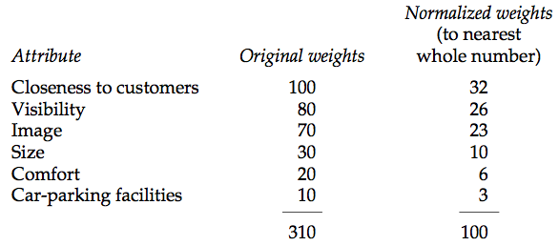
Determining the weights of the attributes
We can now give “closeness to customers” a weight of 100.
The other weight are given by comparing each attribute with “closeness to customers”, giving some score (%) to the next one that could be improved. Example: Visibility is 80% as important as the swing in “Closeness to customers”.
After this, we must to normalize the values.
A swing from the worst “image” to the best “image” is considered to be 70% as important as a swing from the worst to the best location for “closeness to customers”
….. so “image” is assigned a weight of 70.

Slide 18
Calculating aggregate benefits for each location
Addison Square
Attribute Values Weight Value x weight
Closeness to customers 100 32 3200
Visibility 60 26 1560
Image 100 23 2300
Size 75 10 750
Comfort 0 6 0
Car-parking facilities 90 3 270
8080
so aggregate benefits = 8080/100 = 80.8

Slide 19
6. Aggregating the benefits using additive model

Slide 20
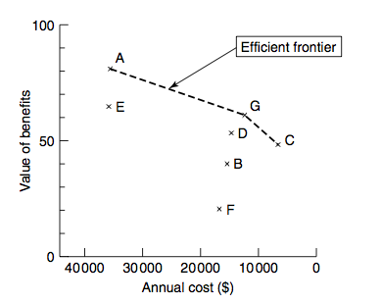
7. Trading benefits against cost
Now, we will take account the costs.
The aggregate value of benefits has been plotted against the annual costs for each of the offices.
Therefore, the only locations which are worth considering are A, G and C.

Slide 21
7. Trading benefits against cost
The choice among the 3 offices on the efficient frontier will depend on the relative weight the owner gives to costs and benefits. If he is much more concerned about benefits, the Addison Square will be his choice.

Slide 22
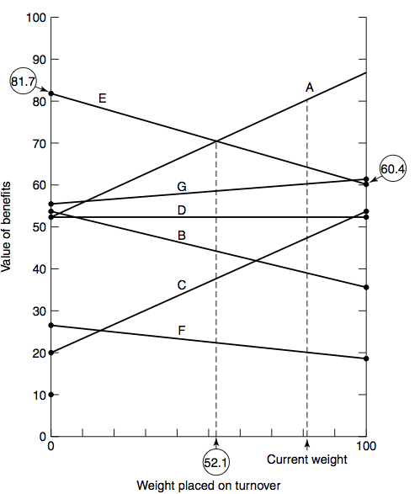
Sensitivity analyses
It is used to examine how robust the choice of an alternative is to changes in the figures used in analysis.
I.e.: If turnover had a weight of 0 this would imply that the three turnover attributes would also have 0 weights, which mean that Elton Street would have benefits with a value 81,7.

Slide 23
The axioms of the method
If the decision maker accepts these axioms, and if he is rational then he should also accept the preference ranking indicated by the method.
A) Decidability: We assumed that the owner was able to decide which of 2 options he preferred.
B) Transitivity: if the owner prefers A to B and B to C, so he prefers A to C.
C) Summation: If the owner prefers A to B and B to C, the strength of preference of A to C must be greater than the strength of A to B.
D) Finite upper and bounds for value: we have to assume that the best option was not so wonderful and the worst option was not so awful.

