Slide 1
TOPICS of LANGUAGE AND CULTURE
Prof. Dr. Daniel Ferraz
CLASS 9 – 16/11/2020

Slide 2
Evaluation?
RP 1 + RP 2 = OK
ASSESSMENT (CPS ETC) = OK
FINAL RP = OK
(INTERVIEW _ NOT ENOUGH)

Slide 3
Outline
INTRO1 – OSDE – more perspectives
INTRO 2 – SHORT VIDEOS ON CULTURAL DIVERSITY
PARTS 1 AND 2 – GEERTZ (CHAPTERS 1 AND 2) + SHORT VIDS
PART 3 - DISCUSSION

Slide 4
Intro: open spaces for dialogue and equity

Slide 7
Intro 2: CULTURAL DIFFERENCES...to be discussed
ALSO – VIDEOS ABOUT CULTURES >>> HSBC (TO EXPLAIN SANTOS)
https://www.youtube.com/watch?v=6_WAmt3cMdk
https://www.youtube.com/watch?v=v1vvLQd53Ps&list=PLAEKUX2eV4jJEqwQnxJjXjlz09G7GGk7f&index=5
https://www.youtube.com/watch?v=GHuO6qmiSgg&list=PLAEKUX2eV4jJEqwQnxJjXjlz09G7GGk7f&index=2

Slide 8
GEERTZ – CHAPTER 1
GEERTZ, C., 1973.
Description: Toward an Interpretive Theory of Culture, Chapter 1, in
The Interpretation of Cultures.
New York: Basic Books
(p 3-20)
Thanks: Walkyria Monte Mór

Slide 9
Gdocs>>> share your comments, questions, examples... (10MIN)
PLEASE , PARTICIPATE
(AS IMPORTANT AS D SPEAKING TO YOU)

Slide 10
Researchers looked for the old key-to-the-universe view
The principle of natural selection
The notion of unconscious motivation
The organization of the means of production
They don't explain everything.
They explain something.

Slide 11
Geertz's concept of culture:
...it is essentially a semiotic one. Believing, with Max Weber, that man is an animal suspended in webs of significance he himself has spun, I take culture to be those webs, and the analysis of it to be therefore not an experimental science in search of law but an interpretive one in search of meaning.
(p 5)

Slide 12
Questions related to culture:
- subjective or objective?
- patterned conduct or a frame of mind or the two mixed?
(p 10)

Slide 13
Contributions of Ethnography:
[It] is establishing rapport, selecting informants, transcribing texts, taking genealogies, mapping fields, keeping a diary, and so on. [...] an elaborate venture in “thick description”. (p 6)

Slide 14
Ethnographer = actor-oriented (trained on the culture of which it is itself a part)
3 (+1) characteristics of ethnographic description:
1) it is interpretive
2) what it is interpretive of is the flow of social discourse
3) the interpreting involved consists in trying to rescue the “said” of such discourse
4) it is microscopic
(very) local perspective

Slide 16
Thick Description: Imagine you are the ethnographer of this group…
Two students rapidly contracting the eyelids of their right eyes:
An involuntary twitch – attending class
A winking (a MEANINGFUL signal) – interpretation??
A date?
A previous agreement?
?

Slide 17
Chapter 2
GEERTZ, C., 1973.
The Impact of the Concept of Culture on the Concept of Man

Slide 18
https://www.youtube.com/watch?v=TaWDXwmjf_Q

Slide 19
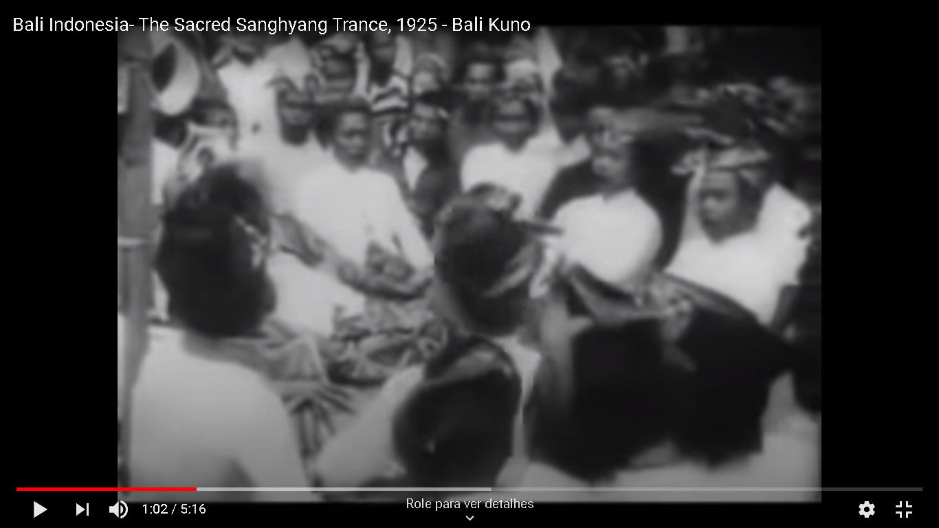
https://www.youtube.com/watch?v=BERKBHbVcy0&ab_channel=TimescapeIndonesia

Slide 20
ZUNI
butterfly
https://www.youtube.com/watch?v=skfq5F2ZuyM&ab_channel=505soaringeagle
rain dance song https://www.youtube.com/watch?v=N_T0V871SPQ
https://www.youtube.com/watch?v=4e5ln-T_KJs&ab_channel=EddyHerier

Slide 21
The rise of scientific concept of culture amounted to, or at least was connected with, the overthrow of the view of human nature dominant in the Enlightenment…”
(p 34)

Slide 22
MODERNITY– HOW HAVE WE GOTTEN HERE?
MODERNIDADE
RACIONALISMO
POSITIVISMO
ILUMINISMO
MODERNISMO
CIENTIFICISMO
EMPIRISMO
CAPITALISMO/NEOLIBERALISMO
ESTRUTURALISMO

Slide 23
The Enlightenment view of man was, of course, that he was wholly of a piece with nature and shared in the general uniformity of composition which natural science, under Bacon’s urging and Newton’s guidance, had discovered there. There is, in brief, a human nature as regularly organized, as thoroughly invariant, and as marvelous simple as Newton’s universe. (p 34)
Scientific
Universal
TO ENLIGHTEN >>> BIG C CULTURE >>>LIGHT >> little c culture
ENLIGHTENMENT >>>EUROPE

Slide 24
[…] Whatever else modern anthropology asserts – and it seems to have asserted almost everything at one time or another – it is firm in the conviction that men unmodified by the customs of particular places do not in fact exist, have never existed, and most important, could not in the very nature of the case exist.
(p 35)
PLACES EMPHASIS >>>>LOCAL CHARACTER OF CULTURE
LOCAL CHARACTER OF MEANING MAKING

Slide 25
Stratigraphic conception
Critiques: the “stratigraphic” conception of the relations between biological, psychological, social, and cultural factors in human life. In this conception, man is a composite of “levels”, each superimposed upon those beneath it and underpinning those above it (p 37)
COMPOSITE OF HIERARCHICAL LEVELS AND LAYERS
NATURE/BIOLOGY AND OR + SOCIAL = CULTURE

Slide 26
, the question still remains whether such universals should be taken as the central elements in the definition of man, whether a lowest-common-denominator view of humanity is what we want anyway.
(p 43)

Slide 27
SYNTHETIC CONCEPTION>>
In short, we need to look for systematic relationships among diverse phenomena, not for substantive identities among similar ones. And to do that with any effectiveness, we need to replace the "stratigraphic“ conception of the relations between the various aspects of human existence with a synthetic one; that is, one in which biological, psyc hological, sociological, and cultural factors can be treated as variables within unitary systems of analysis (p. 44)

Slide 29
To conclude... Nature X + - culture
“Our capacity to speak is surely innate; our capacity to speak English is surely cultural. Smiling at pleasing stimuli and frowning at unpleasing ones are surely in some degree genetically determined; but sardonic smiling and burlesque frowning equally surely predominantly cultural”
“...between all these LIES a COMPLEX SET of SIGNIFICANT SYMBOLS under whose Direction we transform...”

Slide 30
Part 4 (BREAKOUT ROOMS) – DO NOT LEAVE OSDE ANSWERS + GEERTZ
- BASED UPON GEERTZ AND CLASS TODAY, WHAT ARE THE CONSEQUENCES OF EACH CULTURAL PERSPECTIVE IN BRAZILIAN SOCIETY AND IN YOUR LOCAL CONTEXT (USP, DISTRICT, CITY, FAMILY)?

Slide 33
ANSWERS...

Slide 34
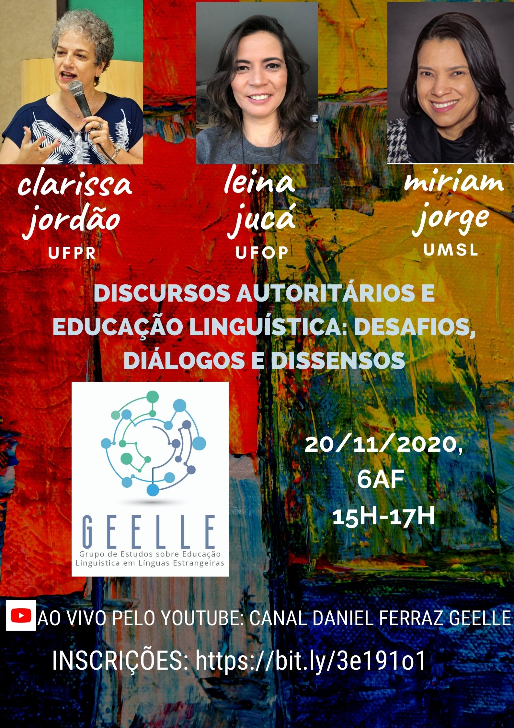
NEXT EVENTS – TUNE IN! This friday

Slide 35
JEALAV – FRIDAY 10AM + 2PM

Slide 36
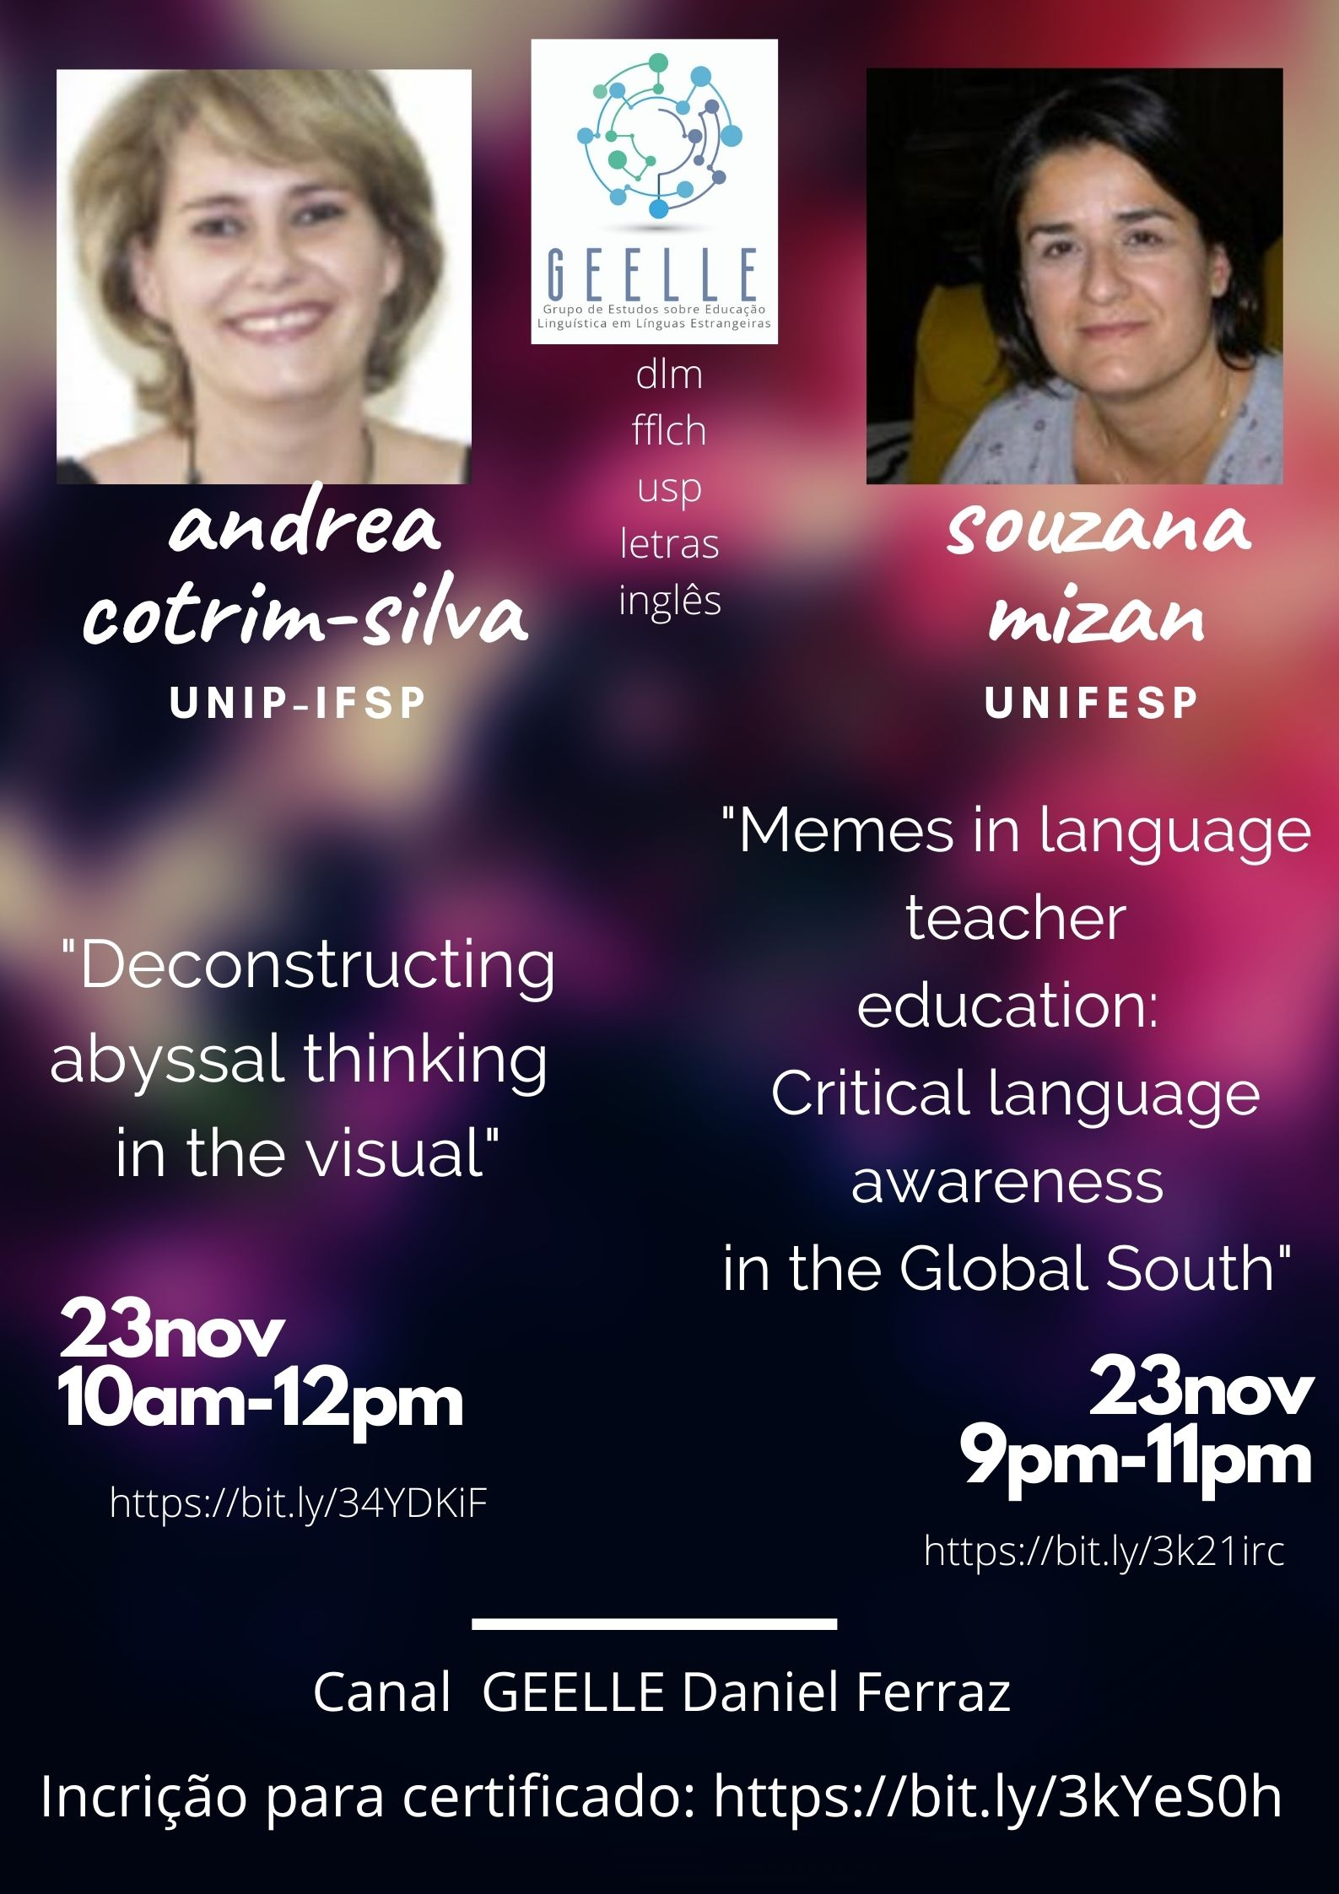
CLASS 10 – 23/11 – PLS COME! INVITE FRIENDS SPRED THE NEWS (SOCIAL MEDIA) + REGISTER YOURSELF (YOUTUBE, depending on reg.)

Slide 37
Class 11 (30/11/20) – Theme: Language & Culture & Society (1) - Cultural identity, post-modernity | Text 9 - A identidade cultural na Pós-Modernidade (HALL, 2006 chapters 1 and 3)

