Slide 1
State of the art literature review on...
Dutra – 2016
dutra@usp.br
UNM

Slide 2
Initial question?
Key authors ?
Best journals ?

Slide 3
Agenda
Initial concepts
Histcite – Free software
Using an example to discover Histcite
WOK: source to Histcite
Guide to Install HIstcite

Slide 4
Some typical questions that can be answered by HistCite analysis
How much literature has been published in this field?
When and in what countries has it been published?
What countries are the major contributors to this field?
What journals cover the literature of the field?
Who are the key authors in this field?
Which articles are the most important?
How have the various contributors to the field influenced each other?

Slide 5
HistCite (free) - bibliometric analysis
it is a software package used for bibliometric analysis and information visualization
Input: bibliographic information (titles, authors, dates, author addresses, references, etc.)

Slide 6
Open Histcite
Web Of Knowledge
Run Histcite
Use Firefox browser and type the following URL (Close IE bowser in order to have only one version running of Histcite). Minimize (do not close) the window with black background.
File /Add file
Select savedrecs.txt file and press <add file>
The saverecs.txt should be in c:/fakepath

Slide 7
Publication Year
Web Of Knowledge
TLCS – Total Local citation score -> number of citations to the Journal from papers WITHIN the collection
TGCS – Total Global citation score -> number of citations to the Journal from WOK collection

Slide 8
Journals
TLCS – Total Local citation score -> number of citations to the Journal from papers WITHIN the collection
TGCS – Total Global citation score -> number of citations to the Journal from WOK collection

Slide 9
Authors
TLCS – Total Local citation score -> number of citations to the author from papers WITHIN the collection
TGCS – Total Global citation score -> number of citations to the author from WOK collection

Slide 10
Cited References (1 to 14,088 references)
Records in blue are part of the collection.
Records in black are not part of the collection as they did not meet Web of Science search criteria used by you, or they are not indexed in Web of Science.
The "WoS" link will automatically search Web of Science for the cited reference
Shows the number of records in which this reference is cited
The “+ Make Record" link (available only on references in black that are not in the collection) allows the user to manual turn a reference into a record in the collection

Slide 11
Categories
Web Of Knowledge
Authors
Journals
Cited References
Yearly output
Country
Historiographs - chronological citation network showing citation links between papers.
TOOLS – GRAPH MAKER

Slide 12
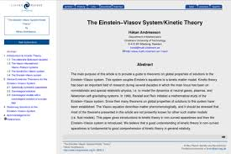
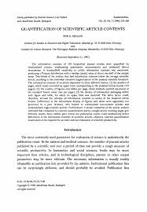
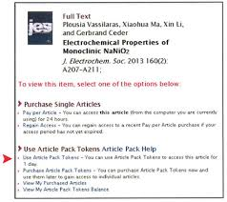
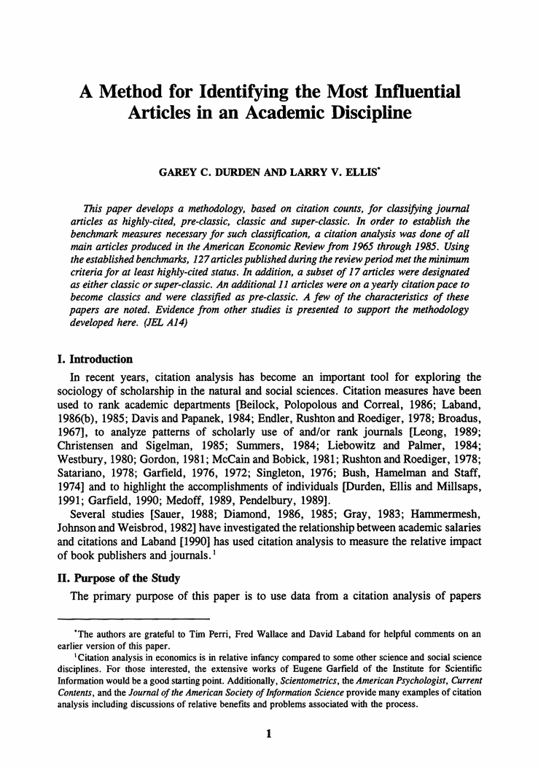
Understanding better
Web Of Knowledge
LCS – Local citation score -> number of citations to the paper from WITHIN the collection
GCS – Global citation score-> number of citations to the paper from ALL sources
LCR – Local cited references -> Number of records in the collection that are cited by the paper. This is the relevance of the paper to the collection
CR – Number of cited references -> Total cited references in the bibliography of the paper
Web of Science
collection
GCS
cites
LCR
Paper 2
Paper 1
Your collection
LCS
cites
Paper 3
Paper

Slide 13
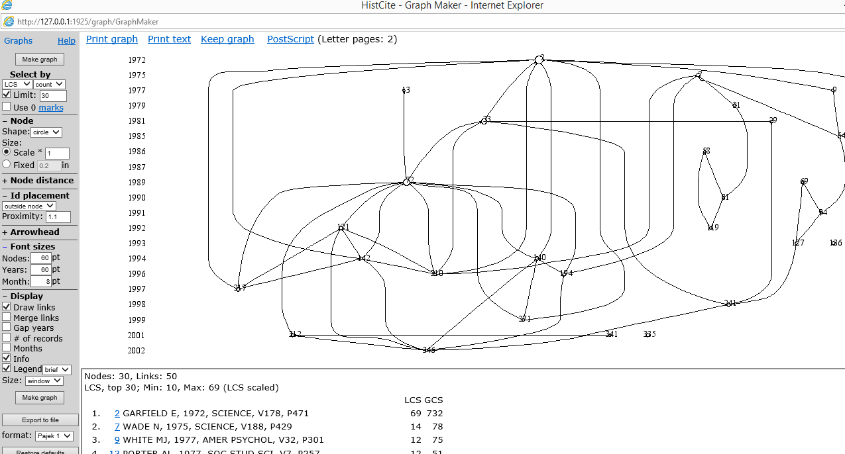
LCS COUNT LIMIT to 30-> select top 30 records from the collection Sorted by LCS
LCS – Local citation score -> number of citations to the paper from WITHIN the collection
Web Of Knowledge

Slide 14
Do your search using WOK
Web Of Knowledge
http://wokinfo.com/
Product access -> Web of Science
Select Web of Science core collection
We need at least 300 papers for better results
Use “AND“ connector and other options of the left side to refine the results, if needed
Time span -> all years
Initially include all papers in the marked list
Review the Market list and delete any paper that should no belong to the list
Quick reference guide to WOS - http://wokinfo.com/media/pdf/qrc/wosqrc.pdf
Video tutorials for WOK - http://wokinfo.com/training_support/training/web-of-knowledge/

Slide 15
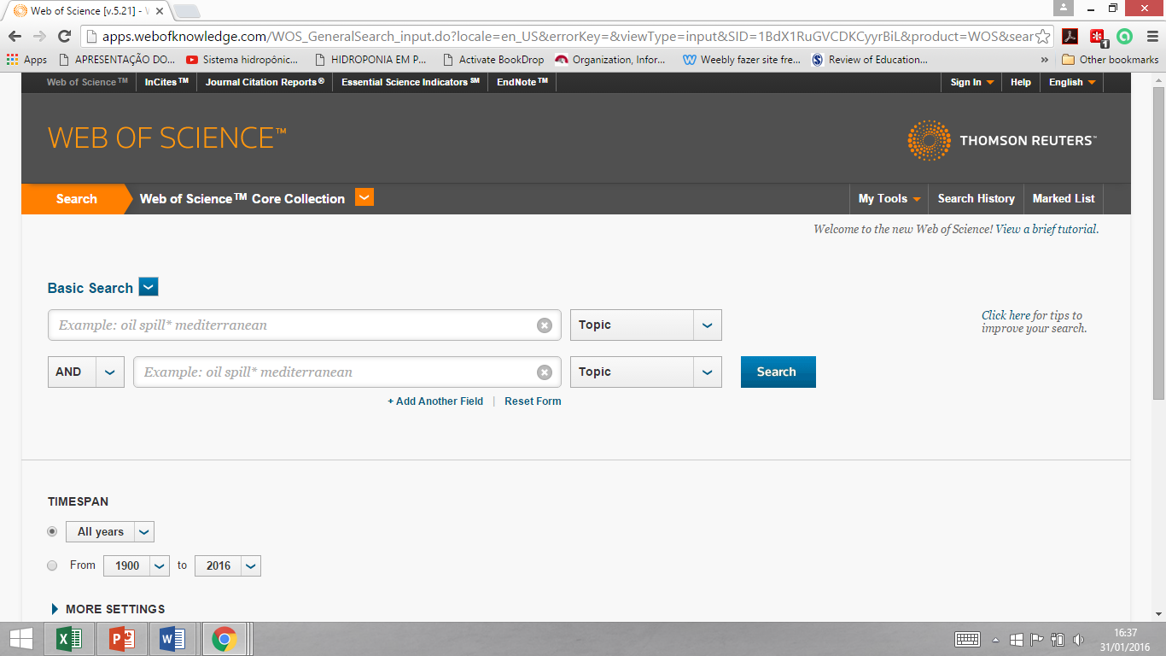
Web Of Knowledge
1

Slide 16
Export to Histcite
Web Of Knowledge
Go to the Market list
Delete unwanted papers
Check “Select all”
Select “Save to other files formats”
Select “Other reference software”
Press “Send” button

Slide 17
Fix the output file (savedrecs.txt) using wordpad
Web Of Knowledge
Change only the first line and then save it to the c:\fakepath folder
Replace: FN Thomson Reuters Web of Science™
by : FN Thomson Reuters Web of Knowledge™

Slide 18
Install Histcite
Histcite Install
Download the software and install in your computer
Where to download (PC only)?
http://interest.science.thomsonreuters.com/forms/HistCite/
Create a new folder c:\fakepath where you should store the files exported from Web of knowledge

Slide 19
References
Wikipedia: https://en.wikipedia.org/wiki/Histcite
Guide to Histcite - http://garfield.library.upenn.edu/histcomp/guide.html
Video tutorials available in youtube channel designed for this presentation
https://www.youtube.com/playlist?list=PLJhGCg6gttFPLQdi0yBLrFzaIf82Nj0SL

