Slide 1
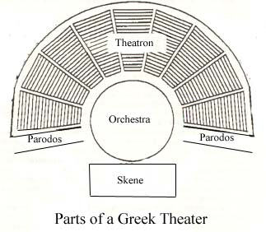

Slide 2
Notes:
EPIDAURUS THEATER

Slide 3
Notes:
ANCIENT ROMAN THEATER

Slide 4
Notes:
ROMAN THEATER IN FIESOLE

Slide 5
Notes:
MEDIEVAL MOVEABLE PLATFORM

Slide 6
Notes:
MEDIEVAL STAGING ON MOVABLE WAGONS

Slide 7
Notes:
MEDIEVAL PAGEANT WAGON

Slide 8
Notes:
ELIZABETHAN STAGE: RECONSTRUCTED GLOBE THEATER

Slide 9
Notes:
GLOBE THEATER

Slide 10
Notes:
GLOBE THEATER

Slide 11
Notes:
COMMEDIA DELL’ARTE CHARACTER ARLECHINO

Slide 12
Notes:
BRIGHELLA

Slide 13
Notes:
COVIELLO

Slide 14
Notes:
PANTALONE

Slide 15
Notes:
COMMEDIA DELL’ARTE PERFORMERS

Slide 16
Notes:
XVII CENTURY FRENCH THEATER

Slide 17
Notes:
DRURY LANE THEATER 1794

Slide 18
Notes:
NEW ROYAL THEATER (VICTORIAN PERIOD_

Slide 19
Notes:
The New Amsterdam Theatre 214 West 42nd Street, New York, NY 10036

