Slide 1
DISCOURSE STUDIES (ESTUDOS DISCURSIVOS)
CLASS 2 - 12/08/19
PROF. DR. DANIEL FERRAZ

Slide 2
General messages/tasks
NEXT CLASSES
OFFICE HOURS – ??
WEDNESDAYS - 14:00 – 15:00
WEDNESDAYS - 18:00 – 19:00

Slide 3
CLASS 1
WHAT WE DID...

Slide 4
EVALUATION
Atividades | Peso
Presence | 20% (2,0)
Participation + Class productions | 30% (3,0)
2 Evaluations - Response Papers | 50% (5,0)
Total: | = 100% (10,0)

Slide 5
CLASS 2 - today
PART ONE:
PERSPECTIVES ON LANGUAGE (LÍNGUA E LINGUAGEM);
MODERNITY, POST MODERNITY, STRUCTURALISM AND POST-STRUCTURALISM REVIEW
HOW DO THESE VIEWS INFLUENCE AND DETERMINE OUR VIEWS ON LANGUAGE, DISCOURSE, EDUCATION AND SOCIETY?
PART TWO:
ANGERMULLER ET AL: DISCOURSE STUDIES – AN INTRODUCTION

Slide 6
COMPLEMENTARY TEXT: ferraz WHAT VIEWS OF LANGUAGE (LÍNGUA E LINGUAGEM) DOES THE TEXT PUT FORWARD?

Slide 7
PROBLEMATIZING QUESTIONS...AND CHALLENGES
CHALLENGE I: HOW DO WE PROBLEMATIZE LANGUAGE? ALSO DO WE PERCEIVE THAT THEY CERTAINLY DETERMINE OUR VIEWS IN RELATION TO DISCOURSES, AND EDUCATION?
CHALLENGE II – IS IT POSSIBLE TO CONNECT STRUCTURALIST-TRADITIONAL VIEWS OF LANGUAGE WITH POST-STRUCTURALIST ONES? CAN THEY BE SEPARATED? DO THEY COMPLEMENT EACH OTHER?
CHALLENGE III – HOW CAN WE UNDERSTAND DISCOURSES CONSIDERING EACH VIEW???

Slide 8
JIGSAW READING

Slide 9
PART 2 – INTRODUCTION ON DISCOURSE STUDIES
DISCOURSE STUDIES READER (BOOK INTRODUCTION)

Slide 10
DISCOURSE STUDIES DISCURSIVE STUDIES
It is not possible to trace the field of Discourse Studies back to one founder, school or field.
Discourse studies (abbreviated as DS) is, we believe, the result of the convergence of a number of theoretical and methodological currents originating in various countries (above all in Europe and North America) and in different disciplines of the social sciences and the humanities (linguistics, sociology, philosophy, literary criticism, anthropology, history…)

Slide 11
DISCOURSE STUDIES
It is not possible to trace the field of Discourse Studies back to one founder, school or field.
EUROPEAN + NORTH AMERICAN THEORIES
(linguistics, sociology, philosophy, literary criticism, anthropology, history…)

Slide 12
HISTORY... DS

Slide 13
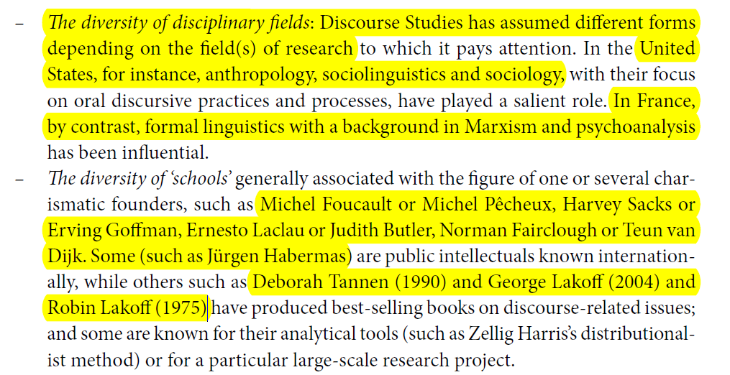

Slide 14
DIVERSITY OF SCHOOLS AND PERSPECTIVES
United States, anthropology, sociolinguistics and sociology,
In France, with a background in Marxism and psychoanalysis

Slide 15
DIVERSITY: The various types of data, corpora and/or genres
Discourse analysts can work with extensive corpora in order to reveal the meaning structures and communication patterns of large discursive communities.
‘Texts’ do not always designate written data; they can comprise written, oral or non-verbal data.

Slide 17
DISCOURSE ANALYSIS X DISCOURSE STUDIES

Slide 18
DA>>DISCURSIVE PRACTICES, RULES, MECHANISMS

Slide 19
DOMAINS...

Slide 23
DS...

Slide 24
DA...

Slide 25
IMPORTANT NOTIONS TO BE STUDIES...
LANGUAGE – LÍNGUA E LINGUAGEM... (CLASS TODAY)
FUTURE CLASSES:
DISCOURSE STUDIES X DISCOURSE ANALYSIS
DISCOURSE (MANY PERSPECTIVES)- MOREOVER – WHICH ONES DO YOU RELATE TO??
DISCURSIVE FORMATIONS
IDENTITIES X SUBJECTIVITIES
“MORE” STRUCTURALIST VIEWS ON D
“MORE” SOCIAL-CRITICAL VIEWS ON D

Slide 26
End notes
danielferrazusp@gmail.com
www.ACADEMIA.EDU/Daniel Ferraz

Slide 27
THANK YOU!!!

