Slide 1
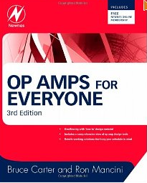
OP AMPs for Everyone Newnes, 2009

Slide 2
All Pass Filters

Slide 3
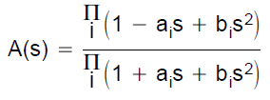
1
All-pass filter has a constant gain across the entire frequency range, and a phase response that changes linearly with frequency.
2
All-pass filters are used in circuits referred to as “phase equalizers” or “delay equalizers.” As discussed in Understanding Linear-Phase Filters, it is sometimes important to ensure that all the frequency components in a signal experience equal temporal delay.
3
Similar to the low-pass filters, all-pass circuits of higher order consist of cascaded first-order and second-order all-pass stages.
(a_{i} and b_{i} being the coefficients of a partial filter)

Slide 4
4
The transfer function expressed by magnitude and phase yields:
Magnitude
(módulo 1)
Phase

Slide 5
5
Group Delay
It is te time by which the all pass filter delays each frequency within a band.
The normalized group delay is calculated by the equations:
The frequency at which the group delay drops to $\frac{1}{\sqrt{2}}$ times its initial value is the corner frequency (f_{C}).

Slide 6
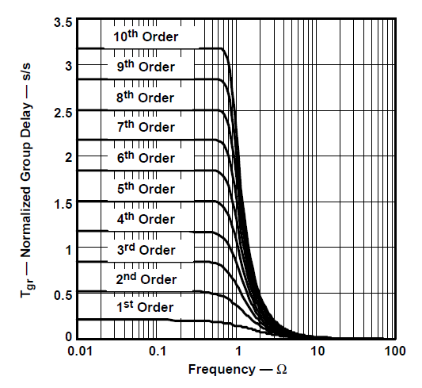
6
The T_{gro} is the value of T_{gr} when Ω < 1.

Slide 7
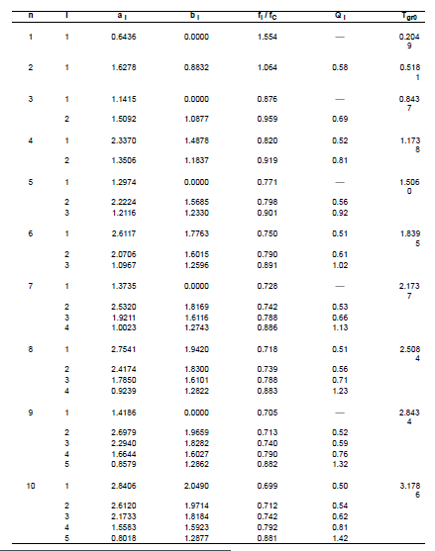
All Pass

Slide 8
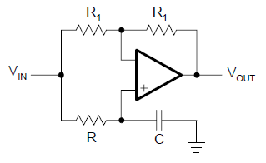
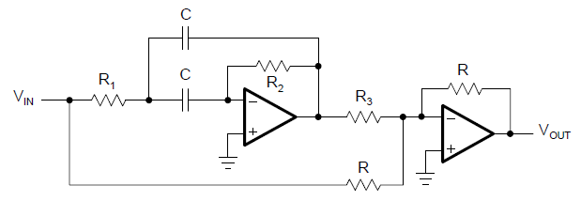
First Order Topology
Second Order Topology
$t_{gro}$= 2RC
$t_{gro}$= 4RC

Slide 9
Designing
All Pass Filters
(First Order Topology)

Slide 10
First Order Topology
1
Specify f_{C} and C
2
Calculate R
3
Delay group

Slide 11
Designing
All Pass Filters
(Second Order Topology)

Slide 12
Second Order Topology
1
Specify f_{C} , R and C
2
Calculate R
3
Calculate R₁ , R_{2 ,} R₃
4
Maximum delay group

Slide 13
Exemple 1:
A signal with the frequency spectrum, 0 < f < 1 kHz, needs to be delayed by 2 ms. To keep the phase distortions at a minimum, the corner frequency of the all-pass filter must be f_{C} ≥ 1 kHz. Design a 2-ms delay all-pass filter
1
The figure below shows a seventh-order all-pass is needed to accomplish the desired delay.

Slide 14
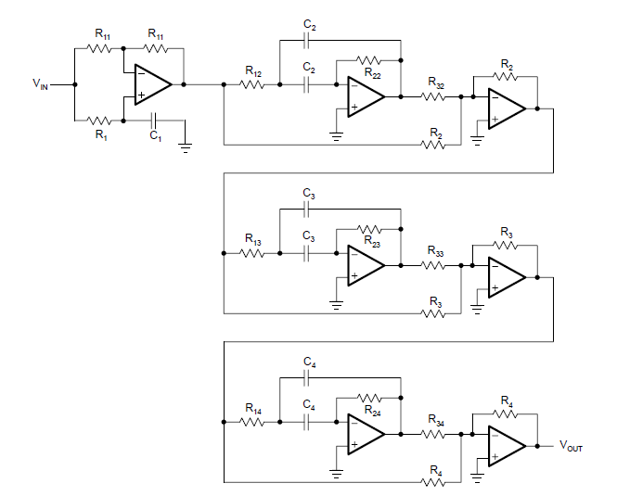
All Pass Filter – 7th Order

Slide 15
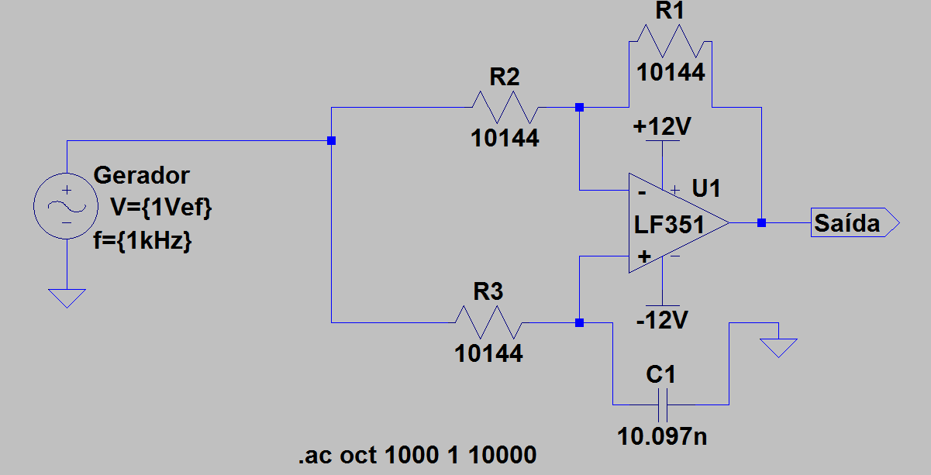
Exemple 2:
Implemente no LTSPice um filtro passa tudo de ordem 1 com frequência de corte 1KHz. Utilize C=10nF.

Slide 16
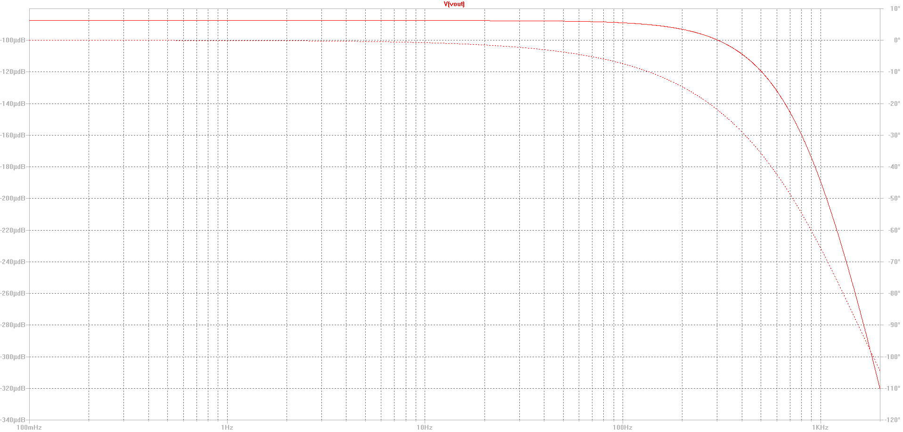
G(dB)
f(Hz)

Slide 17
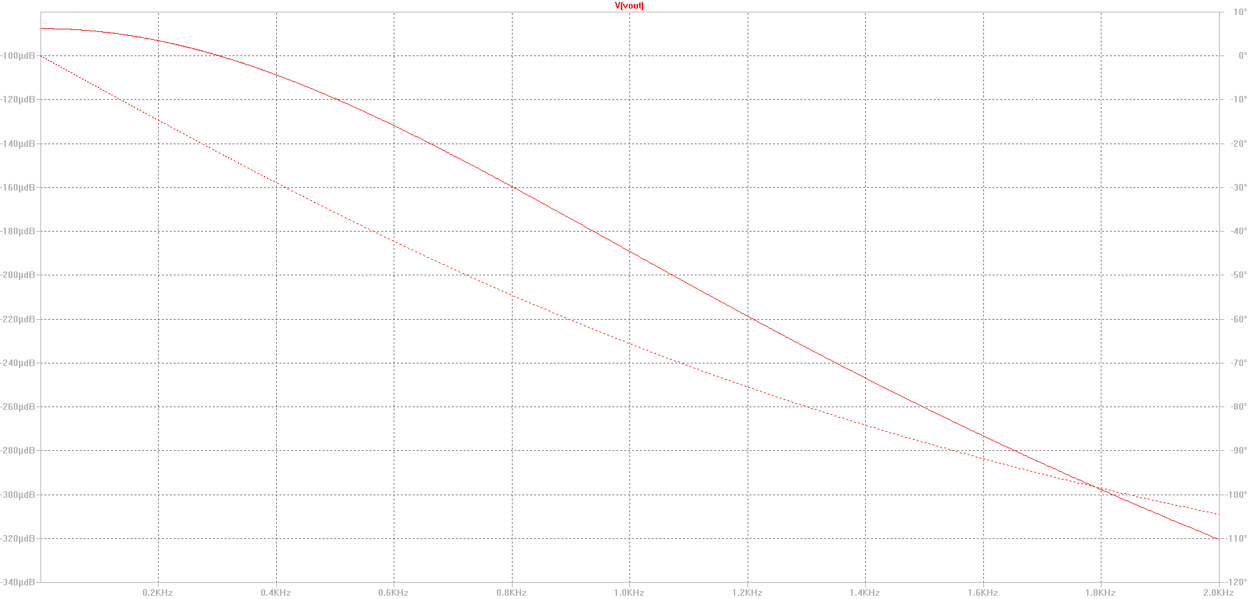
Ɵ
escala
linear
f(Hz)
1KHz

