Slide 1
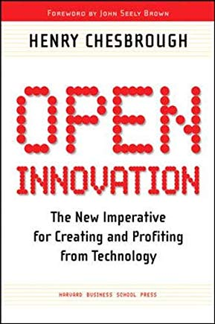
The open innovation paradigma Open Innovation: the new imperative for creating and profiting from technology Henry W. Chesbrough
Cesar Augusto Massaro
28/05/2019

Slide 2
Closed Innovation x Closed Innovation
Closed Innovation
Open Innovation

Slide 3
How to access useful Knowledge
1900 x 2000 – Would you choose to create na internal, central R&D organization? No!
The knowledge landscape in which you operate makes a big difference in how you would answer that question.
Today, there is an abundance of knowledge.
Universities and research labs
Universities with Full Professors and Graduate Students
Approach to apply science to business (societal) problems
Government funds declined and researchers are smarter to chase new (private) funds
New good quality universities and labs in the USA and abroad
Knowledge Diffusion – Patents and Human Capital
Distribution of Patents
More companies participate in Patent production
Many international (outside USA) companies and organizations
Many SME and personal Patent holders
Human Capital
Graduates and post graduates in the US
Attraction of foreign students to be students in US Universities
Portability of Pension System
Expertise is readily available for hire and need not require extensive internal training or inducement of lifelong employment
NIH (Not Invented here) is now a good argument to not be engaging in reinventing the wheel.

Slide 4
How to live in this new environment
New profile
Start surveying the surrounding knowledge landscape
Your researchers must not only need to get knowledge, but also to know how to search and understand wide rage of science and technology
They must understand how to integrate new systems and architecture into products
How?
Hire Full Professors, Graduate Students and provide fund for external research
Offer resource and grants for new projects (attract the offer reducing scanning costs)
Scout young start-up companies – Business development and strategic alliances
(Case of Intel)
New logic of innovation
The traditional industrial R&D is over, but it must be obsolete? No!
Companies have to have internal R&D resources to manage innovation (in a different way)
The new logic will exploit the diffusion of knowledge rather than ignore it
Research function ins not restricted to inventing new internal knowledge, but includes accessing and integrating external knowledge, as well.
The focus is to making the best use of internal and external knowledge in timely way, creatively combining that knowledge in new and different ways to create new products or services

Slide 5
New approaches
The new role of (Industrial ) R&D
From Knowledge generation to knowledge brokering
Identifying and accessing external knowledge in addition to generating internal knowledge
Changes in the career of researchers paths inside R&D functions within firms
HR management – rotate positions, be involved in business development
(Case Merck) – Virtual Lab (network of teams)
The new relationship with Venture Capital (VC)
From pirates to partnership
Fostering start up environment (and creating its own VC approach)
The new way to manage Intellectual Propriety (IP)
From legal department to strategic one
To hold and protect knowledge towards put them to work as fast as you can
Open Innovation must increase the “metabolic rate” in accessing, digesting and utilizing knowledge (attracted or created)
From static to dynamic management of IP (licensing, JV, etc)
Risk of going too fast or too slow… balance the flow of knowledge

Slide 6
New approaches
Internal competition
Increasing the metabolism of knowledge
Incentives (cost x profit center within organizational structure)
Competition from within – divisions, start-ups and licensing
Setting and advancing the architecture with Internal R&D
Internal R&D is an strategic resource
Connecting internal and external resources and giving meaning to them
Coordinate complexity relationship of and to solve ambiguities – systemic approach to R&D and new technology assessment
The need for effective connections requires firms to collaborate with others in their ecosystem, as well as to compete with them
Test and bring new technologies to maturity and integrate them to strategic objectives

