Slide 1
Tragedy

Slide 2
The Medium of narrative …
“The medium is the message.“
Marshall McLuhan (1911–1980)
The Medium is the Message
Narratives come in different forms
Greek Tragedies (theatre plays)
Historical accounts (books, novels, etc.)
Films / Cinema
Theories
Different audiences

Slide 3
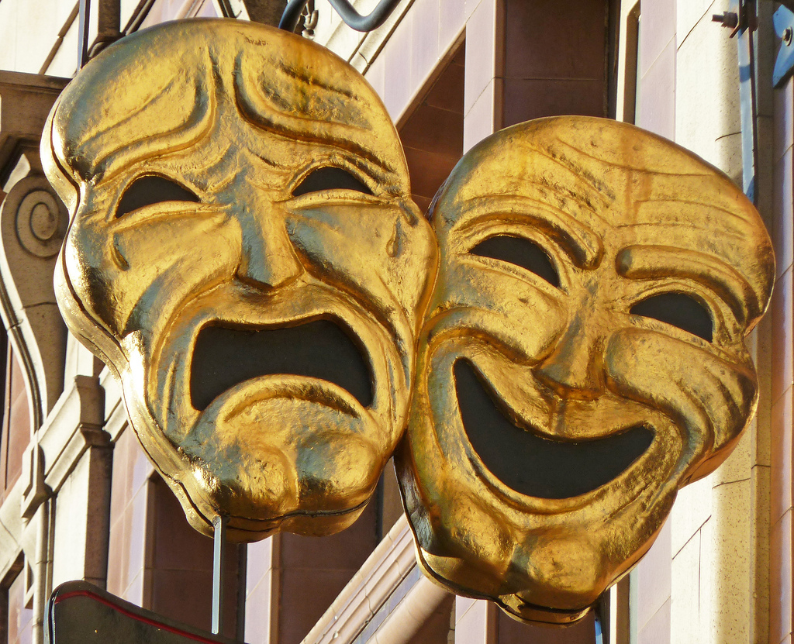
Brainstorming …
Think with your neighbour about two key elements of tragedy and write them down
on the whiteboard !!!

Slide 4
Tragedy in Ancient Greece
The world of Ancient Greece was populated by different narratives to understand and give meaning to their own realities
Stories based on Greek Mythology, the Epical Poems (Euripides‘s The Trojan Women)
Stories based on real events (Thucydides' The Peloponnesian War - Pericles' Funeral Oration / The Melian Dialogue)

Slide 5
The dominant storyline: TRAGEDY
social and political critique
suffering, sorrow, pain
the encounter of different ethical convictions /
ethical conflict (agon) → tragic choice
questions of morality
moral corruption of the powerful
injustice (victims)
HYBRIS vs NEMESIS
. the fall from greatness
. the fall of Empires
. the betrayal of principles
. the loss of the moral high ground
OUTCOME ≠ INITIAL INTENTIONS
Activities / Behaviour

Slide 6
Tragedy and IR – First Considerations
BREXIT: Decision of the UK government to leave the EU.
US Government: Decision of the current US president to withdraw from multilateral agreements and oppose UN institutions.
Refugee Crisis in Europe in 2015/2016: Decision of German Chancellor Angela Merkel to open the borders to hundreds of thousands of Syrian refugees.
2008 Financial Crisis: Decision of US and European governments to bailout banks.

Slide 7
IR-Theories and Tragedy
According to your theory and political theorist(s),
what is the tragedy of IR?
How does this tragedy materialise in the international system?
Describe the decisions and actions of the major protagonists in these tragedies!

Slide 8
Theories and Single Stories
Is your theory a single story?
If not, why is this the case?
If so, what does this story emphasise, what does it ignore?

Slide 9
Similarities
Anarchic self-help system (absence of constraints on state power)
The state as the primary actor
Importance of military capabilities
Pessimism
Balance of power (multipolarism / bipolarism)
Security dilemma
Politics = Power

Slide 10
Differences
Hans Morgenthau
The human factor (psychological aspect)
Focus on values, identities, ideas
Leadership (moral quality of leaders)
Lust for power is inherently human
(psychological relationship)
States are likened to individuals
(psychological explanation)
Destructive potential of power politics can only be
constrained by enlightened leaders /statesmen
Politics is contextual /
depends on the subjective understandings /
goals and skills of the actors involved
John Mearsheimer
States are billard balls / black boxes
States are rational actors
Deterrence
→ Mechanistic world view
Robert Keohane, Robert Axelrod
Payoff structures
Institutions / cooperation
Economic incentives
→ Economic world view

Slide 11
Realists‘, Neo-realists‘ and neo-liberals‘ tragic reading of world politics
Pessimism
Tragic choices which lead to war / destruction
Security dilemma
Hybris – Nemesis / imperial ambitions of state actors
For Morgenthau: human nature is the root of tragedy
For Mearsheimer / Keohane and Axelrod: the architecture of the system is the root of tragedy

Slide 12
Looking at IR-theories from a narrative point of view!
What do we learn?
- Those theories do not represent an absolute point of view!
How can we explain the dominance of those theories (or stories) in IR?
Power
Political context
Storytellers
Audience

