Slide 1
Ebola

Slide 2
The virus …
Ebola: How dangerous is this disease really?
Highly dangerous virus (no effective treatment until 2016/2017)
Far less infections than other neglected diseases (malaria, Chagas disease, etc.)
First appeared in 1976 in 2 simultanous outbreaks (South Sudan and Democratic Republic of Congo near the Ebola river)
belongs to the family of the Filoviridae (Cuenvavirus, Marburgvirus, Ebolavirus)
Ebolavirus consists of five five species: Bundibugyo, Reston, Sudan, Tai Forest and Zaire ebolavirus
Fatality rate is around 50%; depending on the outbreak varying between 25% and 90%
No cure (vaccine) until December 2016
- VSV-EBOV found to be 70 – 100% effective in humans

Slide 3
Chronology of previous Ebola outbreaks
- between 1976 and 2012: more than 20 reported outbreaks in several African countries (Democratic Republic of Congo, Sudan, Uganda, South Africa, Ivory Coast)
- African countries as a perfect breeding ground
→ poverty
→ precarious (or non-existent) public health systems
→ lack of pharmaceutical companies / industry
→ deficient sanitation
→ political neglect
→ semi-democratic and/or authoritarian regimes

Slide 4
A disease is (not) a disease is (not) a disease … the power to define a disease as a disease
Why did the disease not exist for the international community between March 2014 and August 2014? → NEGLECTED DISEASE
After August 2014, how was the disease socially constructed by the WHO, the (international) media and other international actors?
Why was this socially constructed frame much more successful than the frame constructed by the WHO in 2009 on H5N1?

Slide 5
Multilateral action for vaccine development
October 2014: VSV-EBOV: The Public Health Agency of Canada
WHO
GlaxoSmithKline
Merck
Johnson & Johnson
Funding:
Wellcome Trust, UK Department for International Development, Norwegian Government, Canadian Government, MSF
First test trials in Guinea (between March and July 2015):
MSF, Norwegian Institute for Public Health, Ministry of Health of Guinea, other public health officials

Slide 6
2018 Outbreak
8 May 2018: Democratic Republic of the Congo confirms new Ebola outbreak
- From 4 April until 13 May: 39 cases, including 19 deaths (case fatality rate: 49%)
Public Health Response:
- Ring-Vaccination (VSV-EBOV): WHO, Ministry of Health of the DR Congo and MSF
- Funding: WHO (Contingency Fund for Emergencies, US$ 1 million), UN (Central Emergency Response Funds, US$ 2 million), Wellcome Trust (£ 2 million)

Slide 7
Diseases as risks and security threats
Securitisation of disease outbreaks → social construction of a disease as a security threat / risk
- WHO declares the Ebola crisis as a Public Health Emergency of International Concern
on 8 August 2014
- US government: sending 3,000 soldiers to Liberia
- United Nations: UN Mission for Global Emergency Response (UNMEER), first ever UN health emergency mission, 19 September 2014 – 31 July 2015
Video: Ebola Response_How the world came together

Slide 8
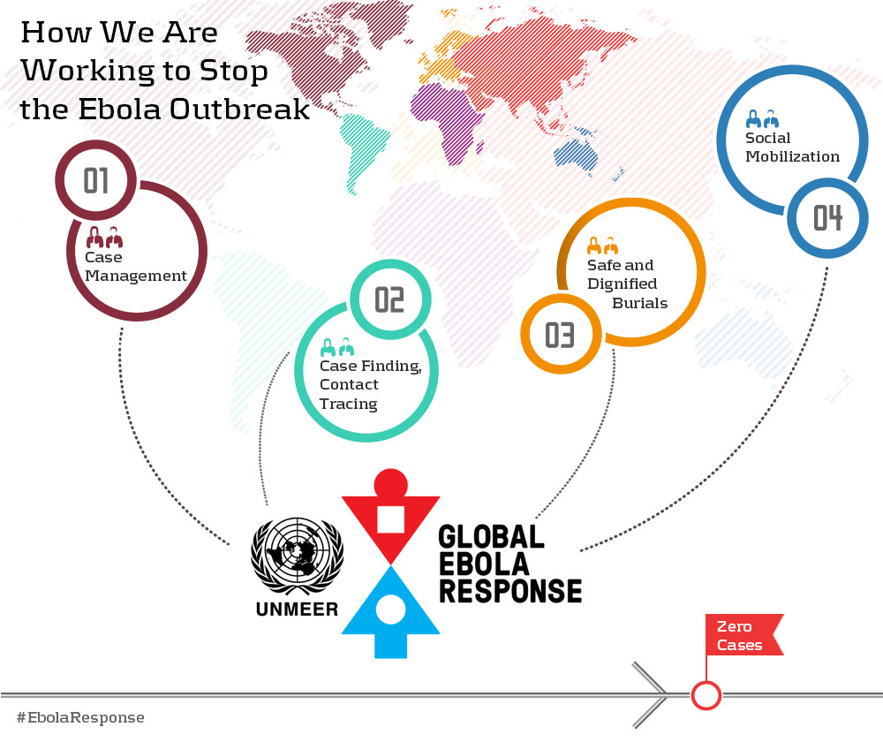
UN Mission for Global Emergency Response (UNMEER)

Slide 9
Acting in an environment of fear and security
Highly securitised
Highly militarised
International military forces
Domestic military forces
Highly segregated
Erecting new demarcations, borders and divisions
Reactive global health mechanisms (IHRs, WHO, international community)
Securitisation frame – disease as a risk and security threat
Risk frame – inherent vulnerability of the Western self

Slide 10
What does the 2014/2015 Ebola crisis tell us about the state of global health governance and international responses to infectious disease outbreaks?
Contrast the activities of MSF with the activities of the international community (WHO, states, etc.)! Which differences in terms of logic, approach and mindset do you find?
How does the militarisation of an emergency response to infectious disease outbreaks change the way in which the disease is tackled?
Which transformative effect did the international response to Ebola have in the three West-African countries?

Slide 11
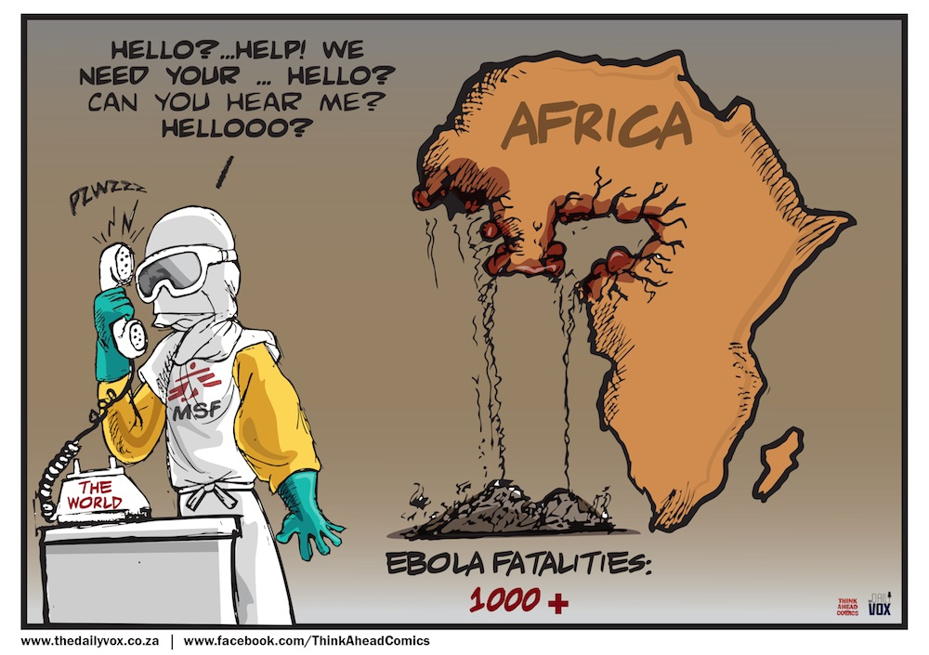

Slide 12
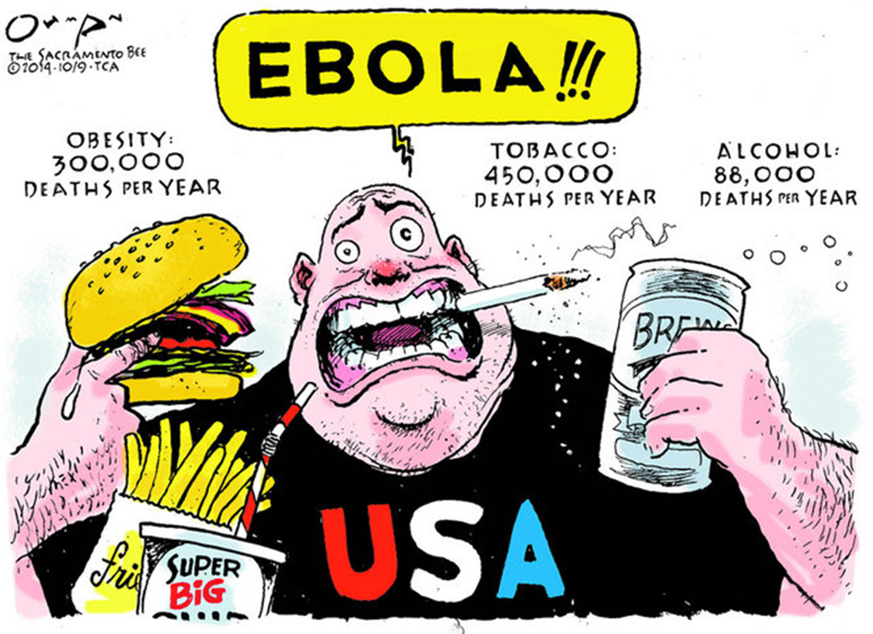

Slide 13
