Slide 1
Close innovation
Henry chesbrought

Slide 2
How to access knowledge
How to pursue the creation of new product?
20th period of great invention.
Shisme between academics and business, lack of financing.
Creation of R&D

Slide 3
R&D department
R&D goal
People & environement
Creation of economie of scale (Alfred Chandler)
R&D as a castle

Slide 4
Shift in the knowledge landscale
Universities State & Industrie
Governement :
Land grant program (after civil war) (no constraint and entrepreneurship)
Morrill Act 1862 (desimination of agriculture)
Creation of link

Slide 5
Mobilizing knowledge
WWII
New frontier of the mind are before us, and if they are with the same vision, boldness, and drive with employement and a fuller more fruitful life ( Roosvelt)
Capitalizing on knowledge (vannenar bush)
Translate military science advance in to civilian improvement:
Science : the endless frontier

Slide 6
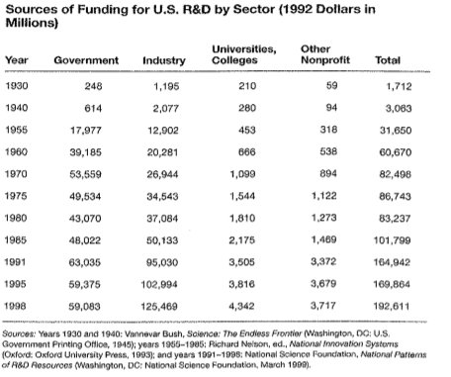
Improvement
University funding
Dependance of Europe :
« A nation which depend on others for its new basic scientific knowledge will be slow in its industrial progress and weak in its competitive position in world trade, regardless of its mechanical skill »
National Research Fund

Slide 7
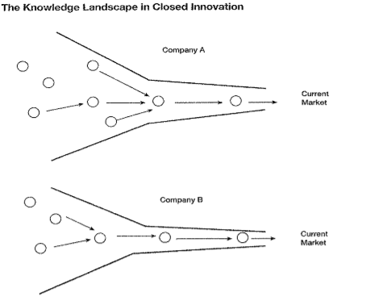
Implication
Research made by university
Expand Knowlegde and Graduate
Insent Industrie : Bell Labs & IBM
Nobel, monopoly, Entry Barrer
Vertival integration
‘Not invented here’

Slide 8
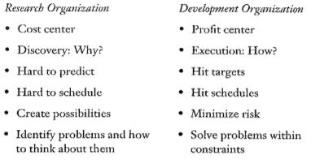
Tension between Reasearch & Development
Research as a cost center (no time constraint, ) :
Small budget
Remove old researcher
Turnover
Development:
Take research as input
Contraint of time and risk
Part of the business unit
Developer manager and input

Slide 9
Comflict in R&D
Separation between Research and Development:
Shelf
‘We are done with this’/ ’We don’t think this is finish yet’
Piled up
Research as bank
Distribution of this money

Slide 10
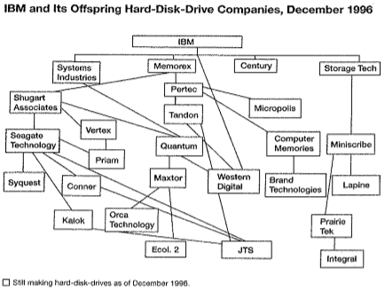
Erosion of Close Innovation #1
Raising of skilled people and mobility :
Due to political vision
Diffusion of the knowledge at each level:
More way out
Possibility to work in the field wanted
Reward
Immagration : half of post doctorant wasn’t US citizen (MIT & Stanford)
30% of people in silicon valley is foreigner

Slide 11
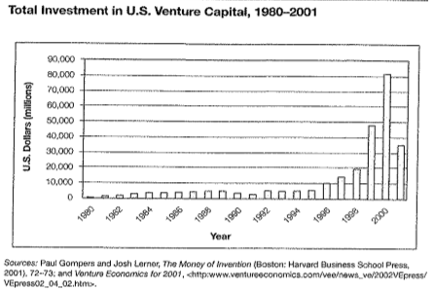
Erosion of Close Innovatoin #2
Venture Capital: (before 1980 very few)
People from companies
Risk / reward

Slide 12
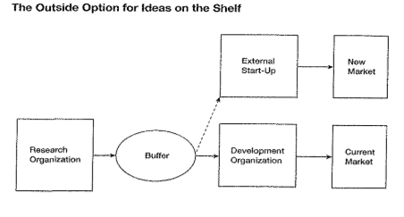
Erosion of Close Innovation #3
External option for idea sitting on the shelf:
Tension between rise the amount of the idea which are not developed
1 & 2 implise the possibilities of those idea to be developed outside
Product life shorten, grow of extrnal option
Metabolisation of idea

Slide 13
Erosion of Close Innovation #4
The increasing capabilitiy of external of suppliers
Big company can’t rely on external supplier (in 19th)
Thnks to 1, 2, 3 more and more specialized companies.
Can help big companies to develop more R&D without beiing in all part
Those supplier are available to ‘everyone’ : shelf can be move to market

Slide 14
Conclusion
The erosion factor loose the link between R and D, linkage of the shelf
Cration of external actor working on those research insight (no close anmore)
New landscape for knowledge:
Campanies of to understand this knew ecosystem to leverage it

