Slide 1
Laboratório 3
Filtros Ativos Passa-Baixa

Slide 2
Roteiro Experimental

Slide 3
ME3000 – Analog Electronic Courseware

Slide 4
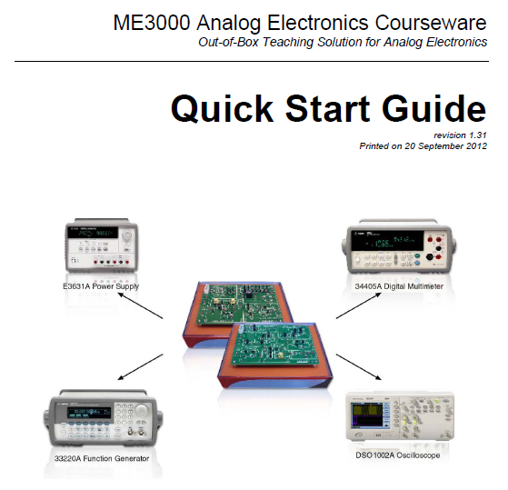

Slide 5
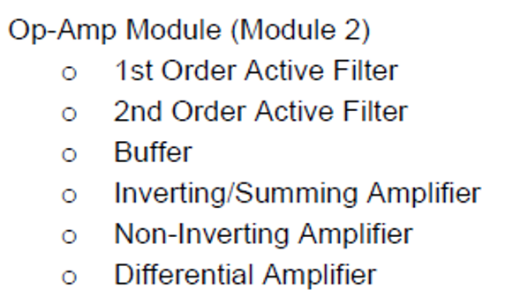
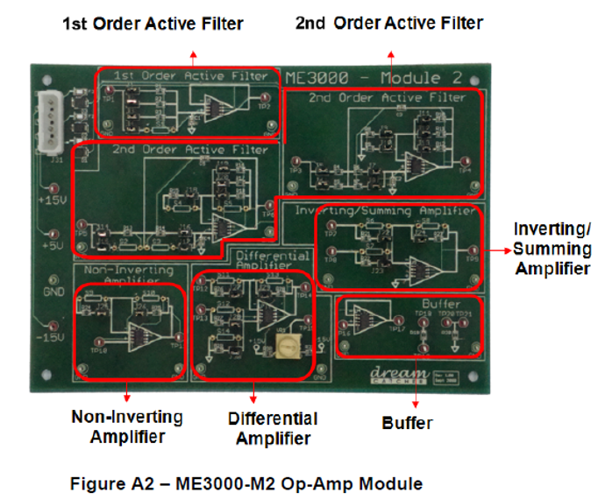

Slide 6
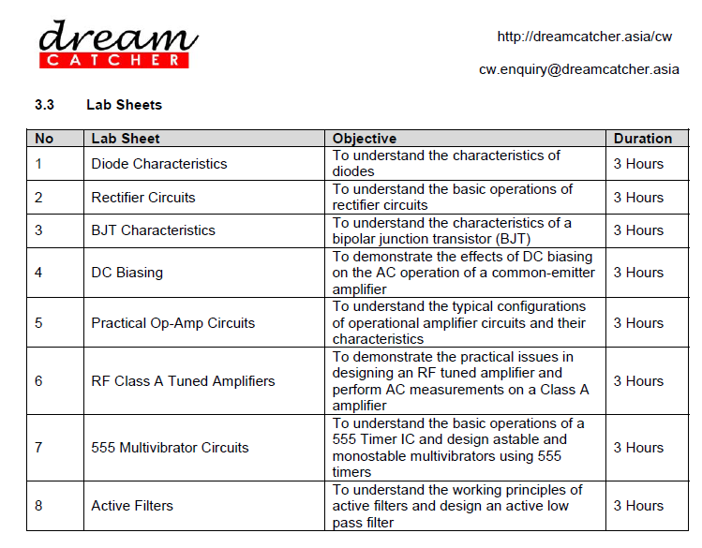

Slide 7
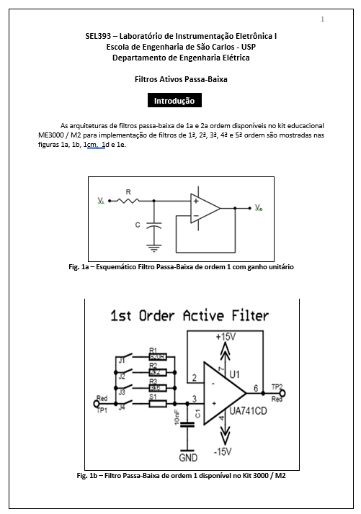

Slide 8
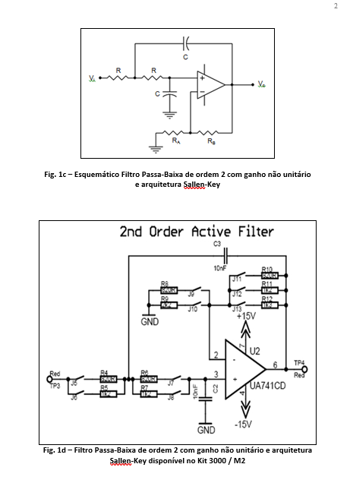

Slide 9
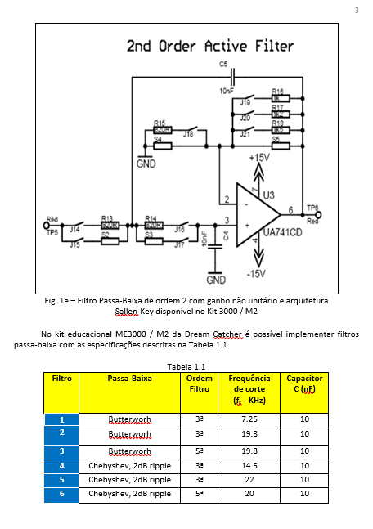

Slide 11
Comparação
Teoria x Experimento

Slide 12
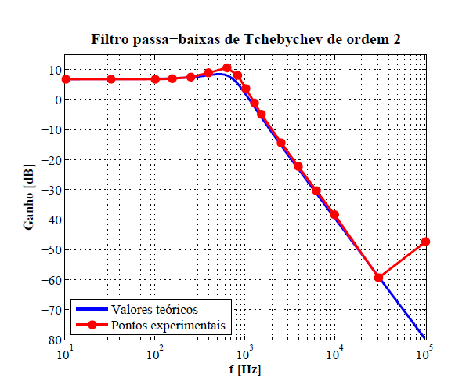
Active Filters : Theory x Experimental

Slide 13
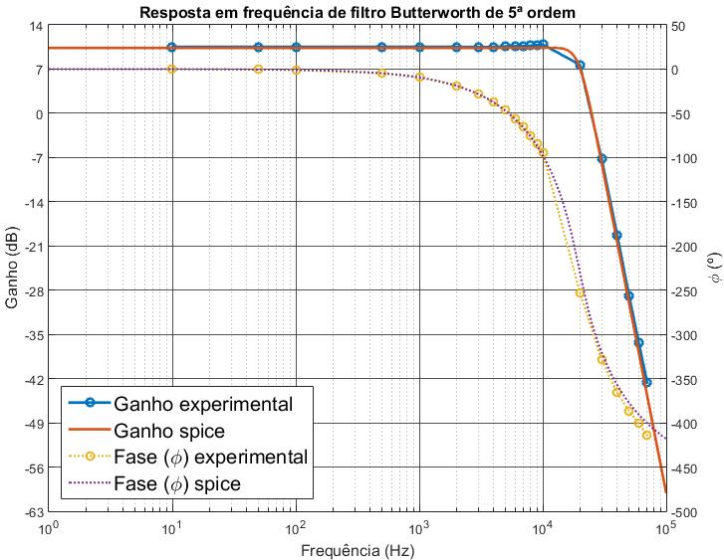
Active Filters : Theory x Experimental
Filtro Passa Baixa Butterwork, ordem n=5, f_{c}= 19.8KHz

Slide 14
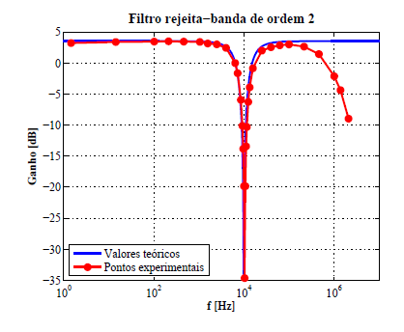
Active Filters : Theory x Experimental

Slide 15
Introduciton
1
2
Applications (few examples):
In telecommunications band pass filters are used in the audio frequency range (0 – 20 KHz).
In telephone centrals high frequency band-pass filters are used for channel selection.
3
There are filters that do not filter any frequencies of a complex input signal, but just add a linear phase shift to each frequency component, thus contributing to a constant time delay. These are called all-pass filters.

Slide 16
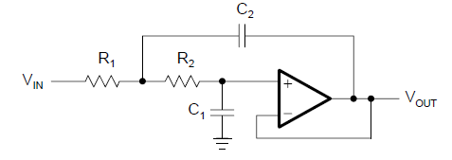
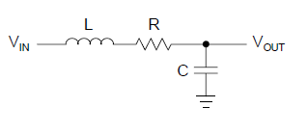
4
At high frequencies (> 1 MHz), all of these filters usually consist of passive components such as inductors (L), resistors (R), and capacitors (C). They are then called LRC filters.
5
In the lower frequency range (1 Hz to 1 MHz), however, the inductor value becomes very
large and the inductor itself gets quite bulky, making economical production difficult.
6
Active filters are circuits that use an operational amplifier (op amp) as the active device in combination with some resistors and capacitors to provide an LRC-like filter performance at low frequencies.
(passivo)
(ativo)

Slide 17
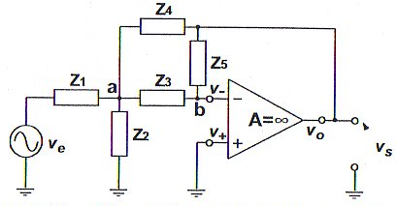
Determinação de Função de Transferência
Filtro Ativo Genérico na Configuração Realimentação Múltipla
1
O ganho de tensão deste circuito pode ser facilmente obtido utilizando-se a LCK nos nós a e b, supondo que o amp op é ideal e aplicando-se a técnica de terra virtual.
2
Nó a:
$\frac{v_{a}}{Z_{2}}$ - $\frac{v_{e}−v_{a}}{Z_{1}}$ - $\frac{v_{s}−v_{a}}{Z_{4}}$ + $\frac{v_{a}}{Z_{3}}$ = 0
$v_{a}\left(\frac{1}{Z_{1}}\text{ − }\frac{1}{Z_{2}}\text{ − }\frac{1}{Z_{3}}\text{ + }\frac{1}{Z_{34}}\right)$- $\frac{v_{e}}{Z_{1}}$= $\frac{v_{s}}{Z_{4}}$

Slide 18
Filtro Ativo Genérico na Configuração Realimentação Múltipla
3
Nó b:
$\frac{v_{s}}{Z_{5}}$ + $\frac{v_{a}}{Z_{3}}$ = 0
$v_{a}$= - $\frac{Z_{3}}{Z_{5}}$ $v_{s}$
G = $\frac{v_{s}}{v_{e}}= \frac{\frac{1}{Z_{1}Z_{3}}}{\frac{1}{Z_{5}}\left(\frac{1}{Z_{1}} \text{+} \frac{1}{Z_{2}} \text{+} \frac{1}{Z_{3}}\text{ + }\frac{1}{Z_{4}}\right)+\frac{1}{Z_{3}Z_{4}}}$

Slide 19
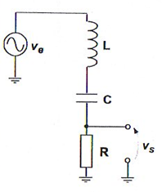
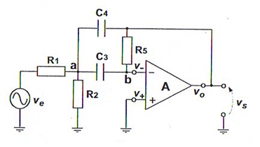
Filtro Passivo X Filtro Ativo
Mostrar que o filtro ativo passa-faixa com realimentação múltipla abaixo tem a mesma função de transferência do filtro passivo RLC.
≡
1
O ganho de tensão do circuito passivo é dado por:
G = $\frac{v_{s}}{v_{e}}= \frac{R}{\left(jwL+R+ \frac{1}{jwC}\right)}$ = $\frac{\frac{jwR}{L}}{−w^{2}+\frac{jwR}{L}+\frac{1}{LC}}=\frac{\frac{jww_{o}}{Q}}{−w^{2}+\frac{jww_{o}}{Q}+w_{o}^{2}}$
[1]
$$w_{o}^{2}= \frac{1}{LC}$$
Q$= \frac{w_{o}L}{R}$

Slide 20
2
O ganho de tensão do circuito ativo, como demonstrado, é dado por:
G = $\frac{v_{s}}{v_{e}}= \frac{\frac{1}{Z_{1}Z_{3}}}{\frac{1}{Z_{5}}\left(\frac{1}{Z_{1}} \text{+} \frac{1}{Z_{2}} \text{+} \frac{1}{Z_{3}}\text{ + }\frac{1}{Z_{4}}\right)+\frac{1}{Z_{3}Z_{4}}}$
$$Z_{1}=R_{1}$$
$$Z_{4}=1/jwC_{4}$$
$$Z_{2}=R_{2}$$
$$Z_{5}=R_{5}$$
$$Z_{3}=1/jwC_{3}$$
G = $\frac{v_{s}}{v_{e}}=−\frac{jwC_{3}}{−w^{2}C_{3}C_{4}+jw\frac{C_{3}+C_{4}}{R_{5}}+\frac{1}{R_{5}}\left(\frac{1}{R_{1}}+\frac{1}{R_{2}}\right)}$
3
Se C₃ = C₄ = C e R₅ = 2R₁ resulta:
G = $\frac{v_{s}}{v_{e}}= \frac{jw/(R_{1}C)}{−w^{2}+jw\frac{2}{R_{5}C}+\frac{1}{R_{5}C^{2}}\left(\frac{1}{R_{1}}+\frac{1}{R_{2}}\right)}$ =$\frac{\frac{jww_{0}}{Q}}{−w^{2}+\frac{jww_{0}}{Q}+w_{0}^{2}}$
[2]
$w_{0}^{2}$=$\frac{1}{2R_{5}C^{2}}\left(\frac{1}{R_{1}}+\frac{1}{R_{2}}\right)$
$Q^{2}$=$\frac{R_{1}}{2}\left(\frac{1}{R_{1}}+\frac{1}{R_{2}}\right)$

Slide 21
G = $\frac{v_{s}}{v_{e}}= \frac{R}{\left(jwL+R+ \frac{1}{jwC}\right)}$ = $\frac{\frac{jwR}{L}}{−w^{2}+\frac{jwR}{L}+\frac{1}{LC}}=\frac{\frac{jww_{o}}{Q}}{−w^{2}+\frac{jww_{o}}{Q}+w_{o}^{2}}$
[1]
$$w_{o}^{2}= \frac{1}{LC}$$
Q$= \frac{w_{o}L}{R}$
G = $\frac{v_{s}}{v_{e}}= \frac{jw/(R_{1}C)}{−w^{2}+jw\frac{2}{R_{5}C}+\frac{1}{R_{5}C^{2}}\left(\frac{1}{R_{1}}+\frac{1}{R_{2}}\right)}$ =$\frac{\frac{jww_{0}}{Q}}{−w^{2}+\frac{jww_{0}}{Q}+w_{0}^{2}}$
[2]
$w_{0}^{2}$=$\frac{1}{2R_{5}C^{2}}\left(\frac{1}{R_{1}}+\frac{1}{R_{2}}\right)$
$Q^{2}$=$\frac{R_{1}}{2}\left(\frac{1}{R_{1}}+\frac{1}{R_{2}}\right)$
[1] = [2]

Slide 22
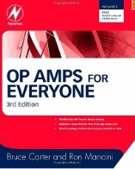
1
Rather than resembling just another filter book, the individual filter sections are written in a cookbook style, thus avoiding tedious mathematical derivations. Each section starts with the general transfer function of a filter, followed by the design equations to calculate the individual circuit components.
2
Introduction to three main filter optimizations (Butterworth, Tschebyscheff, and Bessel).
3
Description of the most common active filter applications:
low-pass
high-pass
band-pass
band-rejection
all-pass filters

Slide 23
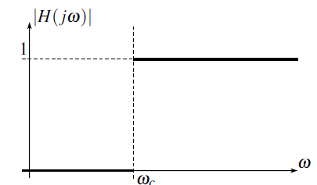
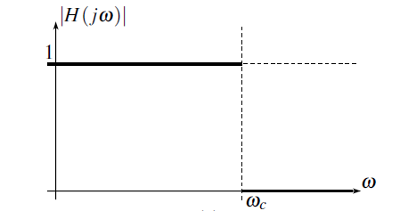
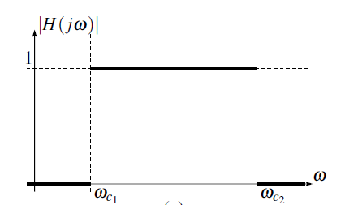
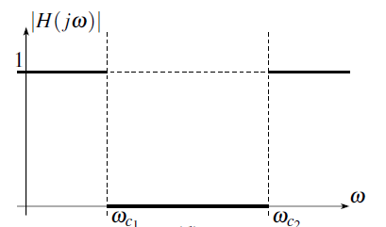
Active Filters
filtro passa-baixa
filtro passa-alta
filtro passa-faixa
filtro rejeita-faixa

Slide 24
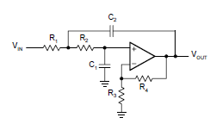
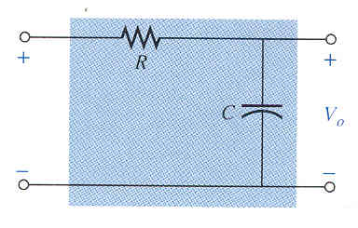
Active Filters
Active Filter
Sallen-Key Topology
filtro passa-baixa
Passive Filter

Slide 25
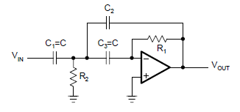
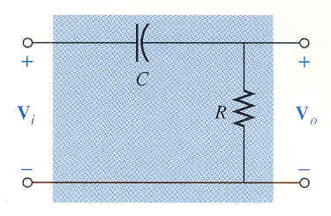
Active Filters
Active Filter
Multiple Feedback Topology
filtro passa-alta
Passive Filter

Slide 26
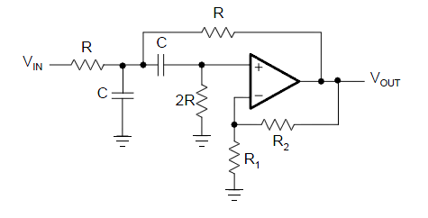
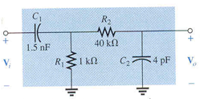
Active Filters
Active Filter
Sallen-Key Topology
Passive Filter
filtro passa-faixa

Slide 27
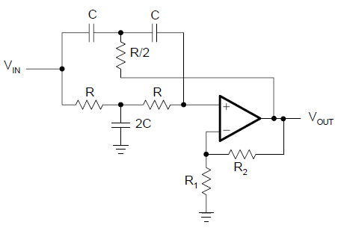
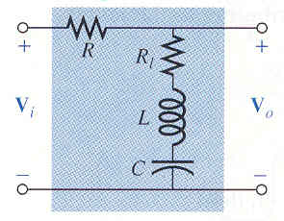
Active Filters
Active Filter
Twin-T Topology
filtro rejeita-faixa
Passive Filter

Slide 28
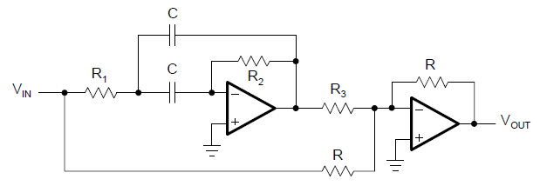
Active Filters
banda de passagem é todo o espectro de frequências
mas com defasagens diferentes ao longo do espectro !
filtro passa-tudo

Slide 29
Low Pass Filters

Slide 30
Butterworth
Low Pass Filter
Chebyshev
Bessel

Slide 31
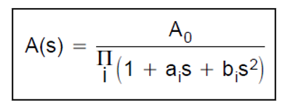
Low Pass Filter
General Transfer Function
1
The filter coefficients a_{i} and b_{i} distinguish between Butterworth, Tschebyscheff, and Bessel filters. The coefficients for all three types of filters are tabulated.
2
The order n determines the gain rolloff above f_{C} (n·20 dB/decade)

Slide 32
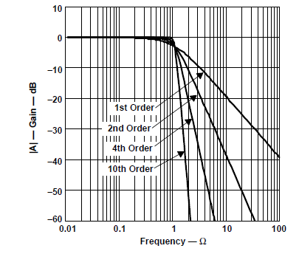
Butterworth Low Pass Filter
The Butterworth low-pass filter provides passband flatness.
Ω = f / f_{C}

Slide 33
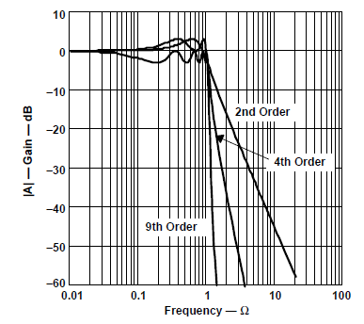
Chebyshev Low Pass Filter
The Tschebyscheff low-pass filters provide an even higher gain rolloff above f_{C}. However, the passband gain is not monotone, but contains ripples of constant magnitude instead. For a given filter order, the higher the passband ripples, the higher the filter’s rolloff.
Ω = f / f_{C}

Slide 34
Ω = f / f_{C}
1
For a given filter order, the higher the passband ripples, the higher the filter’s rolloff.
2
Each ripple accounts for one second-order filter stage.
3
Filters with even order numbers generate ripples above the 0-dB line.
4
Filters with odd order numbers create ripples below 0 dB.

Slide 35
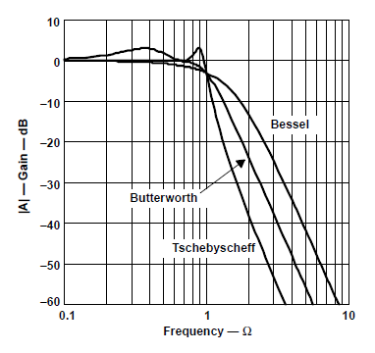
Bessel Low Pass Filter
1
The passband gain of a Bessel low-pass filter is not as flat as that of
the Butterworth low-pass
2
The transition from passband to stopband is by far not as sharp as that of a Tschebyscheff low-pass filter
Ω = f / f_{C}

Slide 36
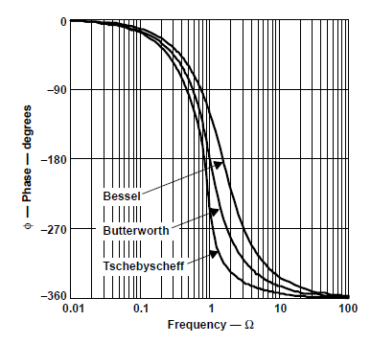
3
The Bessel low-pass filters have a linear phase response over a wide frequency range
Ω = f / f_{C}

Slide 37
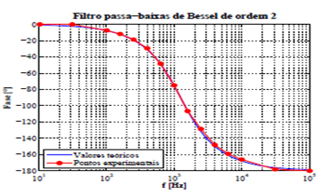
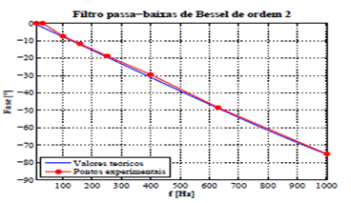
4
The Bessel low-pass filters have a linear phase response over a wide frequency range
(monolog scale)
(linear scale)

Slide 38
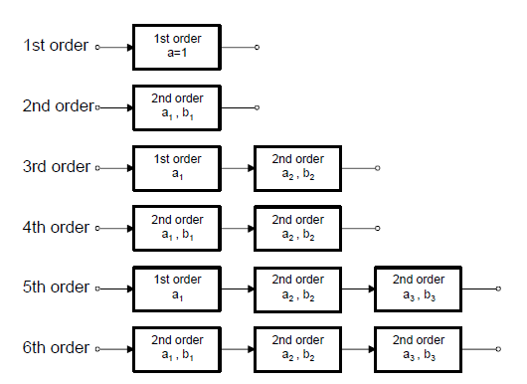
Cascade Filters
The first-order and second-order filter stages are the building blocks for higher-order filters.

Slide 39
Designing
Low Pass Filters

Slide 40
Filters Coefficients

Slide 41
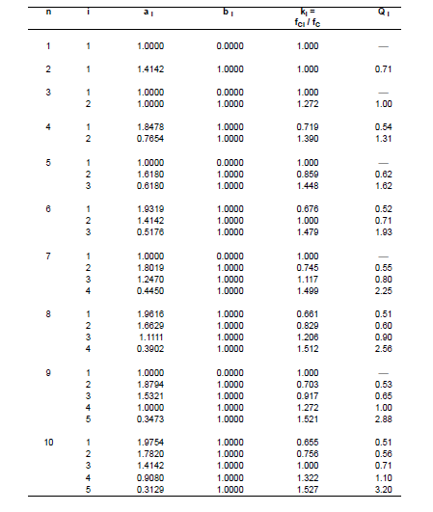
Butterworth Coefficients

Slide 42
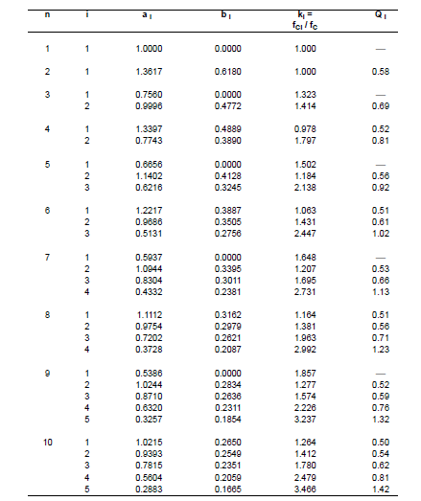
Bessel
Coefficients

Slide 43
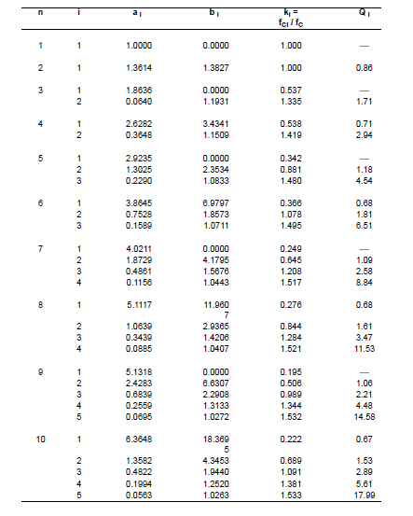
Tschebyscheff Coefficients
(0.5 dB Passband ripple)

Slide 44
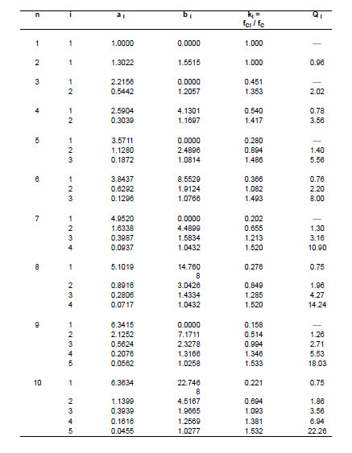
Tschebyscheff Coefficients
(1 dB Passband ripple)

Slide 45
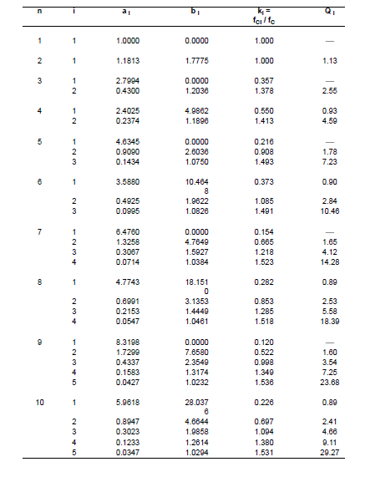
Tschebyscheff Coefficients
(2 dB Passband ripple)

Slide 46
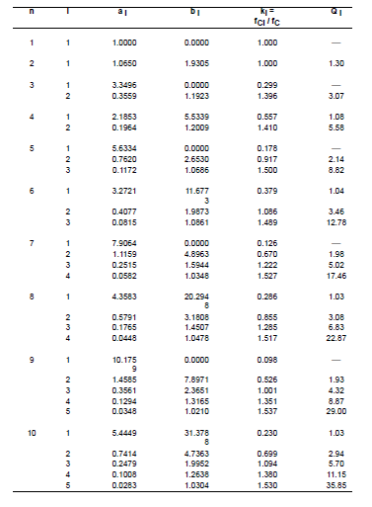
Tschebyscheff Coefficients
(3 dB Passband ripple)

Slide 47
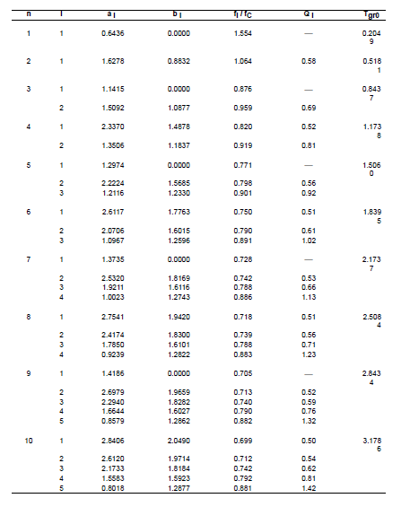
All Pass

Slide 48
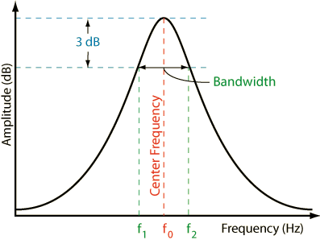
Quality Factor
Band Pass
Filters
$$Q=\frac{f_{o}}{f_{2}−f_{1}}$$
Low and High Pass Filters
$$Q=\frac{\sqrt{b_{i}}}{a_{i}}$$

Slide 49
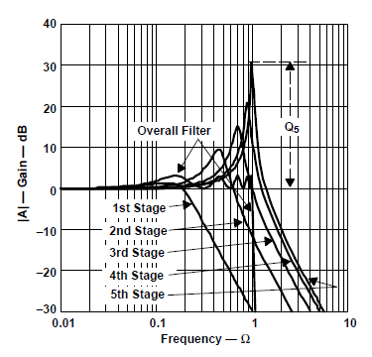
Example: low pass filter with 5 stages
(Tschebyscheff – 2dB)
Tschebyscheff Coefficients
(2 dB Passband ripple)
$$Q=\frac{\sqrt{b_{i}}}{a_{i}}$$
ripple with 5 peaks
$$Q_{5}= \frac{\sqrt{b_{5}}}{a_{5}}$$
Q₅(dB) = 20 logQ₅

Slide 50
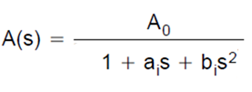
Transfer Function
First order filter
Second order filter

Slide 51
Low Pass Filters
(First Order Topology)

Slide 52
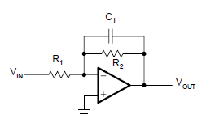
Inverting
a₁
(DC gain)

Slide 53
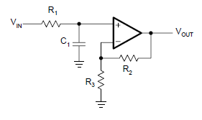
Noninverting
a₁
(DC gain)

Slide 54
Designing Low Pass Filters
(First Order Topology)

Slide 55
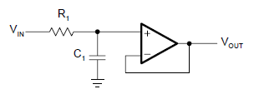
Inverting
Noninverting
(Ganho ≠ 1)
(Ganho = 1)
1
Specify f_{C}, A₀ , C₁
1
Specify f_{C}, A₀, C₁
1
Specify f_{C}, C₁
2
2
2
3
3

Slide 56
Low Pass Filters
(Second Order Topology)

Slide 57
Sallen-Key Topology
Multiple Feedbak Topology

Slide 58
Sallen-Key Topology (A_{o}≠1)
The SK topology is commonly used in filters.
a₁
b₁

Slide 59
Sallen-Key Topology (A_{o}=1)
The SK topology is commonly used in filters.
a₁
b₁

Slide 60
Multiple Feedbak Topology
The MFB topology is commonly used in filters that have high Qs and require a high gain.
a₁
b₁

Slide 61
Designing Low Pass Filters
(Second Order)
Sallen-Key Topology

Slide 62
Sallen-Key Topology
(A_{o} = 1)
1
Pick C₁
2
Determine filter coefficients a₁ e b₁
3
In order to obtain real values under the square root, C2 must satisfy the following condition:
4
Calculate R₁ and R₂

Slide 63
Exemple 1:
Design a second order unity gain Tschebyscheff low pass filter with a corner frequency of 3KHz and a 3dB passband ripple
1
Pick C₁ =22nF
2
Get the Tschebyscheff filters coefficient tables: a₁ = 1.0650 and b₁ = 1,9305

Slide 64
3
4
Calculate R₁ and R₂

Slide 65
Sallen-Key Topology
(A_{o} ≠ 1)
(R₁=R₂= R and C₁=C₂=C)
a₁
b₁

Slide 66
Sallen-Key Topology
(A_{o} ≠1)
1
Get a_{n} and b_{n}
2
Pick C and get R
3
Calculate A₀ and R₄ /R₃
4
Calculate Q

Slide 67
Designing Low Pass Filters
(Higher Order)
Sallen-Key Topology

Slide 68
Exemple 1:
Design a fifth order unity gain Butterworth low pass filter with a corner frequency of 50KHz.

Slide 69
1
Get Butterworth Coefficients

Slide 70
First Filter: first order
2
Pick C₁ = 1nF
3
Get R₁

Slide 71
Second Filter: Sallen-Key second order
4
Pick C₁ = 820pF
5
$R_{1}=\frac{a_{1C_{2}} − \sqrt{a_{1}^{2}C_{2}^{2}−4b_{1}C_{1}C_{2}}}{4πf_{c}C_{1}C_{2}}$ = 1.87K Ω
6
With C₁ = 820pF and C₂ = 1.5nF calculate R₁ and R₂
$R_{2}=\frac{a_{1C_{2}}+ \sqrt{a_{1}^{2}C_{2}^{2}−4b_{1}C_{1}C_{2}}}{4πf_{c}C_{1}C_{2}}$ = 4.42 KΩ

Slide 72
Third Filter: Sallen-Key second order
7
Pick C₁ = 330pF
8
$R_{1}=\frac{a_{1C_{2}} − \sqrt{a_{1}^{2}C_{2}^{2}−4b_{1}C_{1}C_{2}}}{4πf_{c}C_{1}C_{2}}$ = 1.47K Ω
9
With C₁ = 330pF and C₂ = 4.7nF calculate R₁ and R₂
$R_{2}=\frac{a_{1C_{2}}+ \sqrt{a_{1}^{2}C_{2}^{2}−4b_{1}C_{1}C_{2}}}{4πf_{c}C_{1}C_{2}}$ = 4.53 KΩ

Slide 73
Designing Low Pass Filters
(Second Order)
Multiple Feedback Topology

Slide 74
Multiple Feedbak Topology
a₁
b₁

Slide 75
1
Choose C₁ , C₂
2
Calculate R₁, R_{2,} R₃

